Slide 1
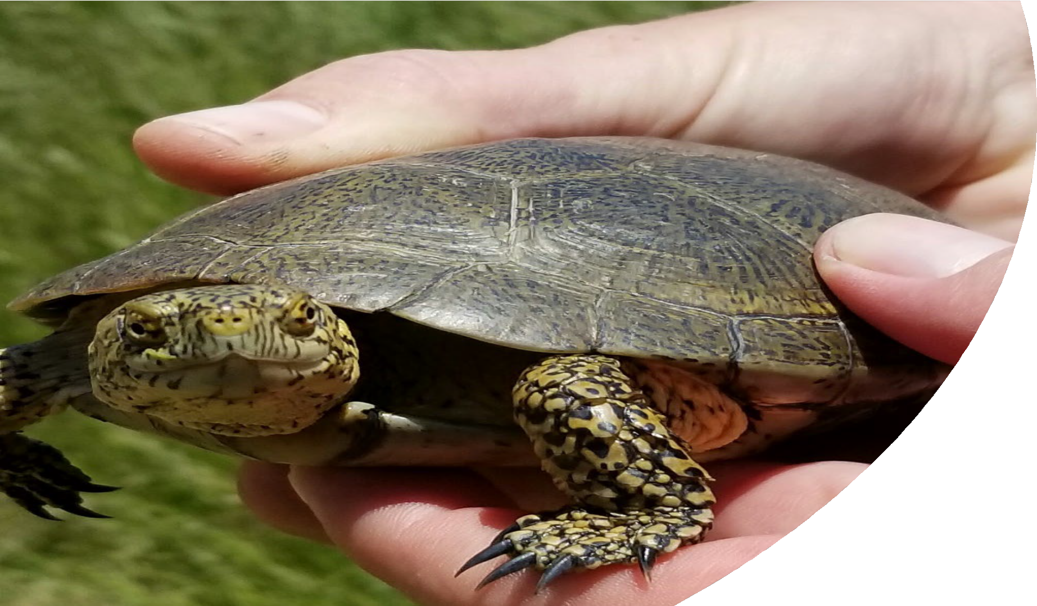
Southwestern
Pond Turtle:
Status Assessment &
Proposed Listing
November 8, 2023
Sandra Hamilton Carlsbad Fish and Wildlife Office
Notes:
Going to discuss the SSA that was the supporting document for the recently published proposed rule to list the northwestern and southwestern pond turtle as threatened species.

Slide 2
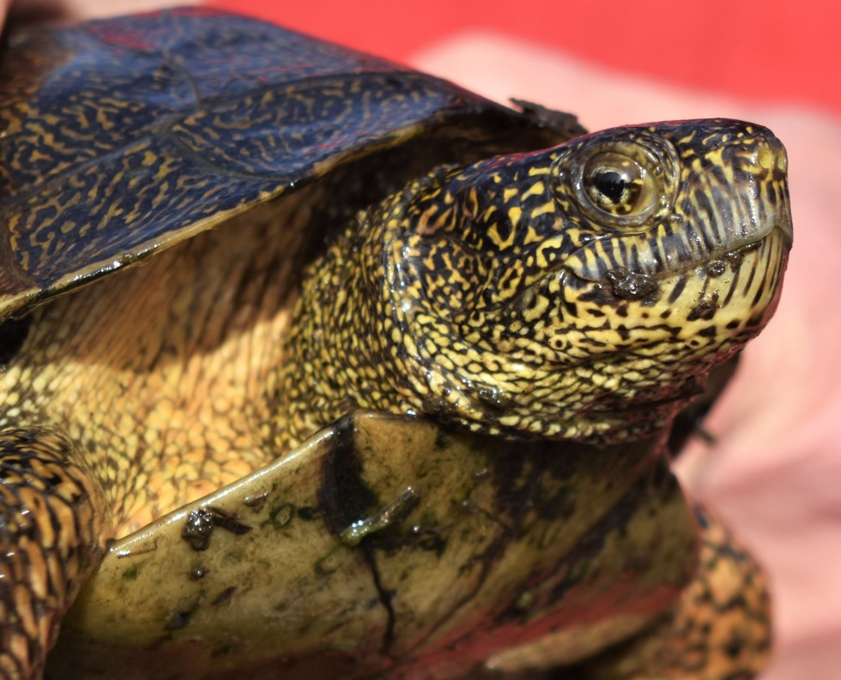
Listing Timeline
2012: Petition
2015: Substantial 90-day
2023: Proposed Rule - Threatened
Species Status Assessment Development
Notes:
This is the standard procedure of how we list species, and this is where we are in the process
-Proposed rule was published in the Federal Register on October 3rd, finding that both Northwestern pond turtle and Southwestern pond turtle are proposed for listing as threatened species
-No Critical Habitat was designated at the time of proposed listing rule. This will be evaluated next year.
-There is a 60-day comment period, which ends December 4th. I will give more details about this later in the presentation.
SSA involves evaluation of positive and negative influences on the species to determine its status now and projected into the future.

Slide 3
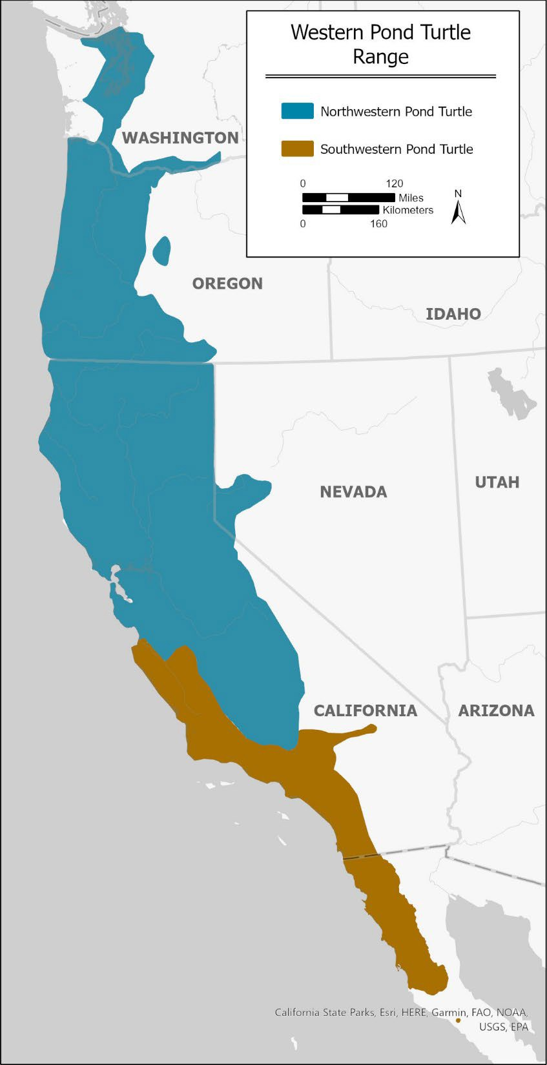
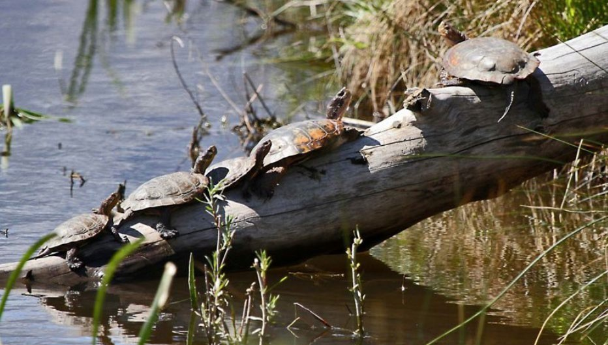
Species range
Notes:
The historical range of western pond turtles extends along the Pacific coast from Puget Sound in Washington to northern Baja California. Recent genetic information has led to a taxonomic split of the western pond turtle into two distinct species. The range of the southwestern pond turtle is restricted to those populations inhabiting the central Coast Range south from the middle of Monterey Bay to the species’ southern range boundary in Baja California.
NWPT: Actinemys marmorata
SWPT: Actinemys pallida

Slide 4
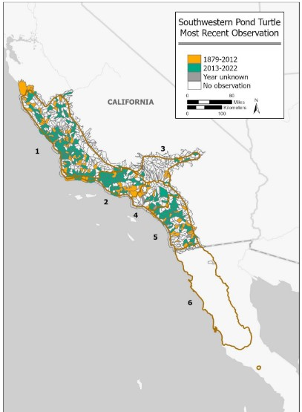
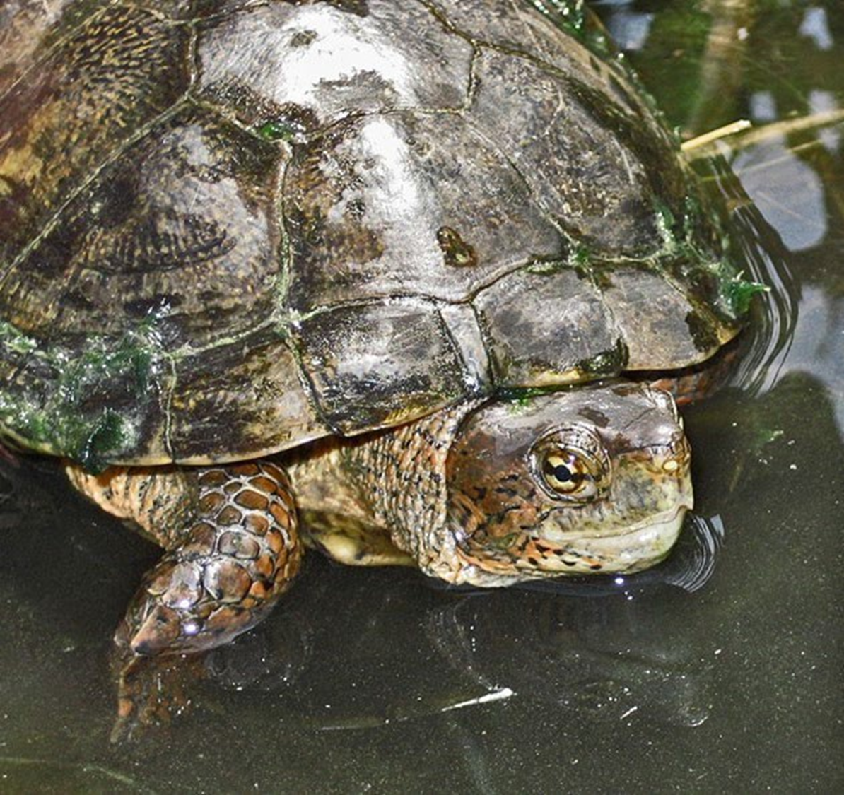
Species Distribution
Notes:
This figure illustrates the historical and current distribution of SWPT, which have been observed widely throughout the range. USGS defined watersheds are drawn on the map and shaded in orange where we have historical sighting records from 1879 through 2012 and the green shaded areas are more recent positive surveys from 2013 through 2022

Slide 5
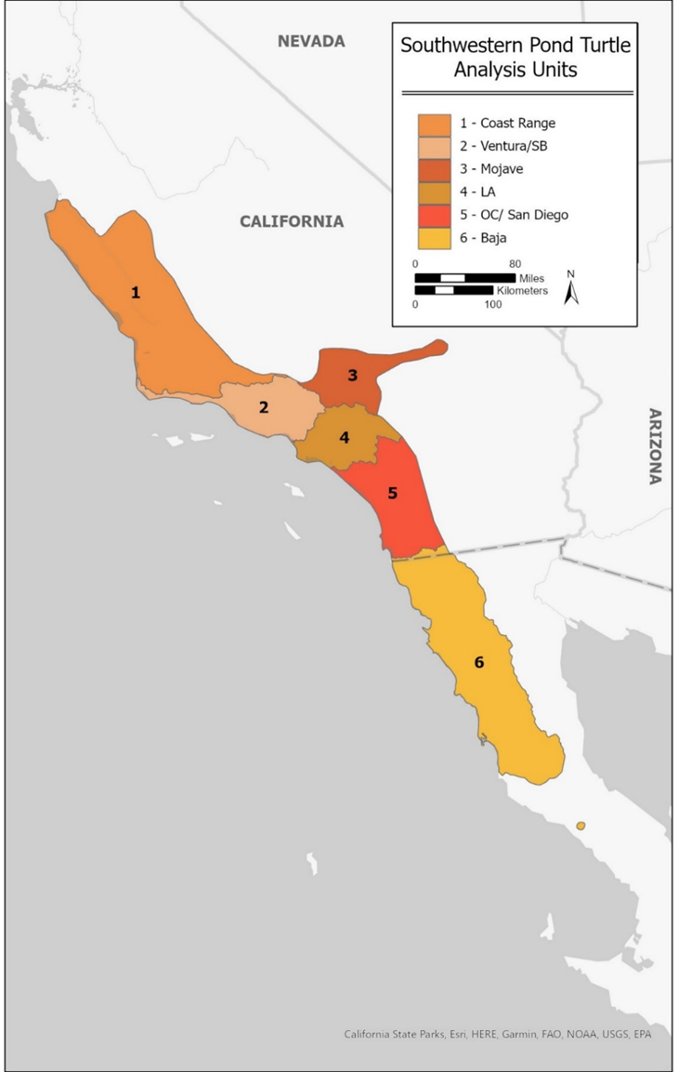
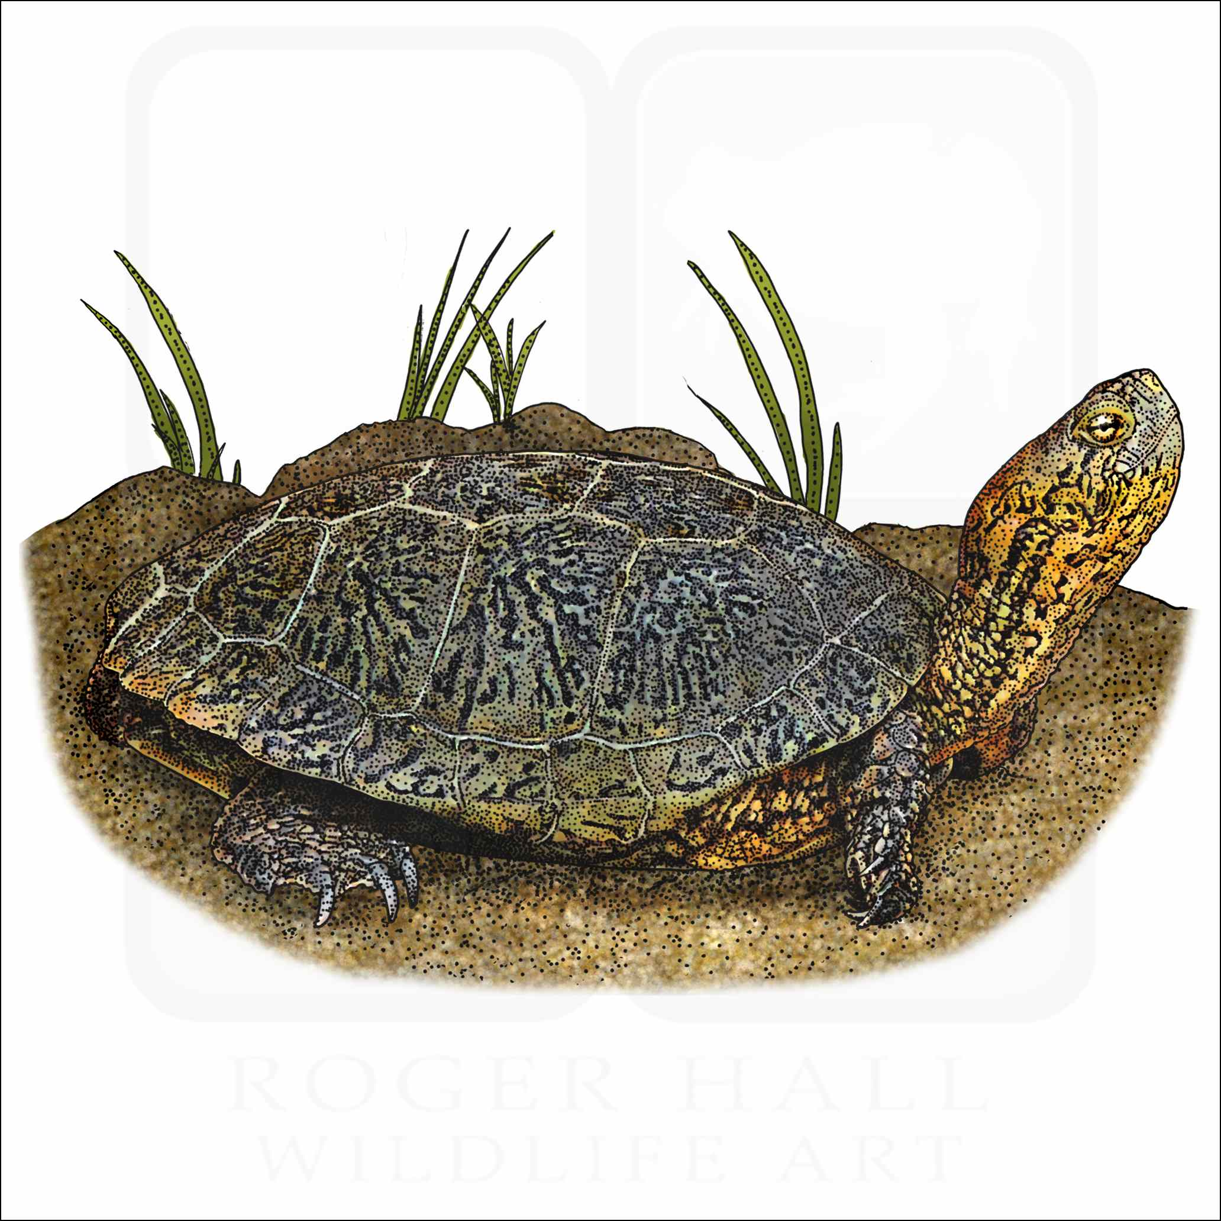
Southwestern Pond Turtle Analysis Units
Notes:
To assess the current and future conditions of the SWPT, we separated the range into six analysis units based on genetic relatedness clusters identified by Shaffer and Scott (2022)

Slide 6
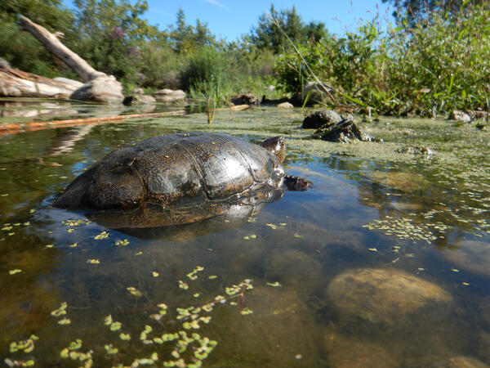
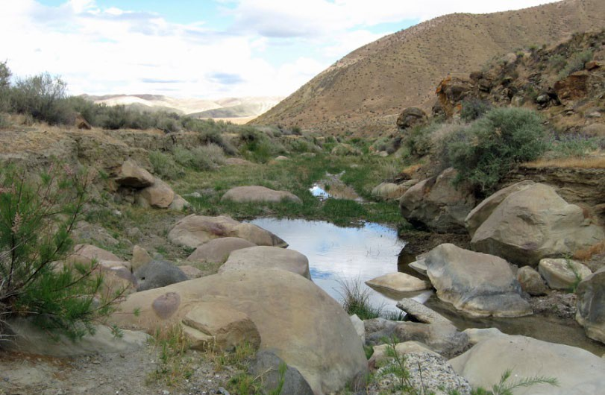
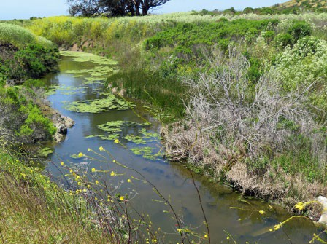
Habitat
Southwestern pond turtles require both aquatic and terrestrial habitats
Notes:
Western pond turtles are semi-aquatic, requiring both aquatic and terrestrial habitats within close proximity to one another. They occur in both permanent and ephemeral aquatic water bodies including rivers and streams, lakes, ponds, reservoirs, settling ponds, marshes, vernal pools, brackish waters, irrigation ditches, and other wetlands. The back-and-forth movements between aquatic and terrestrial habitats (i.e., migration) are typically less than 500 m. The most important habitat needs for the WPT are aquatic habitat, upland habitat, and basking sites.

Slide 7
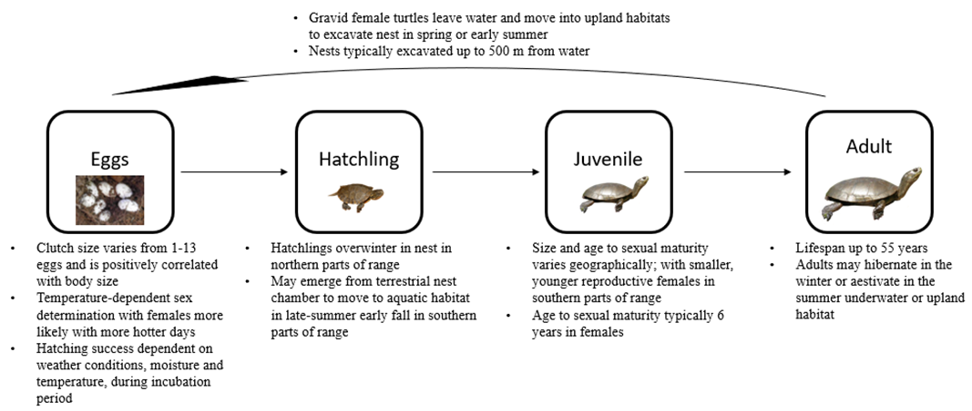
Southwestern Pond Turtle Life History
Notes:
WPT are semi-aquatic and relatively long-lived.
Western pond turtles are semi-aquatic, having both terrestrial and aquatic life history phases. eggs are laid in upland terrestrial habitat, and hatchings, juveniles, and adults use both terrestrial and aquatic habitat. Terrestrial environments are required for nesting, overwintering and aestivation (warm season dormancy), basking, and movement/dispersal. Aquatic environments are required for breeding, feeding, overwintering and sheltering, basking, and movement/dispersal.

Slide 8
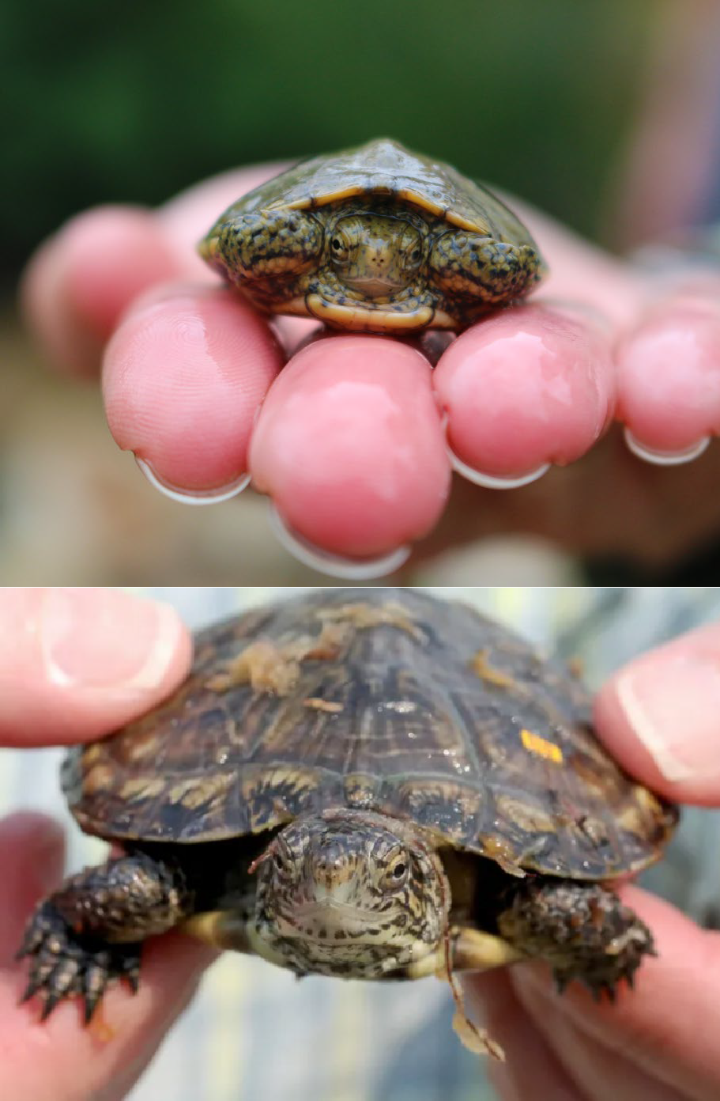
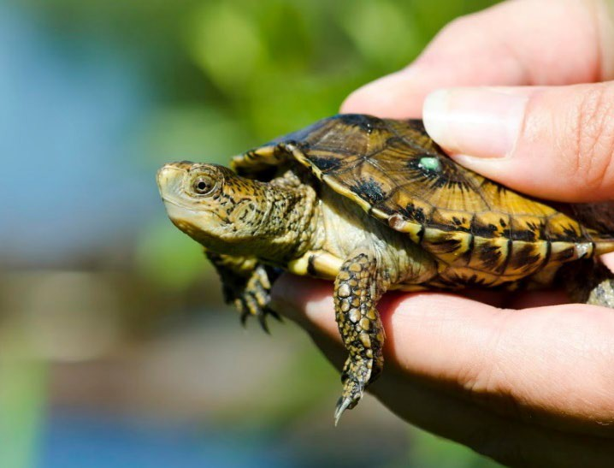
Threats
Predation (nonnative and native)
Contaminants
Disease
Collection
Habitat loss and fragmentation
Road Impacts
Altered hydrology
Nonnative species competition (red-eared sliders)
Climate change (↑ temperature, drought, flood, wildfire)
Notes:
We identified many threats that are potentially impacting the species, but of these…

Slide 9
Threats
Predation (nonnative and native)
Contaminants
Disease
Collection
Habitat loss and fragmentation
Road Impacts
Altered hydrology
Nonnative species competition (red-eared sliders)
Climate change (↑ temperature, drought, flood, wildfire)
Bullfrogs
Anthropogenic impacts (Human modification, habitat loss)
Drought
Notes:
We identified three key threats as most influential in driving the western pond turtle’s current and future condition: predation, human modification/habitat loss, and drought. These factors have had substantial population-level effects that are anticipated to continue into the future, and to be the primary drivers of species viability. These are the threats we analyzed into the future.

Slide 10
Scenarios
Projected out to 2050, 2075, 2100
Threat | Scenario 1 (RCP 8.5) | Scenario 2 (RCP 4.5)
Land conversion | ICLUS wetland loss by State under RCP 8.5/SSP 5 | ICLUS wetland loss by State under RCP 4.5/SSP 2
Drought | Drought frequency increasing at current rates of PDSI moderate and severe drought trends | Drought frequency increasing at a slower rate of PDSI moderate and severe drought trends
Bullfrog presence | Bullfrog spread based on continuation of rate of change | Bullfrog spread based on continuation of rate of change
Notes:
To assess the condition of the SWPT, we modeled the impact of the primary threats influencing the viability of SWPT under two climate change scenarios at three timesteps: 2050, 2075, and 2100. These are two plausible scenarios that capture a range of potential future conditions.

Slide 11
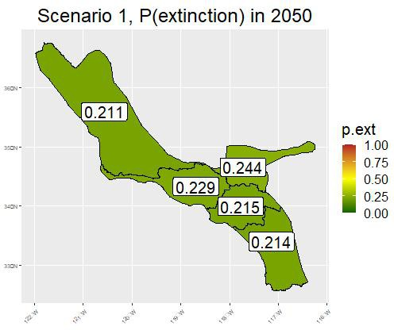
Current Condition: Resiliency
Probability of extinction of 20 to 24 percent suggests that most analysis units are likely to withstand stochastic disturbances in the near term
Notes:
For CC we looked at past current and imminent influences up to 2050 and determined that the species was not in danger of extinction. This figure indicates P(extinction) of each AU, which generally range from 20 to 24 percent.

Slide 12
Current Condition Synthesis
Probability of extinction of 20 to 24 percent suggests the analysis units have ability to withstand stochastic events
Declines in abundance, but likely to maintain much of range which suggests ability to withstand most catastrophic events
Ecological flexibility, and likely to persist suggests ability to adapt to changing environmental conditions
Southwestern pond turtle is likely to sustain populations in the wild in the near term
Notes:
For CC we looked at past current and imminent influences up to 2050 and determined that the species was not in danger of extinction. This figure indicates P(extinction) of each AU, which generally range from 20 to 23 percent.

Slide 13
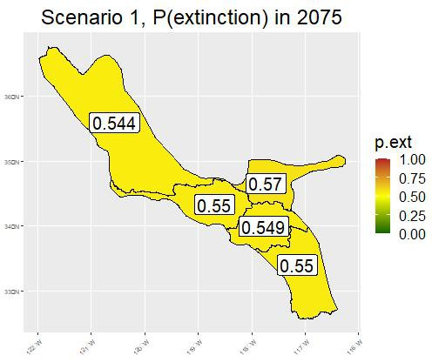
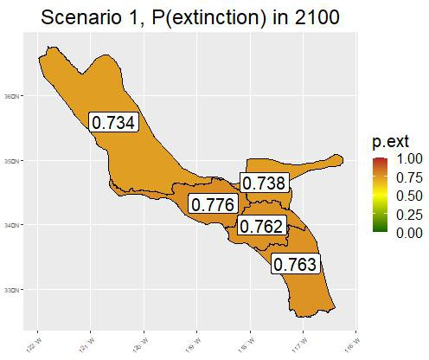
Future Condition (2075 and 2100): Resiliency
Probability of extinction exceeded 50% and 70% for 2075 and 2100
Projections suggest they are less likely to withstand stochastic events
Notes:
For future conditions we projected ongoing influences to 2075 and 2100 and determined the species is less likely to withstand stochastic events. The P(extinction) for each AU exceeds 50 percent in 2050 and exceeds 70 percent in 2100.

Slide 14
Future Condition Synthesis
For all analysis units, extinction is slightly more likely than persistence in 2075 and substantially more likely in 2100
Range contraction would make species less able to withstand catastrophes
Losses would lower genetic diversity, lowering ability to adapt to changing environments
Southwestern pond turtle will have a substantially increasing risk of extinction from stochasticity, catastrophic events, and inability to adapt to changing conditions. This risk increases over time.
Notes:
Therefore, we have proposed to list the southwestern pond turtle as a threatened species.

Slide 15
Next steps
Open comment period until December 4, 2023. We are requesting information related to:
The species biology, range, genetics
Historical or current distribution
Factors that may be affecting the species (conservation actions and threats)
Tribal use or cultural significance
Notes:
Mention what we requested info for:
i.e., biology and distribution, species abundance, tribal use or cultural significance, and threats

Slide 16
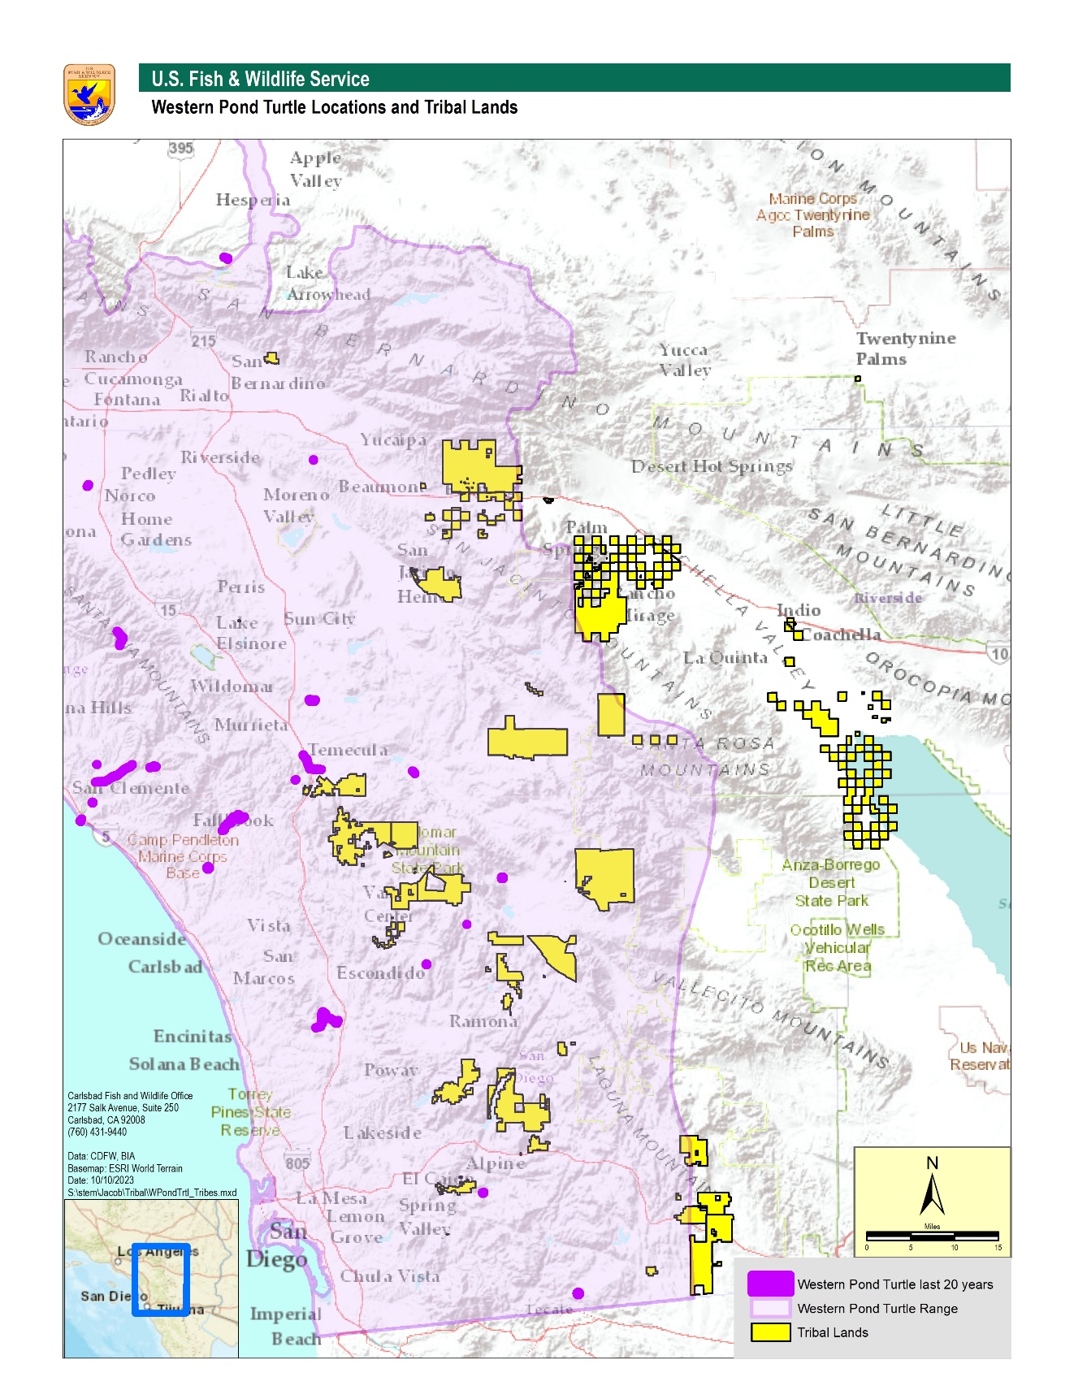
Southwestern Pond Turtle on Tribal Lands
Notes:
Here is a figure of SWPT occurrences relative to Tribal lands. If you have any information you would like to provide you can submit through regulations.gov or we can help you, just speak to a Tribal coordinator for assistance.

Slide 17
Next steps
Final Rule: Fall 2024 (~1 year after proposed rule)
If listed, species receives protections 30 days after the Final Rule publishes
Recovery Plan: within 2.5 years of the Final Rule
Critical Habitat: Separate Rulemaking Process
No ESA protections currently
Notes:
So that was an overview of the proposed rule, next I’ll talk about next steps and where we go from here…
From the time of the Proposed Rule (Oct. 3rd), it will take approximately one year to publish a Final Rule. During this next year, the Service will be reviewing those comments from the 60 day comment period.
There could be a few outcomes of this final rule, including a decision not to list, to list as endangered, or to list as threatened. If the species is listed under the ESA, the species will receive protections 30 days after the final rule is published.
A Recovery Plan outline will come out after the Final Rule, if the species is listed.
A proposed rule, separate from the Final listing rule, for Critical Habitat is forthcoming, with it’s own 60 day comment period
Currently the species does not receive any ESA protections, but can be conferenced on by federal agencies to avoid jeopardy.
CRITICAL HABITAT “We have not yet been able to obtain the necessary economic information needed to develop proposed critical habitat designations for the two species, although we are in the process of obtaining this information. At this time, we find that designation of critical habitat for the northwestern pond turtle and southwestern pond turtle is not determinable. Once we obtain the necessary economic information, we will propose critical habitat designations for the two species.“ Proposed Rule
RECOVERY PERMIT: “Recovery permits are issued to allow for take as part of activities intended to foster the recovery of listed species. A typical use of a recovery permit is to allow for scientific research on a listed species in order to understand better the species' long-term survival needs. ” These are not necessary at this time, since the species is proposed and does not have any ESA protections currently. Should the species be listed, which would come out in the Final Rule next year, then these recovery permits will be issued for activities. https://fwsepermits.servicenowservices.com/fws?id=fws_kb_view&sys_id=881899b11b5f50101f45dbdbe54bcb33

Slide 18
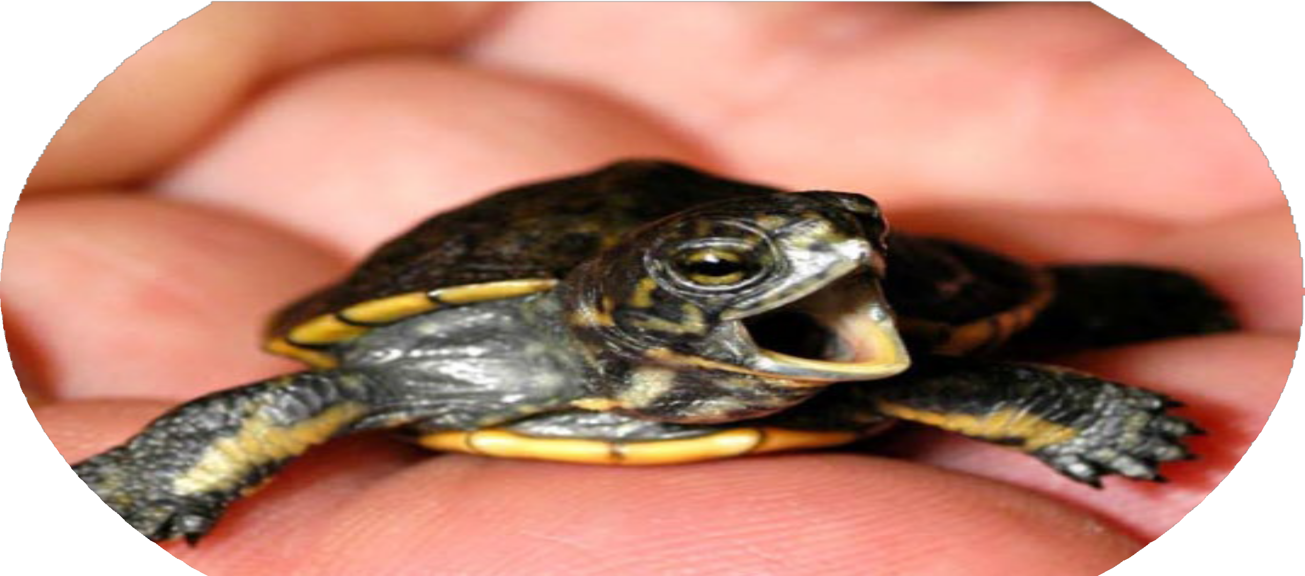
Photo: Pramuk et al. 2013

