Slide 1


The Endangered Species Act and the Utah Prairie Dog
U.S. Fish and Wildlife Service
Ecological Services
Utah Field Office

Slide 2
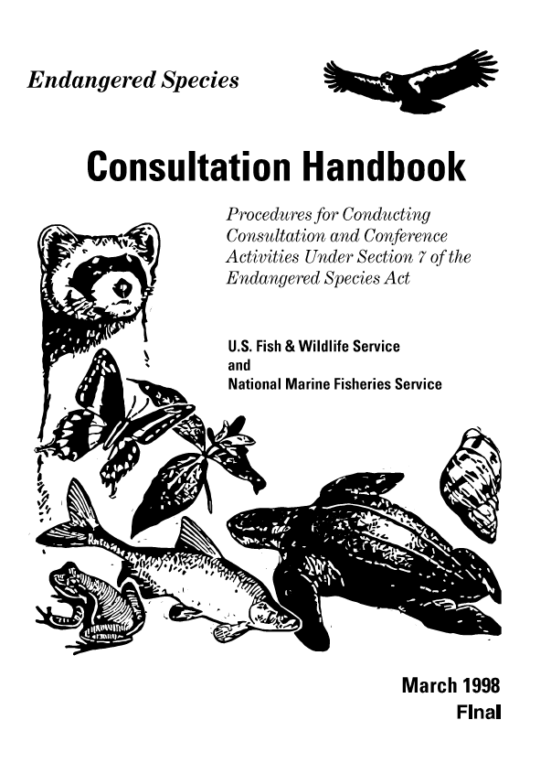
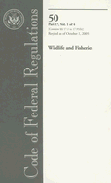
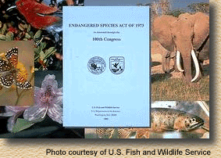
Laws, Regulations & Guidelines
Statutory Authority
  Endangered Species Act
Regulations
  50 CFR 402
Consultation Handbook

Slide 3
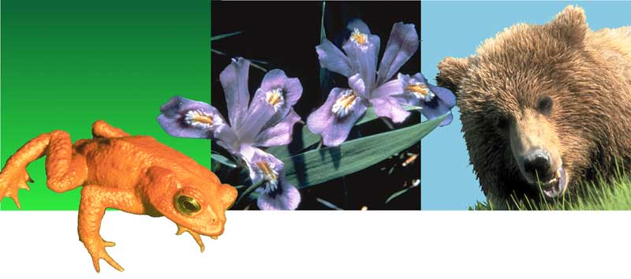

The Endangered Species Act
… working with others to conserve, protect and enhance fish, wildlife, plants and their habitats for the continuing benefit of the American people.

Slide 4
The Endangered Species Act
Section 4:
Listing, Critical Habitat Designation, Recovery, Monitoring
Section 6:
How we work with State Partners (Funding)
Section 7:
The Role of Federal Agencies (Consultation)
Section 9:
Unlawful Activities (Take)
Section 10:
Exceptions, Permits (HCPs, GCPs)

Slide 5
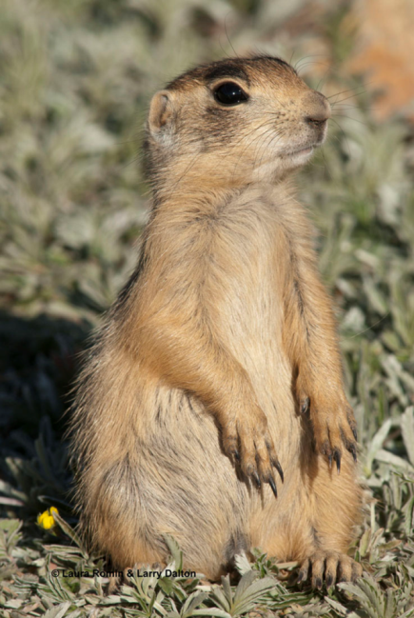
Utah prairie dog Listing Actions (Section 4)
Endangered
  June 4, 1973
  38 FR 14678
Threatened
  May 29, 1984
  49 FR 22330 with special 4(d) rule
4(d) special rule amended
  June 14, 1991
  56 FR 27438
  Revised 4(d) rule Aug, 2 2012
  Expanded to include lands near conservation lands/safety hazards/significant human cultural and burial sites

Slide 6
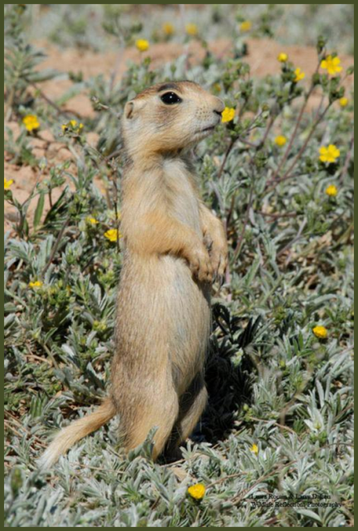
Listing Factors (Section 4)
Present or threatened destruction, modification, or curtailment of its habitat or range;
Over-utilization for commercial, recreational, scientific, or educational purposes;
Disease or predation;
Inadequacy of existing regulatory mechanisms; and
Other natural or manmade factors
© Laura Romin & Larry Dalton

Slide 7

Recovery Plan (Section 4)
First Recovery Plan was finalized- September 30, 1991
Revised Recovery Plan was published in Federal Register Spring 2012
Developed to promote the conservation and recovery of the species

Slide 8
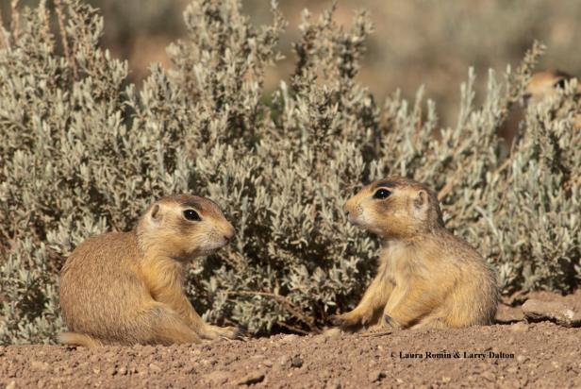
Recovery Plan – 5 basic elements
Recovery goal and a set of delisting criteria
Three general strategies for management
Recommendations for population and habitat monitoring
Research program to address critical information needs
Implementation procedures that specify oversight and coordination responsibilities

Slide 9
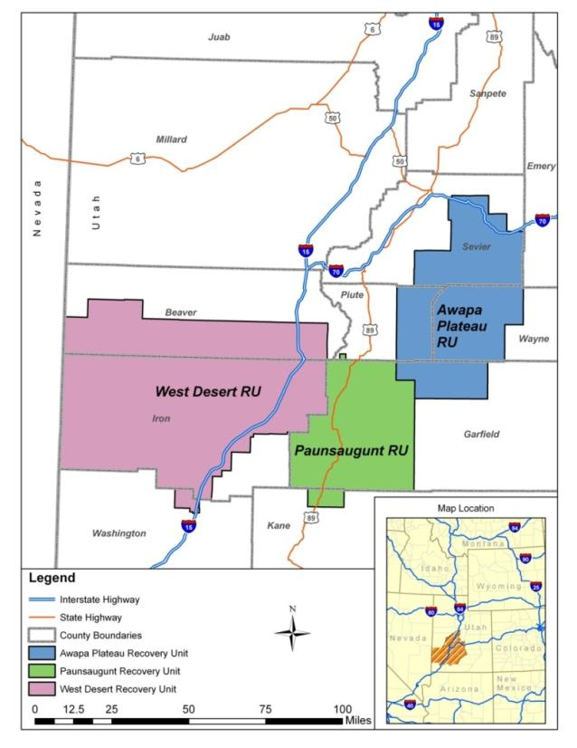
Three Recovery Units (RUs)
Source: USFWS 2011 Draft Recovery Plan

Slide 10
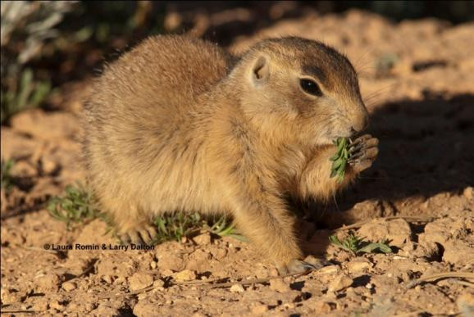
Components of Recovery Plan
Plague Management
Conservation on private lands
Improving translocation techniques
Recovery goals and criteria
  Spatial distribution
  Protected animals and habitat

Slide 11
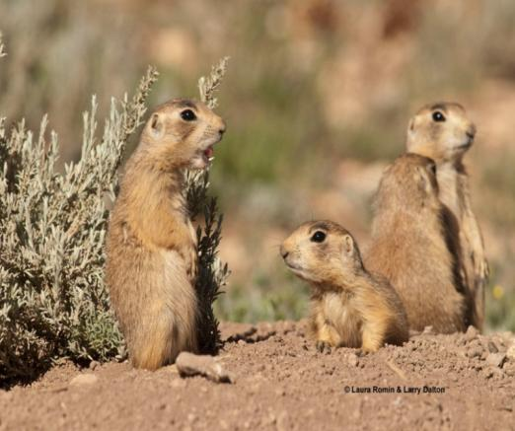
Section 9 of the Act
Makes it unlawful to “take” any threatened or endangered species
Definition of “Take”
  To harass, harm, pursue, hunt, shoot, wound, kill, trap, capture, collect, or attempt to engage in any such conduct.
  Applies to any person or Federal Agency.

Slide 12
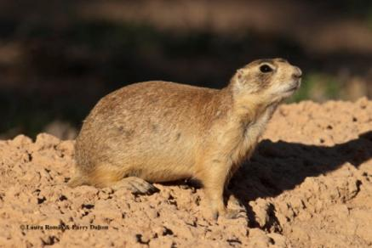
50 CFR 17.3
Definition of “Harm”
“means an act which actually kills or injures wildlife. Such acts may
include significant habitat modification or degradation where it actually
kills or injures wildlife by significantly impairing essential behavioral patterns, including breeding, feeding or sheltering.”
Definition of “Harass”
“means an intentional or negligent act or omission which creates
the likelihood of injury to wildlife by annoying it to such an extent as to significantly disrupt normal behavioral
patterns which include, but are not
limited to, breeding, feeding, or sheltering.”

Slide 13
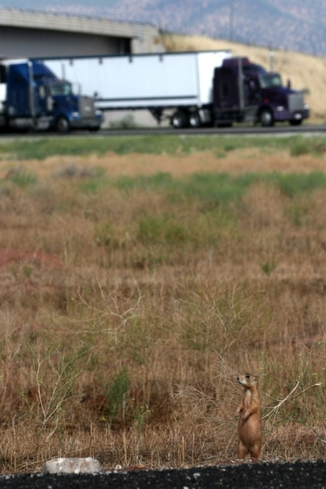
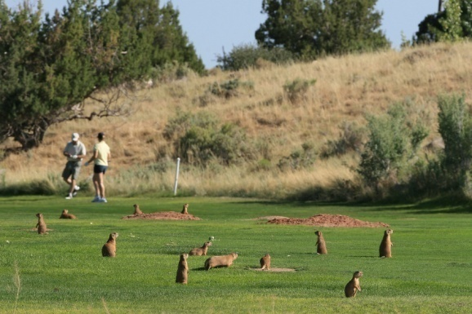
Avoiding Prohibitions of Section 9
Section 7
  Incidental Take Statement
  Federal activities
Source: UPDHCEP Presentation
Source: UPDHCEP Presentation

Slide 14
Evaluating Proposed Projects
Is the project area in or adjacent to Utah prairie dog habitat?
  Habitat mapping
  Field Evaluations
  Coordination with Experts
Will the action potentially impact the Utah prairie dog?
  Noise
  Increased Human Activities
  Habitat Alteration
    Breeding
    Foraging
    Shelter

Slide 15
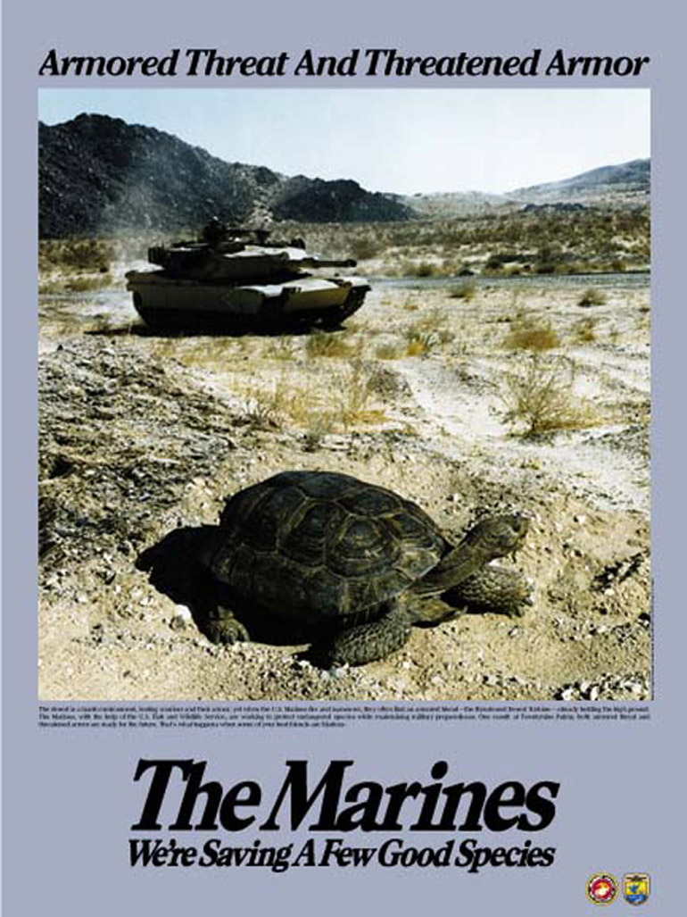
Section 7
The Role of Federal Agencies
7(a)(1) Federal agencies must carry out their programs and authorities to protect and conserve listed species.
7(a)(2) Any action that an agency authorizes, funds, or carries out cannot jeopardize the existence of any listed species.

Slide 16

Section 7 Consultation
50 CFR 402 defines consultation process
  Analyzes effects at individual level in addition to jeopardizing the species
If an action may affect a listed species or critical habitat, the agency must consult with FWS
Early coordination with FWS is important

Slide 17
Section 7 Consultation
No effect = No Consultation necessary
  Project will not directly or indirectly affect listed species or critical habitat.
Is not Likely to Adversely Affect = Informal Consultation
  Project effects on listed species or critical habitat are discountable, insignificant, or completely beneficial.
Is Likely to Adversely Affect = Formal Consultation
  Project will adversely affect listed species or critical habitat.

Slide 18
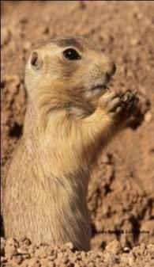
Section 7 Consultation
Informal Consultation
  Determines species to be affected
  Determines the effects
  Explores project modifications to avoid or eliminate effects
  Determines the need for formal consultation

Slide 19

Section 7 Consultation
Formal Consultation
  If effects are adverse, the agency initiates formal consultation.
  Involves detailed information (Biological Assessment)
  Biological Opinion is issued by the Service
  Timeline can total 135 days

Slide 20
Section 7 Consultation
Biological Opinion
  Not likely to jeopardize species or adversely modify critical habitat:
    incidental take statement
    reasonable and prudent measures to minimize take
  Likely to jeopardize species or adversely modify critical habitat:
    reasonable and prudent alternatives to the action
Note: Take is only authorized through formal consultation.

Slide 21
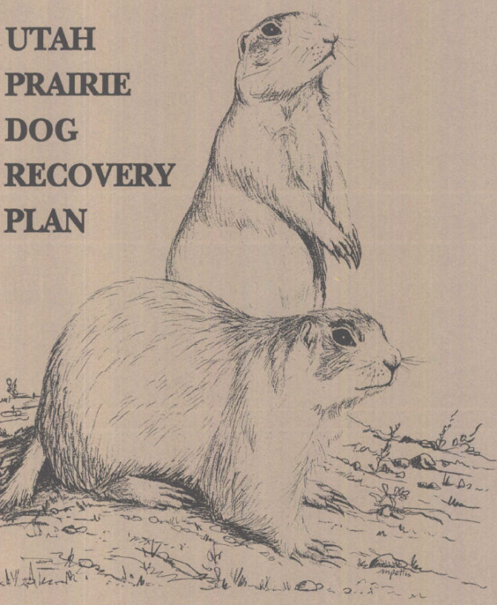
Section 7 Consultation
Incidental Take Statement
Consistency with Recovery Plan
  Includes descriptions of site-specific management actions necessary to conserve and ensure survival of the species

Slide 22
Decision Tree – Section 7 Consultation
Determination
No Effect
No Consultation Required
Will the proposed action affect a listed species or designated critical habitat?
NO
YES
Determination May Affect,
Not Likely to Adversely Affect Informal Consultation
(30 days)
Likely to adversely affect species or critical habitat?
NO
Determination May Affect,
Likely to Adversely Affect
Formal Consultation
(135 days)
YES

Slide 23
More Information
Endangered Species Act of 1973
  http://www.fws.gov/endangered/ESA/content.html
50 CFR 402
  http://frwebgate.access.gpo.gov/cgi-bin/multidb.cgi
The Section 7 Consultation Handbook
  http://endangered.fws.gov/consultations/s7hndbk/s7hndbk.htm
Additional species information
  http://www.fws.gov/endangered/wildlife.html
Section 10
  http://www.fws.gov/endangered/esa/sec10.html

Slide 24
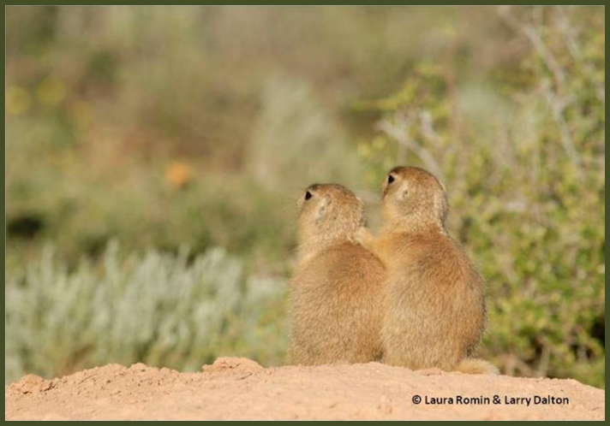
ANY QUESTIONS?

