Slide 1
Bureau of Indian Affairs (BIA) Division of Environmental, Cultural Resources Management & Safety (DECRMS) HEARTH ACT
Presenter:
Jacilyn Snyder
Regional NEPA Coordinator
Pacific Region Office (PRO)
Email: Jacilyn.Snyder@BIA.gov

Slide 2
Overview of HEARTH Act
The Helping Expedite and Advance Responsible Tribal Home Ownership Act of 2012.
Amendment of the Indian long-term Leasing Act of 1955 under U.S.C Sec 415.
May only authorize the following lease types:
Business
Agricultural
Wind and solar lease (WSR)
Wind Energy Evaluation leases (WEEL)
Residential
Public, religious, educational, or recreational leases.
Must only apply to tribal trust and/or restricted land, not to lands held in trust for individual Indian landowners, fee lands or fractionated interests
Must not authorize exploration, development, or extraction of any mineral resources.

Slide 3
Approved BIA HEARTH Acts since 2013

Slide 4
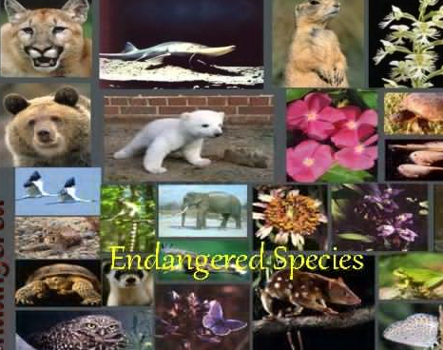
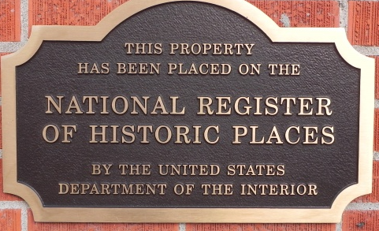
HEARTH Act Enacted
What happens now?
Tribe has authority to approve.
What happens to Section 7 (Endangered Species Act)?
What happens to Section 106 (National Historic Preservation Act)?

Slide 5
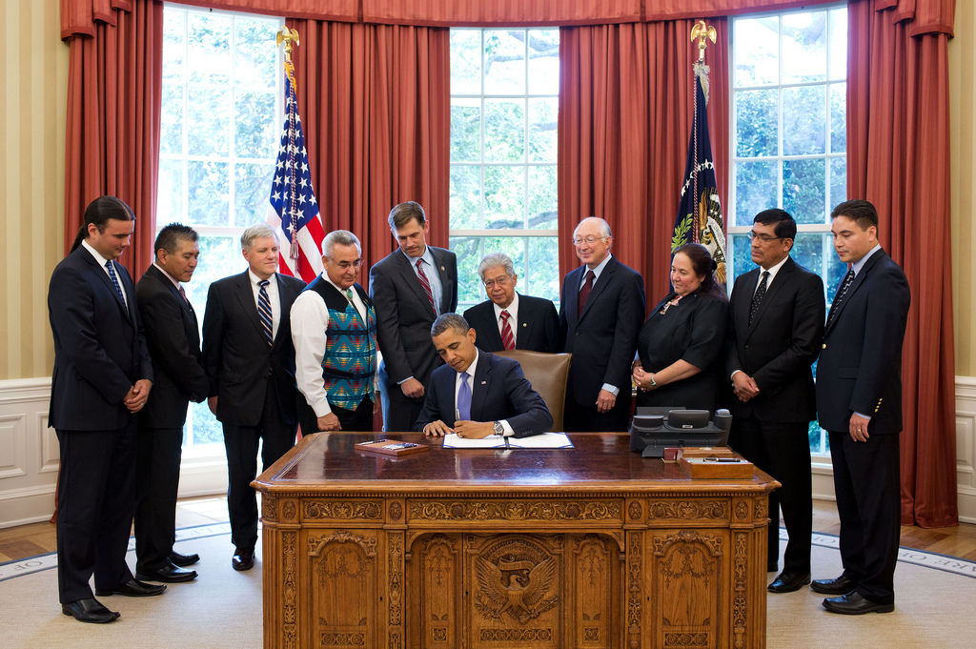
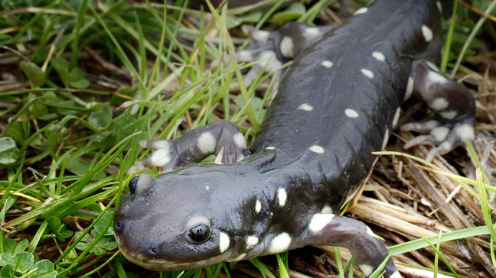
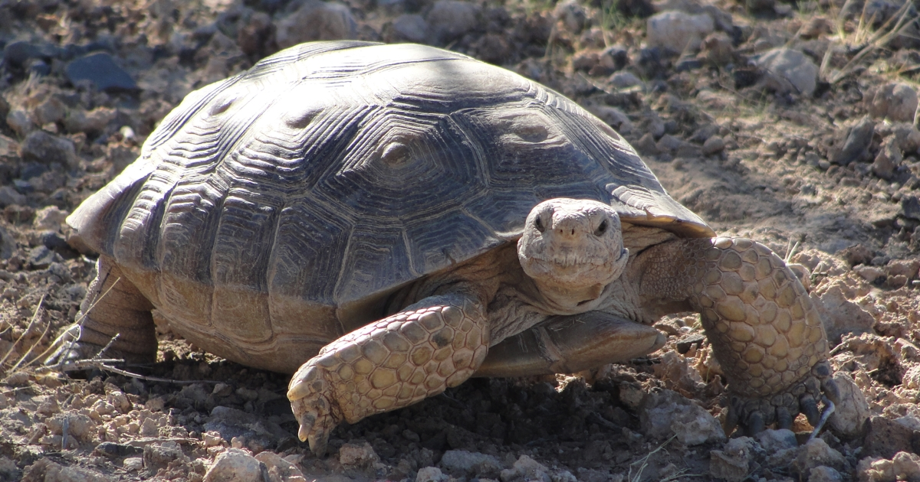
Sensitive Species and the HEARTH Act

Slide 6
HEARTH Act Summary
Helping Expedite and Advance Responsible Tribal Home Ownership Act
Signed into law in 2012
Amendment of the existing Indian Long Term Leasing Act of 1955, under USC Sec 415
Tribes set up their own regulations for leasing
Allows Tribes to negotiate leases themselves
Notes:
Tribes may enact regulations that are tailored to the unique needs of the Tribe’s community.
Supports tribal self-determination
May only authorize the following lease types:
Business
Agricultural
Wind and solar lease (WSR)
Wind Energy Evaluation leases (WEEL)
Residential
Public, religious, educational, or recreational leases

Slide 7
Sensitive Species and the HEARTH Act

Slide 8
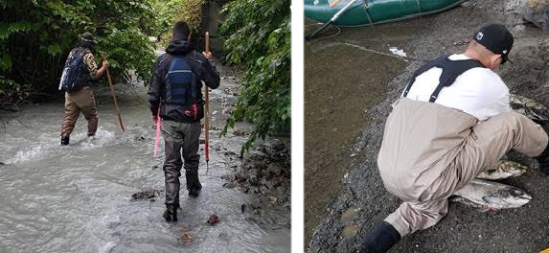
HEARTH Act Environmental Requirements
Environmental review process
Identification and evaluation of the significant effects of the proposed lease on the environment
A period for public notice and comment related to any significant impacts
The tribe’s response to relevant and substantive public comments on environmental impacts
BIA provides technical assistance in developing the environmental review process
California Tiger Salamander – Threatened/Endangered
Notes:
Identification and evaluation of the significant effects of the proposed lease on the environment.
A period for public notice and comment related to any significant impacts of the proposed lease on the environment.
The tribe’s response to relevant and substantive public comments on environmental impacts, prior to tribal approval of the lease.

Slide 9
Sensitive Species and the HEARTH Act

Slide 10
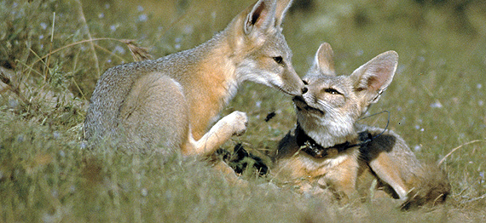
Protection and Conservation of Plants, Wildlife, and Habitat
San Joaquin Kit Fox - Endangered
Endangered Species Act
Migratory Bird Treaty Act
Bald and Golden Eagle Protection Act (BGEPA)
Golden Eagle – Protected under BGEPA
Notes:
These laws still apply to leasing projects under tribal HEARTH Act leases

Slide 11
Sensitive Species and the HEARTH Act

Slide 12
Endangered Species Act Consultation Process
Section 10 Consultation – No federal nexus
Section 7 Consultation – Federal Nexus
Valley Elderberry Longhorn Beetle
Threatened
Notes:
Section 7
Development of a Biological Assessment
US Fish and Wildlife Service issues a Biological Opinion
Informal: Not likely to adversely affect protected species
Formal: May affect protected species

Slide 13
Sensitive Species and the HEARTH Act

Slide 14
How we can help
Is there the potential to impact Threatened or Endangered species or their habitat?
Identifying and evaluating impacts
Development of design features and mitigation
Government to government coordination
Northern Spotted Owl – Threatened
Notes:
Once your regs are set up, you begin setting up a lease project and completing your environmental review
BIA is still available to provide technical support

Slide 15
Sensitive Species and the HEARTH Act

Slide 16
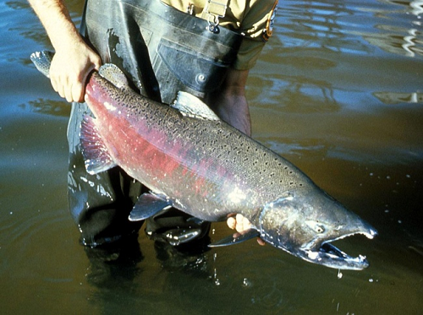
Benefits of Conserving Sensitive Species
Mojave Desert Tortoise – Threatened
Improved ecological functioning
Decreased erosion, resistance to invasive species, healthier air/soil/water, increased biodiversity, improved carbon sequestration
Biodiversity serves consumptive uses
Fishing, harvesting, medicine, etc.
Preserving cultural and recreational values
Wildlife viewing, ecotourism, conservation of species important to cultural heritage
Chinook Salmon – Threatened/Endangered
Notes:
Nature-based solutions strengthen the land by improving ecological functioning
If you think you’d like to develop conservation projects, reach out to me!

Slide 17
Sensitive Species and the HEARTH Act

Slide 18
We are a Resource!
Your BIA Regional Biologist
Assist in analysis, field surveys, coordination with federal agencies, mitigation and project design, etc.
If you have questions or think there may be impacts to listed species, please call me!
Peter DeJongh
peter.dejongh@bia.gov
916-704-0857
Jacilyn Snyder
jacilyn.snyder@bia.gov
Peirson’s Milkvetch – Threatened
Flat-tailed Horned Lizard – Sensitive Species

