Slide 1
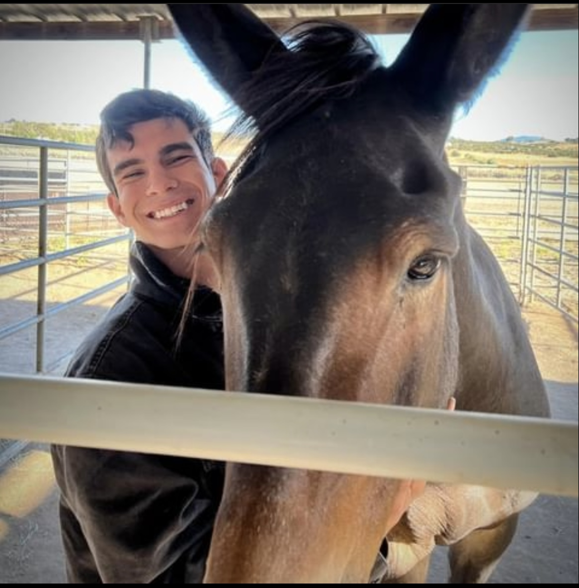
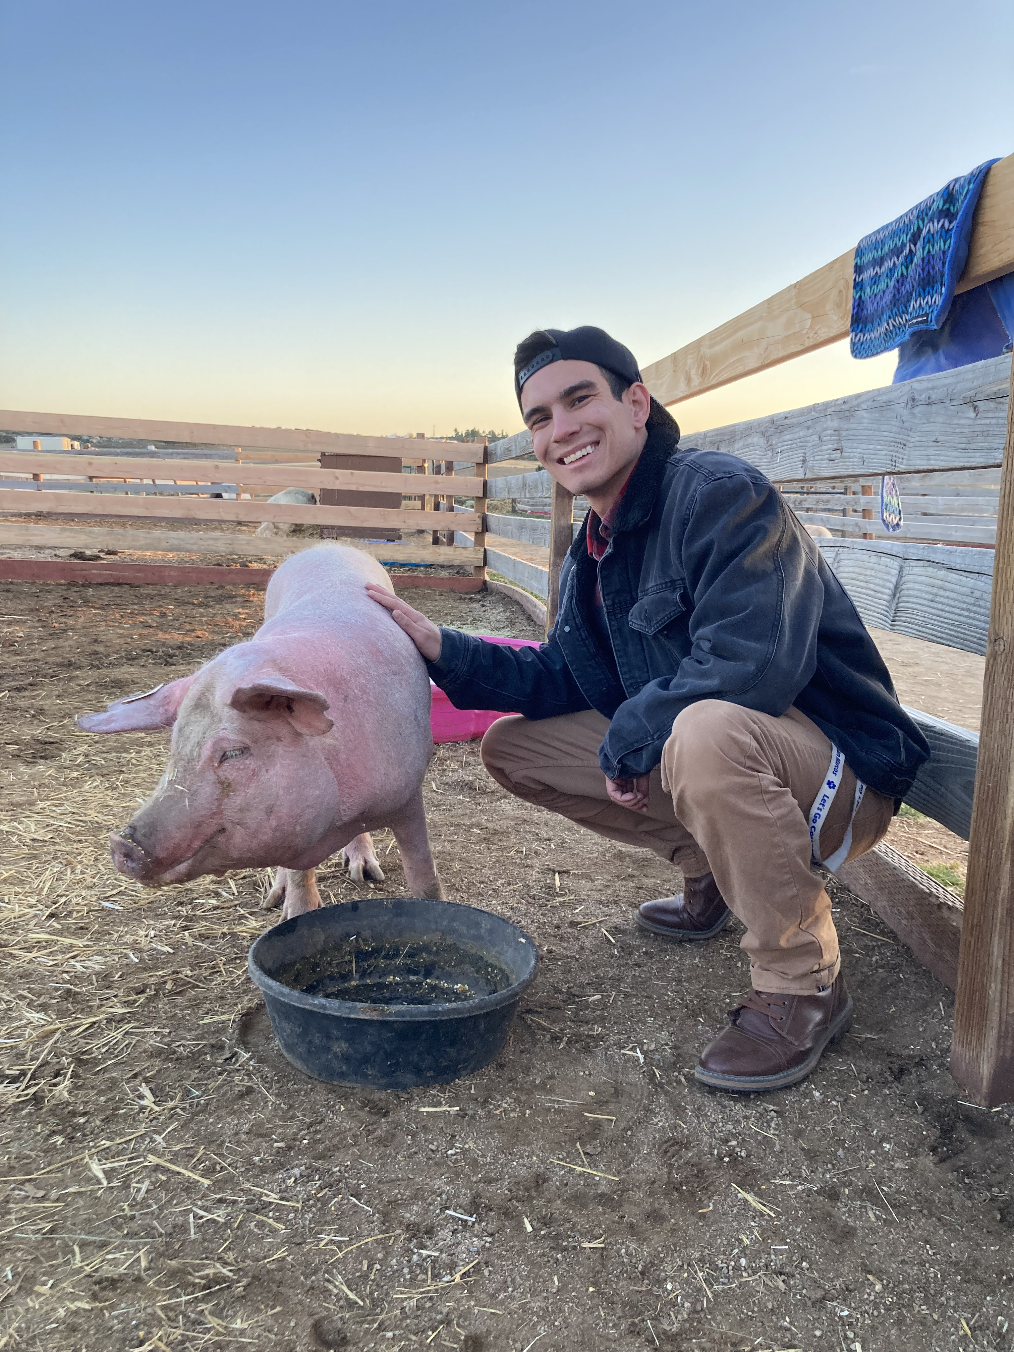
Science in the Service Project
Aiden Valverde
Carlsbad Fish and Wildlife Office
Fall Tribal Coordination Meeting
November 8, 2023
1
Notes:
Howka, my name is Aiden Valverde and I am a descendent of the Iipay/Kumeyaay Nation of Santa Ysabel. I am currently a third year student at Cal State San Marcos with my focused major being American Indian Studies. I am also trying to pursue a career in conservation either at tribal, state, or federal level. I have always had a passion for conservation and a love for animals, while also wanting to educate and teach myself ways that I can support conservation efforts.

Slide 2
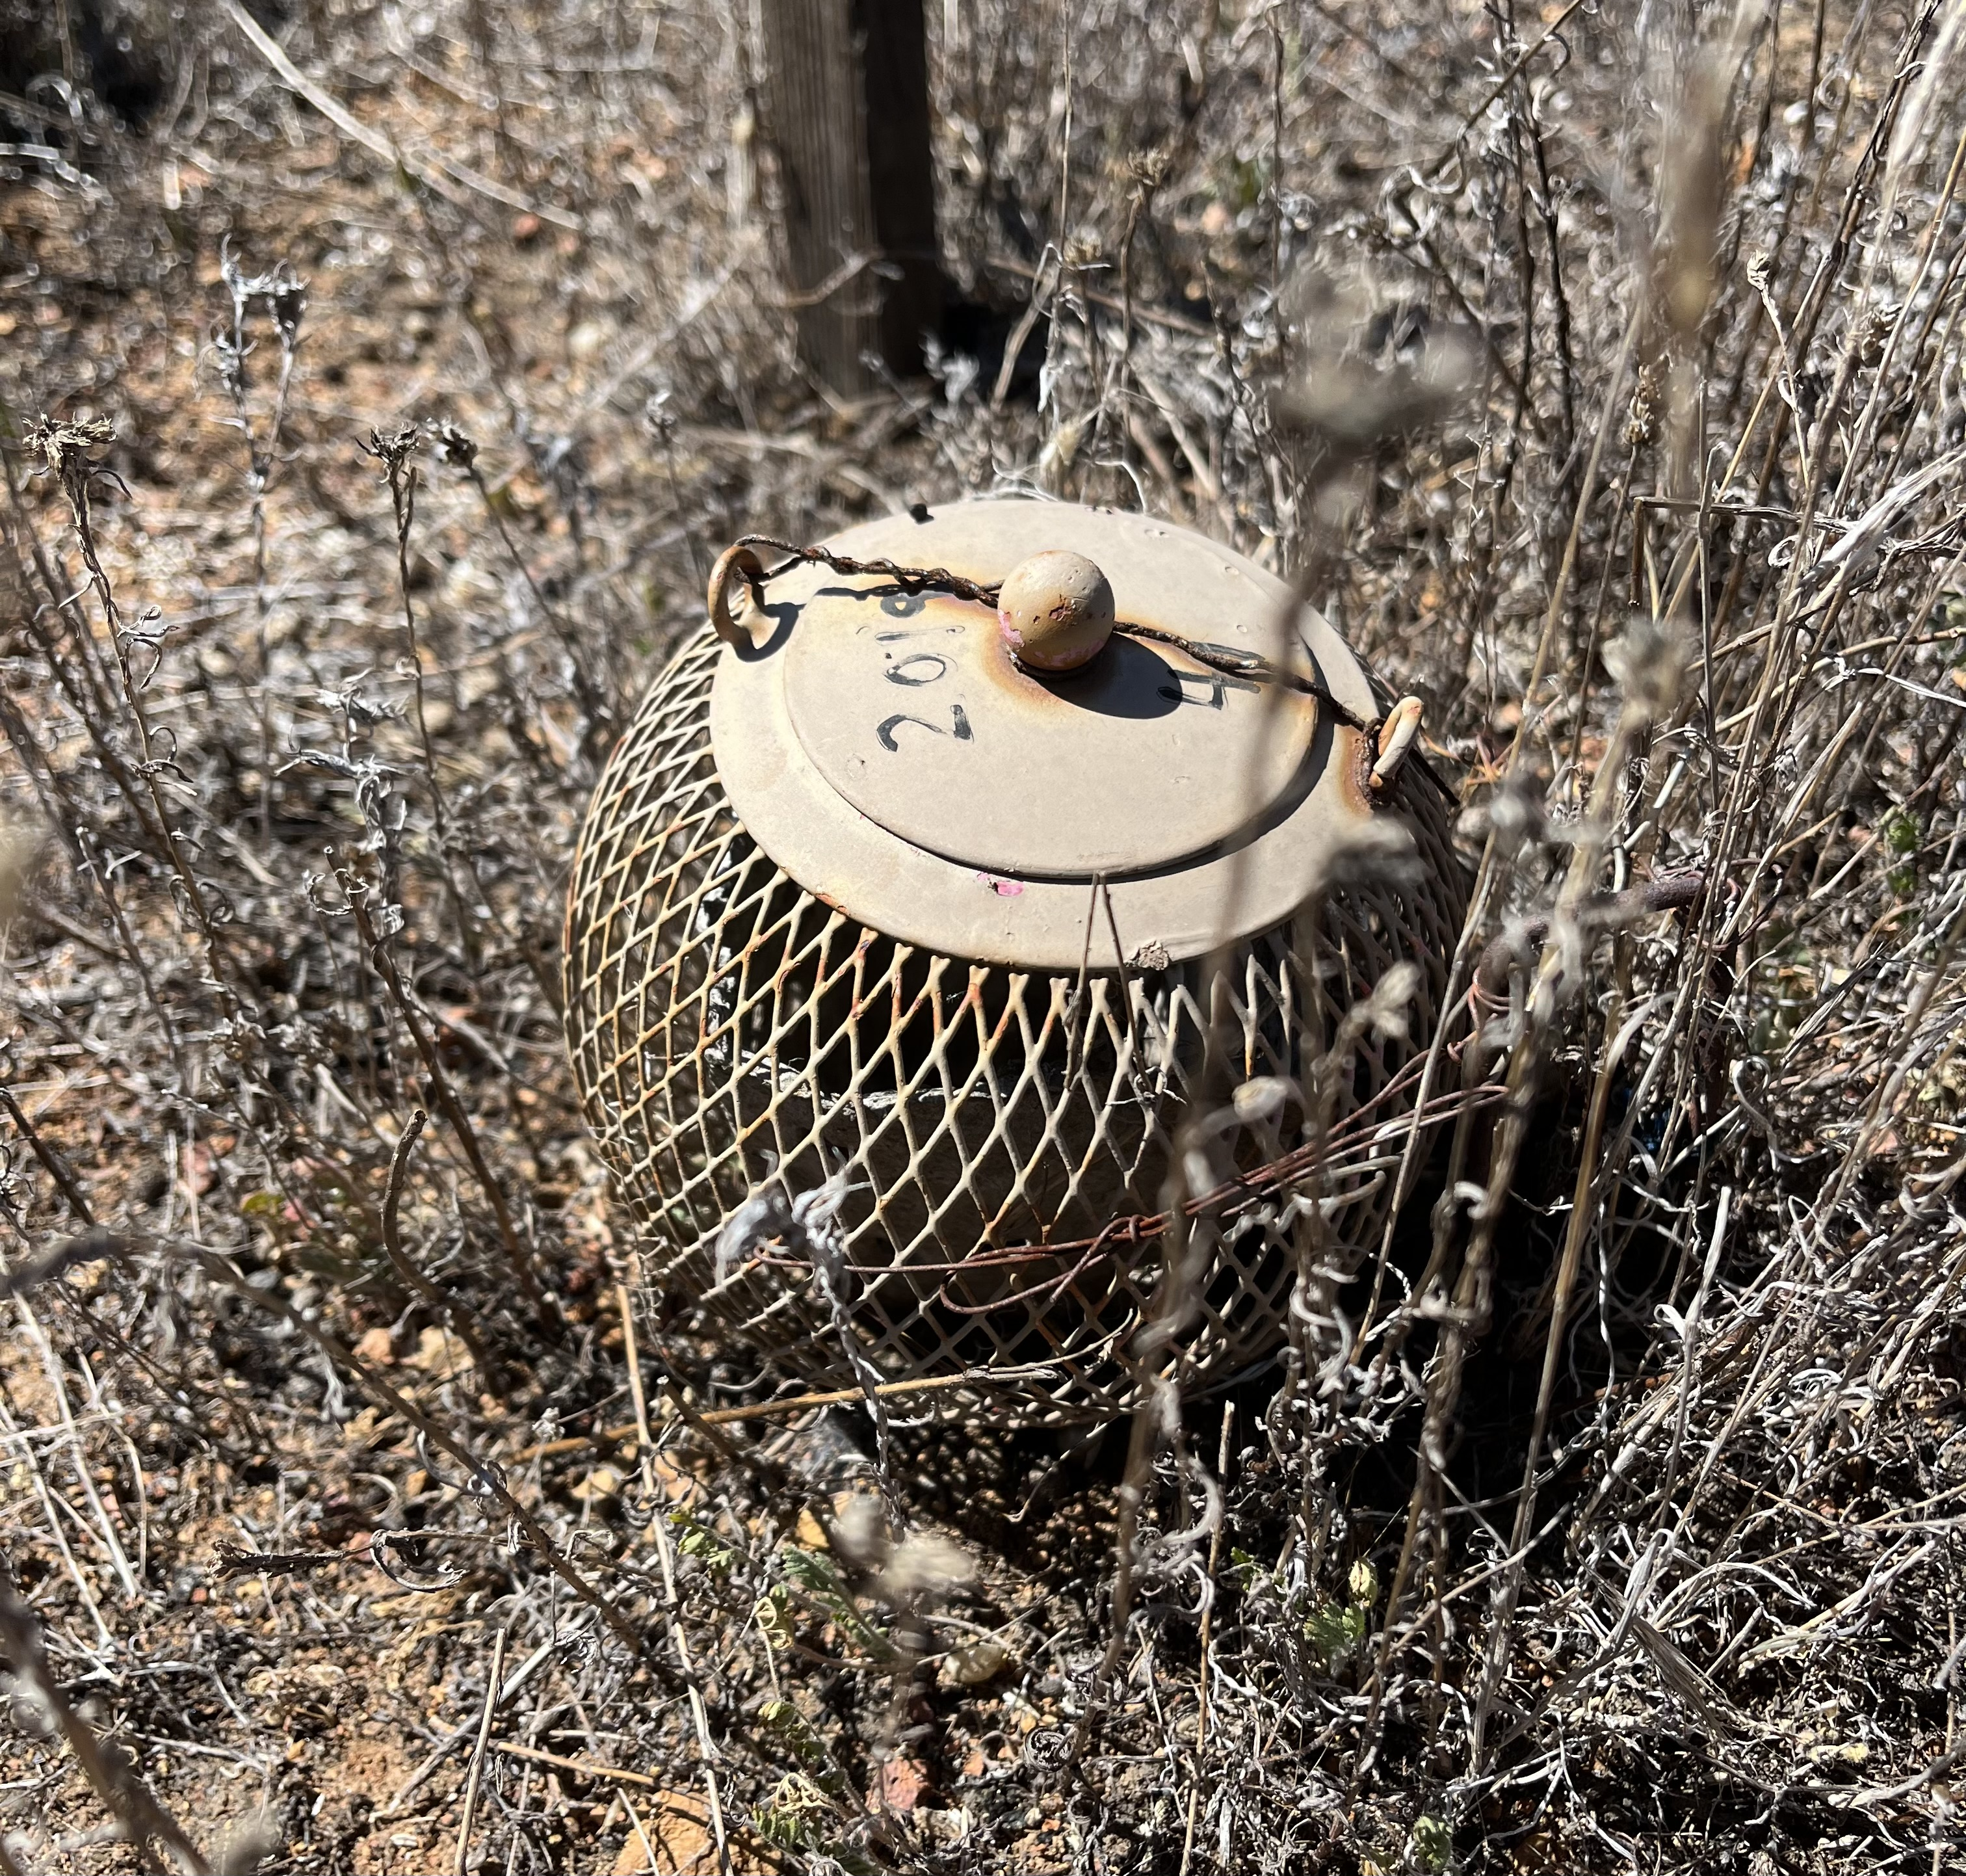
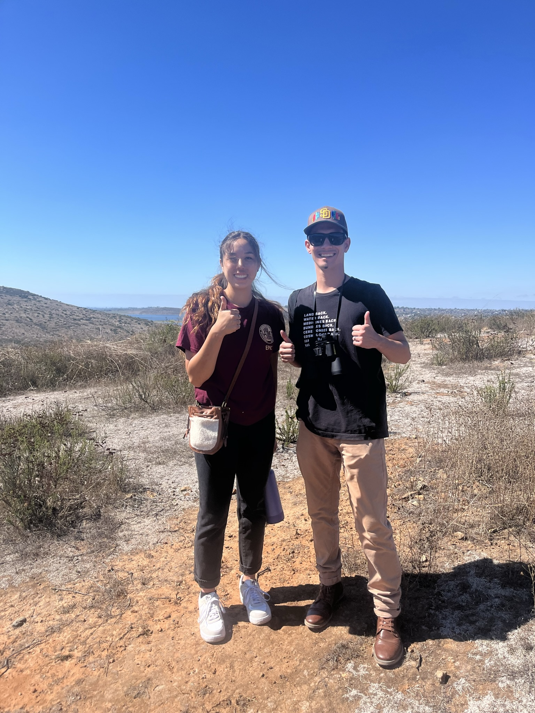
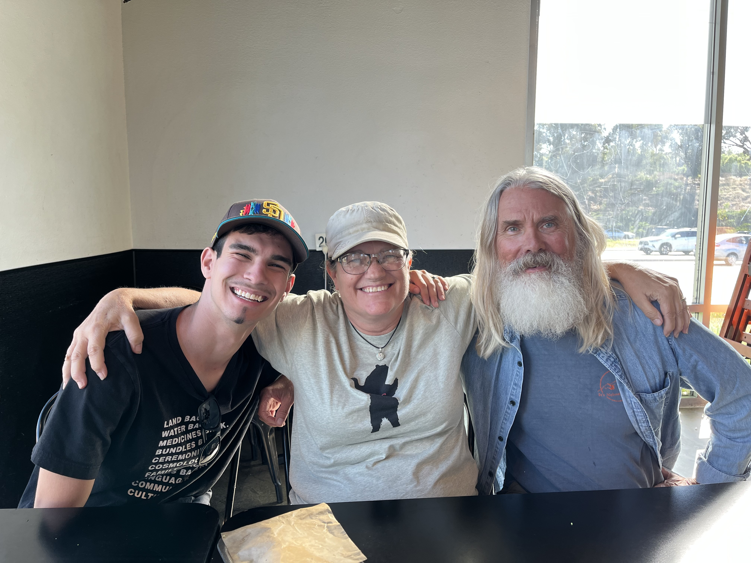
Project Objectives
SIS Program
Project Information
Goals
2
Notes:
The project I am working on is through the Science and Service Program. I am assigned to the Carlsbad Fish and Wildlife office and have been working closely with my supervisor Alison on this.
The main focus for the project is to look at habitat use by three listed species of butterflies native to California, the Laguna Mountain Skipper, Hermes Copper, and Quino Checkerspot and the compatibility with use of traditional resources in their habitats.
The picture on the right is a Quino checkerspot caterpillar cage.

Slide 3
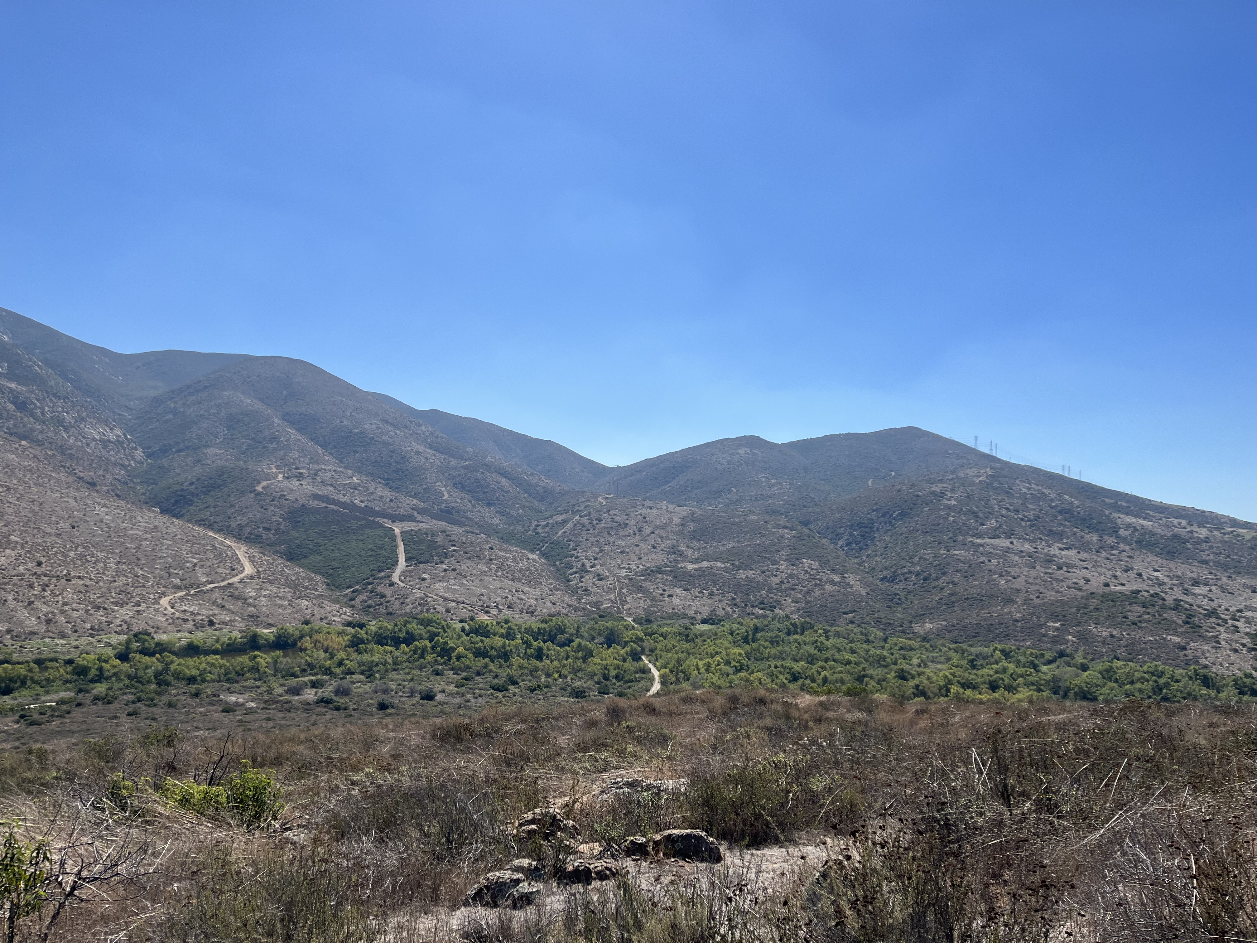
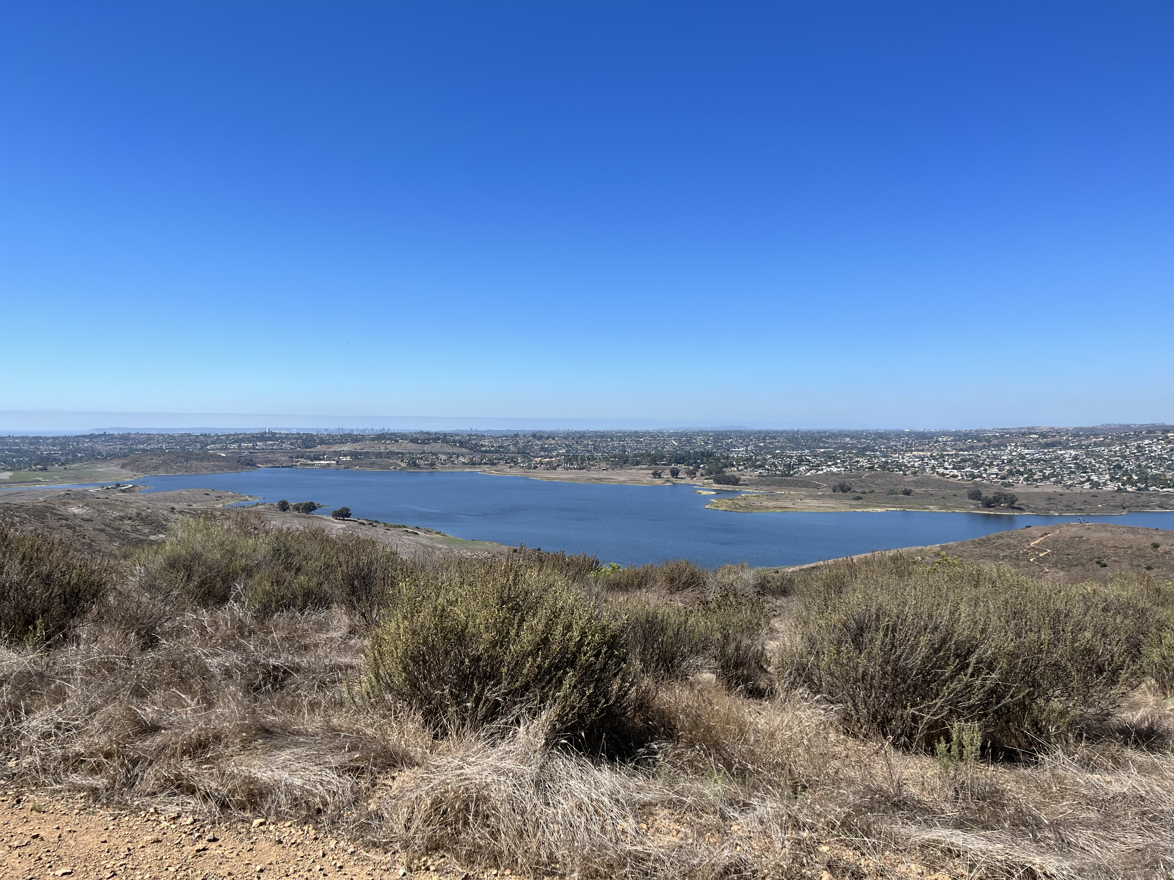
Requests and Outreach
Traditional Practices
Goals and Plans
3
Notes:
The takeaway I want to emphasize in this presentation is my need for information from tribal leaders and community members about current or future desires communities may have for such traditional practices. These can just be ideas or possible activities that members have discussed, it does not have to be any official proposal. This will also personally benefit me in the long run learning about traditional practices and uses, especially of being indigenous descent and my major being American Indian Studies. So far I have been reading all I can about each species and what I can about traditional use, such as ethnobotany, however everything in oral local tradition might not have been documented. I am also interested in looking into the current practices or needs most relevant today. With the information given, a report will be written so see how traditional tribal use aligns with species habitat use, with the intent of the report to help expedite analysis and authorization of any Tribal land use requests on conserved public lands, and of course for Tribal land managers to use for managing impacts on their own lands if desired. Throughout this process I will be following up with communications to individual tribal leaders and councils directly. Please look for my communications through email and postal services.

Slide 4
4
Notes:
This is the northern area that includes my targeted species. The tribal trust lands shown on this map are just for geographic reference of species locations. The red area is Laguna Mountain Skipper habitat, on Palomar Mountain. The blue is Quino Checkerspot Butterfly habitat, distributed throughout the inland valleys and mountain slopes of Riverside County. The range polygons look different because we didn't have a range map for Quino like the other two butterflies. These are population locations.

Slide 5
5
Notes:
This is the southern area that includes my targeted species. The red is again showing the Laguna Mountain Skipper Range, with it currently being reintroduced to the Laguna Mountains by the Fish and Wildlife Service. The blue will again show the Quino Checkerspot habitat range, which ranges from the coastal mesas inland to the foothills and desert's edge. And lastly, the orange is Hermes Copper Butterfly habitat, which will be stretching from the coastal mesas to the slope of Cuyamaca and Laguna Mountains.

Slide 6
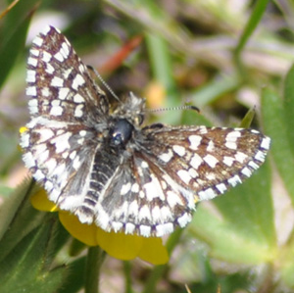
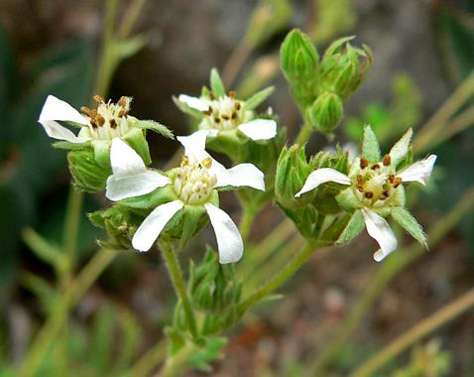
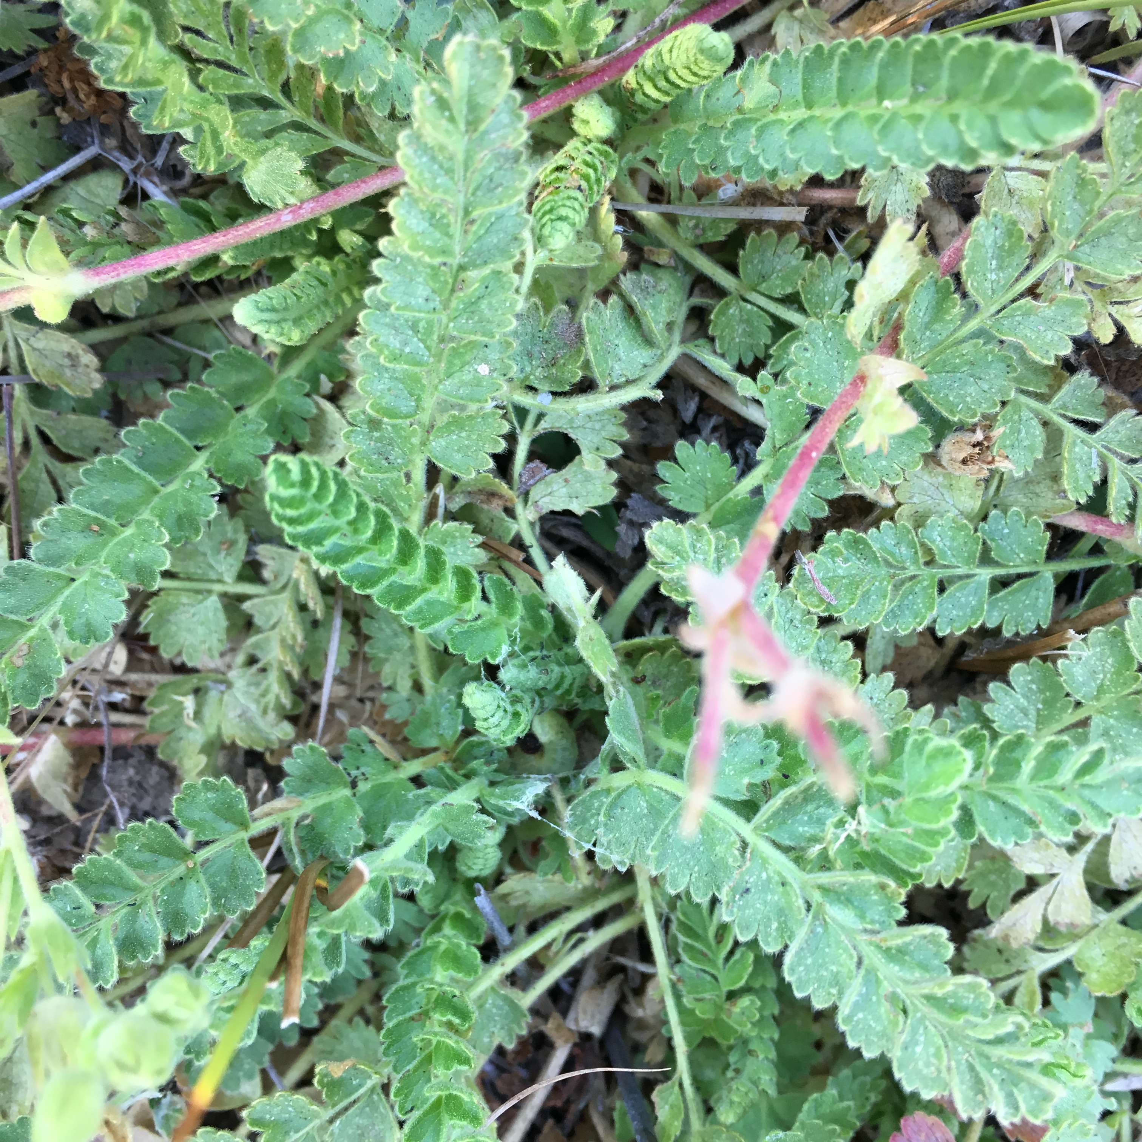
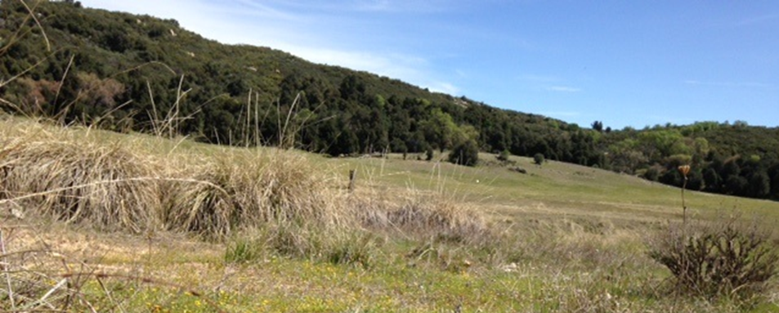
Laguna Mountain Skipper
Host Plant: Cleveland's Horkela
6
Notes:
This is the Laguna Mountain Skipper. Its preferred habitat is wet mountaintop meadows where it uses its primary host plant Cleveland's Horkela. This plant is a low growing long herb.

Slide 7
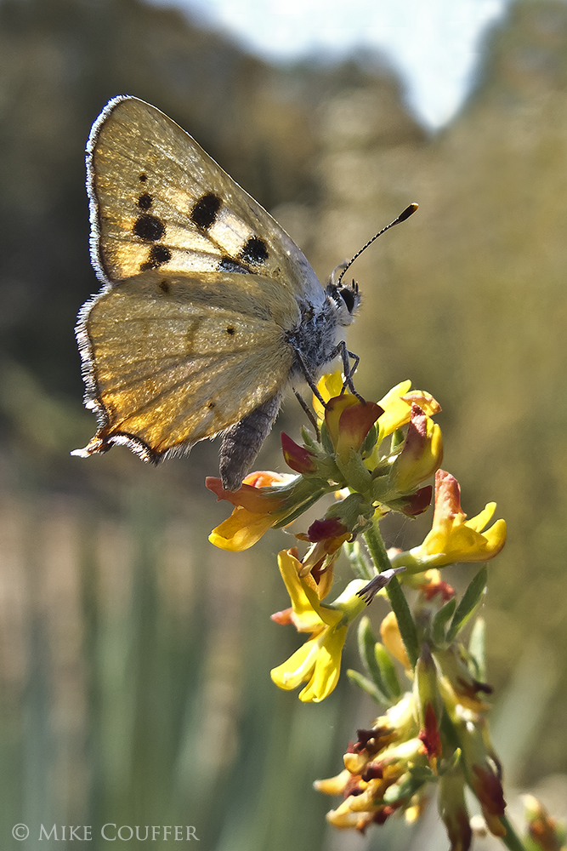
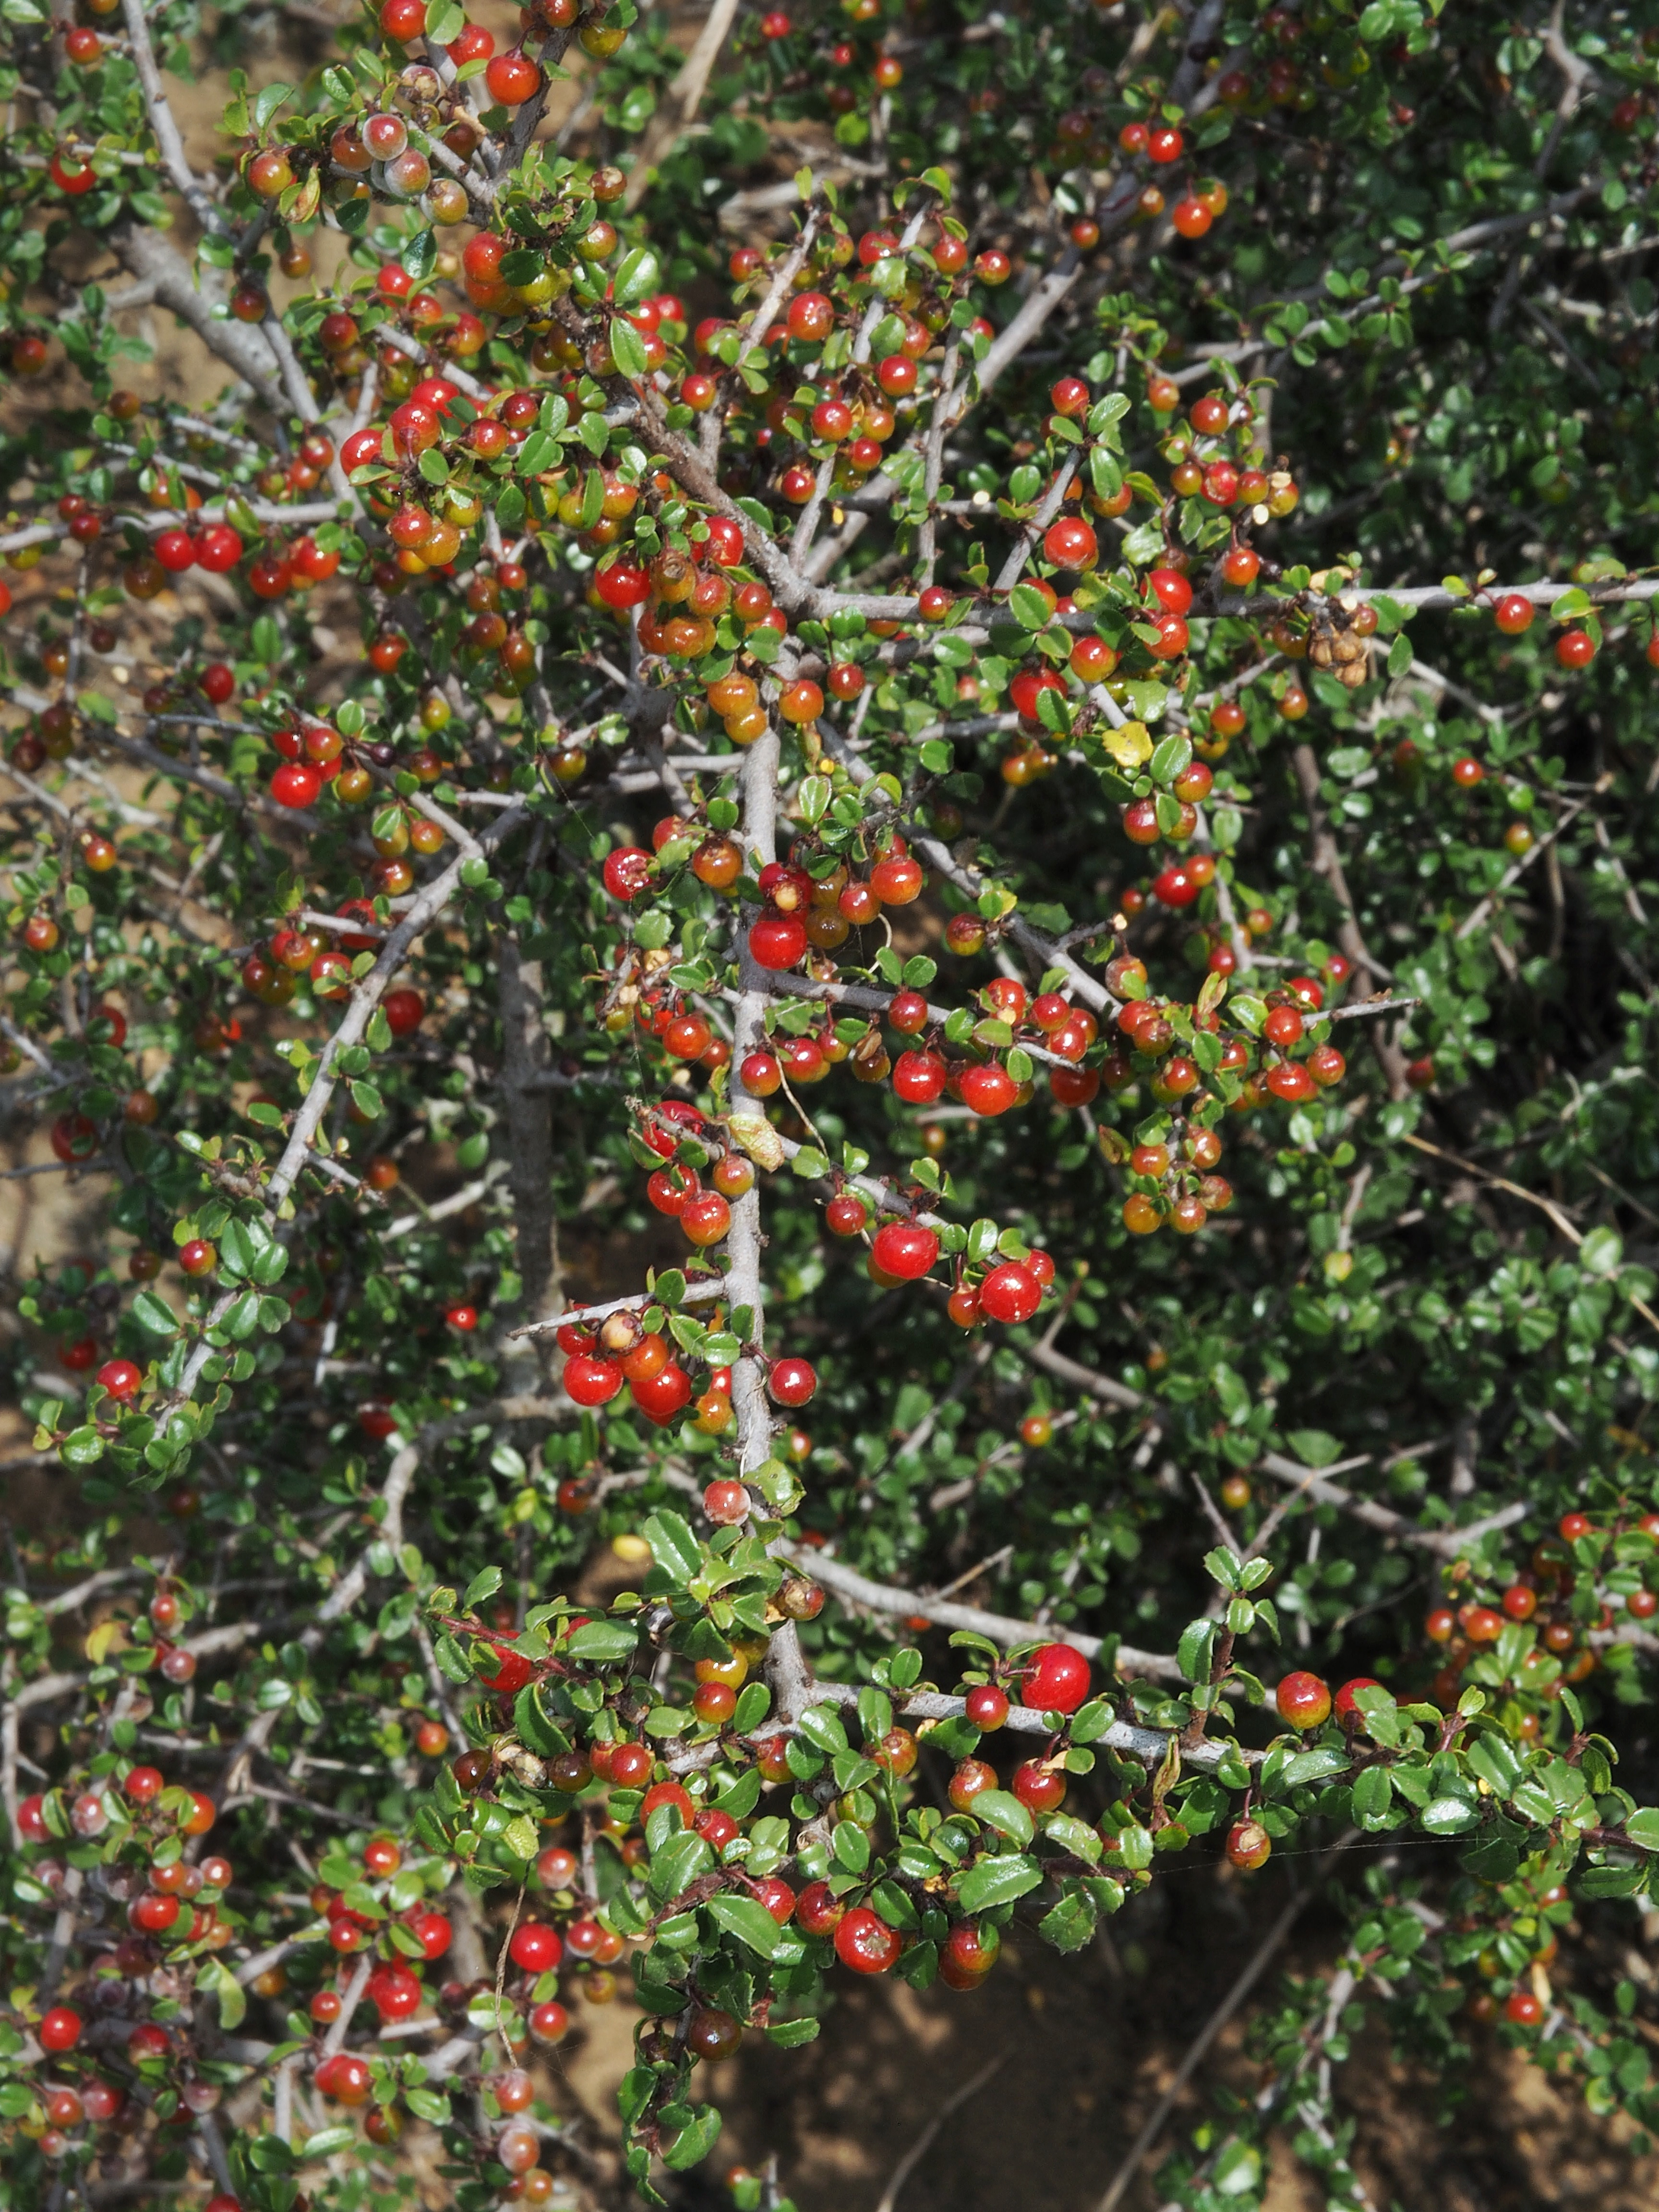
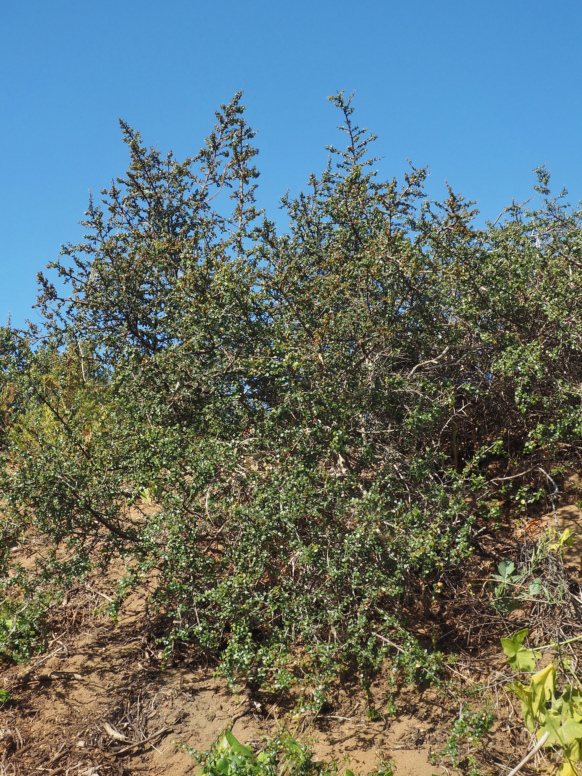
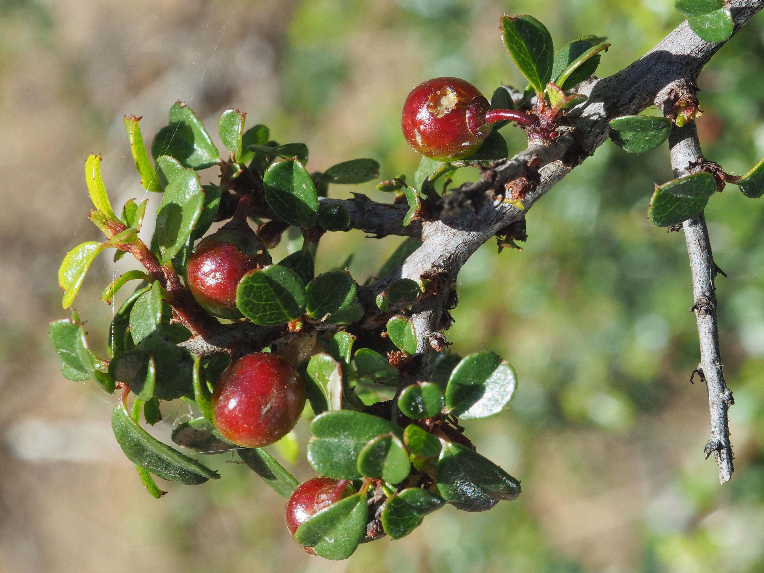
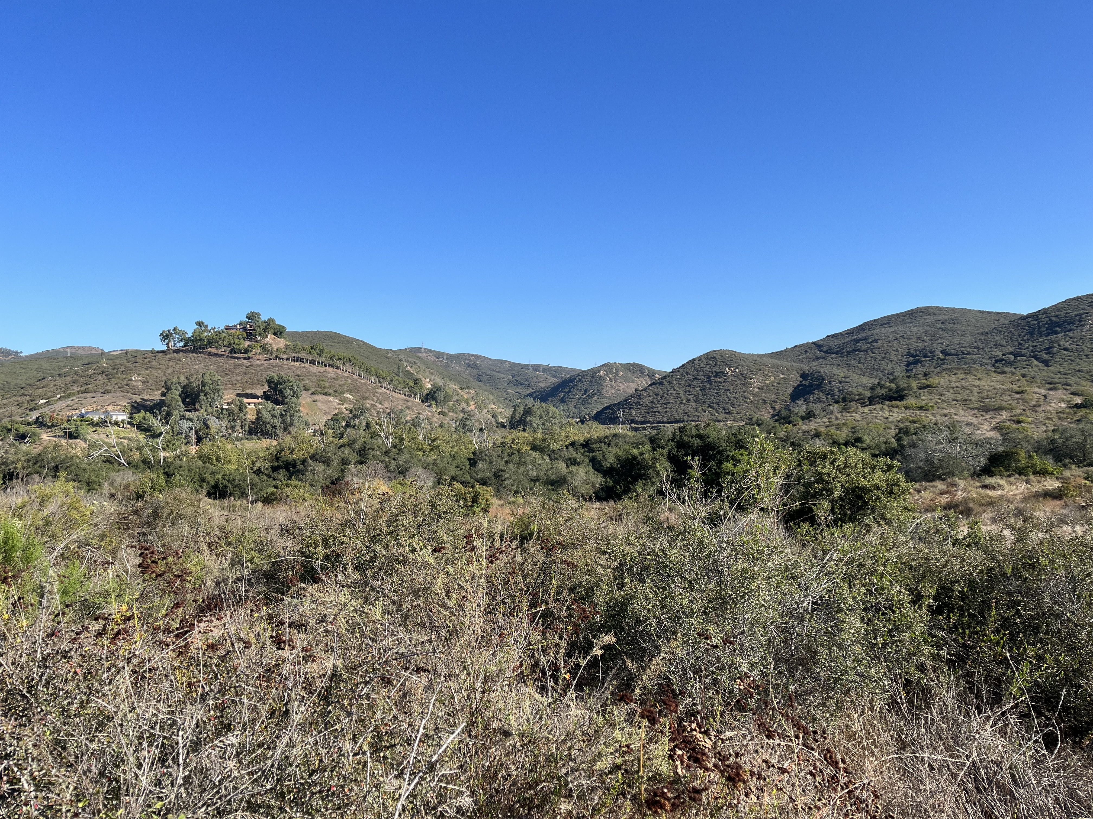
Hermes Copper Butterfly
Host Plant: Spiney red berry
7
Notes:
This is the Hermes Copper Butterfly. It uses habitat in sage scrub and chaparral where its only host plant is found, the spiny red berry. This is a large long-lived shrub

Slide 8
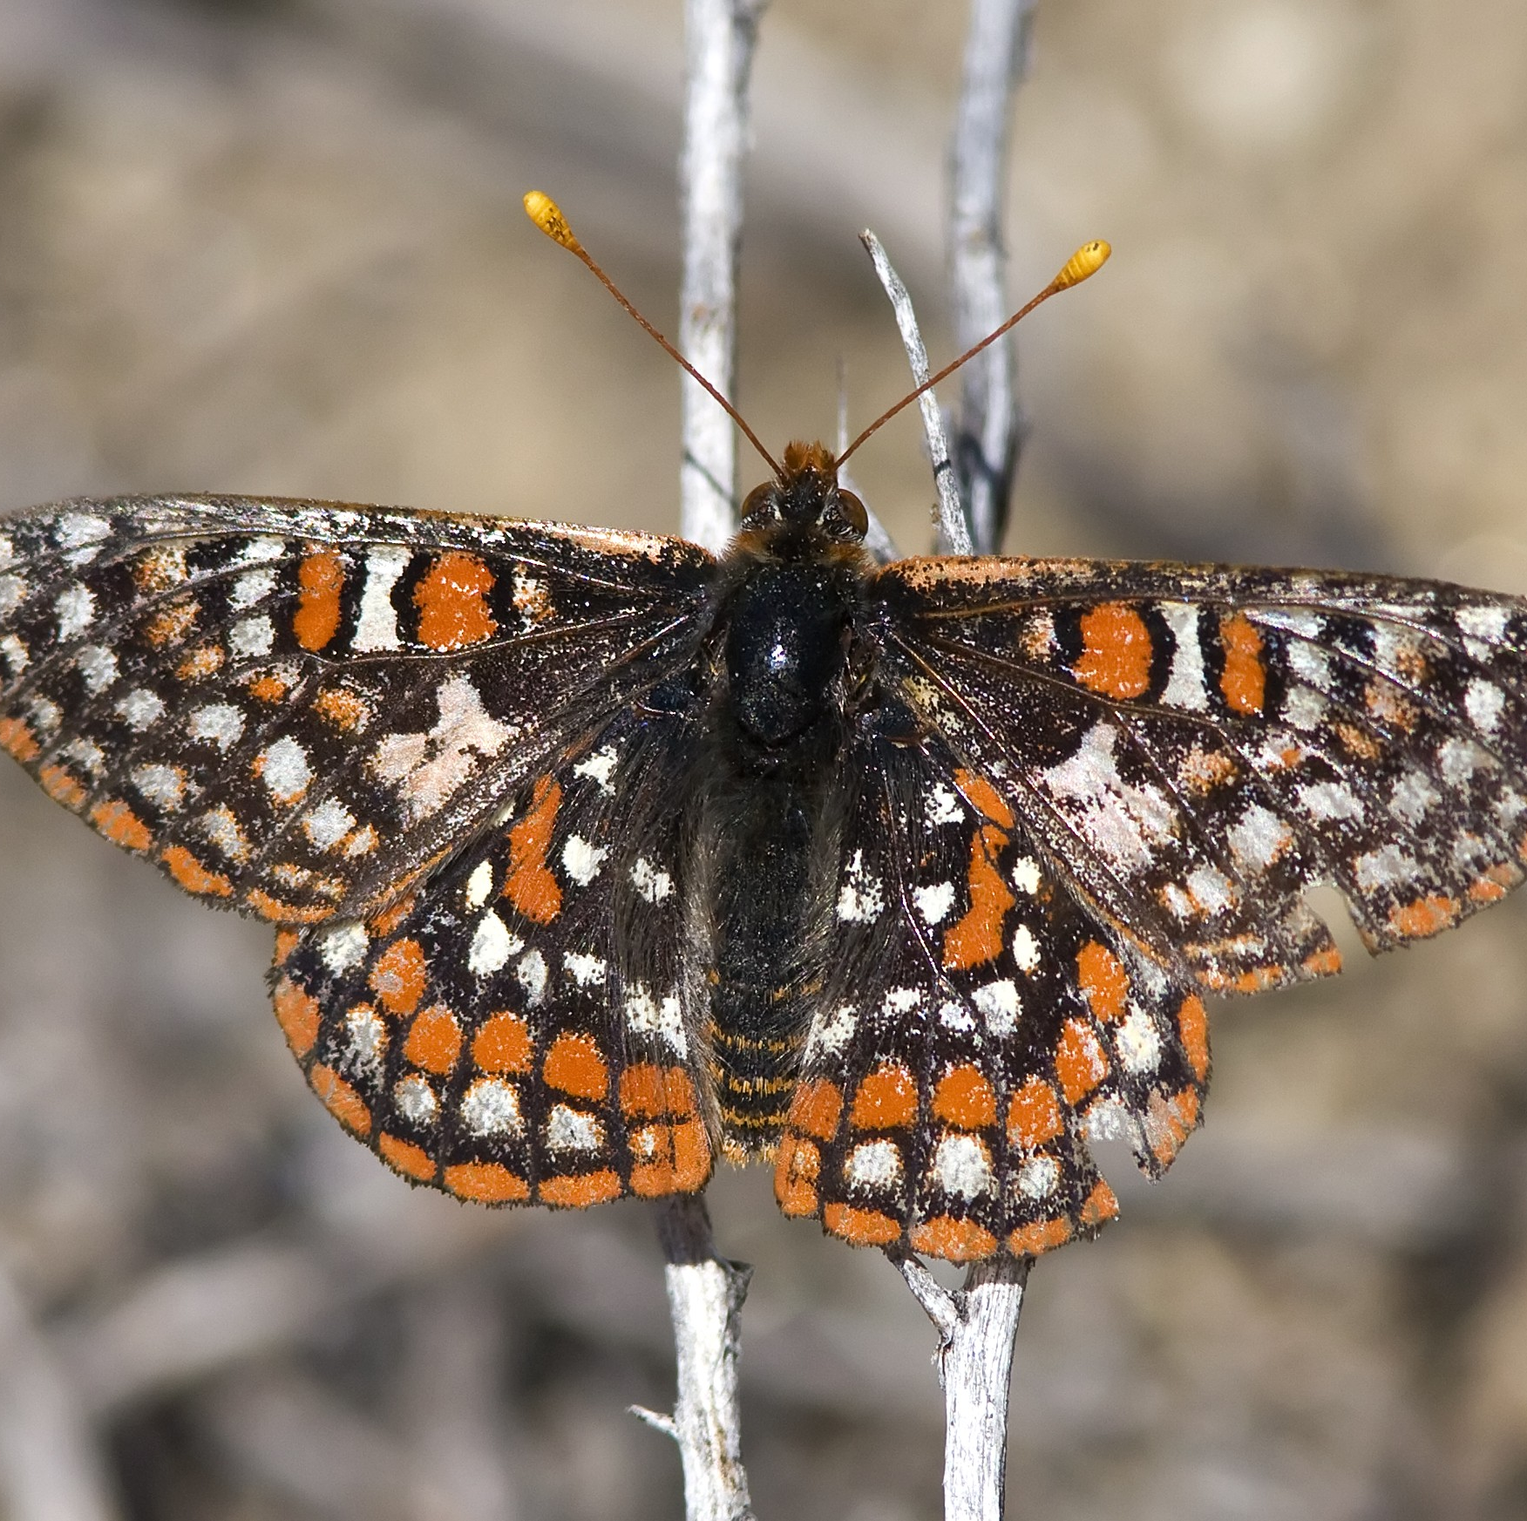
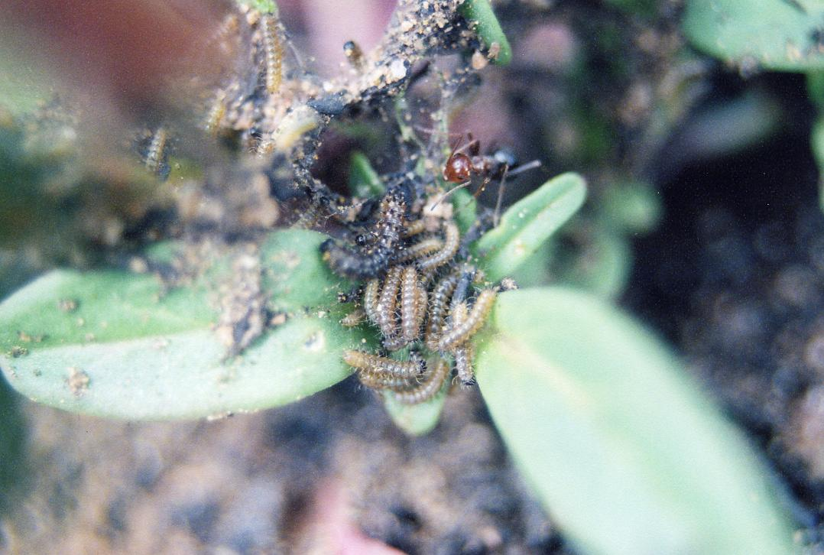
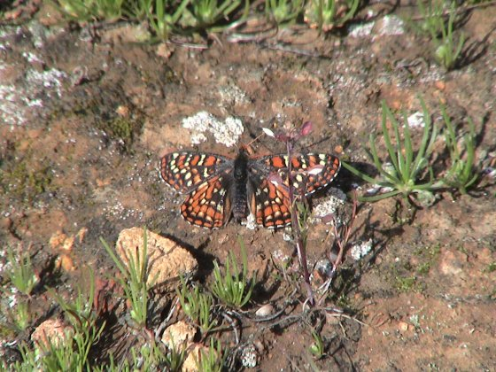
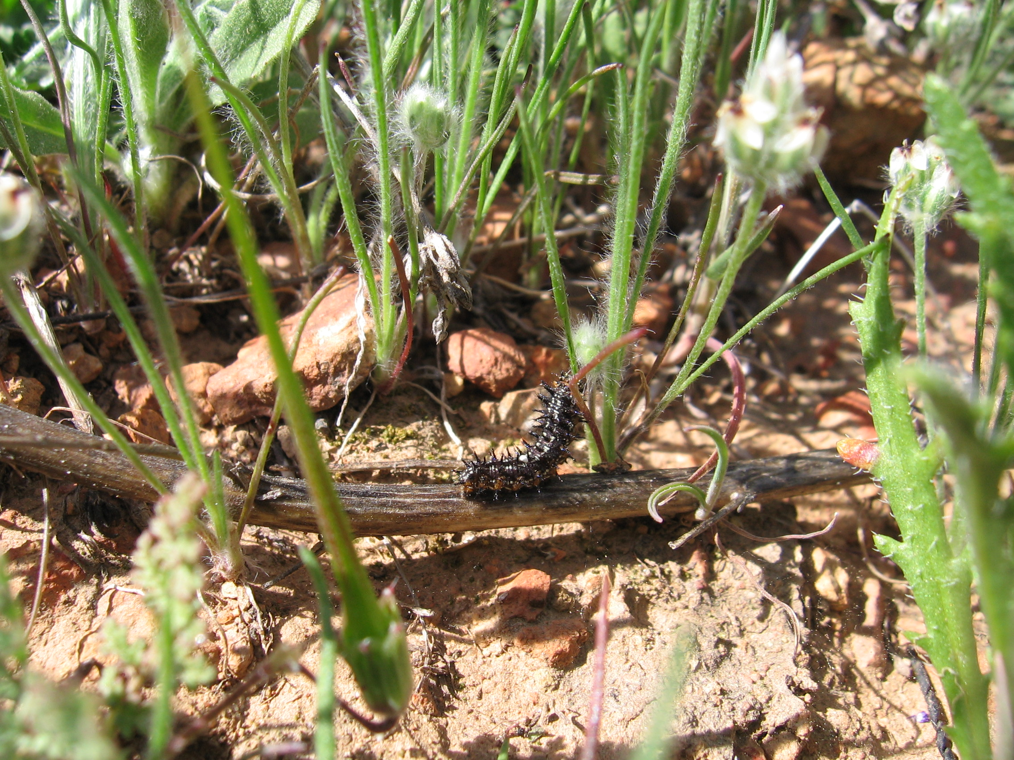
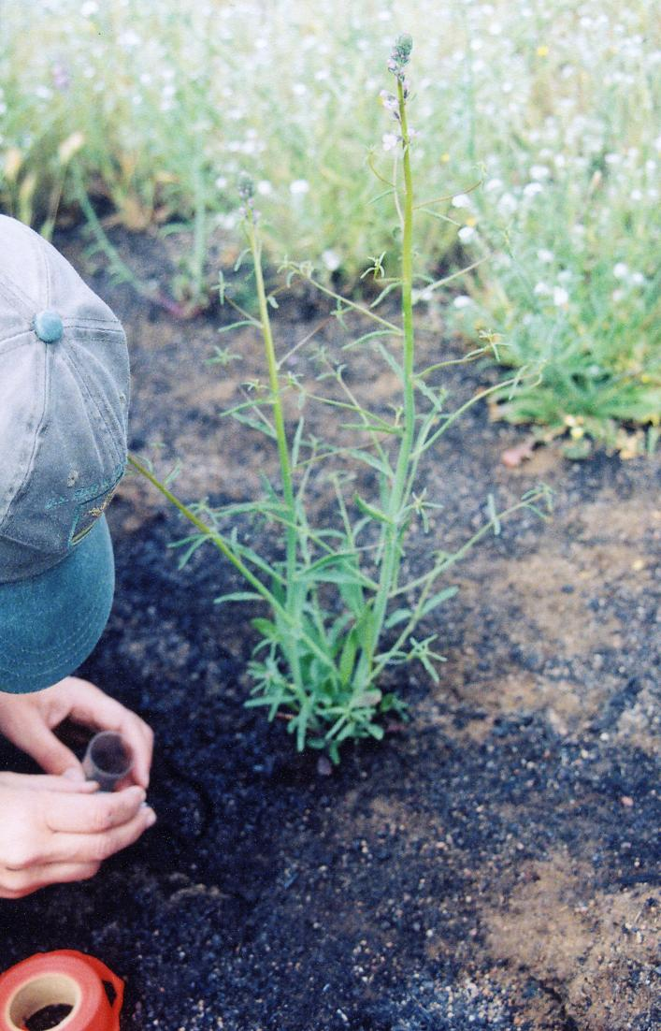
Quino Checkerspot Butterfly
8
Host Plants: dot seed plantain, Patagonian plantain, Chinese houses, and white snap dragon
Notes:
This is the Quino Checkerspot Butterfly. Its habitats are grasslands and open woodlands, mainly sage scrub. Its host plants are dot seed plantain, Patagonian plantain, Chinese houses, and white snap dragon.

Slide 9
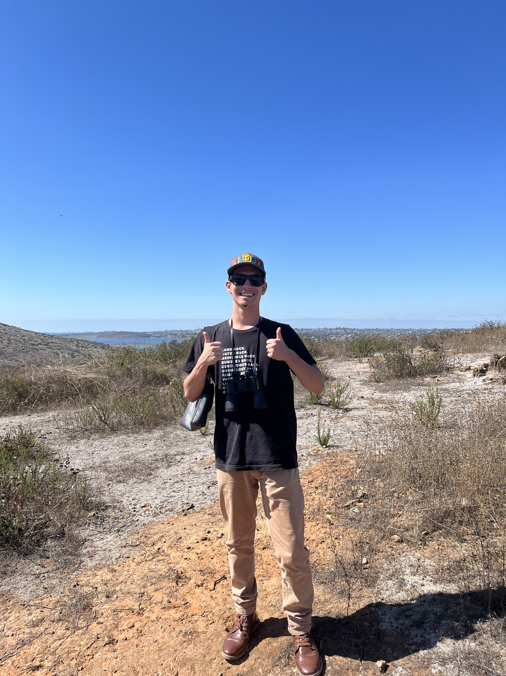
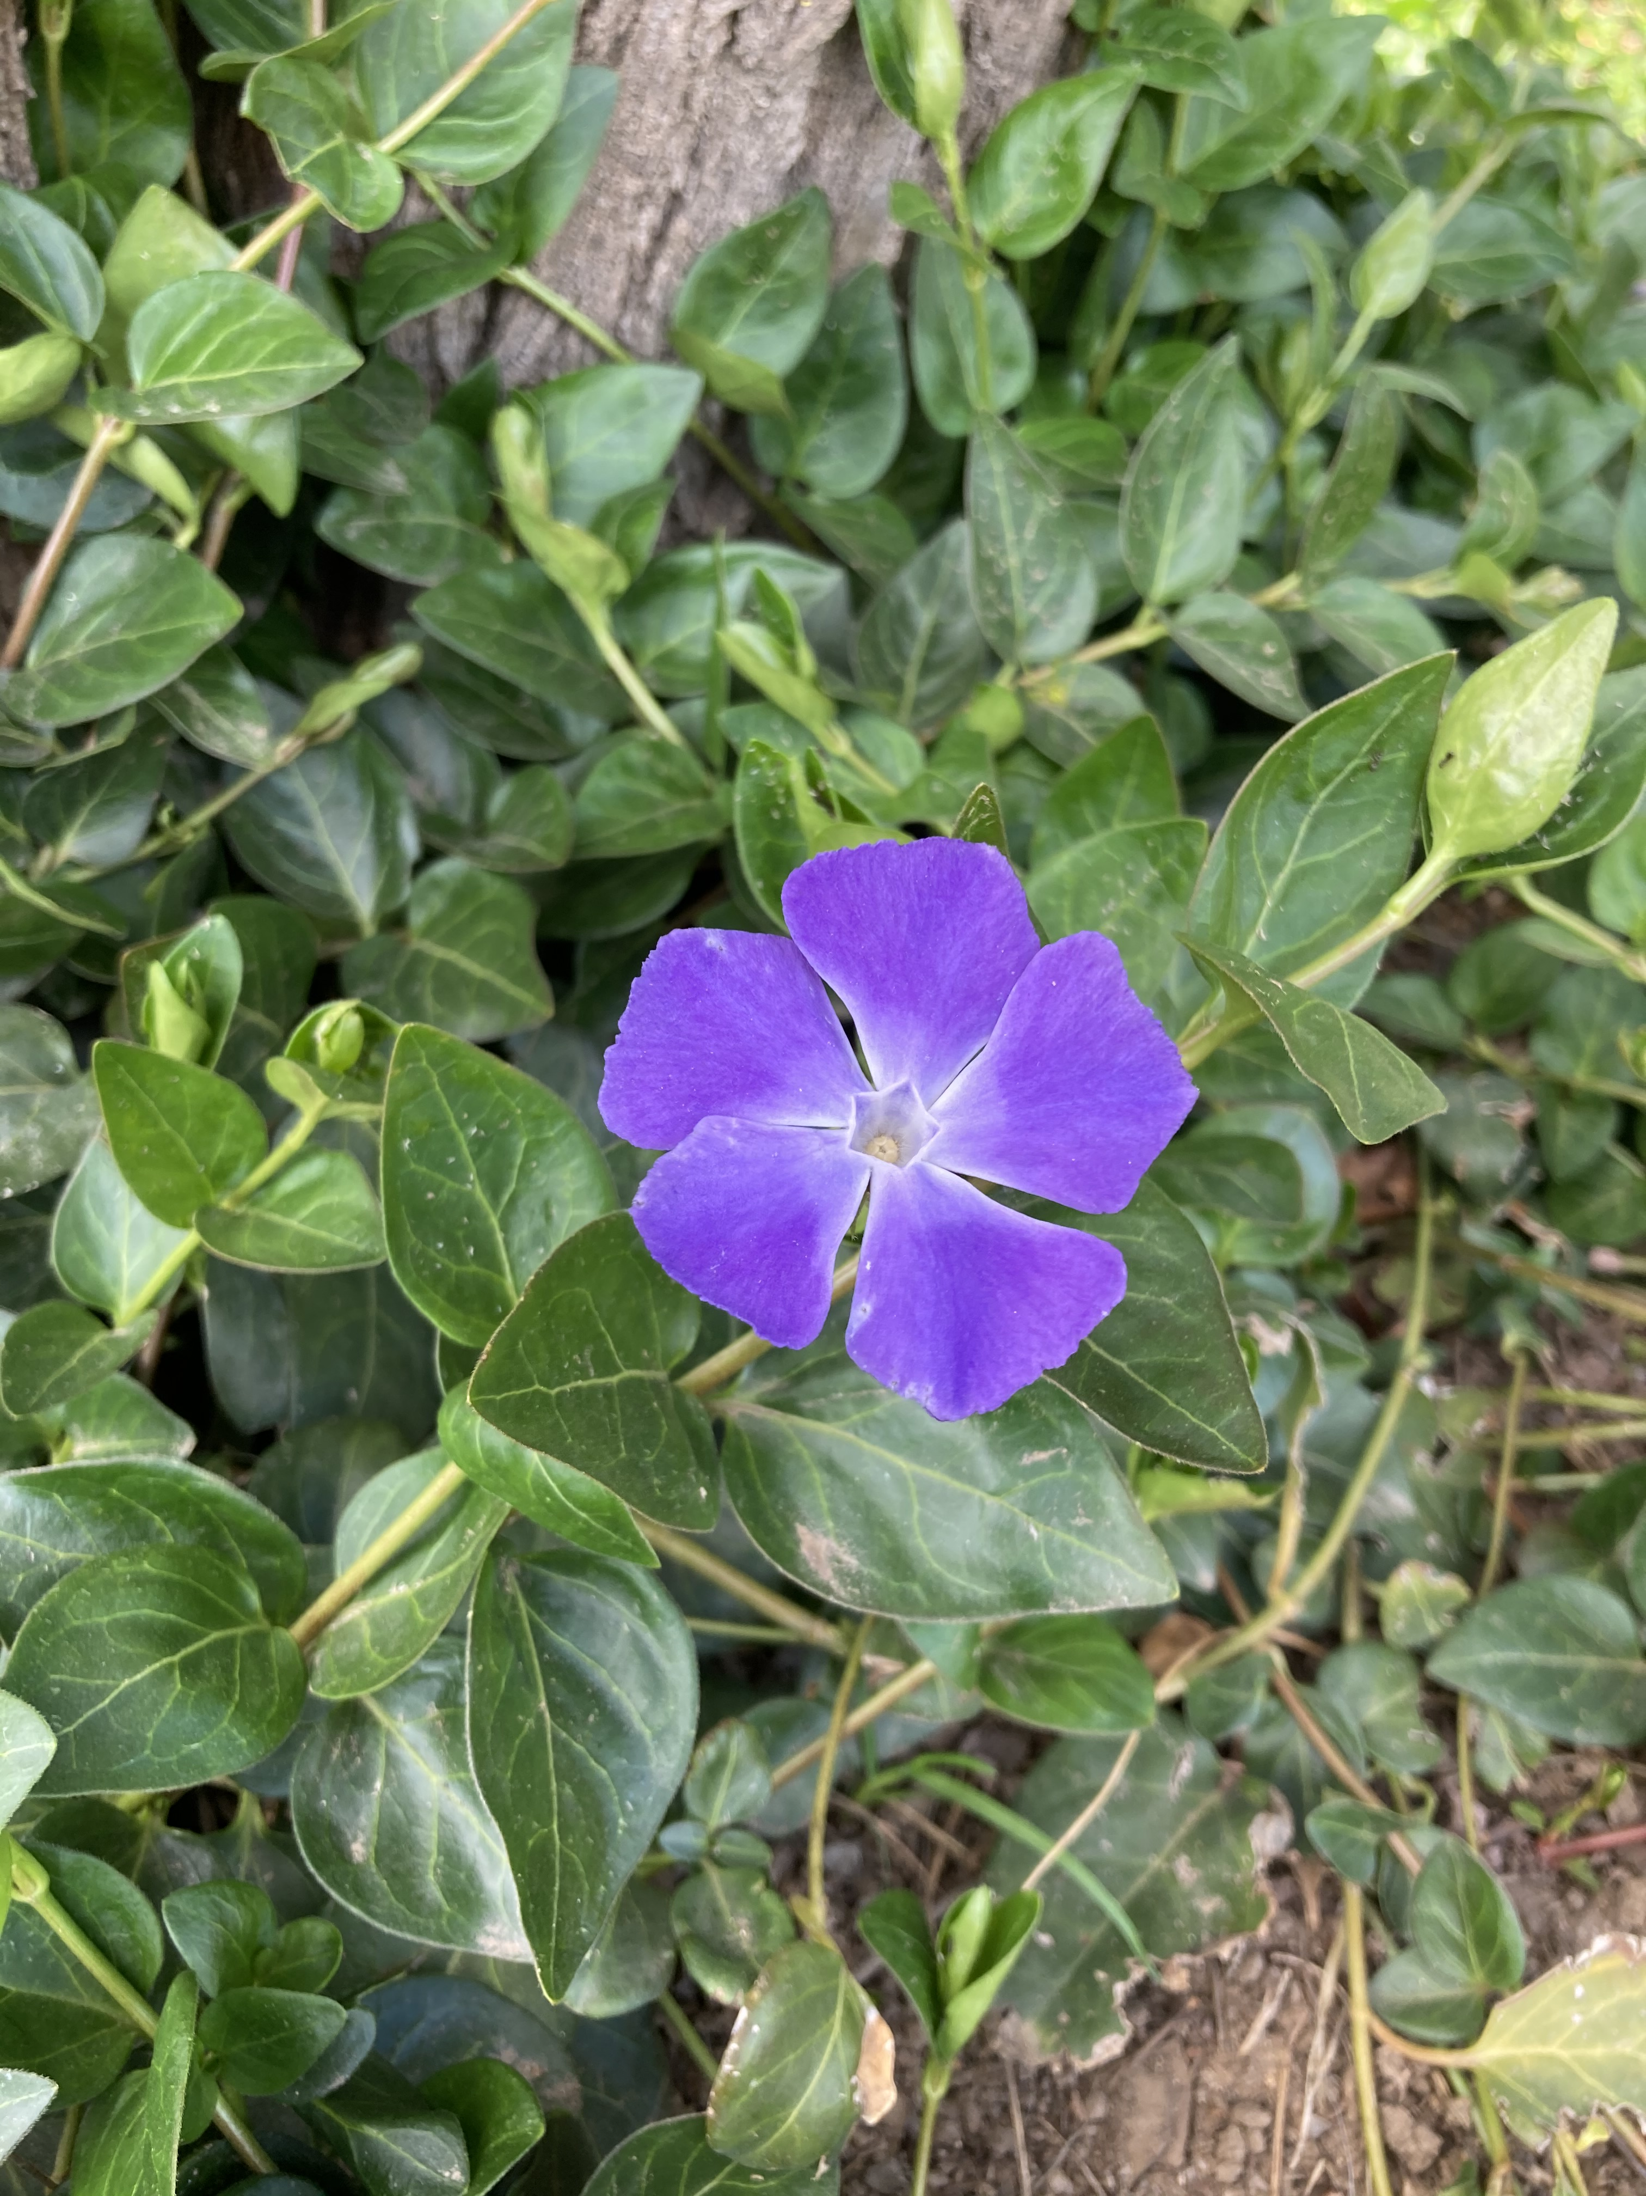
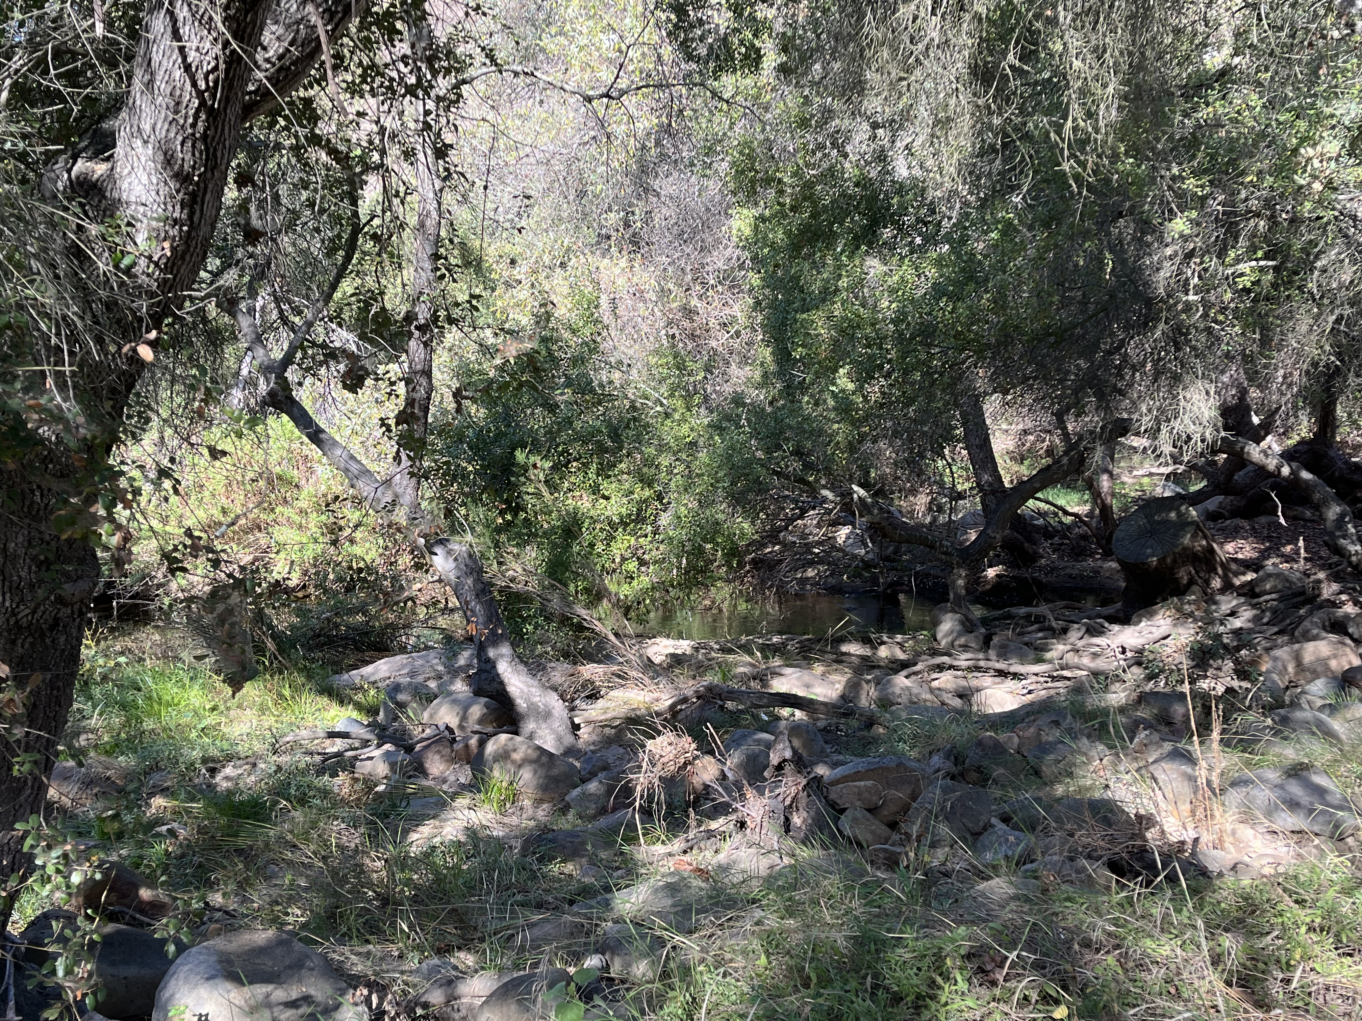
Questions and Contact Information
9
Aiden's email/number: aiden_valverde@fws.gov,
(760)-315-9195.
Alison's email: alison_anderson@fws.gov, (760)-271-4167.
Notes:
Thank you so much for letting me present this project to you all, here’s contact information for future communications. I look forward to reaching out and making connections with you all! I look forward to addressing any questions you may have.

