Slide 1
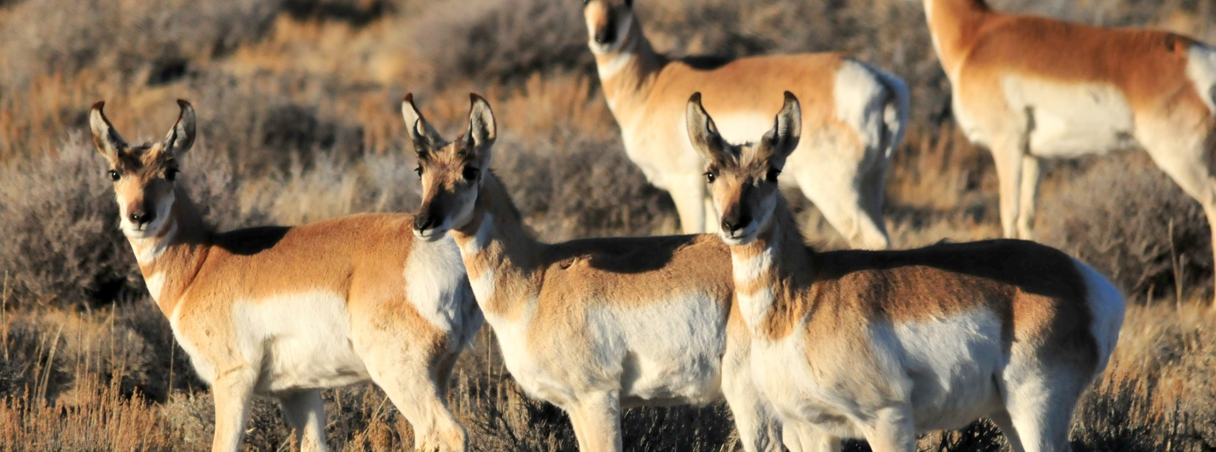
Sagebrush Ecosystem Curriculum
U.S. Fish & Wildlife Service
Notes:
All about the ecosystem

Slide 2
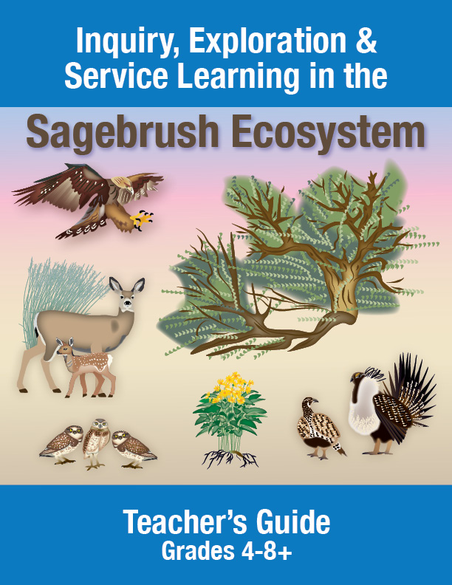
Notes:
Goal to connect students to the ecosystem, including field experiences, but also through technology and activities in schools and nearby nature areas.
“Our vision is to connect students with the sagebrush. We will do this by helping teachers engage students in a variety of ways and get them to think critically about the sagebrush ecosystem and ways to protect it and the diverse species that live there.”
Say that one of the components will be a Teacher’s Guide with 10 lesson plans and supporting activities for grades 4-8, similar to this one created for SOLVE in Oregon, but focused on understanding the sagebrush steppe ecosystem and ways students can support it and the 350 diverse species which live there.
Each lesson plan will be aligned to the Common Core and Next Generation Science Standards and include adaptations and extensions to help teachers meet the needs of all learners. We will be working with partners to make it easy for teachers to incorporate meaningful learning connected to place.
- Service learning projects

Slide 3
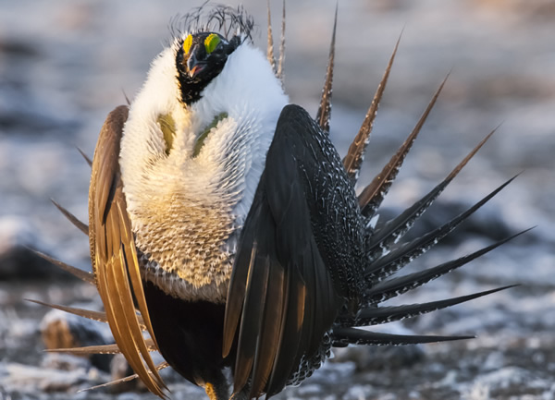
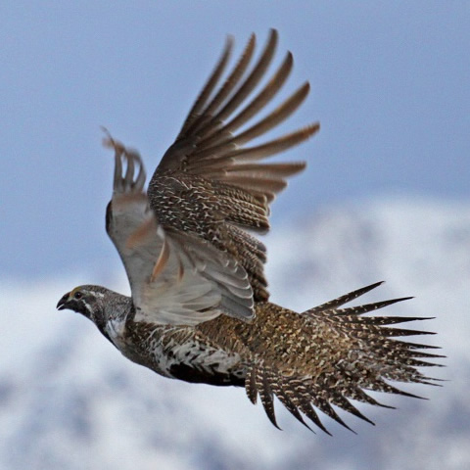
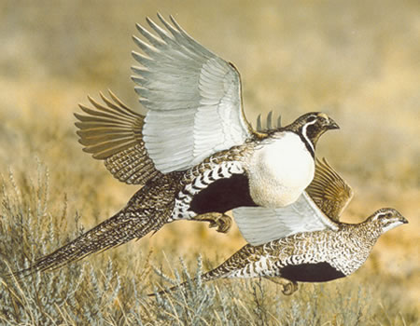
What is the Greater Sage-Grouse
Male
Female
Notes:
The largest grouse species, about the size of a large chicken, that lives in the west.
This bird was considered for listing under the Endangered species Act but because unprecedented conservation partnership across the western United States, in September 2015 it is was found not warranted for listing under the ESA. This collaborative, science-based greater sage-grouse strategy is the largest land conservation effort in U.S. history.
The greater sage-grouse is an umbrella species, emblematic of the health of sagebrush habitat it shares with more than 350 other kinds of wildlife, including world-class populations of mule deer, elk, pronghorn, and golden eagles.

Slide 4
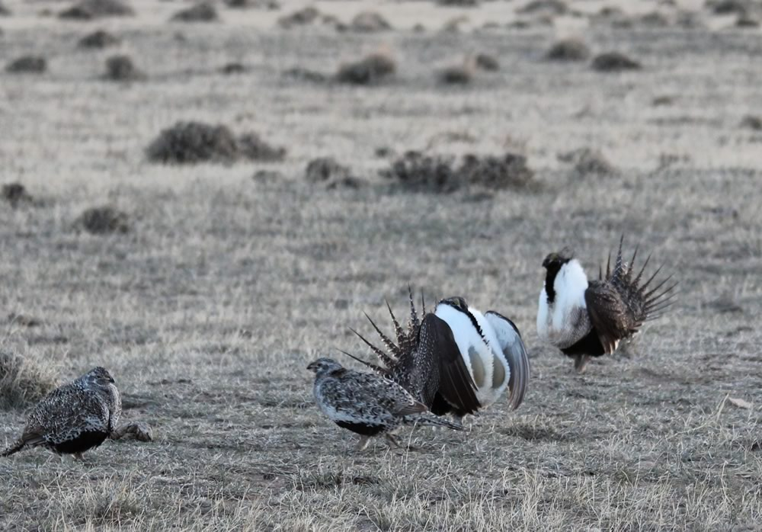
Lek
Notes:
Place where the sage-grouse gather for males to show off and compete for mates

Slide 5

On a Sage Grouse Lek Video

Slide 6
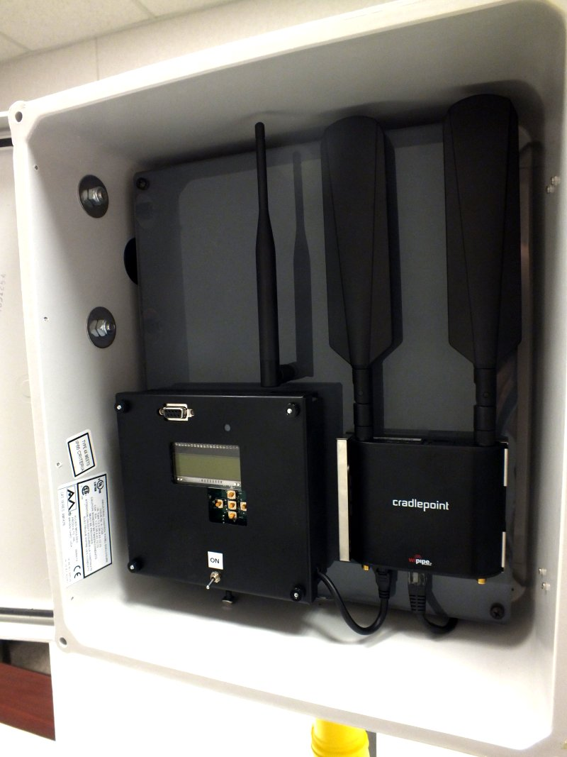
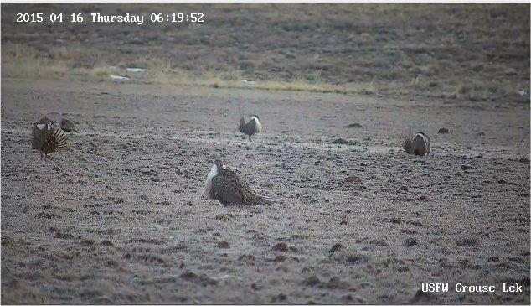

Wildlife Web Cam: 1st time on a Lek
“On a Sage-Grouse Lek” Video
Notes:
The U.S. Fish and Wildlife Service deployed a Live Stream Lek camera to allow people all over the world to view a strutting sage grouse.
The popularity of this camera led to development of this Teacher’s guide

Slide 7
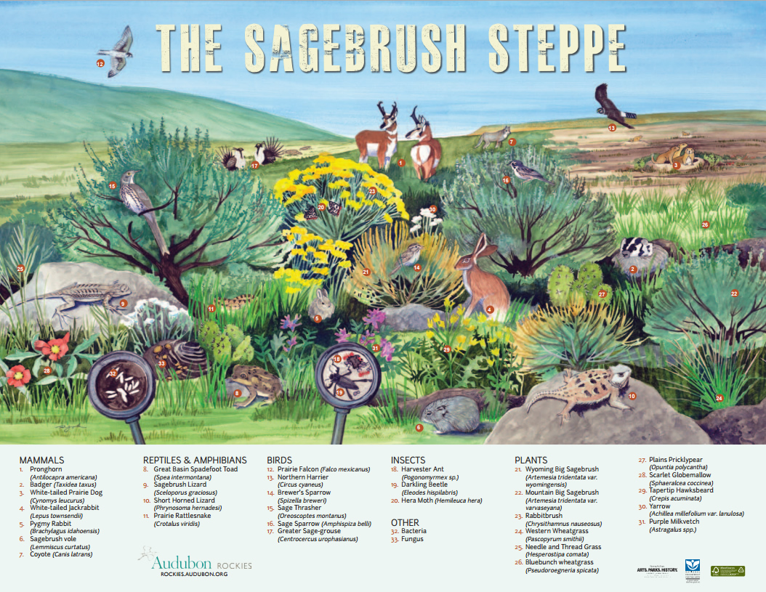
Notes:
This poster about the sagebrush steppe ecosystem was produced by Audobon Wyoming. It shows some of the many living things that are dependent on each other for survival. Can you point out any organisms that you know?

Slide 8
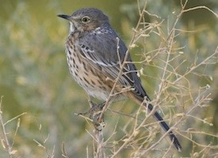
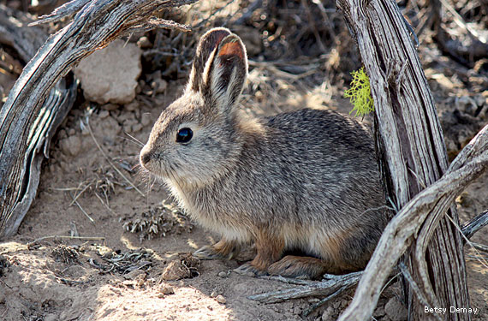
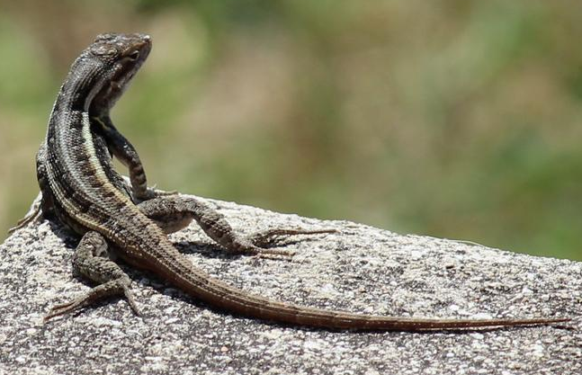
Sagebrush Obligate Species
Include Sage-Grouse and…
Sage sparrow
Brewer’s sparrow
Sage thrasher
Pygmy rabbit
Sage sparrow
Gray flycatcher
Sagebrush vole
Pronghorn antelope
Sagebrush lizard

Slide 9
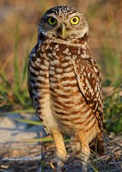
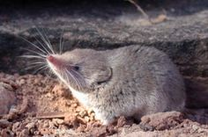
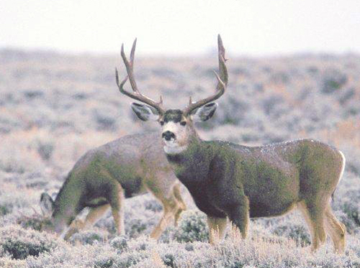
Sagebrush Near-Obligates Include . . .
Burrowing owls
Merriam’s shrew
Mule deer
Vesper sparrow
Striped whipsnake
Loggerhead shrikes
Many more species

Slide 10
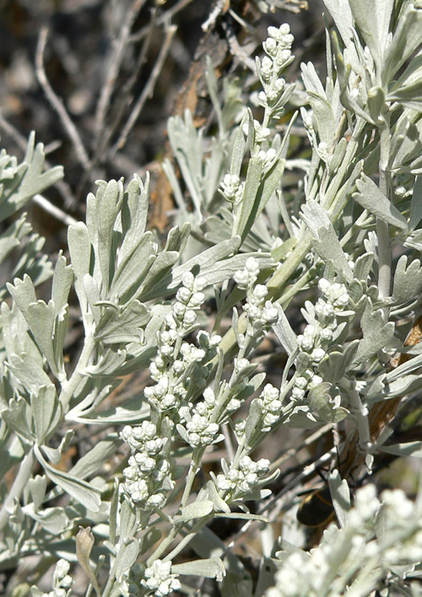
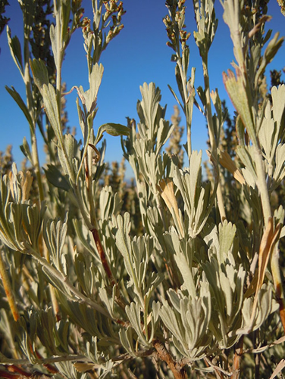
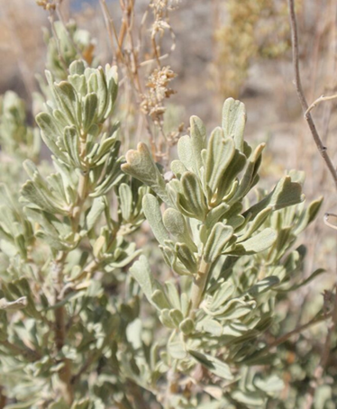
Sagebrush
Big sagebrush
leaves and flowers
Artemisia tridentata
Mountain big
sagebrush
Artemisia tridentata
subsp. vaseyana
Wyoming big
sagebrush
Artemisia tridentata
subsp. wyomingensis

Slide 11
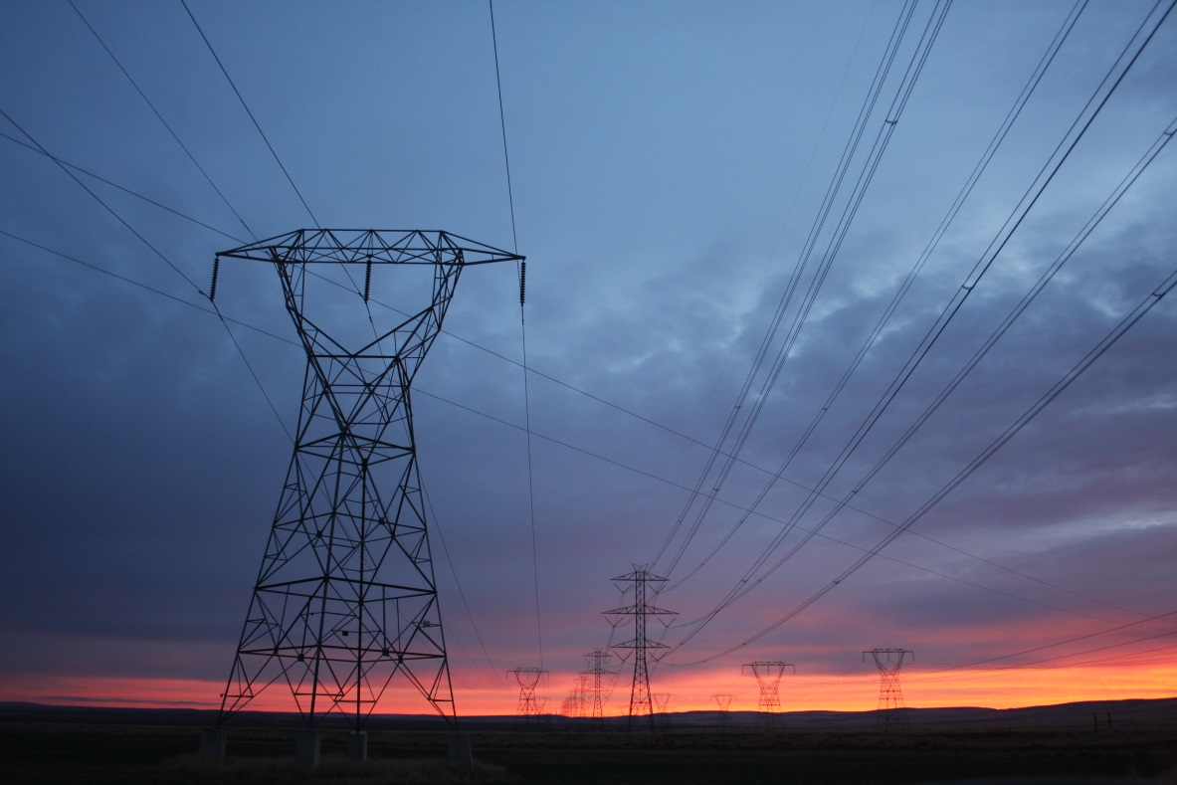
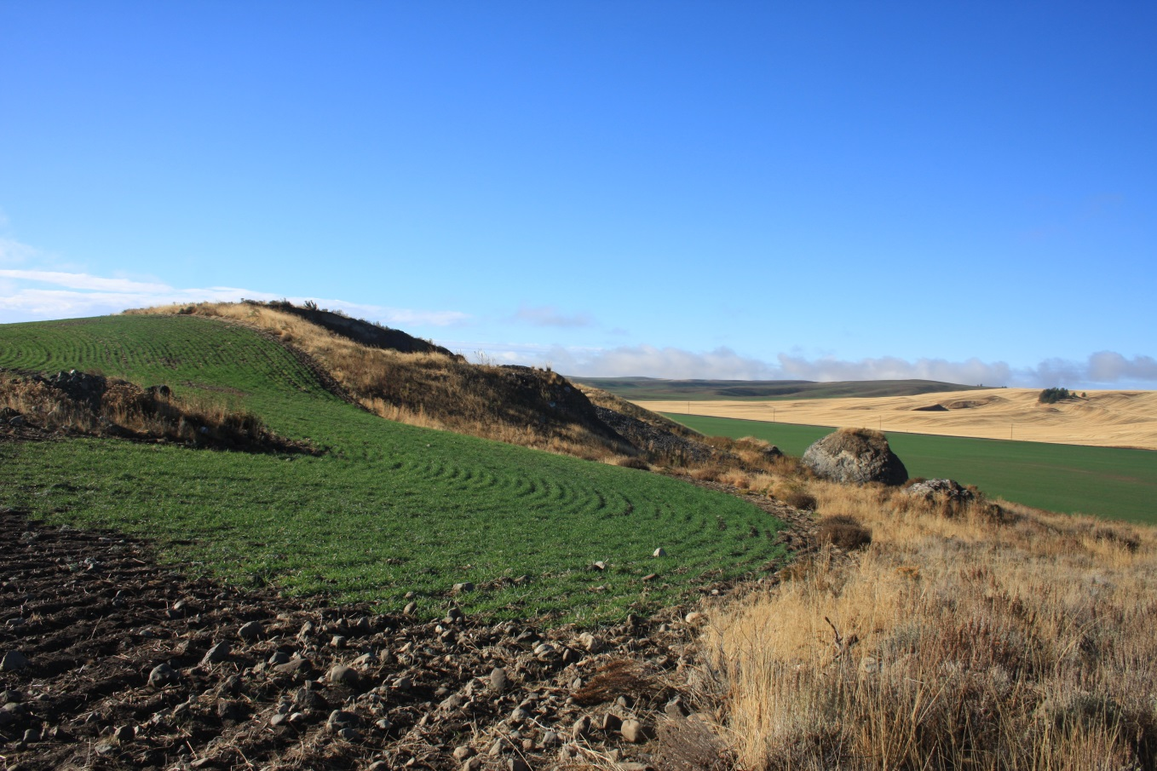
Human Impacts
Notes:
Greater sage-grouse once occupied more than 290 million acres of sagebrush in the West.
Early European settlers reported seeing millions of birds take to the skies.
But the bird, known for its flamboyant mating ritual, has lost almost half of its habitat since then. The most significant threat to the species is habitat loss and fragmentation due to a variety of causes.
In the Rocky Mountain portion of the range, sagebrush habitats have become increasing degraded and fragmented due to fossil fuel and renewable energy development, infrastructure such as roads and power lines, mining, improper grazing, the direct conversion of sagebrush to croplands, and by urban and ex-urban development.
In the Great Basin, incursions of invasive plants such as cheatgrass and conifer, increases in wildfire size, frequency and intensity fueled by invasive plants, along with improper grazing from domestic livestock and free-roaming horses and burros, drought, and mining have eliminated the habitat and degraded the value of large areas of sagebrush habitat for greater sage-grouse.
The threat of habitat loss to fire and invasive species can be exacerbated by even small amounts of development in important habitat.

Slide 12
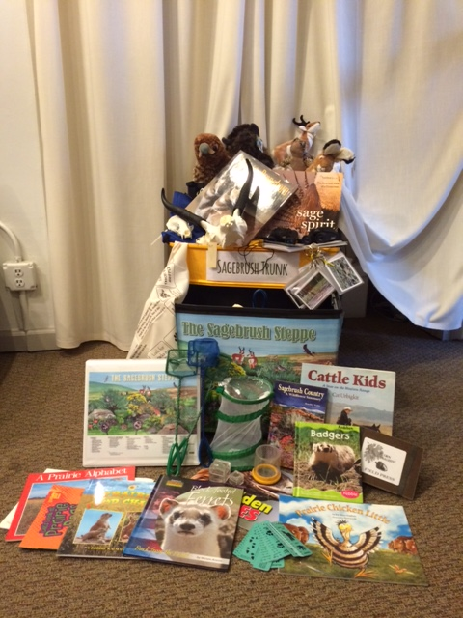
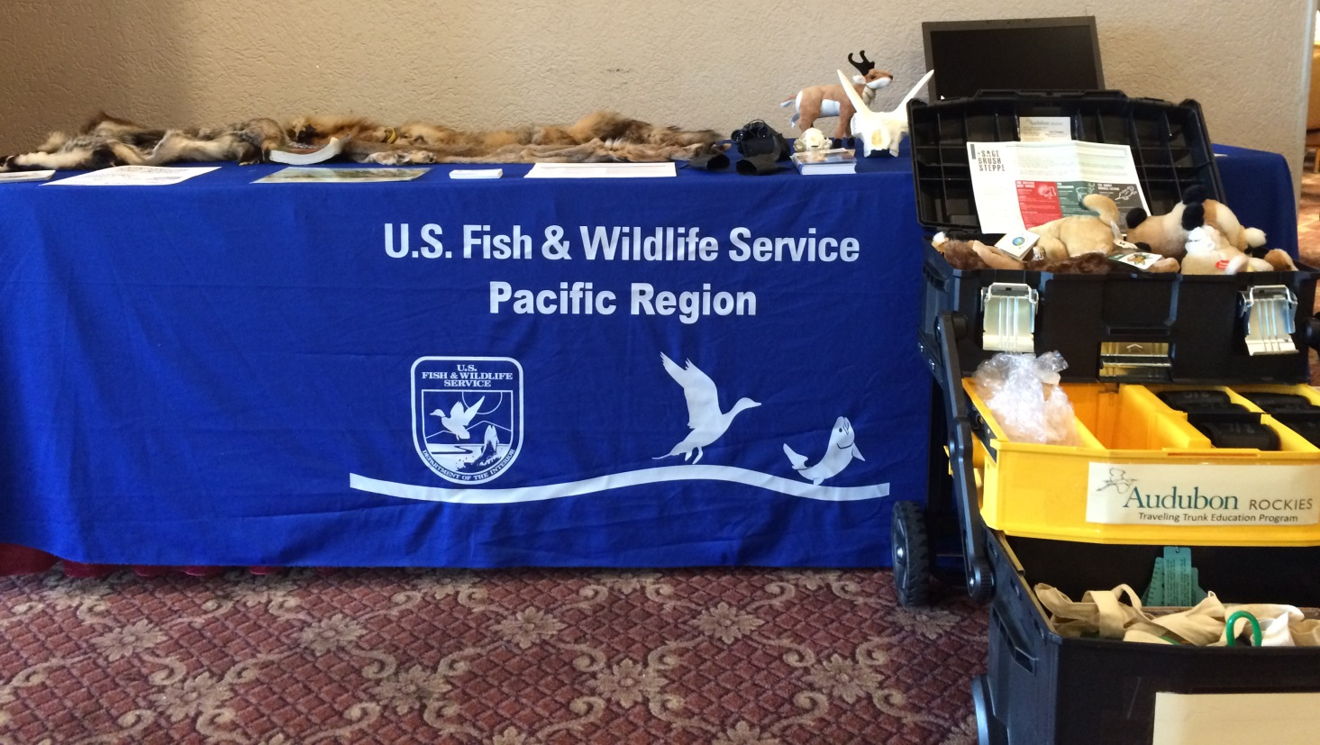
Trunk Contents
Notes:
Jacelyn Downey from Audubon Rockies will be on to present about the sagebrush ecosystem trunk and it’s contents/uses

Slide 13
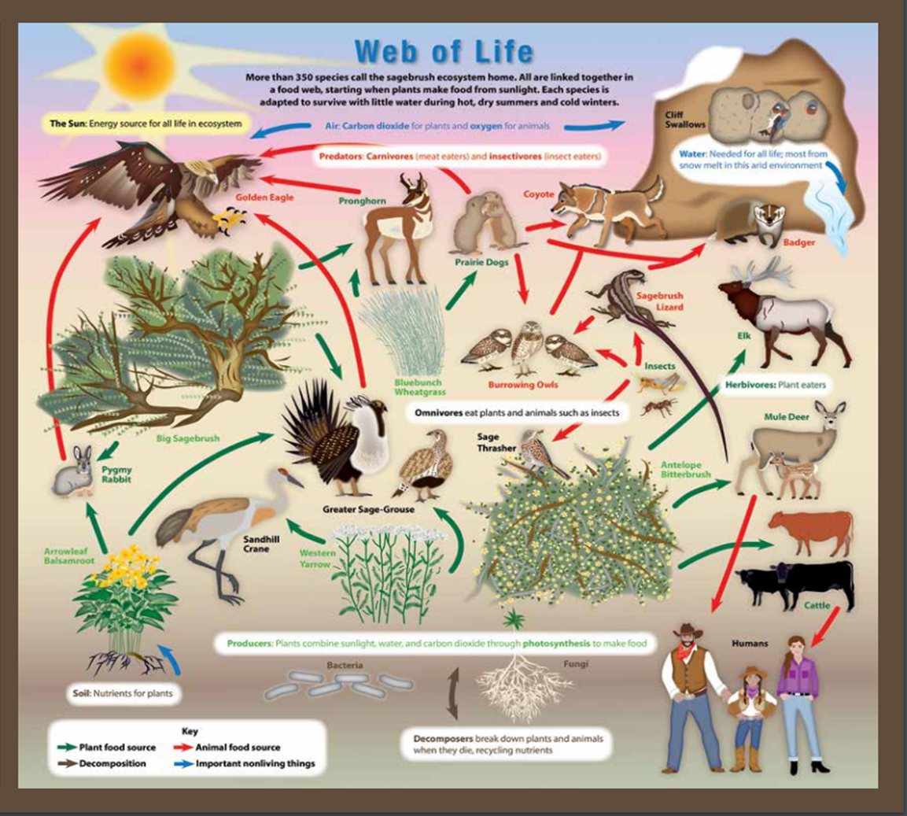
The Sagebrush Sea’s Web of Life
Notes:
This Sagebrush Sea Web of Life poster is available. Contact Anna Harris anna_harris@fws.gov with your requested poster amount and mailing address.

Slide 14
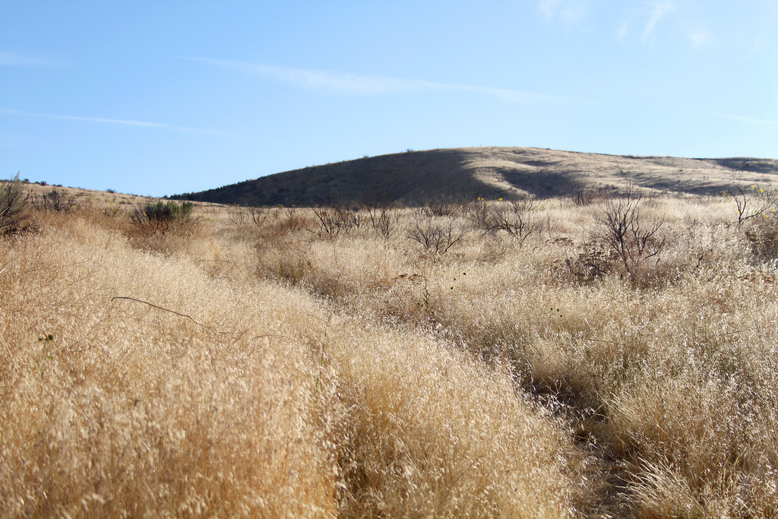
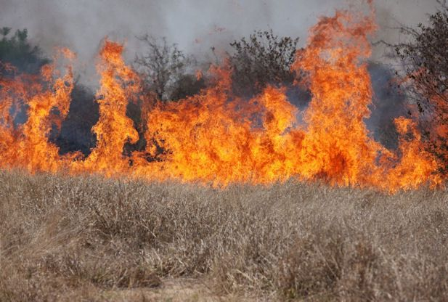
Invasive Plants: A Threat to the Ecosystem

Slide 15
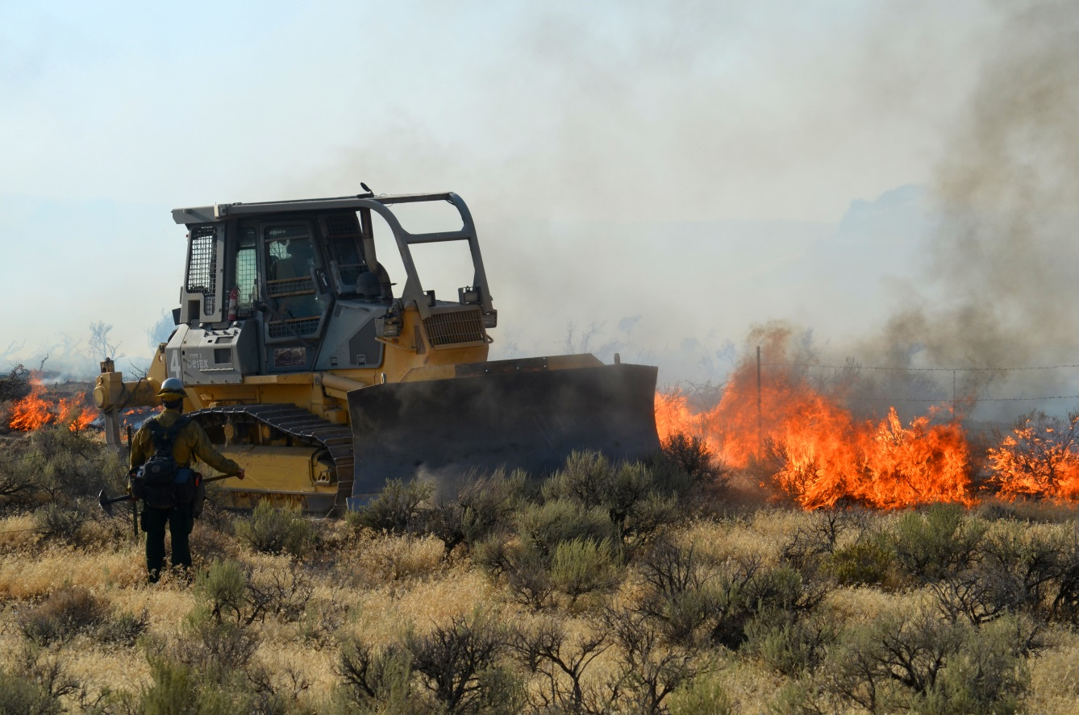
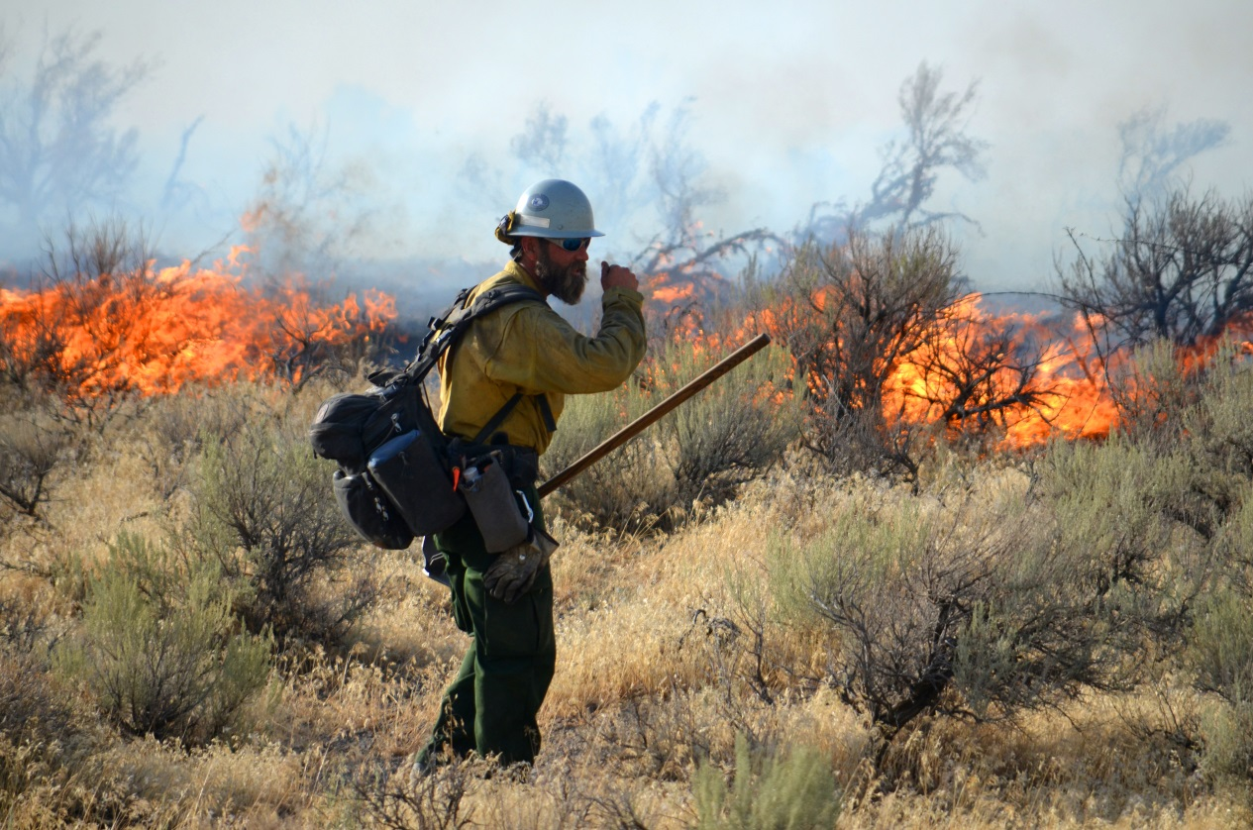
Fire! Impacts on the Sagebrush Ecosystem
Notes:
A local wildland firefighter is useful for this exercise. BLM and Forest Service have many offices throughout the 11 Western States and can provide assistance.
The sagebrush ecosystem evolved with fire. But over the past decade fire has become more intense and more frequent, in large part to the spread of invasive plants like cheatgrass.

Slide 16
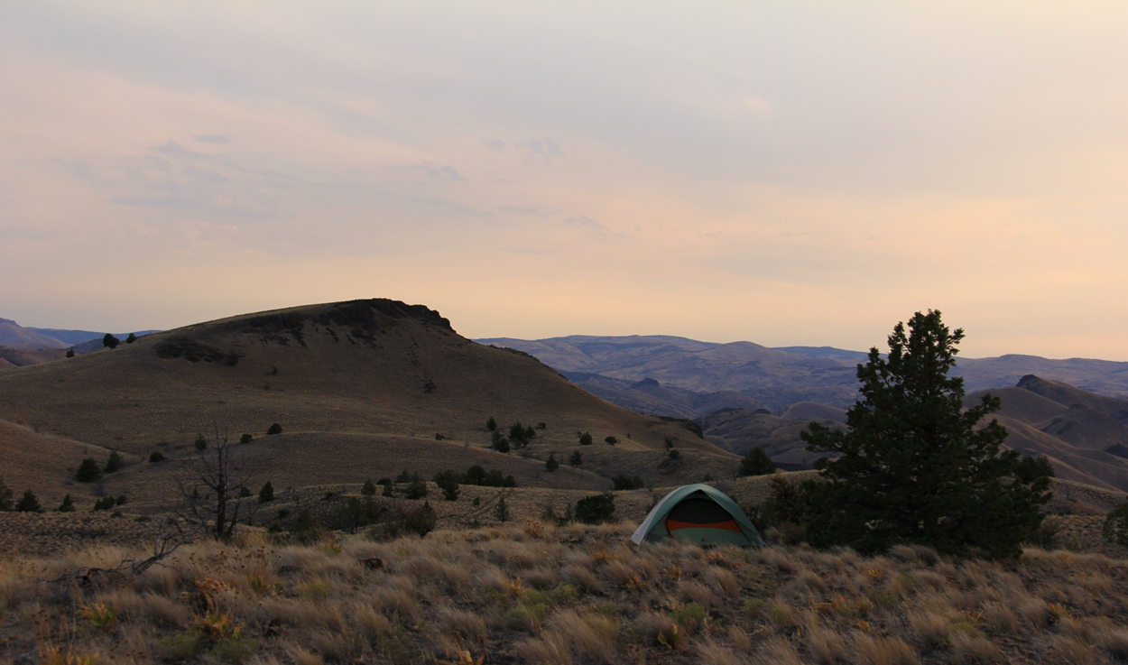
Succession in the Sagebrush Ecosystem

Slide 17
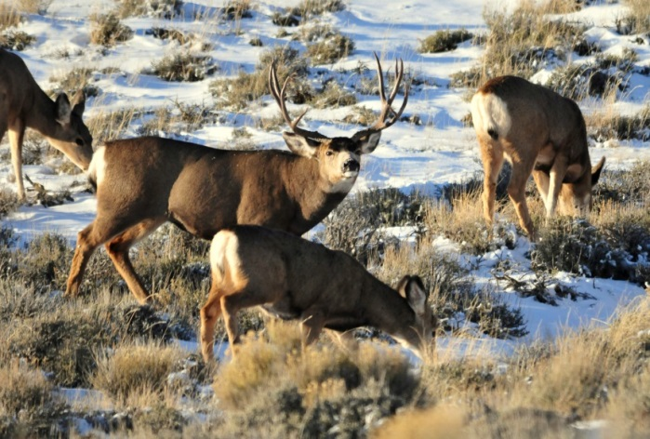
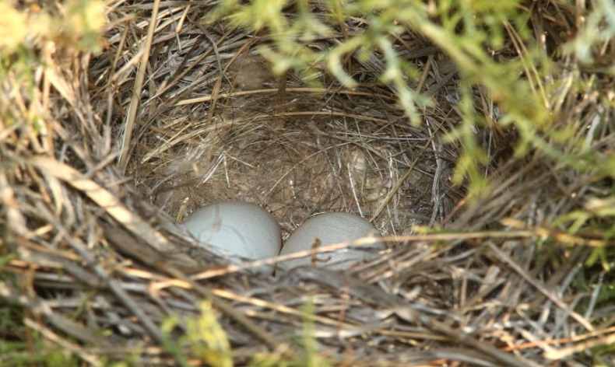
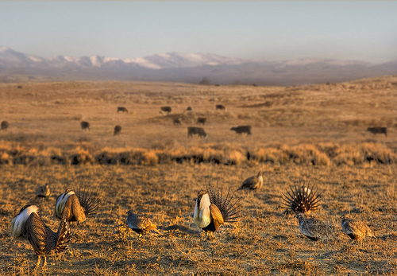
Sagebrush Sea Survival
Food
Water
Shelter
Space
A place to raise young

Slide 18
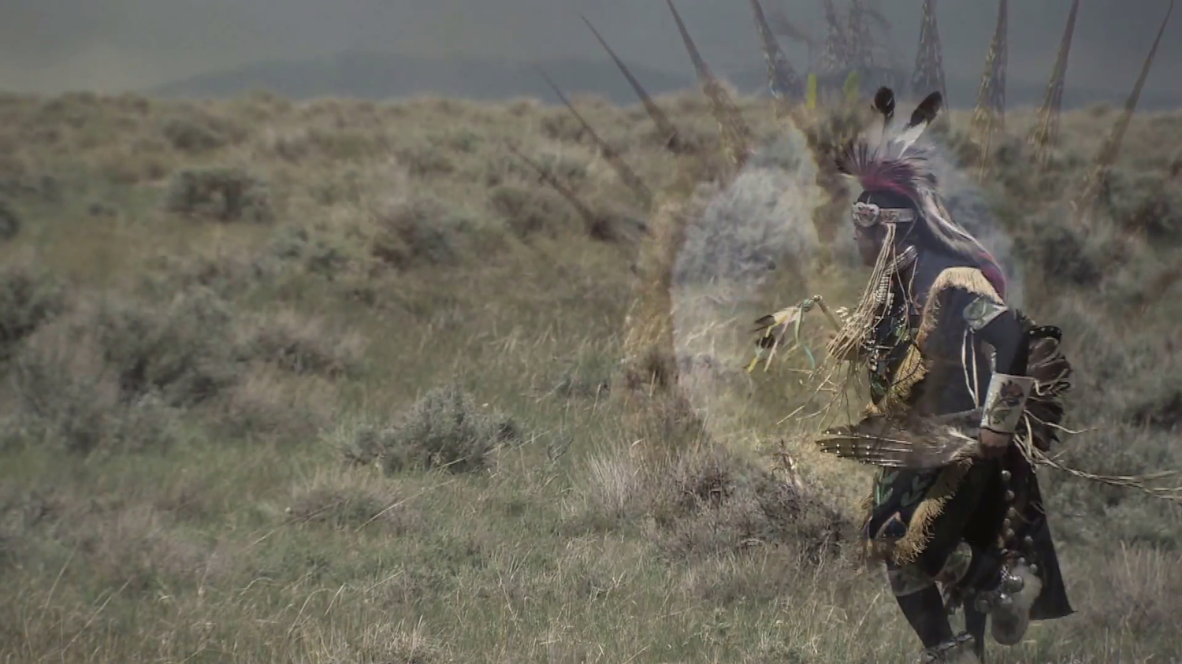
Human Connections

Slide 19
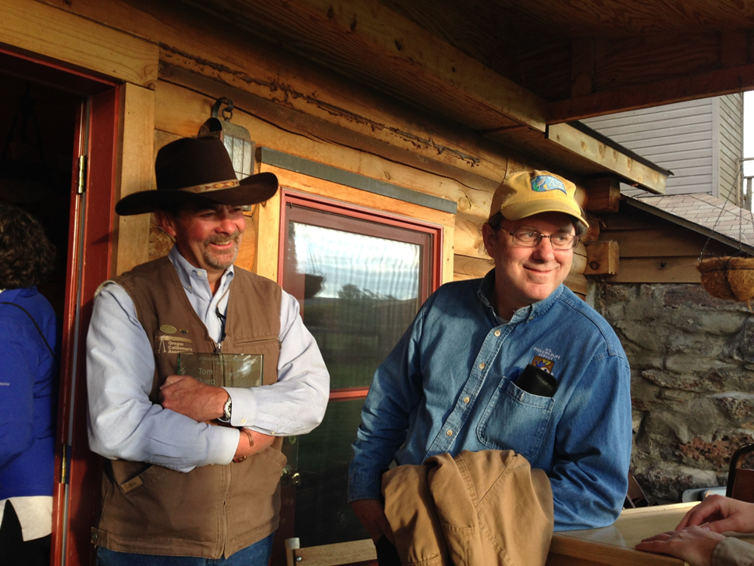
Develop Management Plans
Describe ways scientists and ranchers are helping to improve habitat for sage-grouse and other wildlife

Slide 20
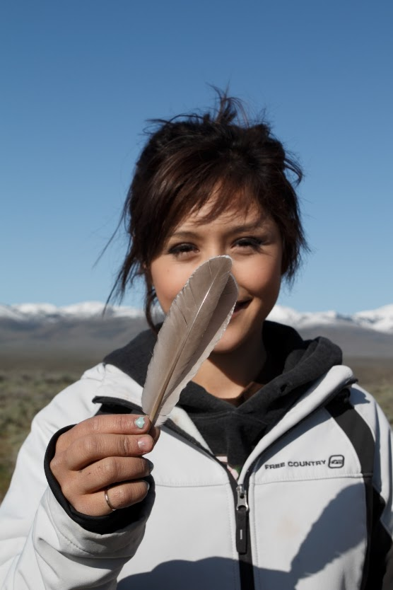
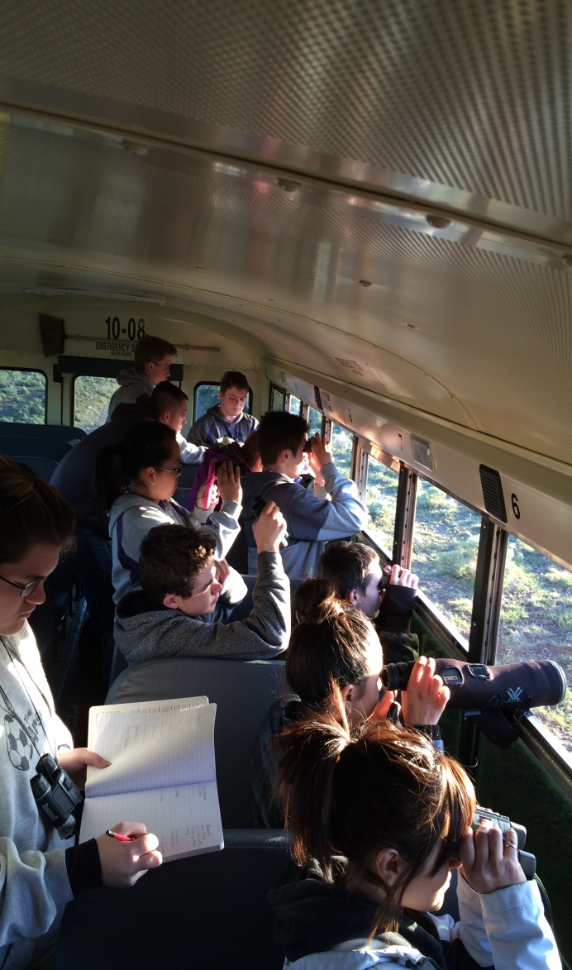
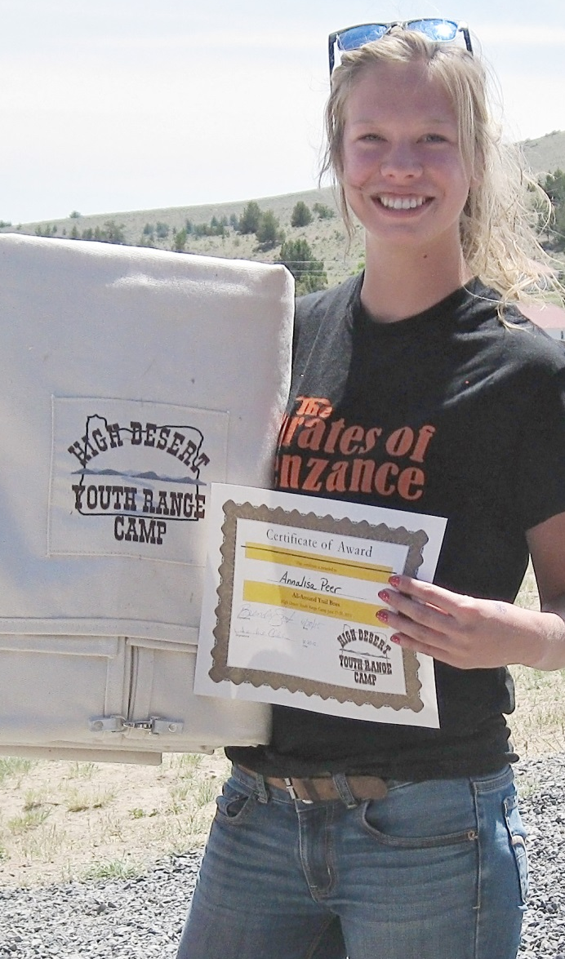
Community Presentations and Engagement
Notes:
“We will be conducting student surveys before and after the program to determine how much students learn and how their attitudes might have been impacted by the experience. The Common Core and Next Generation Science Standards will be integrated into the curriculum in meaningful ways which connect students to the sagebrush and other ecosystems and places the students call home.”

Slide 21
Partners

Slide 22
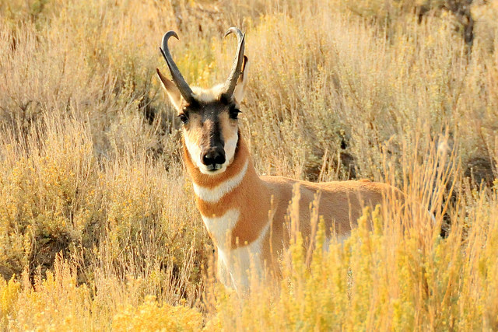
Questions

