Slide 1
I-9 and SF-61 Virtual In-Processing
Overview of the new virtual I-9 and SF-61 process, handled by the HR On-boarding staff through USA Staffing Onboarding

Slide 2
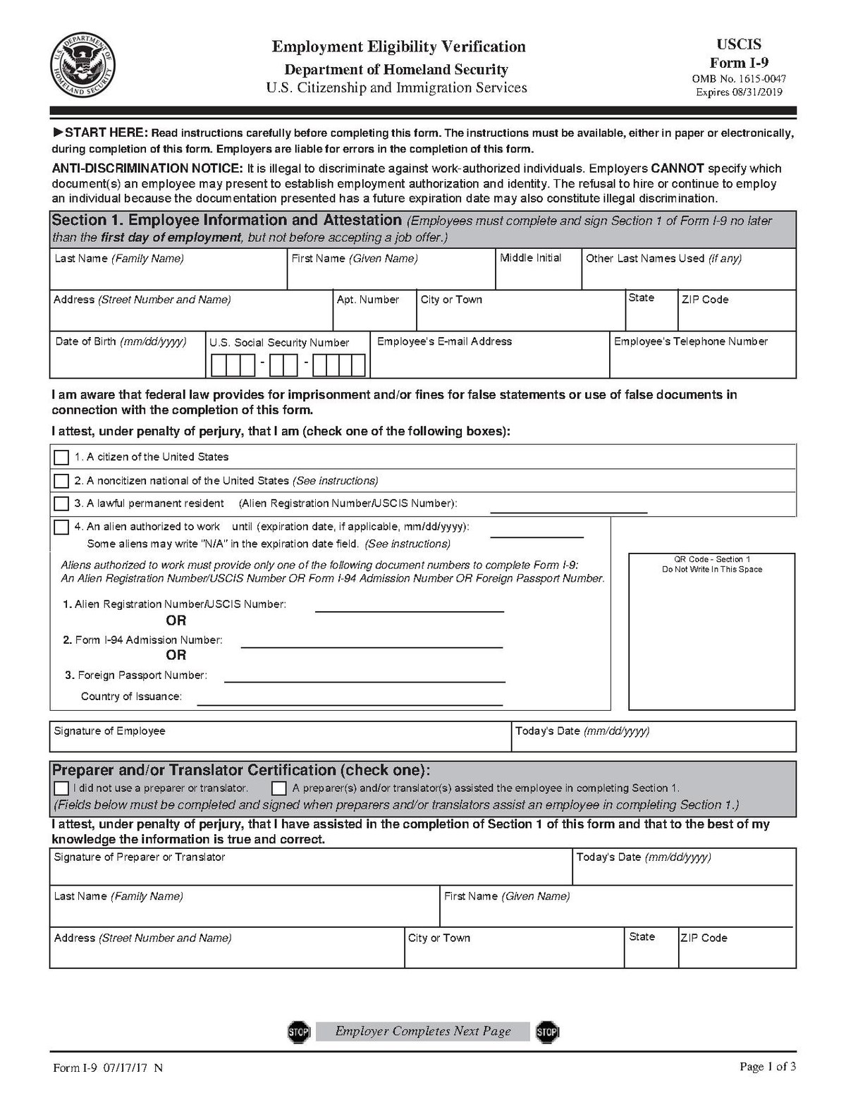
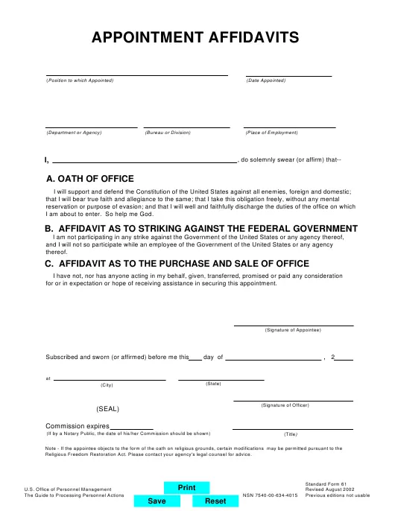
Introduction
Previously, hiring managers or designated administrative staff were responsible for completing the I-9, Employment Eligibility Verification and SF-61, Oath of Office forms on a new employee’s first day of work.
As of February 13, 2022, HR On-boarding staff now work with new hires prior to their first day of employment to ensure all necessary information pertaining to the I-9 and SF-61 are uploaded into USA Staffing Onboarding.
On the new employee's first day, HR Onboarding staff, and the new employee, complete the I-9 and SF-61s virtually, eliminating the need to download, wet sign and re-upload SF-61 and I-9 forms.
This new process will allow for a more expedient, secure, and accurate onboarding experience.

Slide 3
Supervisor Expectations
Be aware that HR On-boarding staff will be contacting the new employee and assigning new tasks the week before the employee is due to arrive.
Be aware that this meeting will take place sometime during the new employees first day of work
Supervisors do not need to attend this meeting.
Facilitate new employee computer access, if necessary.
E.g., lend employee a computer with MS Teams or let employee use conference room as they call into the meeting on their cell phone

Slide 4
Employee Expectations
Before the I-9 and SF-61 Meeting
During the I-9 and SF-61 Meeting
After the I-9 and SF-61 Meeting
Receive invitation to the “First Day In- Processing: SF-61 and I-9 Verification” meeting.
Notify HR Assistant of any scheduled conflicts to the meeting (i.e., PCS movers)
How to contact the appropriate HR Assistant
Upload acceptable ID documents to USA Staffing for the I-9.
List of acceptable I-9 ID documents
Have access to a laptop, tablet or cell phone with a camera and MS Teams.
Mute mics unless told otherwise.
When called upon, turn on camera for HR to verify your face against the uploaded ID documents.
Participate in the Oath of Office Swearing in Ceremony
Wait at least 30 minutes, then access USA Staffing and sign the SF-61 form, as well as all other assigned forms.
The SF-61 form will need to be completed before COB of employees first day of work

Slide 5
HR Onboarding Expectations
Before Employees 1st Day of Work
During the I-9 and SF-61 Verification Meeting
After the I-9 and SF-61 Verification Meeting
Send “First Day In- Processing: SF-61 and I-9 Verification” invitation to new employees (cc supervisors)
Send notification to new employee through USA Staffing with instructions on uploading the I-9 acceptable ID documents.
Verify that the uploaded I-9 ID documents match the new employees face as shown on camera.
Administer the Oath of Office to new employees
Share an American flag on screen, instruct employees to stand, raise their right hand, and repeat after you.
Remind employees to complete all documents within USA Staffing following the meeting
Issue the SF-61 form to the new employee through USA Staffing.
Enter the I-9 documents in USA Staffing and sign the completed I-9 document.
Once employee has signed the SF-61, sign and complete before COB of employees EOD.
Work with any employees unable to attend initial SF-61 and I-9 meeting.

Slide 6
Thank you
JAO HR Onboarding “Update: New Employee In-Processing”
JAO HR Onboarding Contacts
JAO HR On-boarding Sharepoint Site

