Slide 1
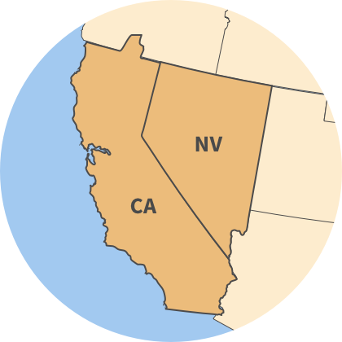
National and Regional Tribal Updates
USFWS Pacific Southwest Region
Eldon Brown Anjaleeqa Baldwin
Native American Liaison Assistant Tribal Coordinator
U.S. Fish and Wildlife Service
November 8, 2023
Notes:
Introduce Anjaleeqa

Slide 2

Today
Tribal Wildlife Grant FY23 Update
Current Efforts for Tribal Engagement
  Native American Policy 5-year Review
  National Coordination on Co-Stewardship
Regional Efforts

Slide 3
USFWS
Tribal Wildlife Grant
The Tribal Wildlife Grants (TWG) Program was created to support the development and implementation of programs for the benefit of wildlife and their habitats and species of Tribal cultural or traditional importance, including species that are not hunted or fished.
Since 2003, providing support for 350 conservation projects administered by participating Federally-recognized tribes. A number of projects funded through the program have focused on climate change impacts on wildlife on tribal lands.
If a Tribe has never received a Tribal Wildlife Grant, the USFWS provides path for federally recognized Tribes to be eligible to receive one, if they submit a proposal.
Next funding announcement expected: February 2024

Slide 4
FY 2023 Update for the USFWS
Tribal Wildlife Grant
FY 2023 Tribal Wildlife Grant
$6.4 million available
71 Tribal Proposals received nationally
36 Tribes were awarded nationally
5 Tribes awarded in the UFWS Pacific Southwest Region
  3 California
  2 Nevada
FWS can provide technical assistance to Tribal proposal

Slide 5
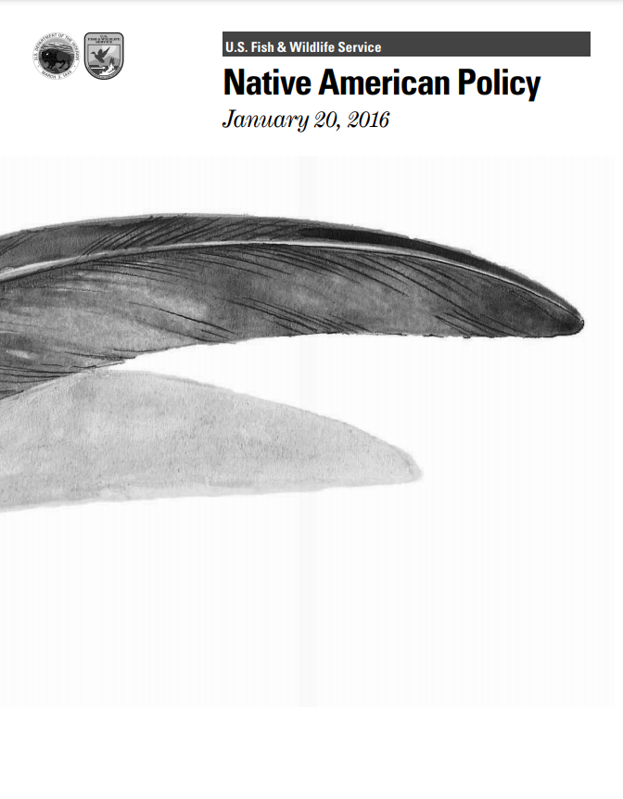
Native American Policy (2016)
Collaborative National Tribal and FWS Effort
Policy is the core to our Tribal engagement
Commitment: 5-year Review of Policy
Conducted in 2022
Notes:
Builds on 3206

Slide 6
5-Year Review Outcomes
Letter sent to Tribes
Employee Training
Increased Capacity
Greater Coordination on Service Actions
Enhance Data Sharing Protocols
Notes:
Builds on 3206

Slide 7

HQ Native American Program
Director’s Order 227
Co-Stewardship
  “[Ensure Tribes interests] play an integral role in decision making…”
  “Engage in co-stewardship, consistent with applicable laws…”
  “Coordinate at the earliest phases of planning and work directly with Tribes…”
  Increase Service staff understanding of Tribal and Native expertise and Indigenous Knowledge
  Ensure processes are in place to respond to Tribes

Slide 8

Regional Updates
FWS Co-Stewardship Workplan
Education and Training
  Tribal Participation Opportunity
Increase Capacity
  Regional Office: Assistant Tribal Coordinator
Continued Coordination

Slide 9
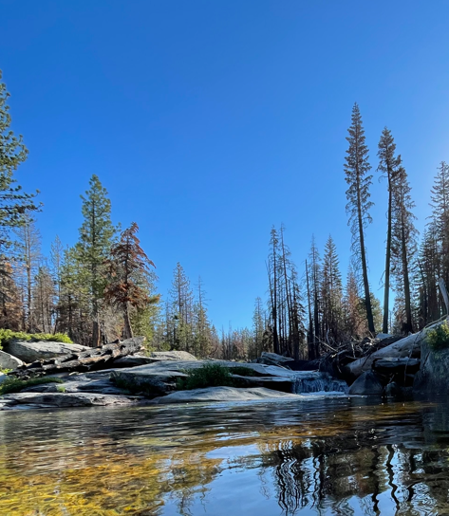
Eldon Brown, Regional Office michael_eldon_brown@fws.gov
Anjaleeqa Baldwin, Regional Office anjaleeqa_Baldwin@fws.gov

