Slide 1
Classification and
Recovery Actions
Carlsbad Fish and Wildlife Office
(including Palm Springs)
Fall Bi-annual Tribal Coordination Meeting
November 8, 2023

Slide 2
Overview
1. Listing Actions
2. Delisting and Downlisting (Endangered to Threatened) Actions
3. Recovery Planning
2
Notes:
For this presentation, our projects are split into three categories: listing, delisting and downlisting, and recovery planning.

Slide 3
Typical Listing Process
90-day finding
12-month finding
Petition received
Substantial
Proposed listing rule (E or T)
Not substantial
Final listing rule
Species Status Assessment
Not warranted
Proposed critical habitat
Final designated critical habitat
3
Notes:
*I am going to start by reviewing the terms 90-day finding and 12-month finding.
*From left to right, is a diagram depicting a typical listing process starting with receipt of a petition to list a species.
*After a petition is received, we decide whether it contains substantial information that listing action may be warranted. This decision as to whether the petition information is substantial, or not substantial, is the 90-day finding.
*If substantial, we do a Species Status Assessment, which informs a 12-mo finding.
*The 12-month finding typically comes in one of two forms… either a proposed rule to list a species as Endangered or Threatened, or it is a finding that listing of the species is not warranted.
*Critical Habitat, in green at the bottom right, can be proposed at the same time as the 12-month finding or sometime thereafter in separate proposed rule.

Slide 4
Listing Actions
Species | Listing Action | Publication Date | Citation
California spotted owl | Not warranted 12-month finding (SFWO lead) 12-month: Proposed to list the southern Distinct Population Segment (DPS) as Endangered | November 8, 2019 February 23, 2023 | 84 FR 60371 88 FR 11600
Joshua tree | Substantial 90-day petition finding Not warranted 12-month finding 12-month: Not warranted NOI sent on Aug 3, 2023 from Wild Earth Guardians | September 14, 2016 August 15, 2019 March 9, 2023 | 81 FR 63160 84 FR 41694 88 FR 14536
Western pond turtle | Substantial 90-day petition finding 12-month: Proposed to list as Threatened | April 12, 2015 October 3, 2023 | 80 FR 19259 88 FR 68370
Western spadefoot | Substantial 90-day petition finding (Sac FWO lead); 12-month listing status review (SFWO lead) | July 1, 2015 Expected 2023 | 80 FR 37568
Santa Ana speckled dace | Substantial 90-day petition finding 12-month listing status-review | June 17, 2021 Expected 2024 | 86 FR 32241
Inyo Rock Daisy | Substantial 90-day petition finding 12-month finding | March 21, 2023 Expected 2026 | 88 FR 16933
4
Notes:
*Jumping right in…There are three 12-month findings that have been finalized since last fall’s meeting (CA spotted owl, Joshua tree, and pond turtle) and there are 3 other listing packages that we are currently working on.

Slide 5
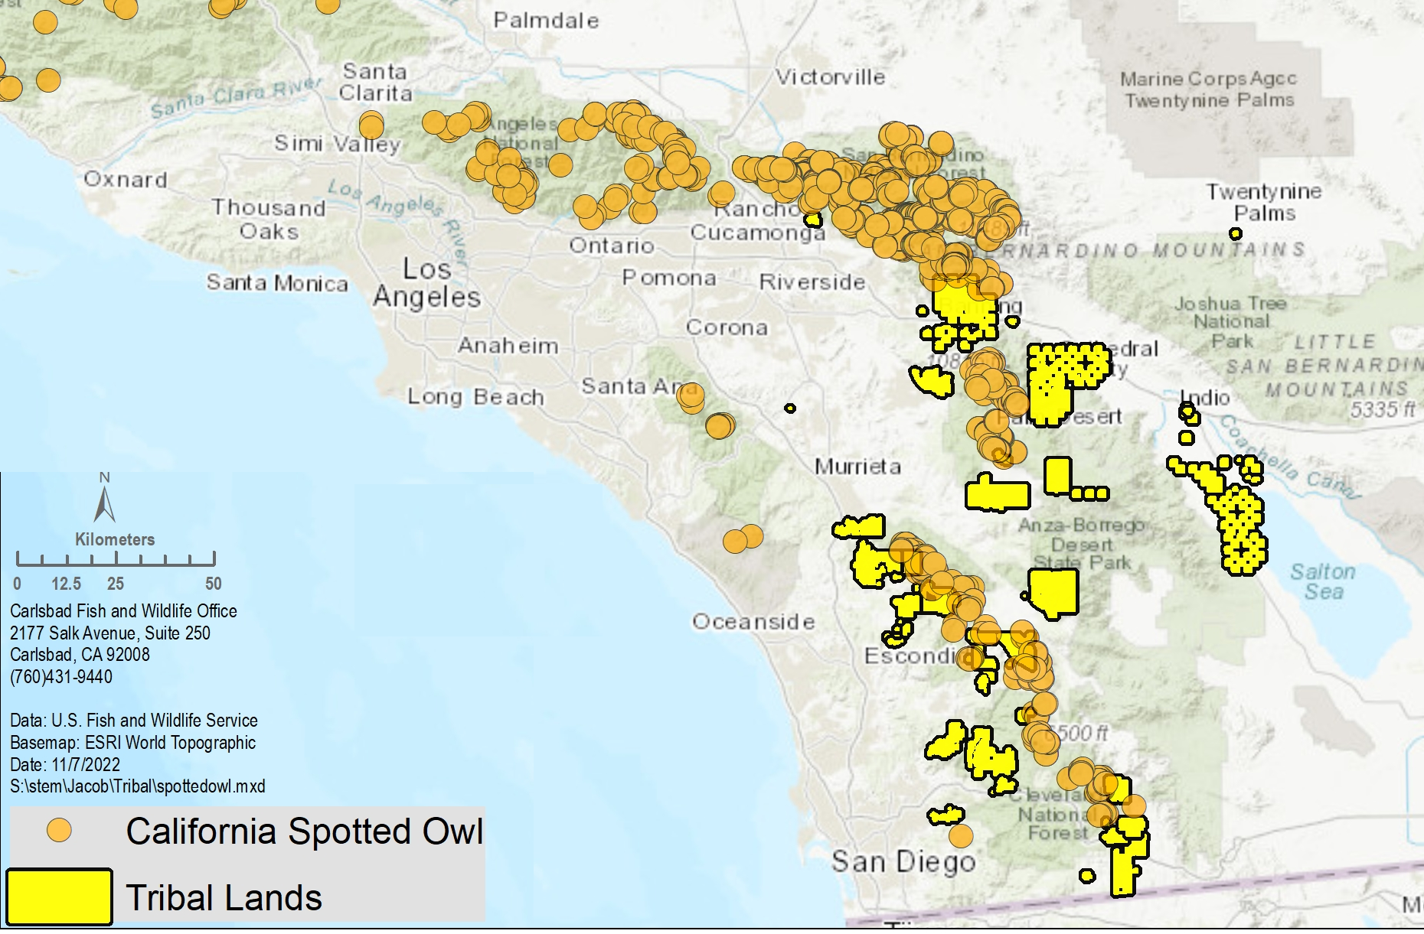
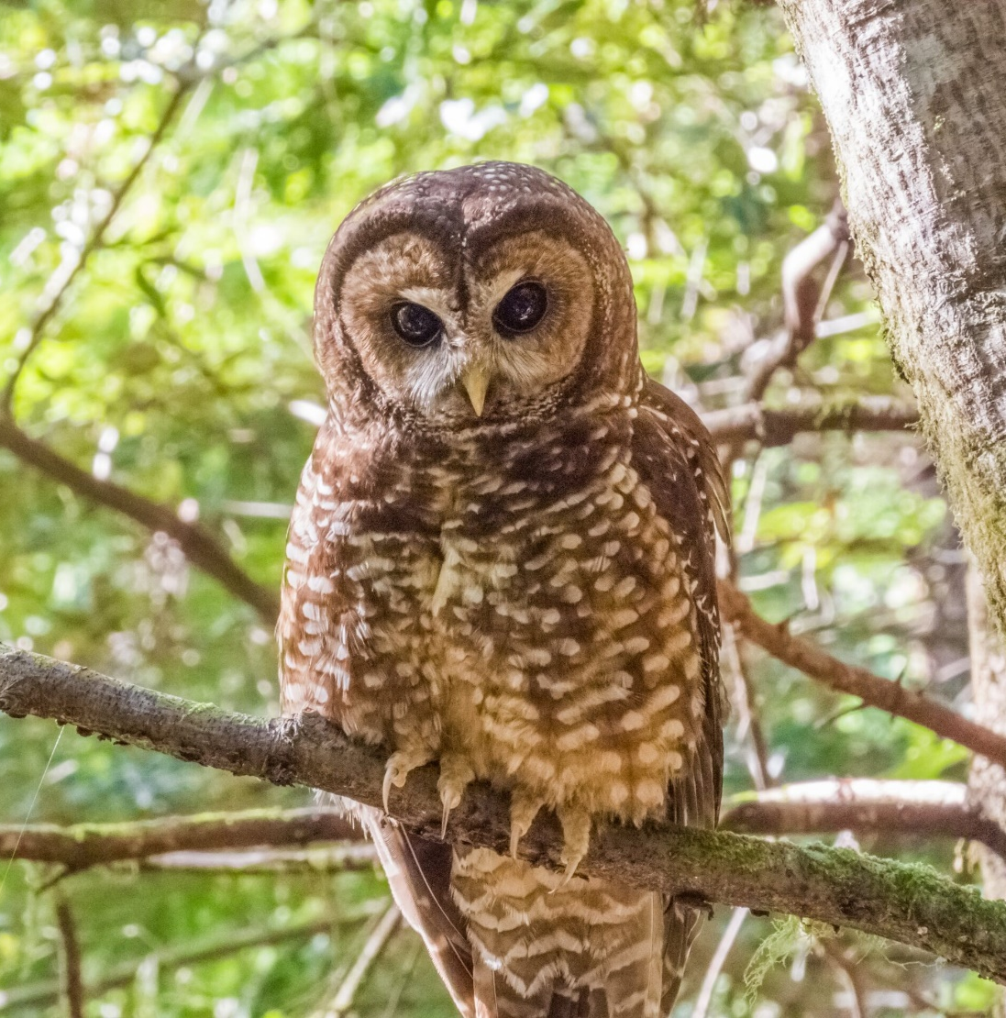
California spotted owl revised 12-month finding
5
Notes:
*The California spotted owl is a subspecies of spotted owl. The map here is zoomed in to show occurrences of the subspecies within our office’s jurisdiction. Tribal trust lands are in yellow.
CLICK

Slide 6
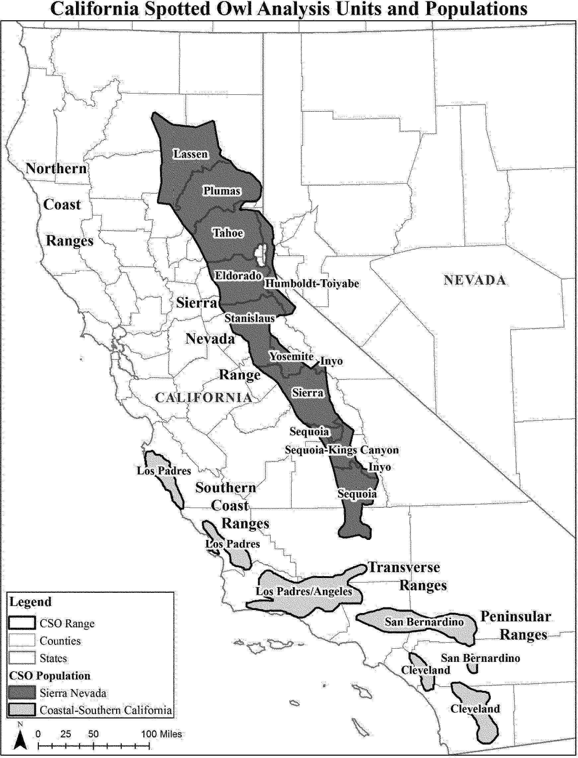
California spotted owl
Two distinct population segments (DPS)
Proposed Threatened
Proposed Endangered
6
Notes:
*In February of this year, we published a 12-month finding that split the range of CA spotted owl into two Distinct Population Segments, or DPSs.
*A DPS is a portion of a species' entire population; it allows us to apply Endangered Species Act protections selectively to smaller portions of a species’ range if the portion is discrete and significant.
*The new finding proposes to list the Coastal-Southern California DPS as endangered and the Sierra Nevada DPS as threatened.
*We received a lot of comments on this proposed rule and we are currently working through them.
Note: Tribes were notified via email in February when the proposed rule published in the Federal Register.

Slide 7
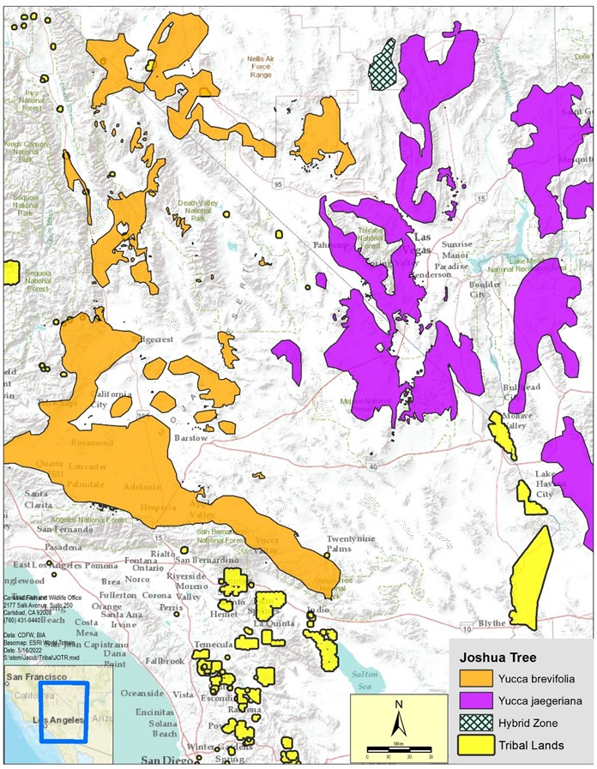
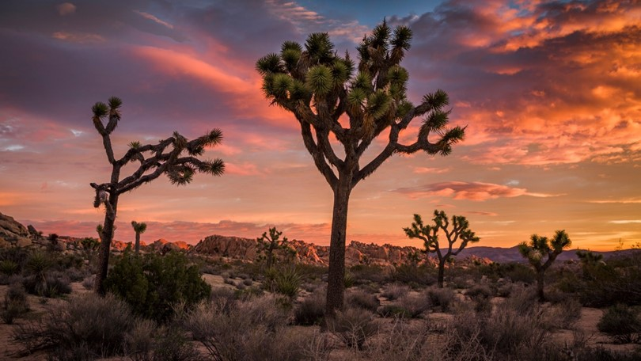
Joshua Tree
revised 12-month finding
7
Notes:
*In March of this year, we published a 12-mo finding for Joshua Tree as not warranted.
*In August, we did receive a 60-day Notice of Intent to sue from Wild Earth Guardians.
Note: Tribes were notified via email in March when the not-warranted finding was published in the Federal Register.

Slide 8
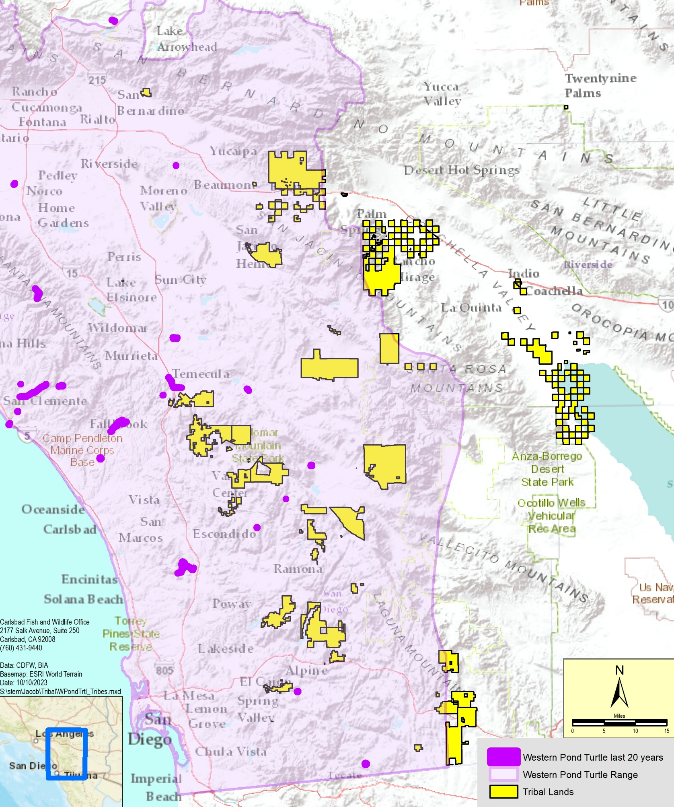
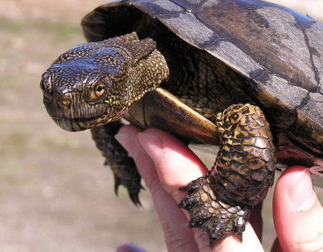
Western pond turtle 12-month finding
NEW! Proposed as Threatened.
Comment through Dec 4.
Docket: FWS-R8-ES-2023-0092
8
Notes:
*The 12-month finding for the western pond turtle was published on Oct 3rd. It is a proposed rule to list both the northern and southern species as Threatened.
*Tribes were notified by the Region via email on Sept 29 and our office sent out the notification again to a wider email list on October 6th.
*There is a 60-day open comment period that will end on Dec 4 so please get your comments in before then.
*We will begin working on a conservation strategy and Critical Habitat in the near future.
*There is also a presentation about the turtle later this meeting so please stay tuned.

Slide 9
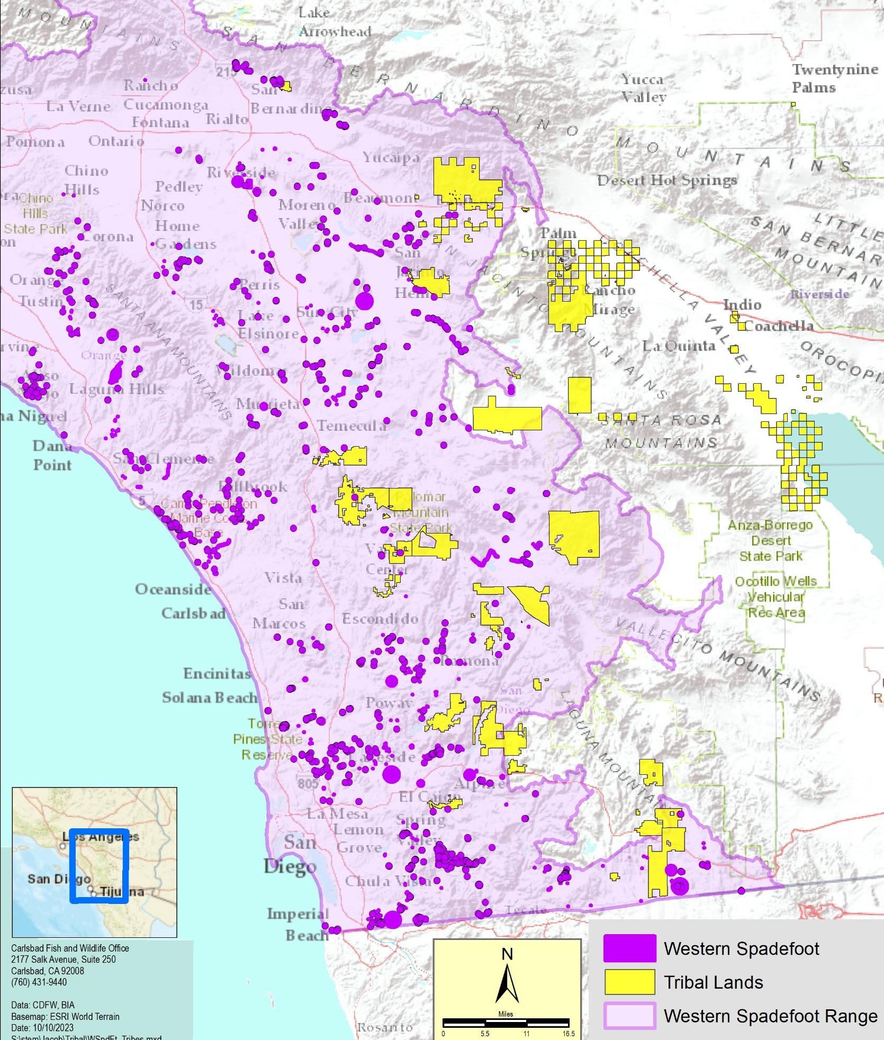
Western spadefoot
12-month finding
9
Notes:
*The western spadefoot is associated with vernal pools throughout California’s Central Valley southward to northwestern Baja Mexico.
*The Sacramento Field Office is lead for this package and the publication of the 12-month finding will come out soon.
*Please be on the lookout for outreach and information about the publication of the 12-mo finding.

Slide 10
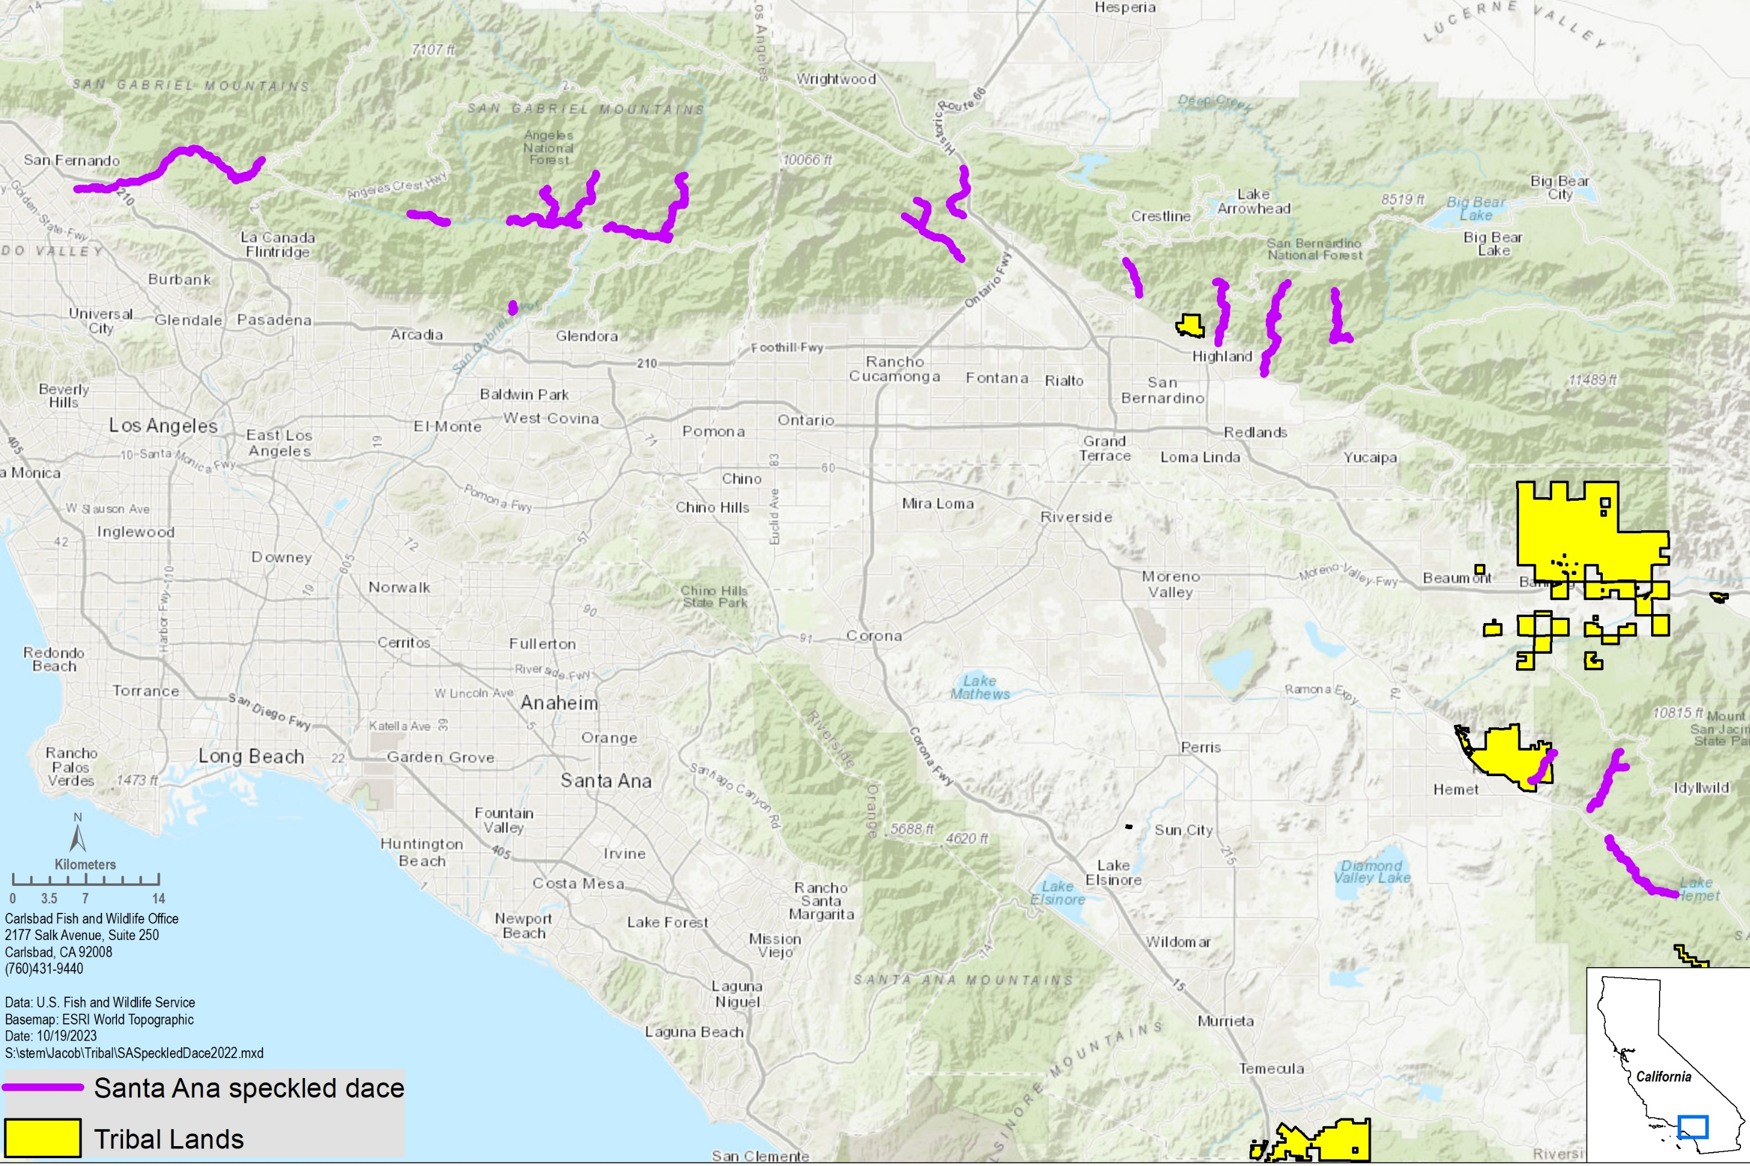
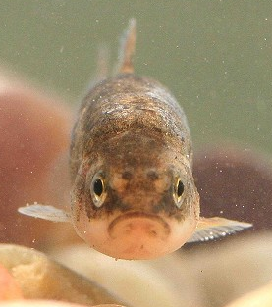
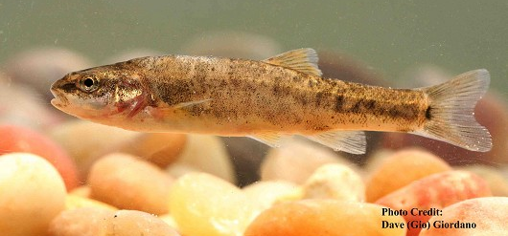
Santa Ana speckled dace
12-month finding
10
Notes:
*Santa Ana speckled dace are generally considered to be a subspecies of speckled dace. They are typically 8-11 cm long and they inhabit the Los Angeles, San Gabriel, Santa Ana, and San Jacinto river systems.
*We are working on the 12-mo finding, which is expected to be published in July 2024.

Slide 11
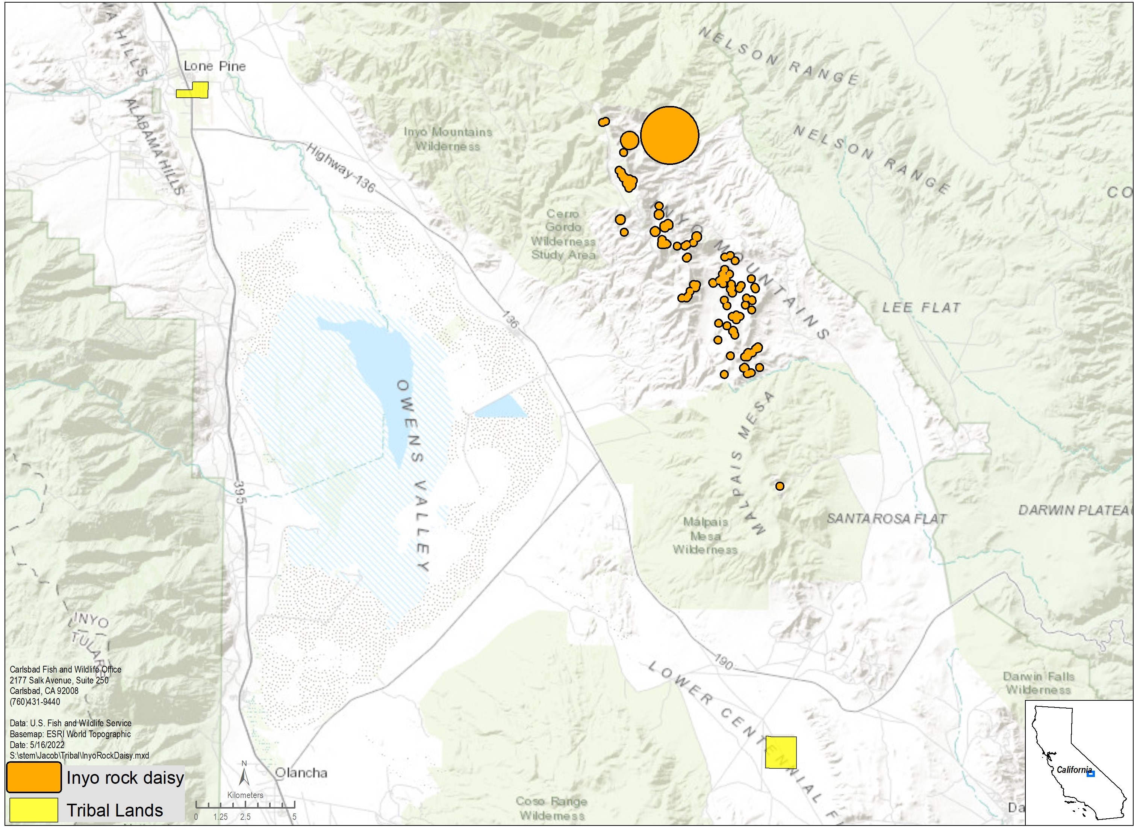
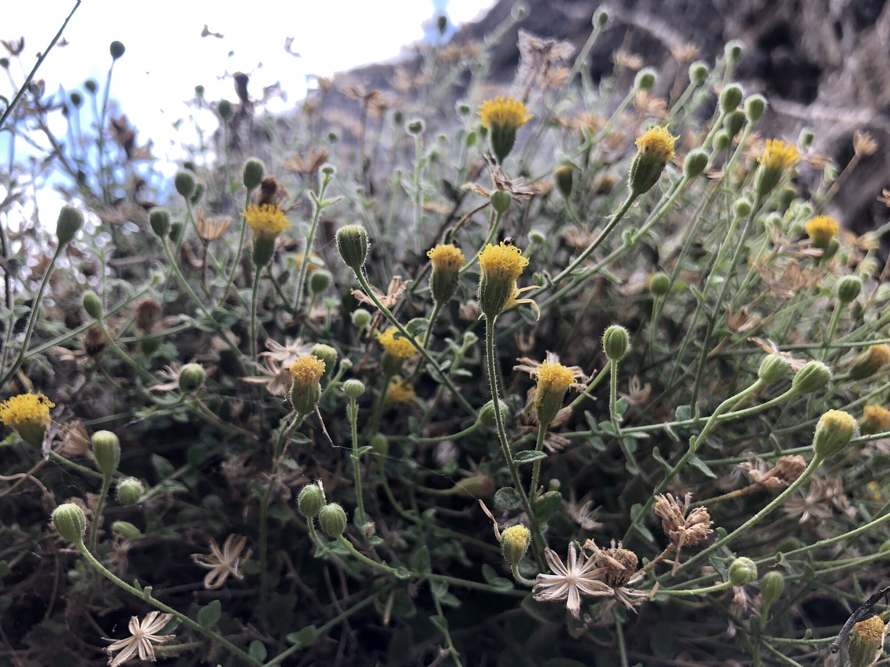
Inyo rock daisy 12-month finding
11
Notes:
*The Inyo rock daisy is endemic to the southern Inyo Mountains in Inyo County.
*In March, we published a 90-day finding that the petition presented substantial information that listing action may be warranted.
*We are currently working on a Conservation Strategy and a species status assessment to inform the 12-mo finding. The 12-month finding is on our workplan, with expected completion in 2026.

Slide 12
Downlisting and Delisting Actions
Species | Listing Action | Publication Date | Citation
Inyo California towhee | Proposed rule to delist Final rule | November 4, 2013 Date to be determined | 78 FR 65938
Triple-ribbed milk-vetch | Species Status Assessment (to inform downlisting or delisting) | Expected 2024
12
Notes:
*There are two species that have upcoming decisions regarding downlisting or delisting.
*Downlisting refers to reclassification of a species from Endangered status to Threatened status. Delisting refers to the removal of a species from the list of E&T species.

Slide 13
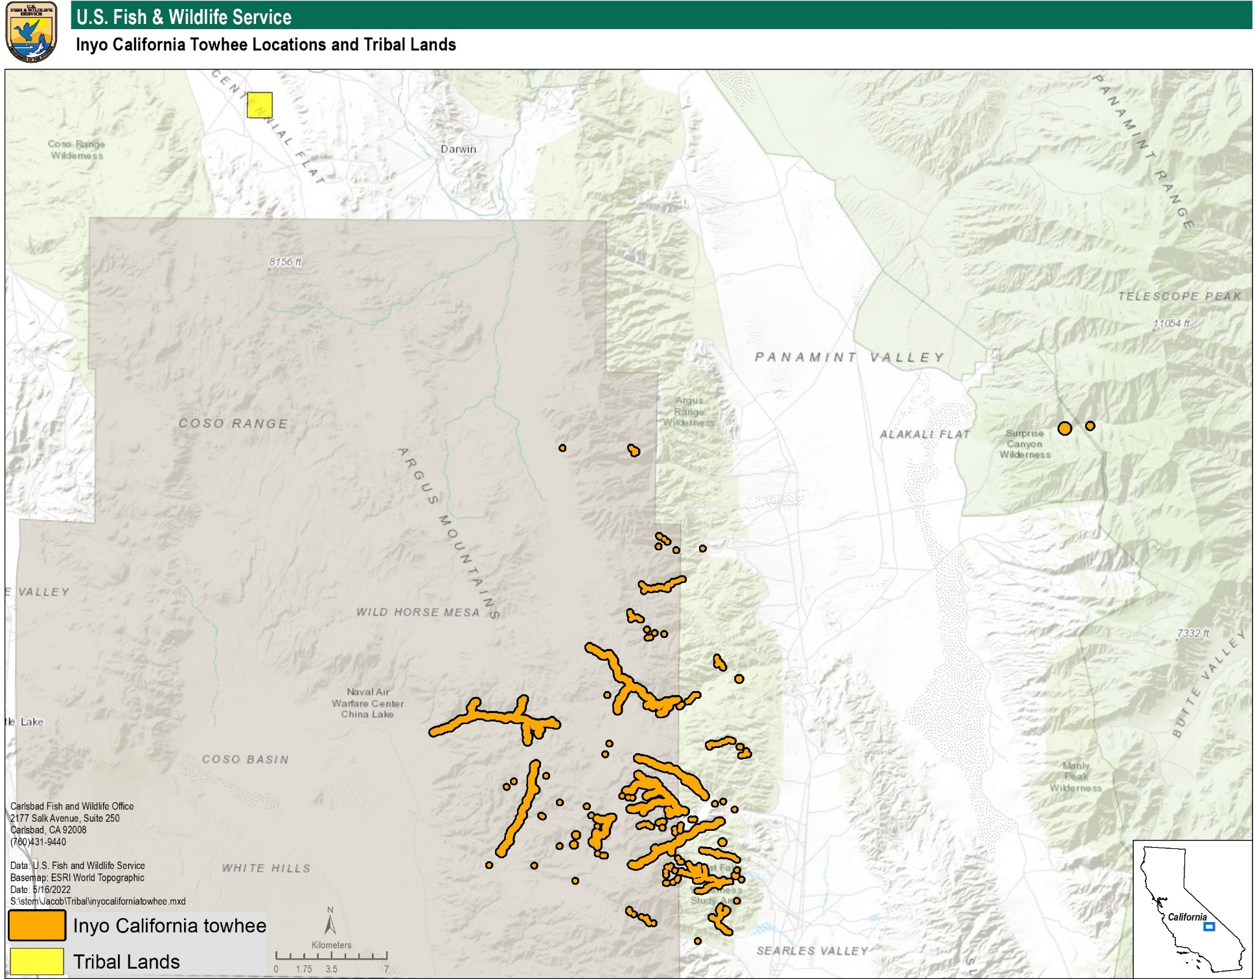
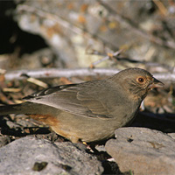
Inyo California towhee
Timbisha Shoshone
13
Notes:
*The Inyo CA towhee is native to the southern Argus Mountains of the Mojave Desert in Inyo County.
*There was a proposed rule to delist the towhee in 2013.
*Our office is continuing to work with partners to reduce threats to the subspecies and organize surveys over the next few years.
*A 5-year review will also be completed soon.

Slide 14
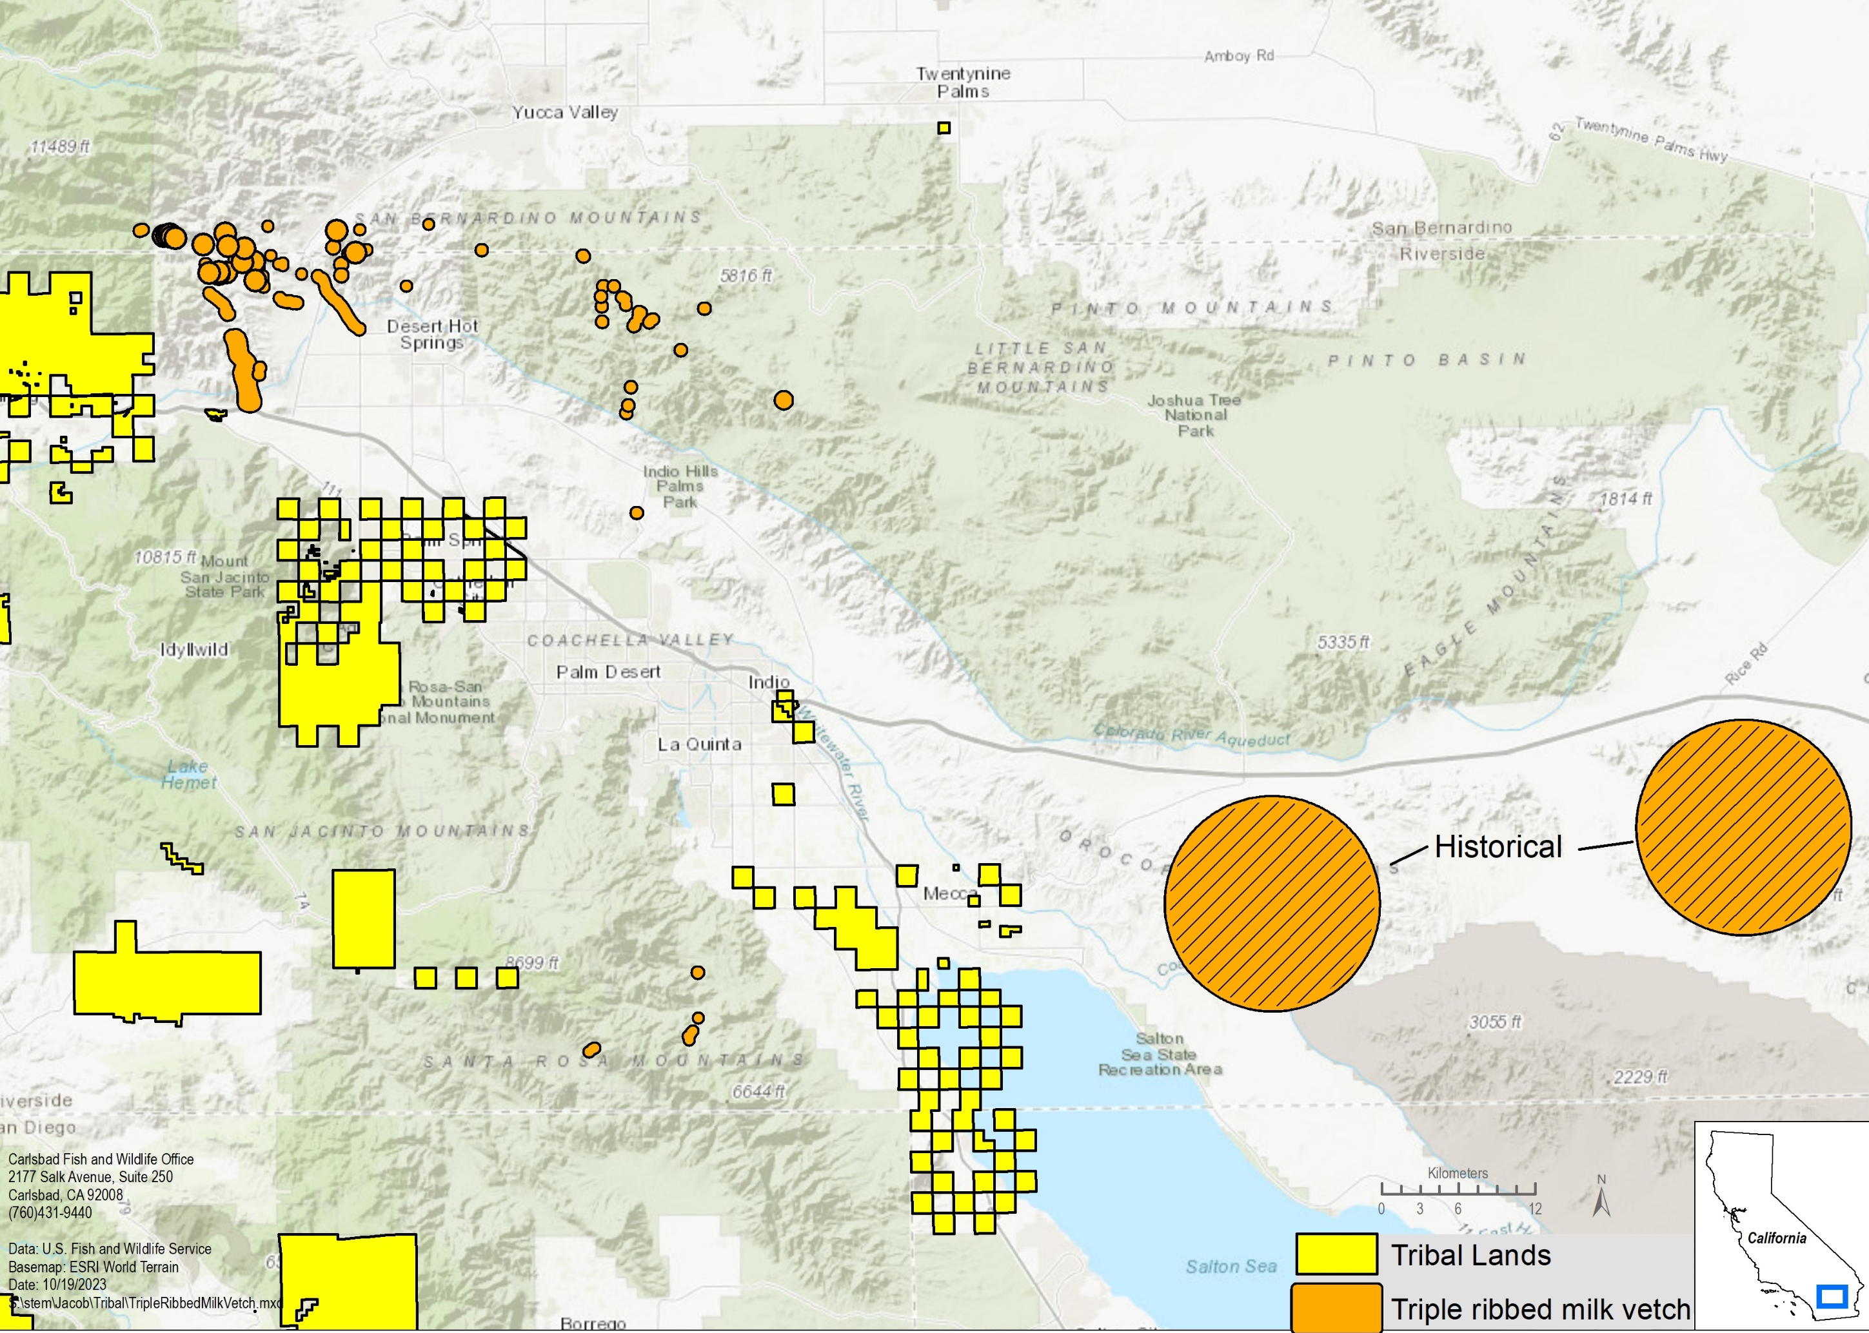
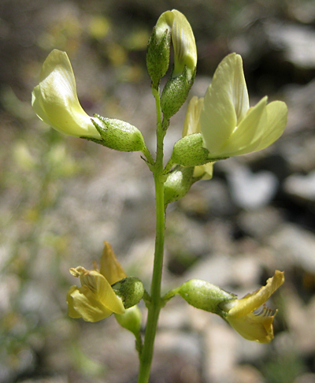
Triple-ribbed milk-vetch (Astragalus tricarinatus) Species Status Assessment
14
Notes:
*The Triple-ribbed milk-vetch is currently listed as Endangered. It is found in desert scrub where the San Bernardino Mountains meet the Mojave and Colorado deserts.
*We are working on a species status assessment because of new information we’ve received over the past few years. This will help us determine if the milk vetch may warrant downlisting or delisting.
*We expect to make a recommendation in 2024.

Slide 15
Recovery Plans
Species | Action | Expected Publication Date
Hermes copper butterfly | Draft Recovery Plan | 2024
San Bernardino kangaroo rat | Draft Recovery Plan | 2024
Coastal California gnatcatcher | Draft Recovery Plan | 2024
Casey's June beetle | Draft Recovery Plan | 2024
San Bernardino bluegrass | Draft Recovery Plan | 2025
15
Notes:
*Our current recovery planning efforts are largely focused on developing draft Recovery Plans, as you can see from the table.
*Recovery plans establish a strategy and criteria for downlisting and delisting.
*Our goal with recovery planning is to have a proactive strategy that, if possible, does not rely on Tribal lands or burden Tribes to achieve recovery of a species.

Slide 16
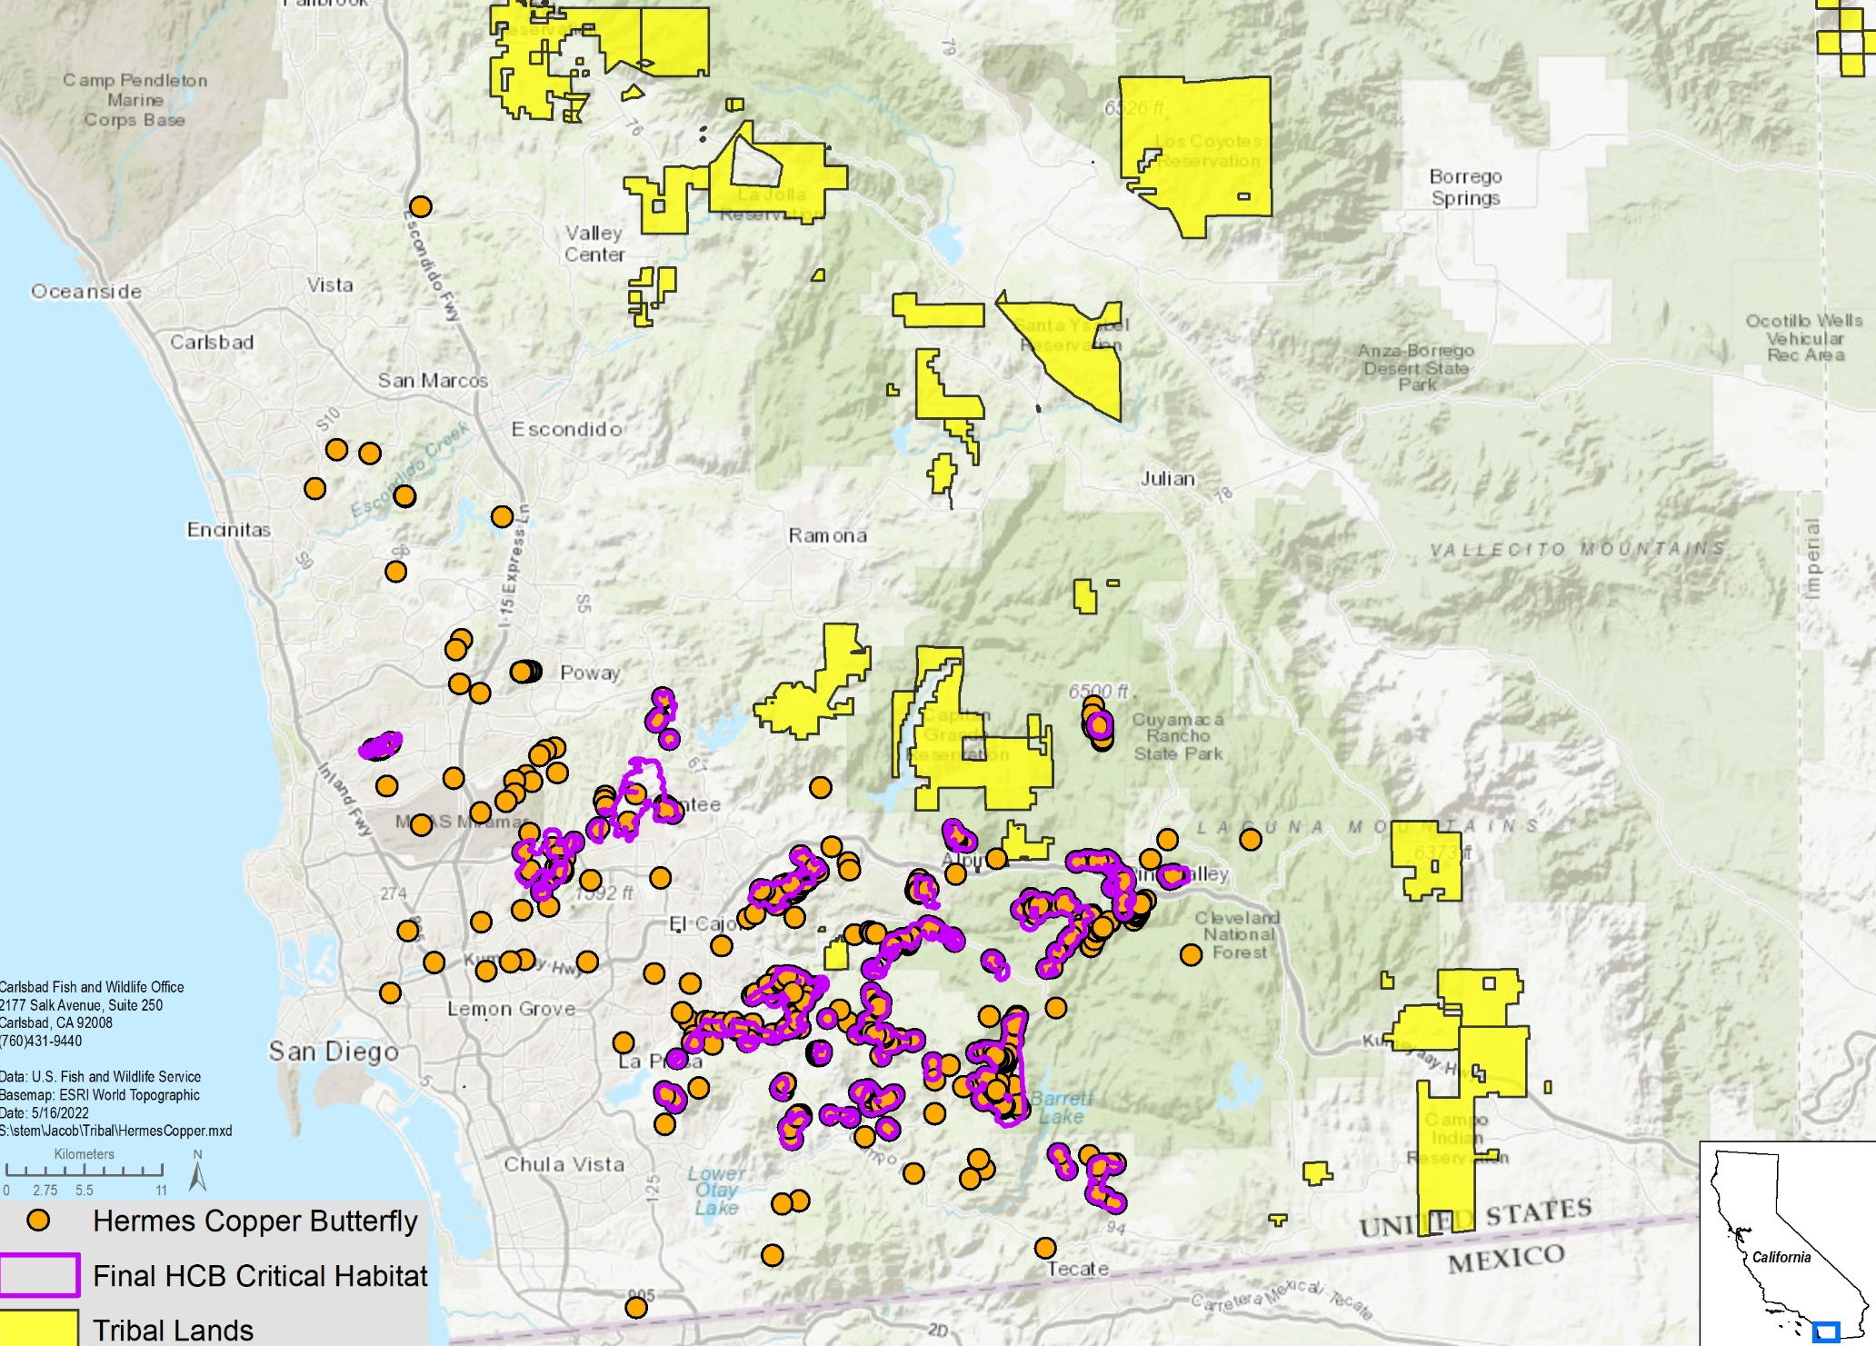
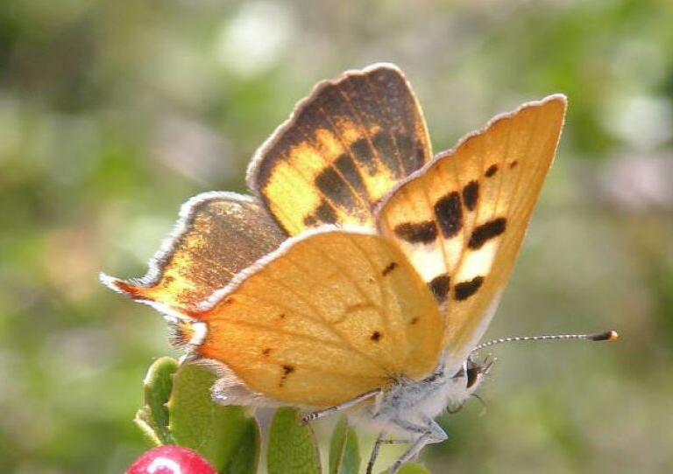
Hermes Copper Butterfly
16
Notes:
*Back in 2021, we finalized the listing rule and critical habitat for the Hermes Copper Butterfly.
*The Draft RP for this species is scheduled to be completed in 2024.

Slide 17
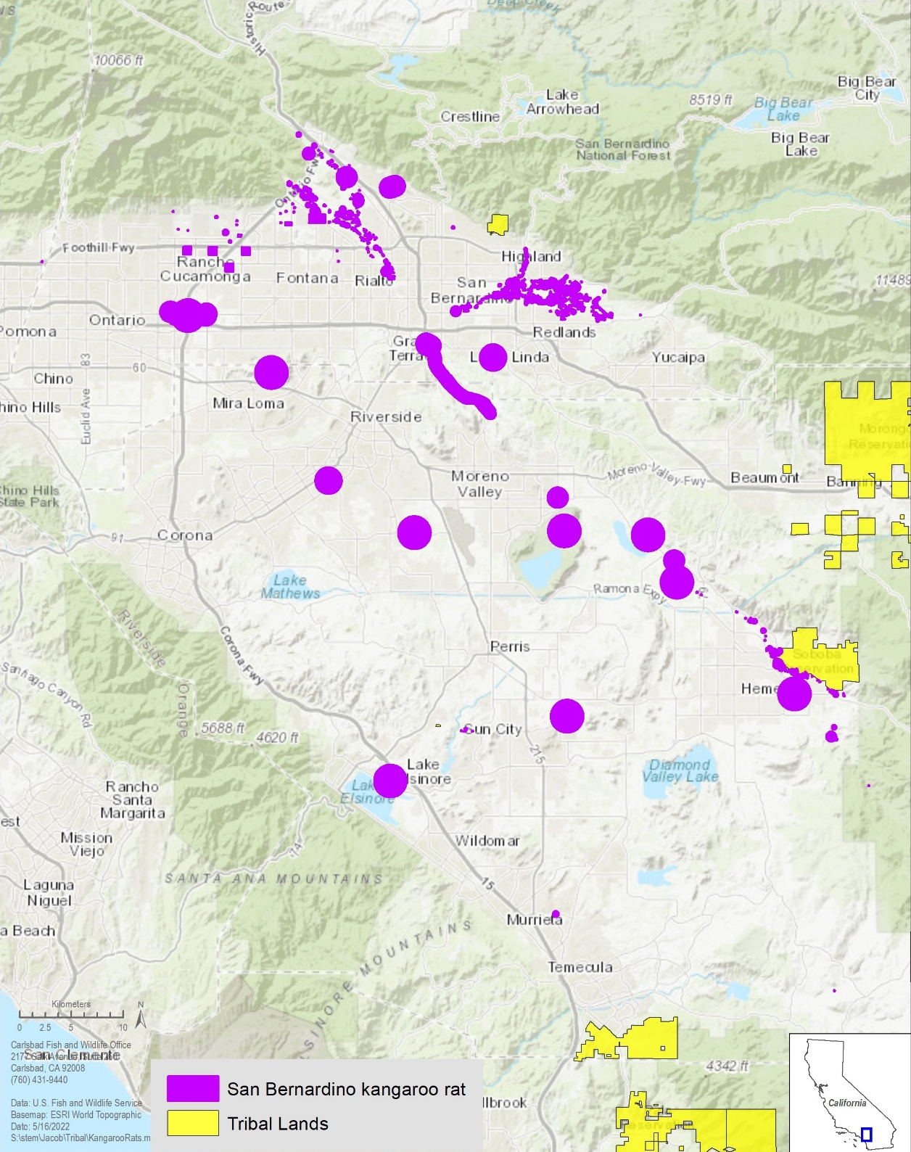
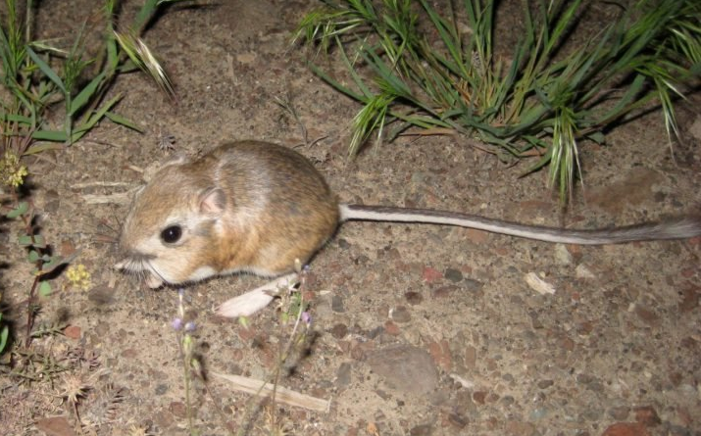
San Bernardino kangaroo rat
17
Notes:
*The San Bernardino Kangaroo Rat is an endangered subspecies of Merriam’s Kangaroo Rat native to the San Bernardino Valley.
*We expect to complete the Draft RP in 2024.

Slide 18
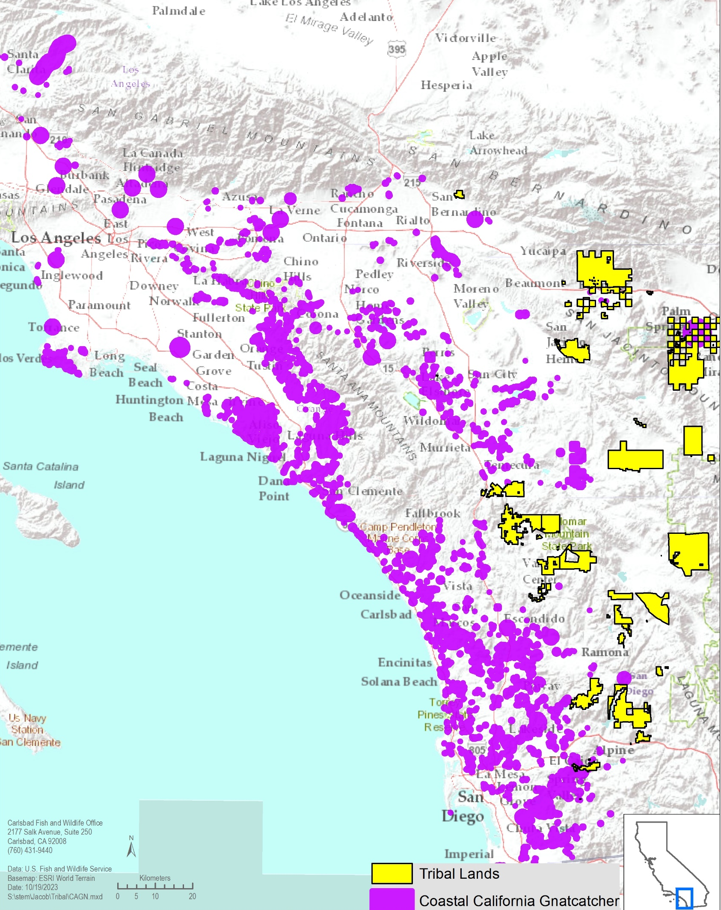
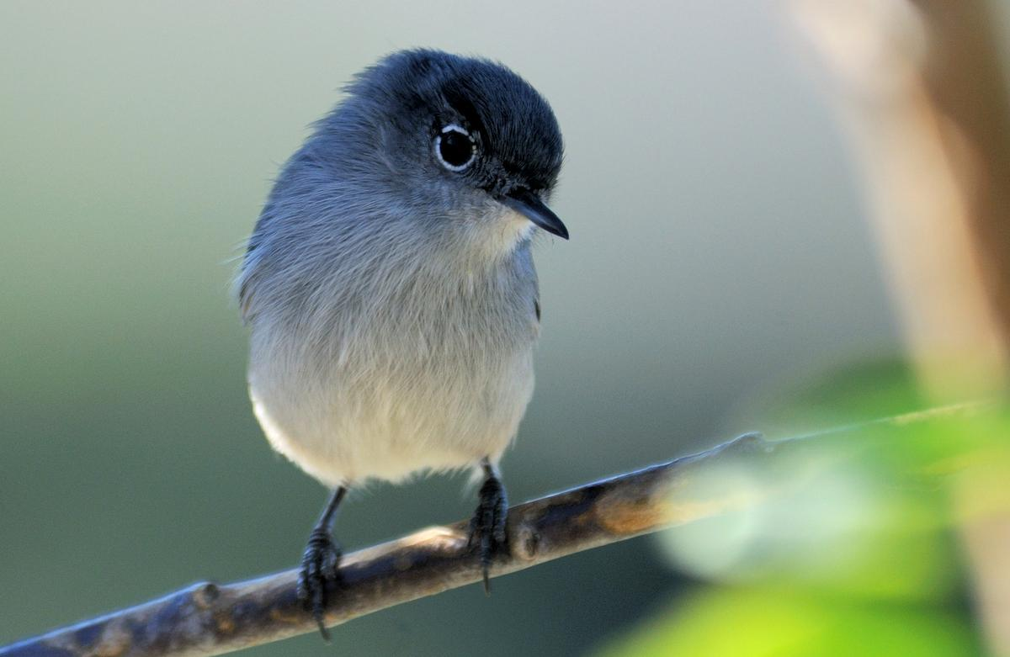
Coastal California Gnatcatcher
18
Notes:
*The coastal California gnatcatcher, a subspecies of the California gnatcatcher, is a small non-migratory songbird that occupies coastal sage scrub in southern CA and Baja.
*We expect to complete the Draft RP in 2024.

Slide 19
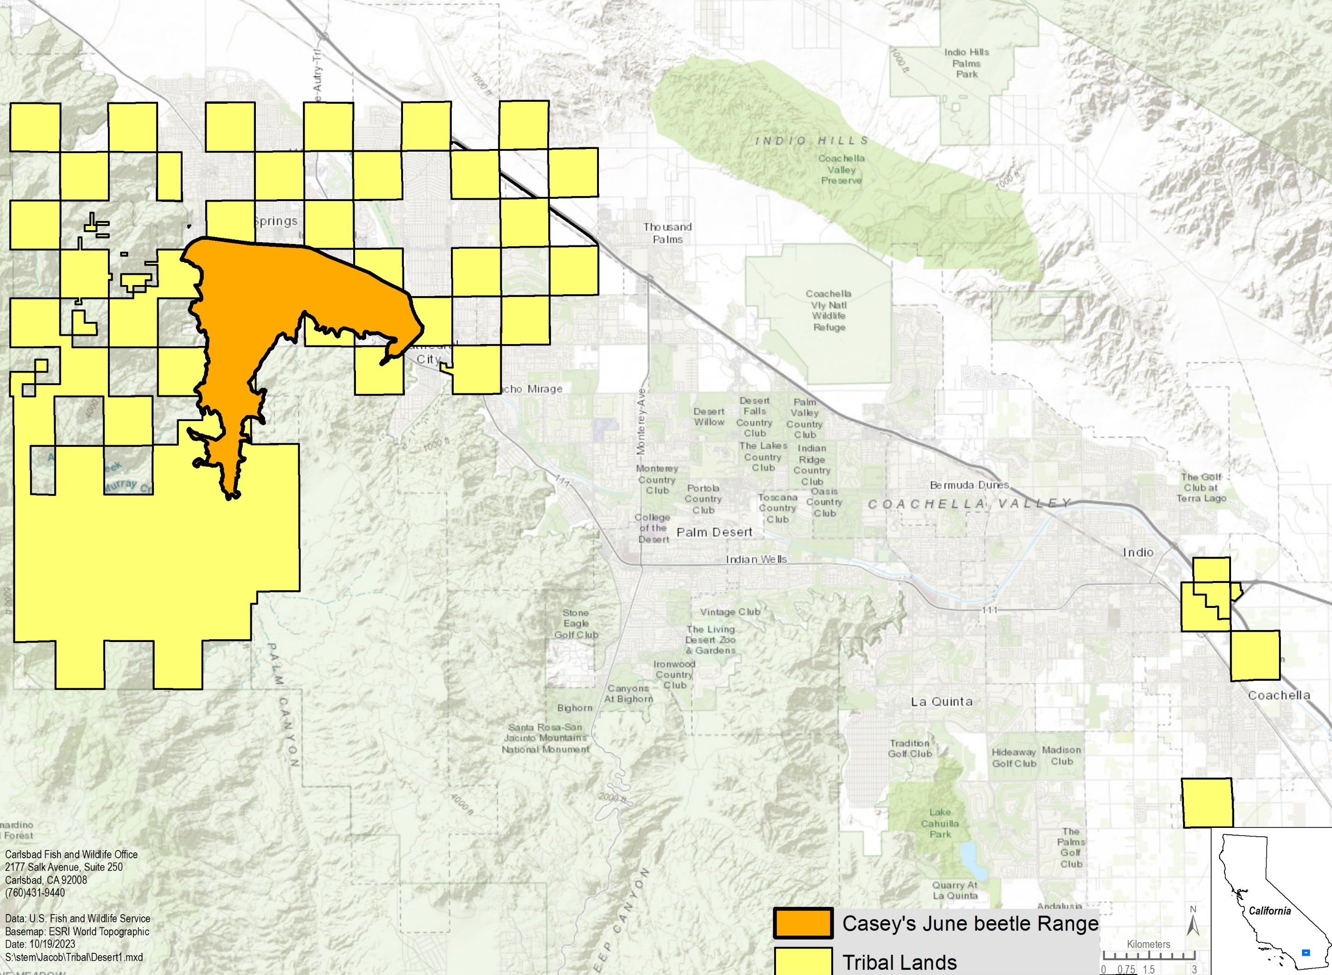
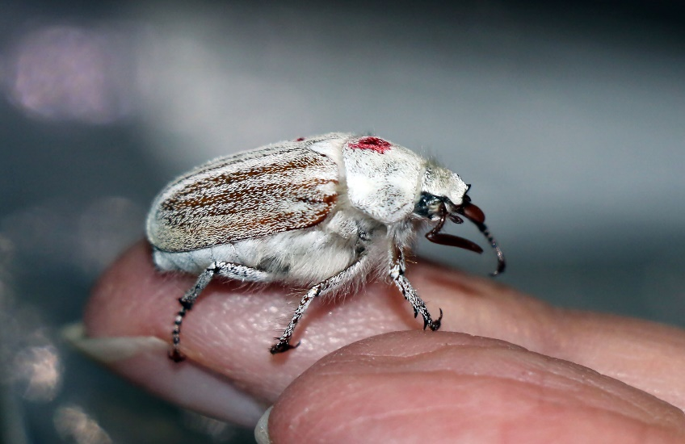
Casey’s June Beetle
Agua Caliente
19
Notes:
*Casey’s June beetle is an endangered scarab beetle in the Palm Springs area that is 1-2 cm long.
*We expect to complete the Draft RP in 2024.

Slide 20
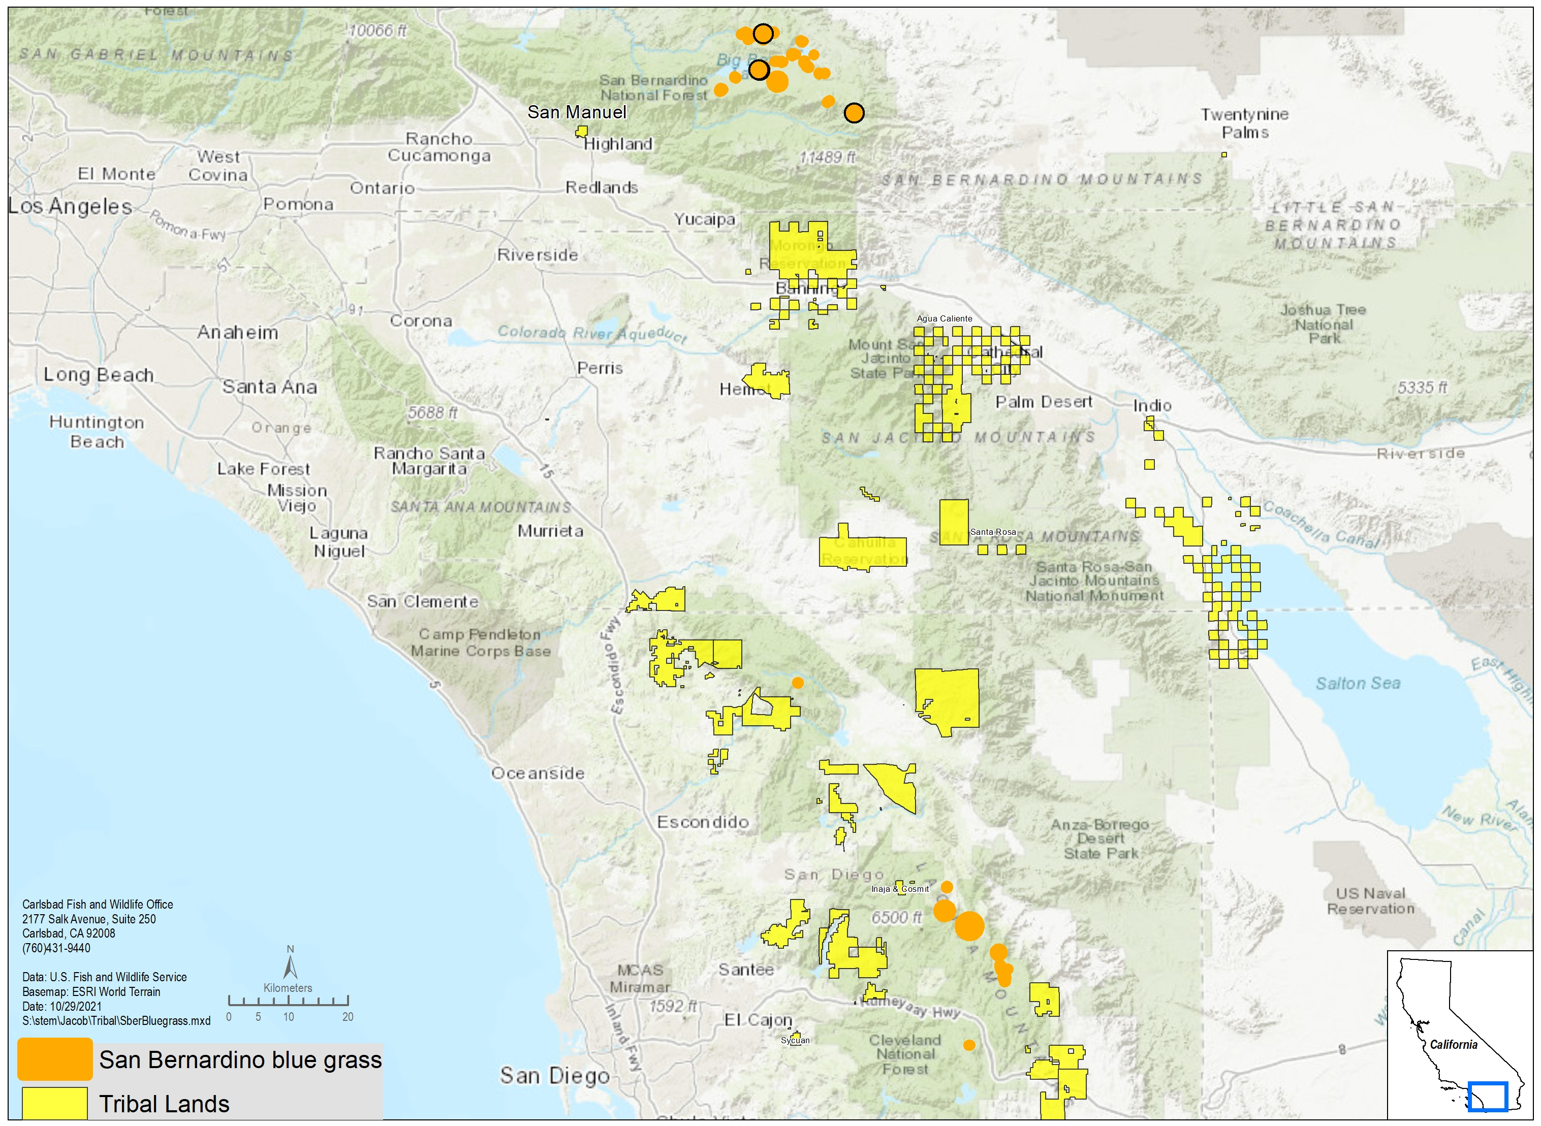
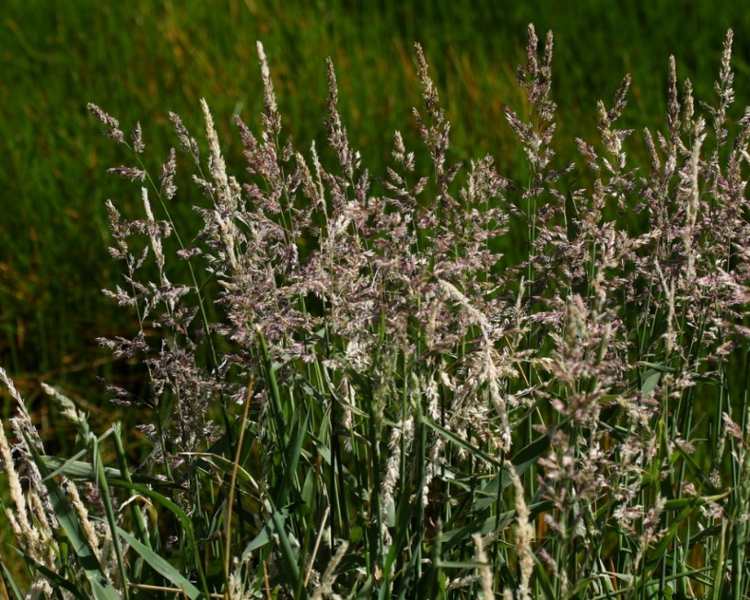
San Bernardino Bluegrass (Poa atropurpurea)
20
Notes:
*San Bernardino bluegrass is an endangered grass species found in wet mountain meadows in 2 regions: near Big Bear in the San Bernardino Mountains and in the Laguna Mountains in San Diego County.
*We expect to complete the Draft RP in 2025.

Slide 21
Five-year status reviews
Completed in 2023
Quino checkerspot butterfly
Coachella Valley milk vetch
Santa Ana River woolly-star
Santa Ana sucker
California Orcutt grass
Spreading Navarretia
Lane Mountain milk-vetch
Thread-leaved brodiaea
Del Mar manzanita
Otay tarplant
Coachella Valley fringe-toed lizard
San Diego button-celery
San Diego mesa-mint
To be completed in 2024
Laguna Mountains skipper
Mountain yellow-legged frog
Peirson's milk-vetch
Eureka dune grass
San Bernardino bluegrass
Casey's June beetle
San Bernardino kangaroo rat
Coastal California gnatcatcher
Inyo California towhee
Santa Cruz Island rockcress
21
Notes:
*Finally, we just completed a large number of 5-year status reviews for listed species (table on the left). The table on the right is a list of 5-years reviews we will complete in 2024.
*5 yr reviews can recommend delisting, downlisting, or uplisting, although they do not actually make that status change.
*In the interest of time we are not reviewing them today, but as always, reach out to us anytime if you are interested in any project or species.

Slide 22
Questions
Photo credit: J. Gilkeson, USFWS
Questions?
cfwo_tribal_coordination@fws.gov
22
Notes:
If there is time, I’m happy to take questions.

