Slide 1
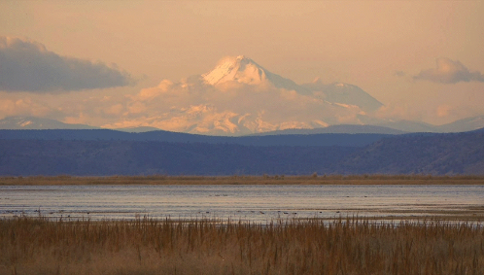
Tule Lake and Lower Klamath Refuges Habitat Conditions
2022

Slide 2
First A Huge Thanks
Refuge Staff – For all the work they do to support wetlands and waterfowl
California Waterfowl Association (CWA) for their continued support with banding, disease management, and advocacy
Ducks Unlimited (DU) for their continued advocacy and support with infrastructure upgrades
Cal-Ore Wetlands & Waterfowl Council (CalOre) for their continued support and advocacy of the refuges
Everyone who cares enough to request information or provide feedback

Slide 3
Klamath Basin National Wildlife Refuge Complex
The Klamath basin National Wildlife Refuge Complex is made up of six Refuges in the Klamath Basin that include Tule Lake, Upper Klamath, Lower Klamath, Klamath Marsh, Bear Valley, and Clear Lake, whose combined mission is to protect what remains of what once was the largest wetlands area west of the Mississippi River. These surviving wetlands remain a highly managed yet critical part of the Pacific Flyway, a place where migrating waterfowl can rest and refuel.

Slide 4
The Kuchel Act and Management of Your Refuges
After nearly a decade of debate between agricultural interests and conservationists over the future of the refuges, The Kuchel Act of 1964 dedicated the lands within the boundaries of Tule Lake and Lower Klamath NWRs to wildlife conservation for the purpose of waterfowl management, with a mandate of continuing an agricultural leasing program consistent with “proper waterfowl management”
At a time, when agricultural crops were viewed as a requirement for waterfowl in the Klamath Basin, and Tule Lake and Lower Klamath NWRs held unparalleled fall waterfowl populations of 5 to 7 million birds, the bill was viewed as a win-win solution.
The debate continues to this day

Slide 5
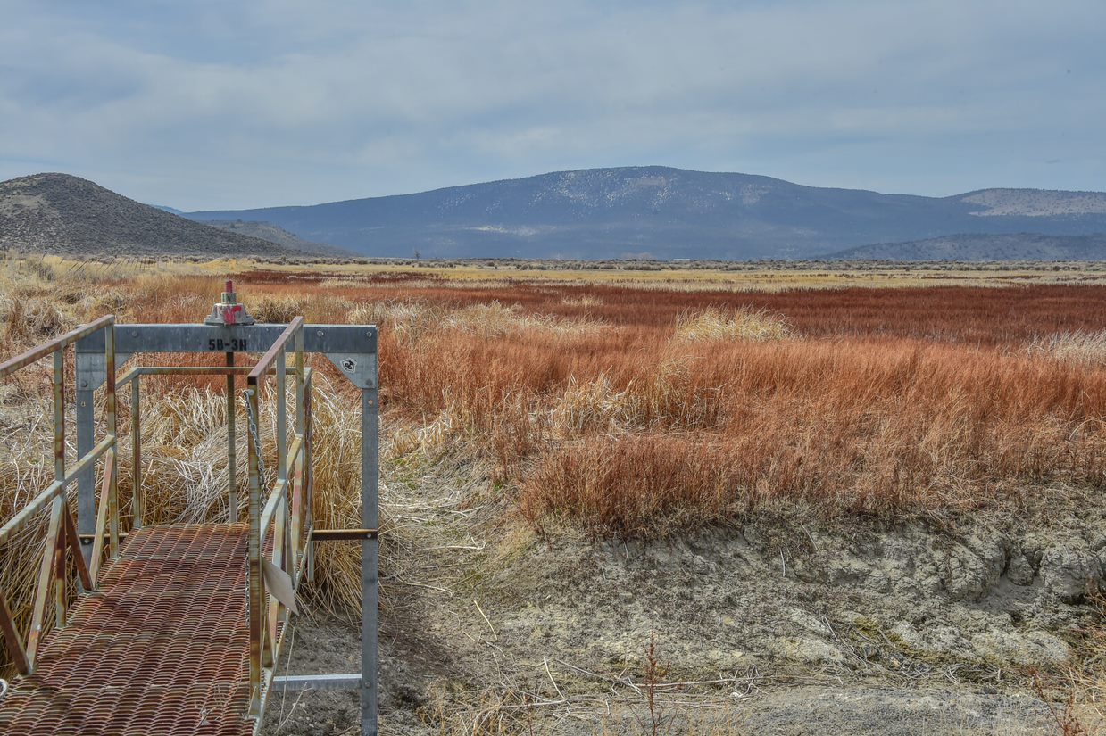
Setting the Stage for Discussion
The Klamath Basin is entering a third year of severe drought and water shortages. Habitat conditions are the worst they have ever been
Drought conditions are impacting everyone - Klamath basin wetlands, waterbirds, fish, and communities (Tribes, conservation, recreation, agriculture) are all suffering due to the challenges around water availability and delivery
The Klamath Basin is losing wetlands at a rapid rate both the physical loss of acres and functional loss of flooded habitat
National Wildlife Refuges in the Klamath Basin continue to face the greatest threats they have experienced since the 1920’s. Waterbird populations are not only the lowest in the refuge's history but importantly Klamath Basin wide indicating a collapse of the most important staging area in the Pacific Flyway.
The Klamath Basin is not alone! Drought conditions are plaguing the western United States and at this time there is concern that little wetland habitat will be available to support fall staging and wintering waterbirds
in the Pacific Flyway
The refuge's goal is to increase the staging population of migrating waterfowl
on LKNWR and TLNWR
Refuge staff want to increase the value of these refuges throughout the year
with special consideration on increasing waterbird populations during the Spring
breeding and fall migration months.

Slide 6
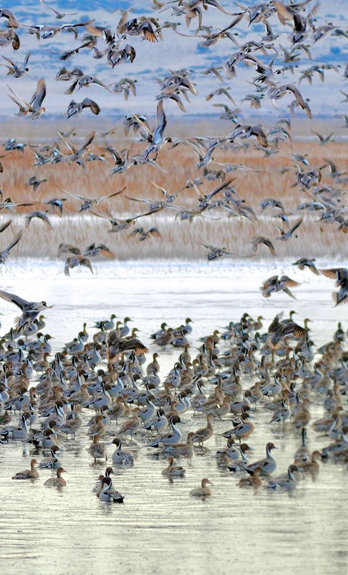
Recreational Use
Tule Lake & Lower Klamath Refuges average greater than 170k visitors per year.
Refuge managers do their best to balance the needs of wildlife, wetland preservation, and people
Six wildlife-dependent recreational uses are allowed when they are compatible with a refuge’s purpose. They include hunting, fishing, wildlife observation, photography, environmental education, and interpretation
A recreational use is compatible when it:
Habitat and water management is based on waterbird needs first
Refuge staff is aware that not every management decision is going to be supported by all user groups
We hope that this presentation will help alleviate some anxiety and frustration
Does not conflict with fish and wildlife habitat goals or objectives, and promotes public understanding and appreciation for the role of managers in managing and protecting these resources
Develops the public's understanding of, and appreciation for, their role in the conservation of our nation’s fish and wildlife resources

Slide 7
Water is Everything
The current biological opinion has effectively modelled LKNWR out of the fall migration picture by reducing water deliveries to both LKNWR and TLNWR to a level that proper waterfowl and wetland management is impossible
Even in the best of the recent water years delivery of water has been 50% or less of the volume needed to properly manage the LKNWR for waterbirds
Water delivery is not occurring or when it does is too late to effectively match habitat with waterbird needs
Water availability is now an issue at TLNWR where the greatest flexibility of water management has historically occurred. Summer and Fall 2022 will mark the first time in the refuge's history that both Sump 1A and 1B will be dry and unavailable for nesting, molting, and migrating waterbirds. This impacts wetlands, endangered species habitat, public recreation, waterbirds and the agricultural community which provides leave and waste grain to help support waterbirds, pheasants, and non-game wildlife
Without appropriate water deliveries waterbird populations are going to continue to decline, this directly impacts recreational opportunities, such as hunting, wildlife viewing, photography, and environmental education
While some take issue with refuge management, if the water issues are not solved everyone loses

Slide 8
Water is Everything Cont.
Recent publications by Intermountain West Joint Venture indicate the biggest limiting factor for fall migrating waterfowl in the Pacific Flyway is the availability of water on Public Managed lands and wetlands are transitioning to shorter periods of availability due to water scarcity.
https://esajournals.onlinelibrary.wiley.com/doi/10.1002/ecs2.2758
https://onlinelibrary.wiley.com/doi/full/10.1111/gcb.15010
https://www.frontiersin.org/articles/10.3389/fevo.2022.844278/full

Slide 9
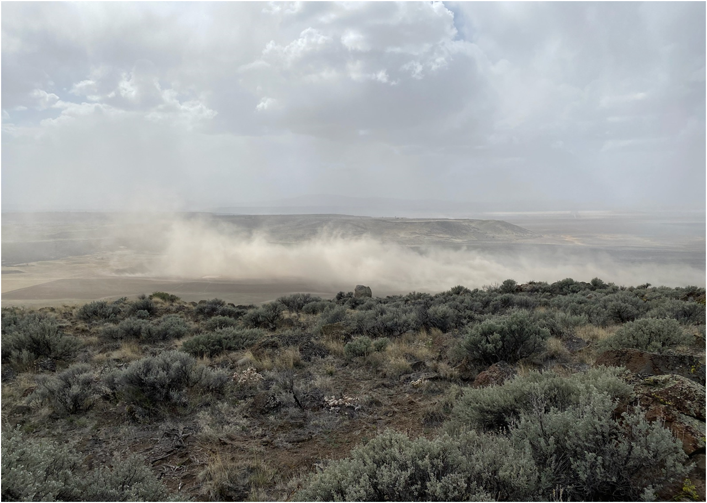
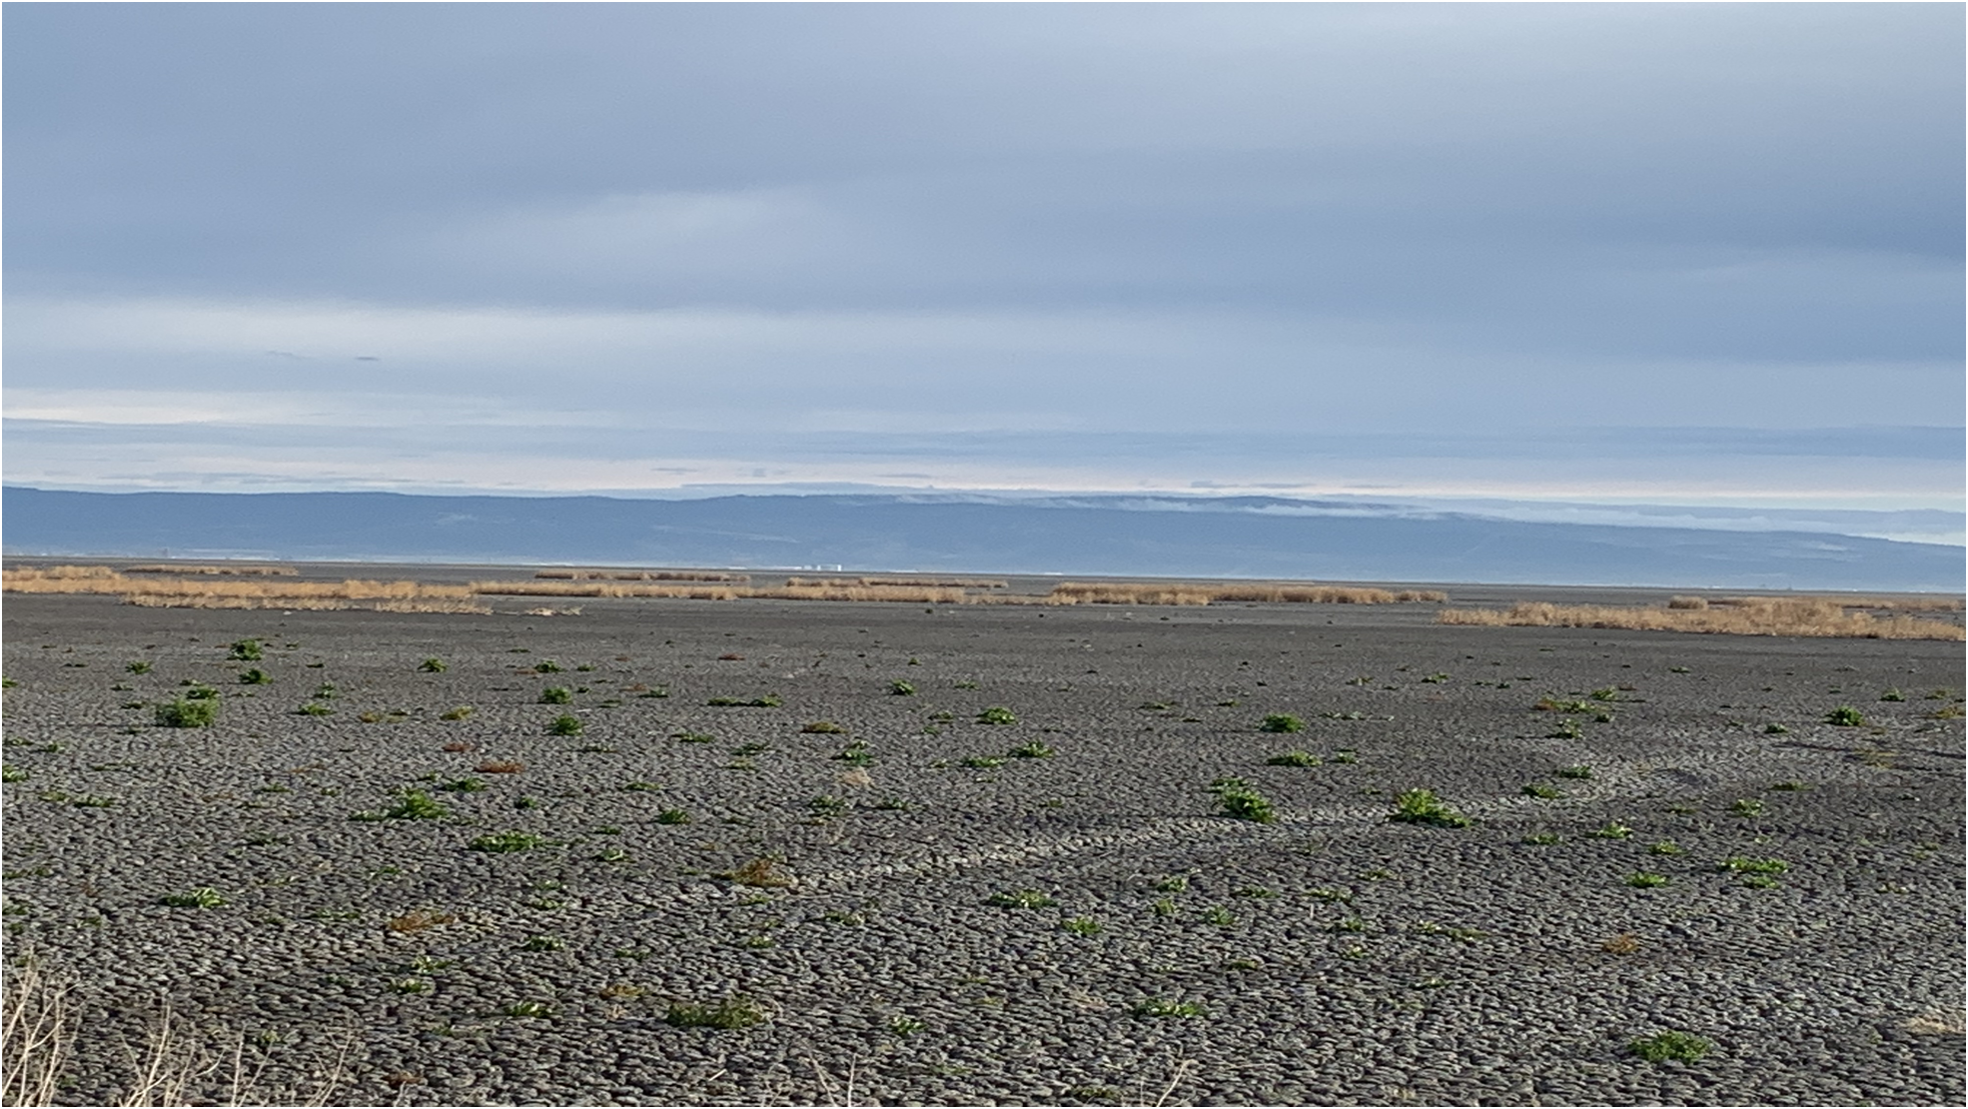
The Big Picture
Most of the Western United States is experiencing some level of drought
Wetland habitat throughout the western mid-continent is likely going to be extremely limited
It is anticipated that core waterbird areas are going to be dry
or experiencing extremely reduced habitat availability
It is uncertain at this time what the impact to migratory waterbirds might be
However, limited habitat can lead to concentrated populations which facilitates disease outbreaks, reduced food resources,
and increased disturbance
Jeff McCreary Ducks Unlimited

Slide 10
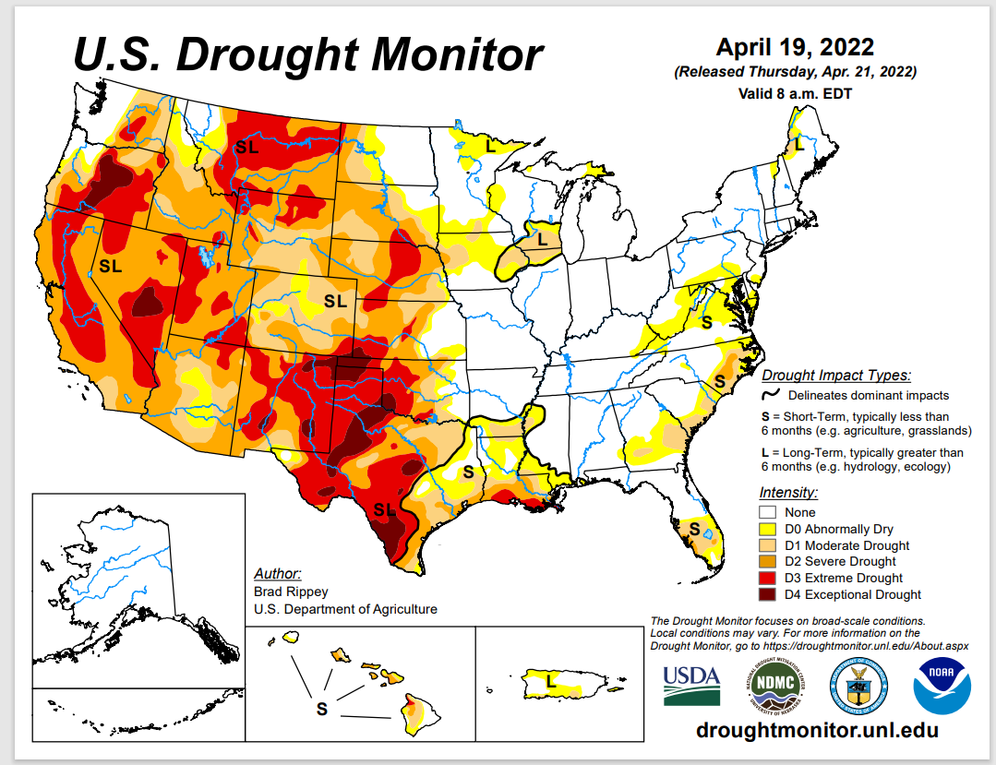
Current Map | U.S. Drought Monitor (unl.edu)

Slide 11
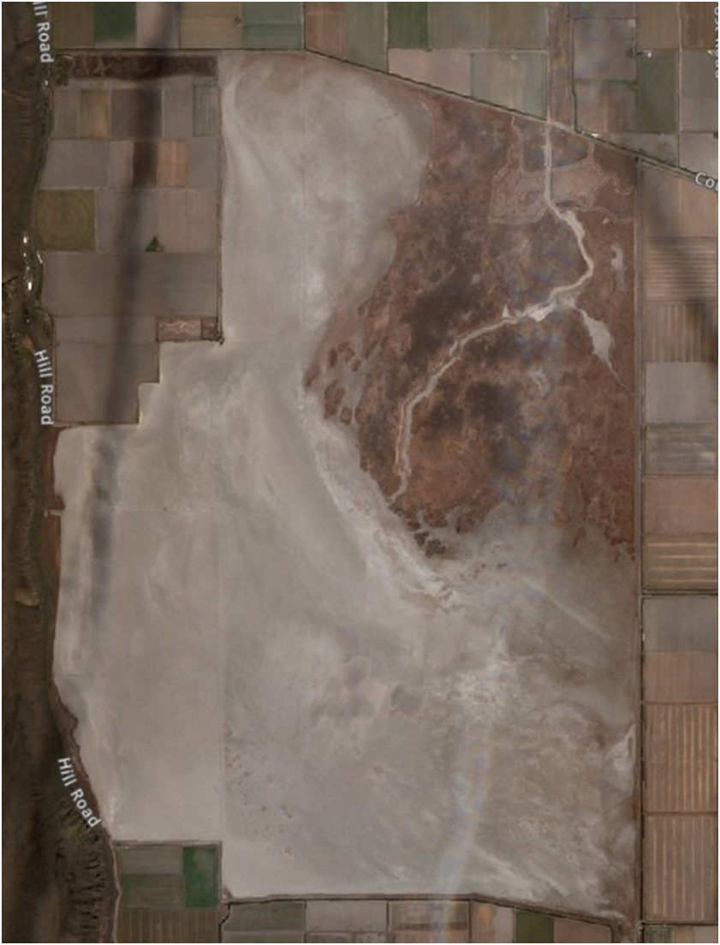
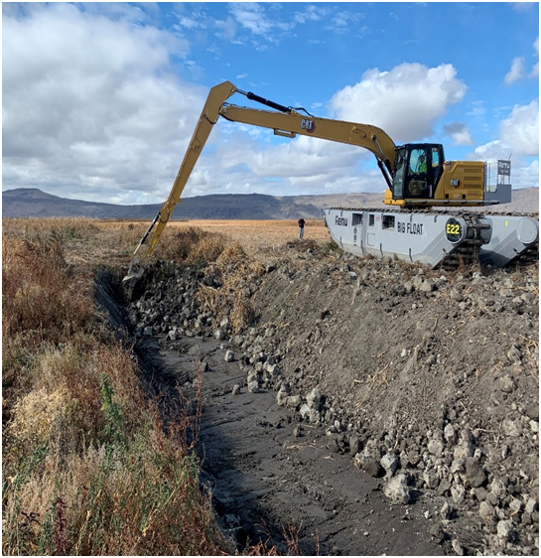
Your Input Matters
We Implement Your Ideas and Address Concerns
We addressed the stripped leave grain issue and adjusted the program to ensure spacing requests brought up by hunting community
We continue to address field access points and parking areas
We produced new map and regulation product to make rules and boundaries more clear
We have removed spoil piles throughout Sump 1A, widened and deepened the lost river channel through 1A, and are now beginning rehabilitation of smaller channels
We have been rehabilitating levees, fixing ditches and trying to increase the amount of land that can be managed when it has water
We are installing new pumps to more efficiently manage the limited water we receive.

Slide 12
General Complaints From This Year
WATER
There wasn’t any
We did not flood
Why was flooding occurring on the Oregon side while no water was being delivered to the California side (LK and TL)
Grain Leave Program
There was too much standing grain this year – Birds won't use it and people can’t effectively hunt it
Disturbance
General public driving in restricted areas disrupting hunts
This was especially problematic for pheasant hunters
People not obeying road closures, or those roads were not adequately posted as closed
Not enough signage or inconsistent signage
Afternoon scouting pushing birds out of feeding areas
Behavior
High shooting
Racing for hunting spots
Accessing closed zones, shooting in closed zones
Refuge Decisions
Sump 1B closure
Hunt Program decisions
All of these concerns will be addressed
in this report

Slide 13
In General, 2021/2022
No water meant no habitat for birds.
This affected birds, refuge visitors, and everyone that enjoys these refuges in the fall and winter and will have a big impact on our agricultural partners and recovery strategies for endemic sucker species.
Water delivery was worse than predicted
Despite poor water, Refuge staff and CWA banded over 4,000 birds early in the summer
Band returns have come back from 7 different states and Mexico this fall with most birds being harvested in the Central Valley
Botulism was for the most part absent across the Refuge Complex.
The collaborative efforts of local agricultural producers to move well water into 1B and facilitate the emergency delivery of water in late August contributed to preventing conditions that may have initiated an outbreak
Poor water delivery reduced habitat availability and resulted in the lowest fall/winter waterfowl populations in recorded history (illustrated in following water availability slides)
The 2021/2022 fall habitat conditions, waterfowl populations and recreational opportunities were horrible
Numerous stakeholders have come together to help find solutions for the water challenges of the refuges including the Klamath Tribes, state wildlife agencies, conservation NGO’s, the agricultural community, media, hunters, birders, photographers, and more.

Slide 14
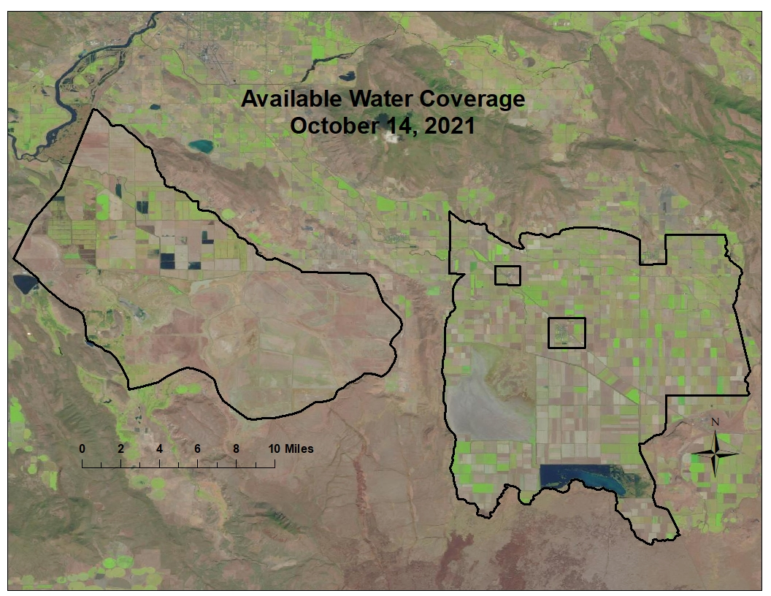

Slide 15
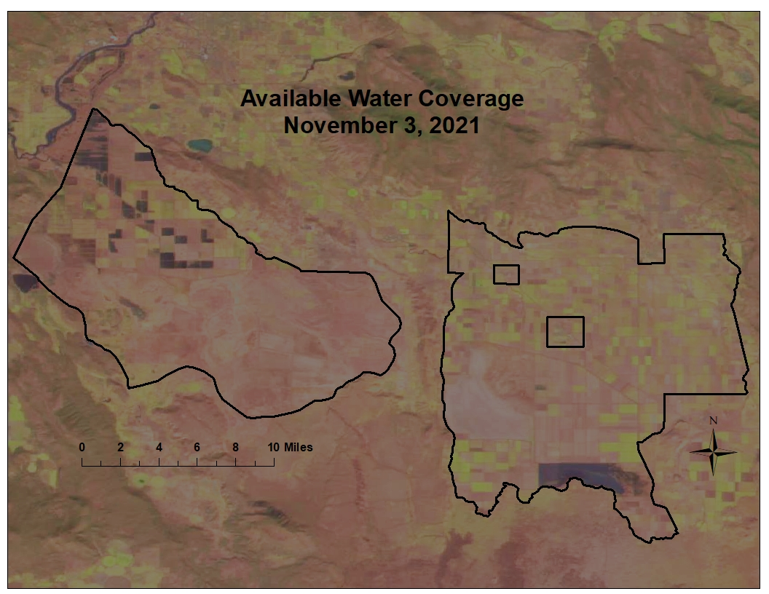

Slide 16
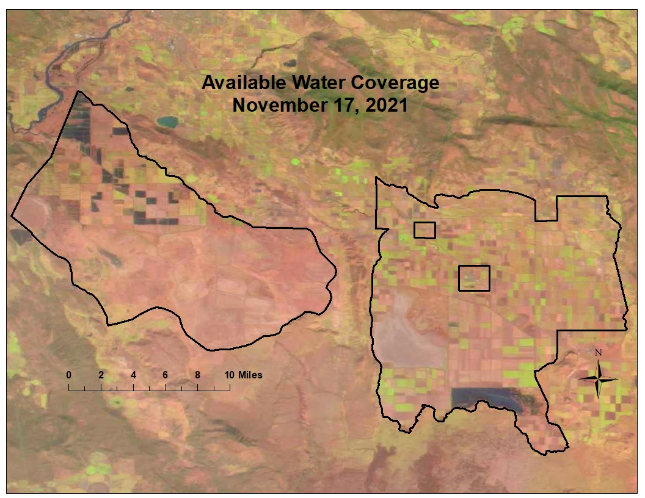

Slide 17
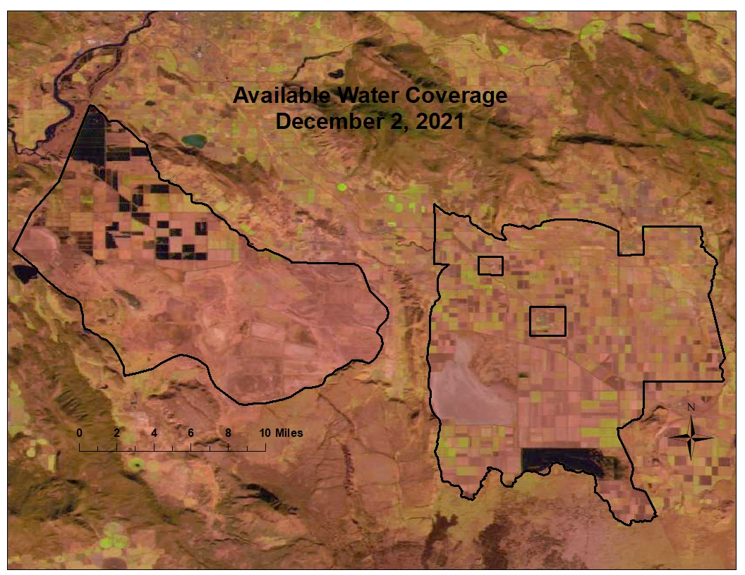

Slide 18
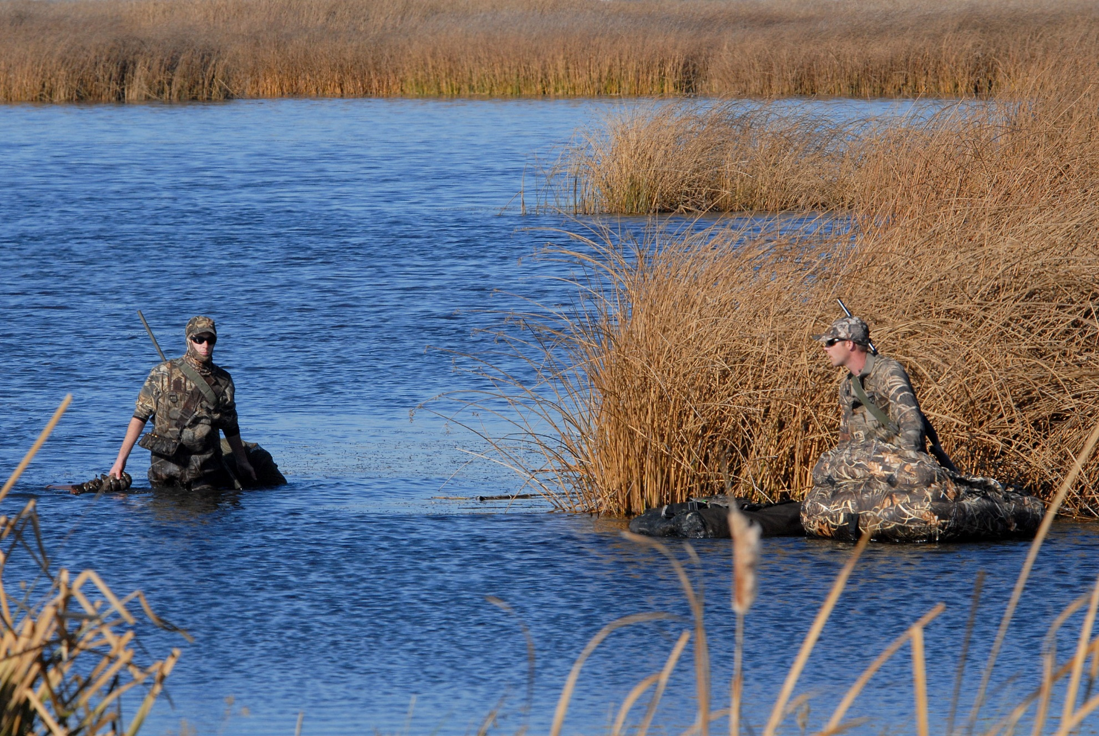
Lower Klamath NWR
Water Report
Fall Waterfowl Population
2022/2023 Outlook

Slide 19
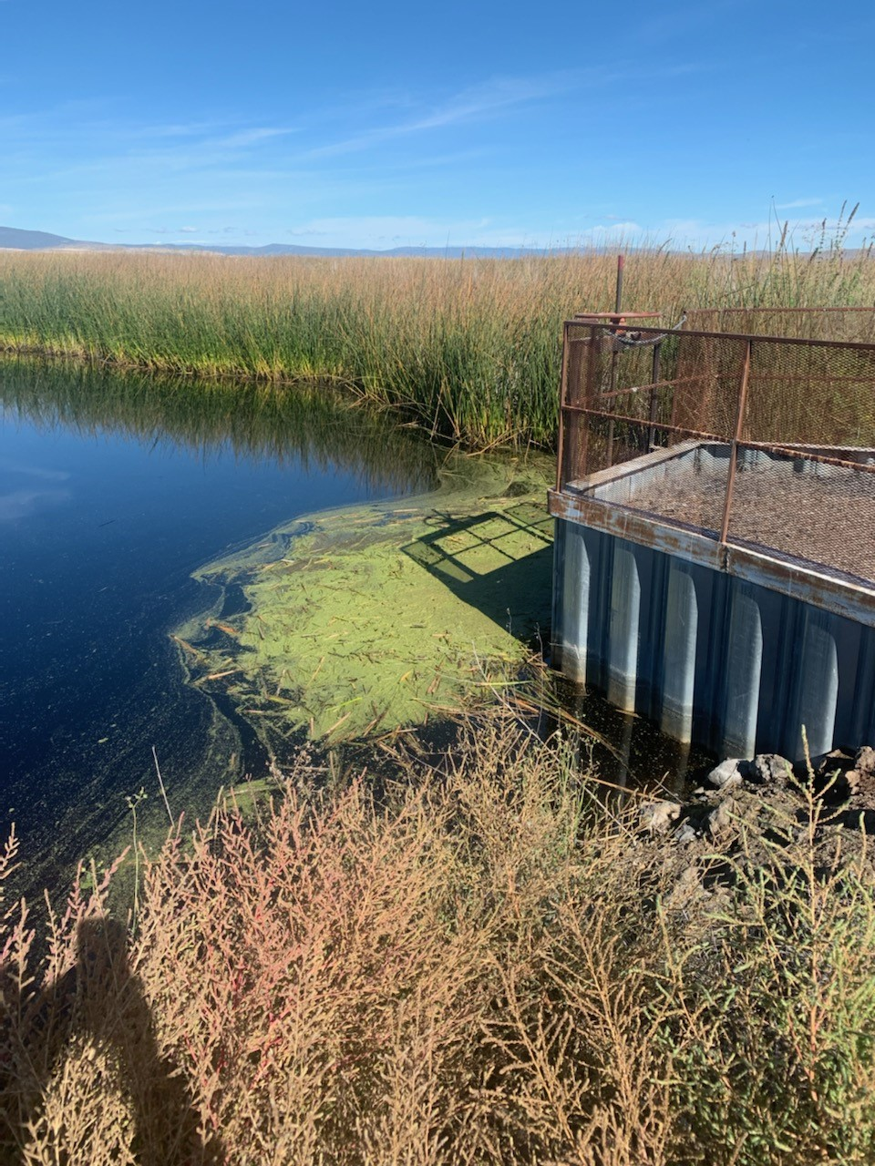
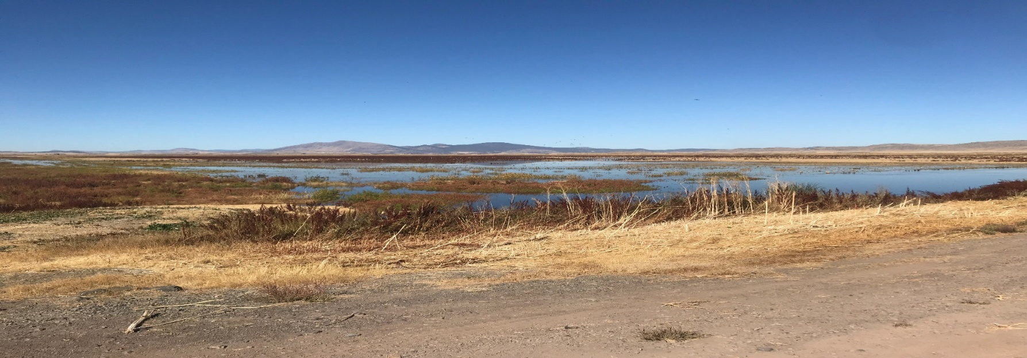
Lower Klamath NWR Fall 2020 Water Delivery
LKNWR effectively received no water during the summer and fall of 2021
Unit 2 was reduced to roughly 100 acres
The limited water the refuge did receive was not enough to maintain Unit 2 through most of the summer and fall
CWA worked to acquire water transfer from upper wood river basin
ADY deliveries via CWA transferred water were ~ 600 AF
The refuge received no fall deliveries so no additional wetland habitat could be flooded
D-Plant deliveries were zero
Acres Flooded going into fall was around 200
Independent pumping of drains by agricultural producers did result in flooding of numerous fields in the Straits Units and this helped support a small numbers of birds throughout the migration period however estimates of total flooded acres are not available

Slide 20
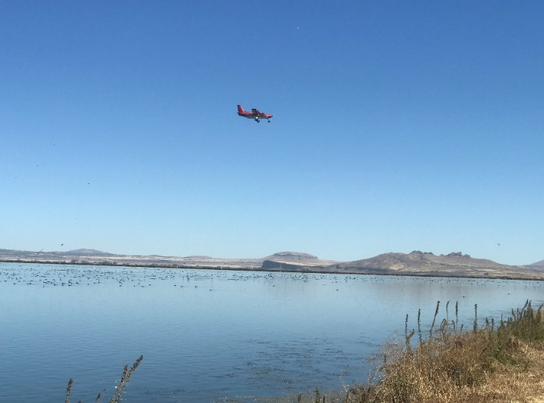
Fall Population
Four aerial surveys were flown fall 2021, inclement weather prevented late winter surveys but we believe the peak of migration was captured
Peak fall duck population was 34,294 on Oct 14, 2021 (8% higher than 2019).
Average duck population over the fall migration was 24,265.
Peak fall goose population was 5,134 on Nov 3 and 21, 2021 (41% higher than 2021)
LKNWR is well below the long-term average and population goals established in the North American Waterfowl Management Plan
(Waterfowl populations represent off refuge counts as well, for 2022 the majority of birds were observed off refuge)
*Population estimates only reflect survey days.

Slide 21
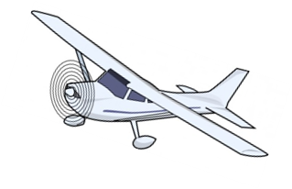
Long Term Peak Fall Duck Counts
Lower Klamath NWR

Slide 22
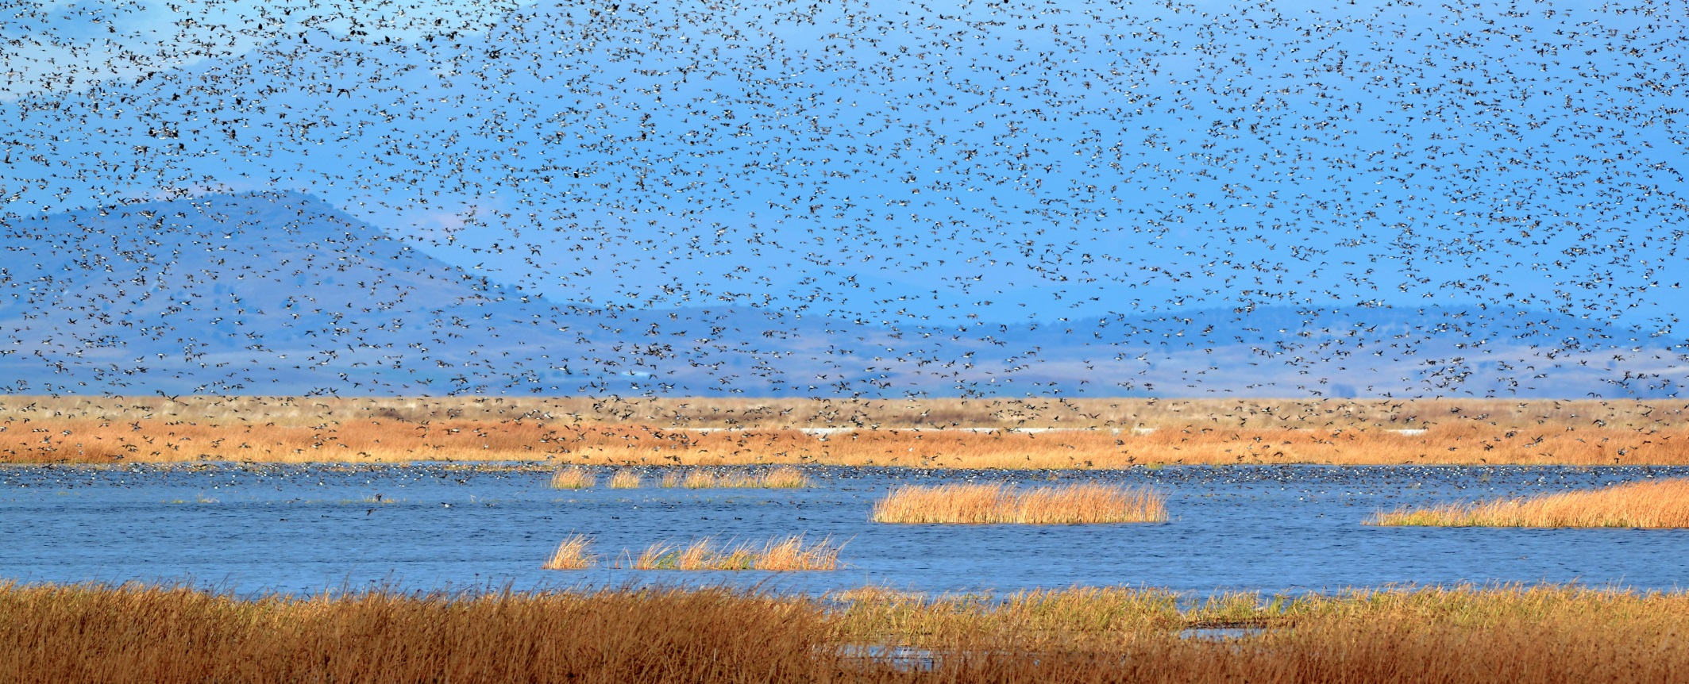
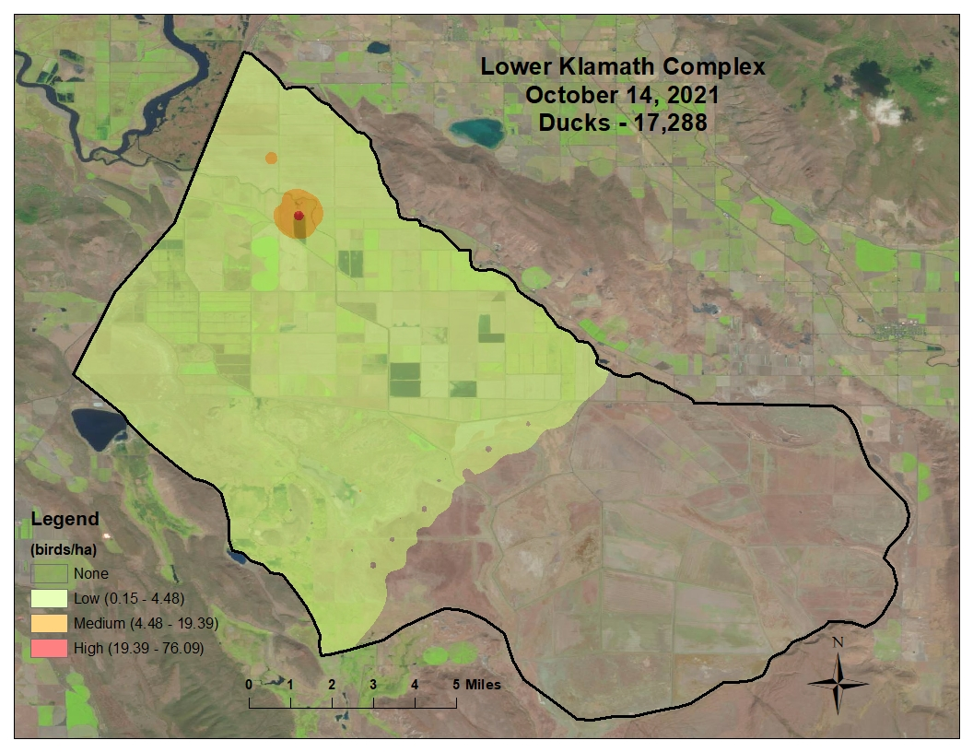
* Population represents ducks counted during flight; actual population estimate is 2X observed number

Slide 23
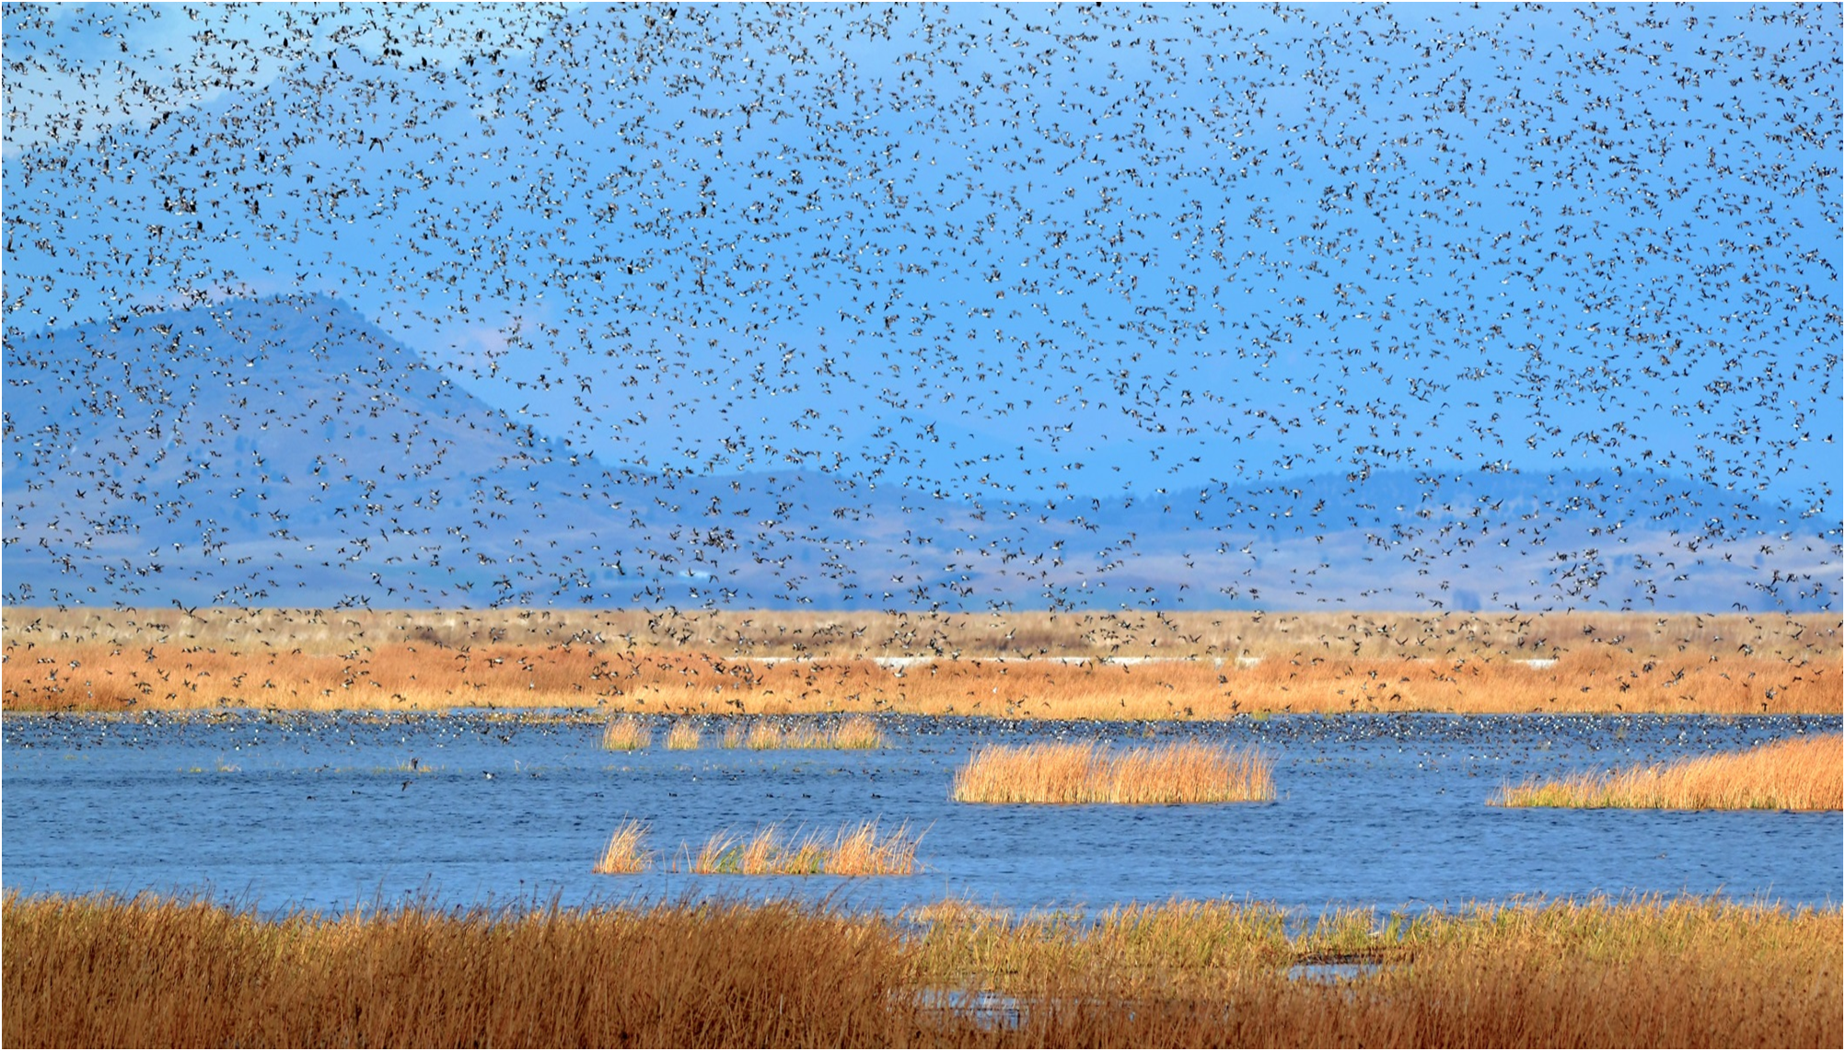
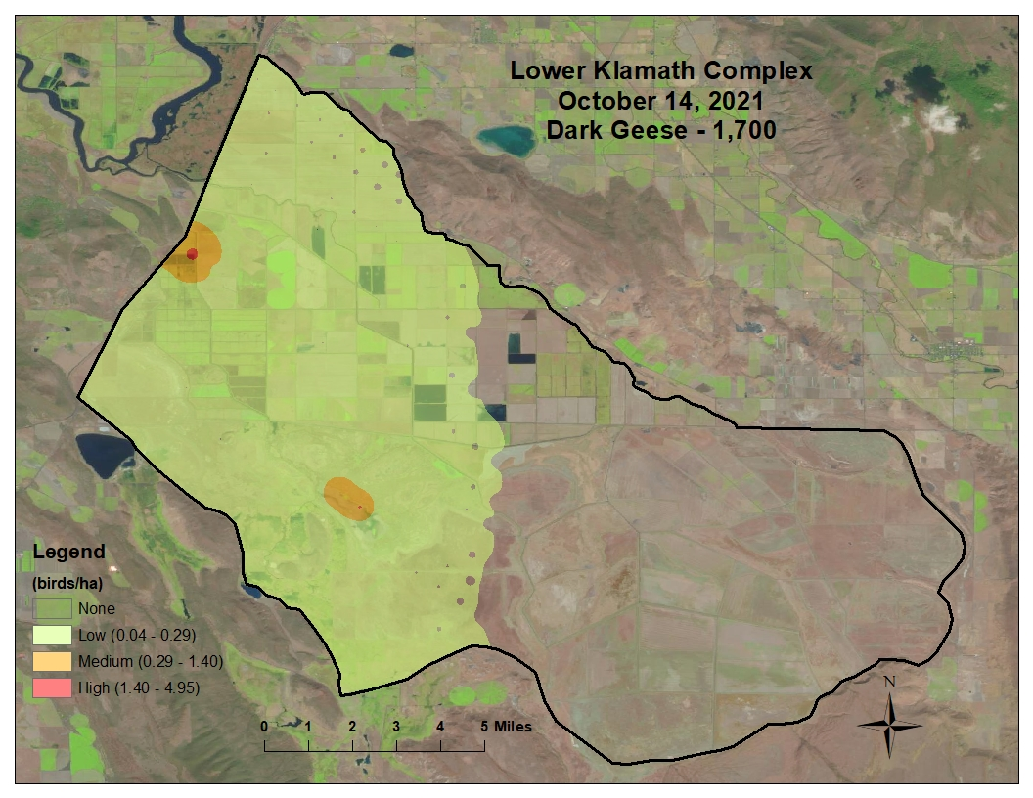

Slide 24
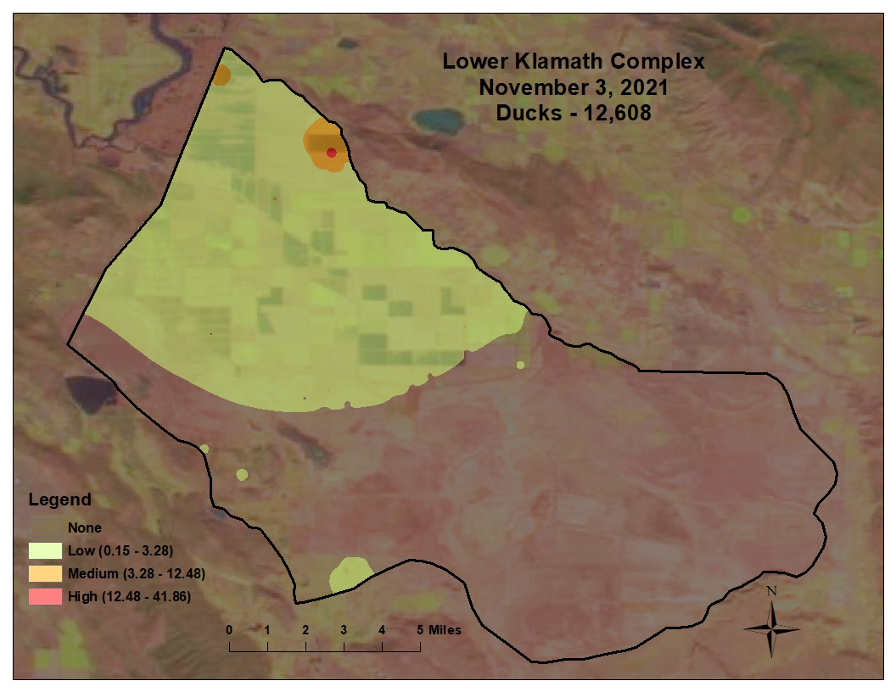
* Population represents ducks counted during flight; actual population estimate is 2X observed number

Slide 25
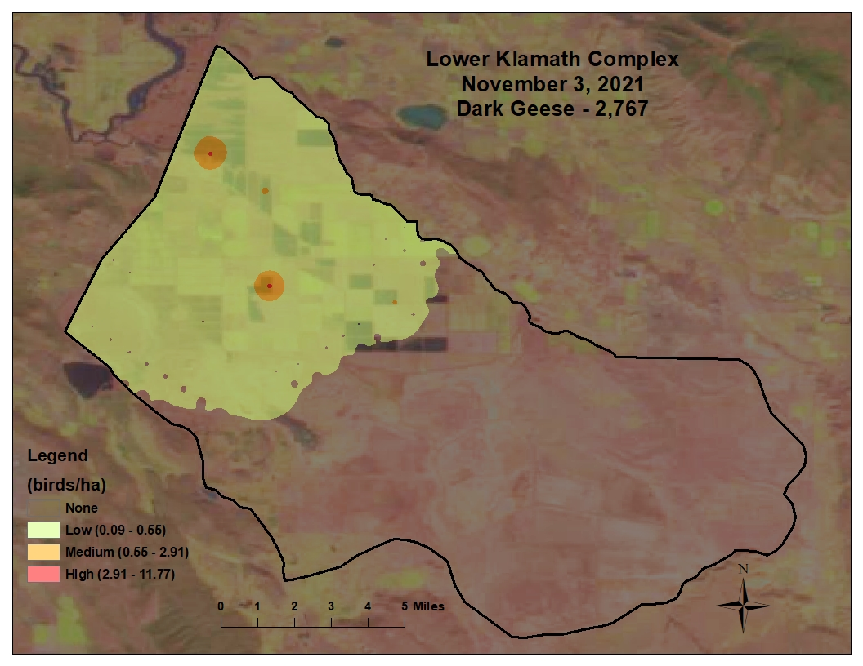

Slide 26
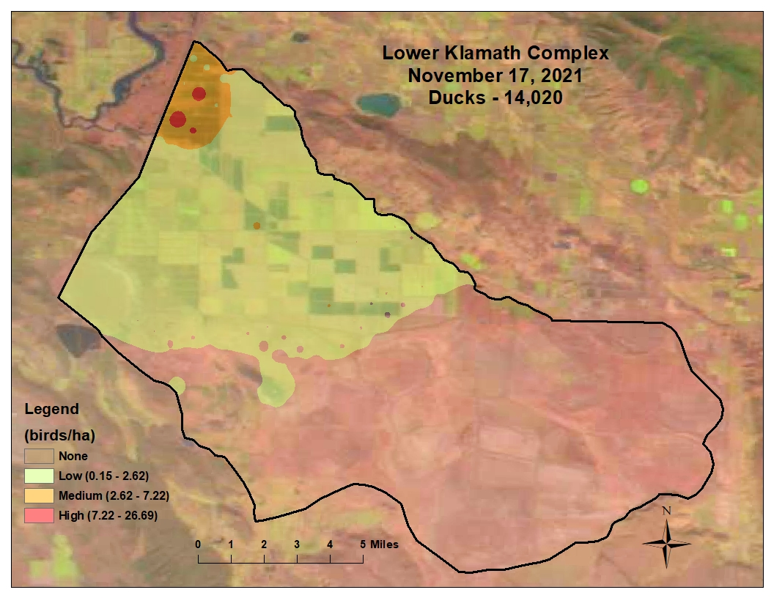
* Population represents ducks counted during flight; actual population estimate is 2X observed number

Slide 27
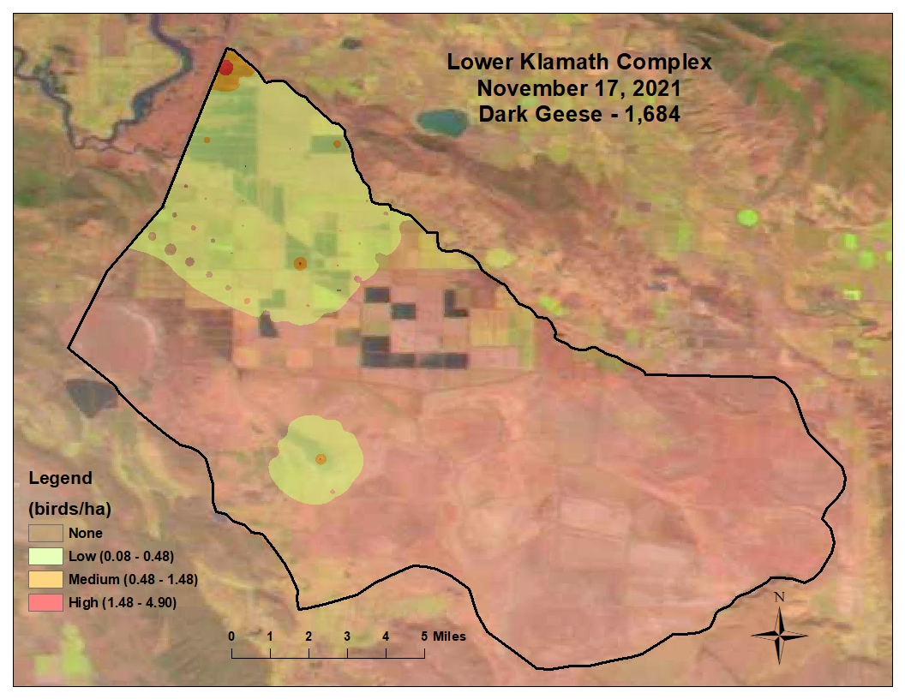

Slide 28
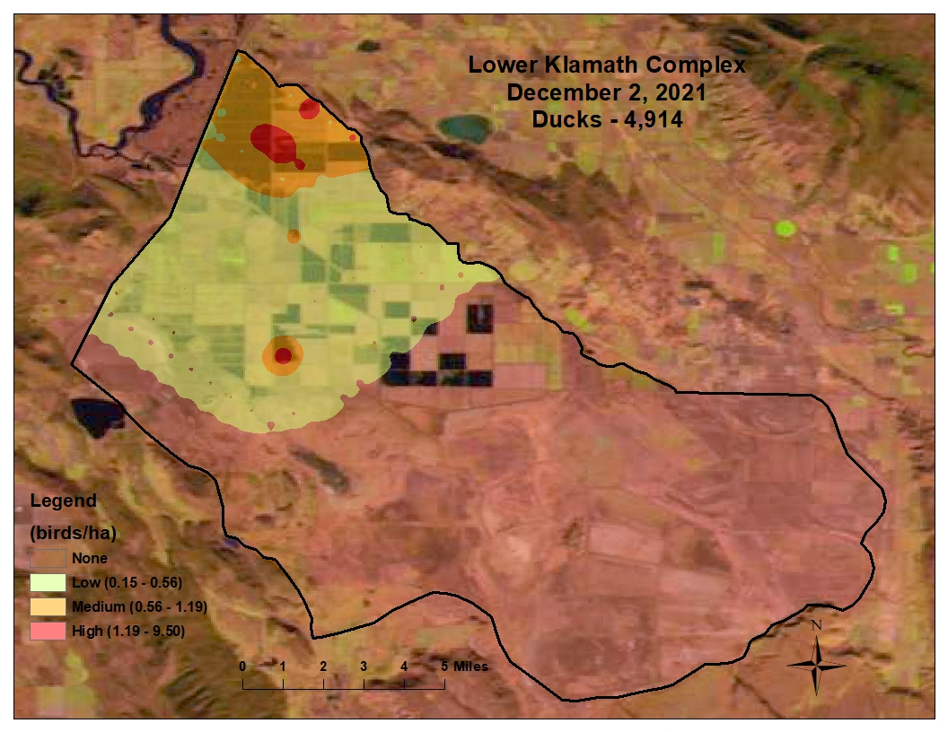
* Population represents ducks counted during flight; actual population estimate is 2X observed number

Slide 29
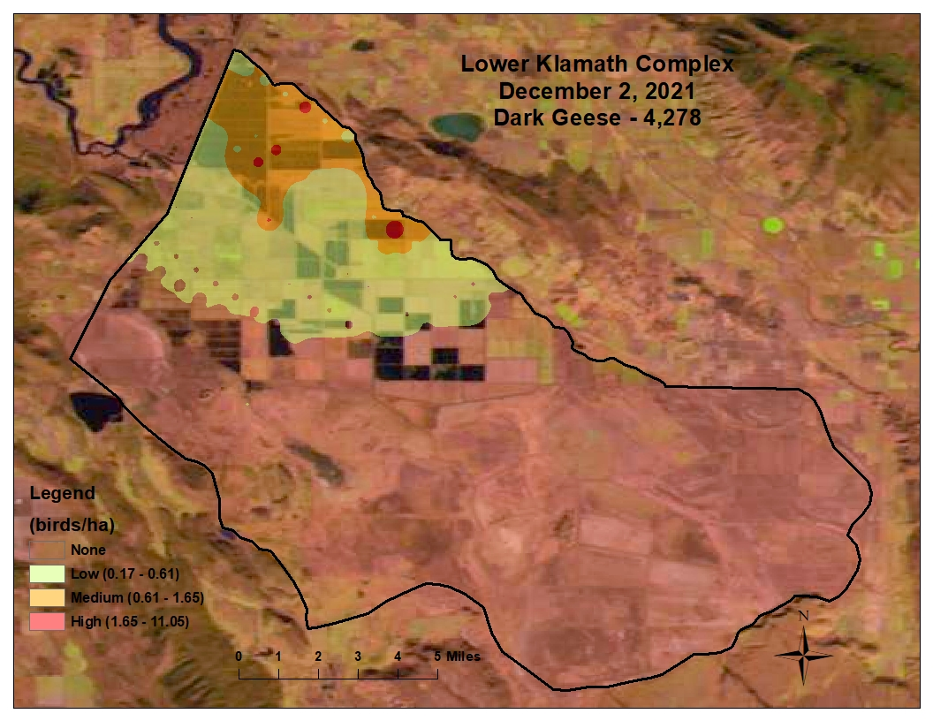

Slide 30
Lower Klamath NWR Summary
Water (timing, amount, duration) continues to be the single biggest issue impacting wetland habitat and waterbird populations at LKNWR.
At the time of this report, LKNWR is expected to receive zero water
Despite frustrations with refuge management decisions, conditions will not improve until better water deliveries are received
If we want to see waterbird populations recover LKNWR needs adequate and reliable summer/fall deliveries to increase the number of permanent wetlands on the refuge
Increases local production (especially mallards which are critical for California and population modelling for the Pacific Flyway)
Increases the visible attraction for migrating waterfowl which results in more staging birds
Provides better sanctuary areas for birds to avoid disturbance
Increases flexibility in water to manage food resources more appropriately
If water deliveries do not improve waterfowl populations are not going to recover. This has and will continue to affect the opportunity and quality of recreational opportunities on LKNWR and surrounding lands

Slide 31
Outlook for 2022/2023 Season
Water availability for the 2022 water year is currently predicted to be worse than 2021.
Wood River water transfer was finalized but water was delivered for only 5 days in 2021.
The refuges transferred water right from Upper Klamath NWR has been terminated.
Only ~700 acre feet of winter water was delivered after December 2022. The bulk of the refuges winter water was used to pay back the emergency transfer of water delivered to Sump 1B earlier in the summer
Under the 2019 Biological Opinion LKNWR is modelled out of all river water deliveries until December
December deliveries can be curtailed if the Central Tendency on the elevation of Upper Klamath Lake is not positive towards the lake filling (as was the case this past year)
USBOR considers the remaining project supply as “Discretionary Water” whether it is or is not used to support refuge water needs is completely up to them
As a result, there is no way to predict if and how much water the refuge will receive through the ADY this fall but at the time of this report there is a strong likelihood LKNWR will receive no water for the fall migration
The refuge was able to pump ~1,390 Acre feet of KDD drain water into unit 2 in March 2022
It is certain there will be no D-Plant water available for LKNWR
As a result of no D-Plant deliveries the refuge will not use wells to start filling White Lake. There is simply not enough supply from the wells to maintain White Lake
Wood River 3,500 acre feet transfer may occur this summer but it is uncertain at this time, this will only provide water to maintain unit 2 through the summer
There will be very limited spring farming on the California side of LKNWR

Slide 32
Changes Coming to Lower Klamath
Some rock islands in 6A than have been navigation hazards will be removed
Oregon Straits will remain closed to waterfowl hunting after 1pm
New maps and regulation pamphlets have been developed that comply with new FWS standards.
Digital, mobile friendly maps will be available for download. They will include location services, which show your location and allow for the collection of GPS points directly onto hunt maps. More information will be posted on refuge web page prior to hunt season.

Slide 33
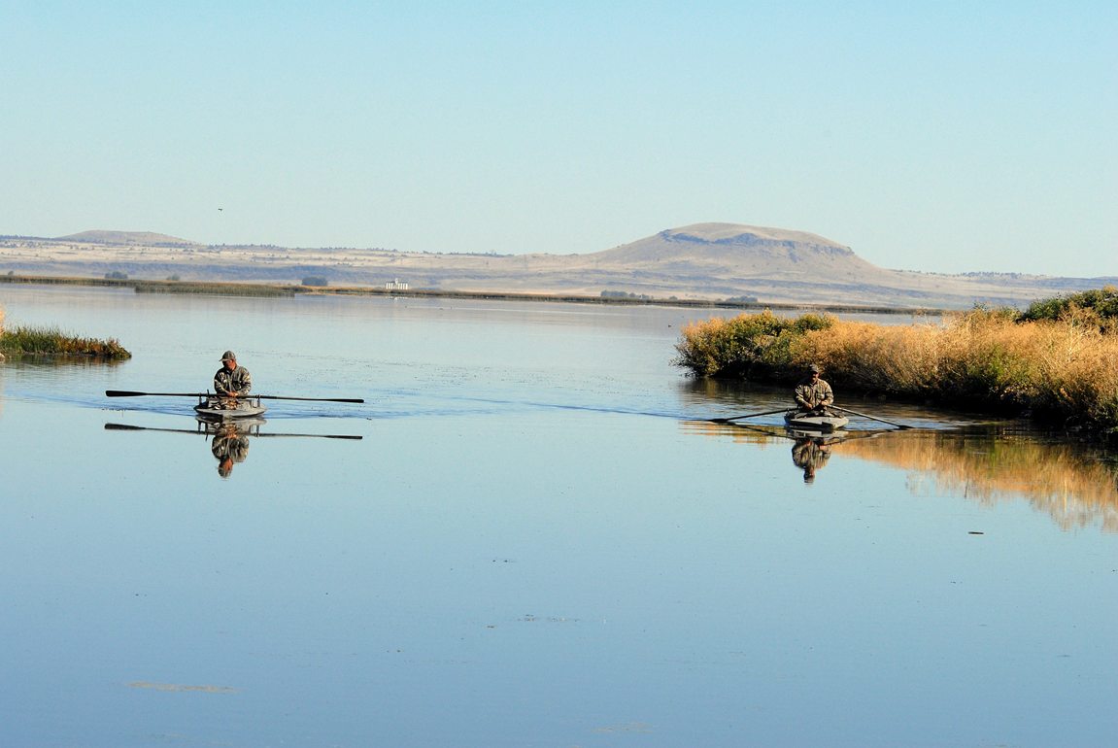
Tule Lake NWR
Water Report
Waterfowl Population
2022/2023 Outlook

Slide 34
Background Context
1964 Kuchel act dictates how much lease ground can be in specific crops
1/3 can be in row crops when conditions allow (the crop and location of those crops is determined by producers)
Water on Lease Lands is controlled by TID and BOR, and the FWS collaborates with both parties on timing and delivery of water
Availability of coop lands for row crop production helps support more flooding throughout the lease lands so integrating row crops into the coop lands increases the availability of early floodable grain
Currently distribution of row crops dictates when and where flooding can occur (when available) – Under normal water availability subbing of row crops is the biggest factor influencing fall flooding on Tule Lake NWR
We expect Tule Lake to go dry for the first time in its history. At this time there is no scheduled delivery of water for the protection of Federally Endangered species, wetlands/waterbirds, or irrigation
Like 2021, drought conditions have forced producers into preventative planting and drought relief programs.
The USFWS cannot support the irrigation of crops in 2022 on federal lands

Slide 35
Fall Population
Four aerial surveys were flown fall 2021, inclement weather prevented late winter surveys but we believe
the peak of migration was captured
Peak fall duck population was 42,002 on Nov 3, 2021 (47% lower than 2020)
Average duck population during the fall migration was 23,609 (63% lower than 2020)
Peak Goose Population was 21,780 on October 14, 2021 (54% higher than 2020)
*Population estimates only reflect survey days.

Slide 36
Long Term Trend of Peak Fall Duck Counts
at Tule Lake NWR

Slide 37
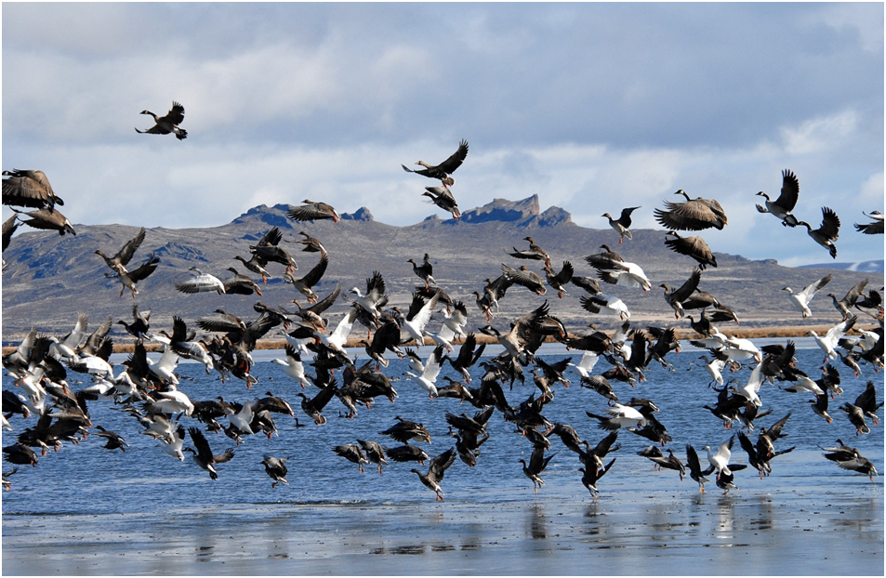
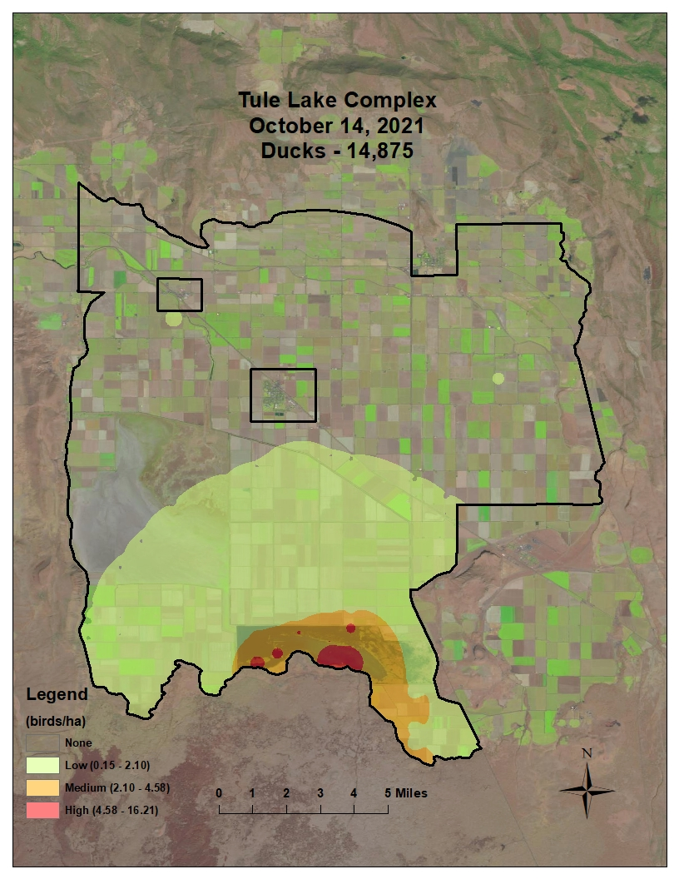
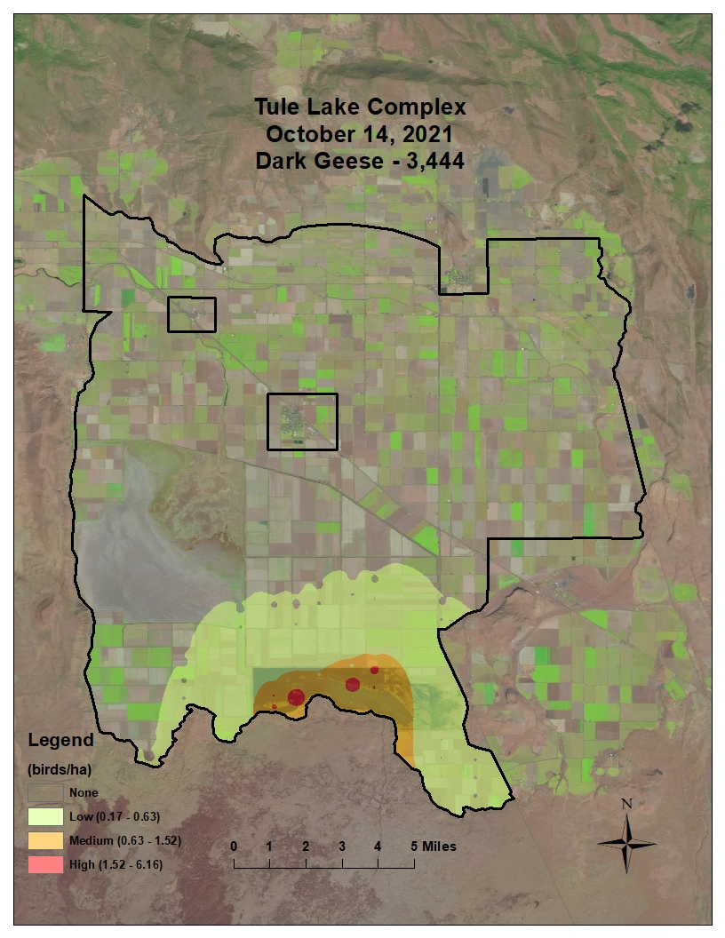
* Population represents ducks counted during flight; actual population estimate is 2X observed number

Slide 38
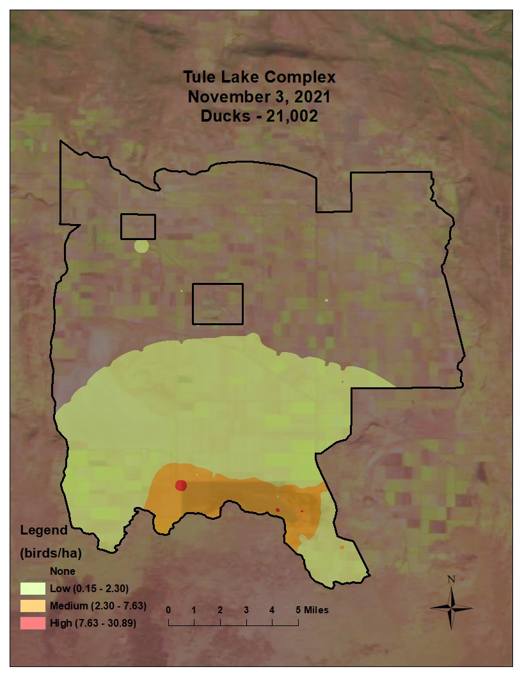
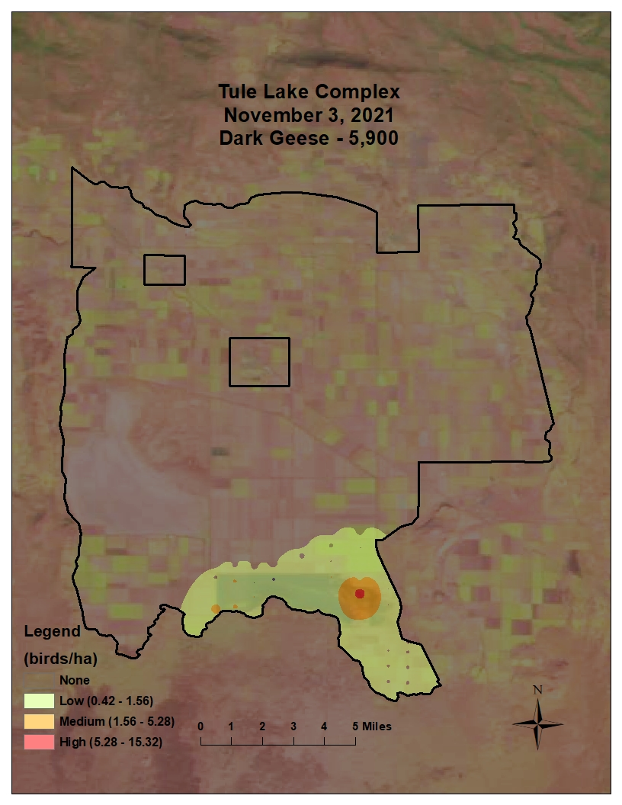
* Population represents ducks counted during flight; actual population estimate is 2X observed number

Slide 39
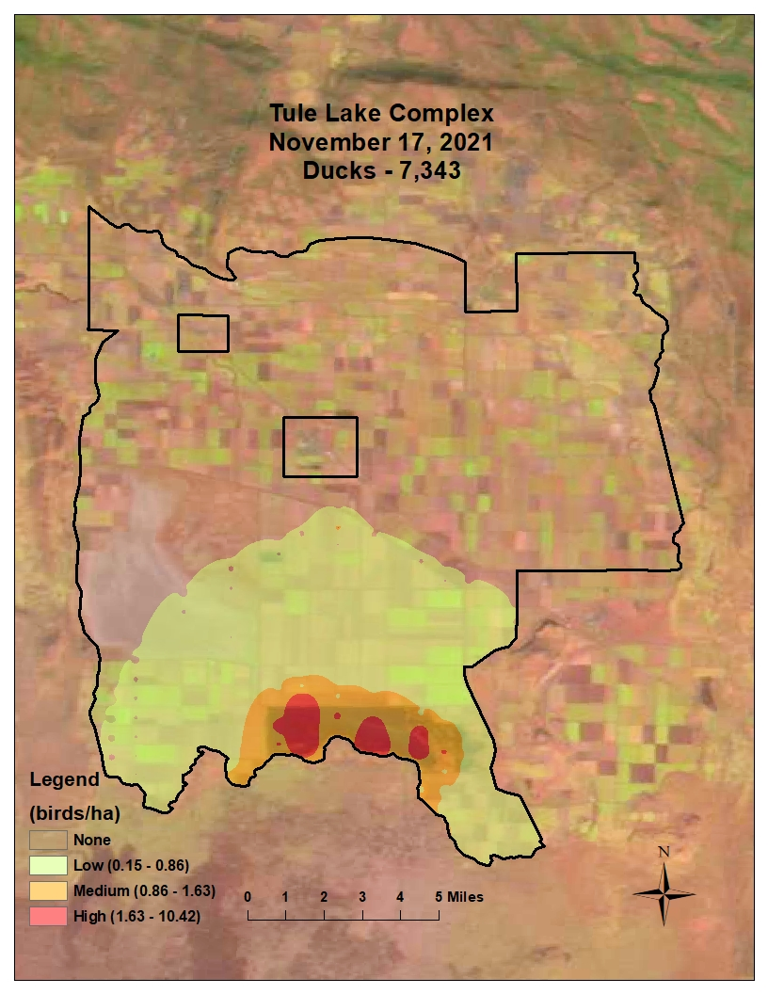
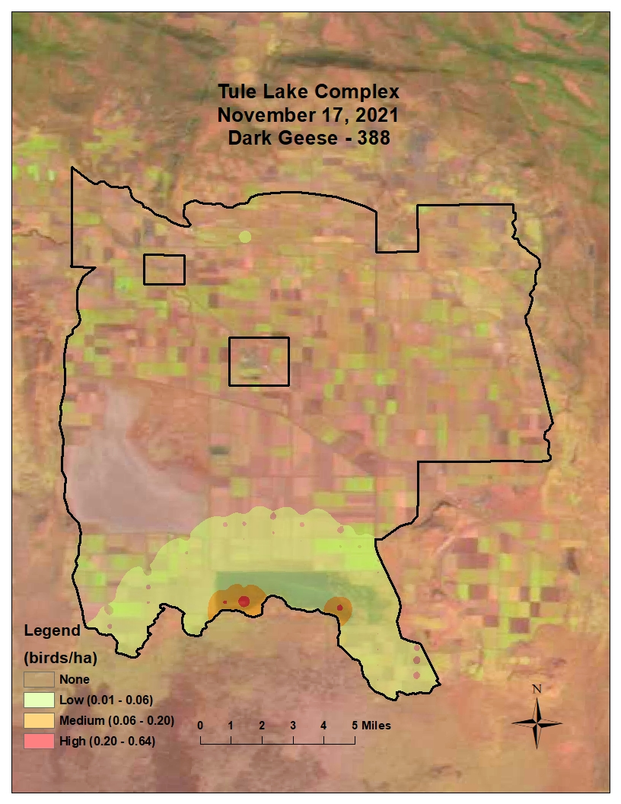
* Population represents ducks counted during flight; actual population estimate is 2X observed number

Slide 40
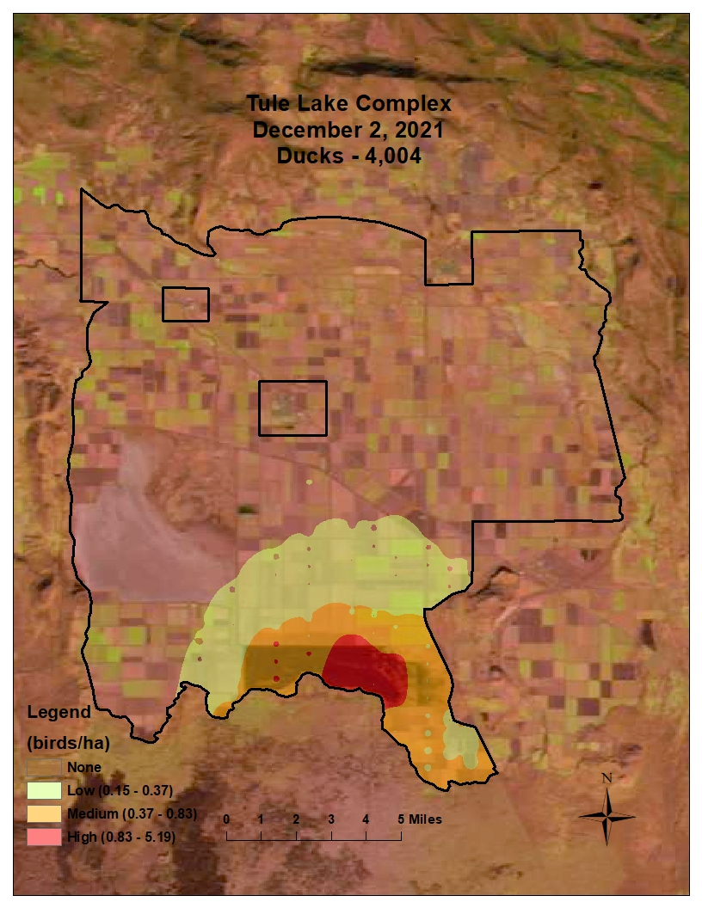
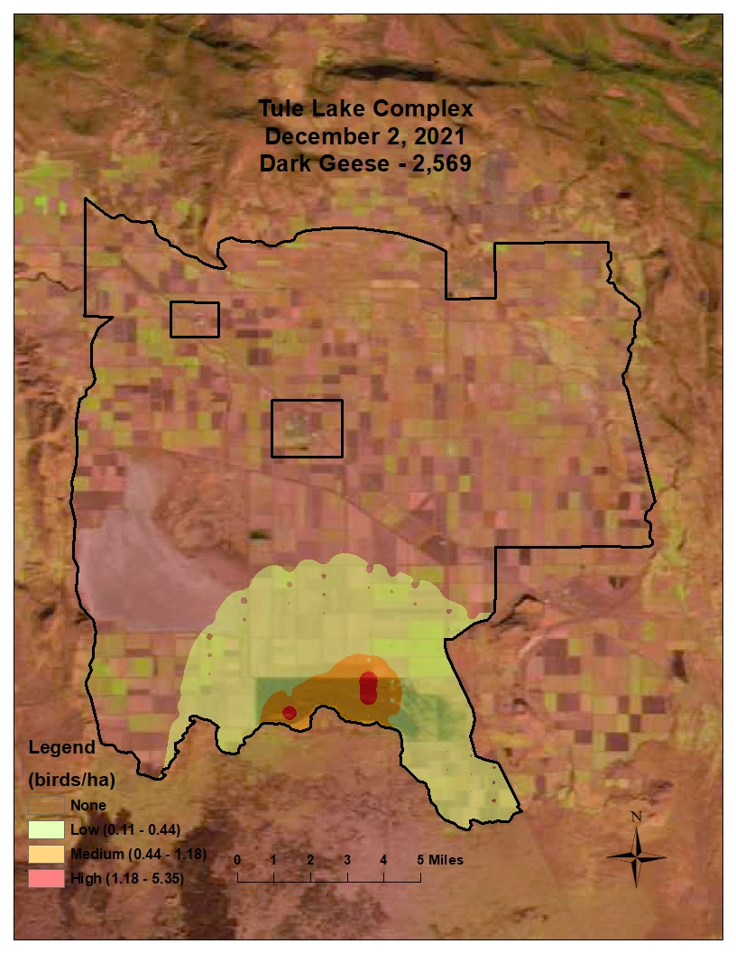
* Population represents ducks counted during flight; actual population estimate is 2X observed number

Slide 41
Growing Issues and Concerns
Both sumps are now experiencing blooms of cyanobacteria, and these have produced dangerous levels of cyanotoxins – This is likely the result of the constant recycling of water and the limited use of D-Plant since the rate increase on electricity and decreased availability of water for needed flushing flows
We have to look back and understand the drivers of the waterbird populations documented in 50’s, 60’s and 70’s to understand impacts of habitat conditions today. Conditions in Sump 1A were key to both the high populations and the long-term decline in waterbird populations.
Each of the sumps are productive for waterbirds for about 10 years after a drying event and then they need to be reset. Historically this happened naturally due to climate driven lake expansions and contractions but under the modern system they are stabilized and rapidly age beyond their productive periods.

Slide 42
Growing Issues and Concerns Cont.
Draw downs on 1B have worked but 1B is 66% smaller than 1A so although it can support a lot of birds the potential in 1A is far greater if wetland conditions could be improved​
Drought, climate change, reduced project allocations, and subsequent reduced return flows resulting from increased irrigation efficiency throughout the Klamath Project are driving the water scarcity for the sumps, walking wetlands, and flooded grain in the fall​
​

Slide 43
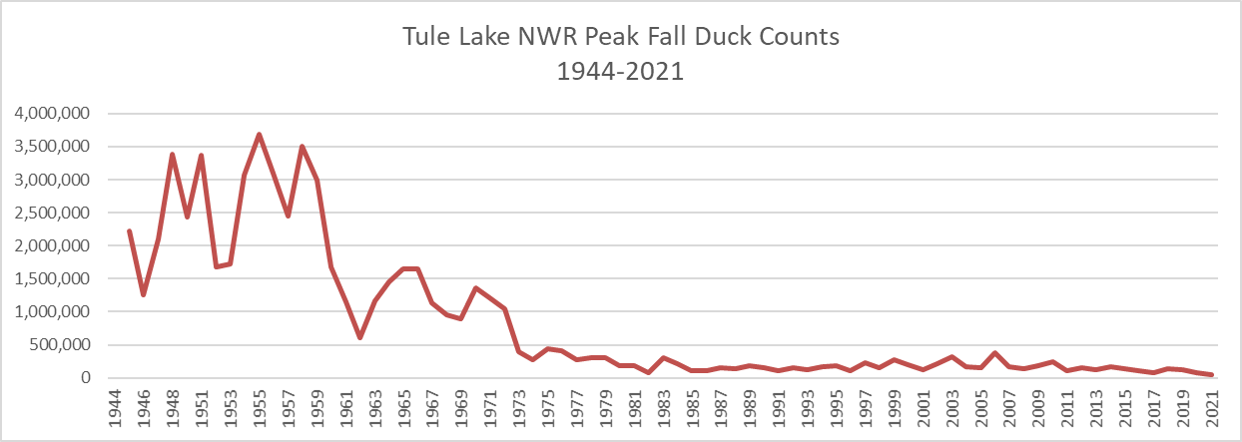
Sumps Stabilized
Declining wetland productivity due to stabilized wetlands
Walking wetlands and Sump 1B drawdowns
Limited or no delivery of water

Slide 44
TLNWR 2021/2022 Summary
Bird numbers continue to decline at Tule Lake NWR
No water availability
No flooded grain
Disturbance is becoming less of an issue due to low visitation
Sump 1A drawdown was successful but we have growing concerns now related to soil health, subsidence, and spread of invasive species and woody encroachment due to the prolonged drought conditions
Visitation was down significantly

Slide 45
Outlook 2022/2023 Season
We expect Tule Lake to go dry for the first time in its history as no water will be made available to support 1B during the summer or to refill either 1A or 1B in the fall to provide habitat for migratory waterbirds
At this time, the refuge does not know how much ground will be planted in cereal grain
The preventative planting program will likely have high participation this year resulting in many lots with standing grain, however, drought and no irrigation will likely effect stand condition and grain production
There will be no water available to move through D-Plant to LKNWR
It is likely there will be no flooding of grain in the fall
Recreation opportunities and quality of experience are expected to sharply decline this fall/winter

Slide 46
Changes To The 2022 Hunt Season
The 2022 hunt season will be influenced by water availability
Water availability is uncertain at this time and management will adjust to the changing conditions. For the most updated information see the Hunter Hotline on our web site.
If conditions do not greatly improve, hunting will only be allowed in field units and daily lottery will again be cancelled.
All interior levees in the spaced blind and free roam areas will be closed to all motorized vehicle traffic to reduce the risk of damage to levee infrastructure and disturbance to both resting birds and hunters
New hunt maps and regulation pamphlets have been developed that comply with new FWS standards. They will be distributed prior to hunt season
Digital mobile friendly versions of the maps will be available for download. They will include location services, which show your location and allow for the collection of GPS points directly onto hunt maps

Slide 47
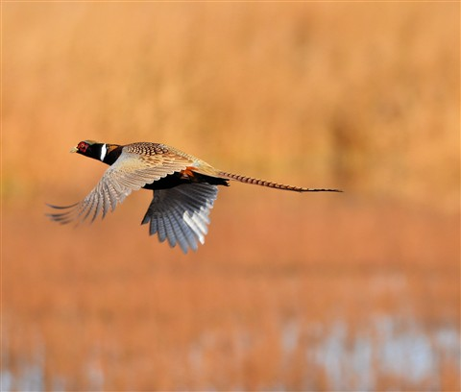
Pheasant Hunting
Pheasant harvest numbers on Lower Klamath and Tule Lake NWR were lower in 2021 than in previous years
Lower Klamath saw a slightly better harvest than did Tule Lake
in 2021, likely due to new hunt boundaries and limited
grain production
Pheasant populations and Nesting success on both Refuges
are expected to continue their decline in 2022 due to drought
Photo Credit - https://www.dpreview.com/galleries

Slide 48
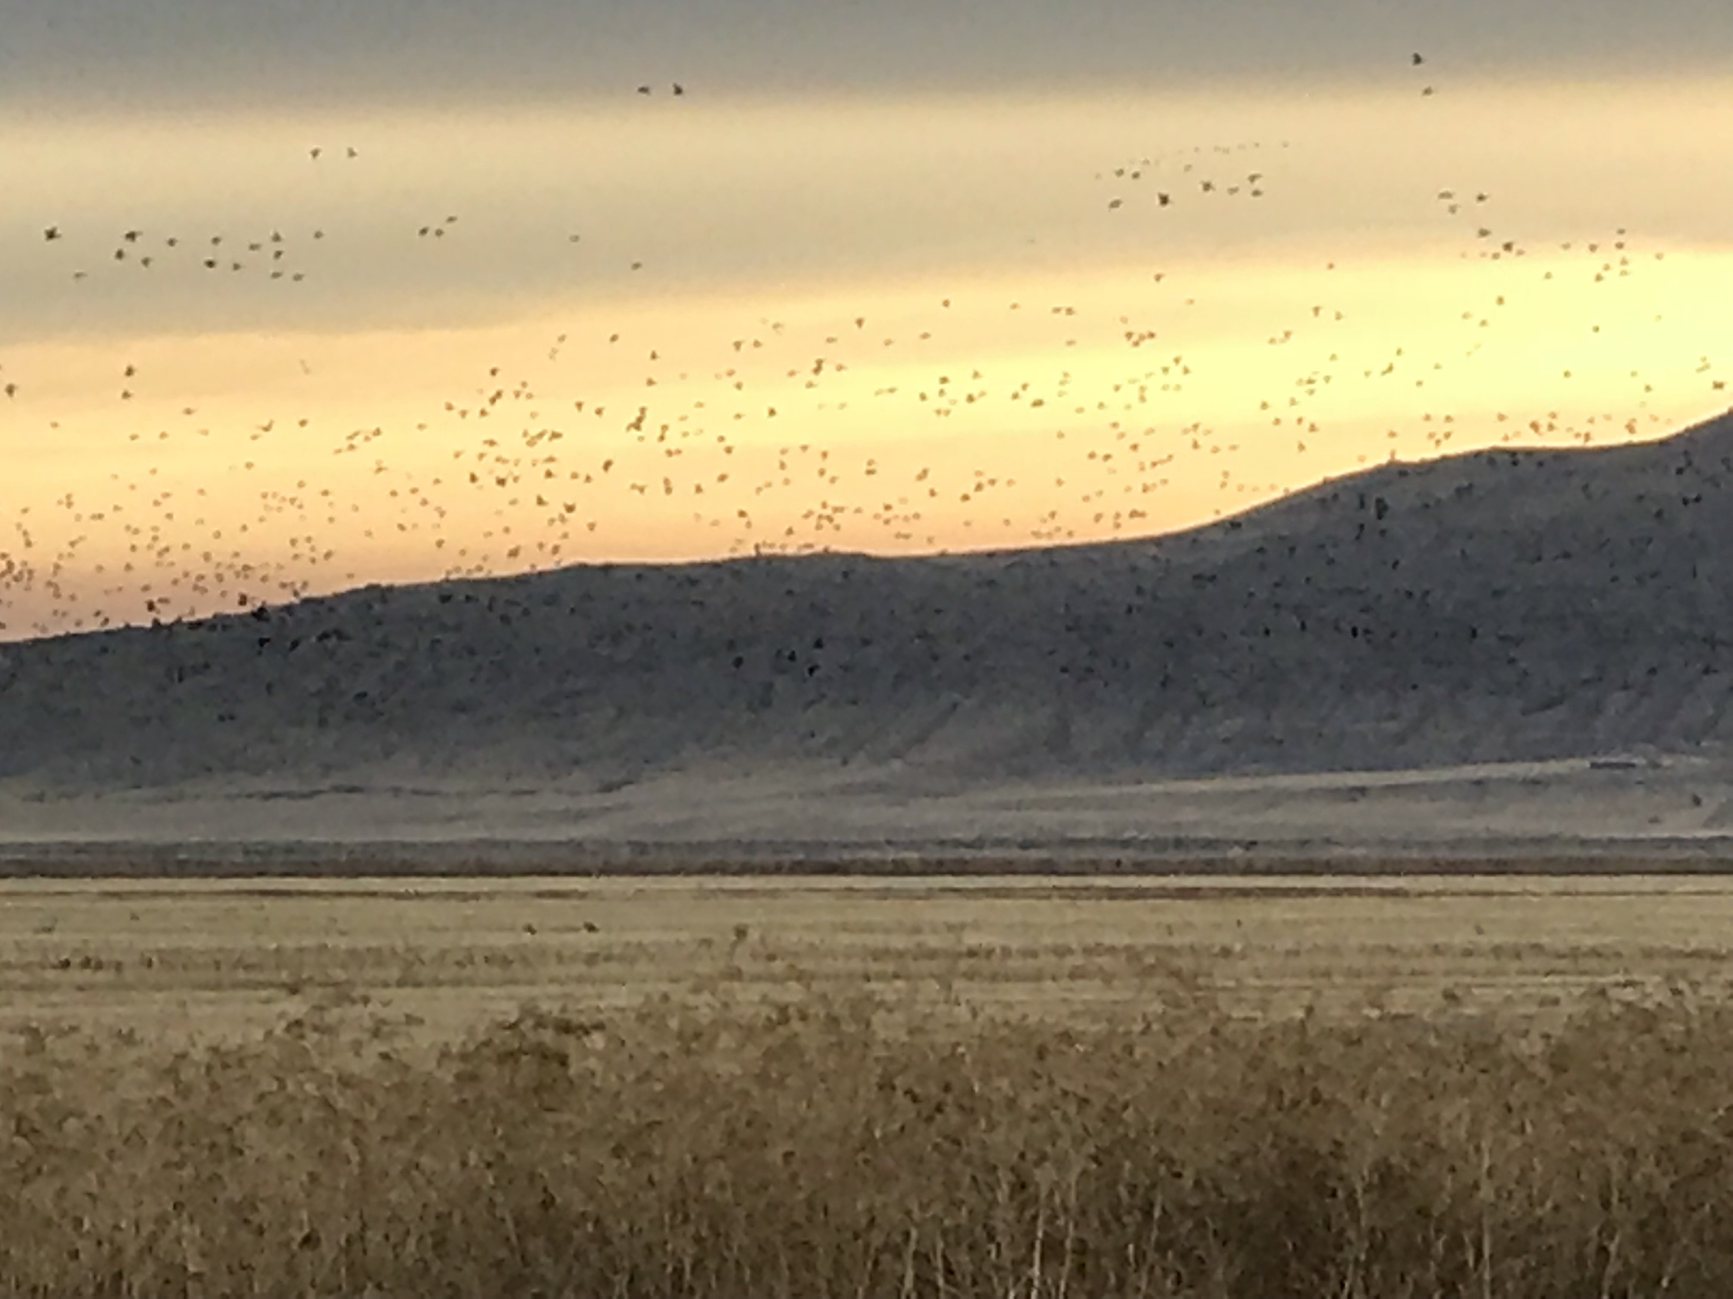
The Most Common Issues Reported during the Hunt season
Unrestricted driving in hunt areas
Increased disturbance from scouting
Standing grain obstructing hunting
Sump 1B closure
Sump 1A not being flooded

Slide 49
Access to Roads And Fields
Unless posted or otherwise identified on a map, all roads are closed. Do not assume that a road is open because there is no sign
When you are finished hunting others may not. Please be considerate while entering and exiting fields and wetlands
To address these concerns, access points will change this year

Slide 50
Increased Disturbance from Scouting
The likelihood of disturbance increases as habitat availability decreases
Scouting can disturb feeding and loafing birds. Disturb them and they will leave
Stay off interior roads and levees, scout from a distance and stay in your vehicle
Calm relaxed birds will make for a better hunting experience, the next day, and over the course of the season

Slide 51
Preventative Plant Standing Grain
Preventative planting is an agricultural practice used to control erosion when land is not in full production
Producers are prohibited from harvesting these fields as part of their agreement with the funding agency
The number of acres enrolled in this program is variable from year to year, however during periods of limited water availability enrollment increases
The Refuge is working with producers to increase open areas prior to seed development to support better access and bird use

Slide 52
New Hunt Projects
The pit blinds at Fry's island have been replanted with native grass cover
We are working to Salvage old boat-in blinds and plan to install them in Sump 1A to provide additional hunting opportunity these Blinds will be available on a first-come first-serve basis similar to the Lower Klamath pit blinds.

Slide 53
Please Contact us with Questions
Steven Jensen – Wildlife Refuge Specialist
steven_jensen@fws.gov
458-232-6123 – Cell
530-667-8308 – Office
John Vradenburg – Supervisory Biologist
john_vradenburg@fws.gov
575-517-7733 – Cell
530-667-8305 - Office
(Cell preferred)

