Slide 1
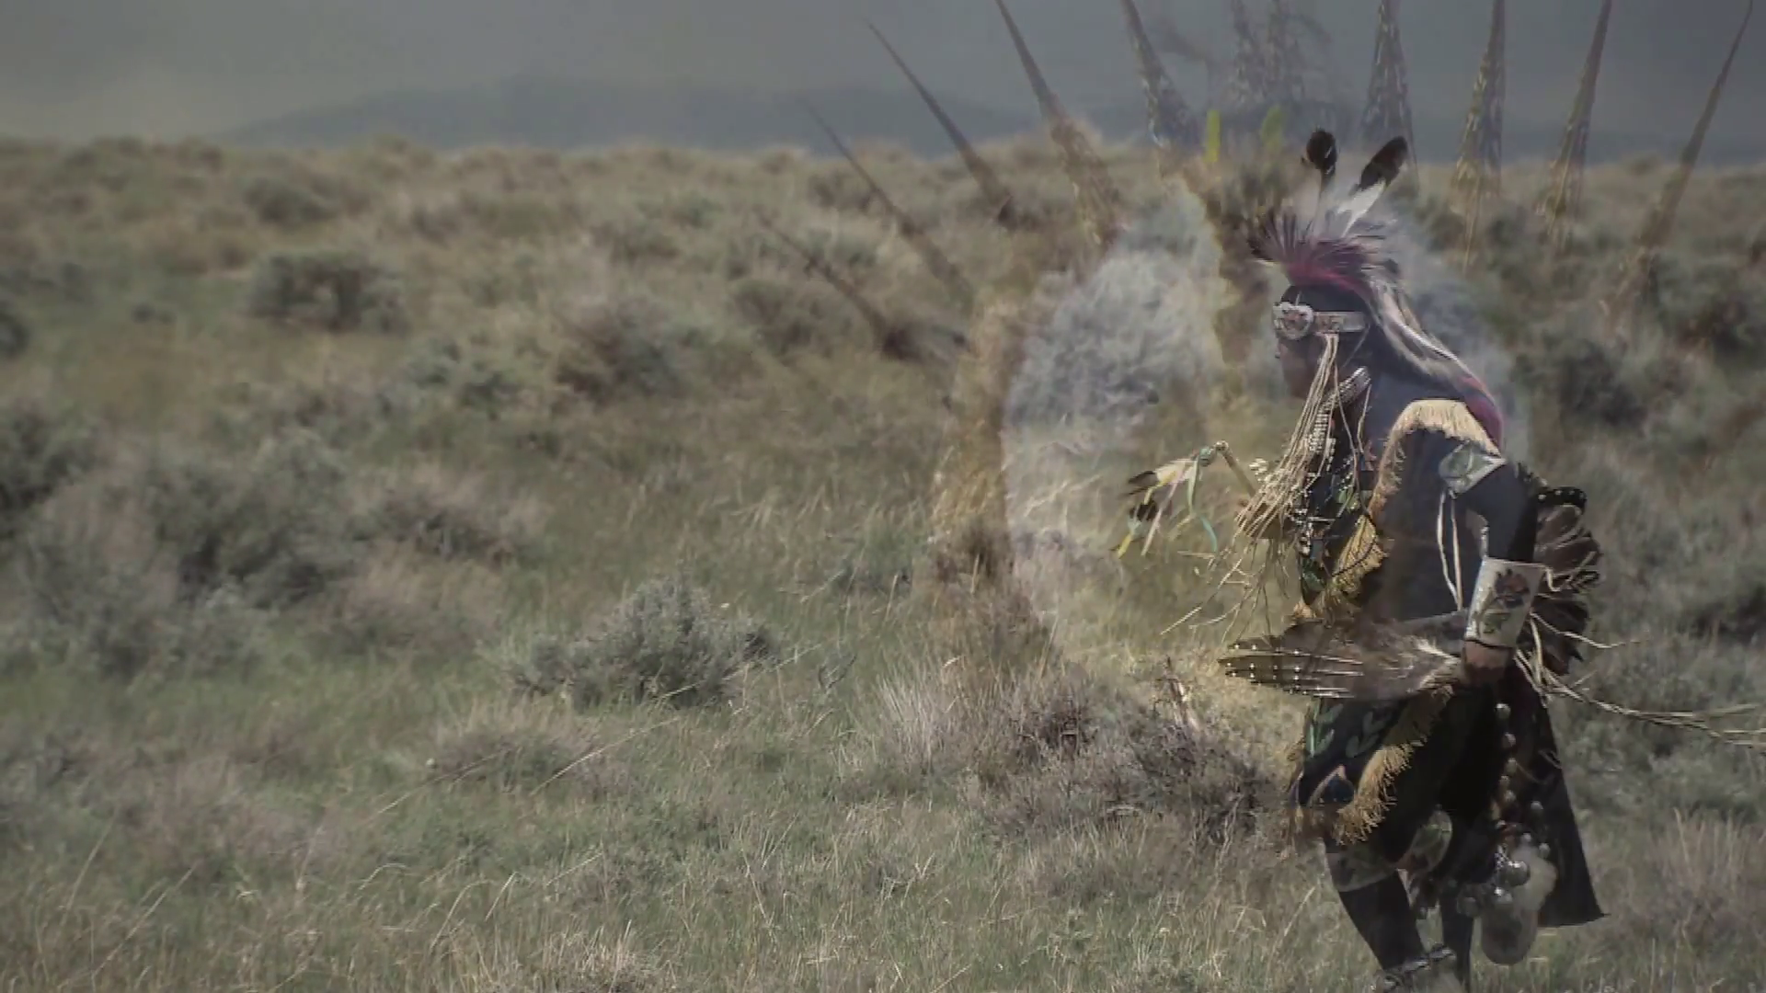
Human Connections to the Sagebrush Sea
Notes:
Presentation prepared for the Sagebrush Ecosystem Curriculum to be used with the lesson plan of the same name found at http://www.fws.gov/greatersagegrouse/education.php.

Slide 2
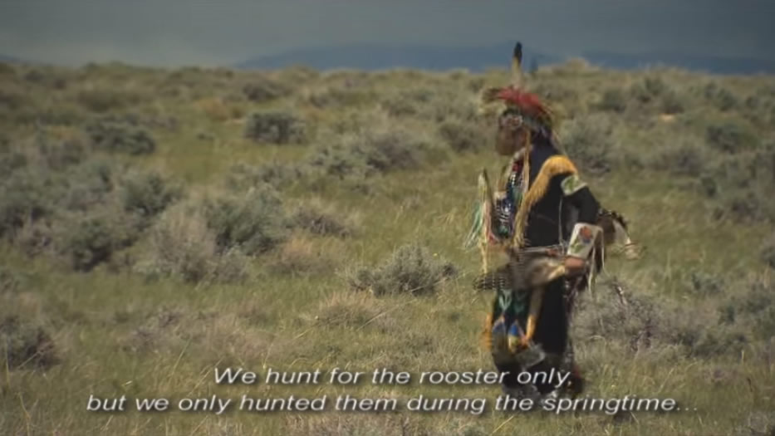
“Chicken Dance” Video From the High Desert Museum Exhibit "Icon of the Sagebrush Sea"
https://youtu.be/be3oqullxMA or http://www.sagegrouseinitiative.com/sagebrush-community/the-people
Notes:
Click the image to play the video on YouTube, or use the link to the Sage-Grouse Initiate website at the bottom and scroll down the page to the video.

Slide 3
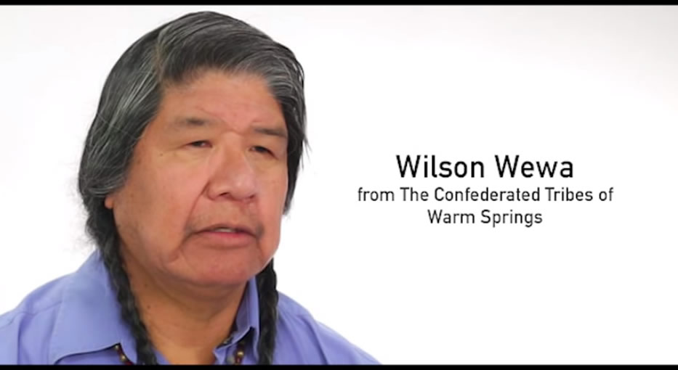
“Sage Grouse Legends of the Wasco and Paiute Tribes” From the High Desert Museum exhibit "Icon of the Sagebrush Sea"
https://youtu.be/ADW6IREJnGY or http://www.sagegrouseinitiative.com/sagebrush-community/the-people
Notes:
Click the image to play the video on YouTube, or use the link to the Sage-Grouse Initiate website at the bottom and scroll down the page to the video.

Slide 4
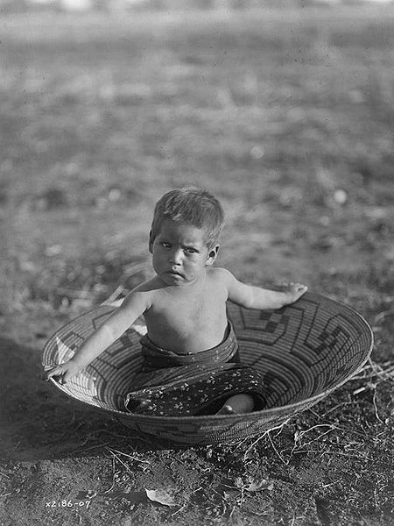
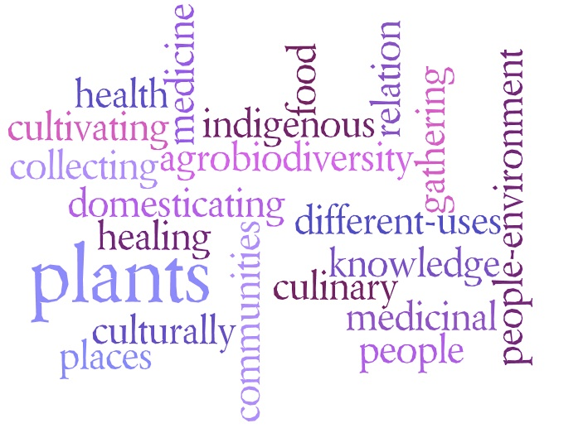
Ethnobotany
Maricopa child in water-tight basket, 1907
Notes:
Human uses of plants
Native Americans used plants for:
Food
Medicine
Household goods
Shelter
Spiritual practices

Slide 5
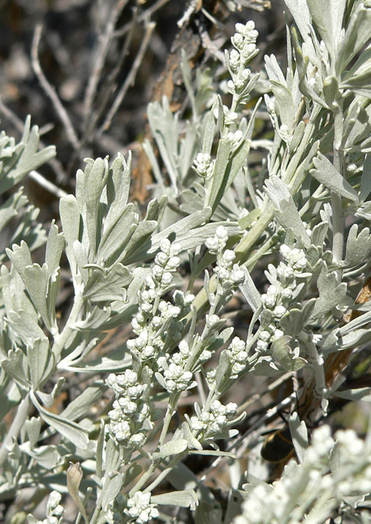
Big Sagebrush
Teas and crushed leaves used to treat:
Wounds/infection
Stomach aches
Sore throat
Headaches
Anti-bacterial, anti-fungal, and antioxidant properties

Slide 6
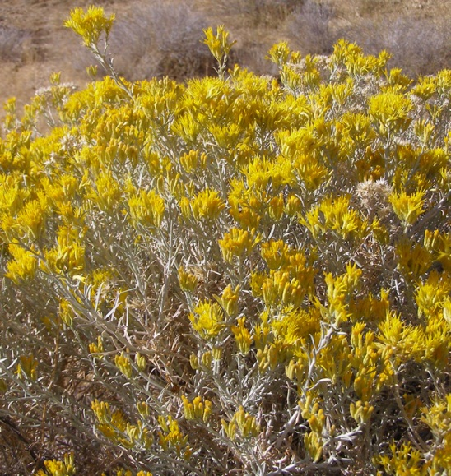
Yellow Rabbitbrush
Similar effects of sagebrush
Teas can treat colds (viruses) and stomach upset

Slide 7
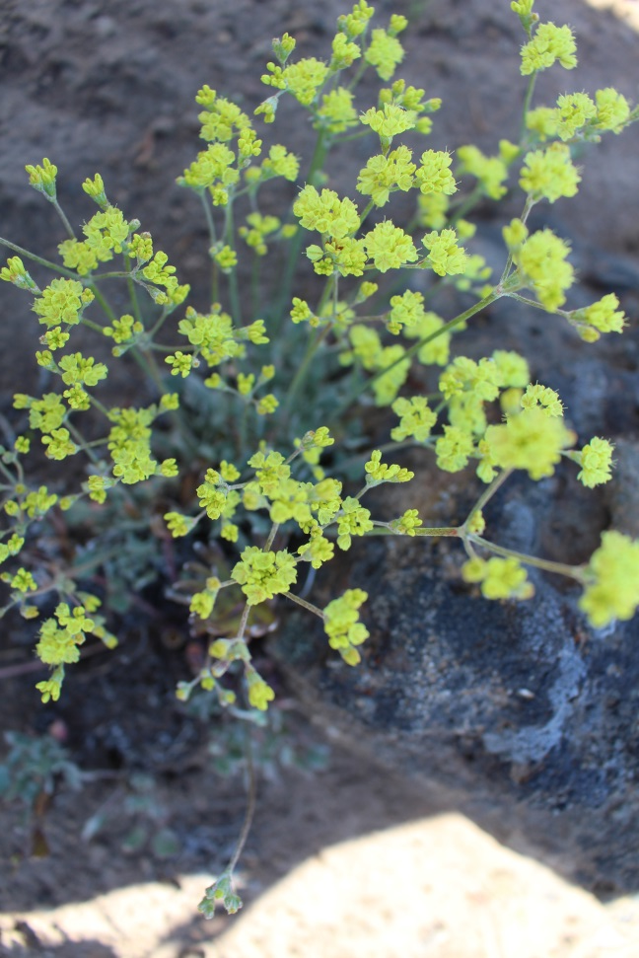
Desert Buckwheat
Strong teas to relieve joint pain and swelling
Eye medicine
Heart aid
Stomach aid

Slide 8
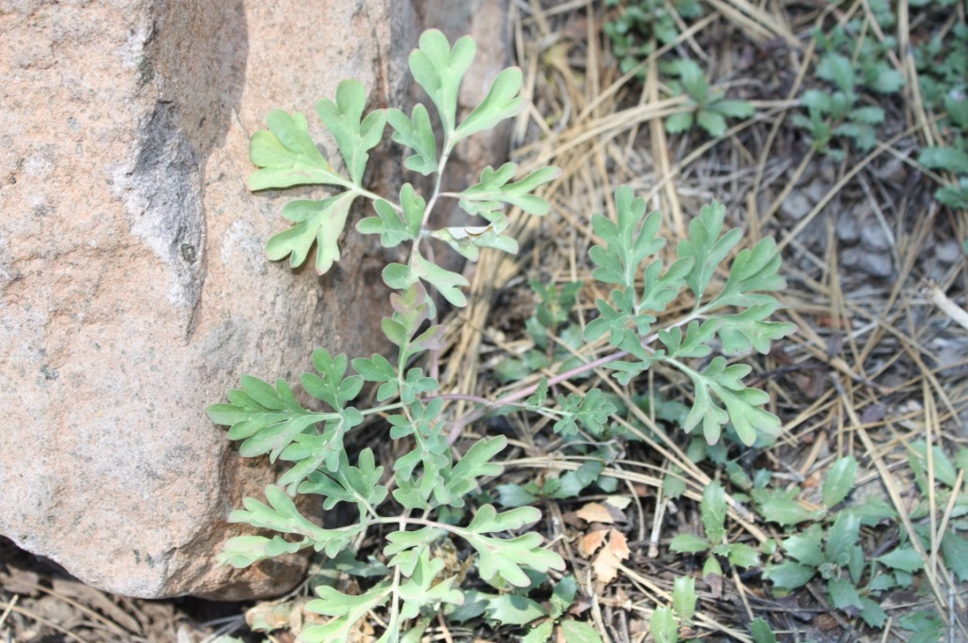
Brown’s Peony
Used as an anti-inflammatory and disinfectant
Immune system stimulant
Photo credit: Scott Lorie

Slide 9
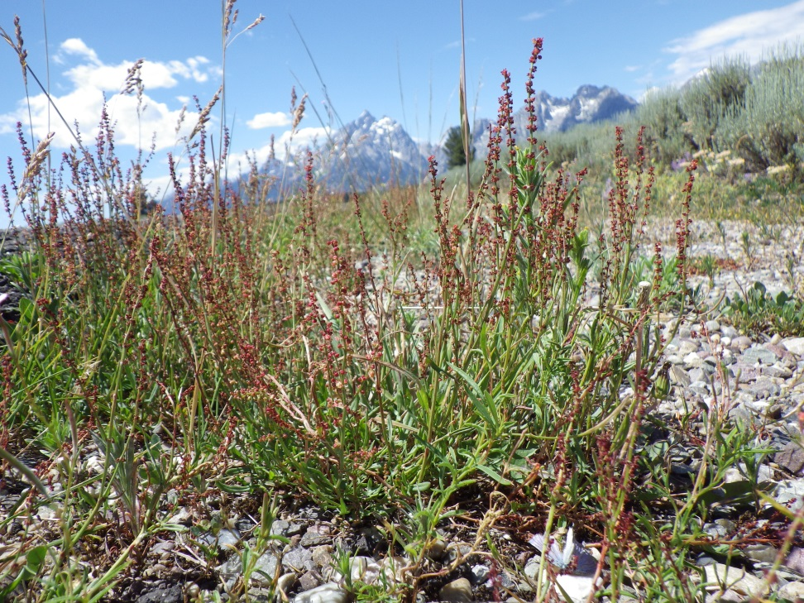
Sheep Sorrel
Treat skin rashes
Science has shown chlorophyll – found in abundance in this plant – is useful to treat cancer
Photo credit: Matt Lavin

Slide 10
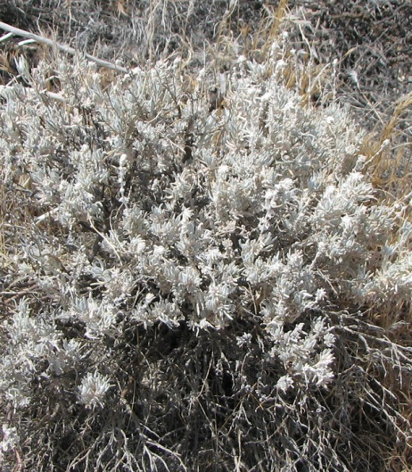
Winterfat
Treat fever and pain
Powdered root used to treat skin problems like rashes, burns, and sores

Slide 11
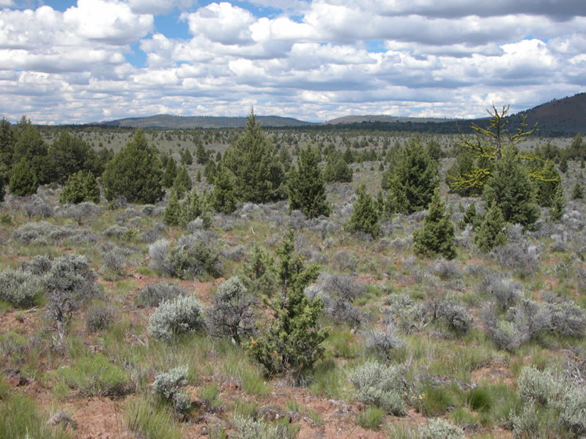
Juniper Encroachment
Photo credit: Oregon State University
Notes:
Human fire suppression has helped juniper take over sagebrush ecosystem areas.

Slide 12
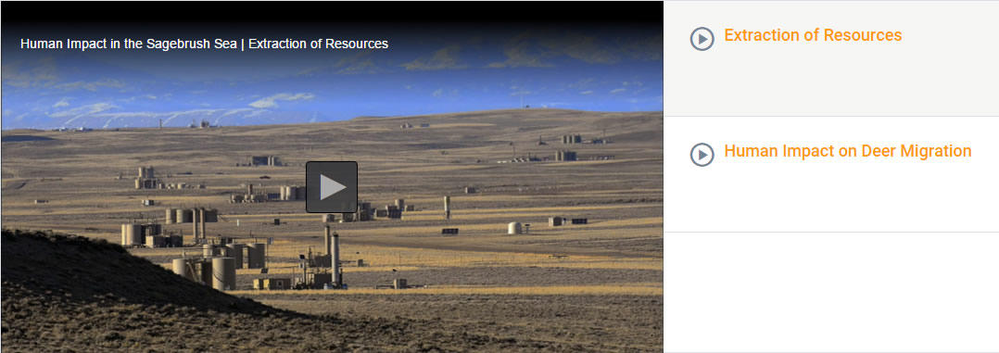
“Human Impact in the Sagebrush Sea” PBS video from NATURE: Sagebrush Sea
http://www.pbslearningmedia.org/resource/nat15.sci.lisci.hisage/human-impact-in-the-sagebrush-sea/

Slide 13
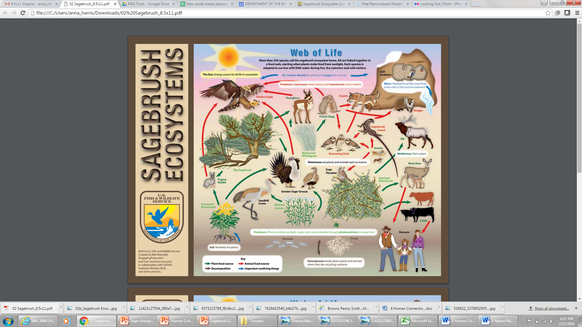
Notes:
Humans are an important component of the Sagebrush Sea Web of Life.
This diagram is a visual representation of the sagebrush ecosystem food web. Students will create their visual diagram to teach others about what they have been learning about sagebrush ecosystems and the human connections to it, both positive and negative.

