Slide 1
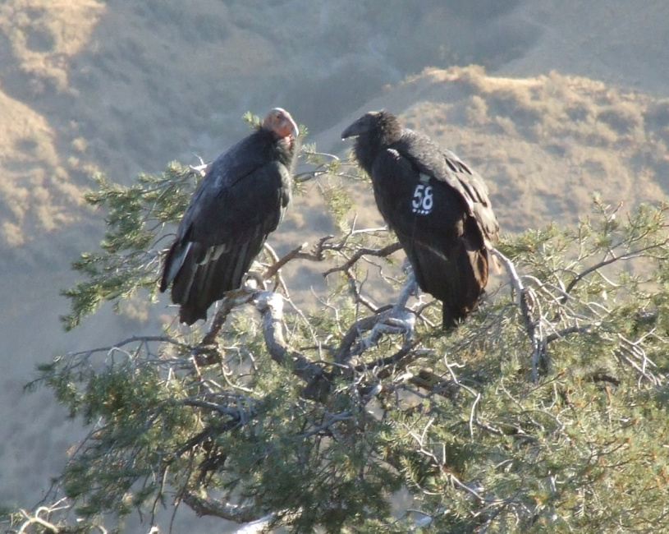
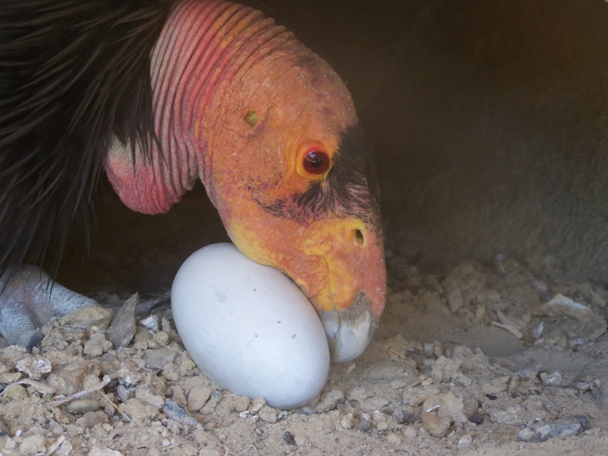
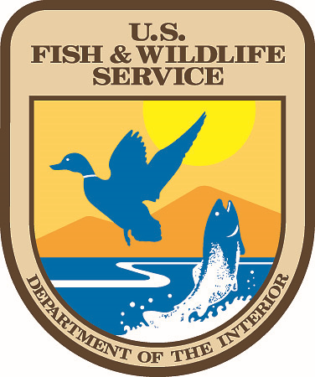
California Condor Recovery Program
Partnerships & Reintroduction
Carlsbad and Palm Springs
2023 Fall Tribal Coordination
November 8, 2023

Slide 2
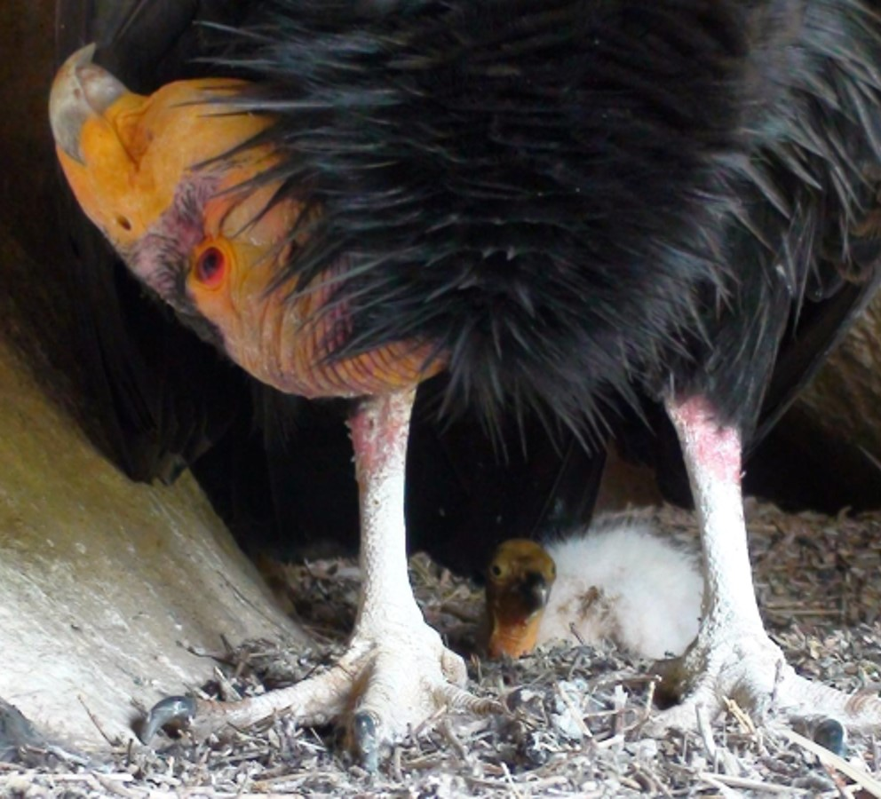
Overview
History of the Program
Current Status
Priority Actions
  Addressing threats
  Captive breeding and release
  Education and Outreach
  Collaborative planning
Feather repositories

Slide 3
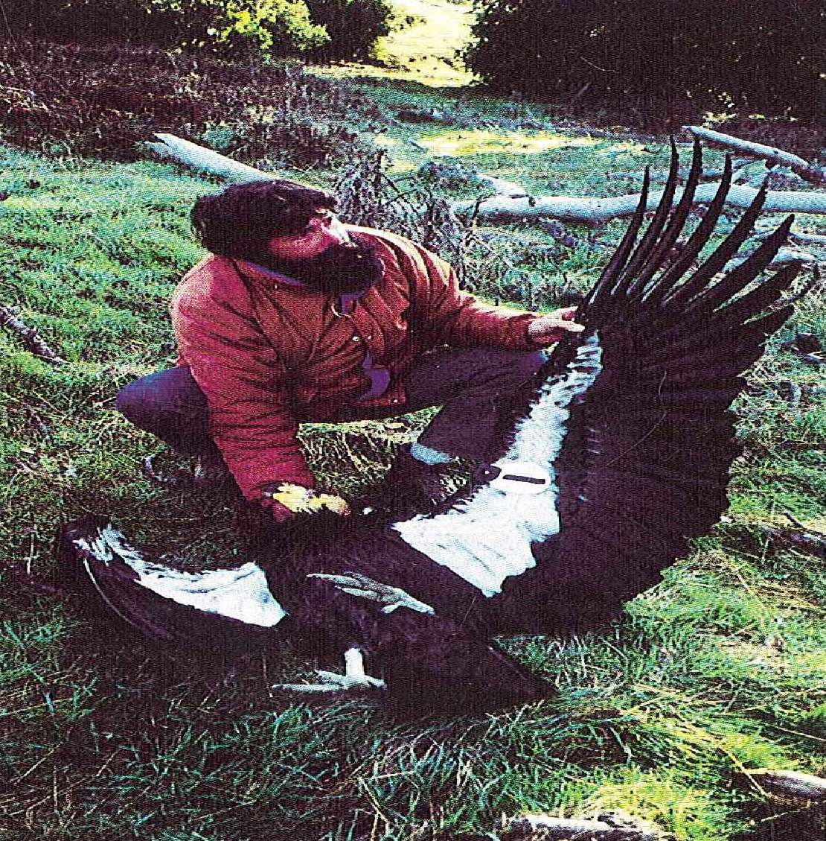
History
1967 Listed under Endangered Species Preservation Act
1975 Recovery Team was established
1987 Last wild condor captured
1988 First successful breeding of condors in the captivity
1992 First captive reared condor released back into the wild
Release sites established in 1992, 1996, 1997, 2002, 2003, 2022
Notes:
The California condor was placed on the precursor to the ESA in 1967, and the first recovery team was established in 1975.
Despite years of studying the species and recovery efforts, by 1982, there were only 22 birds left in the wild and the causes of the population decline were still unknown.
So the program began a coordinated study to understand the causes of mortality and began ATTACHING RADIO-TRANSMITTERS to the remaining WILD birds.
From the tracking efforts during the period of 1983-1986, lead poisoning was established as a primary cause of death, and this was seen as a call to action to trap and bring all the remaining condors into captivity because there was such concern that we could not address the threat in time.
The last wild condor was trapped on Easter Sunday 1987.
Meanwhile our partners at the Los Angeles Zoo and San Diego Zoo were committed to success for captive breeding and in 1988 the first pair produced an egg in captivity at the San Diego Wild Animal Park.
In 1992 they were ready to release the first condors and 2 were released with 2 Andean condors to increase the social group. Andean condors were used as a surrogate species early in the program to inform captive breeding and release strategies.
Success of the reintroduction program was not immediate and there was quickly a pause in the program from later in 1992-1993.
Techniques were revised to improve success and when we restarted the efforts, we moved the release sites to more remote locations to address the tendency of condors to be attracted to human activity, and man-made obstacles and threats.
The initial vision for recovery was to establish a disjunct population so that we would have redundancy on the landscape. And in 1996 a release site was established at the Vermillion Cliffs in Arizona. For this population we used one of the tools under the ESA that provides regulatory flexibility, known as a 10(j) rule; this is commonly referred to as an experimental population.
Building on success of the reintroductions in Southern California and Arizona, additional release sites were established in California in 1997 and 2003
as well Baja California in 2002 in with collaboration from Mexico.
Most recently we also established a release site in Northern California in partnership with the Yurok tribe and Redwood National and State Park in 2022.
Currently our program is guided by the last published recovery plan in 1996, and we completed the most recent 5-year review of the species earlier this year.

Slide 4
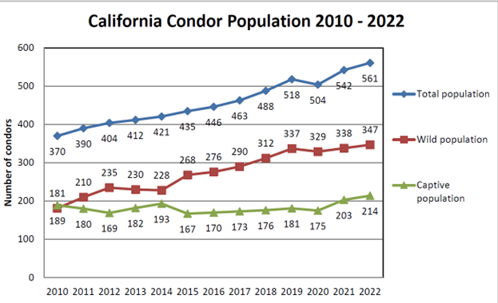
Current Population
2022 - Free Flying Population 347
Arizona – 116
California – 183
  Southern - 89
  Central – 94
Pacific Northwest – 8
Baja – 40
*Does not include the Pacific Northwest
release site that was established in 2022
Notes:
Currently the total population of condors including wild and captive birds is over 500, a substantial increase from the last 23 back in the 80’s. The program does an official count annually, and at the end of 2022 we estimated 347 birds in the wild spread across California, Arizona, and Baja Mexico.
As you can see over the last 12 years through program efforts and with partners, we are slowly seeing growth and recovery of the condor population.
Releases for 2023 are currently underway, with 3 birds released in Northern California earlier today.

Slide 5
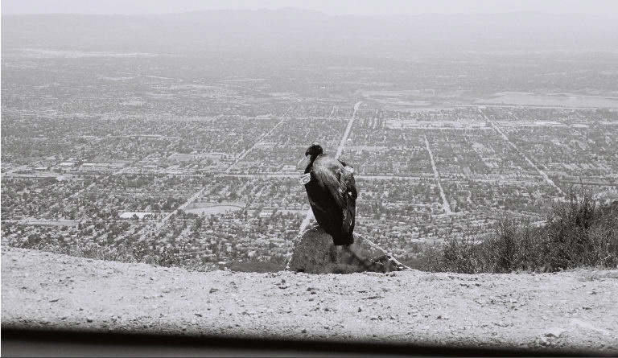
Geographic
Distribution
Notes:
This shows you a general geographic depiction of where condors occur in Arizona and California.
Currently, we have 6 Release sites total:
1 in Arizona,
4 in California
1 in Baja
The large hatched areas represent the boundaries for the experimental populations based on predicted movement.
As you can see in Arizona and Utah the birds expanded outside of the predicted area.
In the Pacific Northwest, you can see the entire State of Oregon is included in the boundary, should the birds choose to head north into that state.

Slide 6
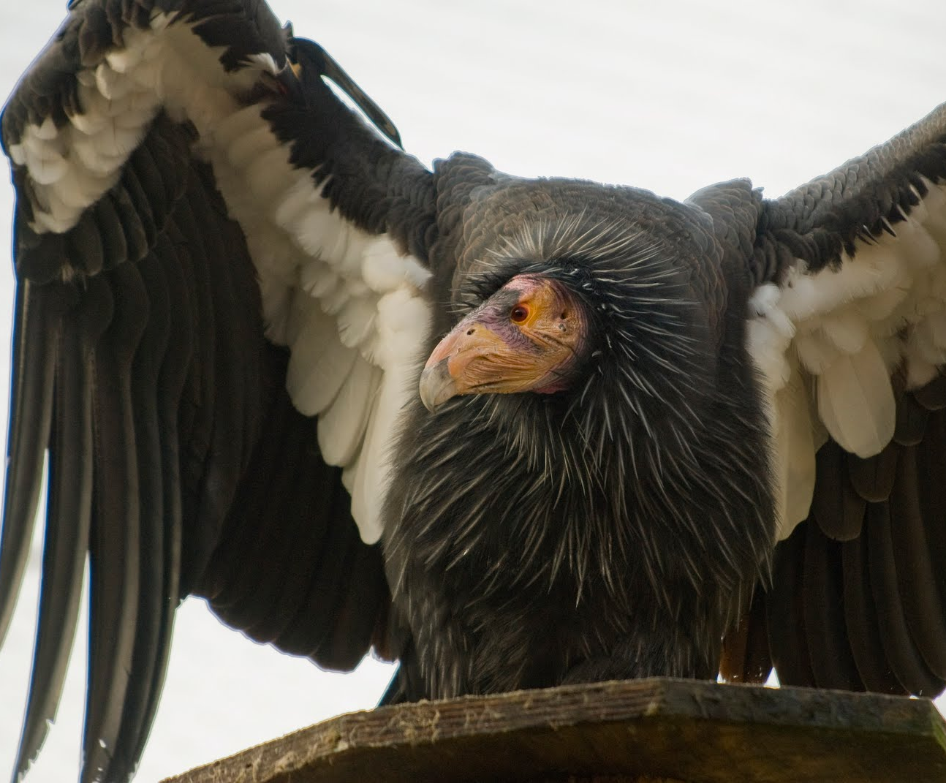
Program Priorities - Implementing Recovery
  Addressing threats
  Captive breeding
  Monitoring
  Outreach & Education
  Collaborative Planning
Notes:
There is consensus among our Partners on our priorities for achieving recovery. Which are …..
In addition, to focus our recovery efforts, in 2024 we are going to initiate some collaborative planning for the program.

Slide 7
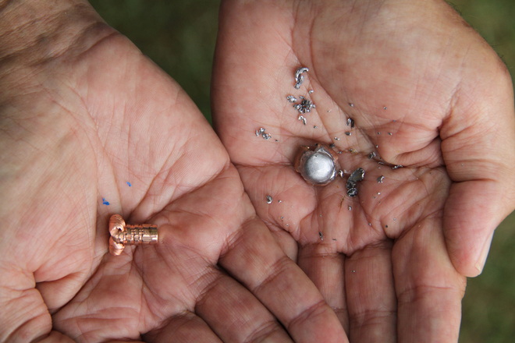
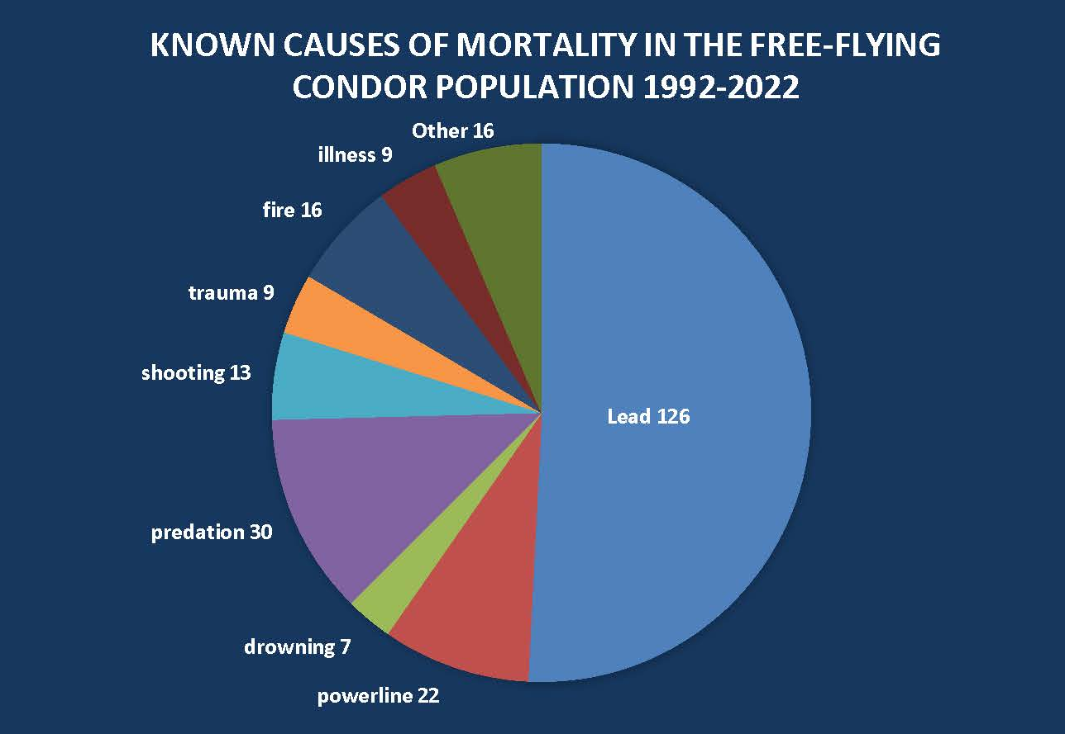
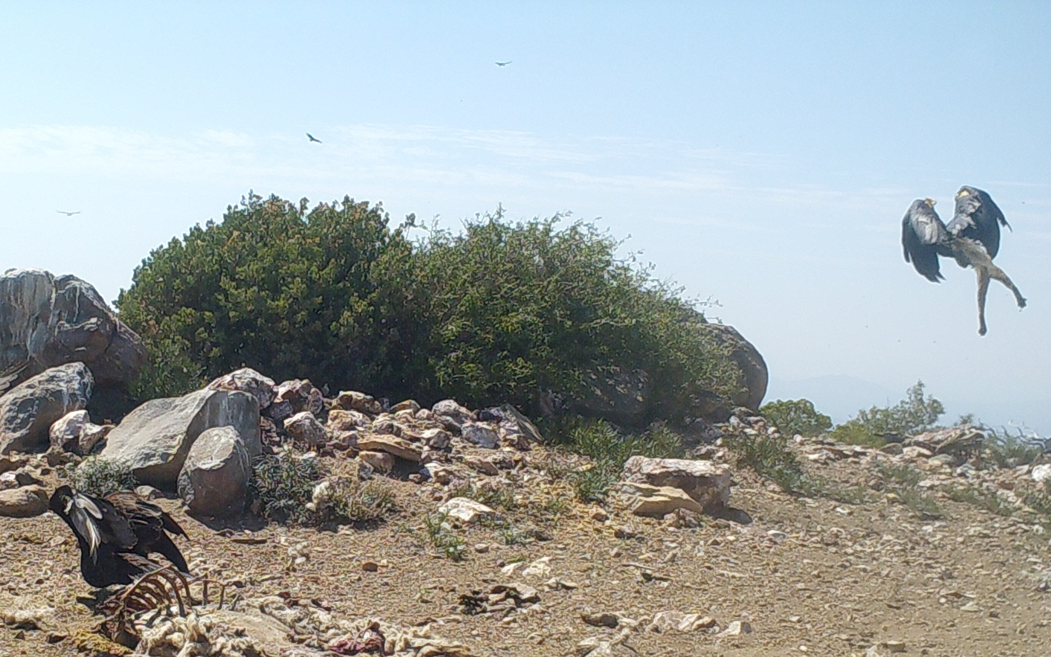
Threats
Notes:
Although we do have a growing population range-wide there are a number of ongoing threats, mostly human caused. Unfortunately, the primary threat to the free-flying condors is still lead via the ingestion of lead fragments from carcasses found during natural foraging events.
Between 1992 and 2022 about 50% of the 248 deaths are of known cause. Currently, we see the greatest number of lead mortalities in central California.
Predation is the second most common cause of mortality; it is thought that some events may occur when a bird is compromised by lead. In other cases, like the bottom picture, from Baja, the predator has keyed in on a congregation during feeding.

Slide 8
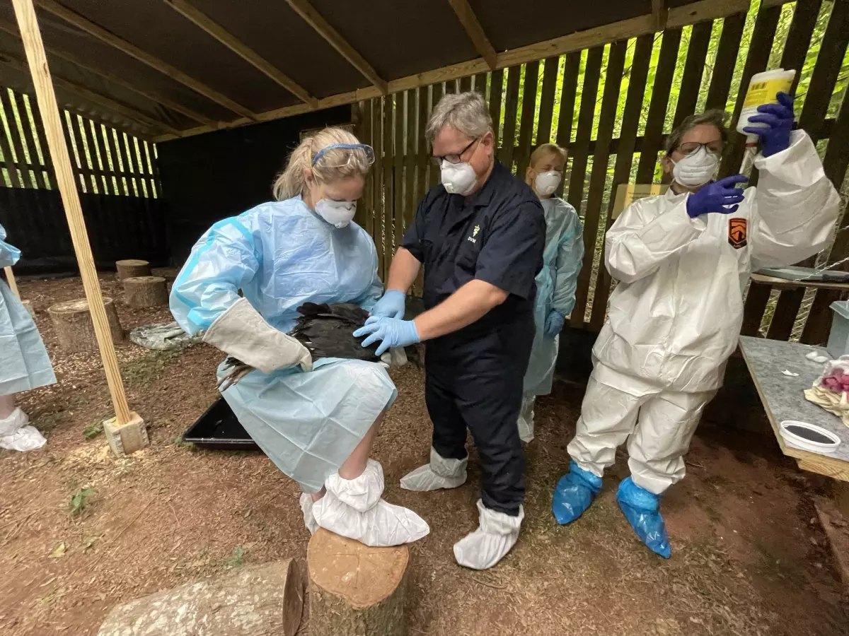
New Threat - Highly Pathogenic Avian Influenza
HPAI documented in California condors in March 2023 in Arizona
Reporting 21 birds died
Emergency use of vaccines authorized by U.S. Department of Agriculture
Safety trials conducted
Currently vaccinating of pre-release birds
More information : https://www.fws.gov/program/california-condor-recovery
Notes:
Unfortunately this year we encountered a new threat when the population in Arizona experienced an outbreak of the highly pathogenic avian influenza.
In early March 2023, The Peregrine Fund, which leads the field team in Arizona, observed wild birds exhibiting signs of illness, initially suspected to be lead toxicosis. But by the end of the month, we confirm there was an HPAI outbreak in the flock.
We are attributing 21 bird deaths to the outbreak, apx 20% of the flock.
Following the outbreak, we received emergency use authorization from US Department of Agriculture to vaccinate condors for HPAI. This is the very first time than any species has been vaccinated in the United States. The poultry industry, for which the vaccines are developed, does not use vaccines because of trade restrictions.
Since the vaccines are developed for poultry, we first conducted safety trials with black vultures.
After confirming safety, we initiated trial in condors at captive breeding facilities.
Trial results are showing that 6 of 10 birds demonstrated antibodies that we expect will provide some level of protection against mortality.
So as HPAI is currently increasing on the landscape we are currently implementing vaccinations for all birds being released this year.

Slide 9
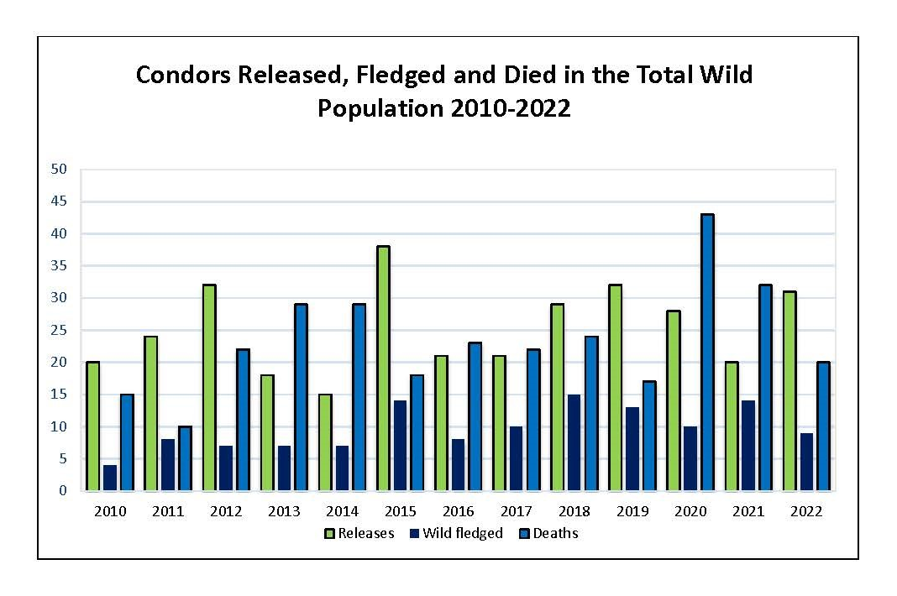
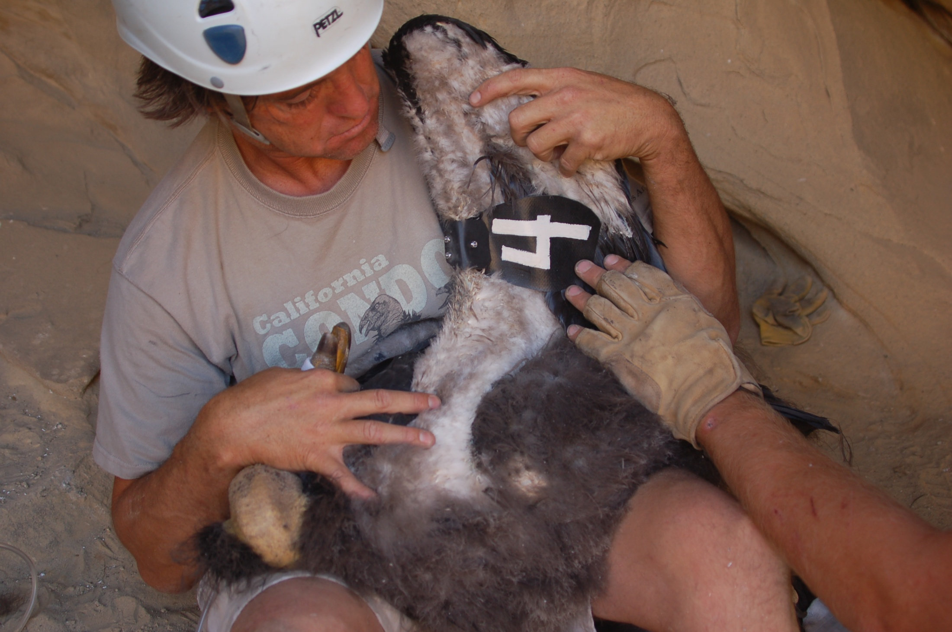
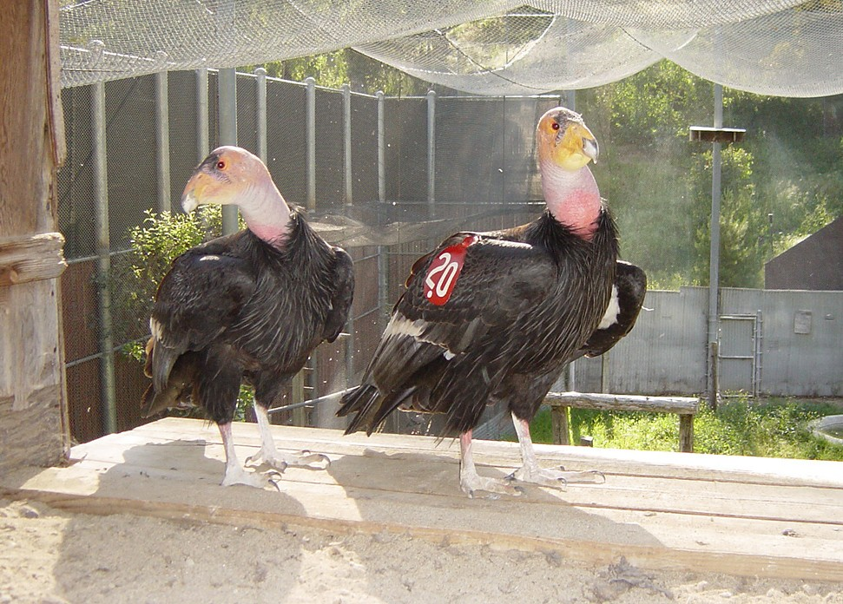
Continuing
Efforts
Notes:
Growth of the condor population is achieved through reintroductions and wild hatched and fledged chicks. However, you can see the natural recruitment in the wild is not sufficient to offset the mortality in the wild. Thus, captive breeding and release of individuals is essential to the recovery program.
In 2022 – 9 condors fledged in the wild and 31 birds were introduced from the captive population. Numbers are not yet in for 2023, but as I mentioned earlier, releases are currently underway in California. We hope to release about 20 birds in California over the next couple of months.
We continue to monitor the flock closely so that we are able to identify nesting events, and when needed attempt to capture and treat sick birds. All of the birds wear patagial wing tags. Most wear VHF radio tracking units, and a subset wear GPS transmitters.

Slide 10
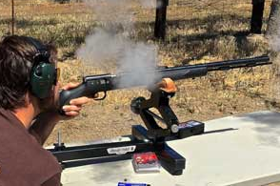
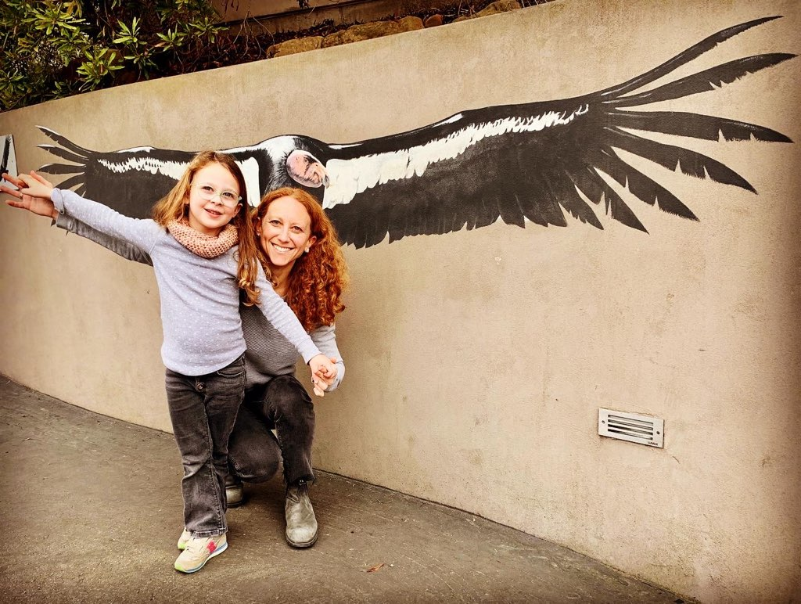
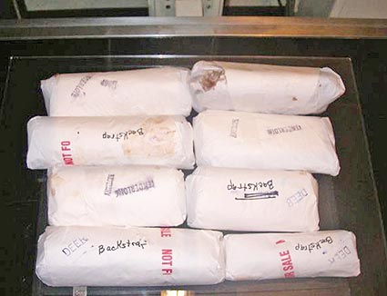

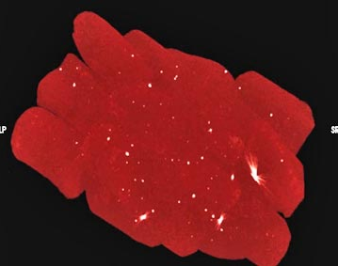
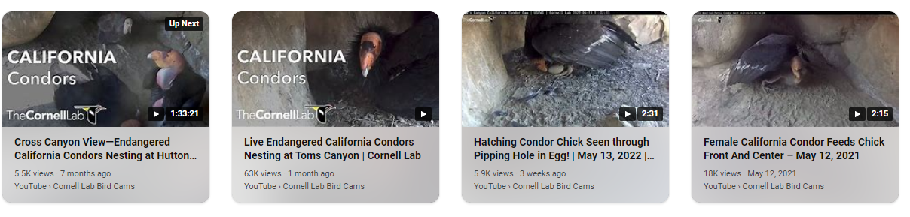
Outreach and Education
Partnering Zoological Institutions
Nest web-cams
Hunting events
Non-lead incentive programs
Notes:
An important part of our program is outreach and education. Our outreach has 2 components: education about condors and our conservation efforts, and outreach and education focused on addressing the threats to condors, including what we can do to improve the habitat for condors.
Education on conservation efforts includes condors on exhibit at zoological institutions, and nest cameras and web-cams at the release sites that allow you to watch the release site, where birds are viewed prior to release and returning to feed on proffered food.
Our non-lead program is focused on educating outdoorsmen on the dangers of using lead bullets. Hunting is very compatible with condors when it is done appropriately with non-lead ammunition. The reality is, lead bullets fragment into the carcass of the animal. This is not only a threat to condors and other scavenging animals such as eagles and wolves, but also to humans.
On the left you see packaged wild harvested venison; below is a radiograph of that same meat, showing lead fragments throughout. This will be unknowingly ingested by the hunter and their family. As part of this program our partners also provide incentives for non-lead ammunitions, including ammo giveaways, coupons, and gut pile raffles.
Our goal is to educate the hunting and shooting community that the benefits to switching to non-lead are ecosystem wide, both for humans and wildlife alike.

Slide 11
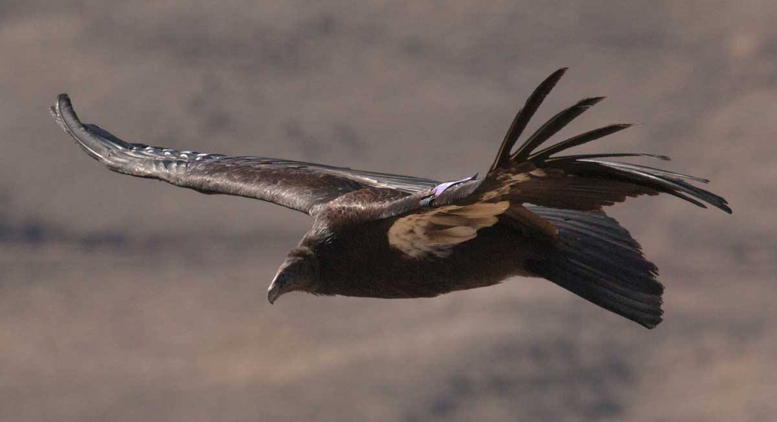
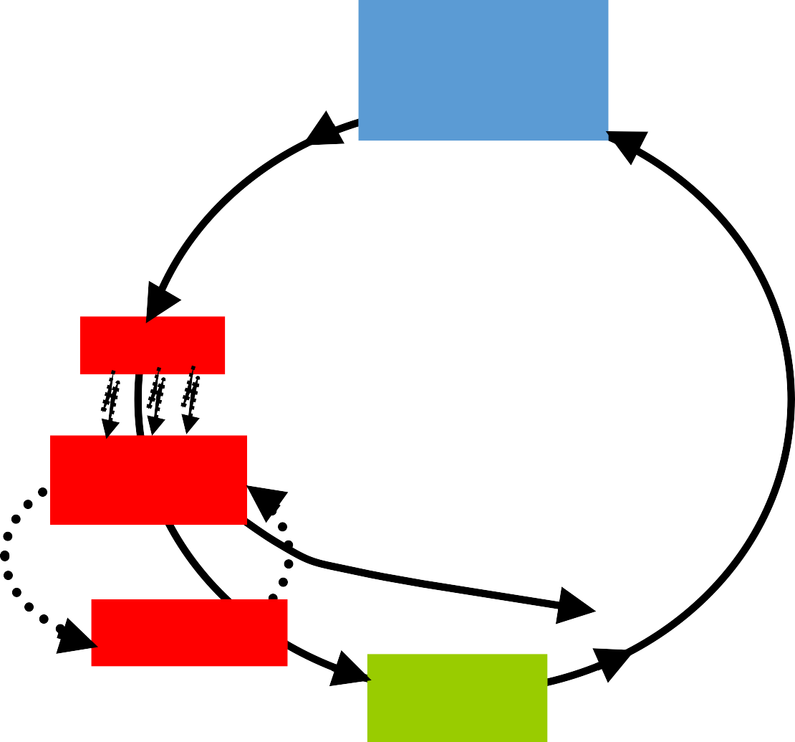
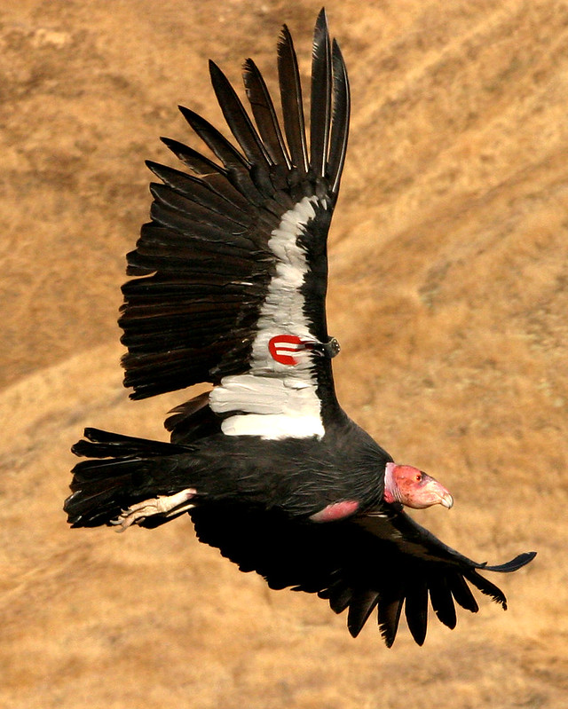
Recovery Implementation
  Collaborative Planning
    Establish interim recovery targets
Management
decisions and actions
Management
efficacy
P(ext) = Start/stop management?
P(ext) = Change monitoring?
Iterative PVA
Threats
Survival &
reproduction
Monitoring data
Demographic rate monitoring
Abundance
Observation
error
Abundance
monitoring
Notes:
As I mentioned earlier, our most recent recovery plan is from 1996, and we have learned a lot since over the years. Although the priorities remain consistent (and are what we have just walked through), implementation of those priorities has been refined. As a Recovery Program, this upcoming year we are planning to establish a shared set of goals and interim targets with our Partners to focus our broad efforts and guide our program. We will do this through development of a Recovery Implementation Strategy.
In this effort we will look to set targets for:
Number of pairs in captive breeding
Number of birds released annually
Number of birds released at each location
Through this effort we seek to establish a focused vision for the program for the next 5-10 years.

Slide 12


Non-Eagle Feather Repositories
For members of federally recognized tribes​
For Native American Religious Purposes
Non-eagle feather repositories​
  Liberty Wildlife Non-Eagle Feather Repository, Phoenix, Arizona​
  ​ SIA – Essential Species Repository, Cyril, Oklahoma​
Notes:
I wanted to provide a little information on how one can legally acquire California condor feathers.
As a member of a federally-recognized Tribe, if you are seeking feathers for Native American Religious purposes, you can apply to one of the two non-eagle feather repositories listed here:
Liberty Wildlife in Arizona and SIA in Oklahoma
We are currently working on efforts to improve the clarity and process for additional eligible groups or institutions to apply to become a non-eagle repository for condor feathers, and an appropriate mechanism for tribal members to acquire naturally molted feathers from free-flying condors.

Slide 13
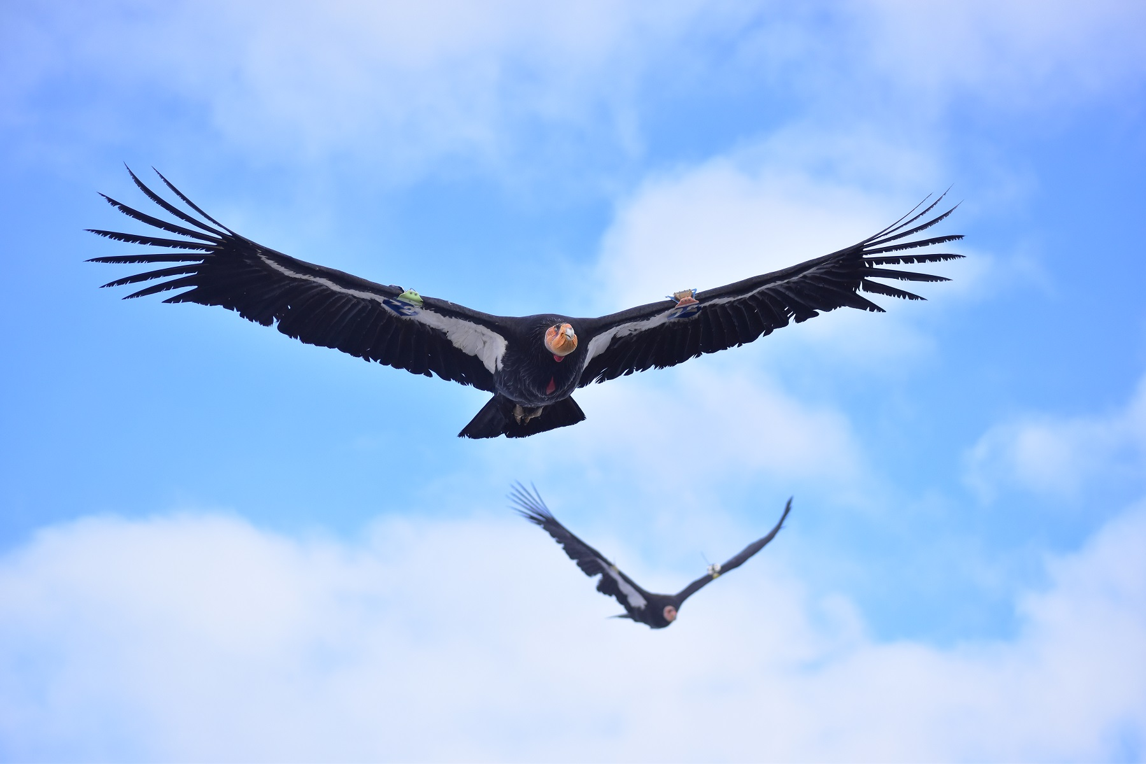
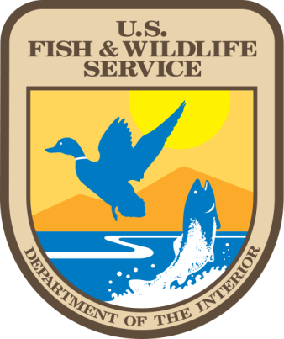






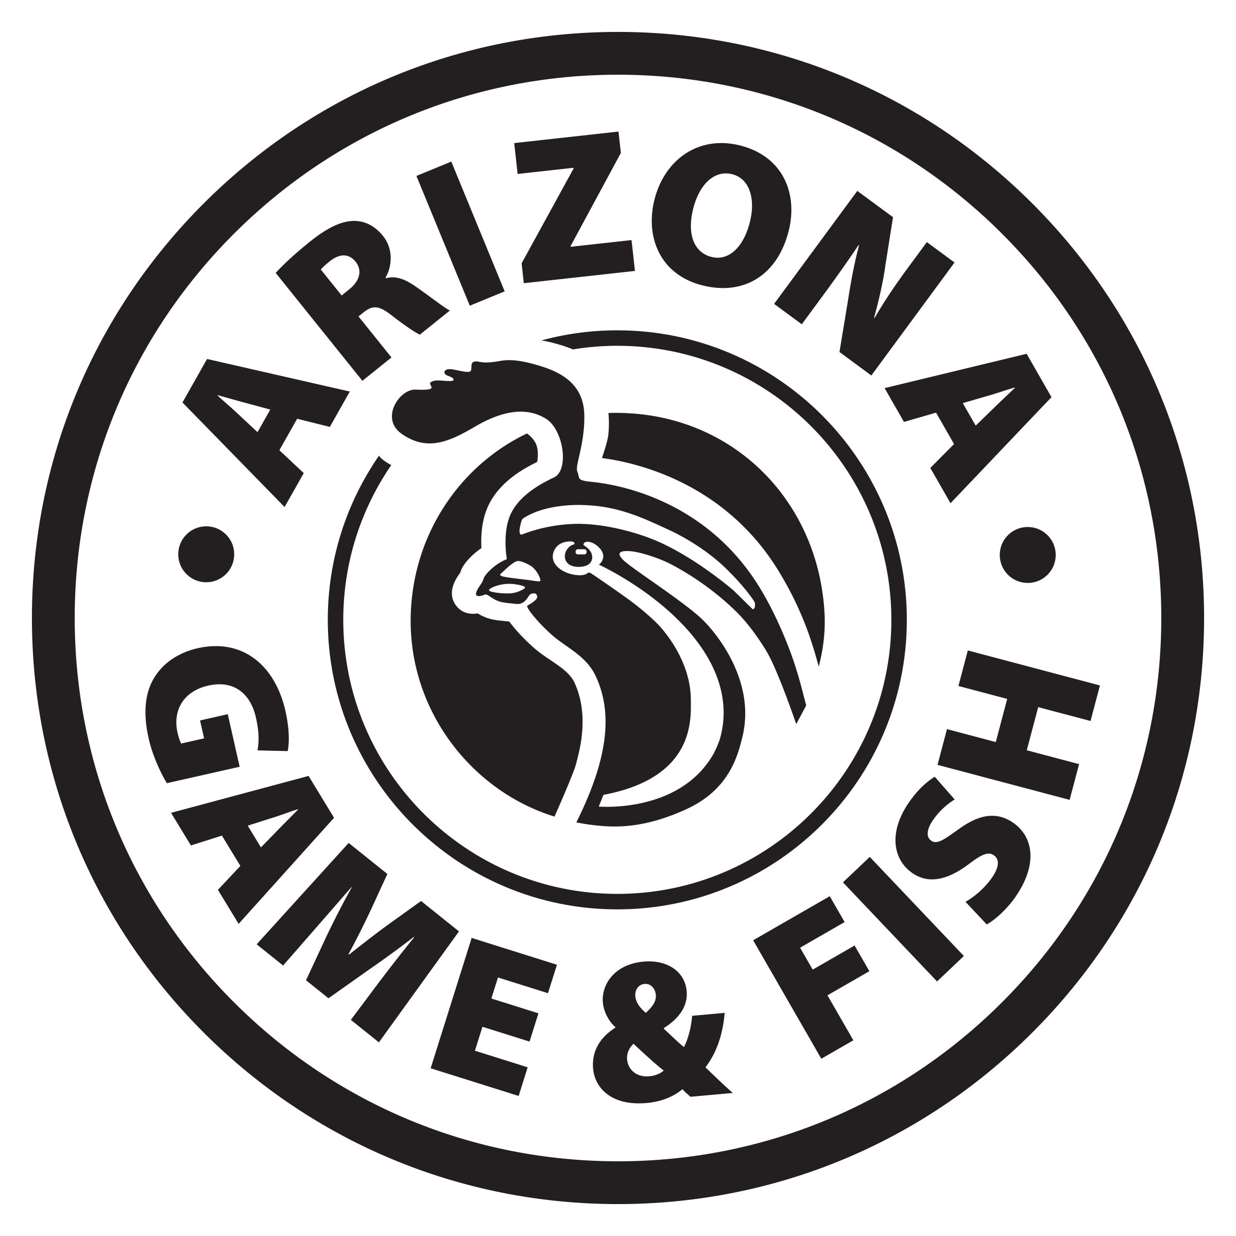
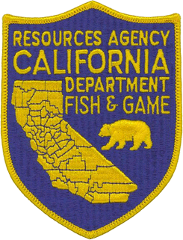
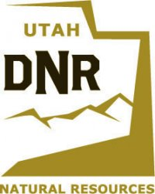



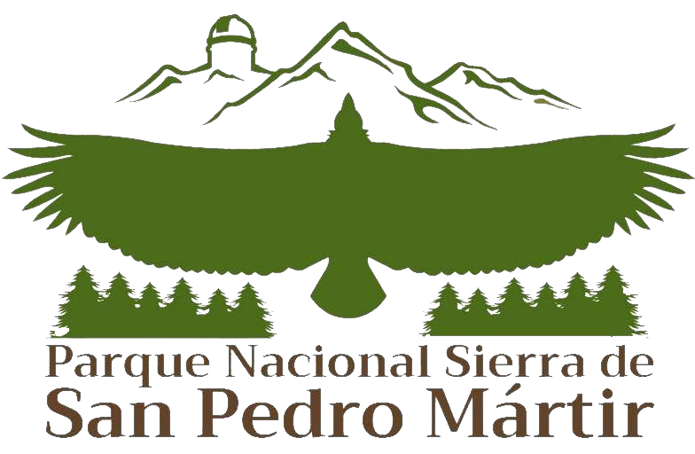









The Partners
Dirección General de Zoológicos y
Conservación de la Fauna Silvestre
Notes:
Finally – we really want to acknowledge all of the Partners that support recovery for the California condor. This is truly a collaborative effort and we would not be as successful as we are today without our Partners

Slide 14
Thank you
Condor Recovery Program
Ashleigh Blackford –Program Coordinator:
ashleigh_blackford@fws.gov
Steve Kirkland – Field Coordinator:
steve_kirkland@fws.gov

