Slide 1
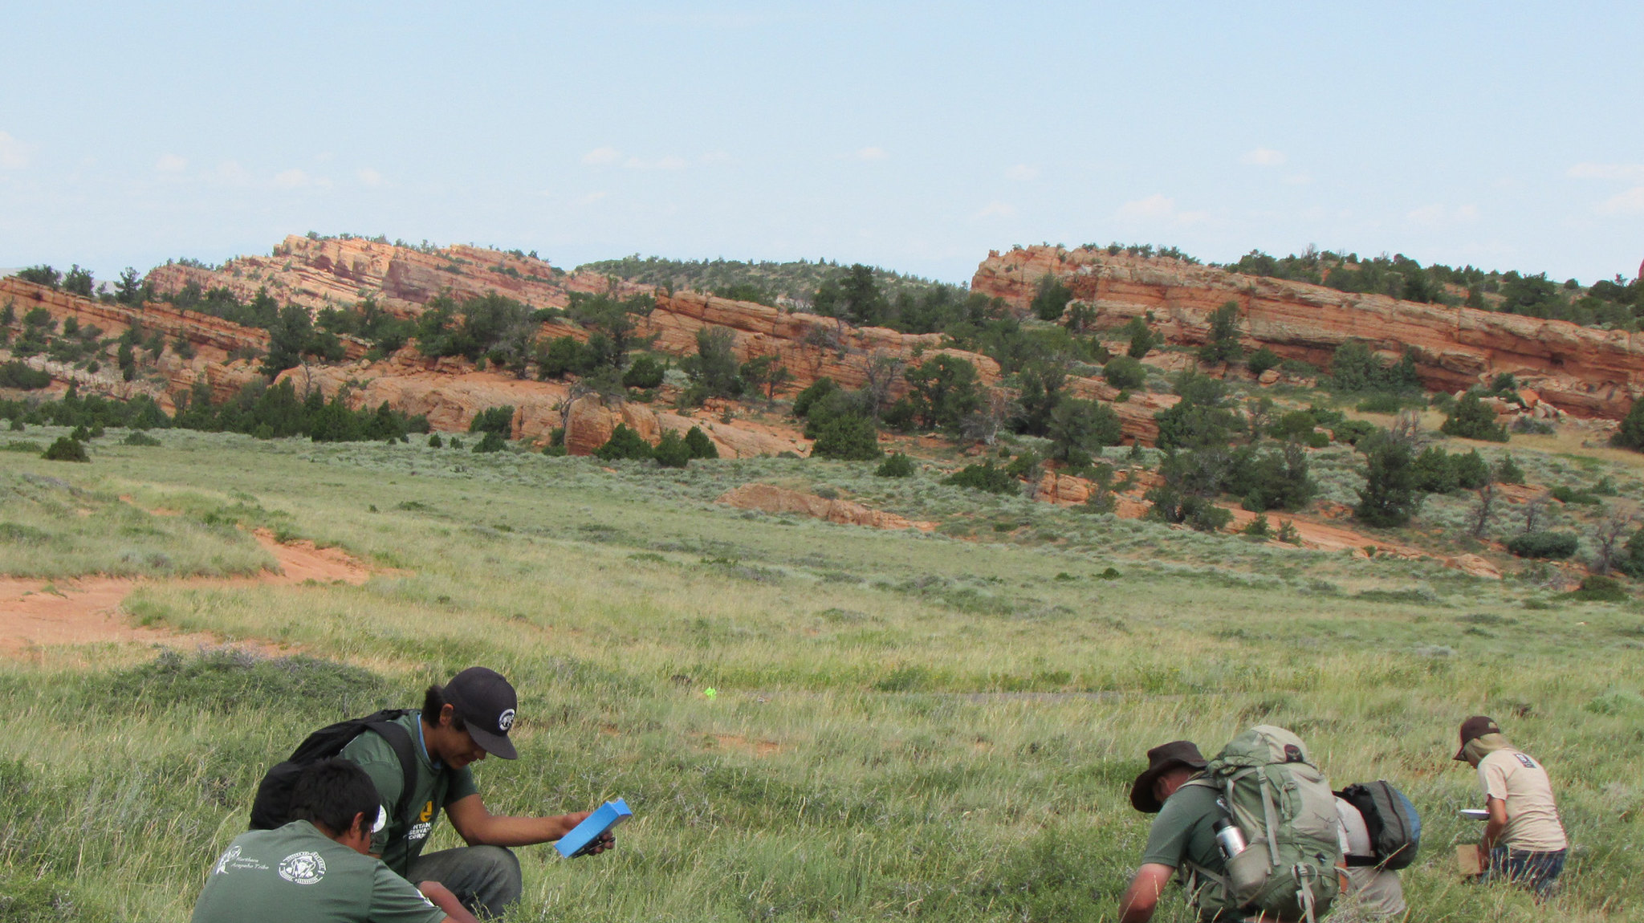

Bureau of Land Management
Bipartisan Infrastructure Law - Inflation Reduction Act
Briefing for Hunting and Wildlife Conservation Council
April 17, 2023

Slide 2
BLM BIL & IRA
Restoration and Resilience Program
 | Estimated BLM BIL & IRA Restoration Funding (million)
 |  |  | FY22-31
BIL | Ecosystem Restoration |  | *130
BIL | Burned Area Rehabilitation |  | 200
BIL | Fuels Management |  | 372
IRA | Section 50221 |  | 145
IRA | Section 50222 |  | 145
 | total |  | 992
IRA | Section 50303 |  | 41
 | total |  | 1,033

Slide 3
BLM BIL & IRA
Restoration and Resilience Program
Restoration treatments and goals will rest on the unique set of threats in focal landscapes, however, restoration will broadly serve to:
Address uncharacteristic wildfire fuel loads in forest- and range-systems;
Restore aquatic ecosystems (streams, meadows, rivers), particularly in dry landscapes;
Conserve habitat for threatened and endangered species, and;
Promote resilient recreation.
The BLM will facilitate this work by developing financial agreements with partners and local communities; building co-stewardship with Tribes, and; distributing funding through youth and Indian youth service corps.

Slide 4
BLM BIL & IRA
Restoration and Resilience Program
BLM intends to use IRA funding to deploy public lands restoration at broad-scales, requiring multiyear investments in large or collocated projects.
Treatments will be deployed using an integrated approach across BLM restoration programs to address complex threats to landscapes.
Funding will largely be directed to focal landscapes to increase restoration success and durability, and ensure support for the interests and needs of states, Tribes, communities, and partners.

Slide 5
BLM BIL & IRA
Restoration and Resilience Program
Consideration for focal landscapes:
Transformational outcomes
Support a diversity of treatments from BLM restoration programs
Durability
State, Tribe, partner, stakeholder support and leverage
Storytelling
Existing landscape conservation design/strategy
Contribution to Departmental and Administrative priorities/initiatives
Sister agency investments
Capacity

Slide 6
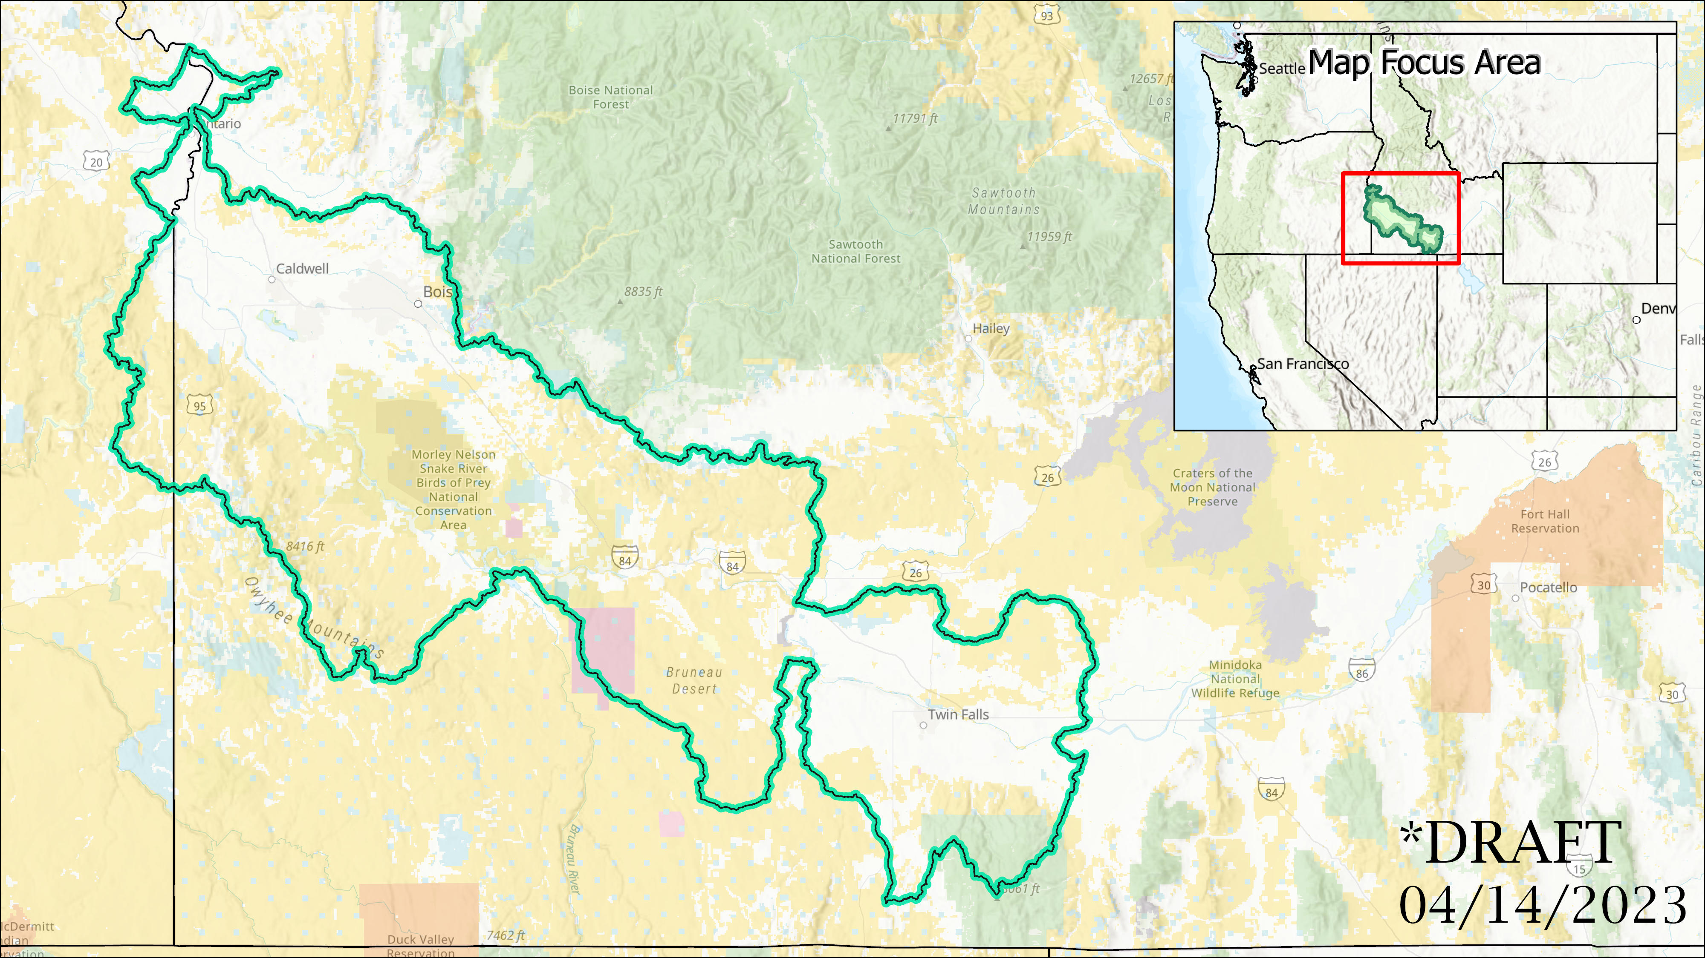

Slide 7
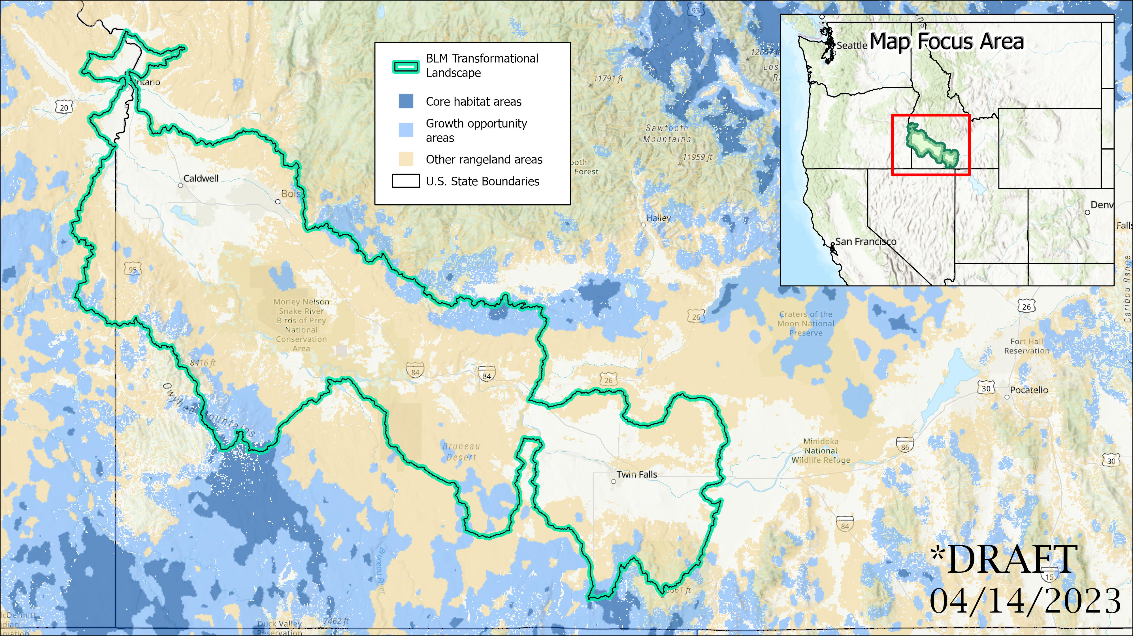

Slide 8
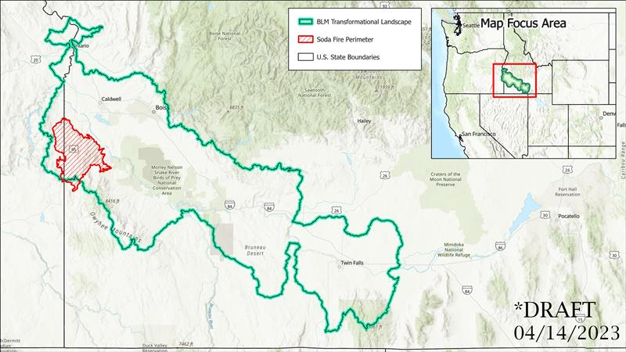

Slide 9
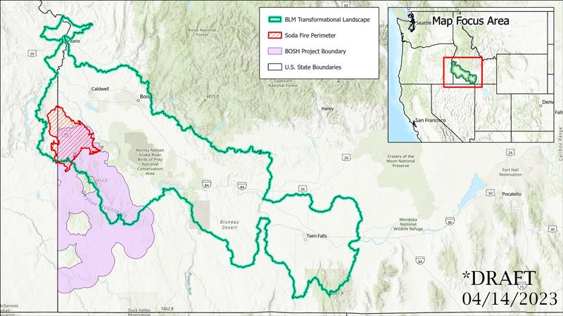

Slide 10
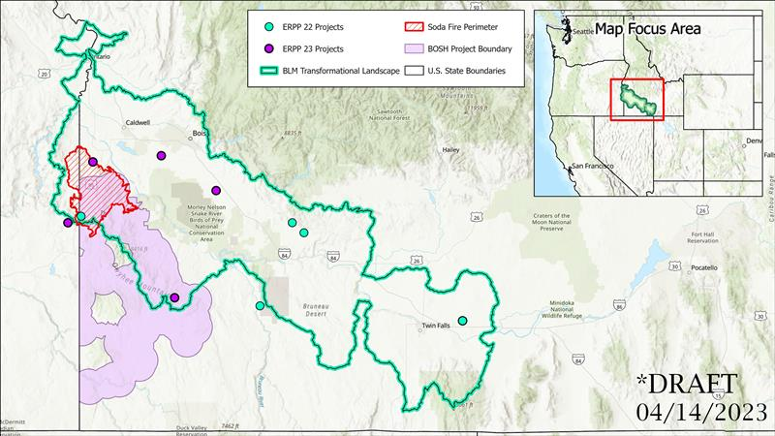

Slide 11
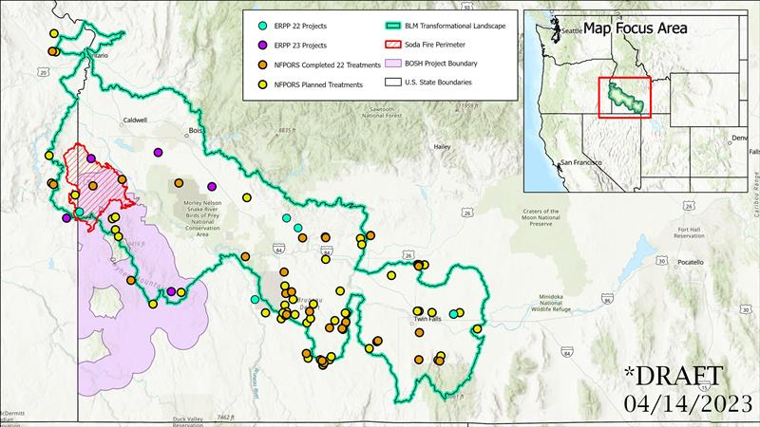

Slide 12
Discussion

