Slide 1

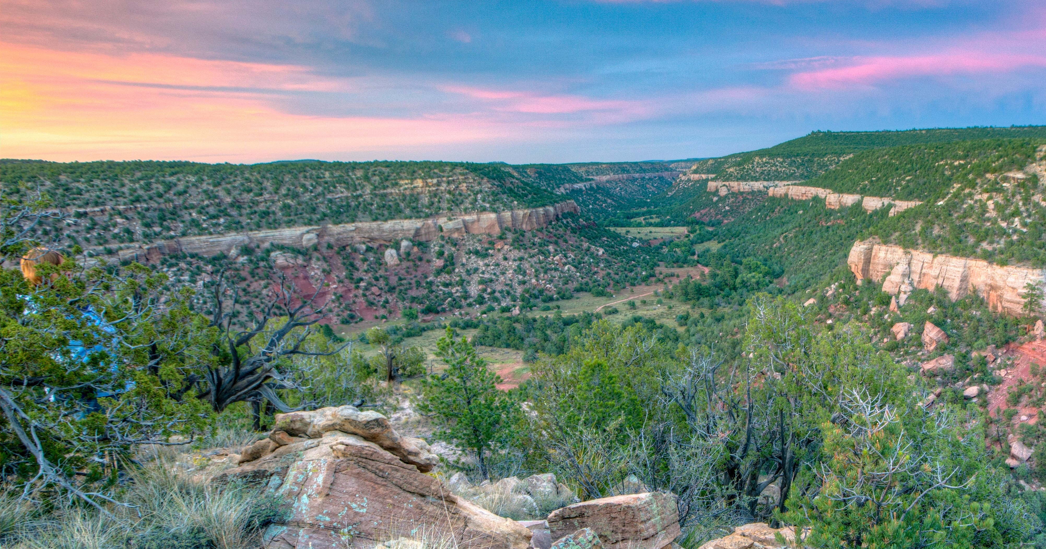
Bureau of Land Management
Landlocked Lands – Jeff Cartwright, Public Land Access Program
Supporting Text

Slide 2
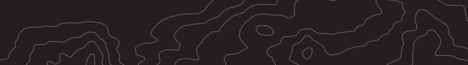
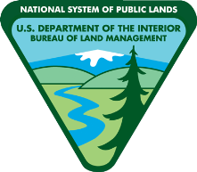
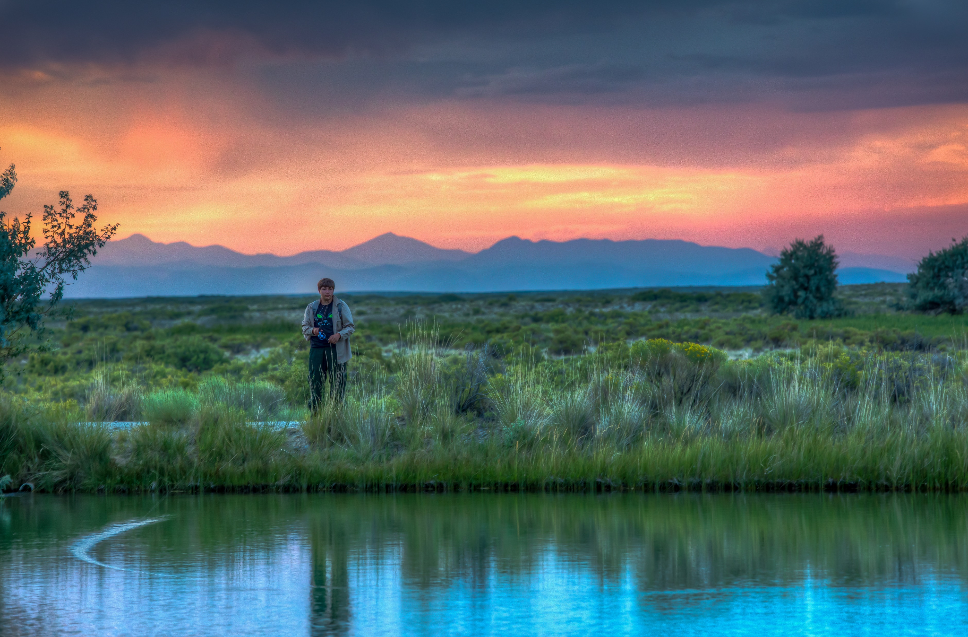
BLM Priority Initiatives
New Public Land Access Program
Increasing public access through the acquisition of land and interest in land to support new and improved recreation opportunities and landscape conservation
Land and Water Conservation Fund Act (LWCF)
  Priority source of funds to gain access to public lands and waters
Dingell Act Nomination List (DANL)
  Identify and prioritize public lands with no or restricted access
Modernizing Access to Our Public Land Act (MAPLand Act)
  Public facing map and data of roads and trails which provide access to public lands and waters
Notes:
Public Land Access (PLA) mission - To facilitate BLM’s ability to complete its multiple use and sustained yield mission by identifying, reserving, acquiring, maximizing, and making publicly available the public land access needs and accomplishments to BLM-managed lands for present and future generations.
BLM has invested substantial effort to acquire and reserve public access to BLM-managed lands, ensuring the public can enjoy the vast landscapes and recreational opportunities public lands have to offer.
The recent passage of the Dingell Act, GAOA, and the MAPLand Act, as well as interest in public access issues by the non-profit and private sectors, have prompted the BLM to review, modernize, and make available to the public, our partners, states and tribal governments, data and information on access to public lands.
Goals of Program
Build a public land access program that supports all BLM programs – Work with all BLM Directorates and Divisions to support public land access needs that may be acquired or reserved for the use and enjoyment of present and future generations.
Identify public land access needs – Work with the public and other stakeholders to identify and acquire or reserve access to public lands and waters.
Prioritize the acquisition of land or interest in land to provide public land access – Utilize the LWCF program to acquire land and interest in land that supports the BLM mission and benefits the public.
Develop and publish public land access data and needs as required by the Dingell and MAPLand Acts.

Slide 3

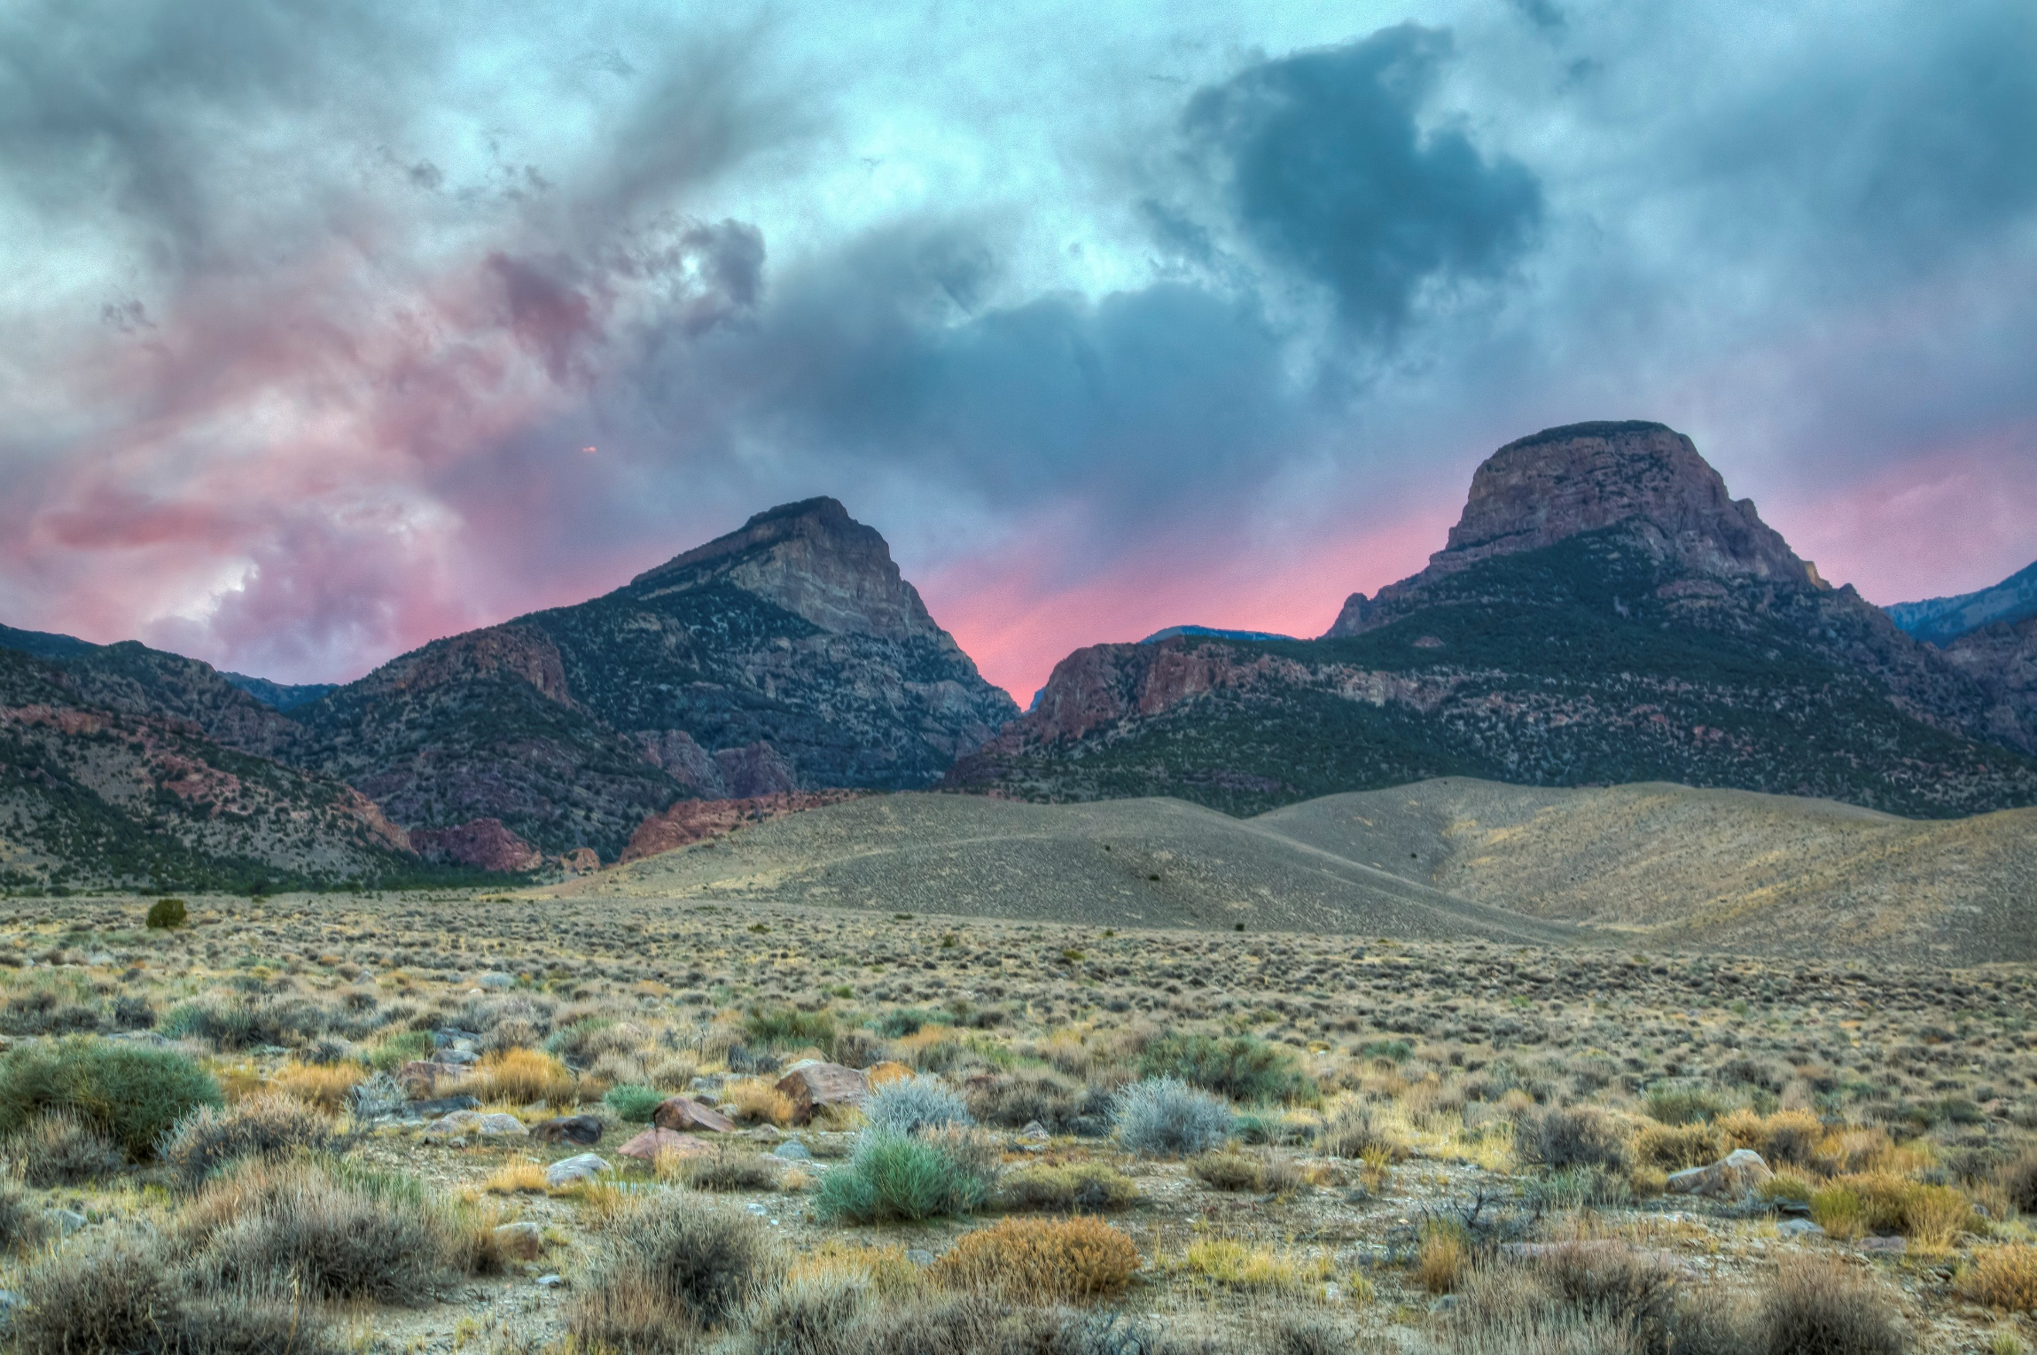
LWCF and Public Access
Section 3001 of the John D. Dingell Jr. Conservation, Management, and Recreation Act of 2019 (Dingell Act)
Directs the Department, working in conjunction with others, to develop a priority list of projects that, through acquisition of land (or an interest in land),
Secure recreational public access to federal land for hunting, fishing, recreational shooting or other outdoor recreation purposes.
Prioritize project nominations that support access to BLM lands included on the BLM’s Dingell Act priority access list.
Notes:
Strong projects supporting recreation access and access to public lands and waters
Rec Access Criteria

Slide 4
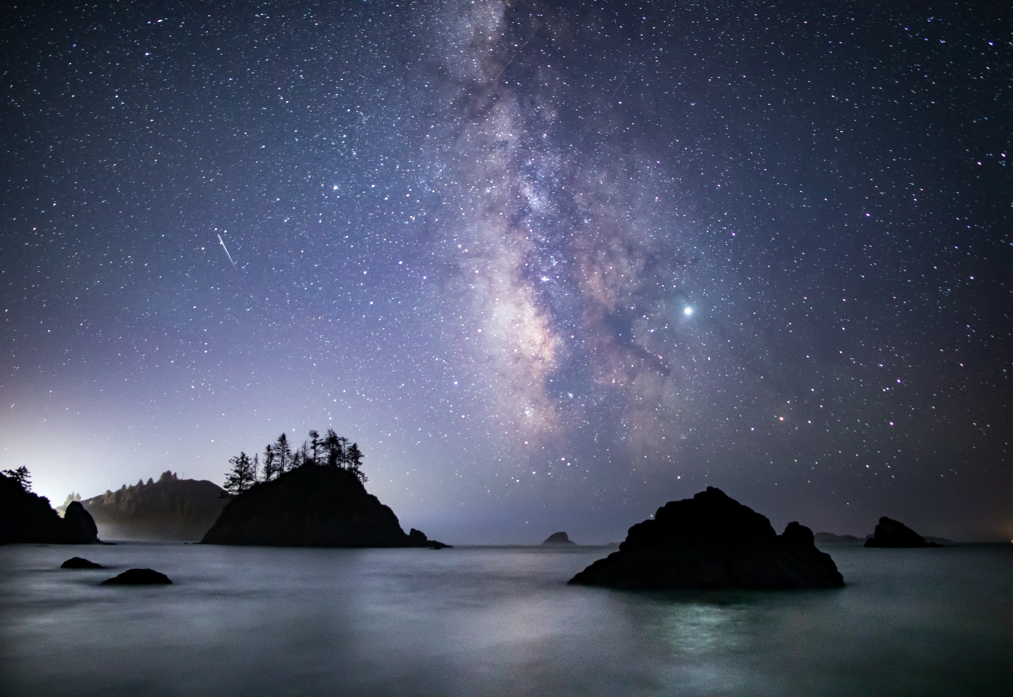
LWCF Recreational Access Criteria
Recreational Access Benefits Underserved Communities or Provides for Equity
Conserves or Protects Against Threats to Resources, Advancing the America the Beautiful Initiative by Securing Recreational Access
Recreational Access Quantity and Quality
Demonstrates Strong Local Partner Support
Project Readiness
BLM State Director’s Priority
Provides Access to BLM Ranked Dingell Act Nominated Parcels
California Coastal National Monument, California
Notes:
Use project-specific details describe how acquisition conserves or protects against threats to Resources, Advancing the America the Beautiful Initiative by Securing Recreational Access in the following areas:
a. Increases local capacity for recreational activities or provides new opportunities in an area with otherwise limited recreational experiences and benefits.
b. Project includes acquisition of sensitive or designated fish or wildlife habitat that also enhances recreation.
c. Provides permanent conservation status (e.g., National Conservation Lands units including national monuments, national conservation areas, wilderness, wild and scenic rivers, national scenic and historic trails, national recreation sites, and any other area designated by Congress to be administered for a conservation purpose).
d. Threats of development/use - The parcel is at risk of imminent development or loss of recreation or other resource values, which may negatively affect public land resource values.

Slide 5
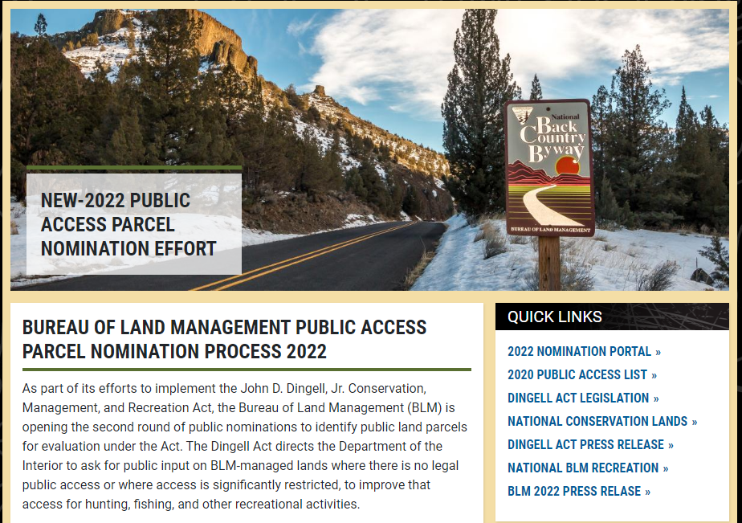
Dingell Act Nomination List
Notes:
Talk about the DANL Website
https://www.blm.gov/about/laws-and-regulations/dingell-act/2022-dingell-act-public-nominations-process

Slide 6
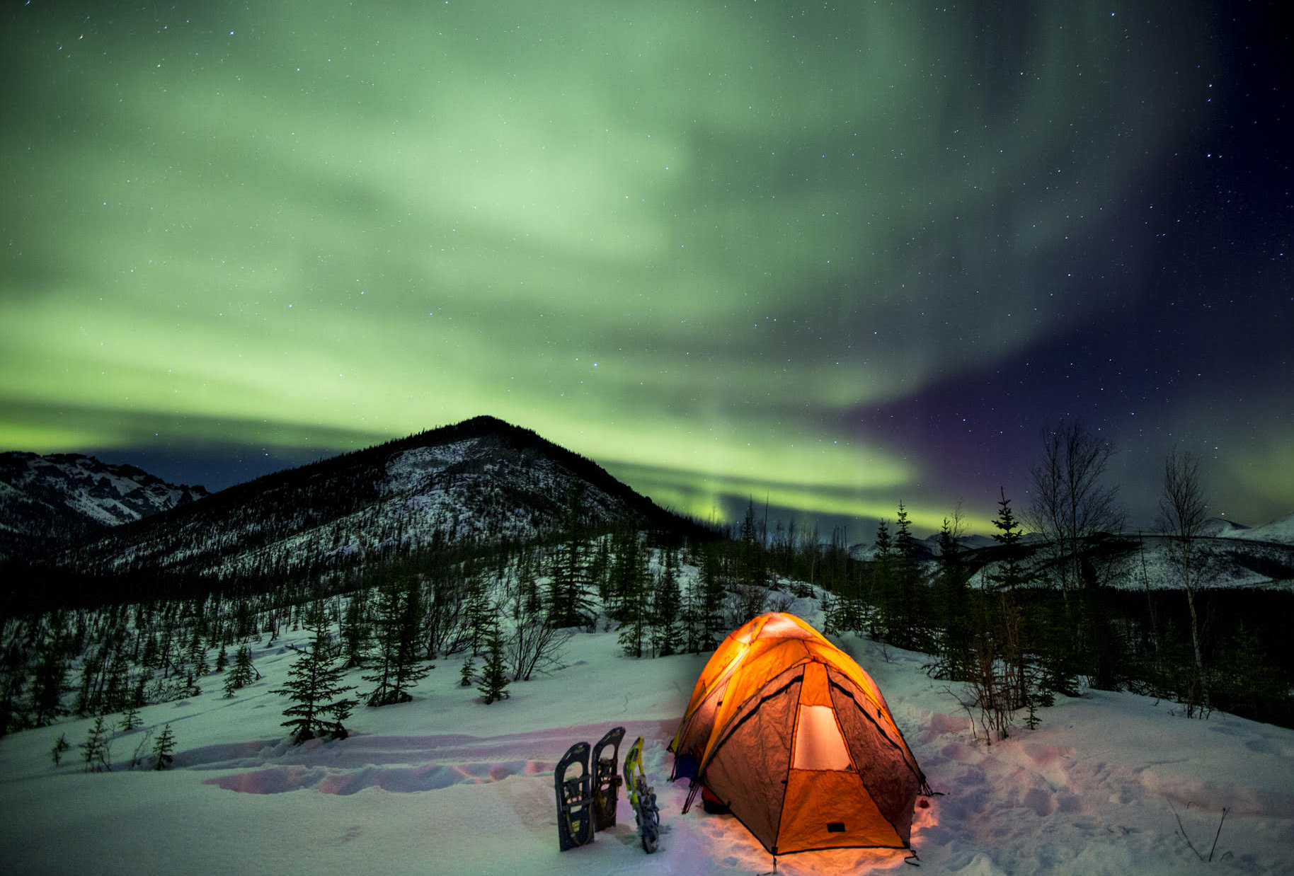
DANL Criteria
  Biannual nomination process (2020 - 2030)
  Existing public land 640+ contiguous acres
  No legal access or significantly restricted access
Notes:
The LAW Sec 4105 of Dingell Act

Slide 7
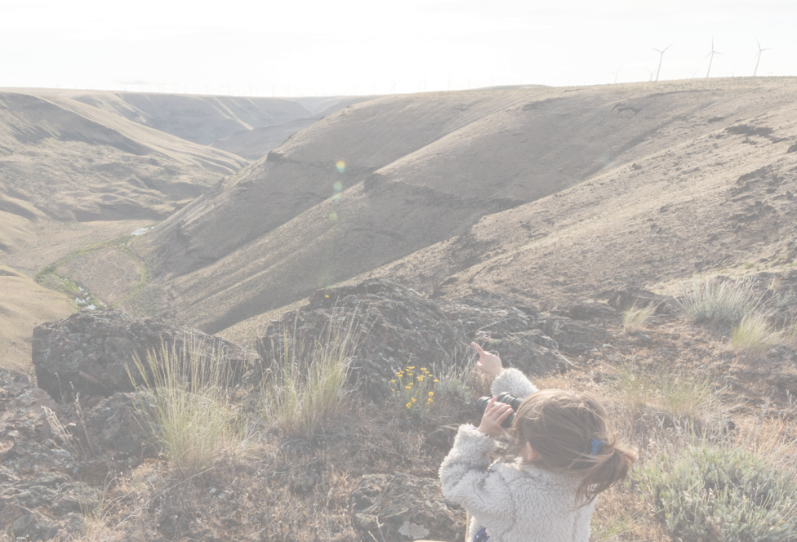
DANL Milestones
2020 Public Comment Period
  Jan 31, through Feb 29, 2020
  5,434 nominations
    37 interest groups
    5 state fish and wildlife agencies
    2 universities
    1 local government
    188 individuals
  712 Public Access List Parcels (492 BLM, 220 Public)
  Summary Letter to Congress May 2022
QUICK LINKS
2022 NOMINATION PORTAL
2020 PUBLIC ACCESS LIST
DINGELL ACT LEGISLATION
NATIONAL CONSERVATION LANDS
DINGELL ACT PRESS RELEASE
BLM 2022 PRESS RELASE
John Day National Wild and Scenic River, Oregon
Photo provided by Western Rivers Conservancy
Notes:
2020 Call for Nominations
2020 Notification to the Hill
2022 Process
2022 Projected Notification
Web Map

Slide 8
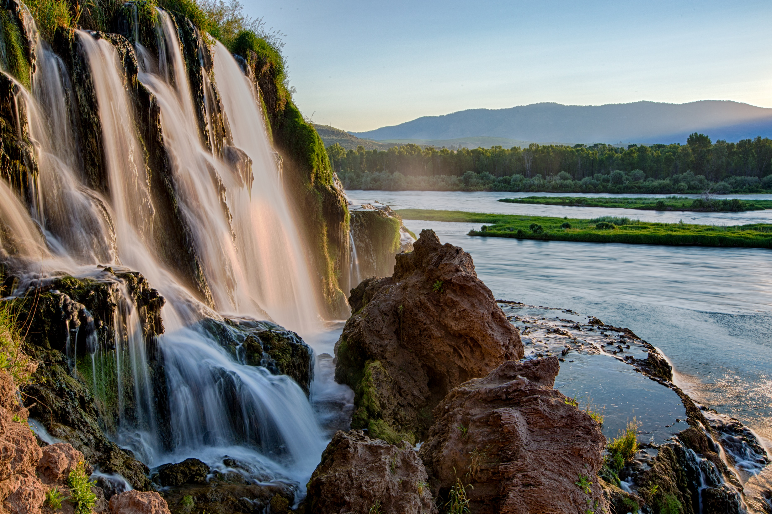
DANL Milestones
2022 Public Comment Period
  May 23, through June 30, 2022
  Introduced an Interactive Web Map/ Nomination Portal
  491 Nominations
    339 Individuals
    25 Recreation User Groups
    22 Conservation Groups
    47 State/County/Local Govt
    2 Federal Govt(non-BLM)
    1 Tribal Government
  Data Analysis: January – April 2023
  TBD Public Access List Parcels
Notes:
2020 Call for Nominations
2020 Notification to the Hill
2022 Process
2022 Projected Notification
Web Map

Slide 9
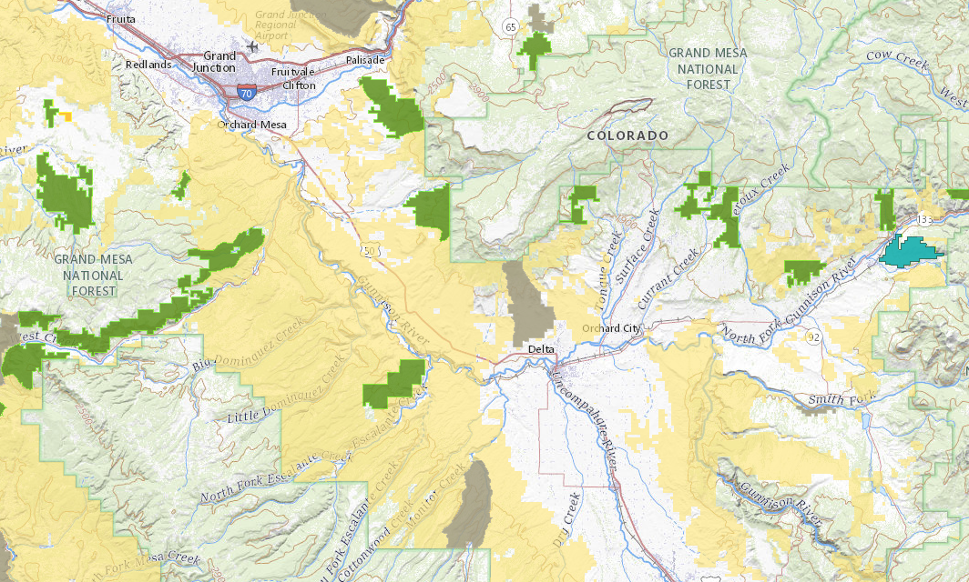
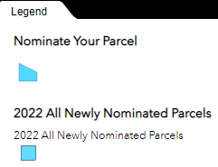
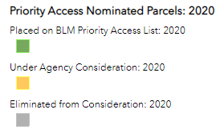
DANL Web Map Portal
Notes:
Show how the nomination process works for 2022
Groundbreaking public portal to “draw” and “submit” access to public lands concerns for BLM consideration. Shows previous nominations, those under consideration, avoids duplication and gives the public latest information.

Slide 10
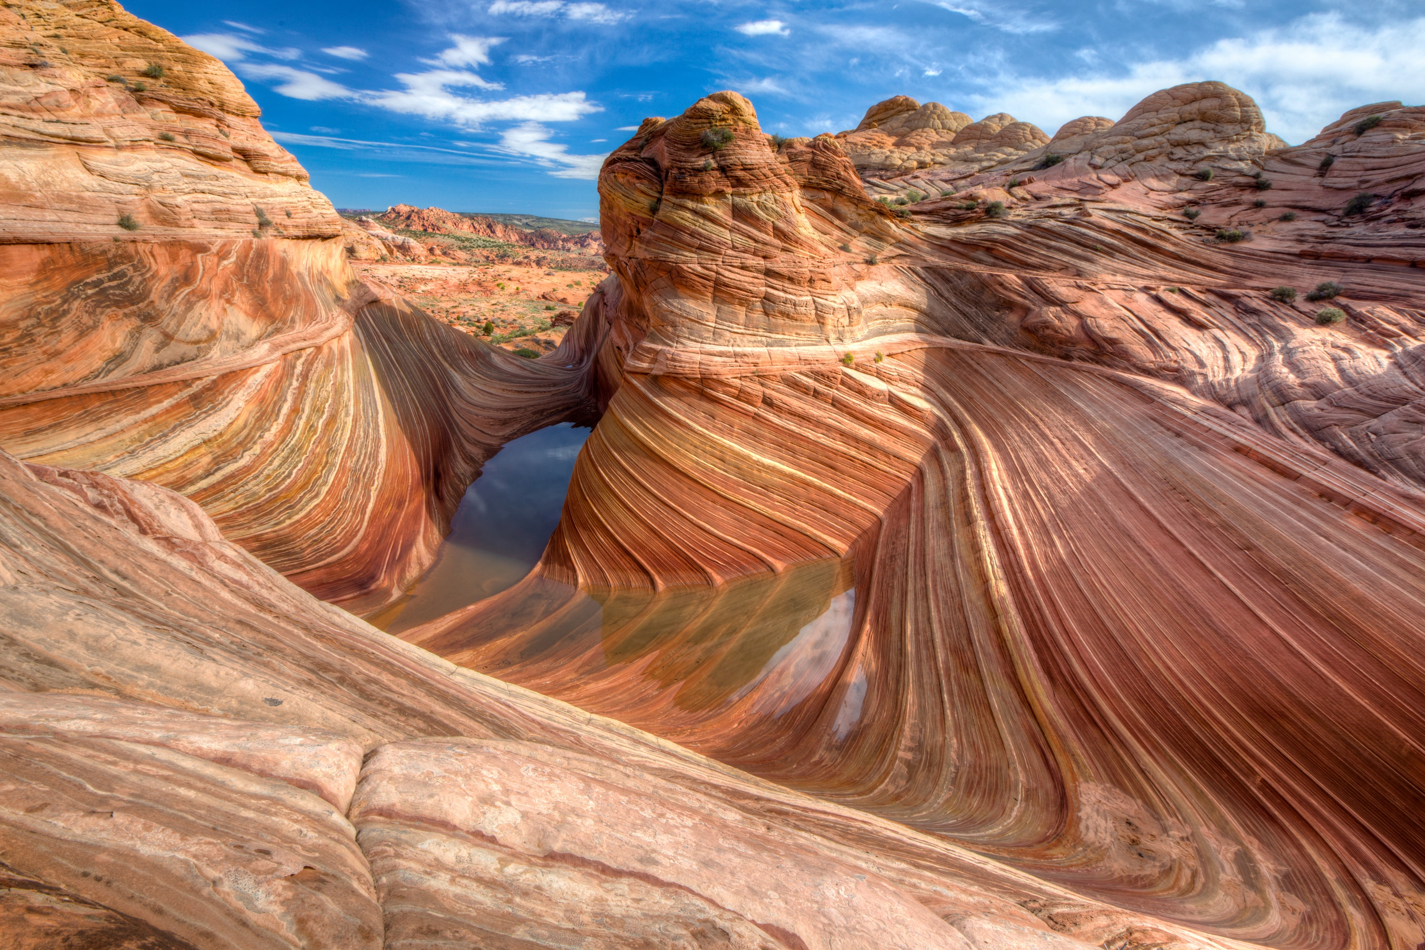
Modernizing Access to our Public Land
Section 4: Digitize and publish GIS mapping data showing Federal rights across private land that provide public recreational access
Public Land Access Data: multi-year effort by the BLM to map all easements and reservations that create or retain public and administrative access
PLAD/MAPLand data affords the BLM additional tools to analyze landlocked parcels and identify opportunities to secure access
Vermillion Cliffs ,Utah
Notes:
Sec 4 of MAPLand Act

Slide 11
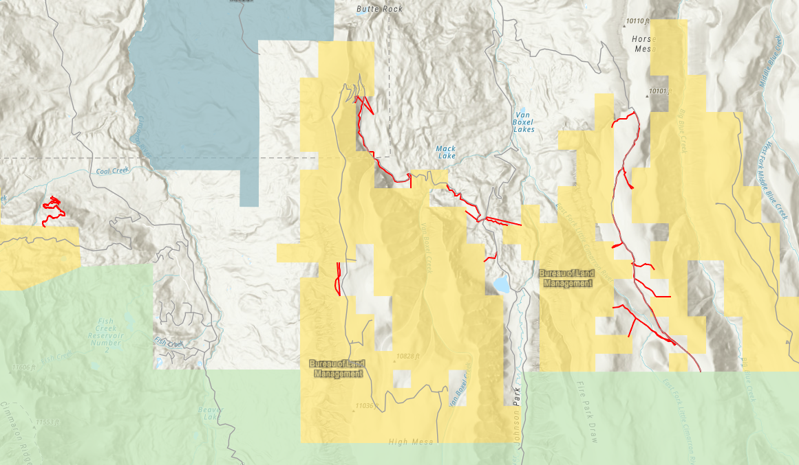
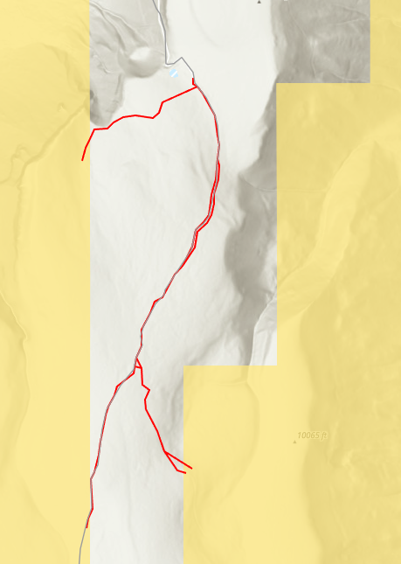
Public Land Access Data Analysis
Notes:
PLAD QC Process
Connection with LWCF and DANL

Slide 12
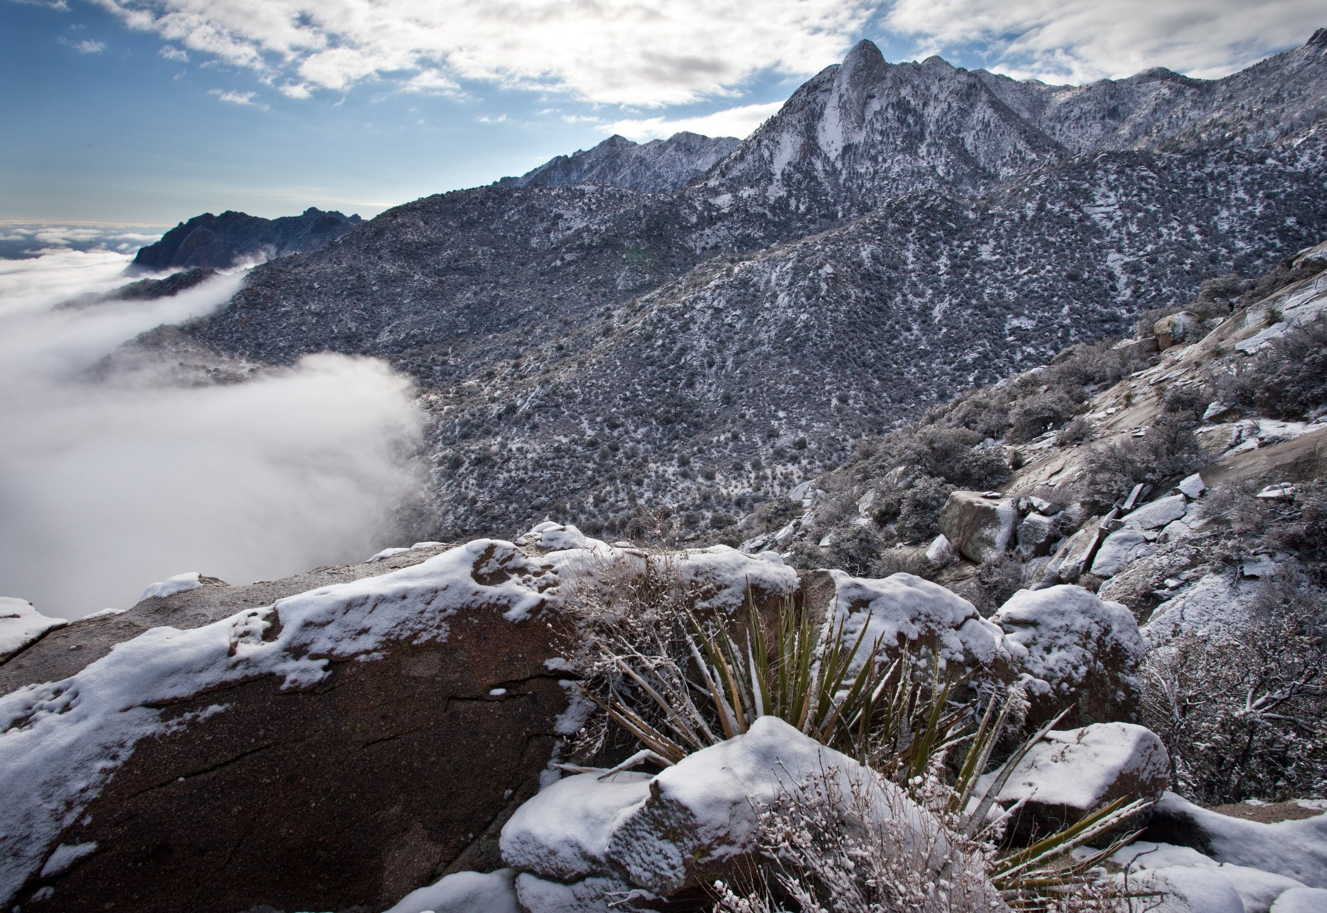
Corner Crossing Laws
Trespass on Private Lands
Casual Use on Public Land
State Law
Organ Mountains, New Mexico
Notes:
BLM supports State law related to legal access over non-Federal land and does not encourage trespass

Slide 13
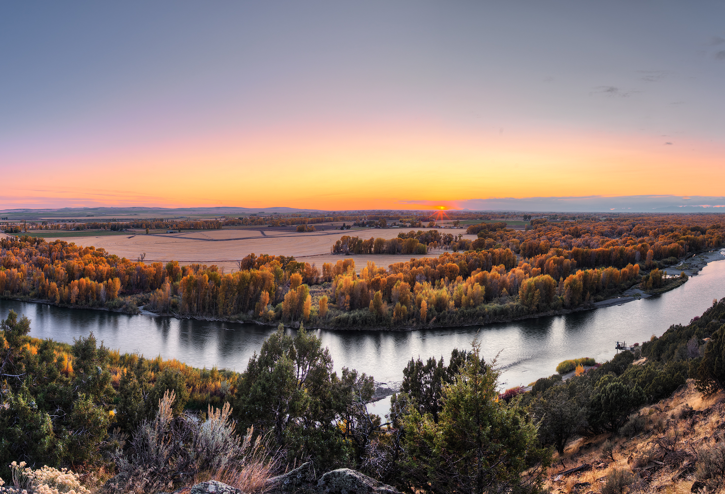
BLM Landlocked Lands
Text
Questions
Jeff Cartwright
Public Land Access Program Manager
jcartwright@blm.gov

