Slide 1
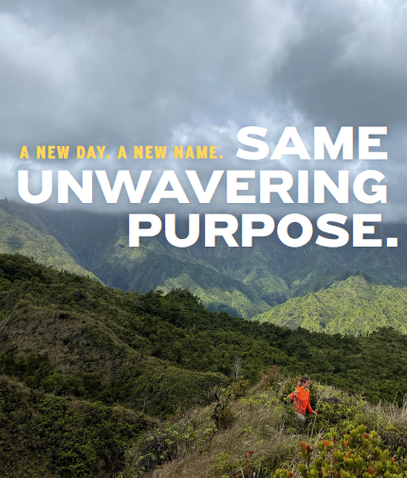

Paul Rauch, Assistant Director

Slide 2
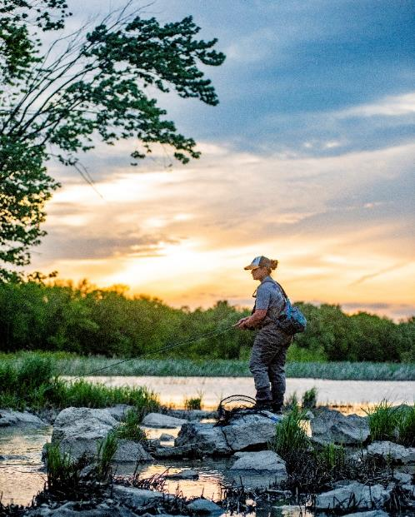
Office of Conservation Investment New Name, Same Unwavering Purpose
We are a program with a legacy started in 1937 with the Wildlife Restoration Grant Program but have grown to support numerous grant programs with a wide range of services for many partners
Today, the Office of Conservation Investment:
Supports thousands of individual grants annually through more than 60 different grant programs
Manages a staff that are occupationally more diverse and cover more fields and skillsets than ever before
Supports other Service programs helping achieve their conservation goals through financial assistance
Notes:
Our new identity honors our eighty-seven-year history of investing in conservation through our two largest grant programs (WR and SFR) while looking to the future and the expanding role of financial assistance to meet the Service’s mission.
Our organizational name has changed but our commitment to the Wildlife Restoration and Sport Fish Restoration grant programs has not. We remain dedicated to administering, managing, and overseeing these keystone programs to the best of our ability, implementing the laws Congress has passed, and doing our part for conservation.

Slide 3



Program Responsibilities
Administer, manage and oversee the allocation and appropriate use of Wildlife and Sport Fish Restoration (WSFR) funds totaling over $1.6 billion annually
Manage ten additional grant programs that fund conservation and connect people with nature
Provide Service-wide financial assistance policy, training, compliance, and operational support for an additional $500 million per year of FWS financial assistance
Evaluate, document, award, and monitor over 4000 funding agreements per year
Notes:
These funds are over half of the Service’s budget.

Slide 4

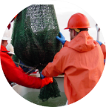
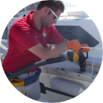
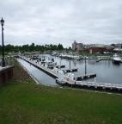
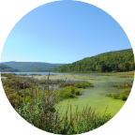
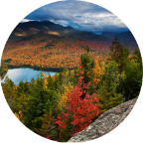
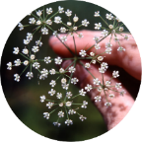
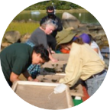
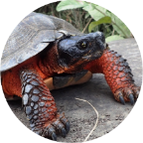
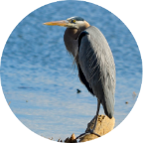
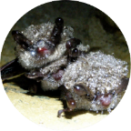
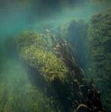
Office of Conservation Investment Grants
Wildlife Restoration
Sport Fish Restoration
Clean Vessel Act
Boating Infrastructure
National Coastal Wetlands Conservation
Highlands Conservation Act
Endangered Species
Tribal Wildlife
State Wildlife
GLRI
National White-Nose Syndrome
Aquatic Invasive Species
Notes:
Here is an example of our expanded role in conservation and outdoor access. These 12 grant programs are directly managed by the Office of Conservation Investment. With dozens of other grants not picture that our staff provide financial assistance and technical support for.
WR and SFR are the cornerstone of our program. While our name has changed, the goal of our financial assistance and grants management services remains straightforward, providing outstanding financial support services that strengthen the Service's core mission, deliver outcomes that foster conservation, improve stewardship of our natural resources, and improve outdoor access.

Slide 5
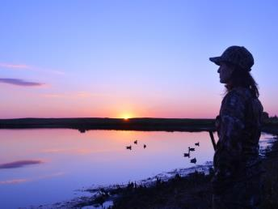
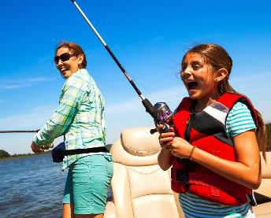
A New Organizational Identity Reflecting Expanded Responsibilities
Over our 87 years as a program, we have undergone many organization changes to better serve the mission of the Service, our partners, and to meet the growing need for conservation and outdoor access
A multiyear evaluation process:
Hosted numerous focus group sessions and informal discussions with state agency staff, NGO partners, and industry leaders
Listening sessions with FWS staff
Selected a name that honors our past and embraces our growing role in conservation
Our new identity as the, Office of Conservation Investment, allows our program to be holistic, inclusive, and relevant to all staff and stakeholders while adding the tag line, Partnering to Fund Conservation and Connect People with Nature, helps tell the world what we do
Notes:
We know that a strong identity leads to organizational success and this renaming effort fosters a program identity that increases awareness with our partners while recognizing our collective and expanded role in conservation. The Office of Conservation Investment has more than 160+ employees throughout the country working on 60 grant programs.
This renaming process was not taken lightly, and we embarked on a multiyear process to gain insights from our staff, state partners, NGOs, and industry. I want to thank everyone that shared their thoughts and expertise during the process.

Slide 6
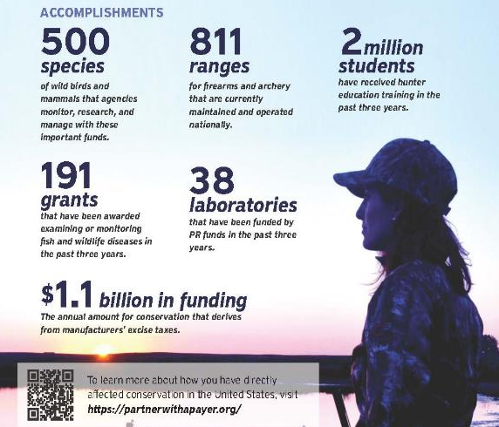
Unwavering Commitment to the Wildlife Restoration Legacy
The WR grants administered through the Office of Conservation Investment have provided billions to partners to fund conservation, stewardship, outdoor access, and to preserve our natural heritage like hunting and fishing.
Notes:
Conservation by its very nature, is an investment in the future. Through the funds managed by the Office of Conservation Investment, grants to state partner agencies have funded the operation and maintenance of over 35 million acres of wildlife management areas for hunting and wildlife viewing, the operation and maintenance of over 9,000 access areas to launch boats for waterway access and fishing, provide hunting and aquatic education courses for millions, support the monitoring of over 500 species of wild mammals and birds, and constructed or renovated over 800 target ranges.

Slide 7
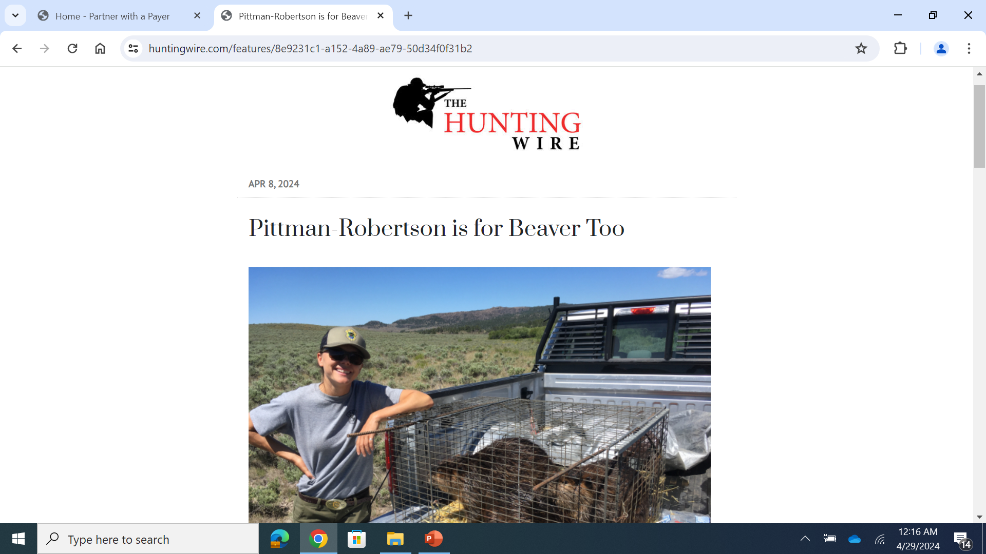
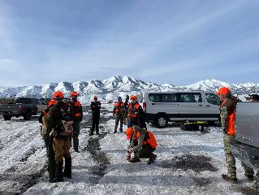
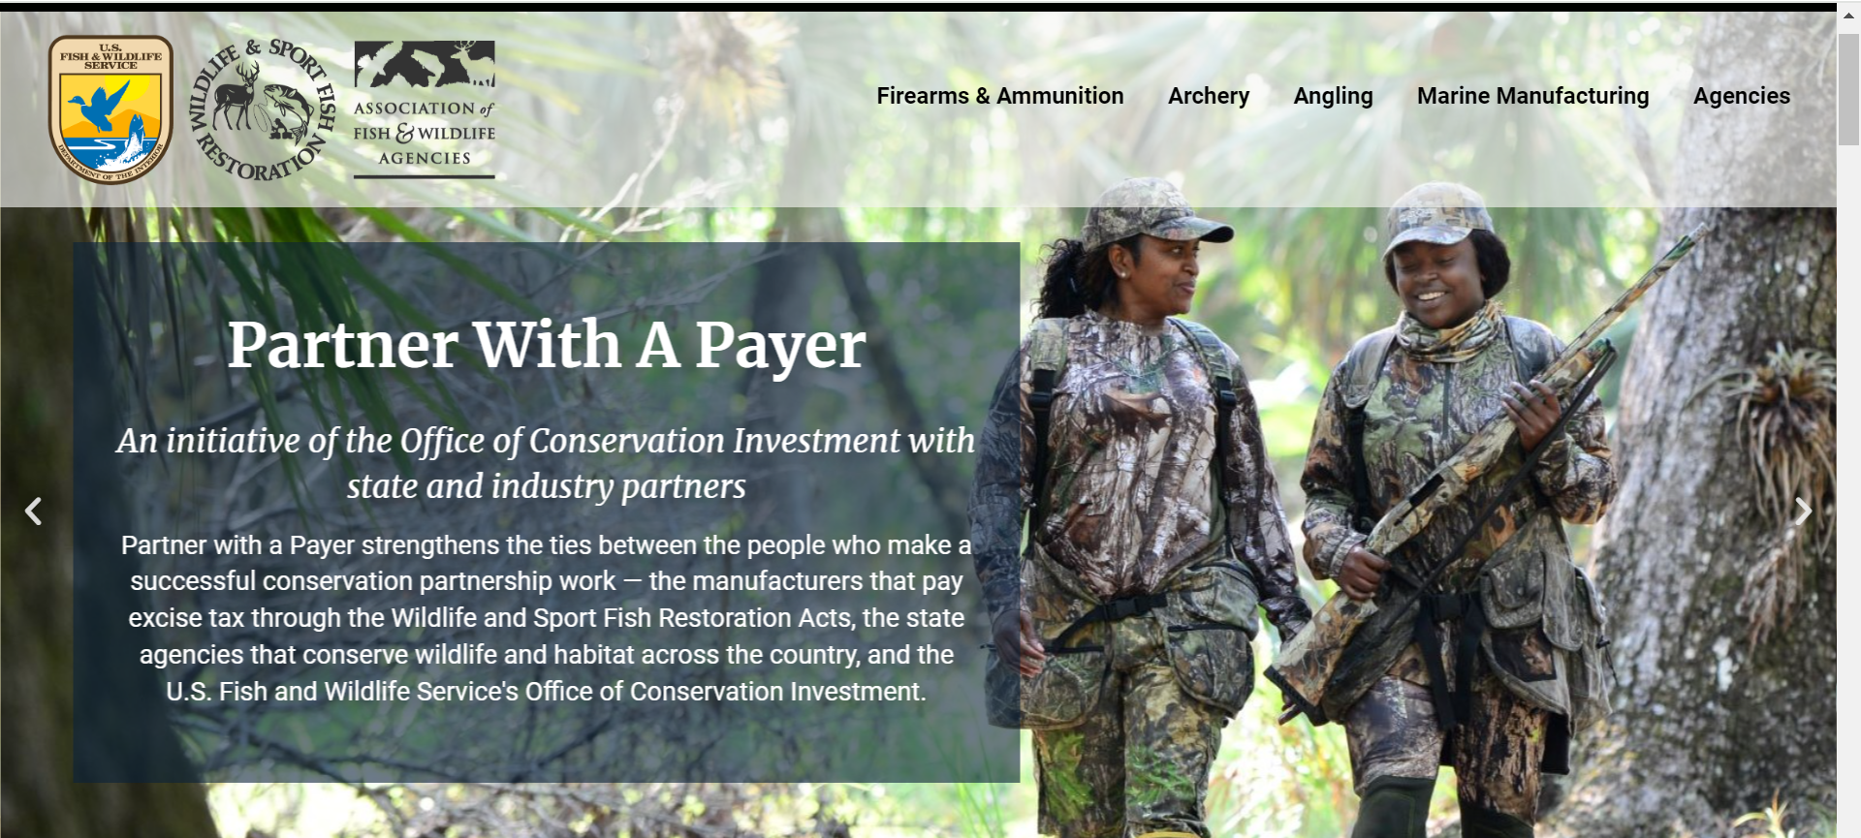
Pride in a Partnership Like no Other
Is reflected in our continued commitment and connection to the hunting, angling, boating, and shooting community:
Partner with a Payer Initiative
  Over 700 attendees at 49 events nationwide
Over 90 articles in trade press like Hunting Wire
Feature stories on fws.gov about WR supported projects and R3 efforts
Active participants in SHOT Show, IHEA, ATA, ICAST, and the R3 Symposium
Encourage staff to attend CLFT
Notes:
As the Office of Conservation Investment, we will continue our partnership with the hunting, angling, boating, and shooting community. Partner with a Payer events have connected over 700 attendees nationwide.
Our communications and outreach work regularly features articles for the hunting wire and the Service’s website. These include features on new public hunting areas, hunter education courses at Tuskegee University, and hunting for sustainability stories.
Our staff attend SHOT show, ATA, IHEA, ICAST, and the R3 symposium to build and maintain connections to the hunting community.
Many new staff members have attended CLFT with the most recent attending in February.

Slide 8

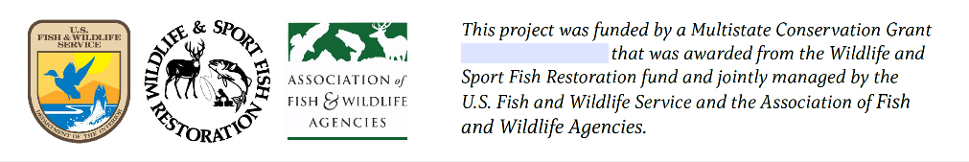
Unchanged Grant Acknowledgments
Grant Acknowledgment - Distinctive Symbols:
Wildlife & Sport Fish Restoration (WSFR)
Wildlife Restoration (WR)
Sport Fish Restoration (SFR)
Clean Vessel Act (CVA)
Multistate Grant Award Acknowledgment:
Notes:
As part of the renaming effort, we will be using a new word mark for our program branding. However, WR and SFR distinctive symbols will continue to be used on WMA signage, public boat ramp signage, and on multistate grants.

Slide 9
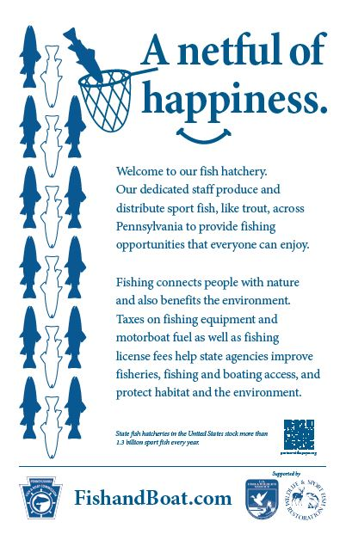
Signage Project
Notes:
Tom Decker is working on a pilot to create new and more welcoming signage that highlights WR and SFR funded projects. 12 or so agencies are currently involved, and new signs are currently in production for Pennsylvania.

Slide 10
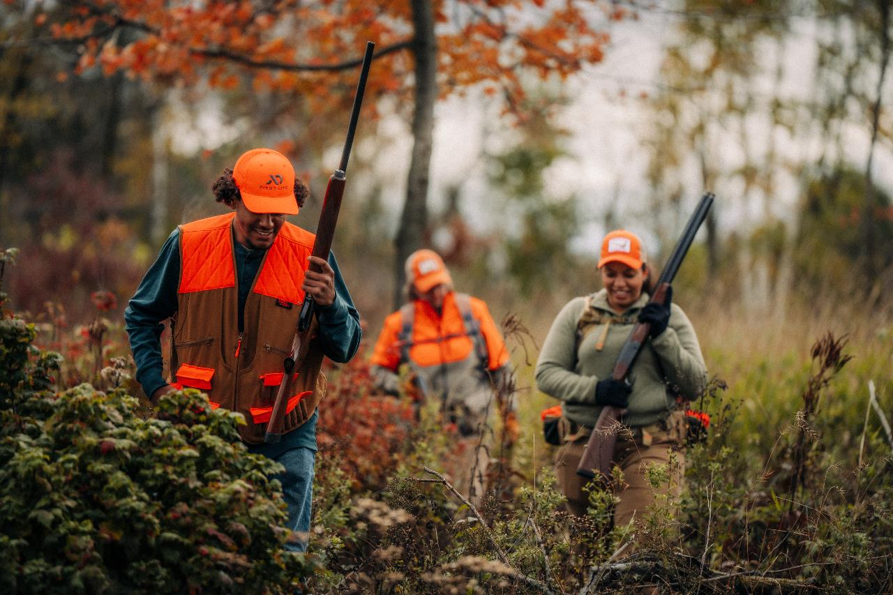
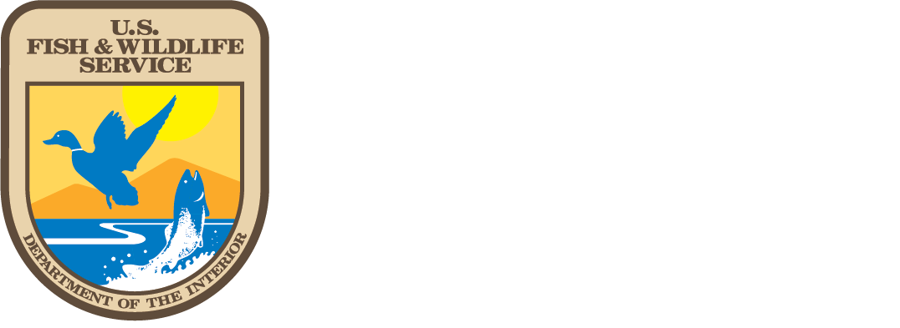

Thank you
Paul Rauch – Assistant Director

