Slide 1
National Old Growth Amendment
Draft Environmental Impact Statement
Status and Process
May 17, 2024
Jennifer McRae, Assistant Director, Planning and Public Engagement
National Old Growth Amendment Team Leader

Slide 2
The Pathway Here
Executive Order 14072 – Strengthening the Nation’s Forests, Communities and Local Economies, April 2022
Secretary’s Memo 1077-04 – Climate Resilience and Carbon Stewardship of America’s National Forests and Grasslands, June 2022
Advanced Notice of Proposed Rulemaking, April 2023
Mature and Old Growth Definition and Inventory,
Climate Risk Viewer Online Tool,
and Threat Analysis
Engagements &
Feedback evaluation
PROPOSED
AMENDMENT
December 20, 2023

Slide 3
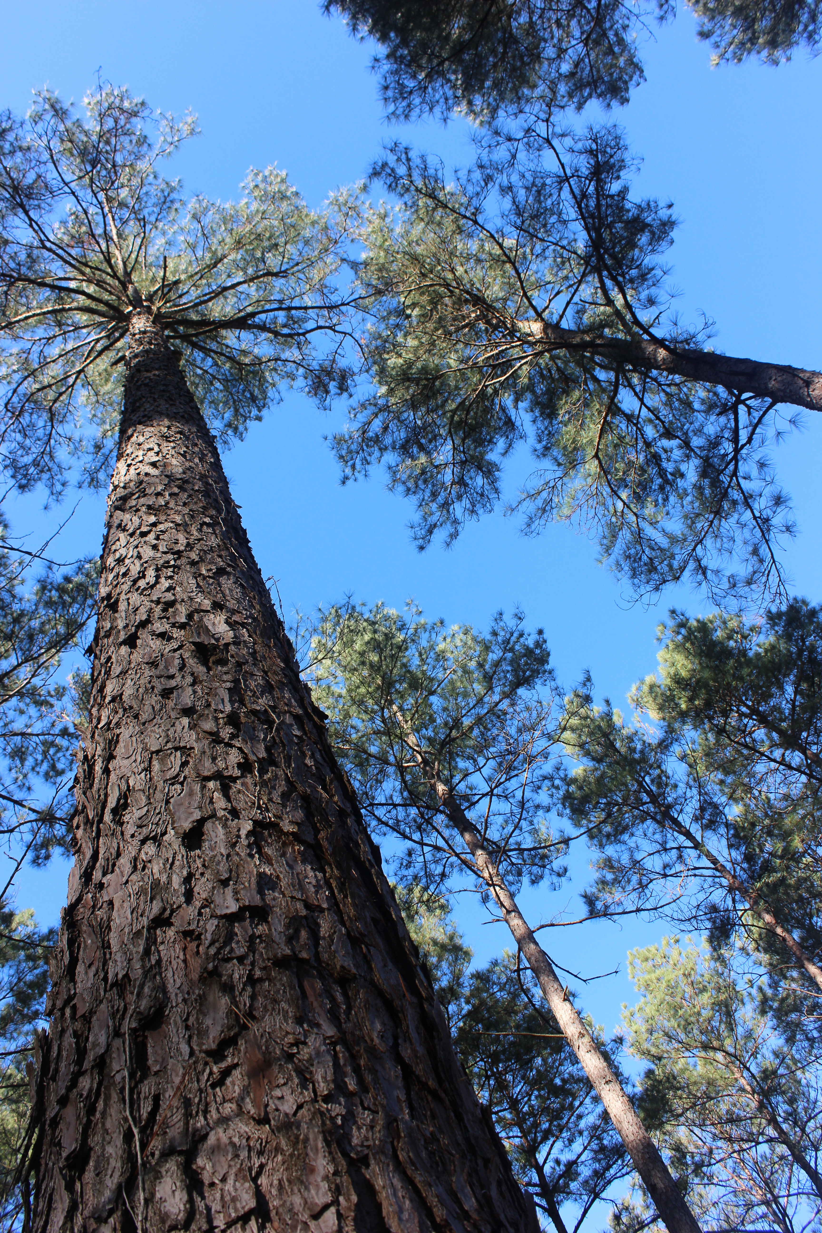
The Amendment
December 20, 2023: Published Notice of Intent to prepare an Environmental Impact Statement in the Federal Register
  Proposal to amend all (128) land management plans
  Consistent direction to conserve and steward existing and recruit future old-growth forest condition

Slide 4
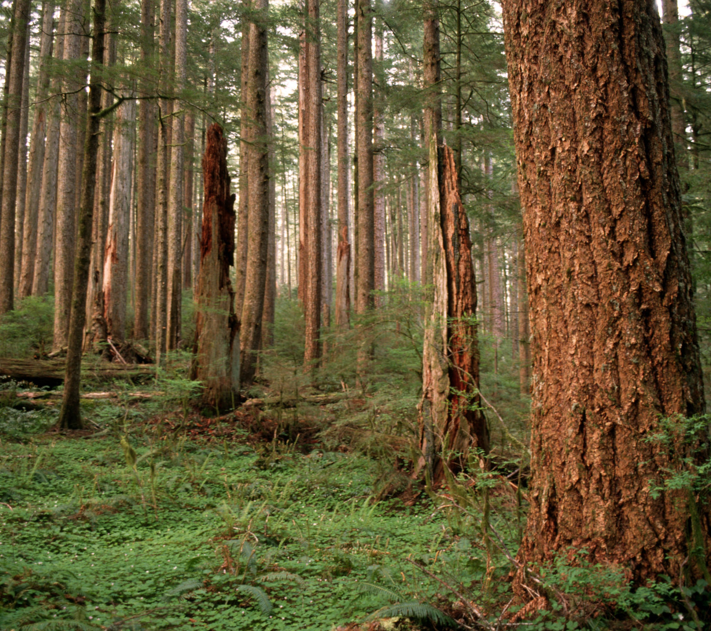
Proposed Actions
Vegetation management activities:
Must not degrade or impair the long-term persistence of old-growth forest conditions.
Must be for the purpose of proactive stewardship to promote resilient and adaptable future environments.
May not be for the primary purpose of growing, tending, harvesting, or regeneration of trees for economic reasons.

Slide 5
Proposed Action
Establish a clear role for Indigenous Knowledge and tribal leadership in the
proactive stewardship and furtherance of old-growth forest conditions
Facilitate a National Old-Growth Monitoring Network to track trends and distribution
patterns in old-growth to inform management
Facilitate the development of geographically informed adaptive management
strategies for old-growth forest conservation

Slide 6
Steps & Process
The Draft Environmental Impact Statement
Public scoping period closed Feb. 2, 2024
Currently analyzing content from over 7,300 responses
Revise proposed action and/or develop action alternative, if needed
Ongoing public engagement with:
  Tribes and Alaska Native Corporations, invitations to consult
  Cooperating agencies to include states, counties and Tribes
  A wide range of stakeholders

Slide 7
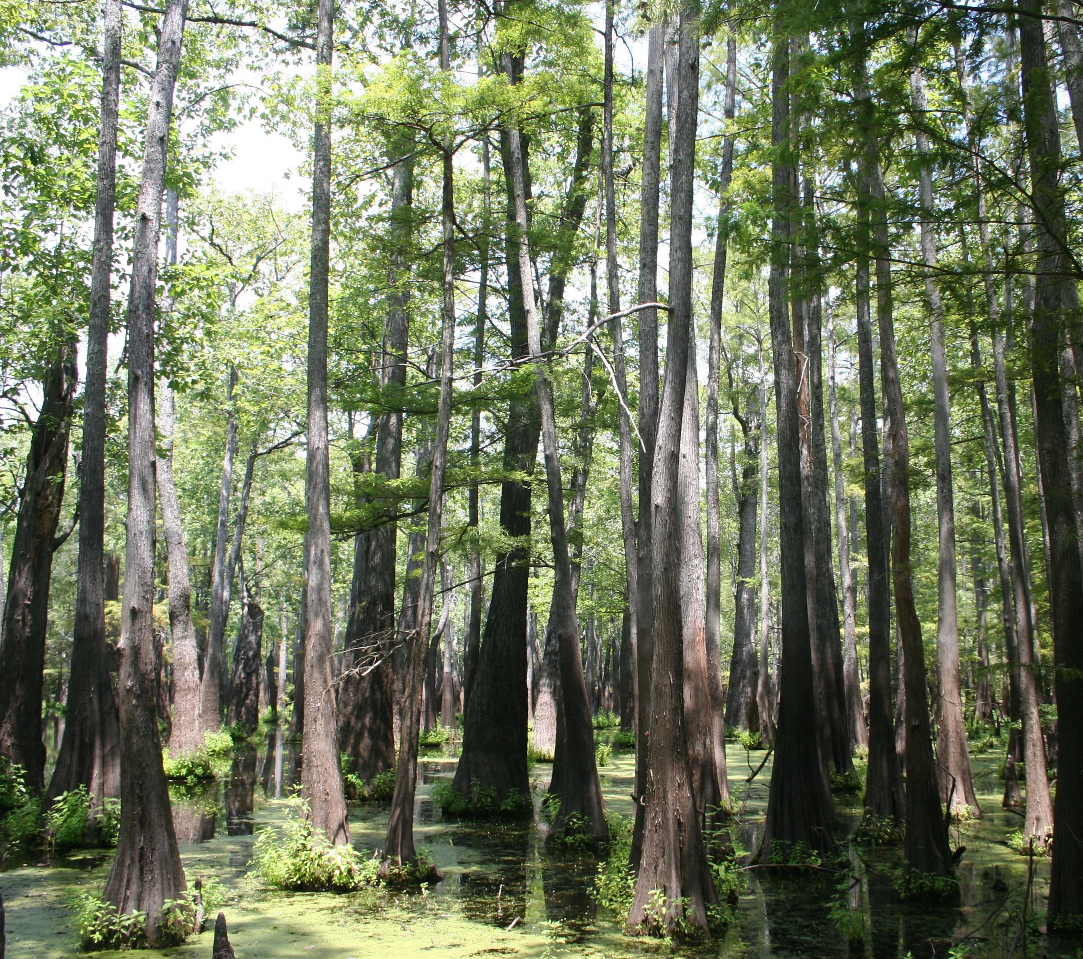
Steps & Process
The Draft Environmental Impact Statement
Prepare and publish Draft Environmental Impact Statement
90-day comment period
Comment analysis
Response to Draft Environmental Impact Statement comments
Publish final Environmental Impact Statement

Slide 8
The Pathway Forward
PROPOSED
AMENDMENT
early, 2025
Support old-growth forest conservation through local collaborative processes
Monitoring, Assessment, Adaptation
Increases in Abundance and Distribution of Old-Growth Forest Conditions

