Slide 1
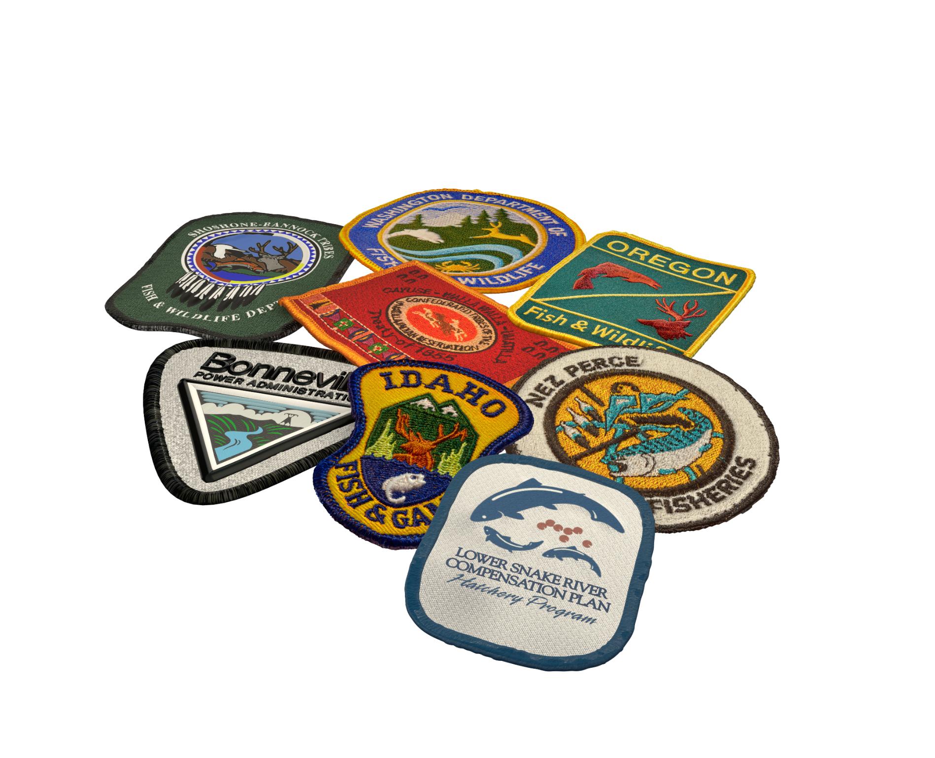
Lower Snake River Compensation Plan
Infrastructure Audits
Nathan Wiese and Chris Starr LSRCP

Slide 2
Goal of Infrastructure Audits
Review current Hatchery practices
Review existing concrete – what could it do?
Identify “bottlenecks” to achieving adult returns
Identify additional opportunities
  Operations
  Infrastructure
  Program changes

Slide 3
LSRCP Steelhead Performance
Facility | Smolts (2024 Goals) | Adult Goal | BY00-12 Mean SAR | Expected Adults | Difference from Goal
Clearwater | 843,000 | 14,000 | 1.37% | 11,549 | (2,451)
Hagerman | 1,560,000 | 13,600 | 1.32% | 20,592 | 6,992
Magic Valley | 1,550,000 | 11,660 | 1.03% | 15,965 | 4,305
Irrigon | 1,015,000 | 11,184 | 1.63% | 16,545 | 5,361
Lyons Ferry | 585,000 | 4,656 | 2.16% | 12,636 | 7,980
 | 5,553,000 | 55,100 | 1.39% | 77,287 | 22,187

Slide 4
Dworshak Steelhead Goals (ACOE)
Basin | Facility | Smolts (2024 Goals) | Adult Goal
Clearwater | Dworshak | 2,100,000 | 19,000

Slide 5
Steelhead Adults/Trapped Adult
BY2000-2012
Facility | Adults Returned per Trapped Adult
Clearwater | 32
Hagerman | 28
Magic Valley | 20
Irrigon | 33
Lyons Ferry | 43
Average | 31

Slide 6
Spring Chinook Adult Returns per Adult Trapped, BY07-16
Facility | Location | Adults Returned per Trapped Adult
McCall | South Fork Salmon | 6.4
Sawtooth | Sawtooth Weir | 5.1
Clearwater | Clear Creek | 6.1
Clearwater | Lower Selway | 5.3
Clearwater | Red River | 3.2
Clearwater | Lochsa | 3.4
Dworshak | North Fork Clearwater | 7.0
Dworshak/NPTH | Lapwai | 7.0
Lookingglass | Catherine | 8.7
Lookingglass | Lostine | 13.1
Lookingglass | Upper Grande Ronde | 5.7
Lookingglass | Lookinglass Creek | 7.4
Lookingglass | Imnaha River | 10.8
 | LSRCP Average | 6.6

Slide 7












Lower Snake River Compensation Plan Program

