Slide 1
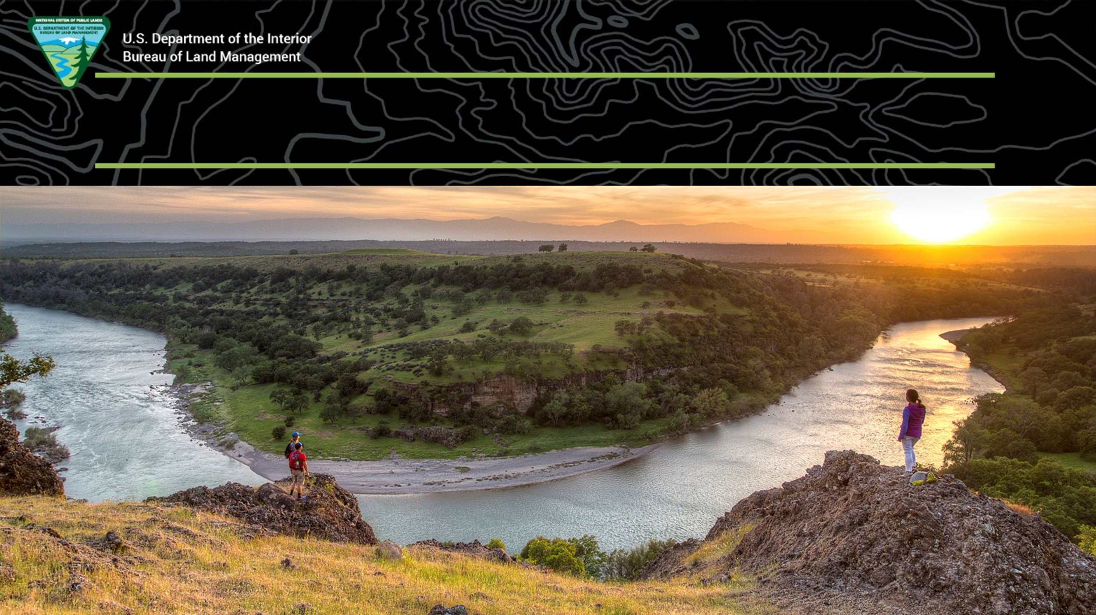
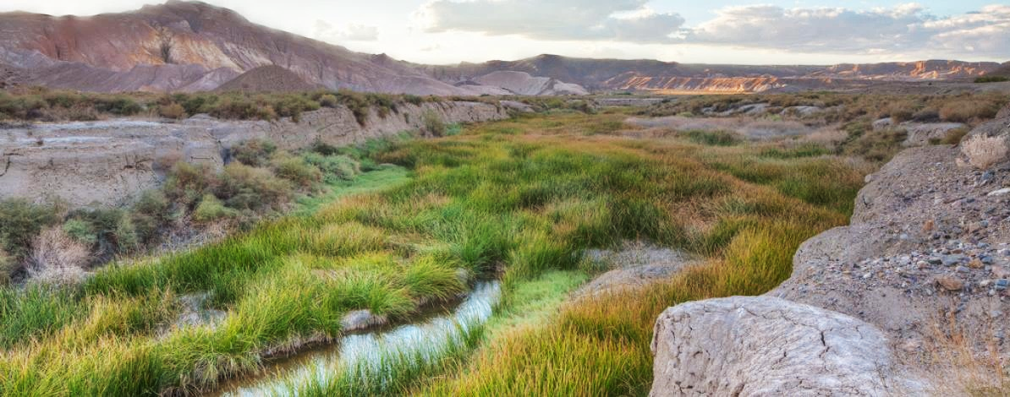
Aquatic Restoration Categorical Exclusion
Notes:
Welcome to the presentation on the proposed Aquatic Restoration Categorical Exclusion and thank you for attending the webinar today. We have four panel members from BLM Headquarters Aquatic Resources Program presenting the webinar, which is expected to take about 20 minutes with about 10 to 15 minutes afterwards to answer any questions you may have.
My name is Sharmila Jepsen, I work for BLM headquarters Aquatic Resources Program as lead fisheries biologist. Paula, Melissa and Scott please introduce yourselves.

Slide 2

National Environmental Policy Act (NEPA)
The Purpose of NEPA and the Mission of the BLM are compatible.
The Bureau of Land Management’s (BLM) mission is to sustain the health, diversity, and productivity of public lands for the use and enjoyment of present and future generations. | The NEPA declares the Federal government’s policy is to maintain conditions under which people and nature can exist in productive harmony.
Notes:
I want to begin by talking a little about NEPA and highlighting the similarity between the mission of the BLM and the purpose of NEPA. The mission of the BLM and the purpose of NEPA are considered compatible.
Read from the slide…

Slide 3
BLM NEPA
An Environmental Assessment
An Environmental Impact Statement
A Categorical Exclusion
Notes:
BLM uses various types of documents to meet our NEPA requirements.
An Environmental Assessment is prepared when the significance of the effects of an action are unclear.
An Environmental Impact Statement is prepared if a proposed action will have a significant environmental impact.
A Categorical Exclusion is prepared when the proposed action belongs to a category of actions that have no potential for significant environmental impacts.
For the Bureau of Land Management, all actions that are analyzed in NEPA documents are guided by Land Use Plans known as Resource Management Plans.

Slide 4
Development of a Categorical Exclusion
The proposed categorical exclusion is based on:
Previous environmental assessments with lack of significance.
Categorical exclusions used by other agencies.
Support for the proposed category in peer reviewed literature.
Notes:
Now …The development of a categorical exclusion is a lengthy and detailed endeavor.
First the language of the Categorical Exclusion is developed, this is based on the activities that are commonly used by BLM.
Next a verification report is prepared, the report substantiates the need for the categorical exclusion. The proposed aquatic restoration categorical exclusion uses the following components to substantiate the need for the categorical exclusion.
Read from the slide…
This is followed by an extensive internal and external review, including BLM solicitors, the Office of Environmental Policy and Compliance and the Center for Environmental Quality.
A 30 –day public comment period will be provided when the federal register notice is released.

Slide 5
Why is BLM preparing this Categorical Exclusion?
To give field offices a new NEPA tool to carry out aquatic restoration work.
To improve the implementation rate of restoration work.
BLM Field Offices currently lack this tool (categorical exclusion) unlike many other agencies.
Notes:
Field Offices have prepared several Environmental Assessments to carry out aquatic restoration work.
Because of their diligent work on these Environmental Assessments, we are able to provide them with an additional NEPA tool to complete aquatic restoration in the form of a categorical exclusion.
This will help expedite the NEPA process and assist in faster implementation of aquatic restoration.
Currently BLM field offices do not have a categorical exclusion for use in implementing aquatic restoration projects. Other agencies do rely on categorical exclusions.

Slide 6
Other agencies with Categorical Exclusions relevant to aquatic restoration
United States Forest Service
Natural Resources Conservation Service
Department of Homeland Security
United States Fish and Wildlife Service
National Park Service
Notes:
Here is some information about other agency categorical exclusions.
Read from the slide…
In comparison, BLM is preparing one category with four activities

Slide 7
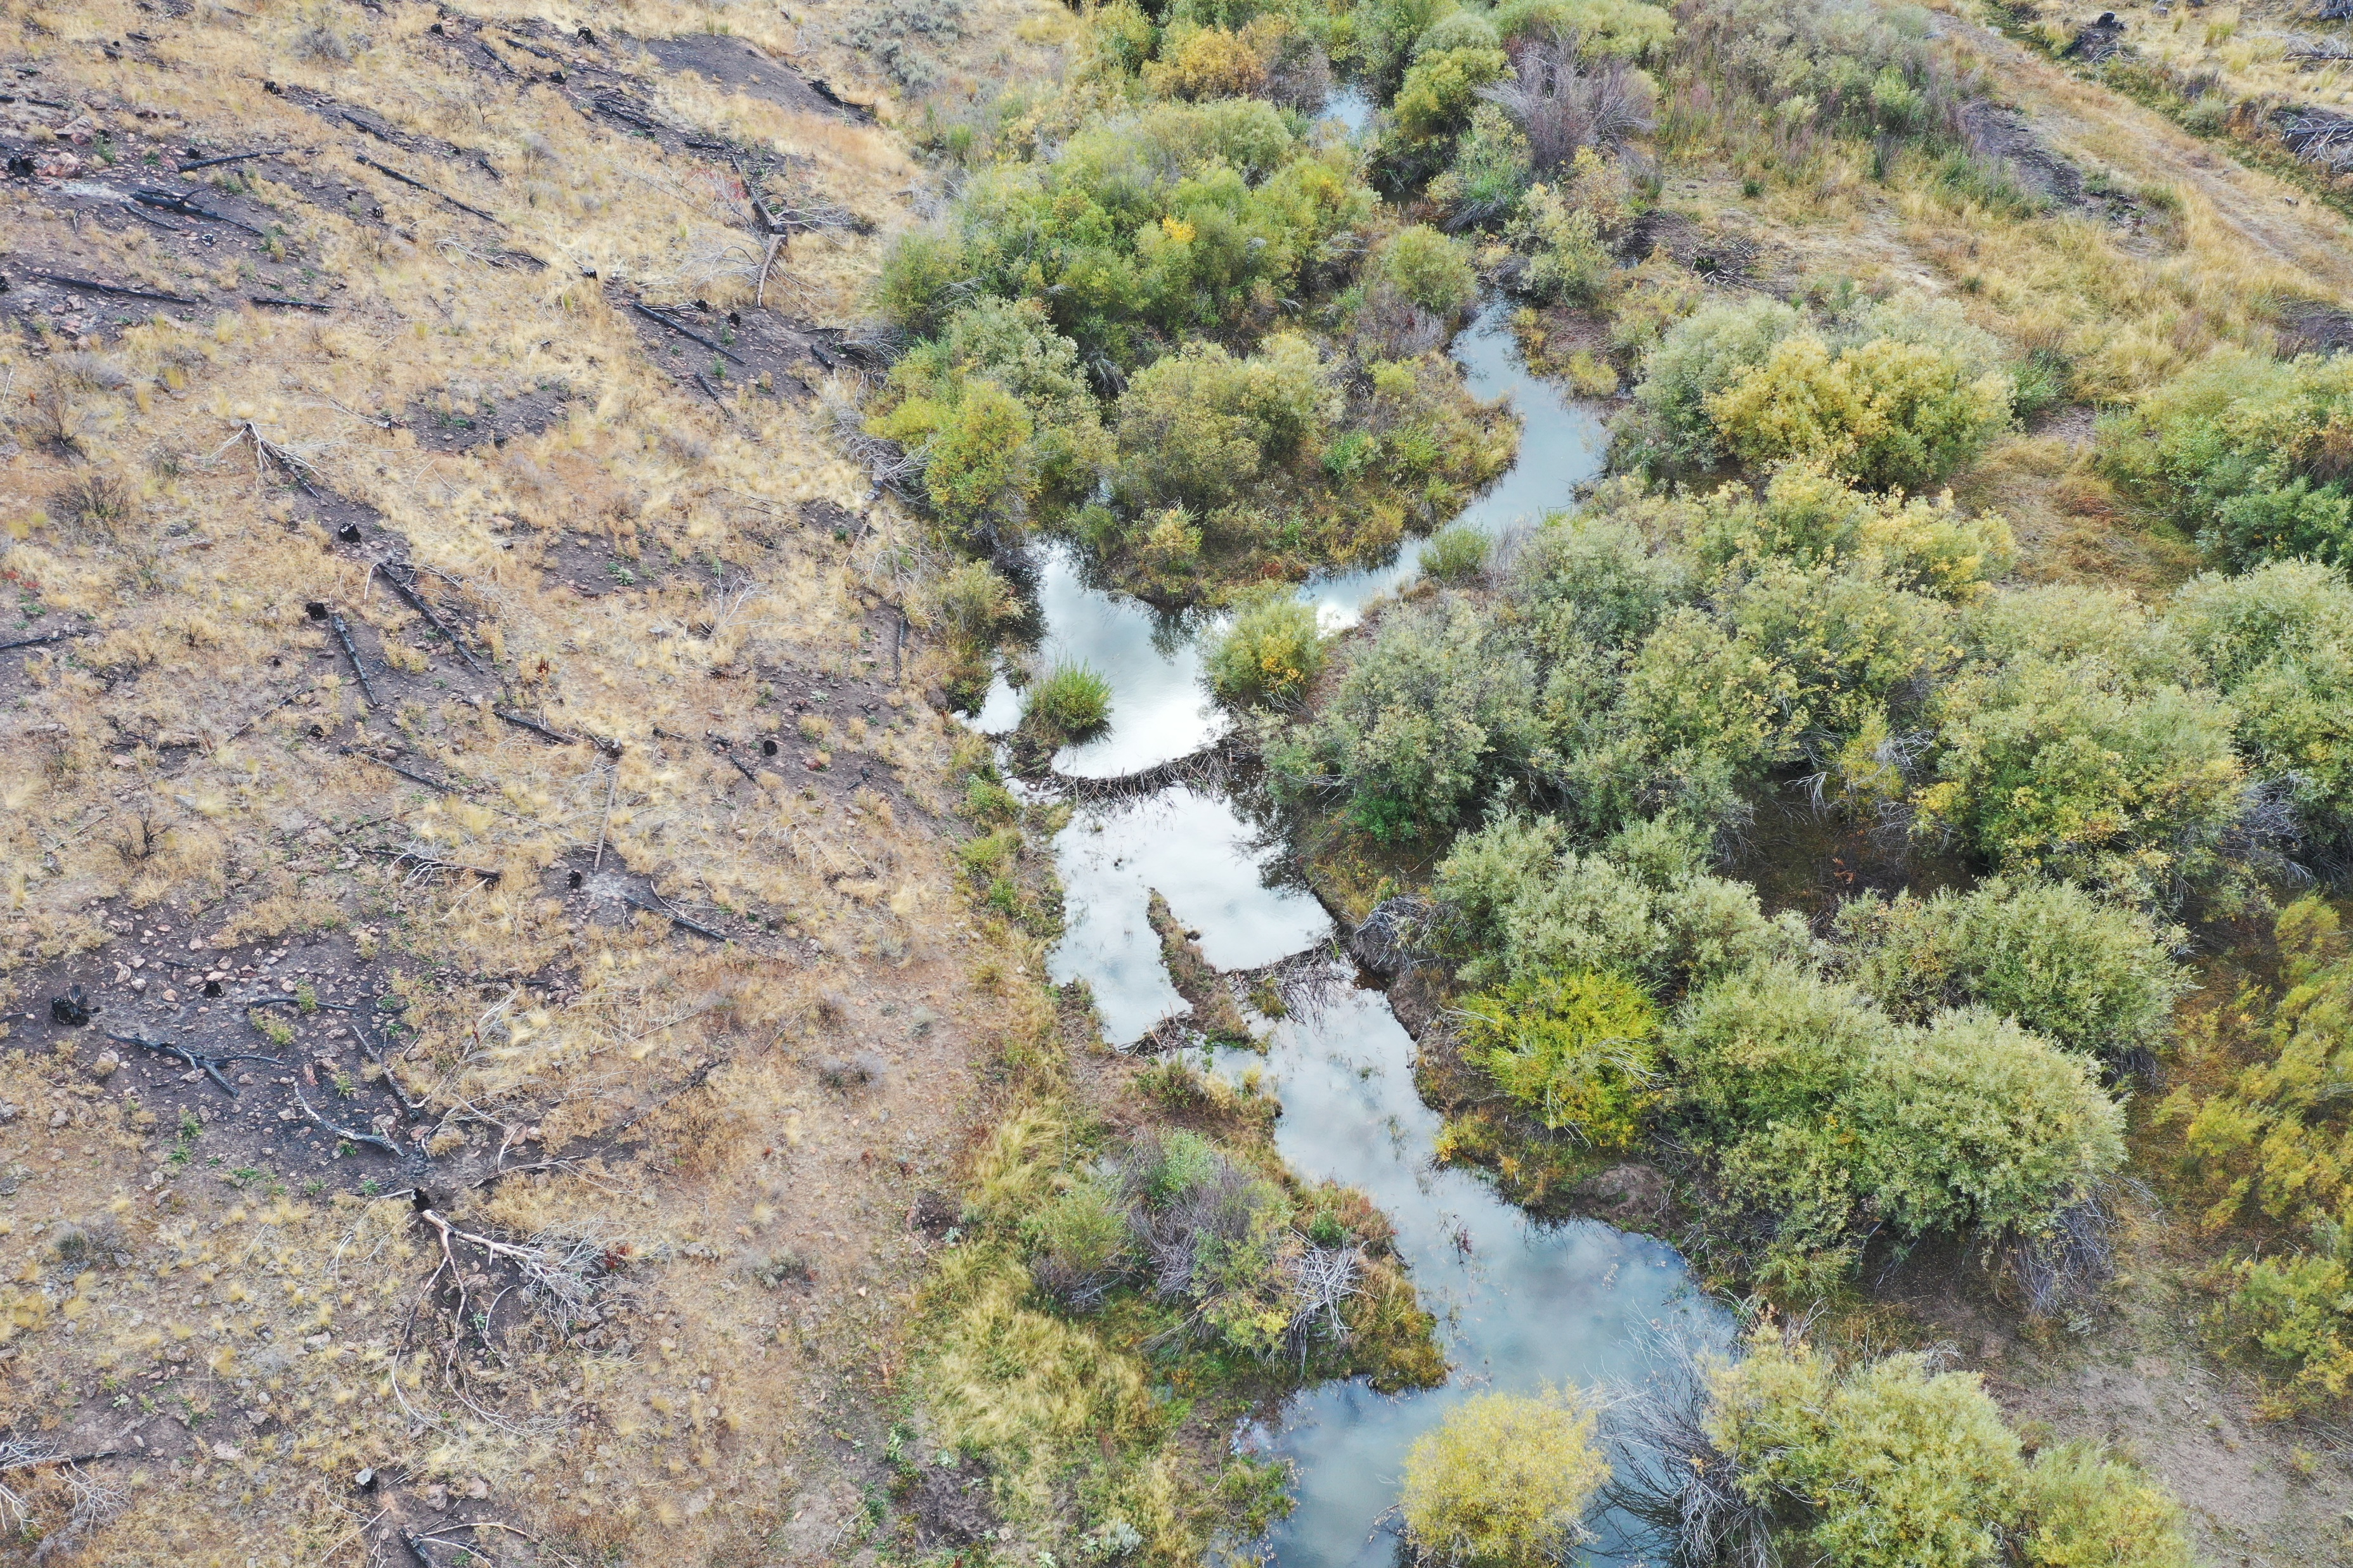
Develop a suite of actions for implementing aquatic restoration under the proposed aquatic restoration CX
Commonly occurring aquatic restoration activities
Improve structural complexity
Improve connectivity
Protect resources
Improve riparian function
Notes:
Our goal in developing this proposed aquatic restoration categorical exclusion for BLM is to include a list of commonly occurring aquatic restoration actions on BLM lands.
The suite of actions being considered are under the following four themes: Improve structural complexity, improve connectivity, protect resources, improve riparian function.

Slide 8
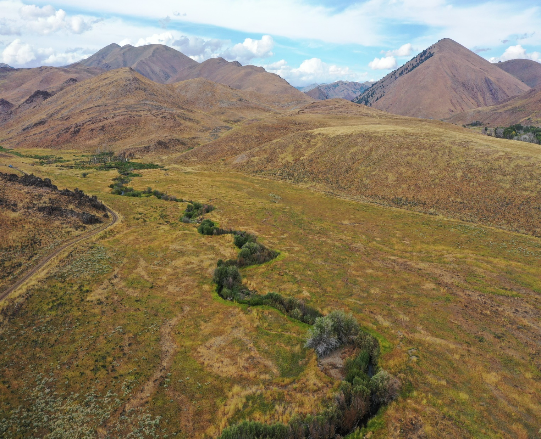
Main Categorical Exclusion language
Implement the following four activities to improve water quality, aquatic and riparian habitat, and overall ecosystem function by enhancing structural complexity, removing barriers to connectivity, and mimicking or promoting natural processes
Notes:
The main categorical exclusion text is the following:
Read from the slide…

Slide 9
Activity 1
Building, modifying, or maintaining small permeable
structures in wetlands including wet meadows, streams,
riparian areas, or other water bodies using natural materials, within a total of 10 stream miles
and/or a total aggregated structural footprint of 100 acres.
Notes:
This is the first of the four activities.
Read from the slide...
What do we mean by small permeable structures? These are small structures such as Beaver Dam Analogs and Post Assisted Log Structures aka BDAs and PALs, they are made out of natural materials These are structures that promote stream meandering, stream braiding, sediment deposition and increase pool and riffle habitat.
Natural materials are best for building these structures. Materials from riparian or upland areas are often used to build these structures.
Each activity has a size associated with it. These miles and acreages are from the Environmental Assessment documents that have been prepared by Field and District Offices.
In instances where Field or District Offices have prepared programmatic Environmental Assessments, we looked at how many miles and acres of aquatic restoration was implemented in one season. These size limitations are within the capabilities and needs of Field and District Offices.

Slide 10
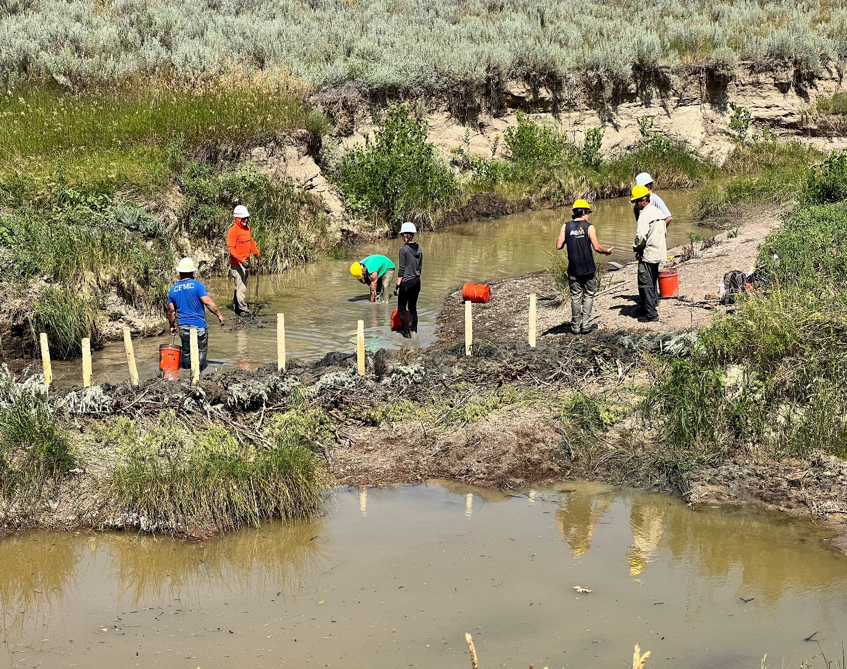
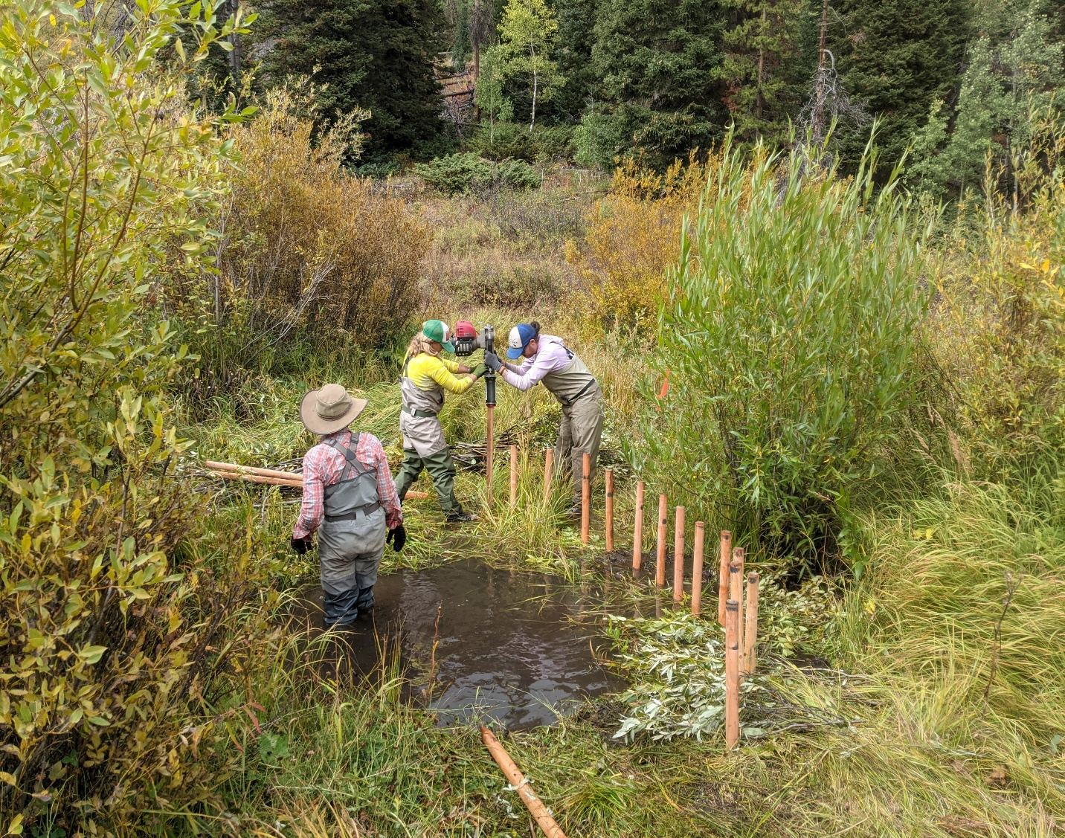
Activity 1
Small permeable structures in streams and riparian areas
Notes:
I’ll go over the activities in detail. Activity 1 includes permeable structures that are usually hand built with the aid of a motorized pole pounder.
We consider these structures to be non-permanent and likely to be redistributed under high flow conditions to mimic natural conditions. These structures called BDAs or PALS are important restoration techniques for promoting processes to restore natural conditions.

Slide 11
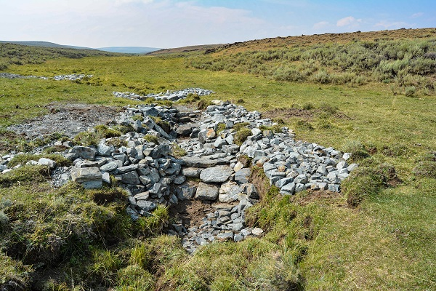
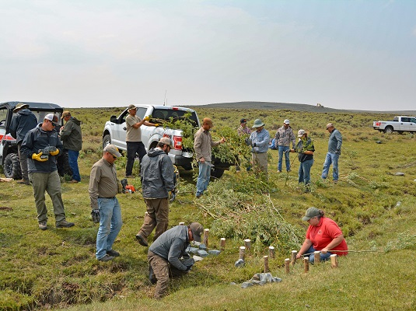
Activity 1
Small permeable structures in wetlands and wet meadows
Notes:
Activity 1 also includes, small structures such as Zeedyk structures shown in the picture to the left which help stabilize head cuts in small prairie streams; they are commonly implemented on BLM lands. A Categorical Exclusion will help implement these actions quickly.

Slide 12
Activity 2
Removing, modifying, or replacing culverts; installing, modifying, or replacing fish screens; removing or modifying up to one mile of a water control structure such as a ditch; and decommissioning up to one mile of roads or unauthorized trails.
Notes:
Activity 2 is the following:
Read from the slide…

Slide 13
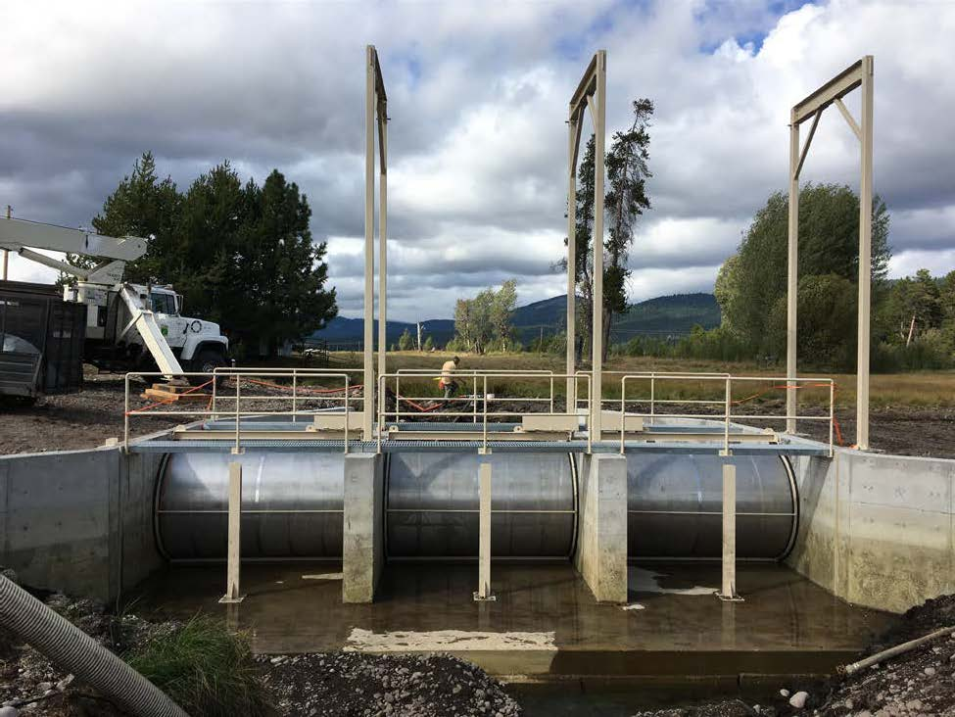
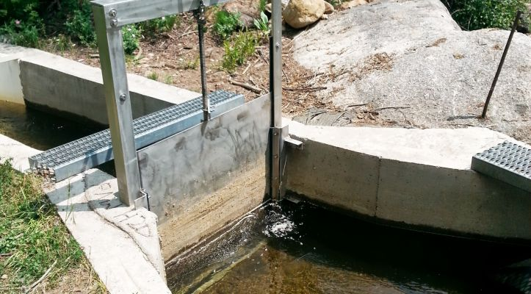
Activity 2
Removing, replacing or modifying gates and installing fish screens
Notes:
Activity 2 also proposes removing, replacing, or modifying gates and installing fish screens. The picture on the left is a newly replaced fish screen on the Wood River in Oregon, BLM worked with Western Native Trout Initiative on this. Fish are diverted back to the river instead of being driven into agricultural fields.
Gates used in diversion structures are replaced regularly, they help maintain proper water levels to balance agricultural needs with the needs of aquatic species. These gates need fish screens to keep fish and other aquatic species from entering diversion canals and being forced into agricultural fields. Gates such as these need to be modified or replaced with gates that have fish screens, so that when these gates are open, fish and other aquatic species do not get swept into diversion canals.

Slide 14
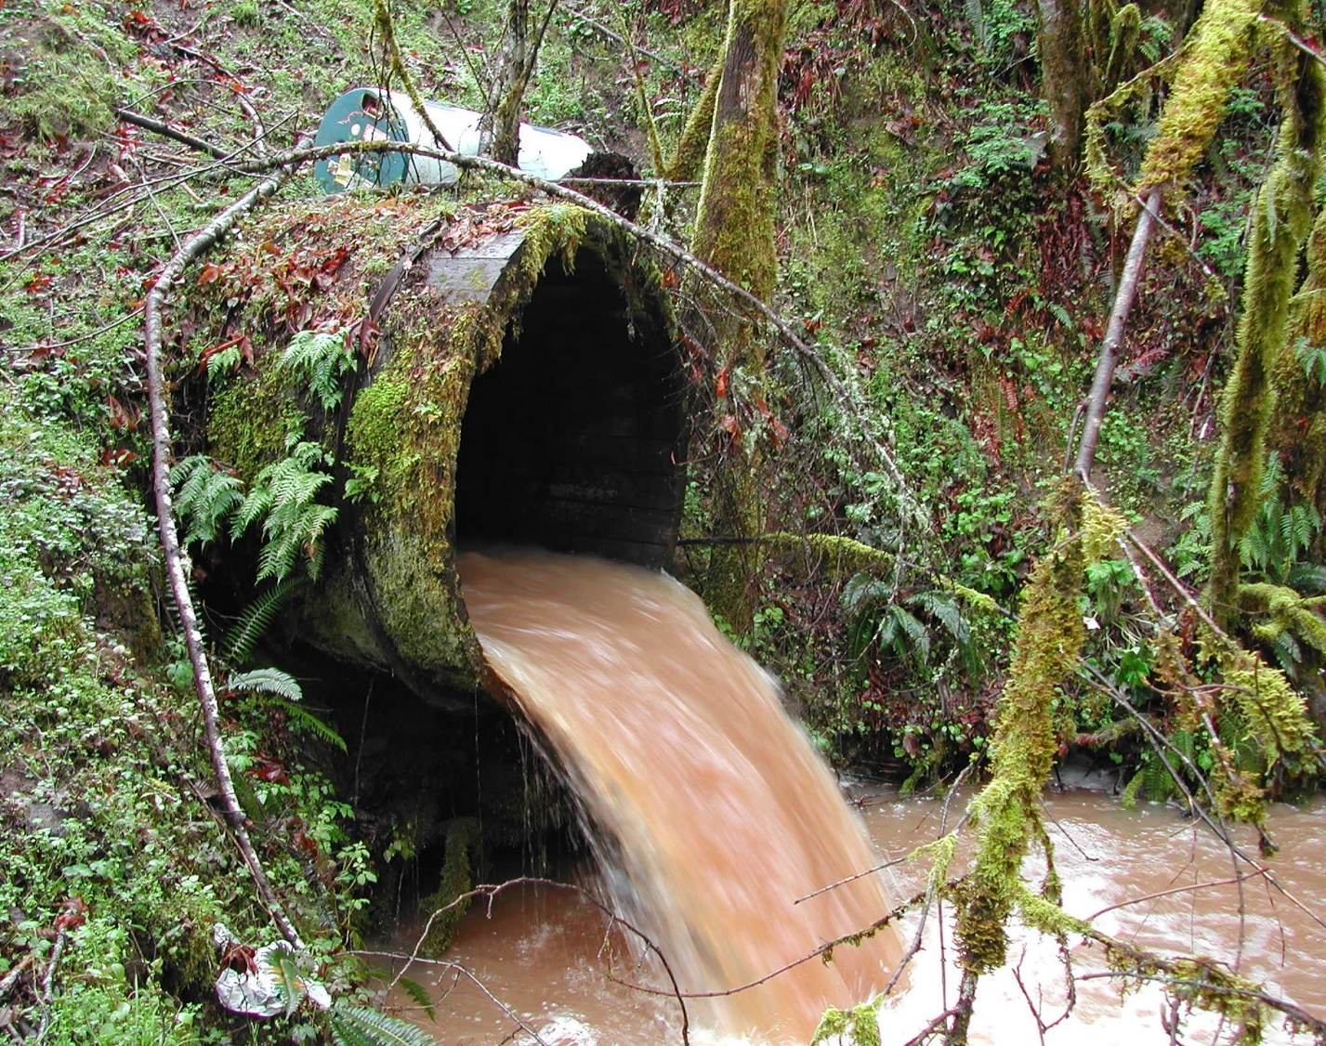
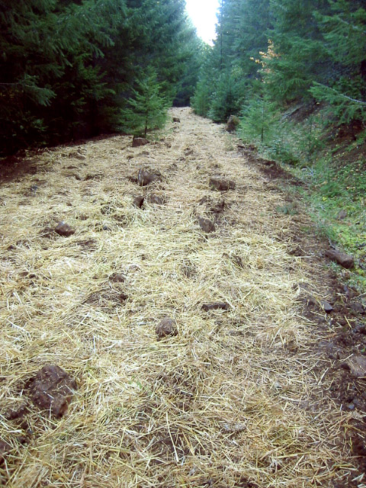
Activity 2
Removing, replacing, or modifying culverts, and road/unauthorized trail decommissioning
Notes:
Activity 2 includes removing, replacing or modifying culverts and includes decommissioning roads and unauthorized trails.
Culverts used at stream and road crossings have a life span of about 40 to 60 years. They tend to structurally weaken and can become barriers to movement of aquatic species over time; aquatic species need access to a diversity of aquatic habitats, barriers such as these prevent that. When these types of infrastructure are not replaced, they continue to deteriorate, making the problem worse.
Decommissioning roads and unauthorized trails helps reconnect streams with their networks. Poorly maintained roads and unauthorized trails can disconnect streams from their networks and can become an extension of the stream network.
Small segments of roads and unauthorized trails that impede floodplain connectivity are good candidates for decommissioning under this Categorical Exclusion.

Slide 15
Activity 3
Removing, replacing, or modifying existing protective enclosures and/or building wildlife friendly fencing to encompass up to 100 Acres.
Notes:
Activity 3
Read from the slide…

Slide 16
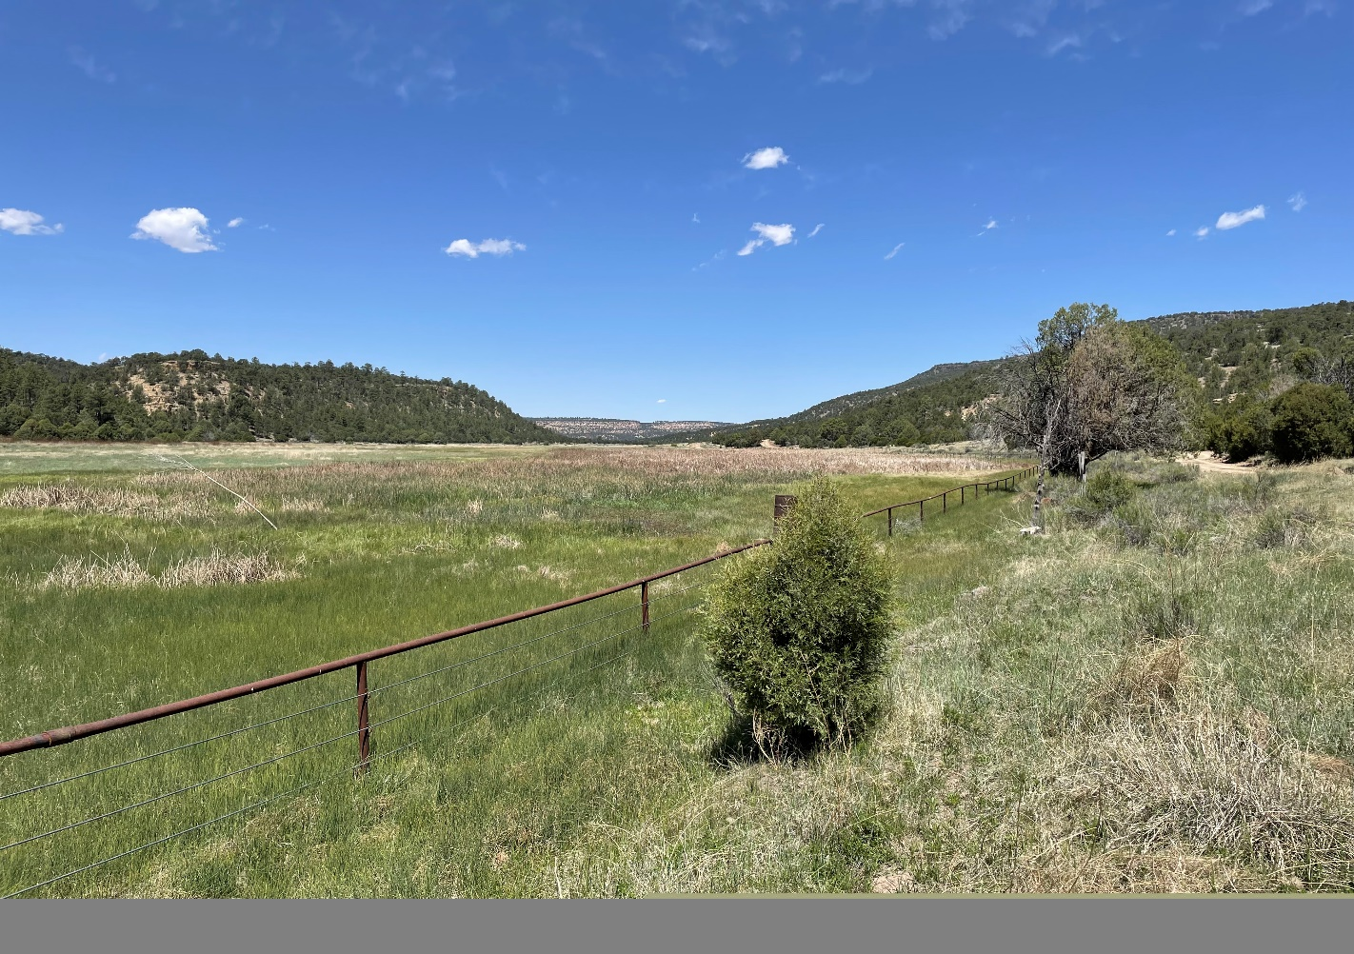
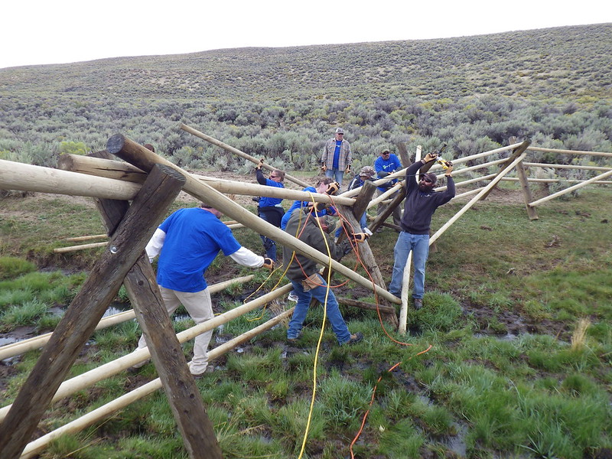
Activity 3
Removing, replacing, modifying existing protective enclosures and/or building wildlife friendly fencing – facilitating recovery
Notes:
Here are some photos of fencing.
Riparian areas often need time to recover in order to maintain self sustaining processes.
Wildlife friendly fencing is ideal in areas where restoration has been completed and the protection of fragile resources is needed.
Some areas may need a permanent fence whereas other areas may require temporary fencing.

Slide 17
Activity 4
Removal of invasive non-native and/or invasive native aquatic
and riparian plants by manual or mechanical methods within a
total of 100 acres, and/or planting and seeding with native
species in wetland, riparian, and wet meadow areas.
Notes:
Activity 4
Read from the slide…

Slide 18
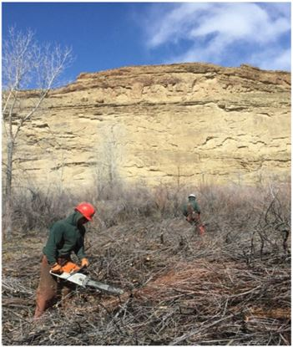
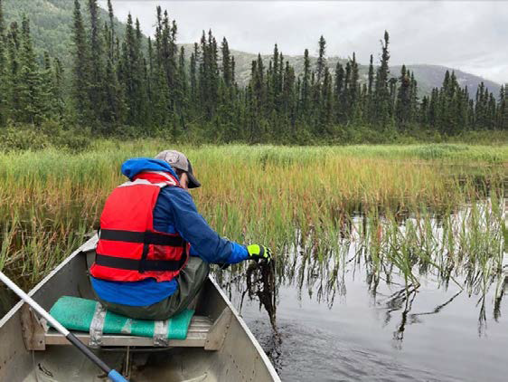
Activity 4
Removing invasive riparian and aquatic vegetation
Notes:
Activity 4 proposes the removal of invasive non-native and/or invasive native aquatic and riparian plants using manual or mechanical methods.
Many riparian areas in BLM have problem species such as Russian Olives and Tamarisk.
The picture on the left shows tamarisk removal using chain saws.
Elodea is an aquatic plant that can be problem in some parts of BLM and is usually manually or mechanically removed, the picture on the right shows manual removal.
Only manual and mechanical methods for removal are being considered in this categorical exclusion.

Slide 19
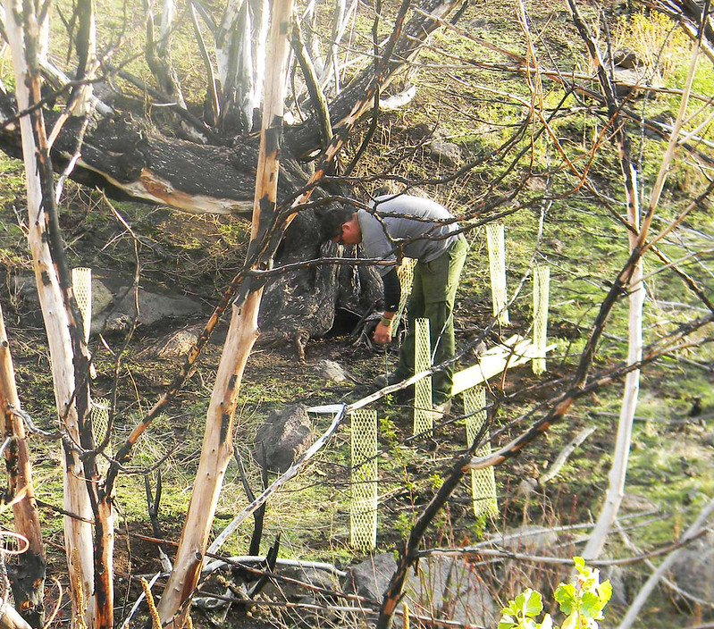
Activity 4
Planting seedlings
Notes:
Activity 4 also includes riparian planting and seeding with native species. Following the removal of invasive species, planting seedlings and seeding are important for the reestablishment of native species.

Slide 20
Extraordinary Circumstances Checklist
There are twelve extraordinary circumstances to evaluate.
They range from evaluations of significant impacts on Threatened and Endangered species, to impacts on sole or principal drinking water aquifers.
If any of the extraordinary circumstances apply in any specific circumstance, the categorical exclusion cannot be used.
Notes:
The Center for Environmental Quality regulations provide the following guidance… when implementing any of the activities under the proposed categorical exclusion, an agency must consider the specific circumstances associated with the proposed activity to rule out any extraordinary circumstances that may give rise to significant environmental effects requiring further analysis and documentation in an Environmental Assessment or an Environmental Impact Statement.
Therefore, each of the twelve extraordinary circumstances must be evaluated for each specific action.
Read from the slide…second bullet

Slide 21
Activities that were suggested but not included
Removal of low head dams.
Use of other methods to control riparian invasive plants such as chemical use and prescribed fire.
Placing barriers to benefit recovery of Threatened and Endangered fish.
Providing alternative water sources to manage livestock.
Notes:
These were some activities that were suggested but not included.
One was the removal of low head dams.
Another activity was - use of other methods to control riparian invasive plants such as with chemical use and prescribed fire.
Activities for placement of barriers to separate invasive aquatic species from native threatened and endangered fish on BLM lands were also considered for inclusion.
And, providing alternative water sources to manage livestock was given consideration.
We didn’t regard these activities as commonly occurring aquatic restoration activities, except for chemical use to control riparian invasive plants.
There are other efforts underway by the Department of Interior to move forward with developing a categorical exclusion that includes chemical use to control riparian invasive plants. Advice from the Office of Environmental Policy and Compliance was to wait for the availability of that categorical exclusion for the use of chemicals to control riparian invasive plants on BLM lands.

Slide 22
Next steps
Center for Environmental Quality (CEQ) review in Spring 2024.
Federal Register Notice and 30-day public comment period will occur, post CEQ review.
Notes:
The next steps for the documents related to the proposed aquatic restoration categorical exclusion are the following:
BLM will complete an internal review with the BLM Solicitor in mid-August 2023.
The Office of Environmental Policy and Compliance will review the documents in mid-September 2023.
The Center for Environmental Quality will receive the documents in mid October 2023 for review.
After CEQ review and comment resolution, BLM will release the Federal Register Notice which will include a 30-day public comment period.

Slide 23
Questions?
Contact Information: spremdas@blm.gov Sharmila Jepsen (Fisheries) swmiller@blm.gov Scott Miller (Program Lead) pcutillo@blm.gov Paula Cutillo (Water Resources) mdickard@blm.gov Melissa Dickard (Riparian)
Notes:
We are here to answer any questions you may have.
Here is our contact information.
Now Melissa Dickard will be reading questions from the chat, we hope to have some answers for you.

