Slide 1
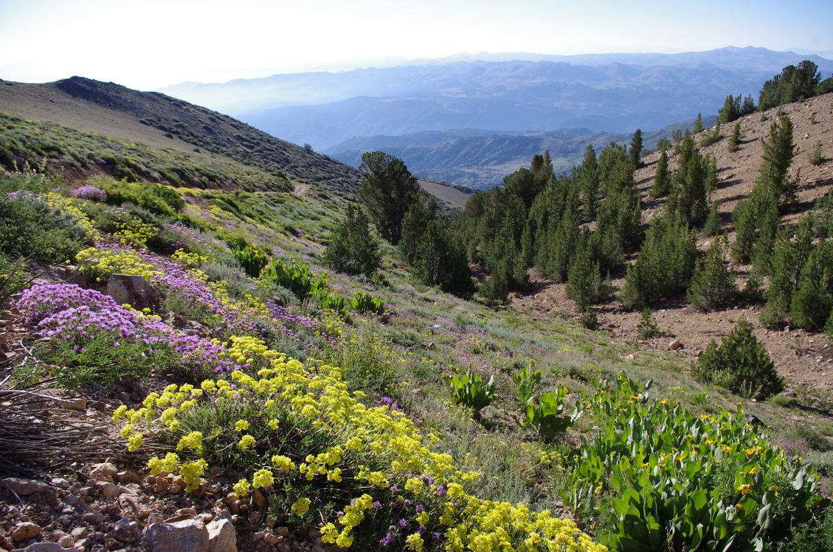

Native Plants of the Sagebrush Ecosystem

Slide 2
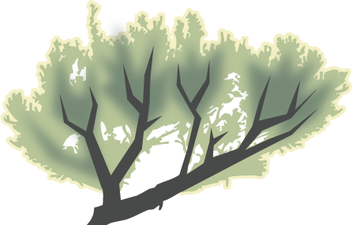
Shrubs woody plants smaller than trees with several main stems arising at or near the ground

Slide 3
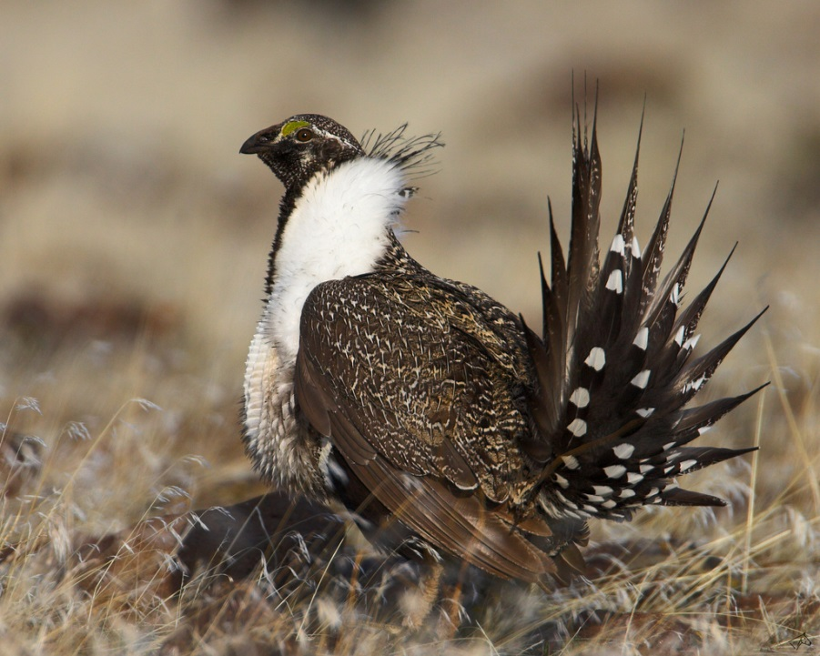
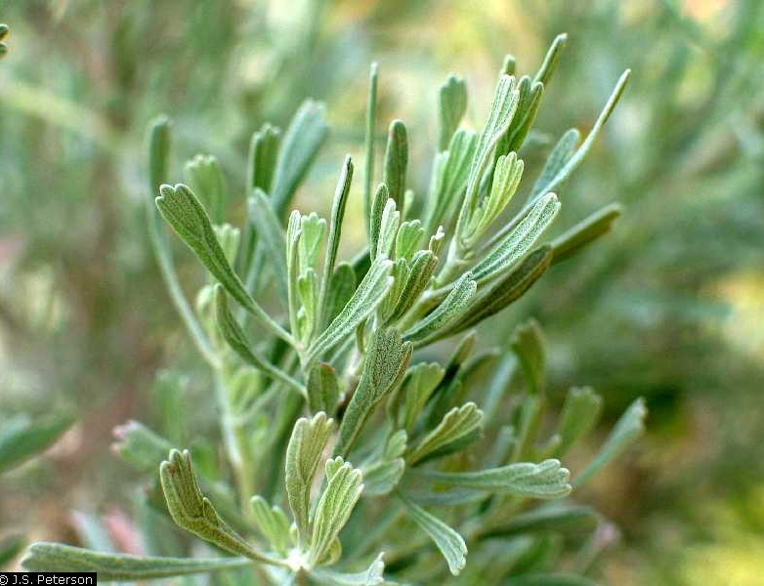

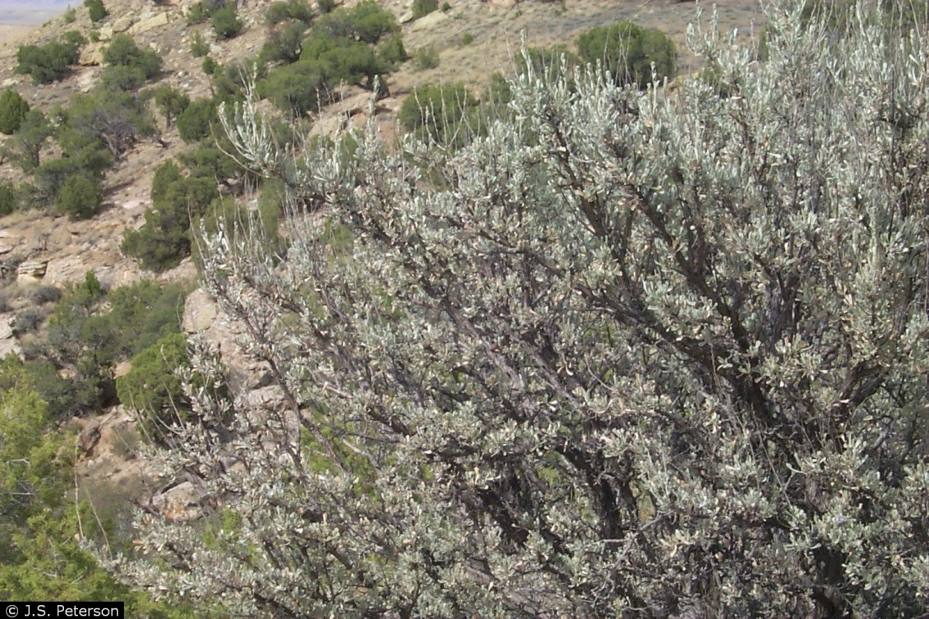
Sagebrush
Artemisia tridentata
Life form: Shrub
Height: 4’-7’
Flower Color: Yellow-Cream
Wildlife Uses: Critical for sage-grouse; sage grouse eat the leaves and rely on it for cover

Slide 4
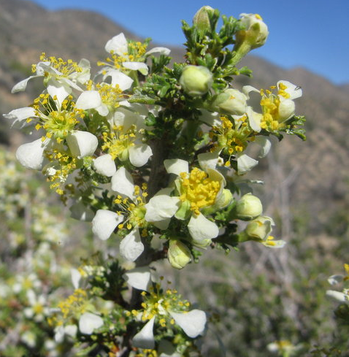

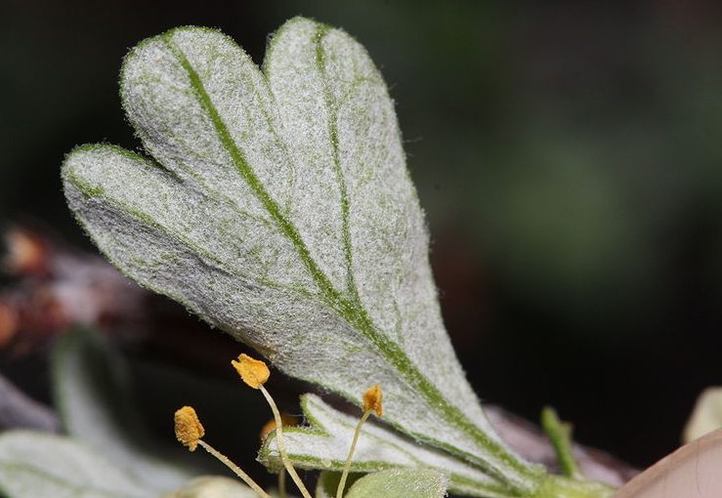
Bitterbrush
Purshia tridentata
Life form: Shrub
Height: 2-6’
Flower Color: Yellow-White
Wildlife Uses:
Provides cover for small mammals and birds
Seeds eaten by small animals

Slide 5
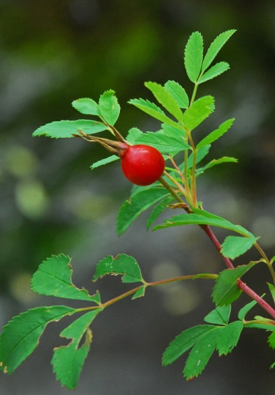

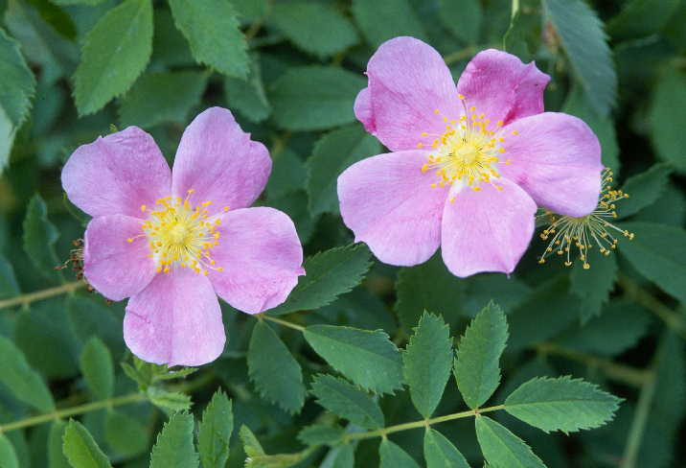
Woods’ Rose
Rosa woodsii
Life form: Shrub
Height: 2-10’
Flower Color: Pink
Wildlife Uses:
Good for bees gathering pollen
Rose hips are eaten by insects, birds, and small mammals

Slide 6
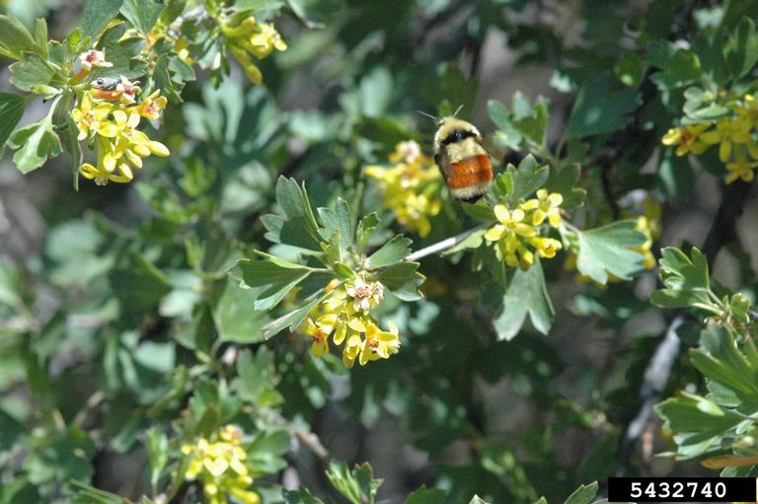

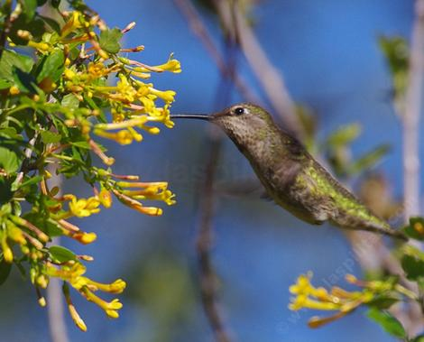
Golden Currant
Ribes aureum
Life form: Shrub
Height: 3-10'
Flower Color: Yellow
Wildlife Uses:
Flowers provide nectar for hummingbirds, butterflies and bees
Birds, bears, and rodents eat the fruit

Slide 7
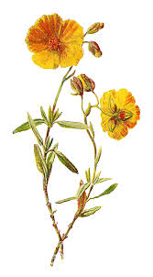
Forbs herbaceous flowering plants that are not grasses

Slide 8
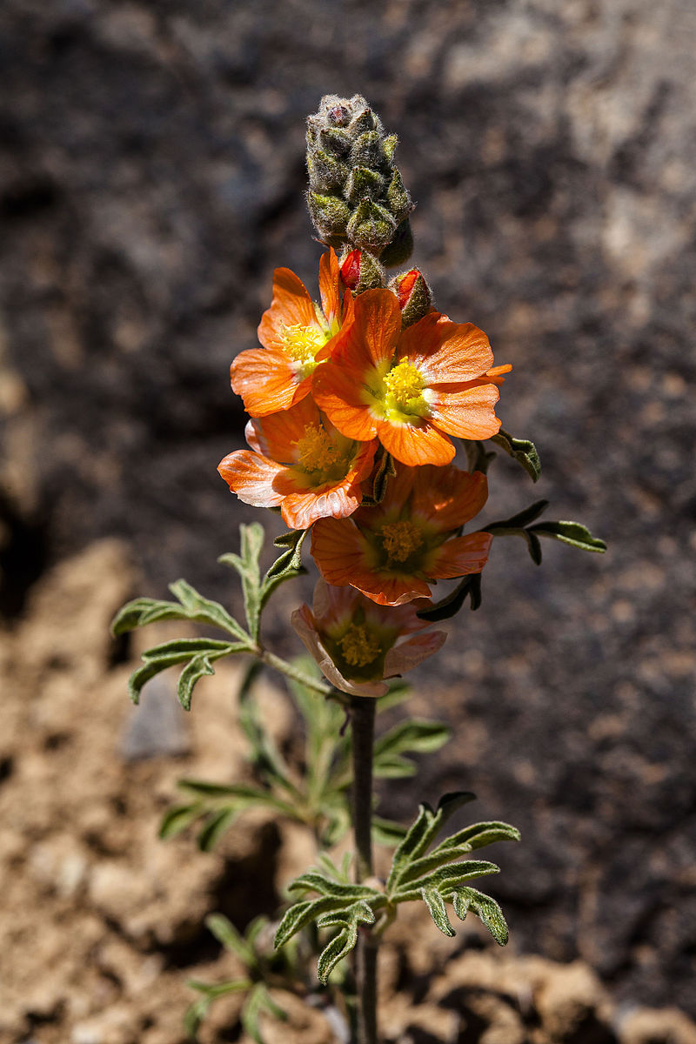

Scarlet Globemallow
Sphaeralcea ambigua
Life form: Forb
Height: 4-16” (10–40 cm)
Flower Color: Reddish orange
Wildlife Uses:
Pollen and nectar for bees and other insects
Image by Hovenweep National Monument - Globemallow (Sphaeralcea coccinea), CC BY 2.0, https://commons.wikimedia.org/w/index.php?curid=44927670

Slide 9
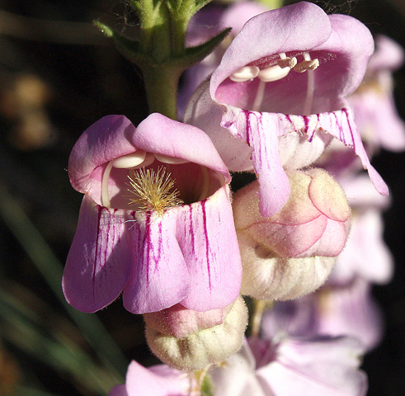
Palmer’s Penstemon
Penstemon palmeri
Life form: Forb
Height: 3-6’
Flower Color: white-pink
Wildlife Uses: Attracts large numbers of native bees

Slide 10
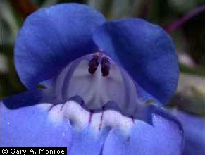
Royal Penstemon
Penstemon speciosus
Life form: Forb
Height: 1-2’
Flower Color: Blue
Wildlife Uses: Attracts pollinators

Slide 11
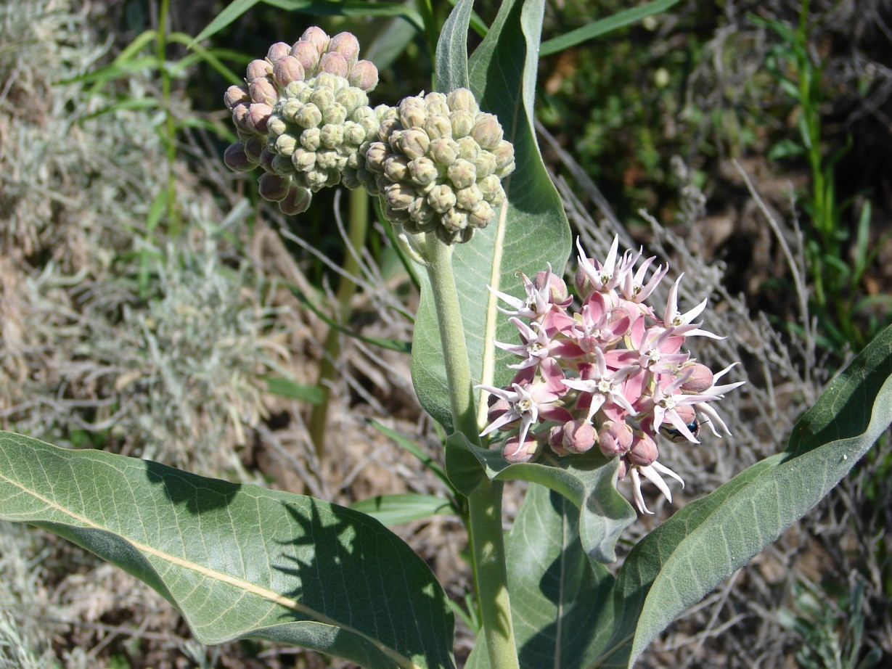

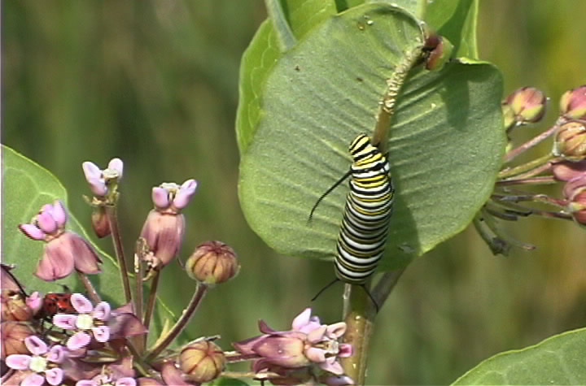
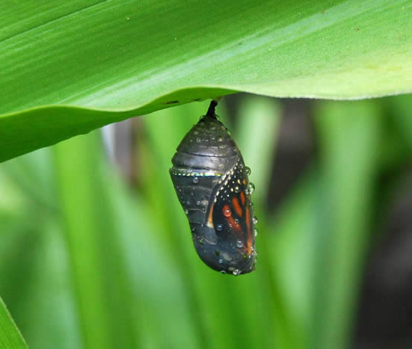
Showy Milkweed
Asclepias speciosa
Life form: Wildflower
Height: 2-3'
Flower Color: Pink
Wildlife Uses:
Attractive to butterflies, bees, and other insects.
Monarch butterflies are dependent on milkweeds

Slide 12

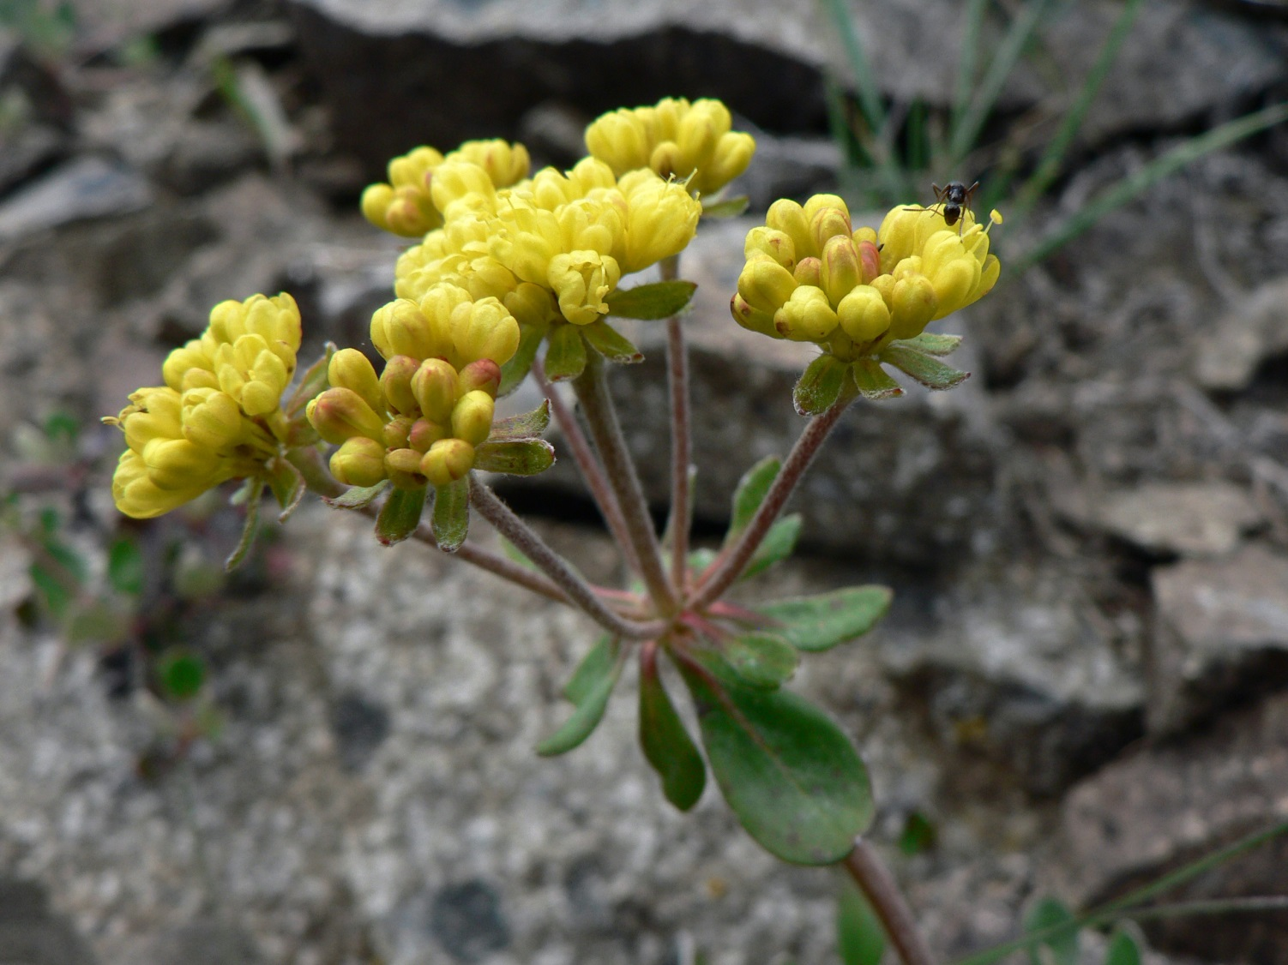
Sulfur Flower Buckwheat
Eriogonum umbellatum
Life form: Forb
Height: Up to 4”-2’
Flower Color: Yellow
Wildlife Uses: Attracts pollinators

Slide 13

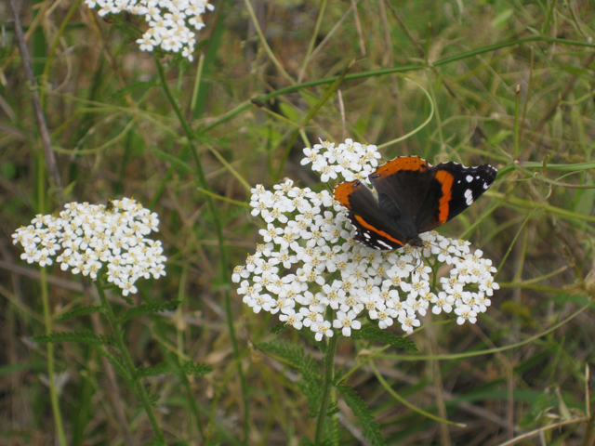
Yarrow
Achillea millefolium
Red Admiral on Yarrow
Life form: Forb
Height: 1-3’
Flower Color: White
Wildlife Uses:
Attracts a large number of native bees
Attracts predatory or parasitoid insects that prey on pest insects
Good for 4- to 8-week-old sage grouse chicks

Slide 14
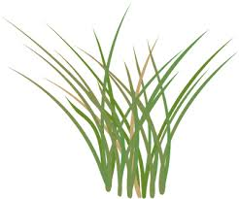
Grasses
Short plants with long narrow leaves

Slide 15
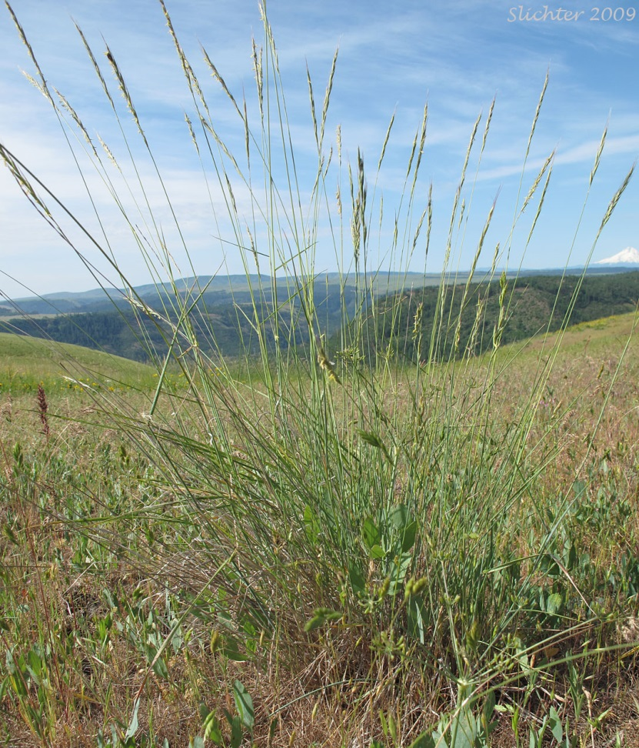
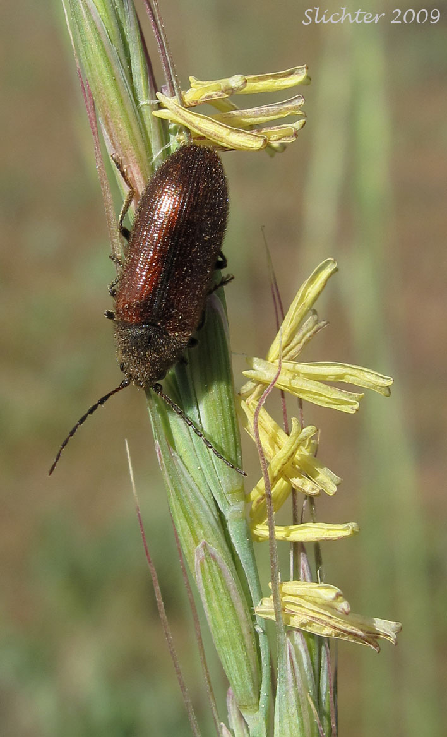

Bluebunch Wheatgrass
Pseudoroegneria spicata
Life form: Grass
Height: 12-30”
Wildlife Uses: Good forage for elk, deer, and antelope

Slide 16
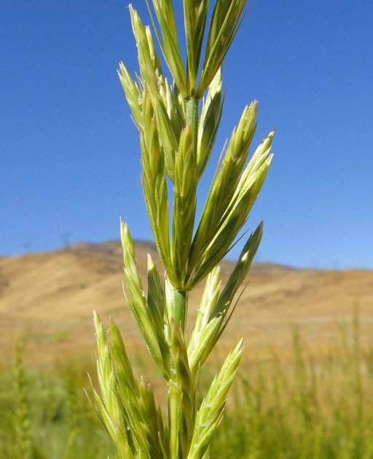
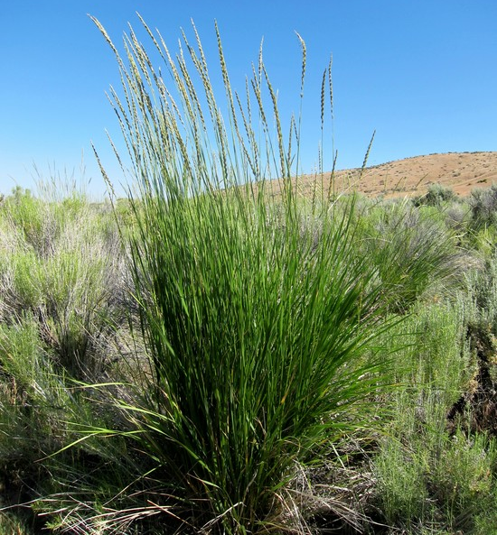
Great Basin Wildrye
Leymus cinereus
Life form: Grass
Height: 3-6’
Wildlife Uses: Excellent cover for small animals and birds

Slide 17
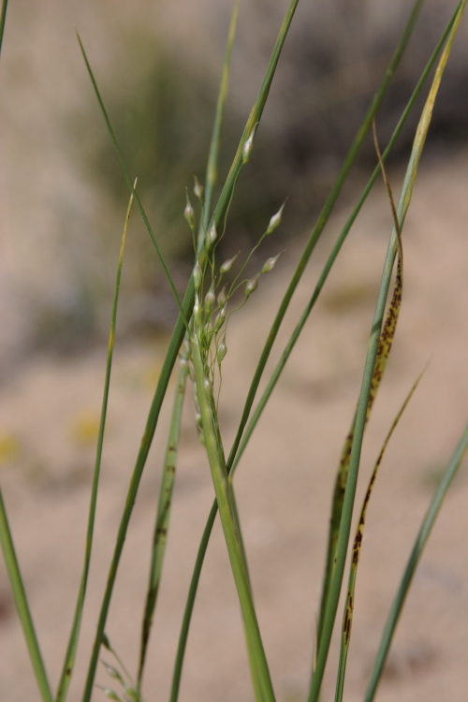

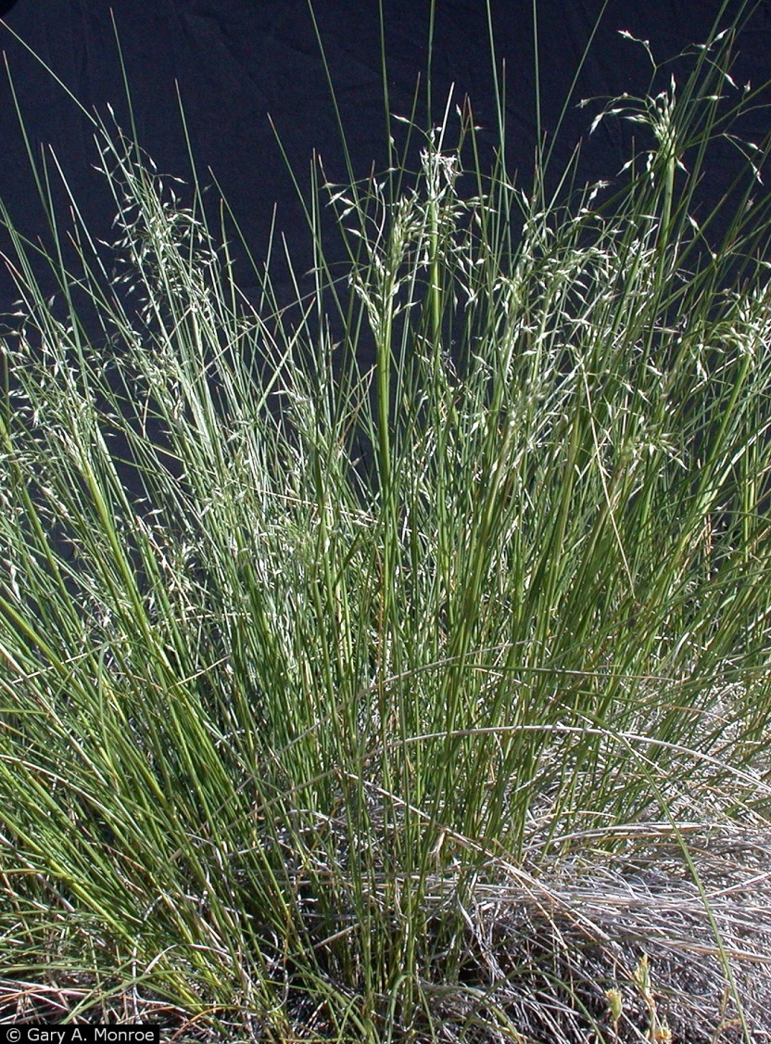
Indian Ricegrass
Achnatherum hymenoides
Life form: Grass
Height: 1-3’
Wildlife Uses:
Good cover for birds and small mammals
Seeds eaten by many species of birds and rabbits

Slide 18
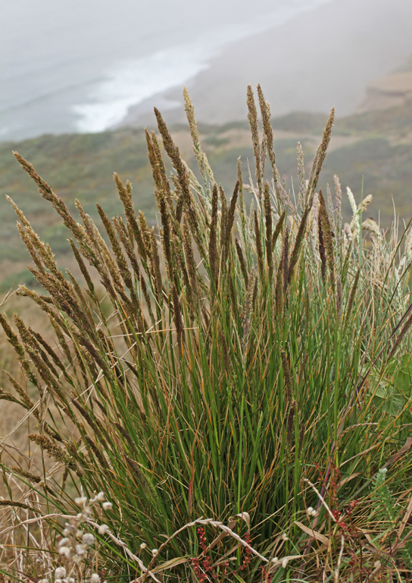

Tufted Hair Grass
Deschampsia cespitosa
Life form: Grass
Height: 20-60”
Wildlife Uses: Host plant for several butterflies.

Slide 19
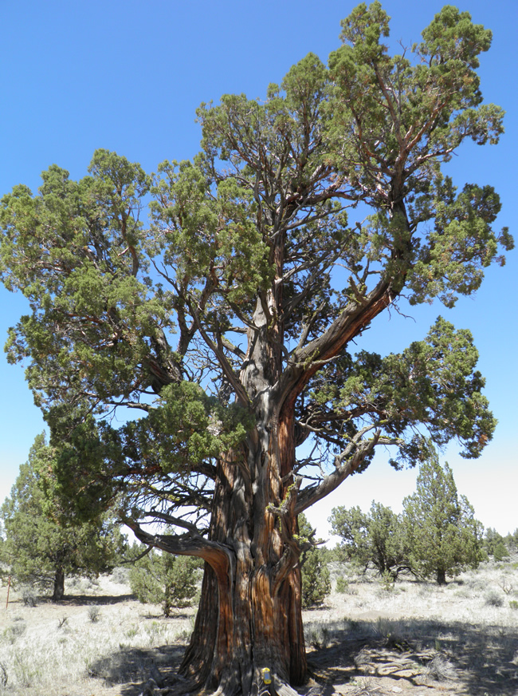
Trees woody plants with one main stem

Slide 20
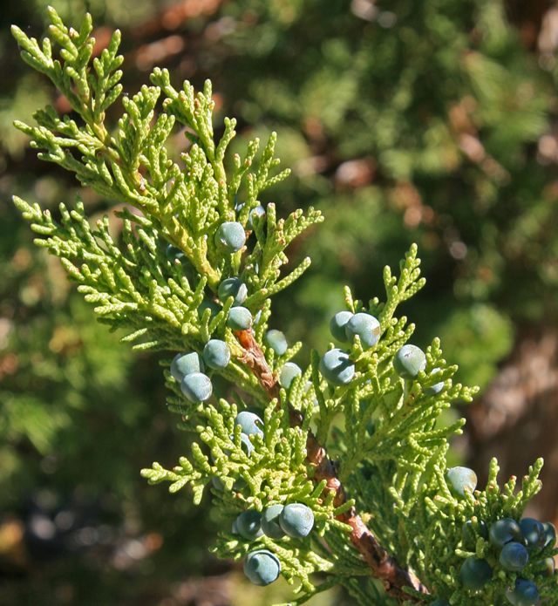
Western Juniper
Juniperus occidentalis
Height: Grows 13–32’ (4–10 m) tall
Wildlife Uses: Nesting; berries for food; perch for hunting (can be problem for sage-grouse, etc.)

Slide 21
Sample Design

