Slide 1


CHANGE IS HAPPENING AT MY HATCHERY OR TO MY PROGRAM
Permitting, Planning and Implementation Considerations
A
Lower Snake River Compensation Plan Program
2022 Annual Meeting
Boise, May 17-18, 2022
Mark Robertson
mark_robertson@fws.gov
B

Slide 2
Recap -- Checking the Boxes
US –v- OR
  2018-2027 Management Agreement
  Tribal Consultation
  Change has the potential to impact many others
ESA
  NMFS and FWS
Permitting
  Federal, State and Local
ESA
US-v-OR
Permits

Slide 3

Recap -- Checking the Boxes
(Less Important for Maintenance Projects)
Develop BA
Informs BO
HGMP
Project Description
Informs S10 & 4(d)
PAC Proposal
US-v-OR
All of This + Process/Permits = Change
(Embrace it [it’s okay to be grumpy]; don’t fight it)

Slide 4
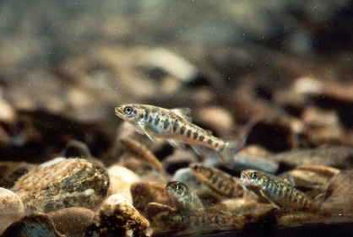
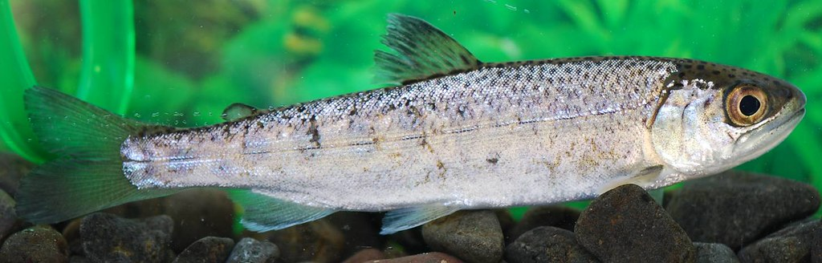
Examples – Production Changes
Conversion of Parr to Smolts in Clearwater
  NPT/BPA Funded Program
  Discontinue parr releases in Meadow Cr.
  400K Parr to 200K Smolts at NPTH to be released in Lolo Creek
Move Lolo Creek Release to Lapwai Creek
  LSRCP Funded Program
  Increase program from 180K to 200K

Slide 5

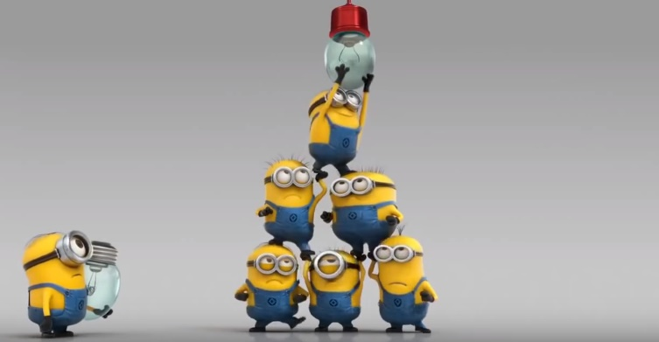
Examples – Production Changes
Cascading Changes
  Co-manager discussions
US-v-OR
  NPT/BPA in, LSRCP out
ESA
  Section 7 for NMFS/FWS
    HGMP and AOP linkages
    NPT took lead

Slide 6
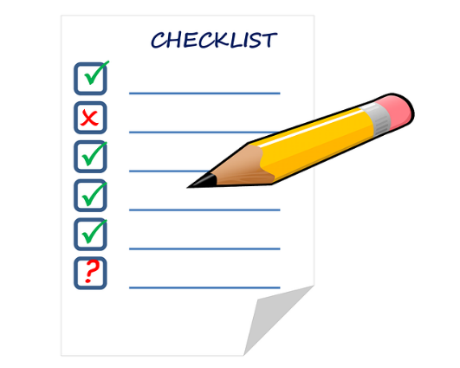
Examples – ESA Compliance
EF Naturals (Steelhead)
  LSRCP Funded Program
  Approaching Take Limits
    Make changes to BO entering release year ’23
  LSRCP initiating coordination with FWS
  IDFG initiating coordination with NMFS
  Coordinated Effort to Stay Ahead of the Game

Slide 7
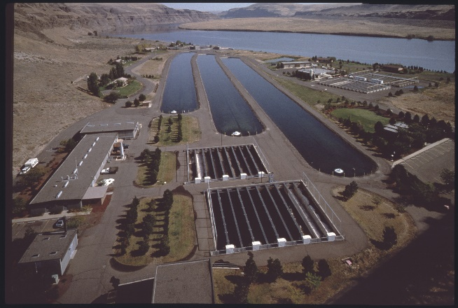
Examples – Project Implementation
Marmes Generator Building
  Last in a series of unfortunate events (electrical fire and pipeline leak) at Lyons Ferry Hatchery
  Fairly straightforward???
    Within existing facility boundary (maybe?) on previously disturbed ground
    No ESA issues, no production issues, no permitting issues (maybe?)
    No engineering/design/contracting issues (maybe?)
    Still need to do paperwork (internal)

Slide 8
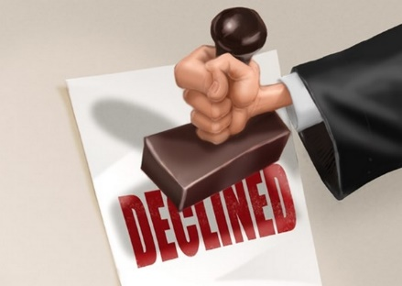
Examples – Project Implementation
Marmes Generator Building
  HOWEVER………..
    Realty issue with the COE; Process/Paperwork to reconcile Marmes site boundary issues
    Delays could affect contracting
      Lead time for ordering pieces/parts
      Cost escalation
  Unforeseen issues = scrambling
    FWS/COE coord. at higher levels

Slide 9
Examples – Project Implementation
Dayton Satellite Facility Weir
  Weir/Dam in an active state of failure
  Emergency actions last year
  Lots of paperwork needs
    Engineering/Design/Contracting
    ESA BOs for NMFS and FWS
    COE 404 permit/JARPA
    Section 106 cultural clearance
    WA – Dept. Ecol. SEPA, WDFW HPA, City/County permits

Slide 10
Examples – Project Implementation
Dayton Satellite Facility Weir
  Using consultants to tackle most of the work
  Lots of paperwork = lots of time
    Early coordination
    Reviews
    Procedural timeframes outside of our control
    Supply chain concerns
    Did I say “active state of failure”

Slide 11
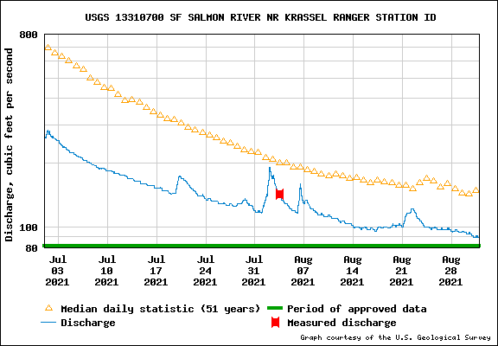
Examples – Project Implementation
McCall Hatchery Adult Holding Pond
  Water temperature issues at SF Salmon Satellite Facility – Climate Change?
  Rapid River Hatchery no longer an option
  Build new adult holding ponds
    SF Salmon Program – LSRCP
    JCAPE – NPT/BPA

Slide 12
Examples – Project Implementation
McCall Hatchery Adult Holding Pond
  Fairly straightforward
    Within existing facility on previously disturbed ground
    No ESA issues, no production issues, no permitting issues
    No engineering/design/ contracting issues
    Still need to do paperwork (internal)
    Cost constraints – “new” infrastructure

Slide 13

Summary
Each “Change” has its own challenges
  Re-use/re-purpose as appropriate
Timing is Everything
  Plan wisely
  Be ready for some surprises
  Always have contingencies
Communication/coordination at all levels
Don’t Fight the System
  Focus on efficient use of existing tools

Slide 14



Questions???
Input???
Experiences to Share???

