Slide 1
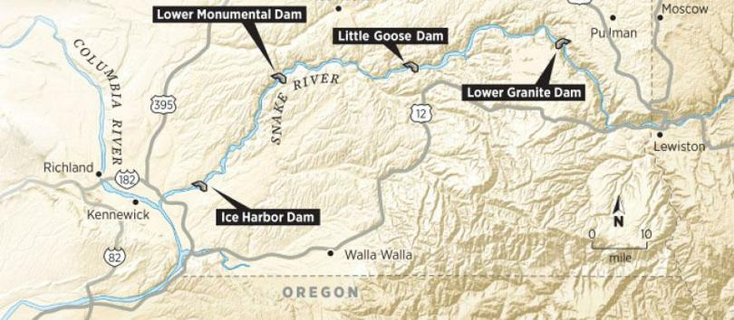
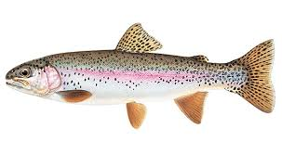
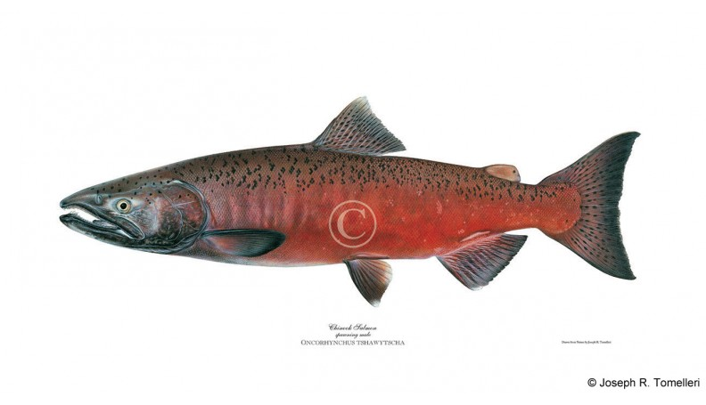
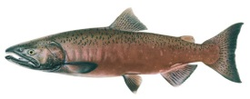
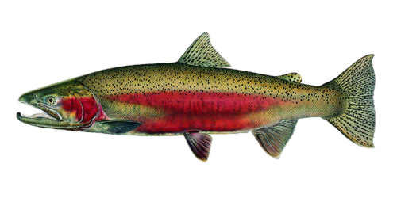
Lower Snake River Compensation Plan
Program Performance
Rod Engle USFWS-LSRCP
Notes:
WE ARE CURRENTLY ON BREAK

Slide 2
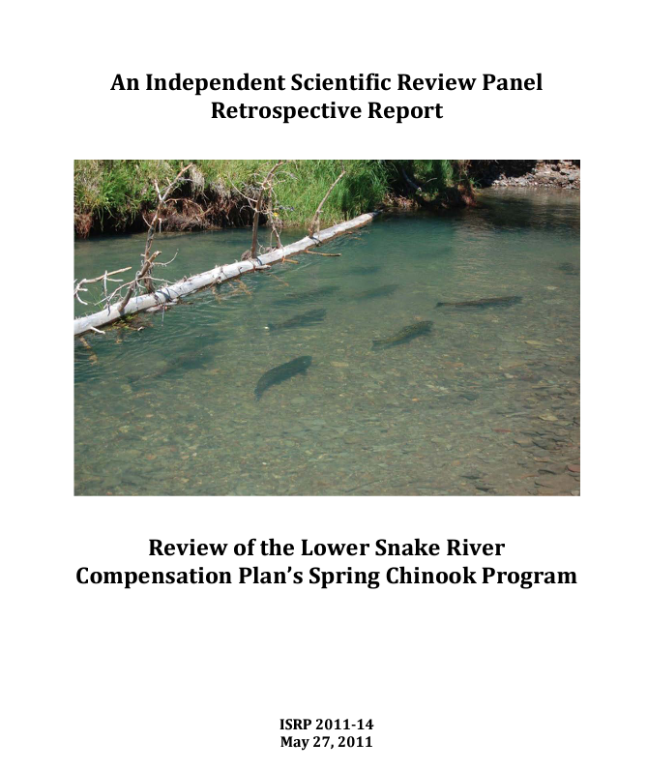
ISRP – Spring/Summer Chinook
December 13-15th Boise, ID – LSRCP/Fed. Building
  Oxford Suites - Block
Last Review 12 years ago
  Programmatic changes
  Different story on returns
  Science
    Performance toward goals
    Informed or informs decision making into the future
Initiated discussions on narratives, presentations, agenda…..

Slide 3
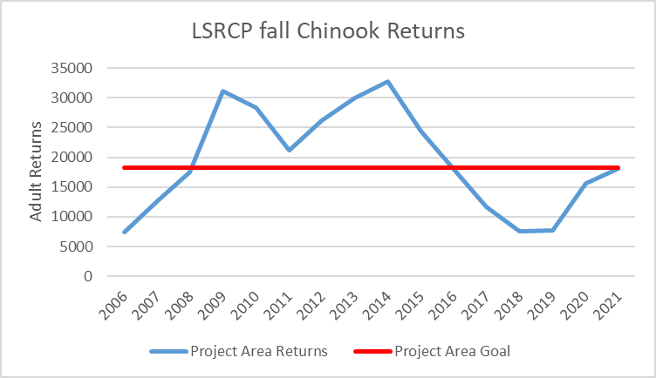

Discussion ongoing regarding changes with LSRCP fall Chinook production.

Slide 4
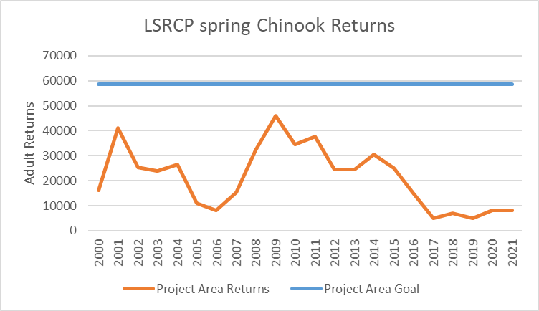

Discussions ongoing regarding changes with LSRCP spring/summer Chinook production and with upcoming ISRP review.

Slide 5

Let’s talk about steelhead!

Slide 6
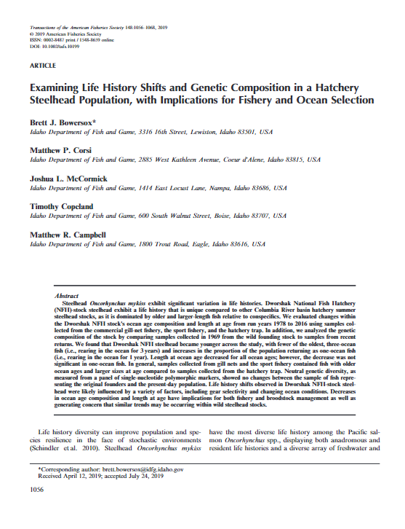
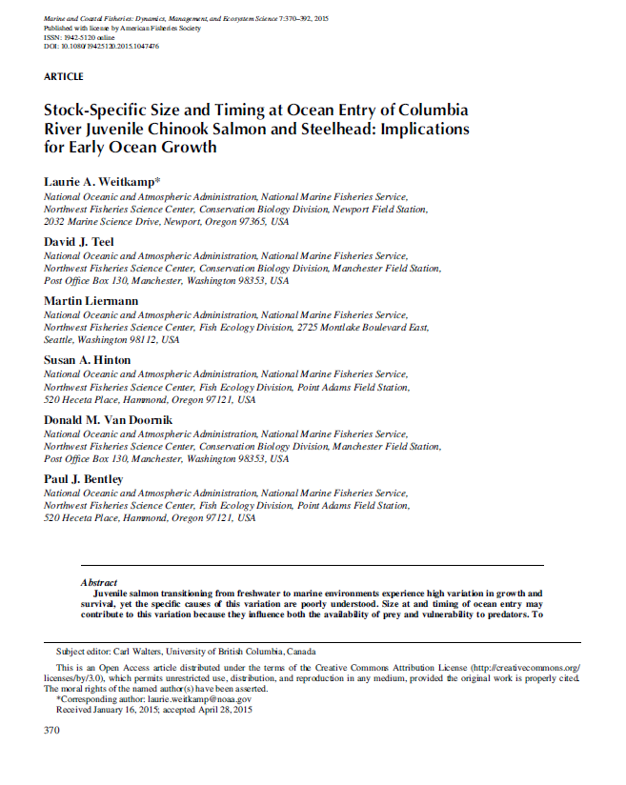
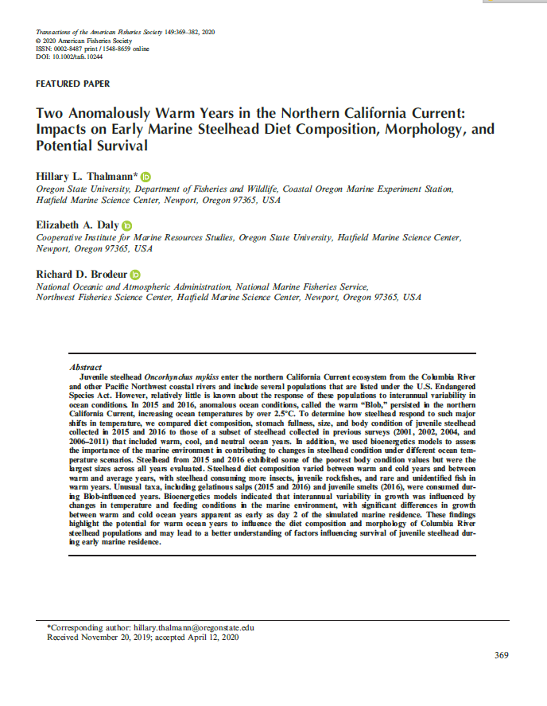
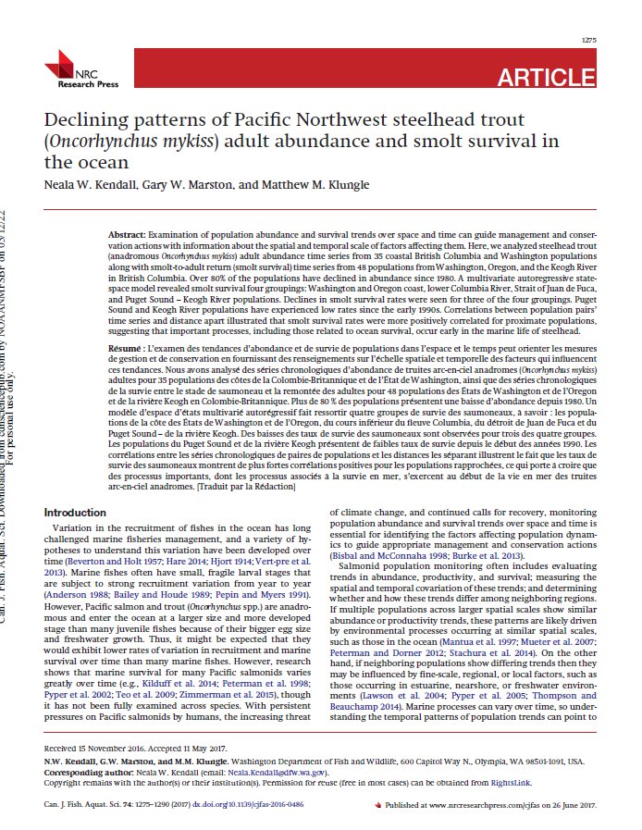
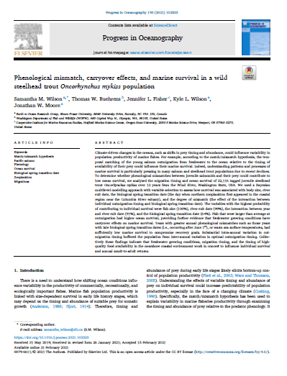
What is happening with steelhead?
Ocean prey and surface temperature changes, ocean warming, blob.
Population declines coastwide and in-basin.
Declines in adult size/age (environment, fisheries)
Rapidly decreasing abundance and fisheries (2015)
Notes:
Wilson et al. Phenological mismatch, carryover effects, and marine survival in a wild steelhead trout Oncorhynchus mykiss population – ocean prey and surface temperature
Yesterday – L. Weitkamp, blob prey availability, sea surface temps.
Kendall et al. 2017 - Declining patterns of Pacific Northwest steelhead trout (Oncorhynchus mykiss) adult abundance and smolt survival in the ocean
Thalmann et al. 2020 - Two Anomalously Warm Years in the Northern California Current: Impacts on Early Marine Steelhead Diet Composition, Morphology, and Potential Survival
Van Doornik et al. 2019 - Insights, from genetic analyses, into stock-specific distribution of juvenile steelhead (Oncorhynchus mykiss) from the Columbia River during early marine migration
Bowersox et al. – Examining life history shifts and genetic composition in a hatchery steelhead population, with implication for fishery and ocean selection.

Slide 8
Thanks Tucker Jones – ODFW (Joint Staff Report Data)

Slide 11
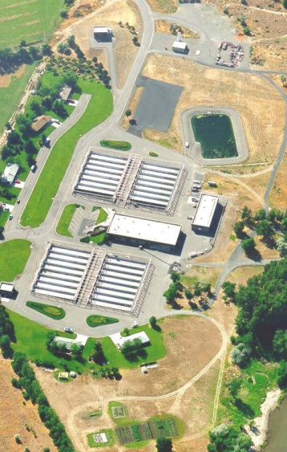
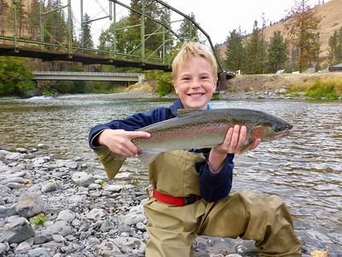
What are we doing? – In Discussions
Discussing Reciprocal Study Implementation (second year)
  2x increase in survival if Wallowa stock reared at LFH.
  Current option would be 20% increase in steelhead adults to Oregon, upstream of LGD.
  Potential benefits to Imnaha Steelhead (ESA-listed) through reduced density rearing at Irrigon.
Upper Salmon A/B discussion (this year)
  Increase in steelhead adults with partial to full switch from B to A (variable based on option)
Both potential changes aren’t cost prohibitive.

Slide 12
Wallowa Stock Steelhead – Irrigon/Lyons Ferry
Current production in LSRCP program.
Release Site | WDFW Lyons Ferry | ODFW - Irrigon
on-station | 60,000
Touchet River | 100,000
Cottonwood - Grande Ronde | 225,000
Wallowa (1st) - Grande Ronde |  | 400,000
Wallowa (2nd) - Grande Ronde |  | 160,000
Big Canyon - Grande Ronde |  | 240,000
Totals | 385,000 | 800,000
= 1,185,000
Imnaha Stock Steelhead at Irrigon
Release Site | Irrigon/Little Sheep
Steelhead - Imnaha | 215,000

Slide 13
Background – Wallowa Stock
J. Bumgarner - WDFW

Slide 14
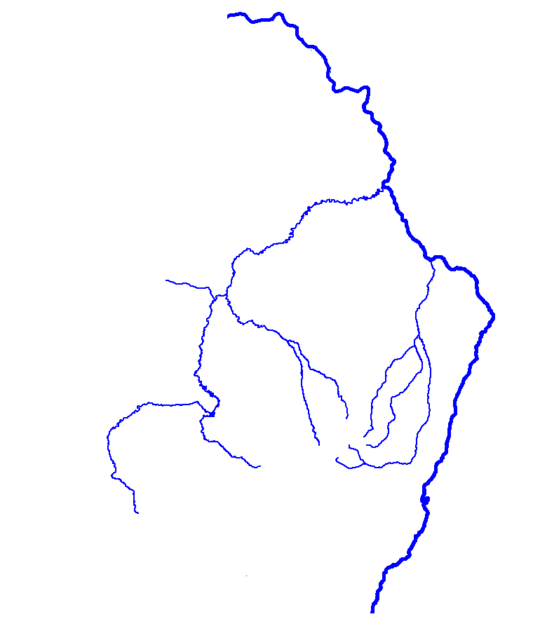

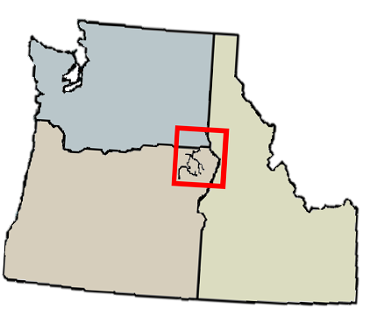
Reciprocal Study Design 2015-2018 Release Years
N
Lyons Ferry
Hatchery
LOWER GRANITE DAM
160K Total
4K PIT
20K CWT
20 0 20 40
Kilometers
Columbia River
Irrigon
Hatchery
40K Total
4K PIT
25K CWT
Cottonwood Creek Acclimation
40K Total
4K PIT
No CWT
480K Total
4K PIT
25K CWT
Wallowa Hatchery
Thanks - J. Bumgarner - WDFW

Slide 15
Smolt-to-Adult Survival to Bonneville Dam – PIT Tags
WDFW
ODFW
Cottonwood Release
Wallowa Release
Thanks J. Bumgarner - WDFW

Slide 16
Smolt-to-Adult Survival to Bonneville Dam – PIT Pooled Years
WDFW
ODFW
Cottonwood Release
Wallowa Release
1.6X
2.5X
N=195
N=119
N=203
N=92

Slide 17

Wallowa Stock Steelhead – Irrigon and Lyons Ferry
Additional Production/Performance in LSRCP
Potential production change in LSRCP program.
Release Site | WDFW Lyons Ferry | ODFW - Irrigon
on-station | 60,000
Touchet River | 100,000
Cottonwood - Grande Ronde | 225,000
Wallowa (1st) - Grande Ronde | 243,000
Wallowa (2nd) - Grande Ronde | 97,000
Big Canyon - Grande Ronde | 145,000
NE Oregon Spring Chinook |  | ?????
Totals | 870,000
20% increase in steelhead adults, gain production space and options…..
additional spring Chinook in Oregon, lower density rearing for Imnaha Steelhead

Slide 18
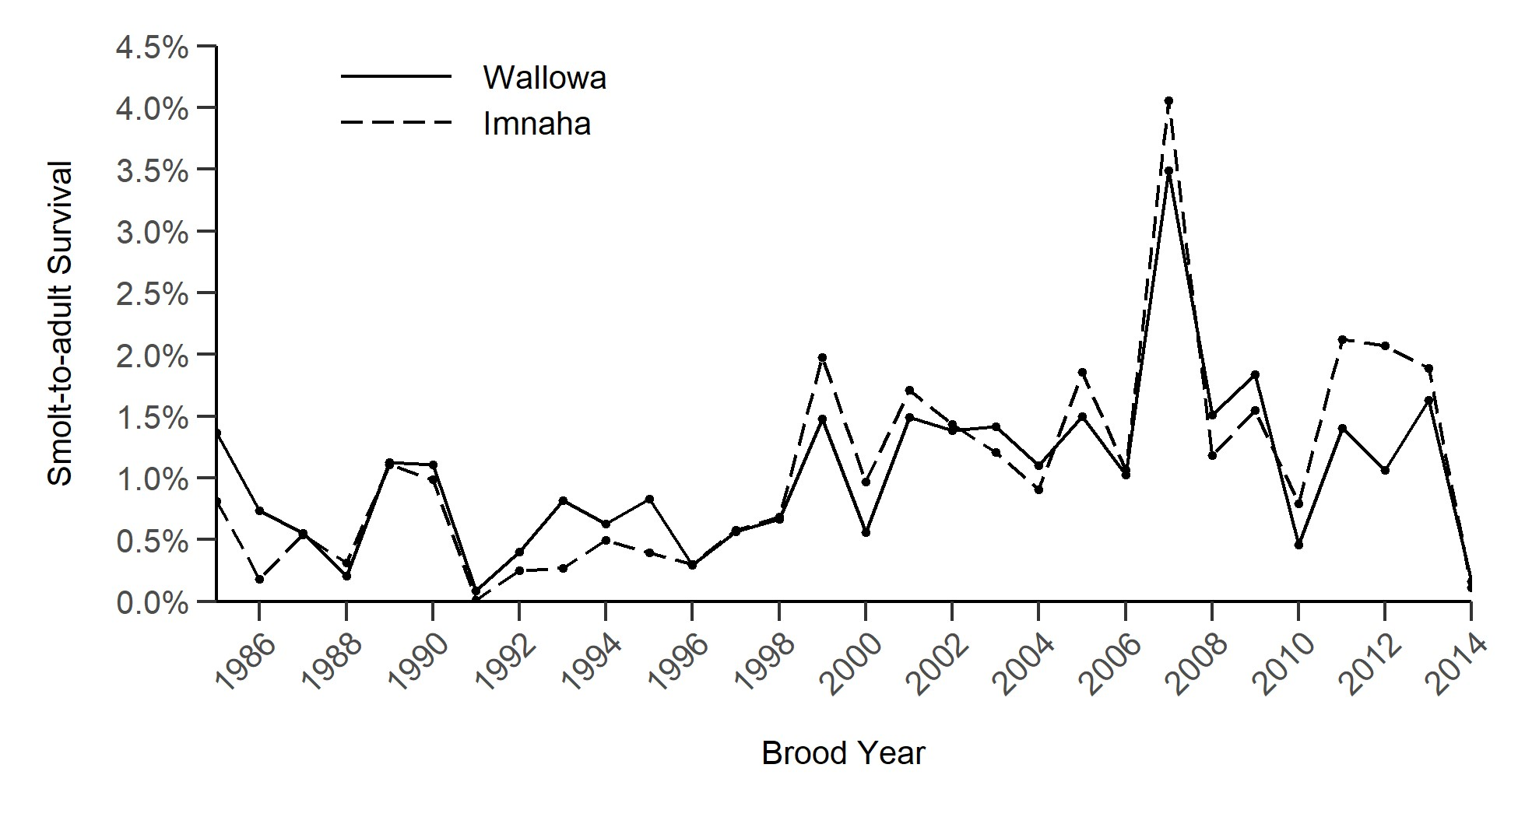
J. Smith – ODFW Steelhead Report
Could ESA-listed Imnaha stock summer steelhead program reared at Irrigon improve with rearing at lower densities?
Release Site | Irrigon/Little Sheep
Steelhead - Imnaha | 215,000

Slide 19
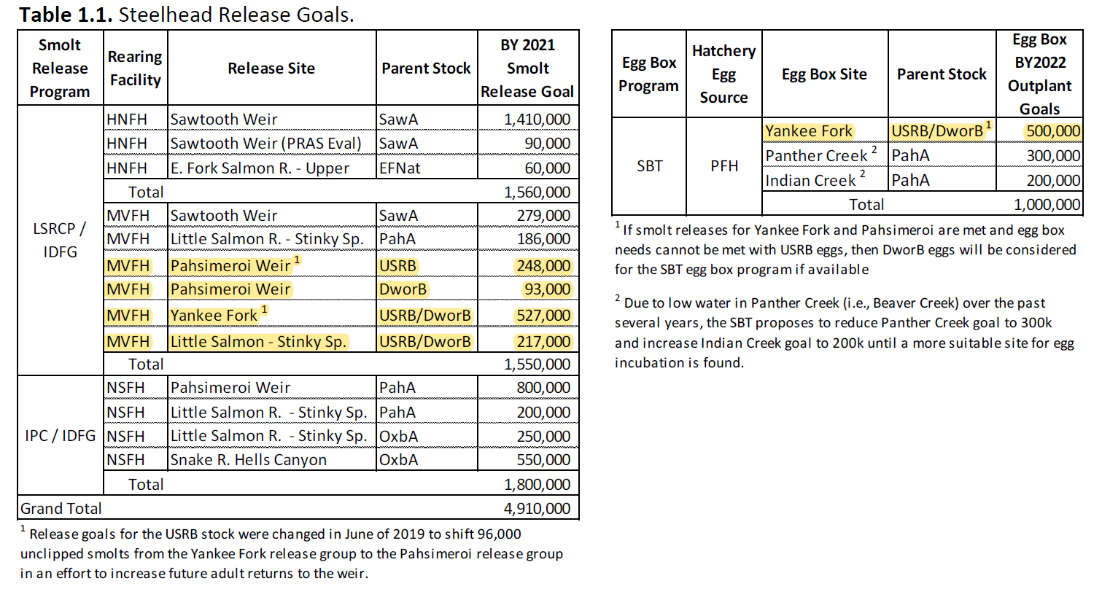
Production of A/B in Upper Salmon
Notes:
We have a broodstock issue with the B-steelhead program that we’ve been working through in these years of decline. Often we have to get eggs from DNFH to make the B-steelhead program whole.
1.085M smolts are B stock
500K egg box program possible for B-stock
Clearwater programs total 2.94 M (all B-stock), 843K is LSRCP production. Compositionally, Salmon is smaller component of overall B production (27%) and not as well performing as programs in Clearwater Basin.

Slide 20
Local Brood for B-Steelhead in Upper Salmon (USAL)
Number of Smolts Released at PFH
Dwor | USAL | Total | % of Releases using USAL
30,303 | 91,525 | 121,828 | 75%
88,704 | 98,655 | 187,359 | 53%
75,786 | 112,571 | 188,357 | 60%
138,195 |  | 138,195 | 0%
94,647 | 94,313 | 188,960 | 50%
93,600 | 155,000 | 248,600 | 62%
93,240 | 155,660 | 248,900 | 63%
93,690 | 156,340 | 250,030 | 63%
106,080 | 143,130 | 249,210 | 57%
91,620 | 247,610 | 339,230 | 73%
93,670 | 249,330 | 343,000 | 73%
999,535 | 1,504,134 | 2,503,669 | 60%
BY | DWOR Smolts Released | USAL Smolts Released | Total Smolts Released | % of Releases using USAL
2010 | 811,341 | 91,525 | 902,866 | 10%
2011 | 869,566 | 98,655 | 968,221 | 10%
2012 | 950,313 | 112,571 | 1,062,884 | 11%
2013 | 138,195 | 931,522 | 1,069,717 | 87%
2014 | 284,070 | 416,580 | 700,650 | 59%
2015 | 499,090 | 524,000 | 1,023,090 | 51%
2016 | 93,240 | 999,200 | 1,092,440 | 91%
2017 | 390,290 | 352,290 | 742,580 | 47%
2018 | 939,230 | 143,130 | 1,082,360 | 13%
2019 | 155,190 | 756,770 | 911,960 | 83%
2020 | 404,290 | 591,880 | 996,170 | 59%

Slide 21
SAR of A and B Steelhead in Upper Salmon
Brood Year | A Average (Saw-Pah-Oxb) | B Average (DWOR-USAL) | Surv Advan. (A/B)
2010 | 0.84% | 0.28% | 3.0
2011 | 1.51% | 0.47% | 3.2
2012 | 1.21% | 0.41% | 3.0
2013 | 1.33% | 0.57% | 2.3
2014 | 0.19% | 0.02% | 10.9
2015 | 0.81% | 0.22% | 3.6
2016 | 0.32% | 0.12% | 2.7
Average | 0.89% | 0.30% | 3.0
Brood Year | B MV-DWOR | B MV-USAL | Localized B-Advantage
2010 | 0.12% | 0.44% | 3.5
2011 | 0.42% | 0.53% | 1.3
2012 | 0.17% | 0.65% | 3.9
2013 | 0.49% | 0.65% | 1.3
2014 | 0.00% | 0.03% | 8.8
2015 | 0.18% | 0.27% | 1.5
2016 | 0.13% | 0.11% | 0.8
Average | 0.22% | 0.38% | 1.8
DWOR B vs. USAL B
in Salmon Basin
Combined A vs Combined B in Salmon Basin
B. Leth - IDFG Survival Data
Notes:
SAR data to project area - Release to LGD based on PBT analyses, no PIT/CWT.
Since BY2013, about <2/3 of the releases have been USAL B stock…. ~62%.

Slide 22
Alternatives
In development…

Slide 23
HRT Alternatives for Magic Valley B-run
Current program with implementation of all recommendations.
Develop a locally adapted broodstock for maintaining a segregated harvest program for B-run steelhead in the Upper Salmon River.
Develop an integrated B-run steelhead conservation and harvest program from fish native to the Salmon River (SF and MF).
Discontinue the transfer of Dworshak steelhead eggs to Magic Valley FH. Replace with direct releases from Clearwater FH to the Salmon River.
Terminate the B-run steelhead program and increase the size of the A-run steelhead program at Magic Valley FH.
Terminate the existing A and B-run steelhead programs and replace with resident fish programs for the Salmon and Snake River basin.
Terminate all programs, decommission hatchery, and implement alternative mitigation strategies.
Notes:
Slide 18: Proposed review timeline
We expect the entire review process to take approximately three years, beginning September 2005 and ending September 2008.

Slide 24
HRT Alternatives for Magic Valley B-run
Current program with implementation of all recommendations.
Develop a locally adapted broodstock for maintaining a segregated harvest program for B-run steelhead in the Upper Salmon River.
Develop an integrated B-run steelhead conservation and harvest program from fish native to the Salmon River (SF and MF).
Discontinue the transfer of Dworshak steelhead eggs to Magic Valley FH. Replace with direct releases from Clearwater FH to the Salmon River.
Terminate the B-run steelhead program and increase the size of the A-run steelhead program at Magic Valley FH.
Terminate the existing A and B-run steelhead programs and replace with resident fish programs for the Salmon and Snake River basin.
Terminate all programs, decommission hatchery, and implement alternative mitigation strategies.
Notes:
Slide 18: Proposed review timeline
We expect the entire review process to take approximately three years, beginning September 2005 and ending September 2008.

Slide 25
Summary
Changes would improve
  Abundance
  Performance
  Hopefully, all fisheries in time.
Status quo won’t produce more adults, steelhead won’t fix themselves.
Changes aren’t cost prohibitive.
Adaptive Management – defined by Kingsford et al. 2017
  “Adaptive management should include governance, planning, implementation of decisions, and monitoring and evaluation of subsequent outcomes”

Slide 26
Questions?

Slide 27
Length of USAL-B (cm)
 | USAL |  | DWOR- CFH
Brood Year | 1-Oc | 2/3-Oc | 1-Oc | 2/3-Oc
2014 | 64 | 76 | 66 | 81
2015 | 61 | 76 | 62 | 82
2016 | 64 | 79 | 67 | 84
2017 | 58 | 81 | - | 80
2018 | 61 | 79 | 67 | 80
2019 | 63 | 77 | 64 | 82
2020 | 64 | 76 | - | 80
Average | 62 | 78 | 65 | 81
Length cuttoff for
B-steelhead 78 cm

