Slide 1
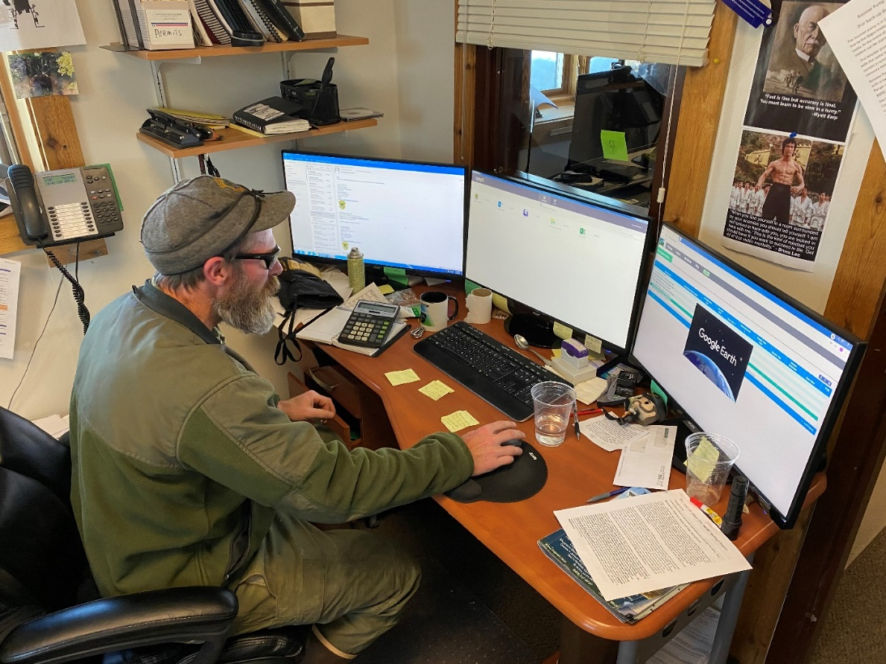

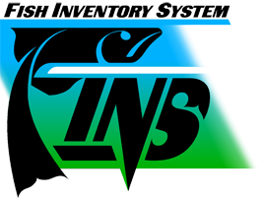
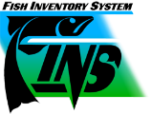
Exploring the Use of FINS Data – Real Life
Examples from Hatchery and M&E Staff
Chris Sullivan and Beau Gunter
LSRCP Annual Meeting
May 18, 2022

Slide 2
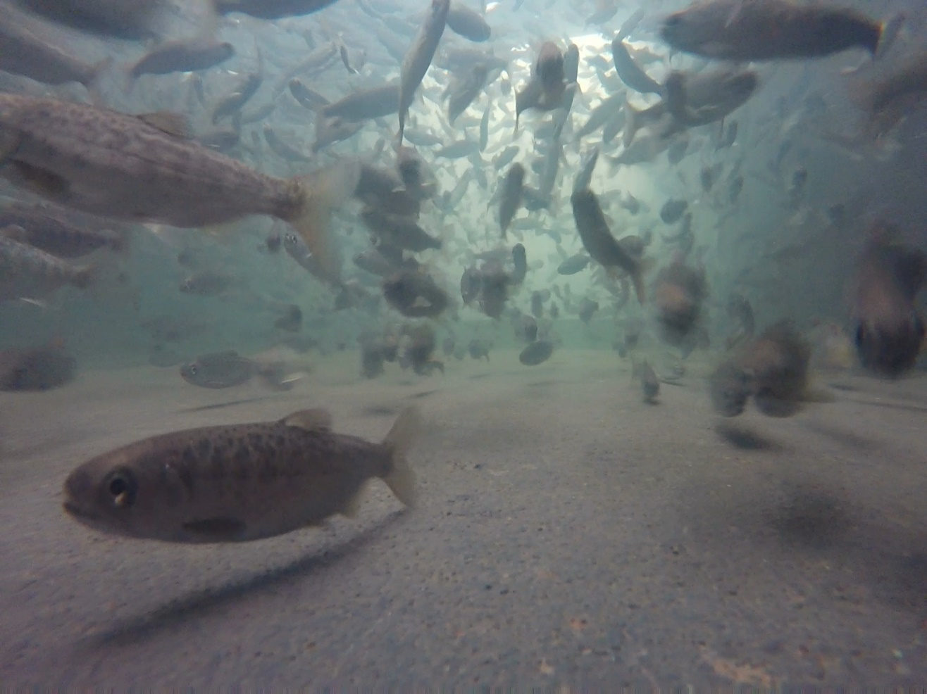
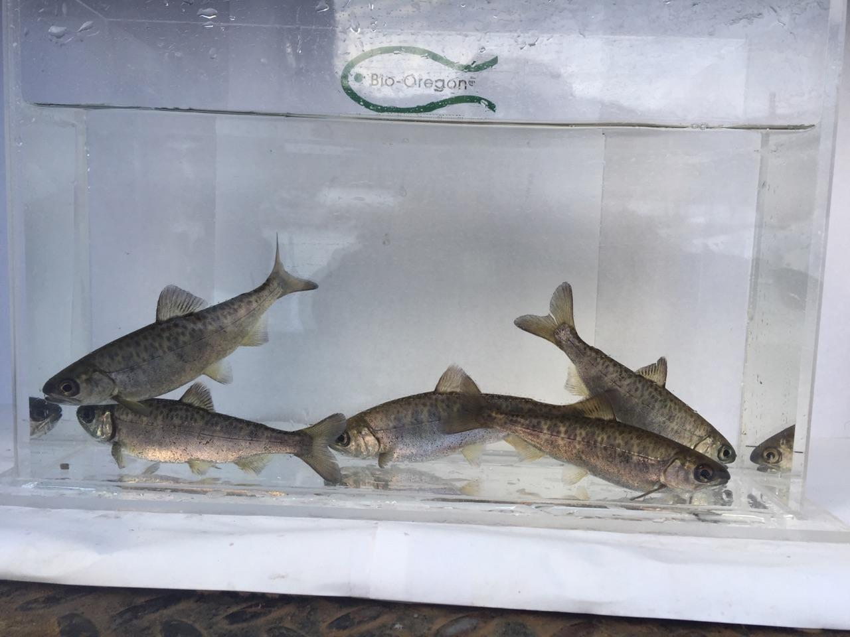
Using FINS to Meet Hatchery
Data Requirements
Beau Gunter – IDFG Hatchery Complex Manager

Slide 3
IDFG Reporting
Idaho Fish and Game hatcheries are currently using data from FINS to generate annual run reports and monthly production summaries
All the information used is available using data from FINS
This allows anyone with a login to duplicate the data found in the reports

Slide 4
ISRP Review
A review of performance for all LSRCP hatchery Chinook programs
Provides a good example of metrics that can be found in FINS that all hatcheries will be reviewed on.
Notes:
Since ISRP is a theme for this year, I thought using the metrics needed for this review as the example of Real Life uses of FINS would be meaningful for all Hatcheries.

Slide 5
ISRP metrics available in FINS
Yearly Brood Stock Collection
Pre-Spawn Mortality
Egg to Smolt Survival
Yearly Smolt Releases
Density Index
Size at Release
Notes:
I will show examples from hatcheries across the state to demonstrate how each of these metrics is readily available in FINS.
Please note that some of the reports have been condensed to make them presentable in this format. If you run the same report it won’t look exactly like the format displayed on the screen.

Slide 6
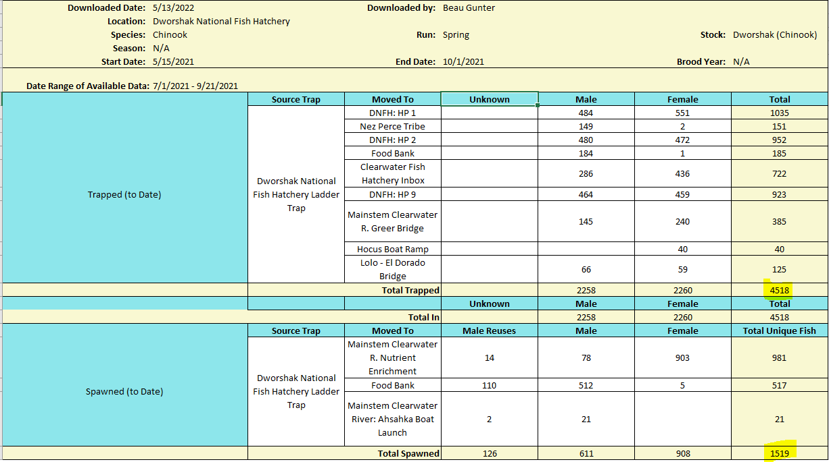
Yearly Brood Stock Collection
Data Tab-Summary-Fish Return
Notes:
The Fish Return Summary is probably the most informative pre-built query that FINS has developed and is the perfect place to look for brood stock collection numbers. Here is last year’s chinook trapping numbers from Dworshak. I also included the spawned numbers to demonstrate that both those aspect of “brood collection” could be reported at the same time.

Slide 7
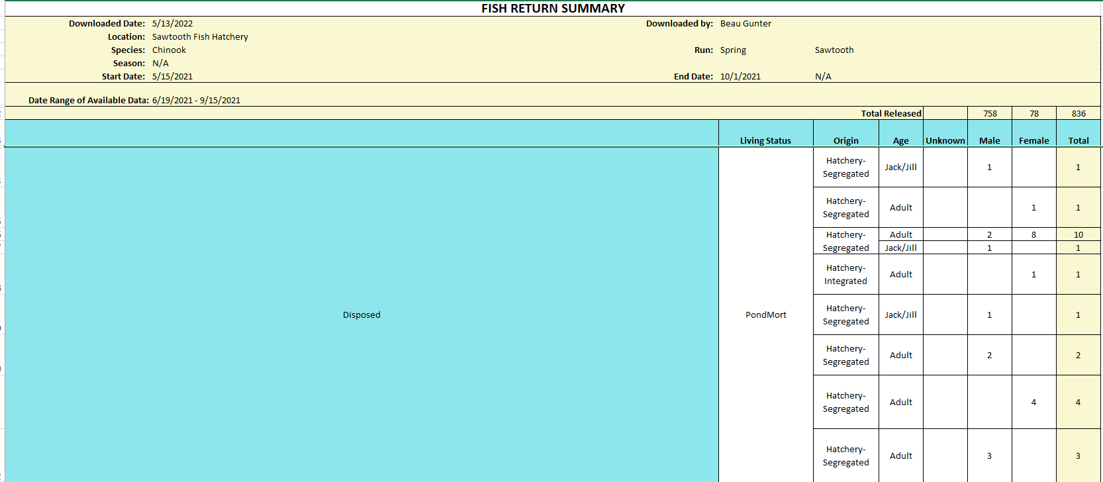
Pre-Spawn Mortality
Data Tab-Summary-Fish Return
Notes:
Fish Return is also a good place to find your mortality numbers. Here is an example from the Sawtooth Fish Hatchery representing the mortality experienced in the ponds in 2021. There are several options as you are building the return summary. To obtain mortality numbers be sure to include “disposed” under the disposition tab.

Slide 8
Egg to Smolt Survival
Run one of 2 queries to identify eyed eggs
Eyed Egg= Data tab-Summary-Inventory-Enumerated
Notes:
There are several ways to determine egg to smolt survival with FINS. I prefer identifying my initial egg inventory and then using the final release numbers (next slide) to make the calculations. There are 2 methods to know for getting egg numbers. If it is a facility which incubates and rears to release such as the McCall example used here, the first method of using enumerated inventory is appropriate. If it is a facility which has eggs shipped like Magic Valley, then using the shipped egg inventory is appropriate. The next slide will demonstrate how to get the final release numbers for calculating survival.

Slide 9
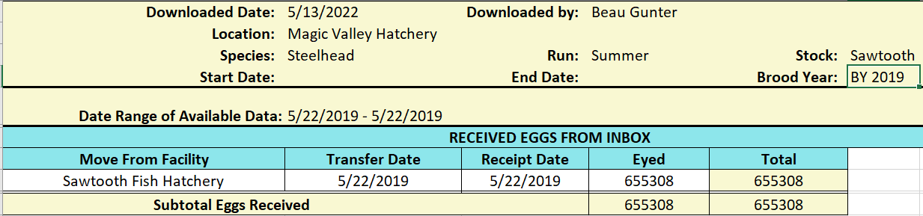
Egg to Smolt Survival
Run one of 2 queries to identify eyed eggs
Eyed Egg= Data tab-Summary-Inventory-Enumerated
Eyed Eggs Received=Data Tab-Summary-Shipping/Transfer
Notes:
There are several ways to determine egg to smolt survival with FINS. I prefer identifying my initial egg inventory and then using the final release numbers (next slide) to make the calculations. There are 2 methods to know for getting egg numbers. If it is a facility which incubates and rears to release such as the McCall example used here, the first method of using enumerated inventory is appropriate. If it is a facility which has eggs shipped like Magic Valley, then using the shipped egg inventory is appropriate. The next slide will demonstrate how to get the final release numbers for calculating survival.

Slide 10
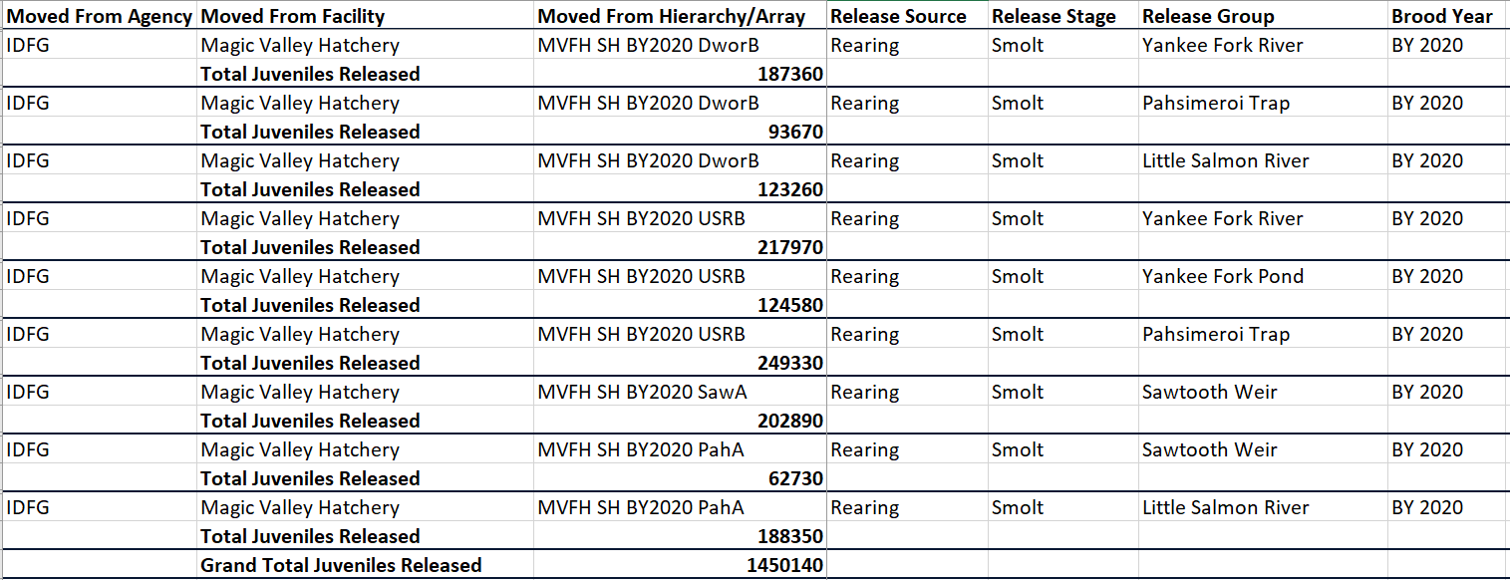
Annual Smolt Release
Data Tab-Summary-Release
Notes:
When the release query is run, multiple incubation and rearing arrays can be run. This report represents all smolt releases from Magic Valley for BY2020. I have modified this report by removing each individual raceway, so it could be easily viewed here.

Slide 11
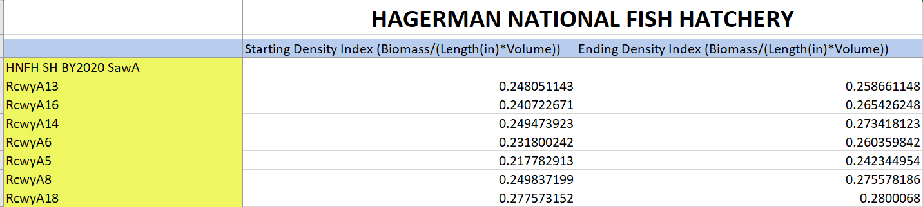
Density Index
Data Tab-Summary-Inventory-Rearing Production Summary
Notes:
Reporting the density index is a great opportunity to introduce the Rearing Production summary. There is a plethora of information which can be gathered from the rearing production summary. For this example we are using a few of Hagerman National Sawtooth stock raceways to demonstrate how the Density index can easily be obtained.

Slide 12
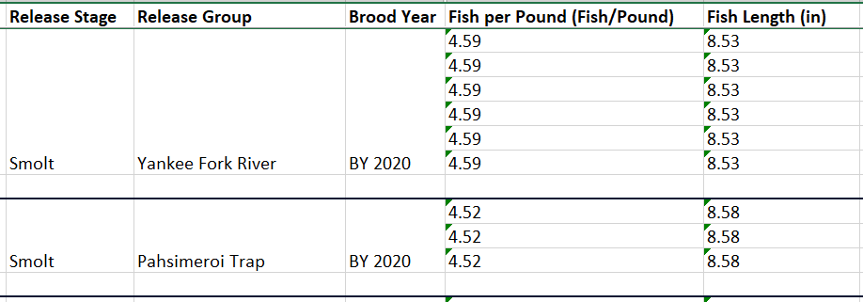
Size at Release
Release summary has size data associated with each release group.
Notes:
Finally, size at release is obtained with the Release Summary. This shows another section of the Magic Valley example shown earlier which identifies the size at release for some of their release groups.
These are just a few of the real life hatchery related metrics which can easily be pulled from FINS. If you have specific examples of things you are looking for that aren’t immediately obvious in the query option, there are some creative ways to get at these questions. I would be happy to discuss with folks if they have issues.

Slide 13
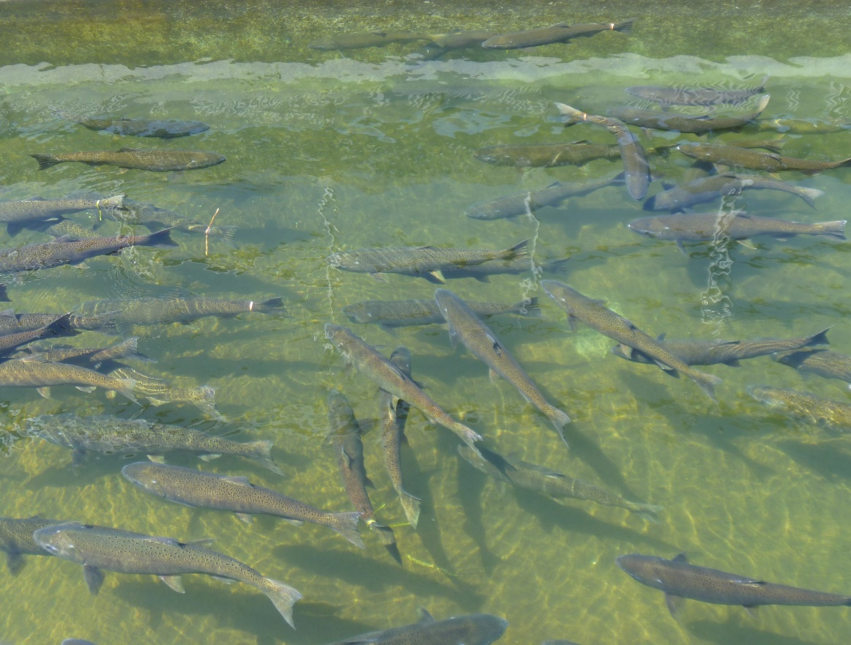
Exploring the Use of FINS Data for M&E Purposes
Chris Sullivan – IDFG Anadromous Fisheries Coordinator

Slide 14
In-season Chinook coordination

Slide 15
Hatchery weir management
Integrated Chinook Programs
  McCall
  Sawtooth
  Pahsimeroi

Slide 16
Hatchery weir management
Integrated Chinook Programs
  McCall
  Sawtooth
  Pahsimeroi

Slide 17
Hatchery weir management
Integrated Chinook Programs
  McCall
  Sawtooth
  Pahsimeroi
Steelhead
  USAL-B @ Pahsimeroi
  EF Natural brood acquisition

Slide 18
Parentage Based Tagging
Tools are still in development and beta testing
PBT tracking
PBT tag rate calculator

Slide 19
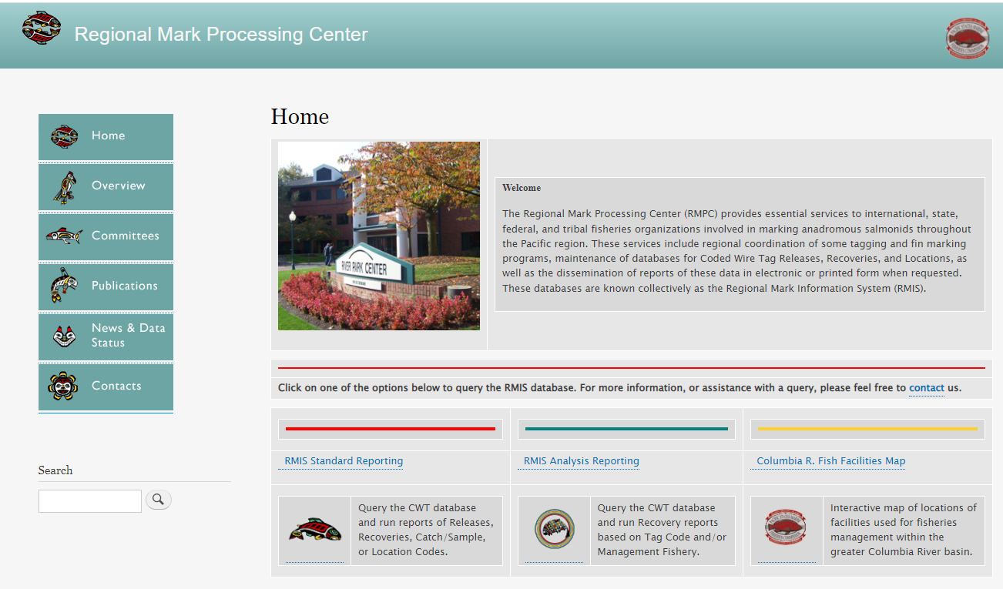
Release summary for RMIS
Used to generate the CWT information to upload to RMIS

Slide 20
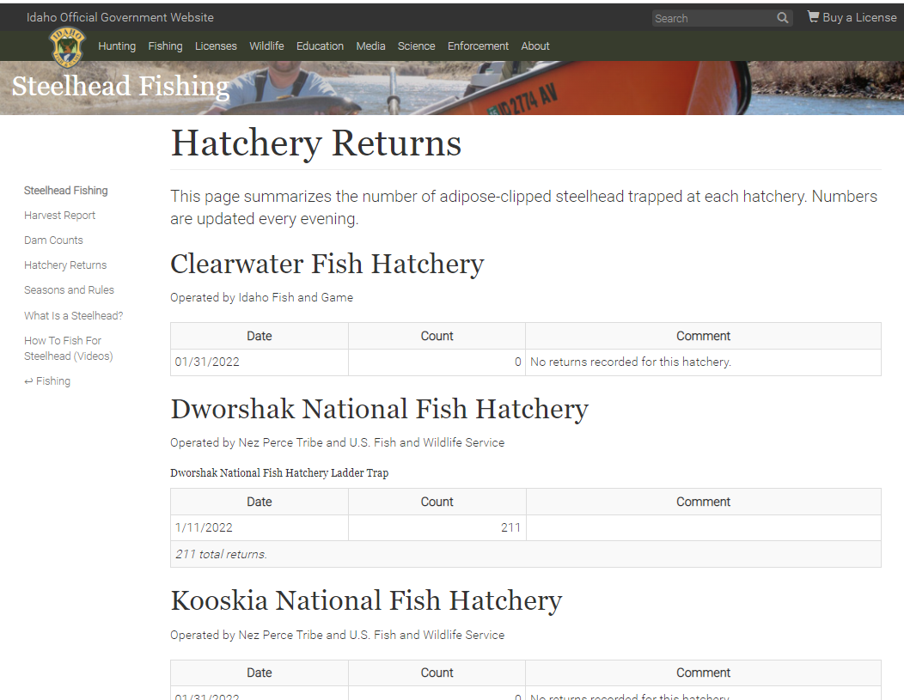
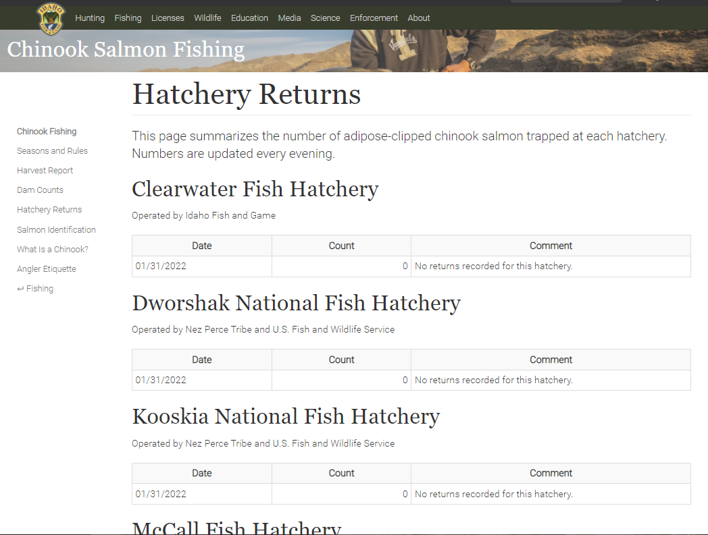
Trapping updates for IDFG website

Slide 21
In-season run and brood assessments
PIT tag detections at hatchery traps
  Helpful to assess run timing and broodstock planning
  Combination of LGR detections, in-stream arrays, hatchery traps
  In-season travel times
  Fish return summaries and other tools

Slide 22
In-season run and brood assessments
PIT tag detections at hatchery traps
  Helpful to assess run timing and broodstock planning
  Combination of LGR detections, in-stream arrays, hatchery traps
  In-season travel times
  Fish return summaries and other tools
Estimating in-season fecundity of trapped/spawned adults

Slide 23
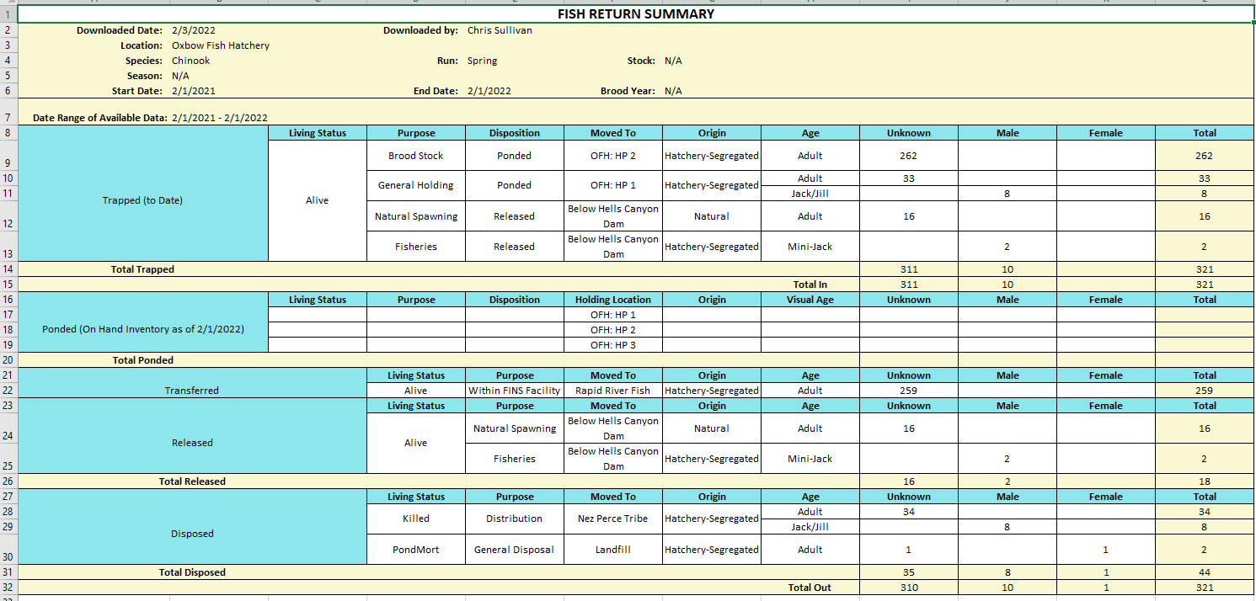
Fish Return Summary

Slide 24
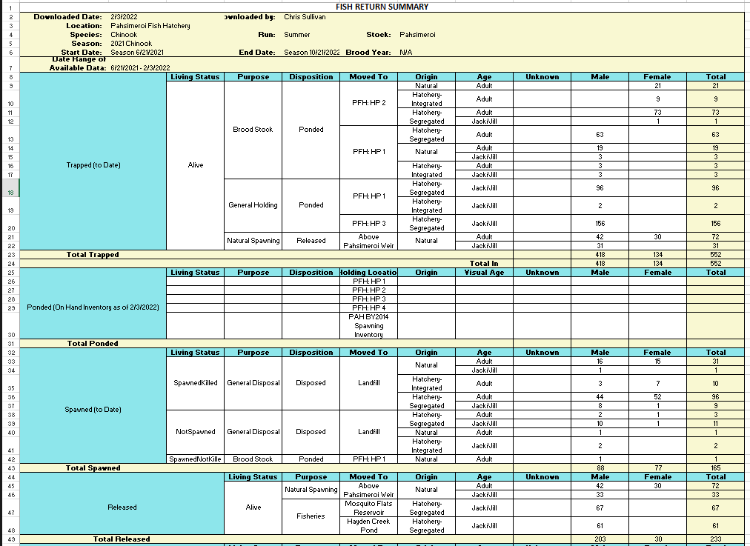
Fish Return
Summary

Slide 25
Questions?

