Slide 1

Are current hatchery strategies designed
to engage with
future ocean variation?
(this will be very Chinook salmon-centric)
Brian Beckman
NWFSC, NMFS, Seattle

Slide 2
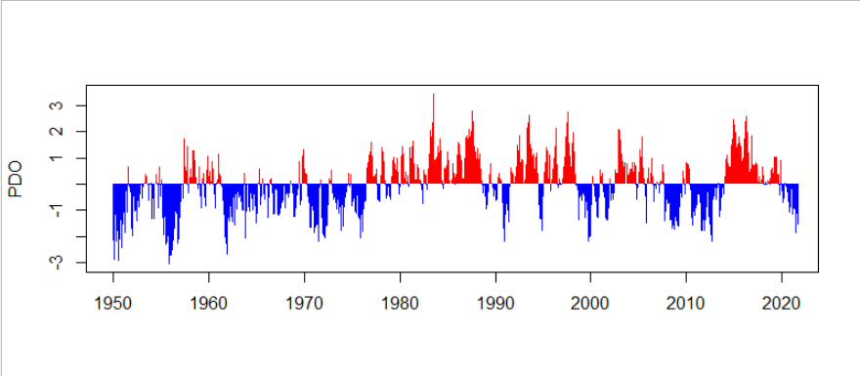
The ocean has been variable and unpredictable
but “stable” flipping between two states
Warm phase
PDO
Cool phase

Slide 3
Hatchery production strategies were
developed during a period of predictably
”good” ocean conditions =>
Our perception is good = normal
PDO

Slide 4
Trajectory of hatchery production strategies
in the Puget Sound

Slide 5
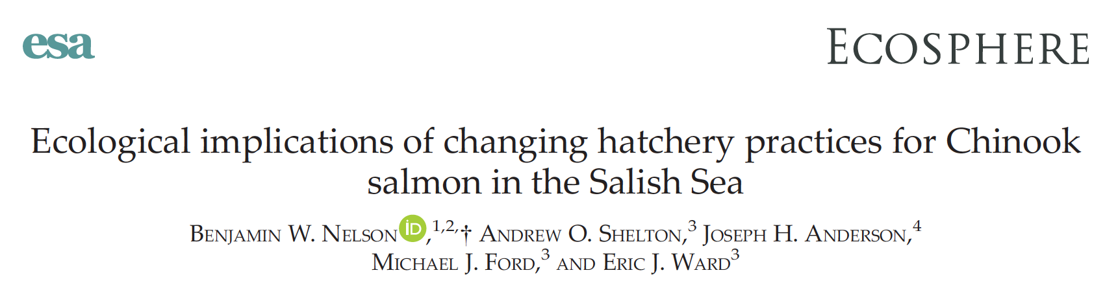
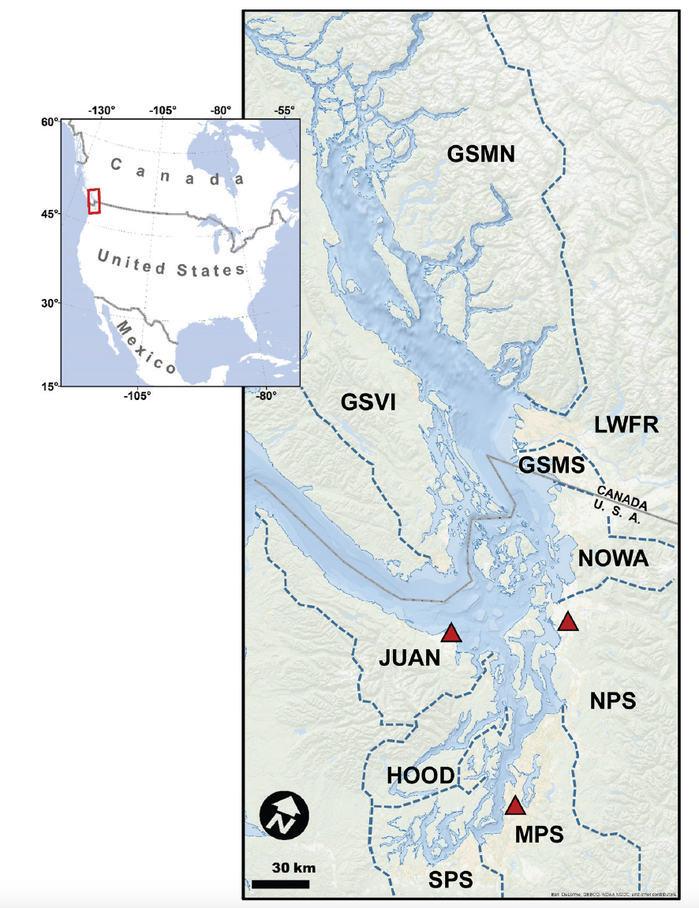
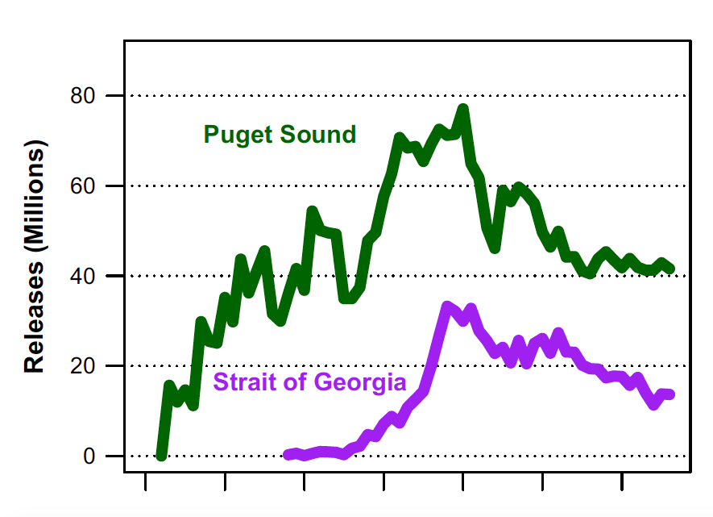
Chinook Salmon Hatchery Releases
(millions)
40 million
20 million
1950 1970 1990 2010

Slide 6
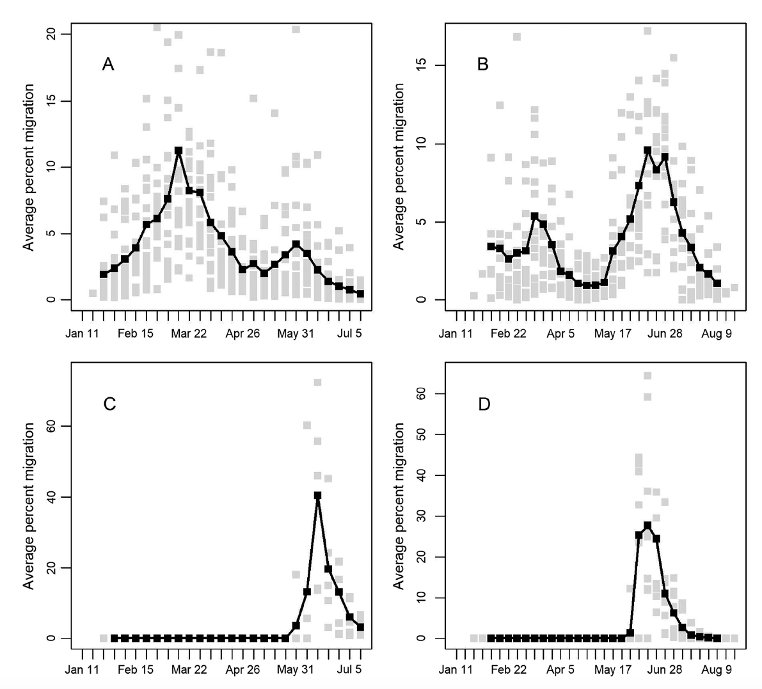
Current natural fish migration timing is variable and extended (6 months)
Current hatchery fish timing is unimodal and short (6 weeks)
Natural
Skagit River
Dungeness River
Migrants (%)
Migrants (%)
Abundance
of migrating
Chinook salmon smolts
at weirs/traps
Hatchery
Migrants (%)
Migrants (%)
Feb Apr July
Feb May Aug
Nelson et al. 2019

Slide 7
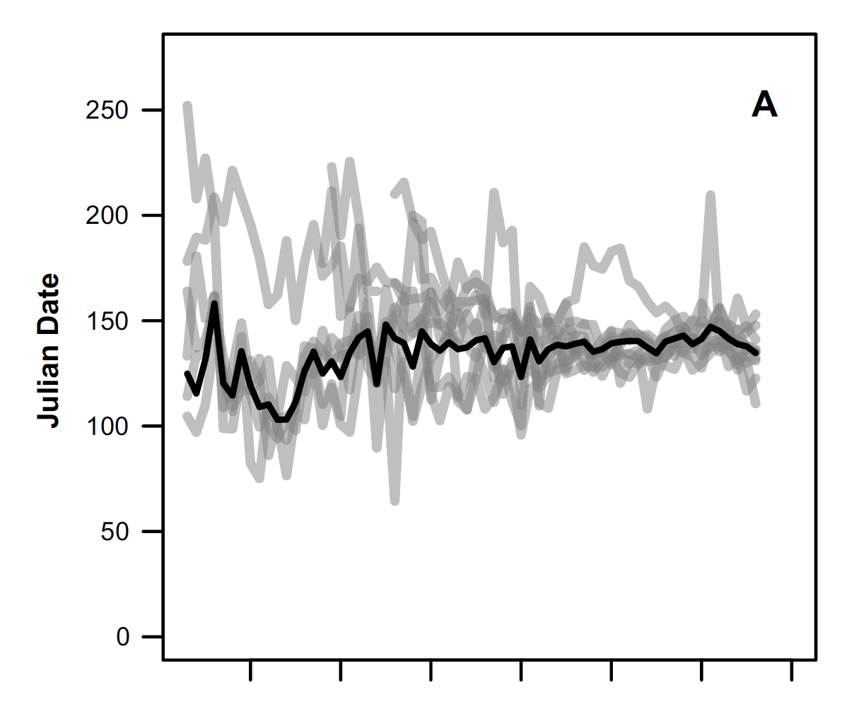
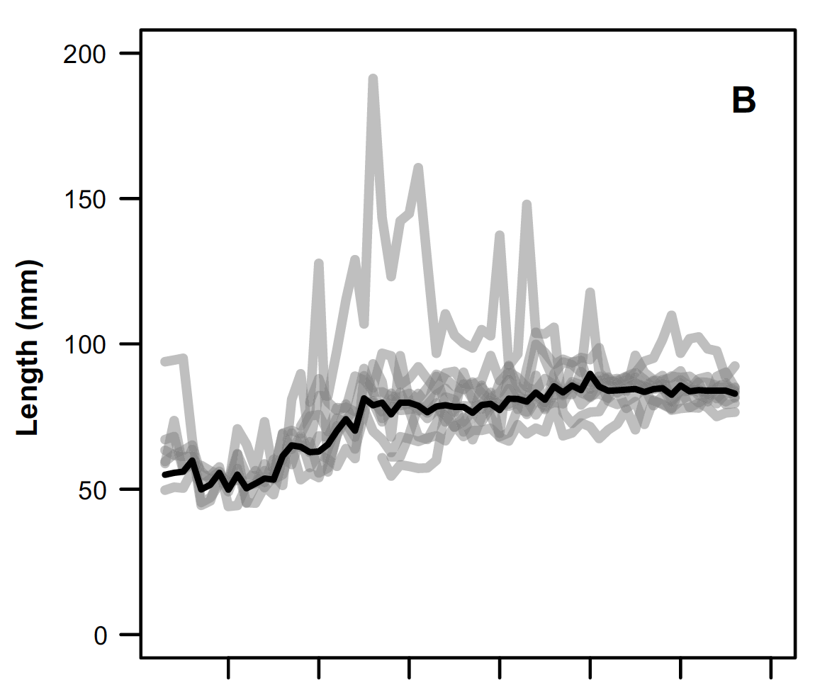
Variation in hatchery release time and release size of
Chinook salmon in Salish Sea has decreased and become
unimodal
Release Date
Release Size
Late
May
Day of year
80mm
1950 1970 1990 2010
1950 1970 1990 2010
from CWT records
Nelson et al. 2019

Slide 8
We might consider the varying ocean as a
Roulette Wheel
As managers we make bets on ocean survival based on time and size at release

Slide 9
Puget Sound strategy: release of
a uniform group of smolts in the early summer
(the big bet)
Based on:
A history of success
Size/time release studies
Forty million on:
5 June at 40 fpp

Slide 10
A common Col R strategy is a single release of
yearlings in the spring
One million on:
5 April at 18 fpp
Based on:
A history of success
Size/time release studies

Slide 11
Are current hatchery strategies always successful?
Or, is there a consistent return of fish?

Slide 12
Spring Chinook salmon count at Bonneville, 2019 – 2021
Do we have a problem?
ESA listings

Slide 13
Steelhead count at Bonneville, 2017 – 2021
Do we have a problem?

Slide 14
Current hatchery strategies may result in poor returns but
stability of ocean ecosystem has ensured success
when ocean conditions
return to a cool and productive regime
-> 2020??
=> Maintain current strategies based expectations of a stable ocean?
PDO

Slide 15
Spring Chinook salmon count at Bonneville, 2022
Is the problem solved????
CBR in-season
prediction
12 May
Count
12 May 22

Slide 16
Current PDO – it’s easy to think returns will be better
Warm phase
PDO
monthly
2020
2021
2022
Cool phase
2010 2011 2012 2013 2014 2015 2016 2017 2018 2019 2020 2021 2022

Slide 17
Patterns of ocean variation are changing

Slide 18
Amount of ”heat” in upper ocean is increasing
Cheng et al. 2022

Slide 19
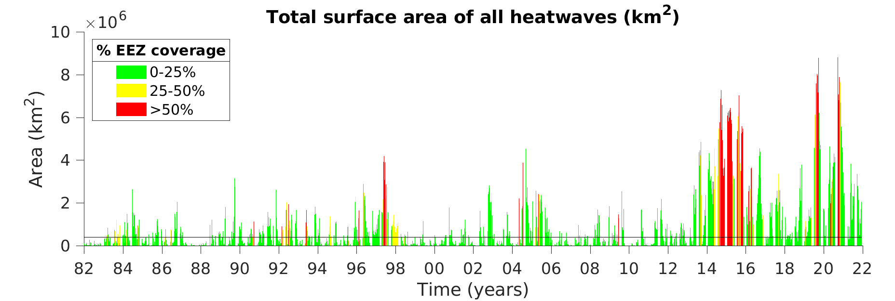
Marine heat waves are increasing
in frequency and magnitude
Common > 6 million km²
Rare < 4 million km²
2020-21 California Current Ecosystem Status Report NOAA California Current IEA Team

Slide 20
The forecast is for even more
marine heat waves w/ warming
Marine-based
heat waves
(2014-16, 2018, 2019)
Land-based
heat waves
(June 21)

Slide 21
There is an increasing trend in marine heat
Variability is increasing
The variation is becoming more intense
The ocean is becoming more unpredictable
Marine conditions are exceeding historic norms
Might the PDO “flip” become unstable?

Slide 22
Do we want to continue with the current strategy (the big bet) or
perhaps consider some alternatives?
One million on:
5 April at 18 fpp
Based on:
A history of success
Size/time release studies

Slide 23
Are hatchery goals 1) maximizing return every year or
2) minimizing variance in return between years?

Slide 24
Are there alternative production strategies that might produce
different patterns of variance?
Annual mean is higher
Max annual catch is higher
Minimum is lower (bust?)
Minimum annual catch is higher
Variance is lower
Mean is lower
Max
Abundance
Min
the big bet
something else
Year

Slide 25
250k each on: ???? at ????
Bet small – win small
but don’t bust

Slide 26
What data do we have on ”small bets”?
Willamette spring Chinook salmon, ODFW
4 hatcheries, varying release dates, several decades of CWTs
Mining RMIS

Slide 27
Willamette R spring Chinook SAR by release month

Slide 28
November returns are never “great”

Slide 29
On average, March release SAR is higher,
~ 30% of the time November release SAR is higher
November is higher - 12
About the same - 6
March is higher - 21
1978 – 2018, Willamette, Marion Forks, South Santiam, McKenzie
Spring Chinook salmon CWTs
lumped and averaged

Slide 30
November returns are never “great”
But – sometimes better

Slide 31
This is not a solution – it’s an approach to
consider
Bet small – win small
but don’t bust

Slide 32
Caveats & Constraints
Release smolts, not parr
River flow & water temperature
Passage & transport
Many others
Bet small – win small
but don’t bust

Slide 33
There are different ways to generate diversity, within a program
or within a sub-basin between programs
=> No reason any one program needs to generate all diversity
April
November
March
March
May

Slide 34
How do we make short-term management decisions,
within varying and unpredictable marine conditions,
while considering a long-term trend?

