Slide 1
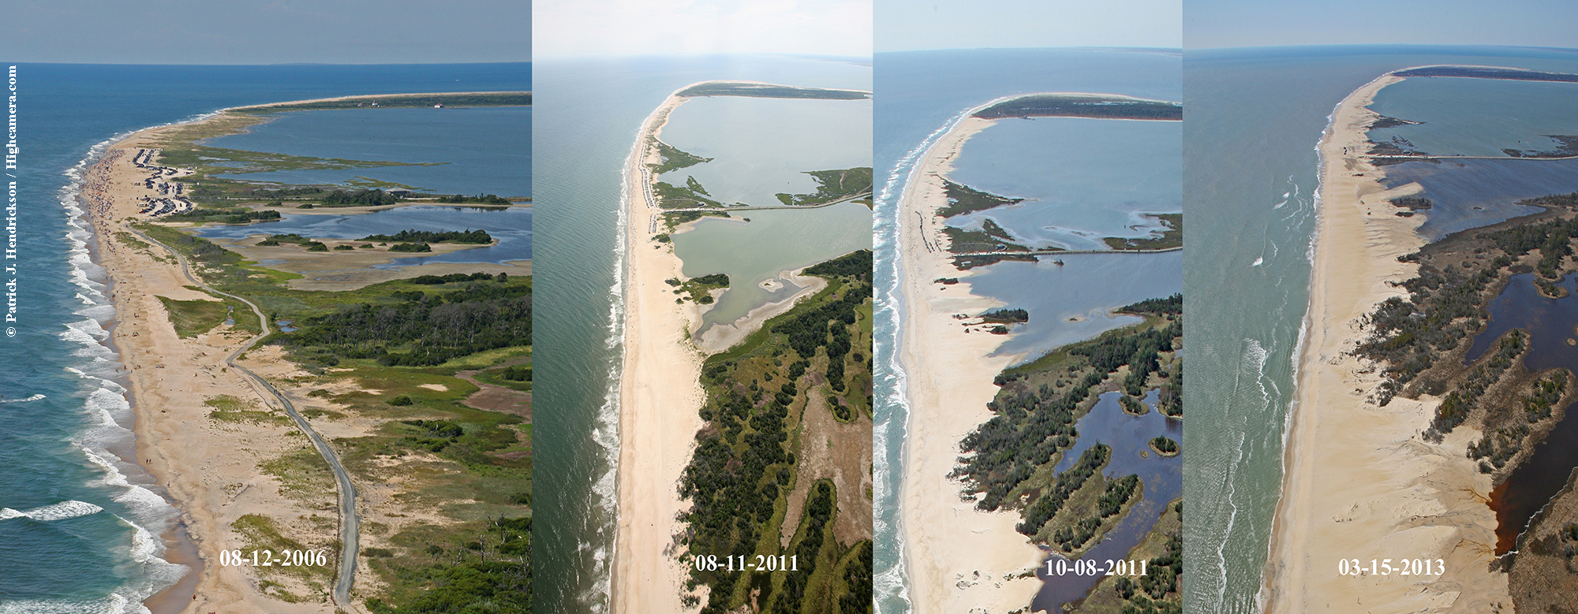


Assateague Island Beach Chincoteague National Wildlife Refuge Assateague Island National Seashore
September 25, 2024
Notes:
As you know, the FWS CNWR and NPS ASIS have managed the recreational beach on CHN for many years.
Both agencies recognize that the beach is a hugely important economic asset to the local community.

Slide 2
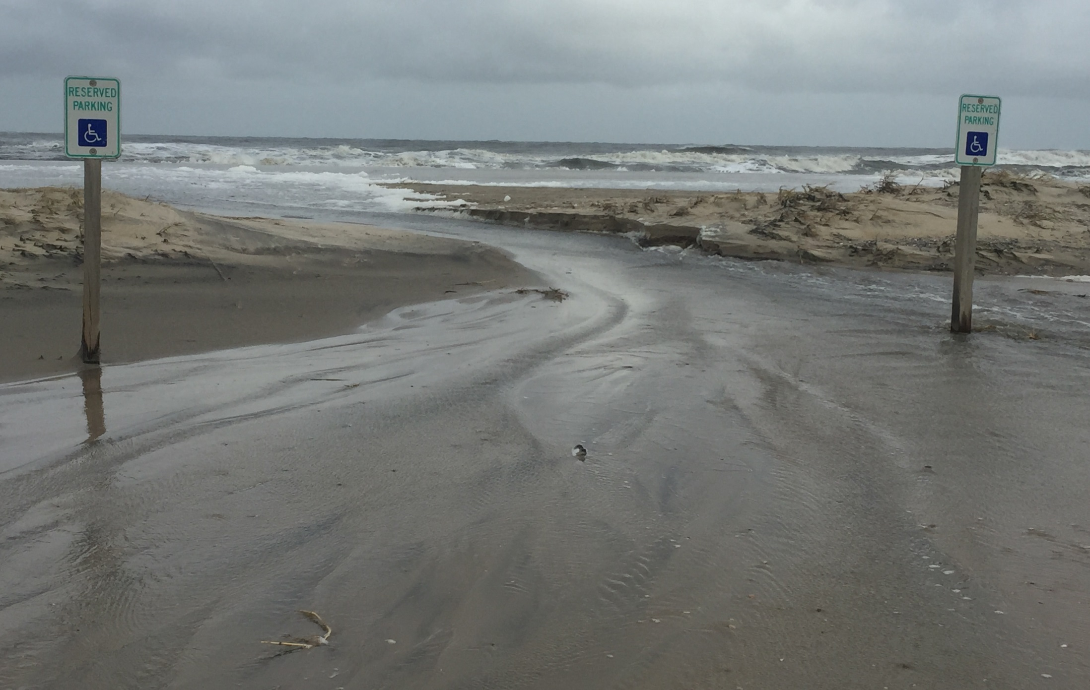
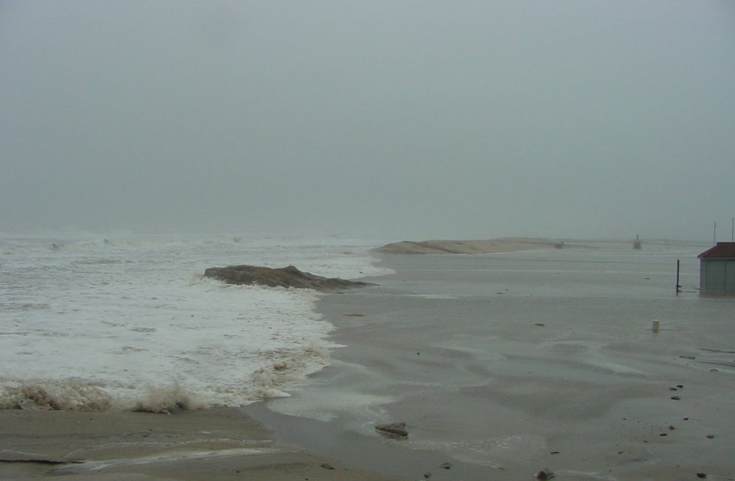
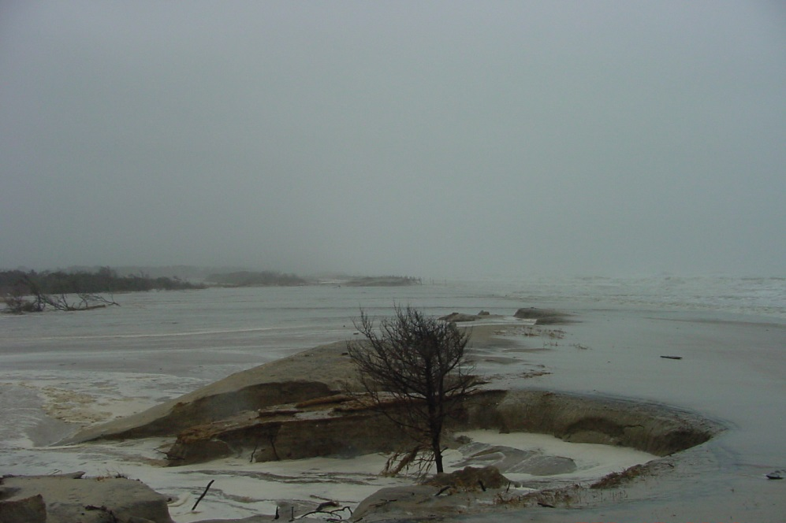
The current beach site has become increasingly vulnerable
to storms, high tides, and erosion over the past several decades.
Notes:
Unfortunately, over many decades, escalating coastal erosion from storm damage and high tides have threatened the continued existence of the beach.

Slide 3
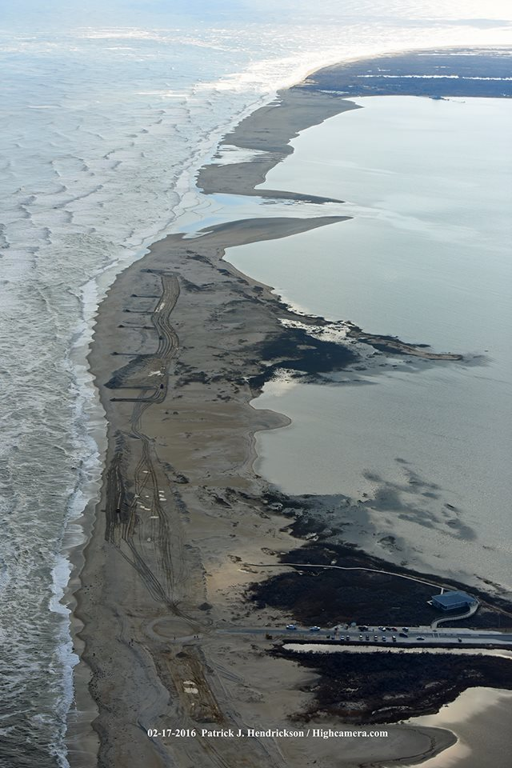
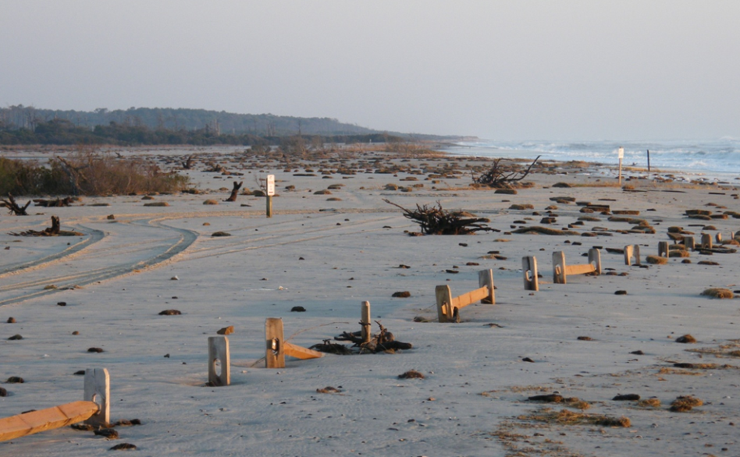
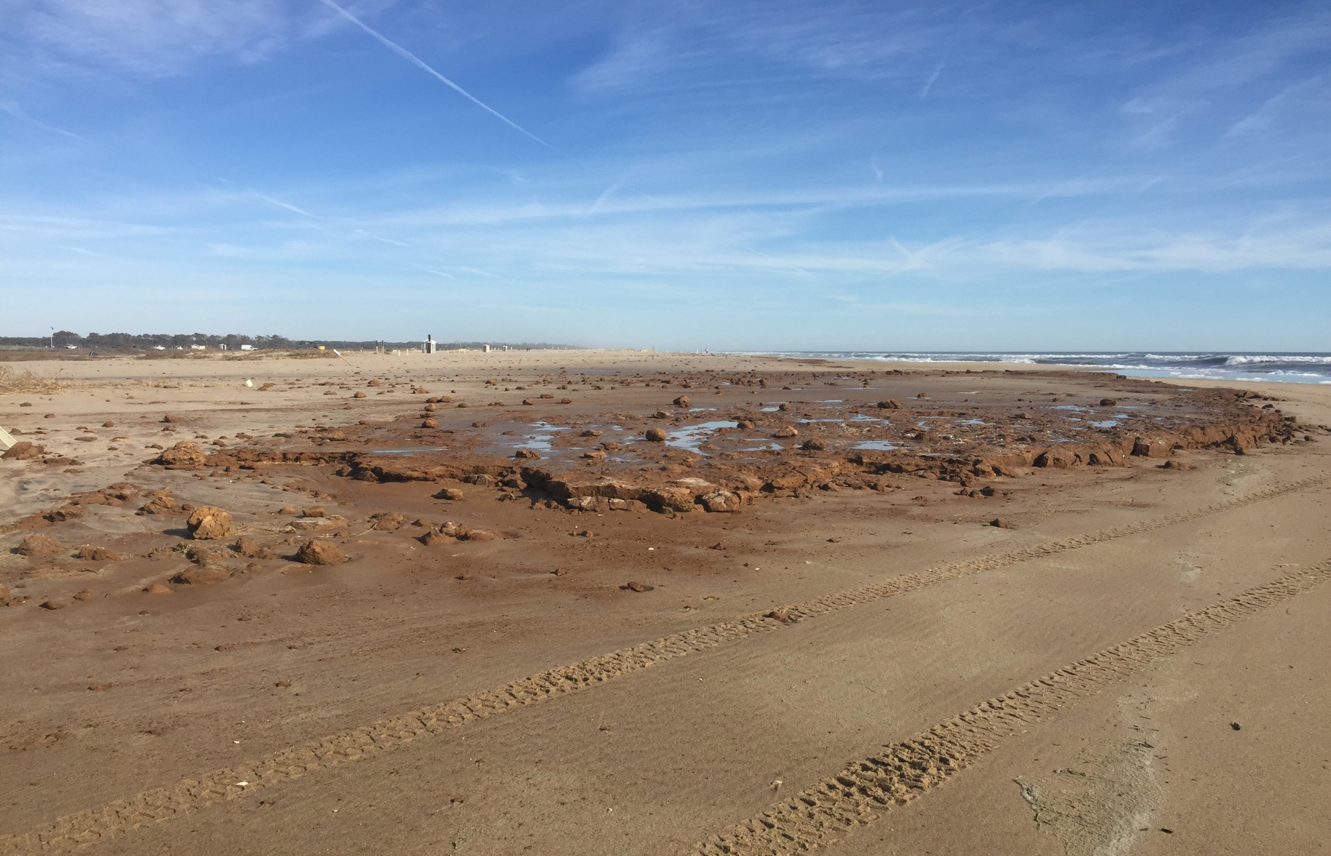
Resulting in repeated damage to beach facilities
Hook
Atlantic Ocean
Toms Cove
Recreational Beach Parking Lot after being destroyed by “Jonas” in 2016
Toms Cove Visitor Contact Station
Notes:
These events have repeatedly damaged or destroyed the facilities at the beach including the current parking lots.
Boardwalks and other structures that were once present, have long since washed away.

Slide 4
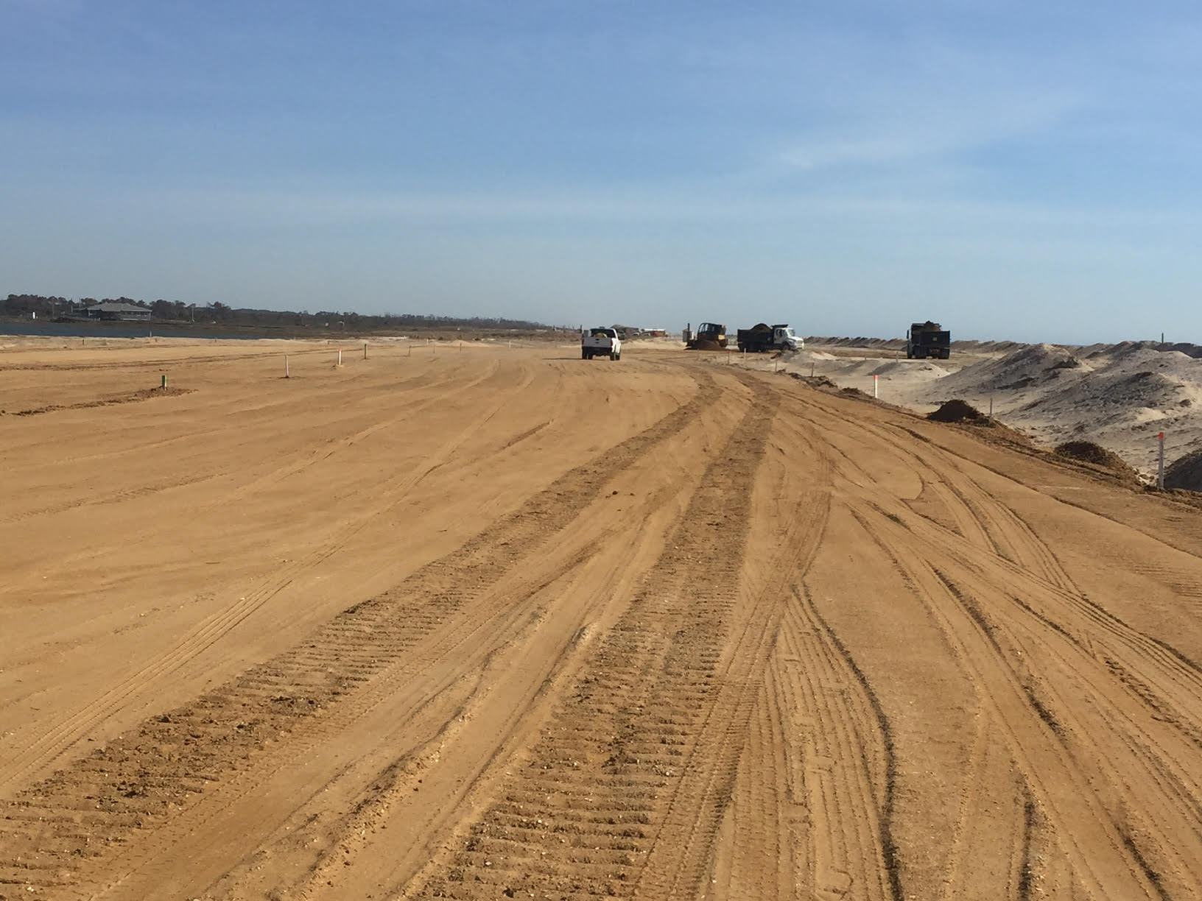
Requiring costly repairs
$100,000-400,000/year
$15M since 2003
Notes:
Consequently, annual maintenance costs have been very high over the years and have become unsustainable.
Each year, repair and maintenance costs can range $100,000-400,000/yr.
Since 2003, these costs have totaled $15M.

Slide 5
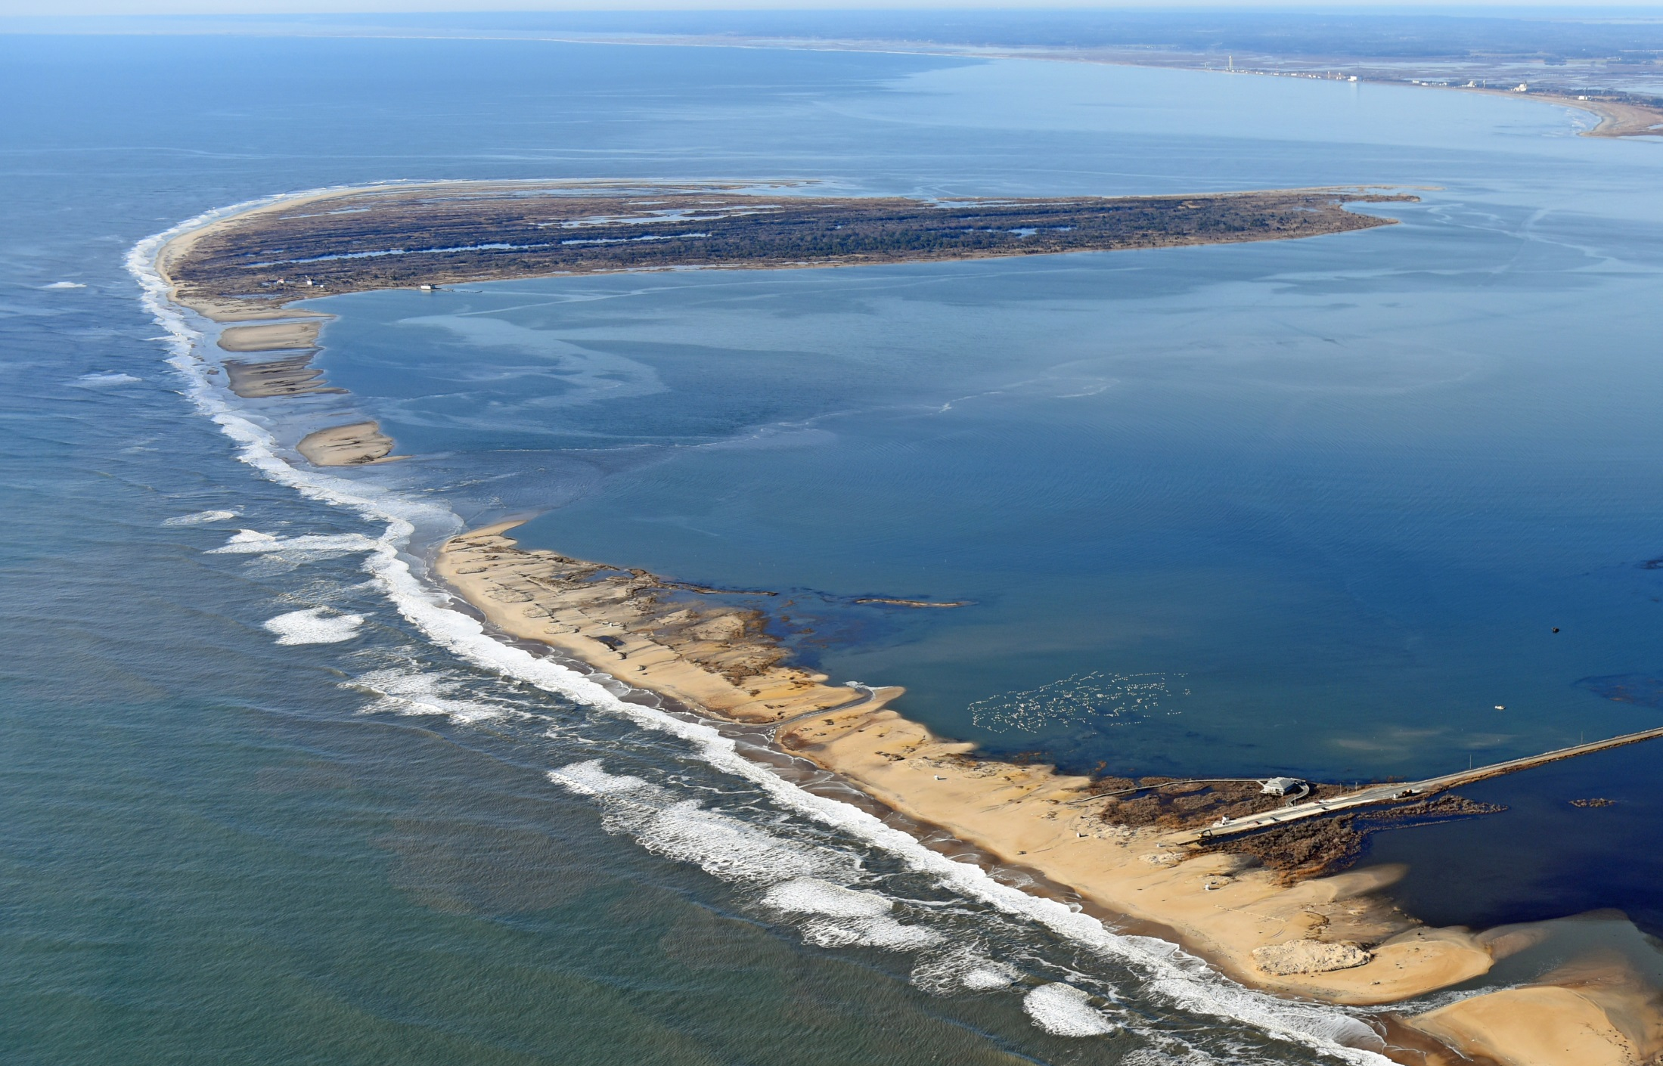
Hook
Toms Cove
Overwash
Toms Cove Visitor Contact Station
Atlantic Ocean
Recreational Beach Parking Lot destroyed by “Jonas” in 2016
Patrick J. Hendrickson/Highcamera.com
Even moderate storms pose a significant threat.
Repair costs for WS Jonas in 2016 = $600,000
Notes:
Costs aside, eventually the beach will be damaged beyond repair as very little land remains at the beach location with no room to continue to move facilities to the west.
Even moderate storms are beginning to push the limits of our abilities to repair and what we can afford.
This photo shows the aftermath of Winter Storm Jonas in 2016, with significant overwash that required rebuilding the parking areas at a cost of $600,000.

Slide 6
Barrier Island Movement - West
Trail is overtaken by 2011
2006
2011
2013
The southern end of Assateague Island is migrating west
at a rate of approx. 10-13ft/year.
Notes:
This series of photos provides a good illustration of how the public beach portion continues to change as the island moves at ~10-13 ft per year to the west.
Note the arrows.
The old Swan Cove trail shows a good example as its now in the ocean.

Slide 7

2015 – Final Comprehensive Conservation Plan & EIS completed that included decision to move the beach to a more stable and resilient location
2018 – a follow-up joint FWS-NPS EA completed that further defined the project
Relocating the beach would:
Ensure the conservation of wildlife
Continue to provide public beach facilities and recreation
Significantly reduce maintenance costs
Protect the local economy
Notes:
In 2015 the FWS completed our Comprehensive Conservation Plan (CCP) and associated EIS for the Refuge. These are the documents that guide our long-term management of the refuge.
A key issue was how to deal with the future of the public beach.
FWS’ decision in the CCP and in a follow-up joint EA with NPS completed in 2018, was to move the recreational beach and its associated infrastructure 1.5 miles north to a new more stable and resilient location.
The move would require a new entrance road, multi-use bike path, new parking lots to replicate existing parking capacity (~961 spaces), access to the beach from the parking lots, and other visitor amenities.
Relocating the beach would help conserve the wildlife resources on the refuge a key component of the FWS mission
Continue to provide a public beach when the current area is destroyed
while significantly reducing annual and long-term maintenance costs
and protecting the economy of the Town of Chincoteague and surrounding areas.

Slide 8
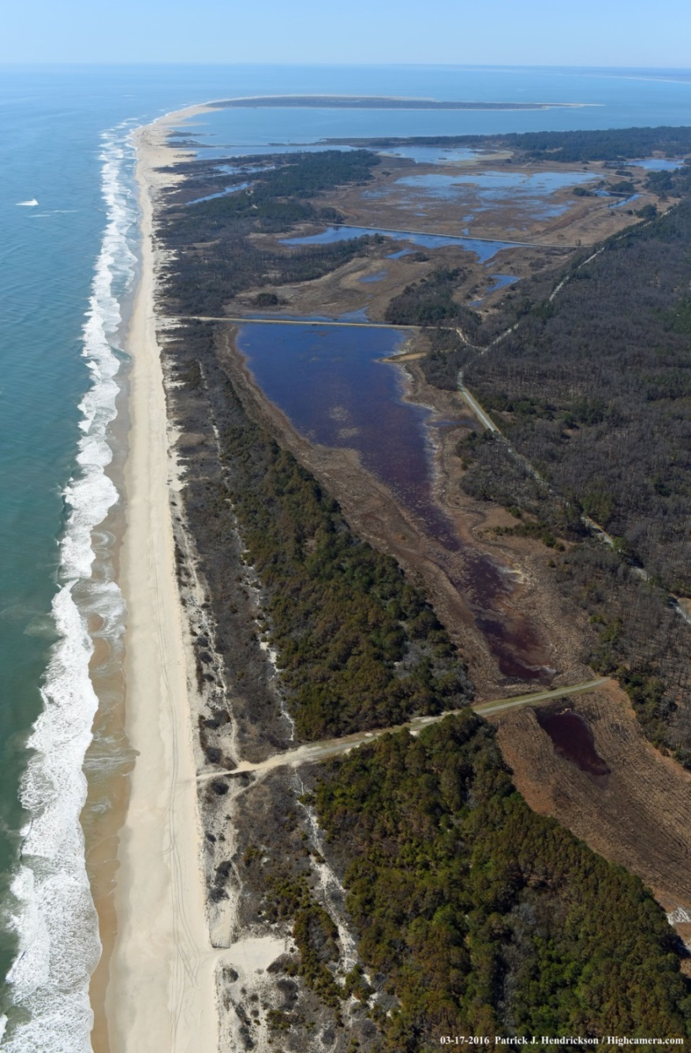
New Beach Location
2.5 miles north of the current site
Keeping it 1 mile long
Maintaining the existing ~961 space parking capacity
Accommodate westward shoreline movement to ensure a minimum 25-year lifespan
Beach Road
Current Recreational Beach
& Parking Lot
Beach Road
Service Road
New Recreational Beach
and Parking Lot
Notes:
Through these planning processes, a new location was selected 1.5 miles to the north. Basically, centered on D-Dike.
The new beach area would continue to be 1 mile long and
Maintain the existing parking capacity.

Slide 9
Funding
Since 2015 several unsuccessful external and internal grant proposals were submitted by FWS/NPS in cooperation with the Town of Chincoteague and Accomack County
Oct 2022, FWS applied for USDOT FHWA NSFLTP grant for construction of:
New entrance road
Multi-use bike path
Parking lots
Beach access trails and boardwalks
FHWA awarded the USFWS $17.7 million dollars for construction.
Notes:
Since 2015, the FWS and NPS also have been pursuing funding to complete construction of the FHWA design.
After several unsuccessful external and internal grant proposals, in October 2022, the FWS applied to the FHWA, Nationally Significant Federal Lands and Tribal Projects (NSFLTP) grant program to fund a portion (Phase 1) of beach relocation (using contract cost estimates from 2019 adjusted for inflation).
Under this proposal we would replace only the existing infrastructure - one entrance road but including new entrance lane, a bike path, all parking and the boardwalks.
I’ll talk a little more about why on the next slide.
In July 2023, the FHWA announced the USFWS will be awarded $17.7 million dollars to begin construction.

