Slide 1
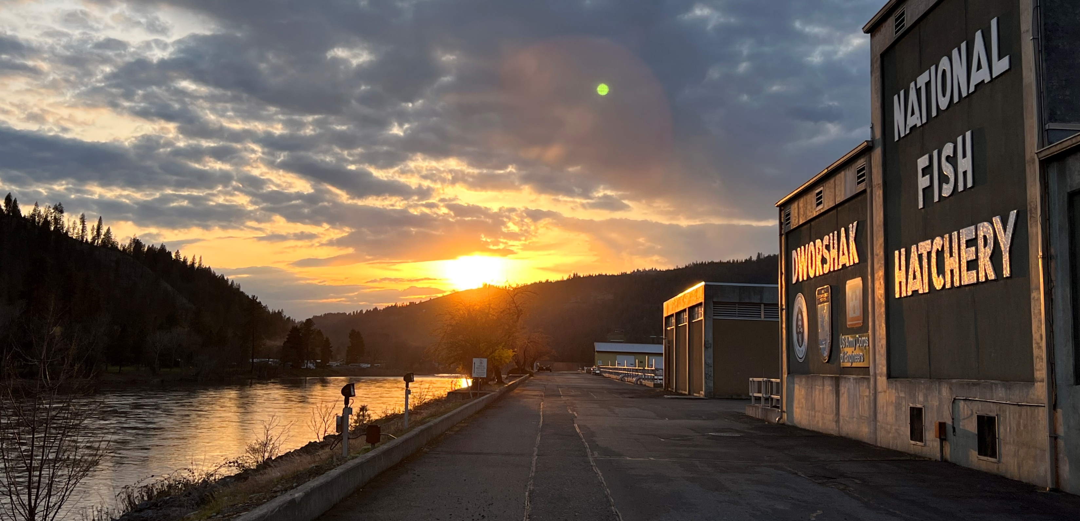
Lower Snake River Compensation Plan
Infrastructure Audits
Dworshak National Fish Hatchery

Slide 2
Mitigation Goal
20,000 adults Back to the Clearwater River
Production Goals
1.2 million – Mainstem Clearwater
300K – Clear Creek
200K – Lolo Creek
400K – South Fork Localized Brood to South Fork Clearwater

Slide 3

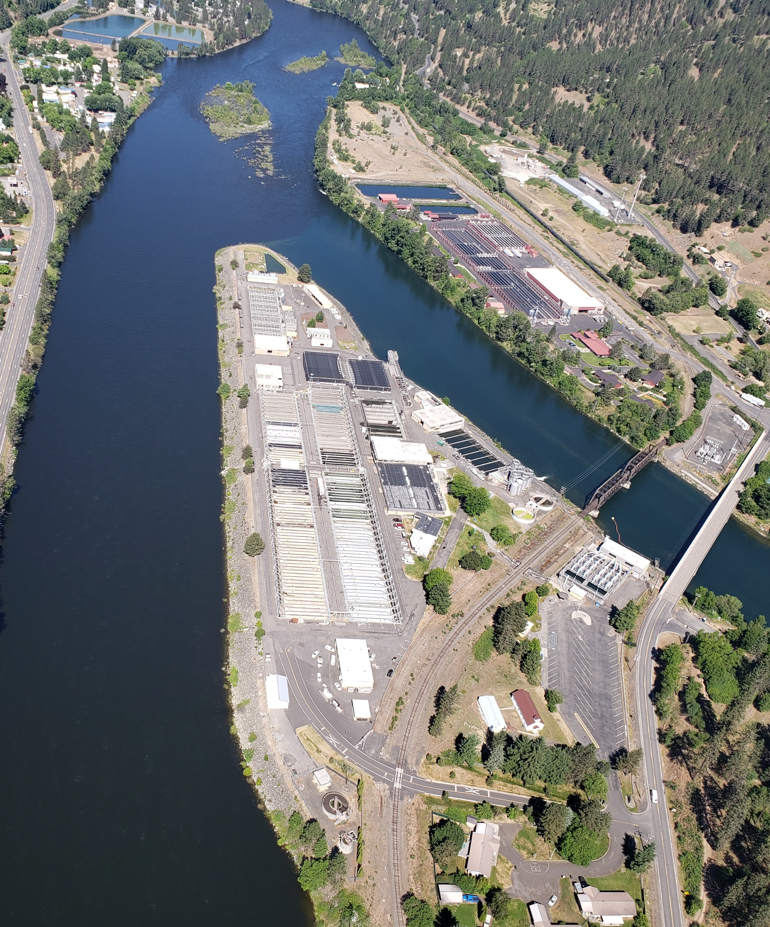
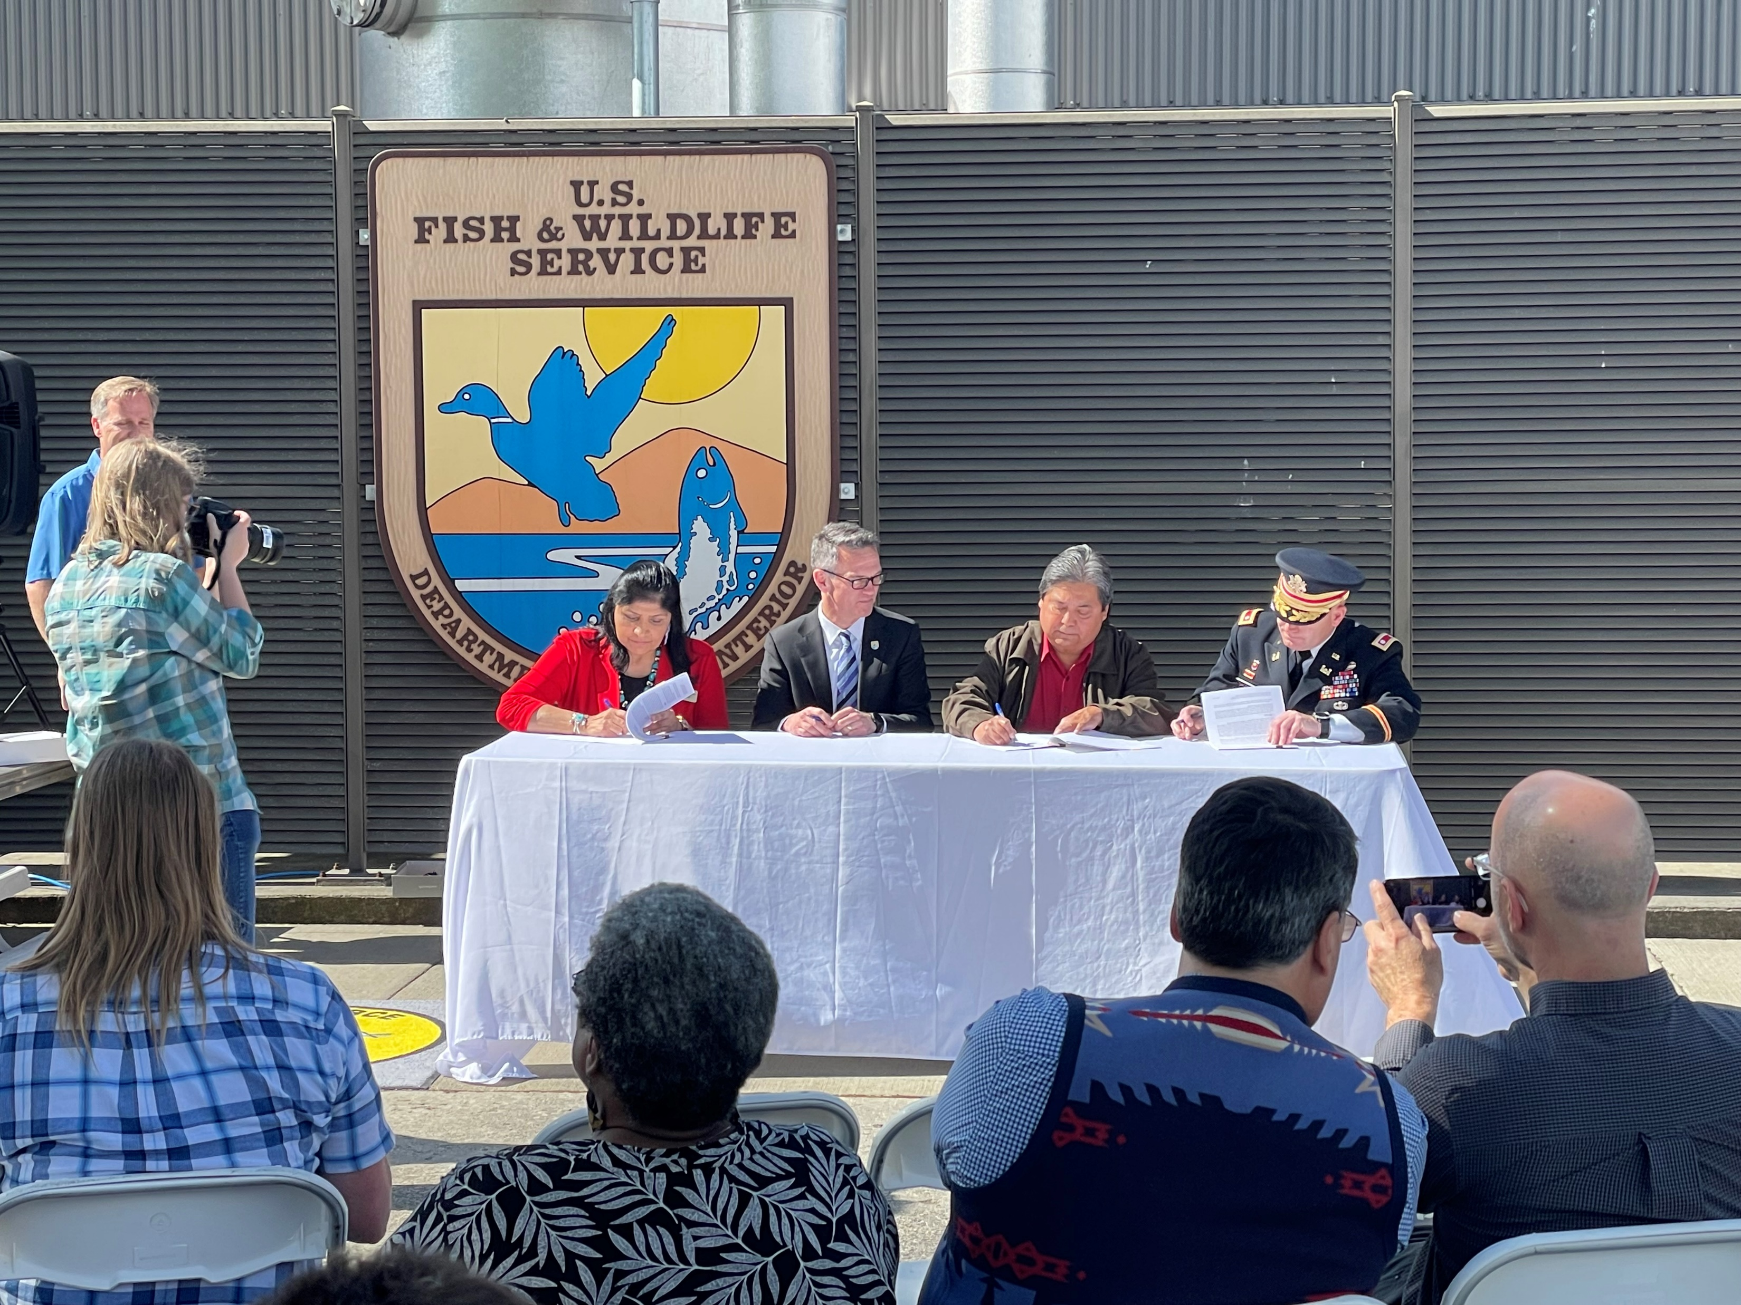
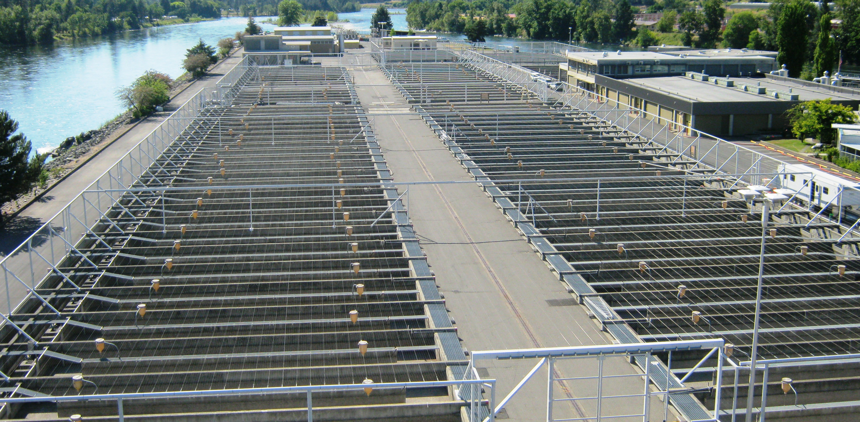
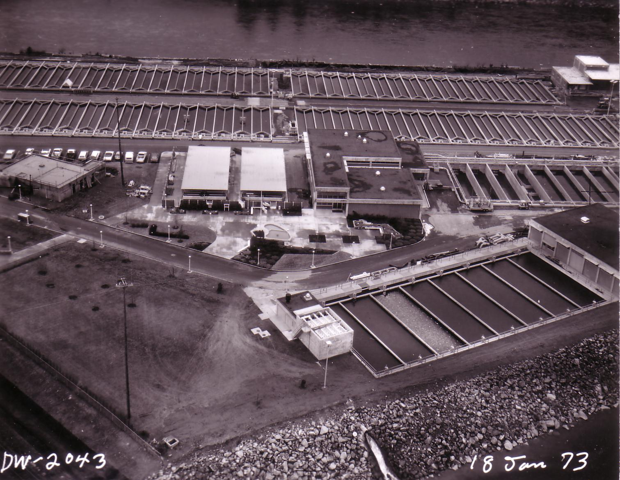
Located at the confluence of the north fork and middle fork of the Clearwater River.
Transition of the facility to Nez Perce management of all production and maintenance occurred in June 2022.

Slide 4
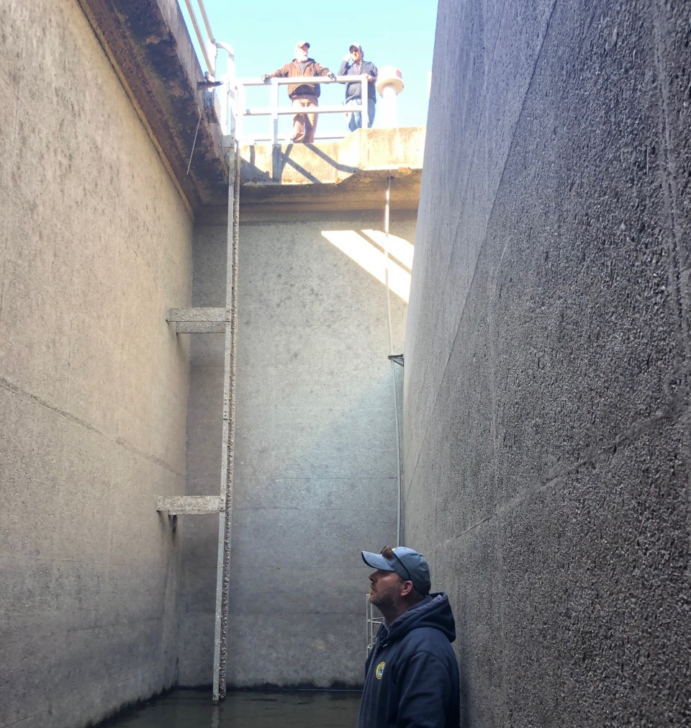
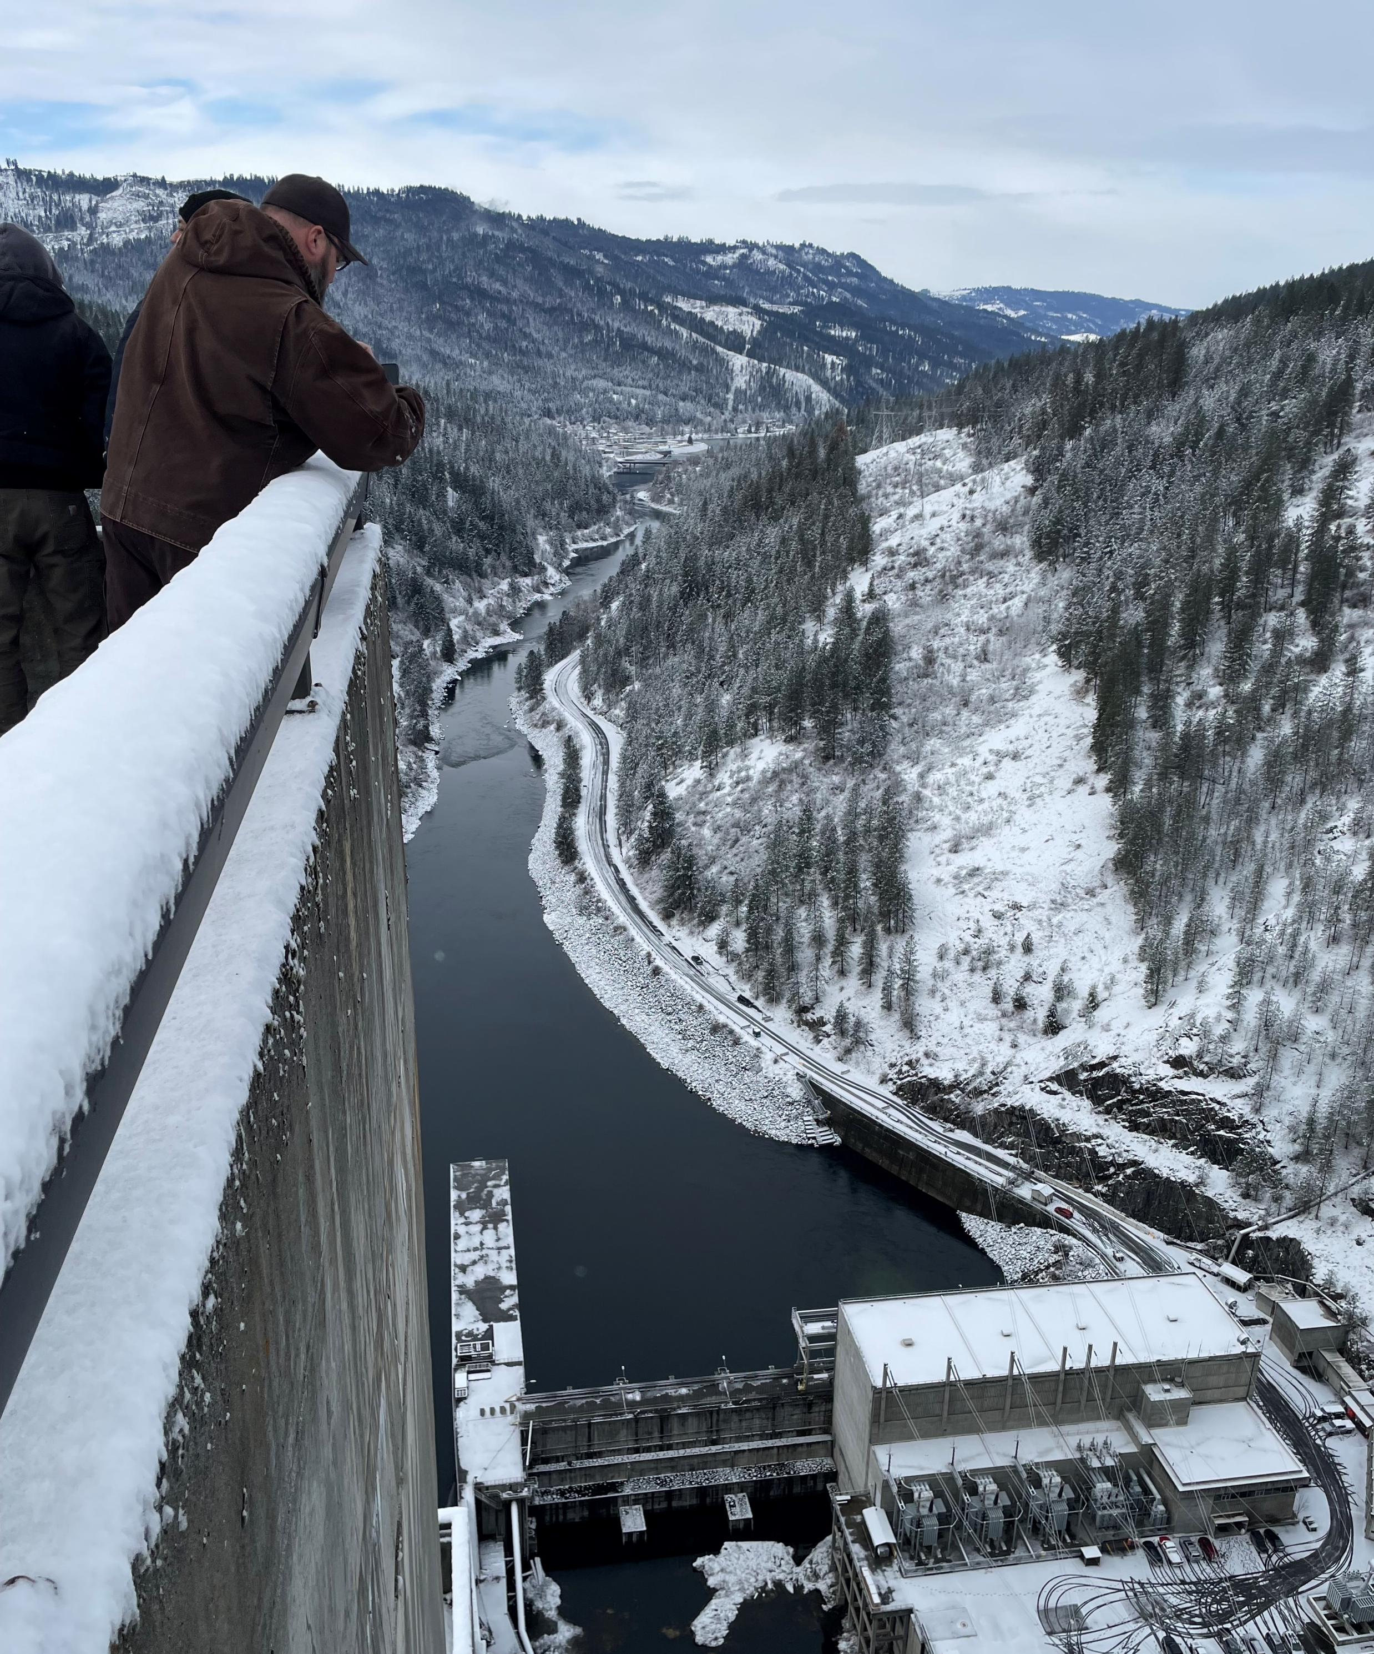
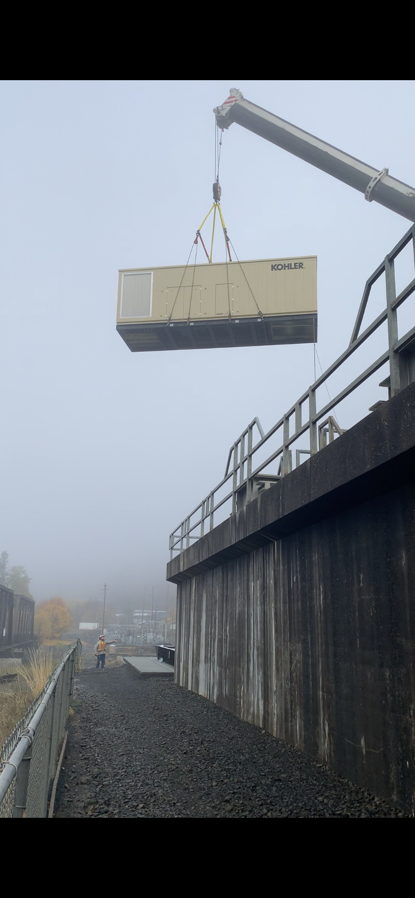
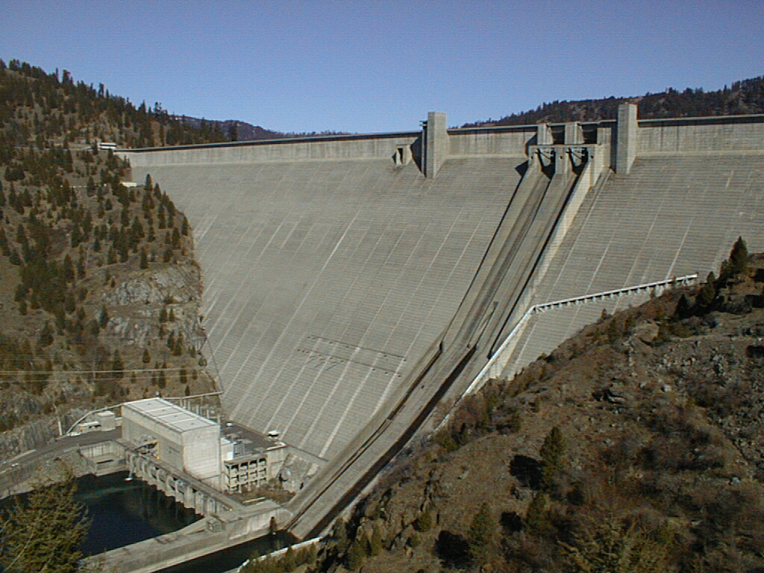
Water Supply
154 CFS is supplied from Dworshak’s six main river pumps. Water source is the North Fork of the Clearwater River.
Temperatures range from 40 – 50 degrees.
Two generators supply backup power in the case of an outage
We do not have ice or leaf season, but we do have algae season
Anadromous fish are present in front of pump forebay
Dam operations may cause high Total dissolved gas levels.

Slide 5
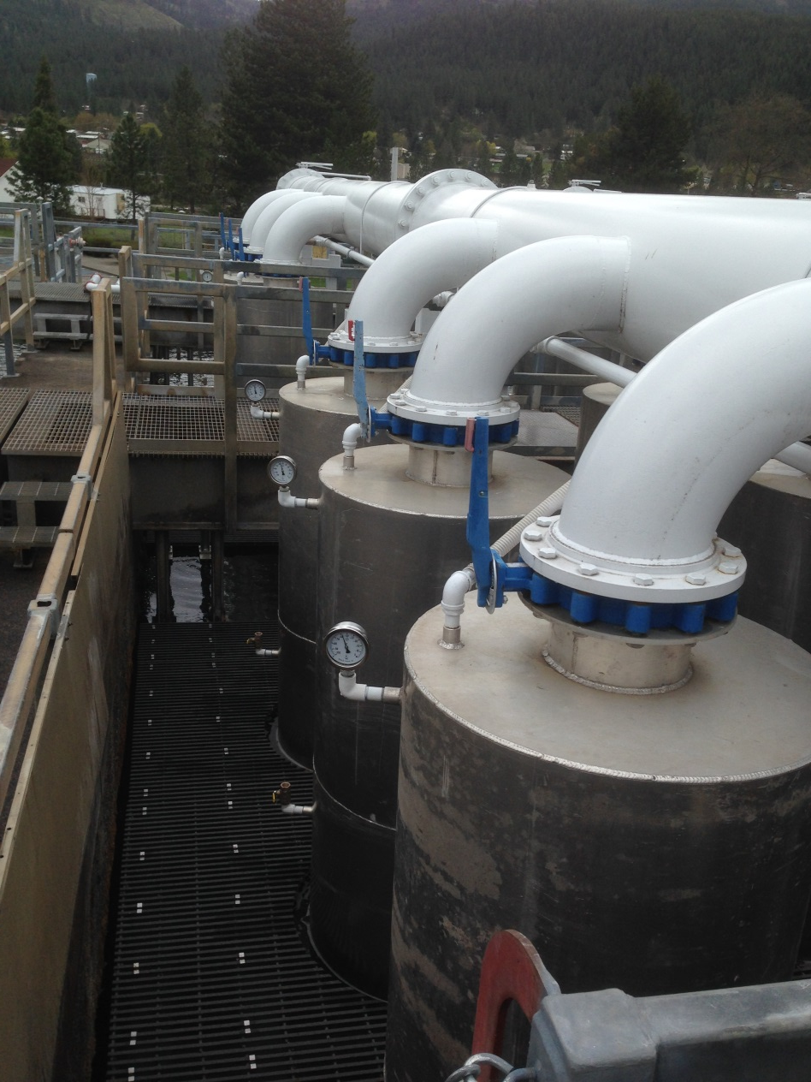

Slide 6
Water Supply
All Reservoir water is a shared resource with Clearwater Hatchery.
Secondary reservoir water supply is 9 CFS at a temperature of around 40 -44 degrees.
Primary water supply ranges from 50 CFS in May, 24 CFS in July, down to 6 CFS in September.
Primary water supplies the Steelhead incubation, nursery and early rearing with “clean” water prior to introduction to river water.
Primary water ranges from 46 – 56 degrees prior to boiler use. Temperature controlled by Clearwater Hatchery

Slide 7


Slide 8
Pd8
This page intentionally left blank
Pg 8

Slide 9
Pg 9
Pd8
This page intentionally left blank

Slide 10
Pd8
This page intentionally left blank
Pg 10

Slide 11
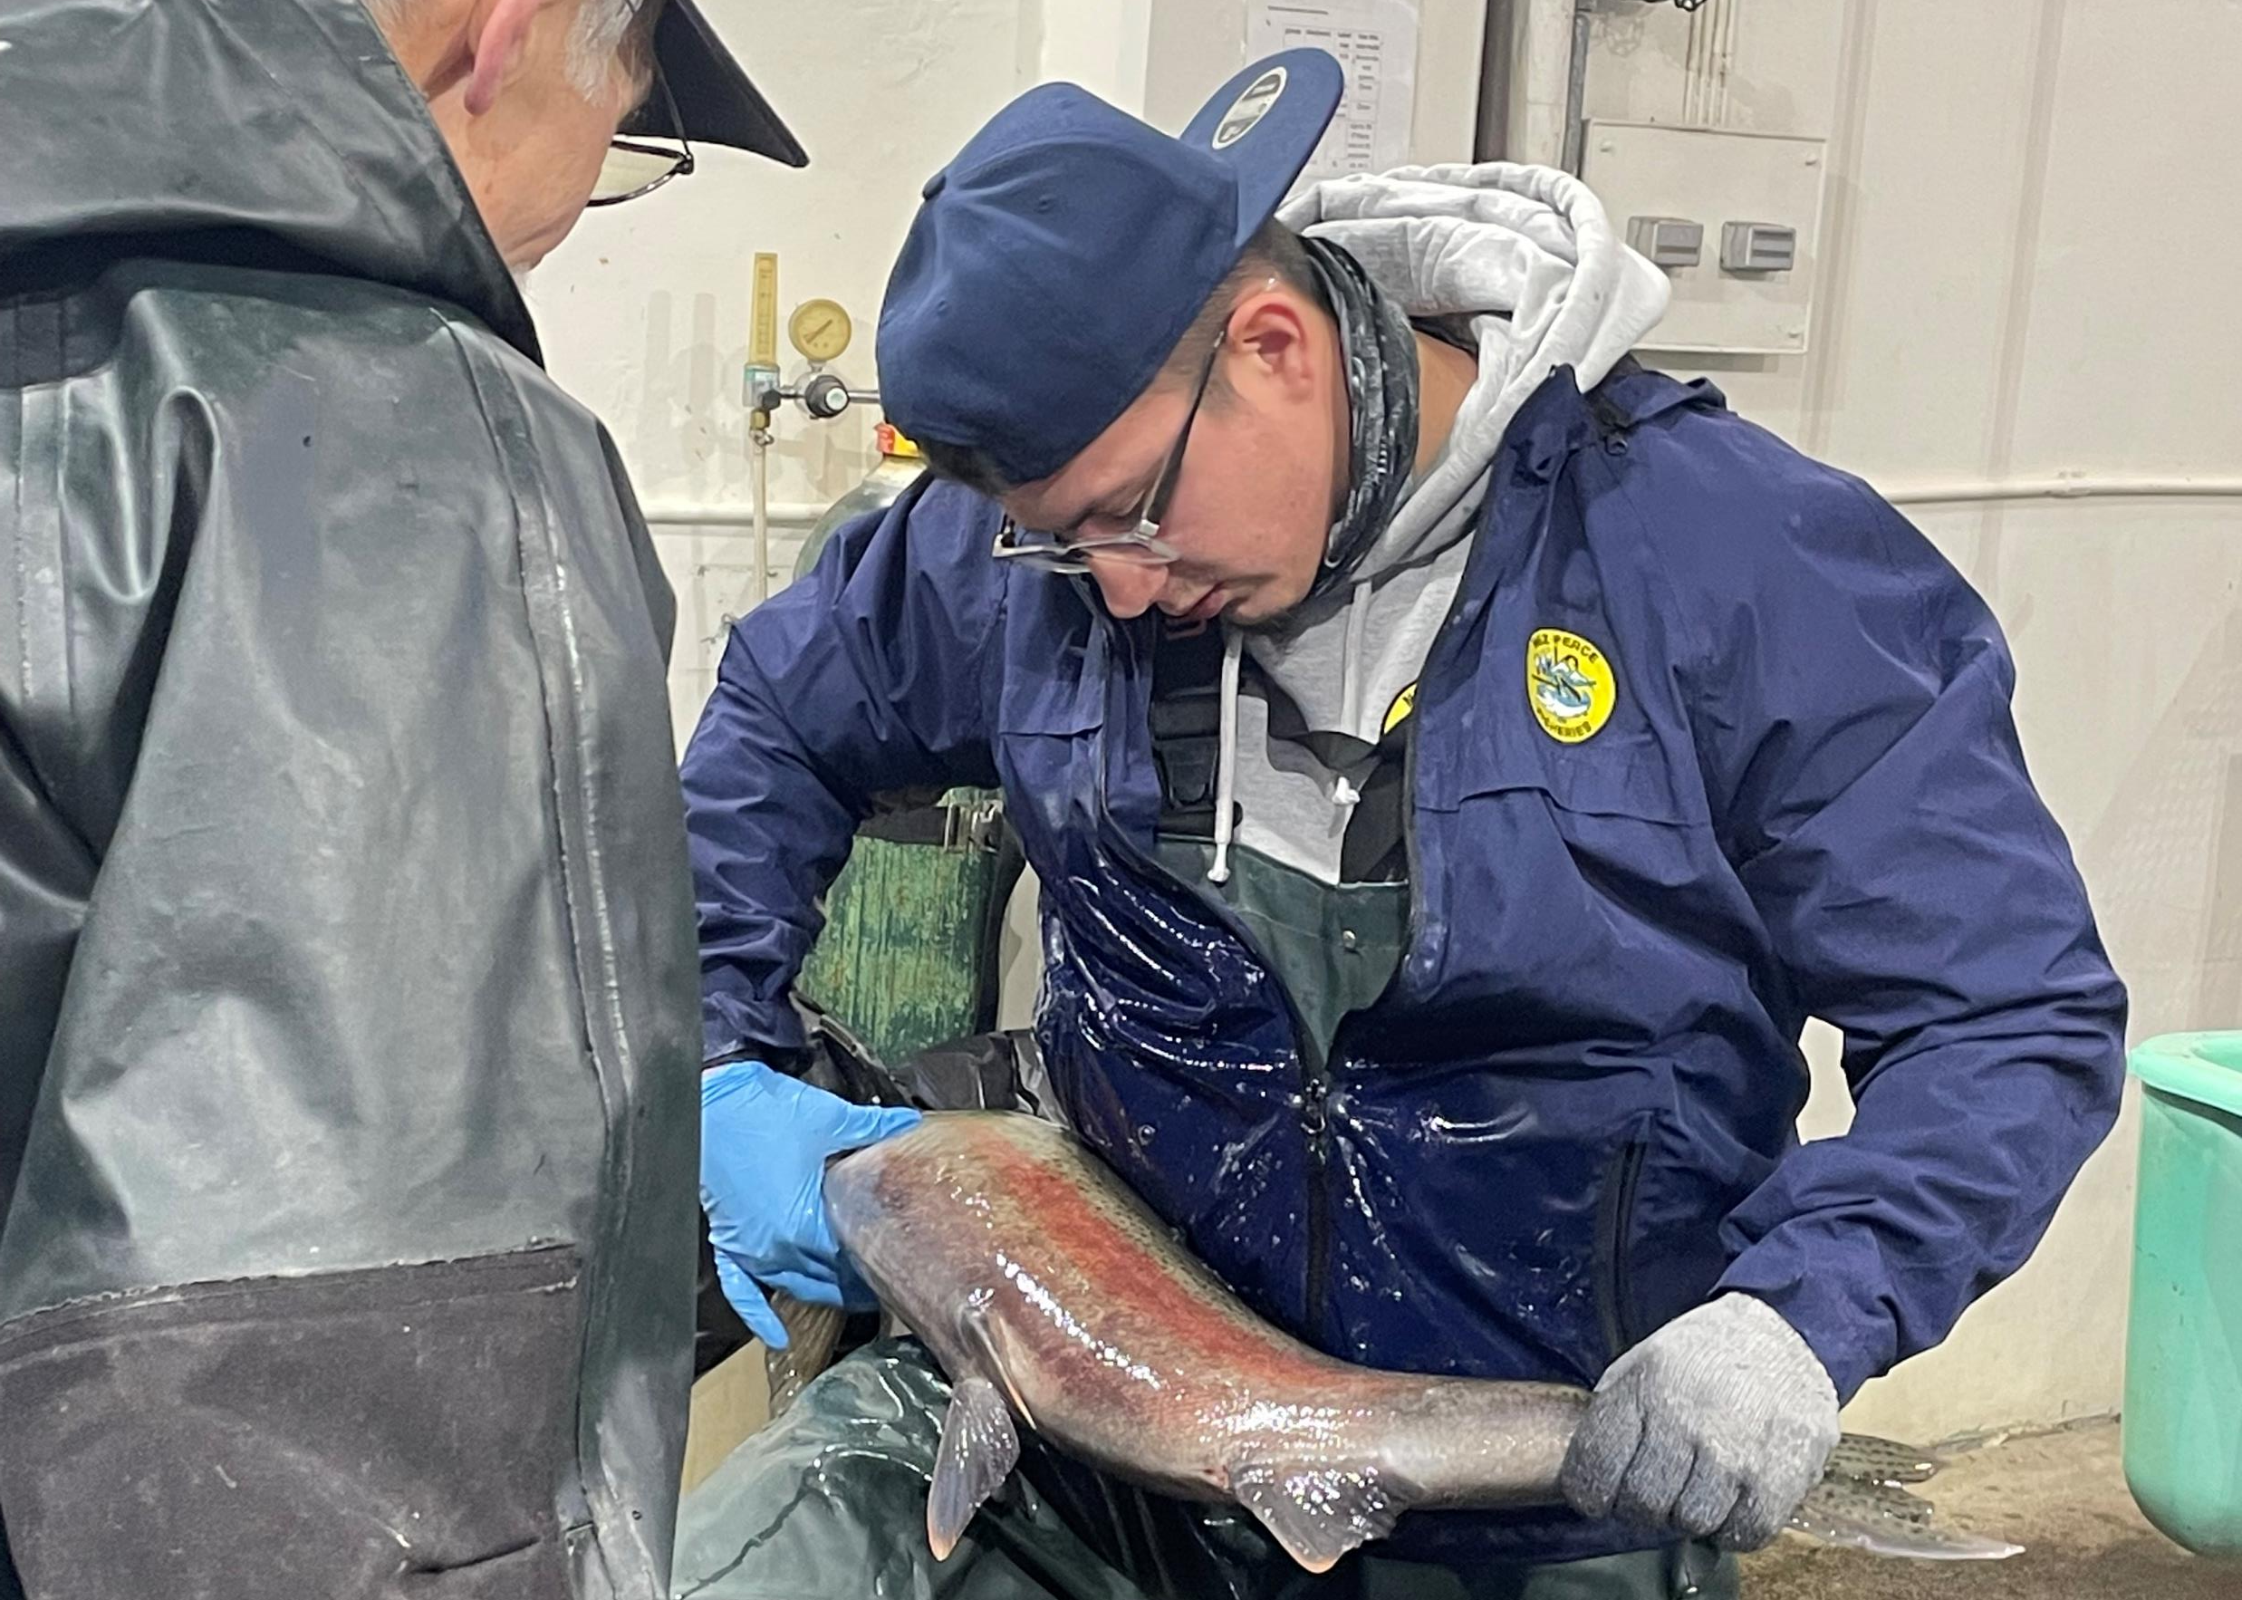
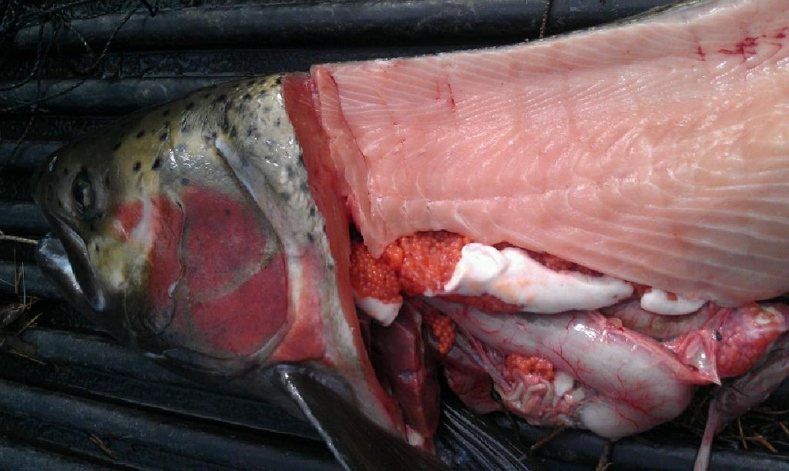
Broodstock
820 SST Adults are collected for the season including 450 early returning Fall collected Brood
Approximately 570 Angler caught South Fork Steelhead brood are held at Dworshak for CFH and DNFH Brood. Of these, 180 are spawned for Dworshak production.
3 Holding ponds and 1 trap pond – each can hold 1000 adults at max capacity
Fish ladder and holding ponds require almost an entire pump to run properly

Slide 12
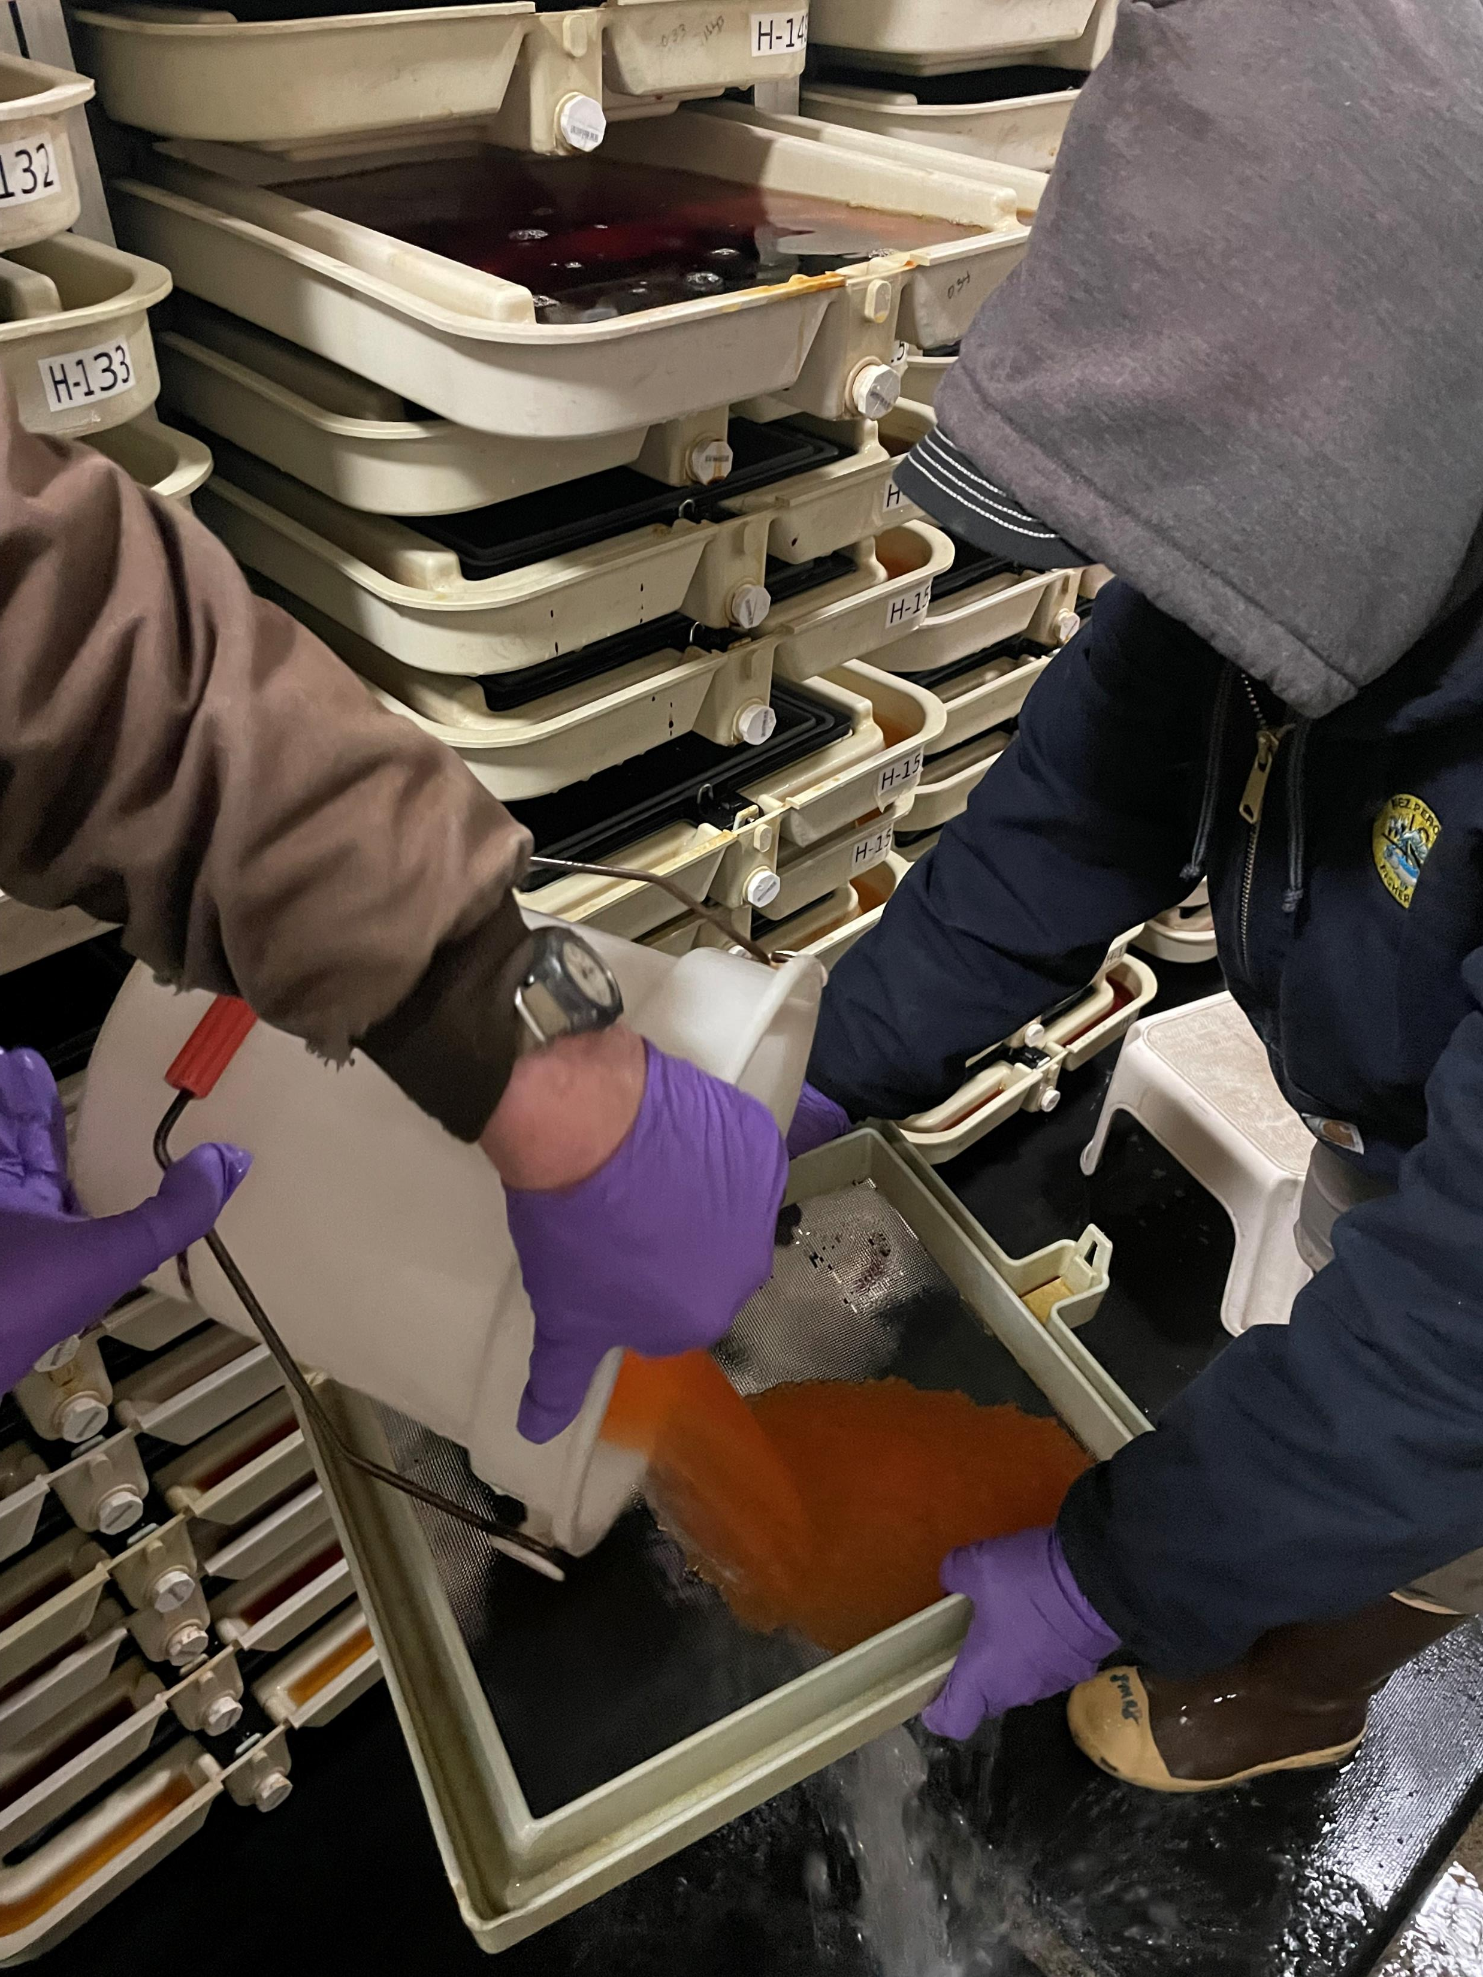
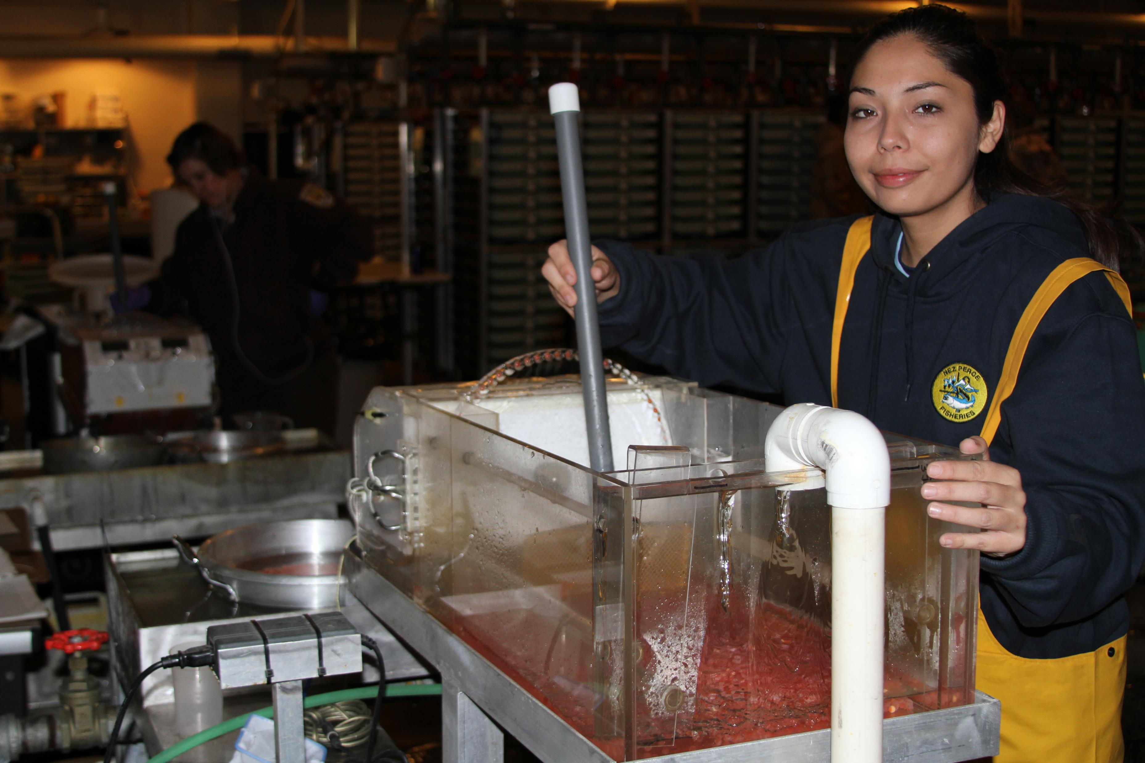
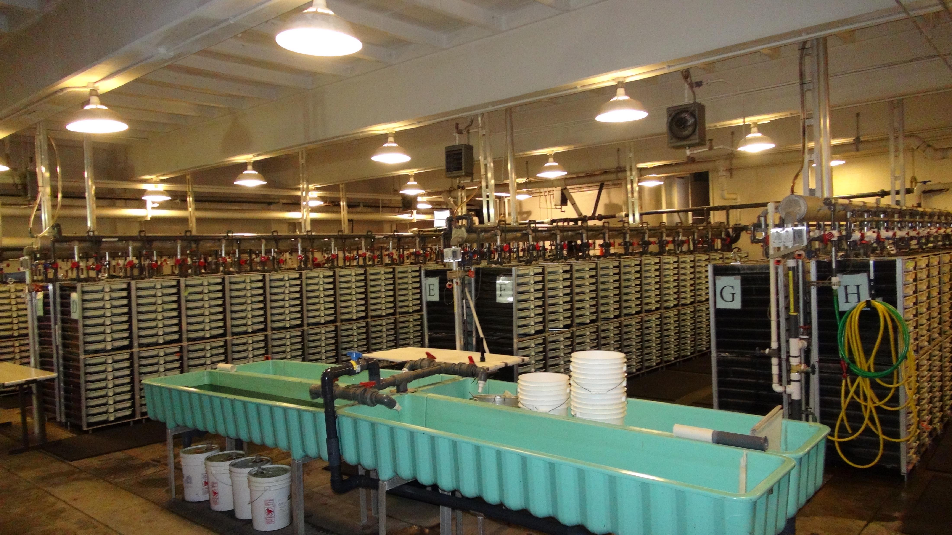
Incubation
1740 Incubation trays split between 3 species
Chilled temperature 36-42 degrees
Cold water from 42-46 degrees
Heated water typically run at 54 degrees
Steelhead trayed 1 female per tray
Enumerated with Van Gaalen egg picker into trays of 3800 – 5000 eggs
Steelhead incubation stacks flow set at 4 GPM
Treated 3x weekly with Iodine and Formalin

Slide 13
IHNV
Prior to 2008 IHNV was thought to be managed at Dworshak Hatchery
In 2008 a virulent strain of IHNV caused a loss of over 500,000 juvenile SST
In 2009, over 1 million juvenile SST were lost to IHNV
Parties and policy makers strongly supported Dworshak’s attempts to remedy the issue through construction and program changes
The facility was modified to change from a re-use facility to single pass
Research established that reservoir water was a key to survival. Fish that remained on reservoir water until 60fpp were resistant to the virus.
Coordination with CFH on sharing reservoir water, and program changes utilizing reservoir water systems and temperature control allowed for the development of successful rearing strategies.

Slide 14
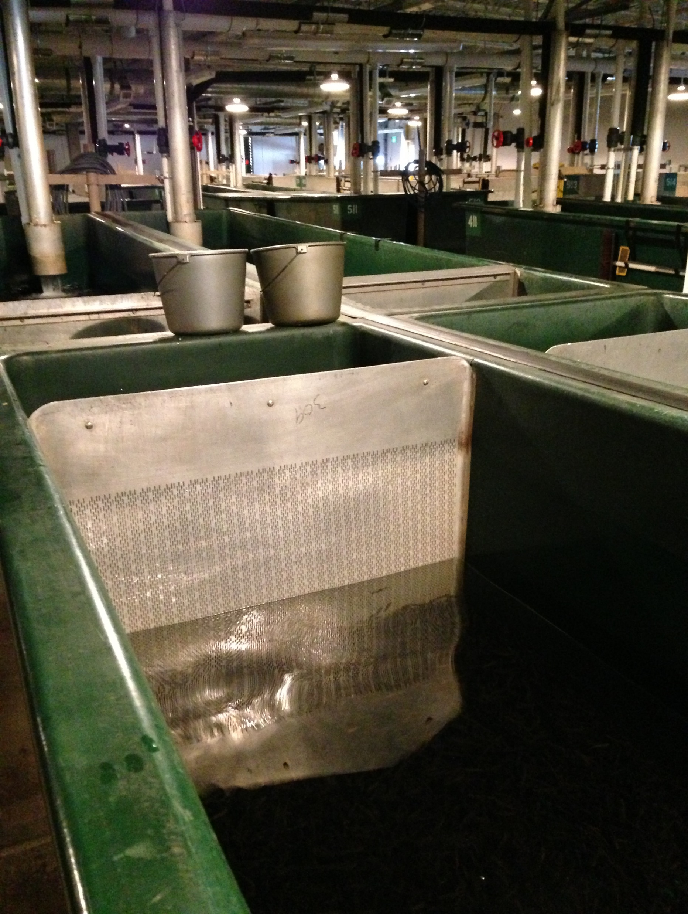
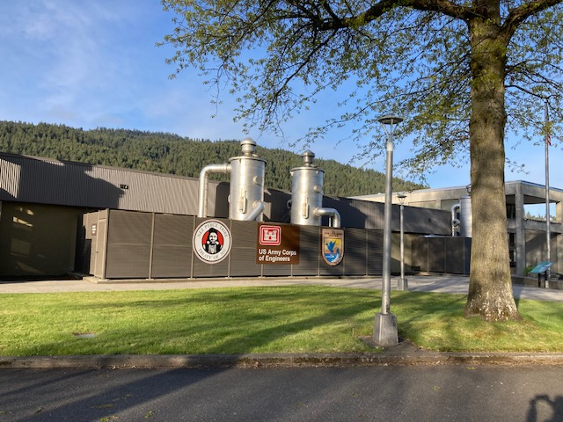
Nursery Rearing
124 nursery tanks
Boilers heat water to 56 degrees.
Fish are marked from nursery into outdoor rearing

Slide 15
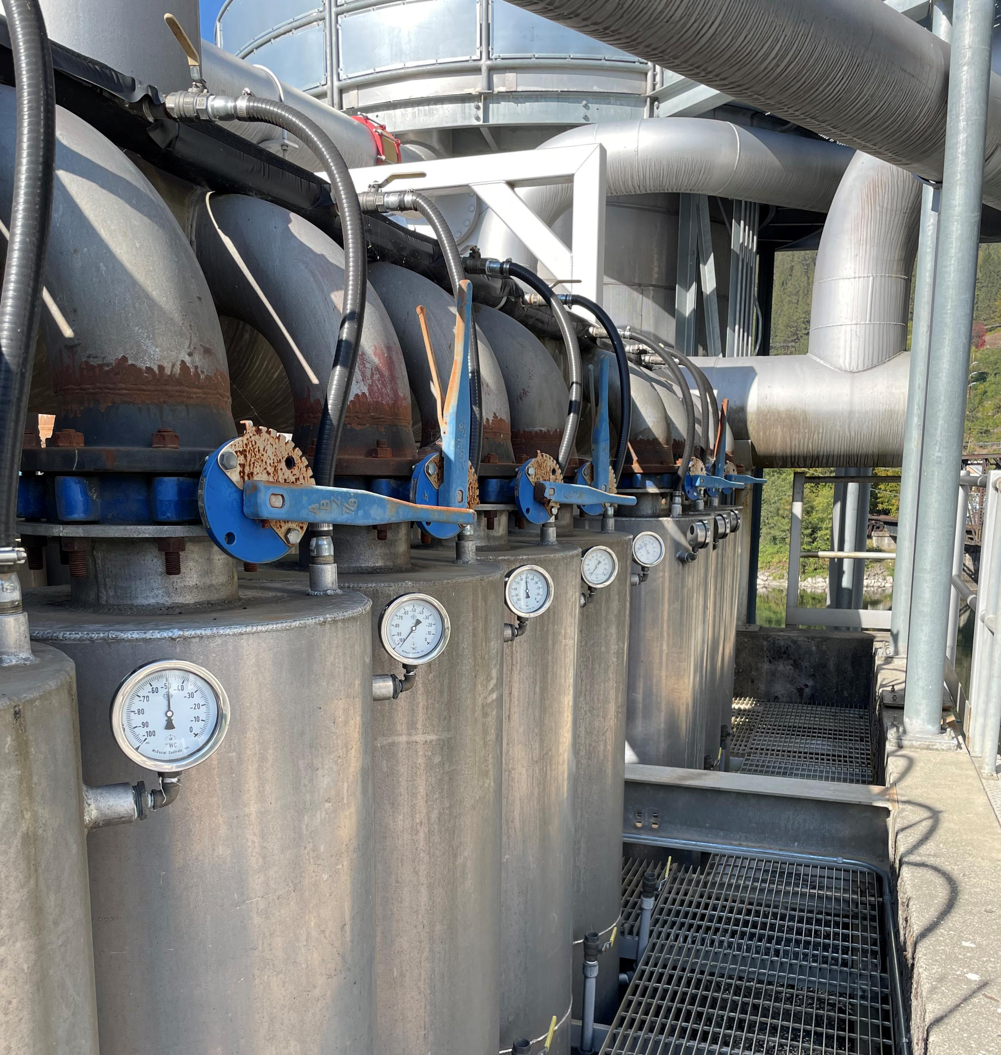
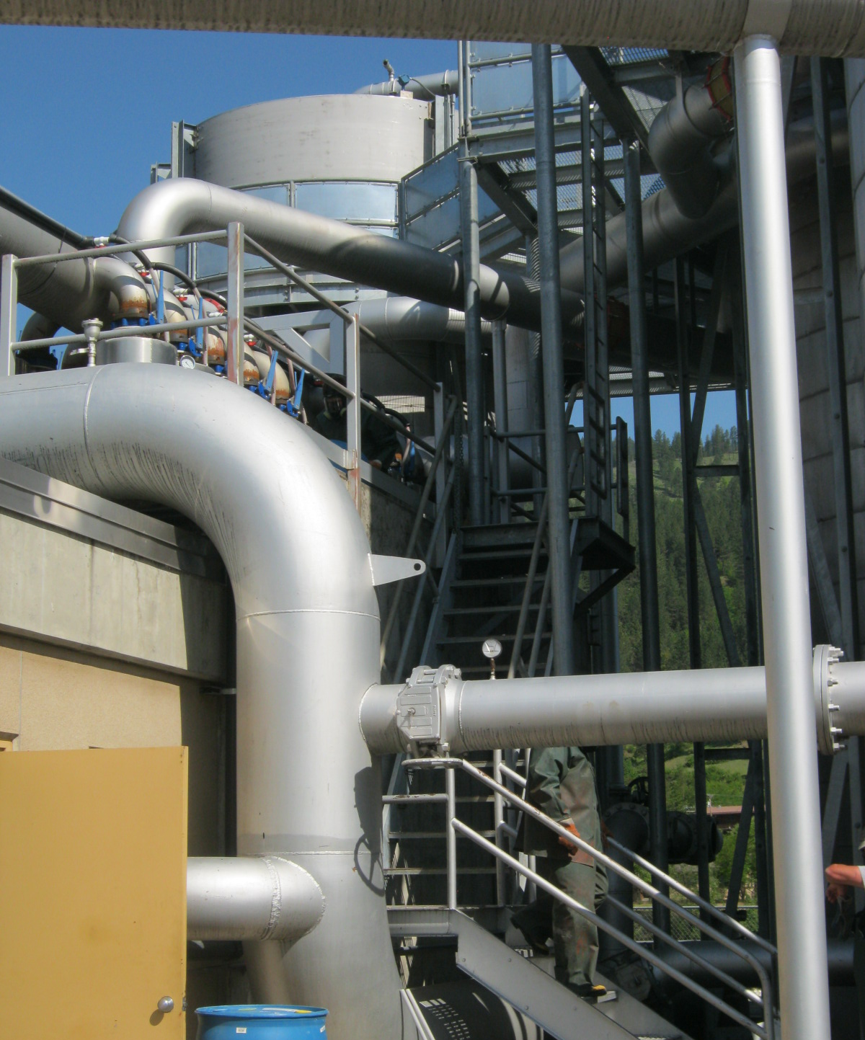
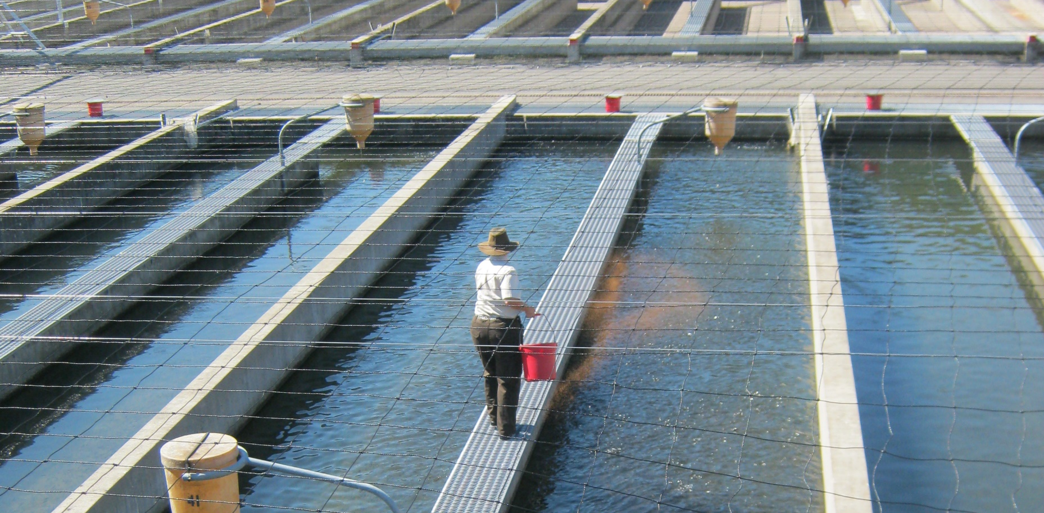
Outside Early Rearing
System 1
Steelhead are marked/ tagged in System 1.
System 1 is the only outside rearing with “clean” reservoir water.
Fish are raised to 60 fpp prior to moving to final rearing
Reservoir water is shared with CFH. The DNFH supply gets reduced as CFH requires more water to rear their own programs.
Prior to exposure to river water, SST are fed Bio Pro 2.

Slide 16
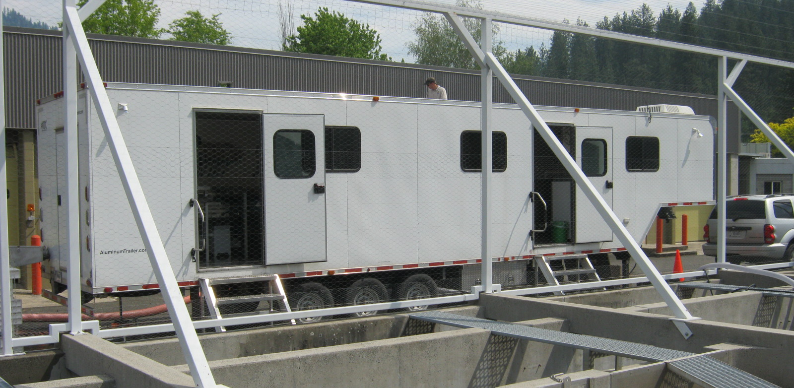
Marking
USFWS Auto Trailer
48,000 fish marked per day
Size range 100 – 200 fpp
Marking takes 2 months
Marking/tagging from May 30 – July twentysomething…
Pit tagging in January

Slide 17
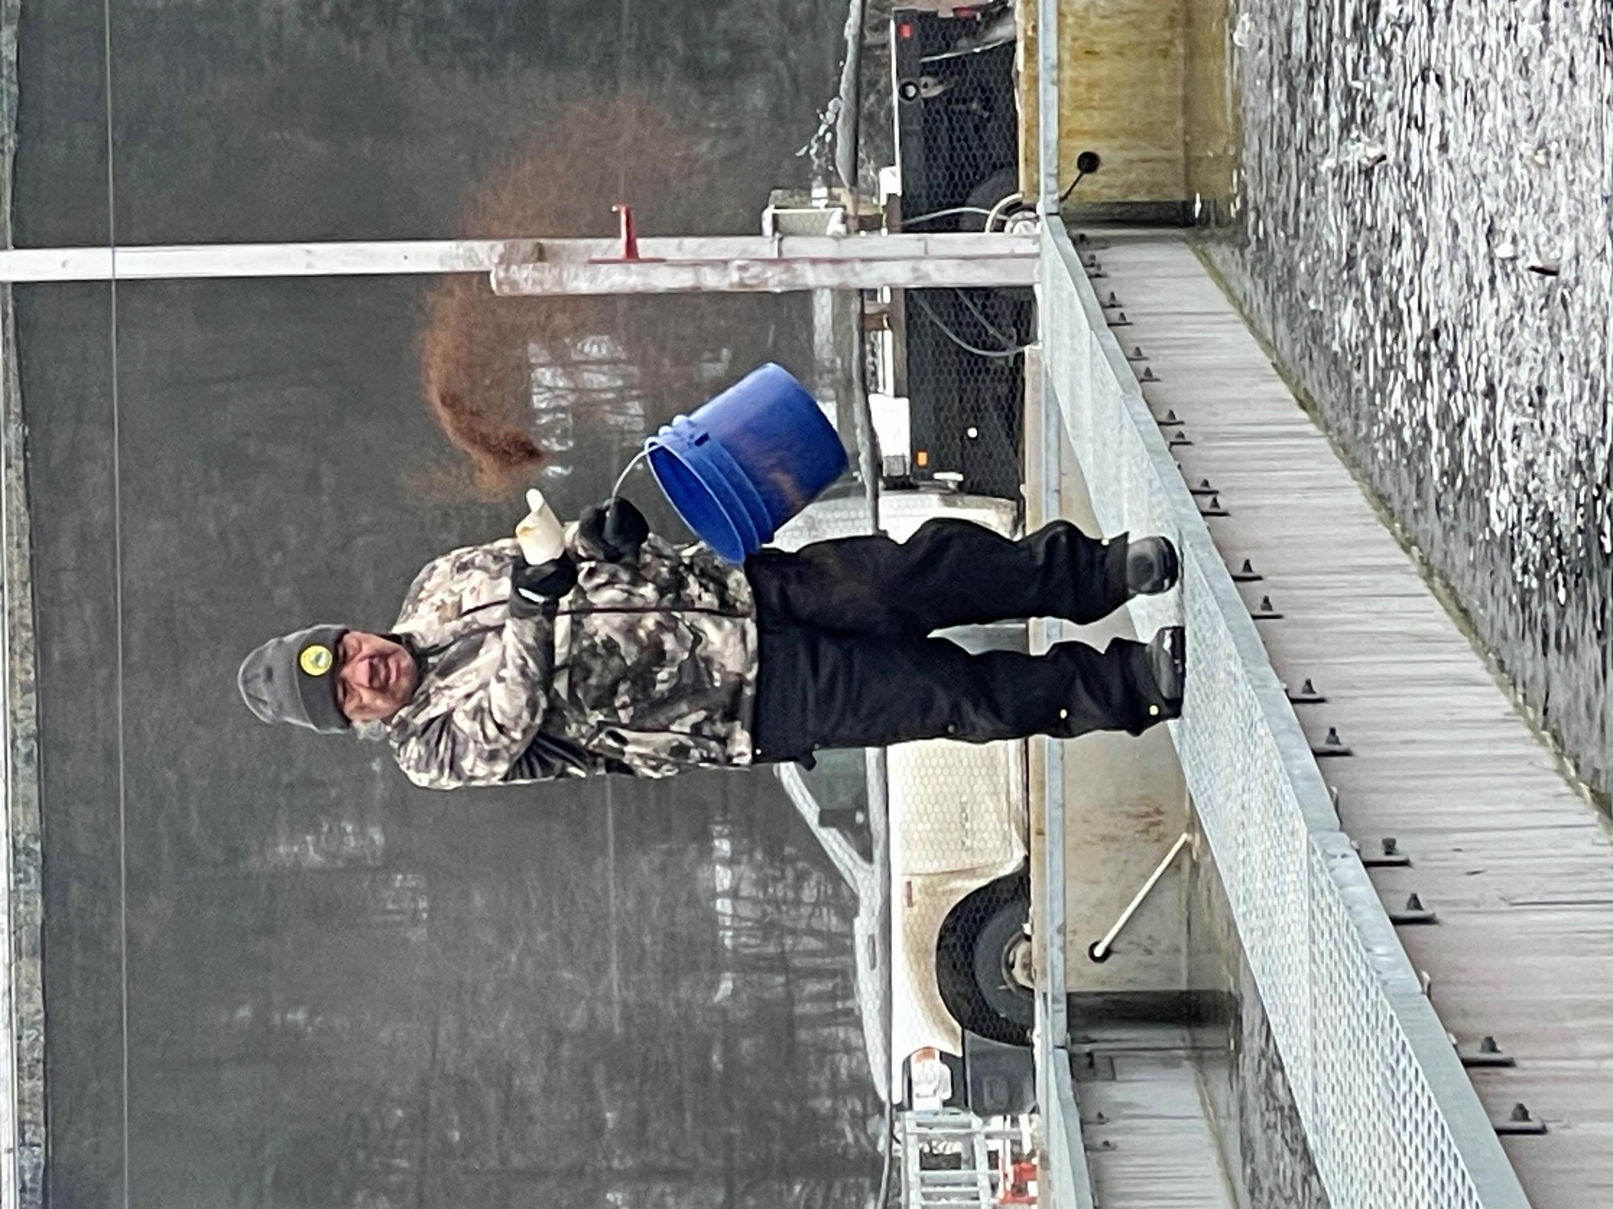
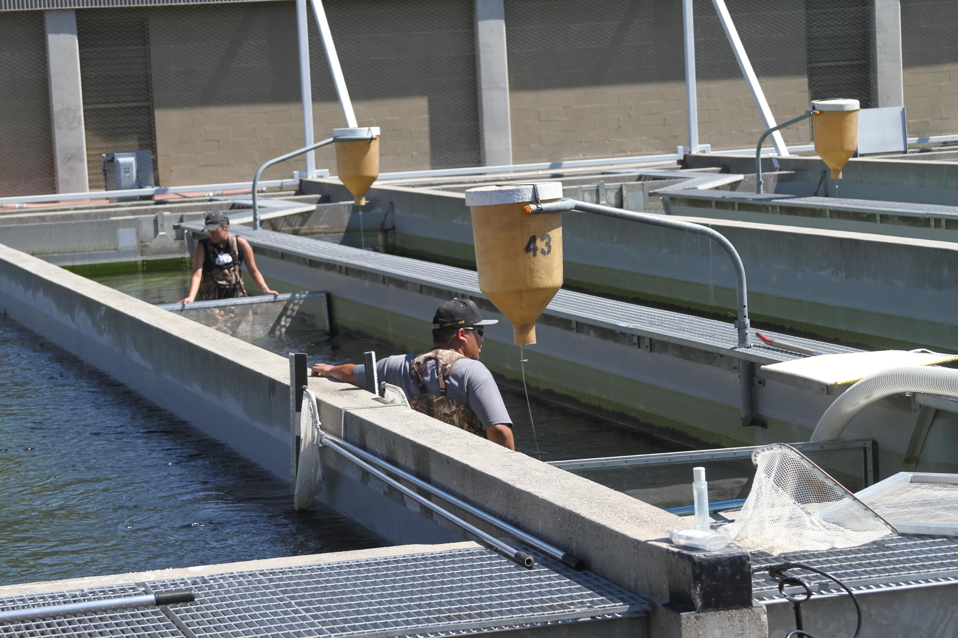
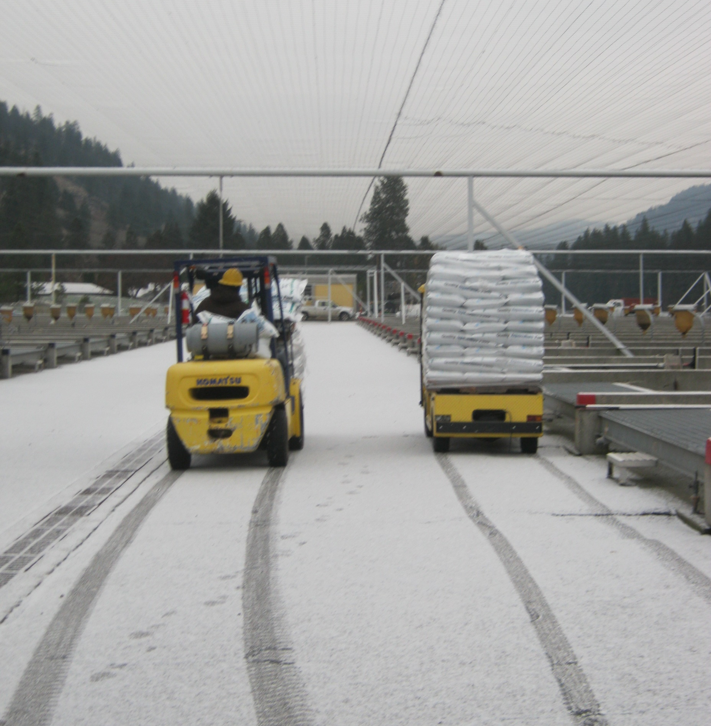
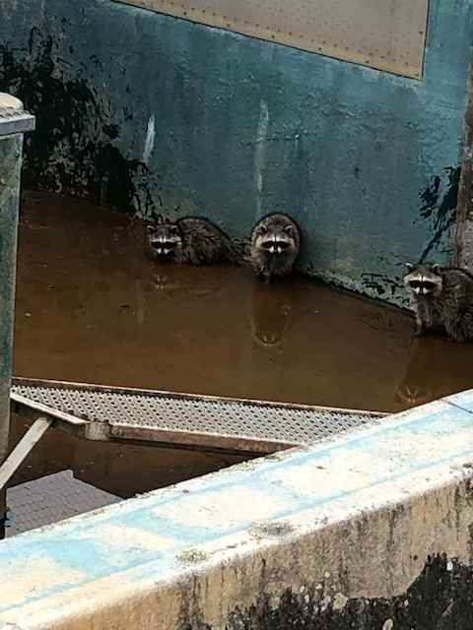
Outdoor
Rearing
River water temperature peaks in October at 49.8 degrees
River water is from 40-44 degrees from December – June
Demand feeders utilized once fish are on feed pellet size 2.5
Vaki counter used to split fish to final rearing
Fish are reared in 68 Burrows ponds at 42,000 per pond until release at 5.6fpp

Slide 18
Pd8
This page was not intentionally left blank.
See, there’s words here.
Not blank.
Pg 16

Slide 19
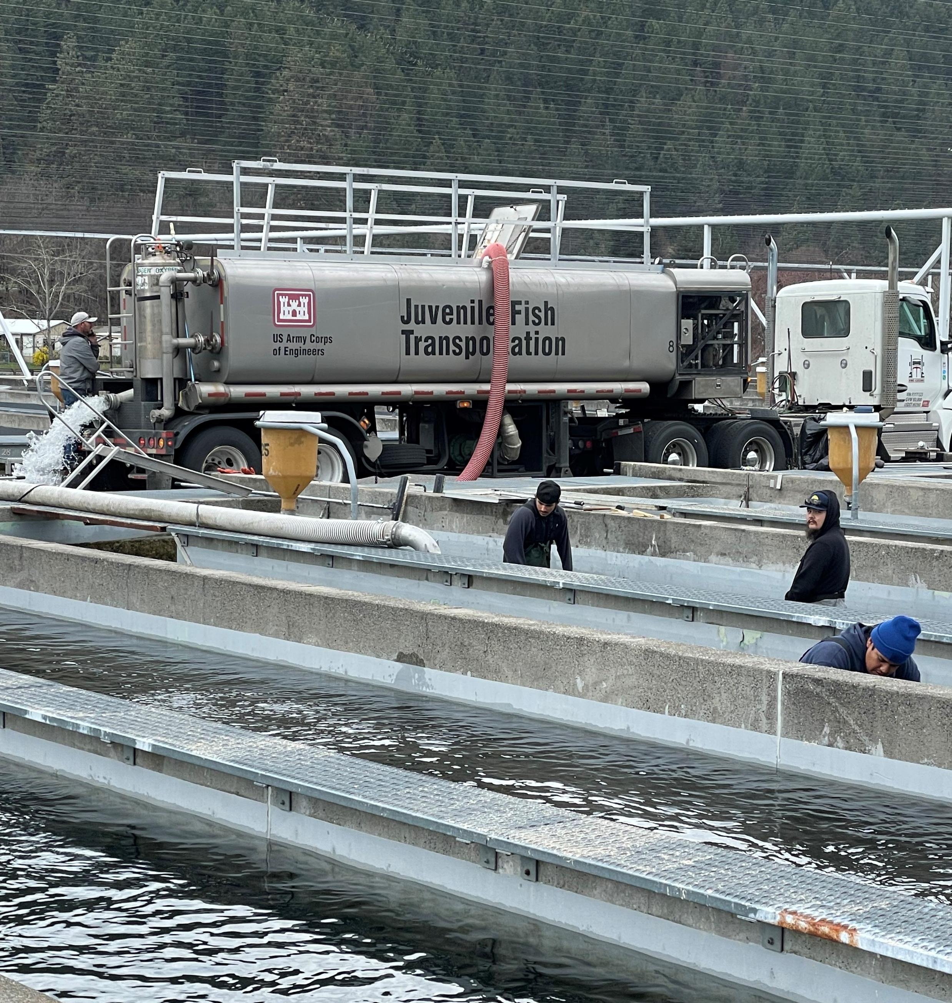
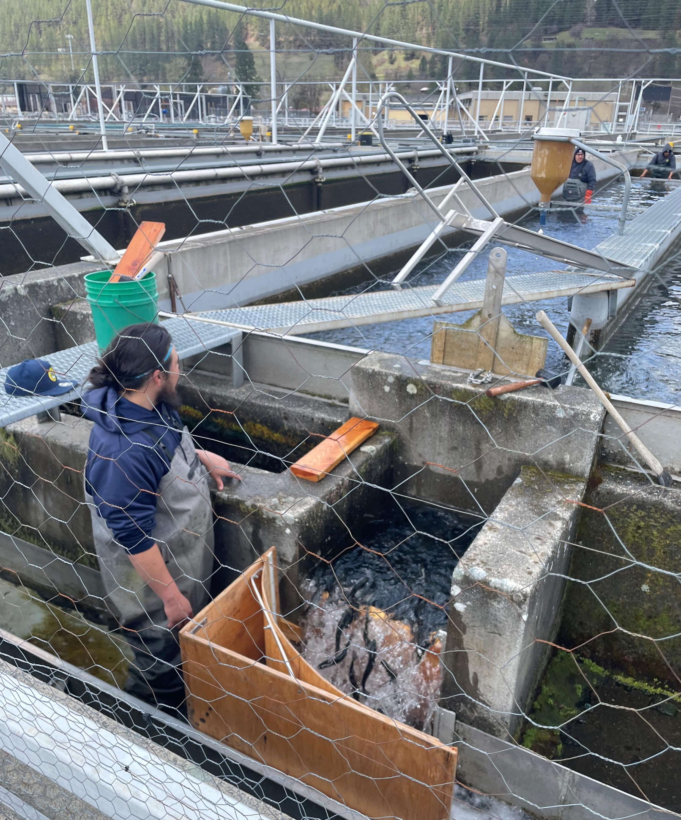
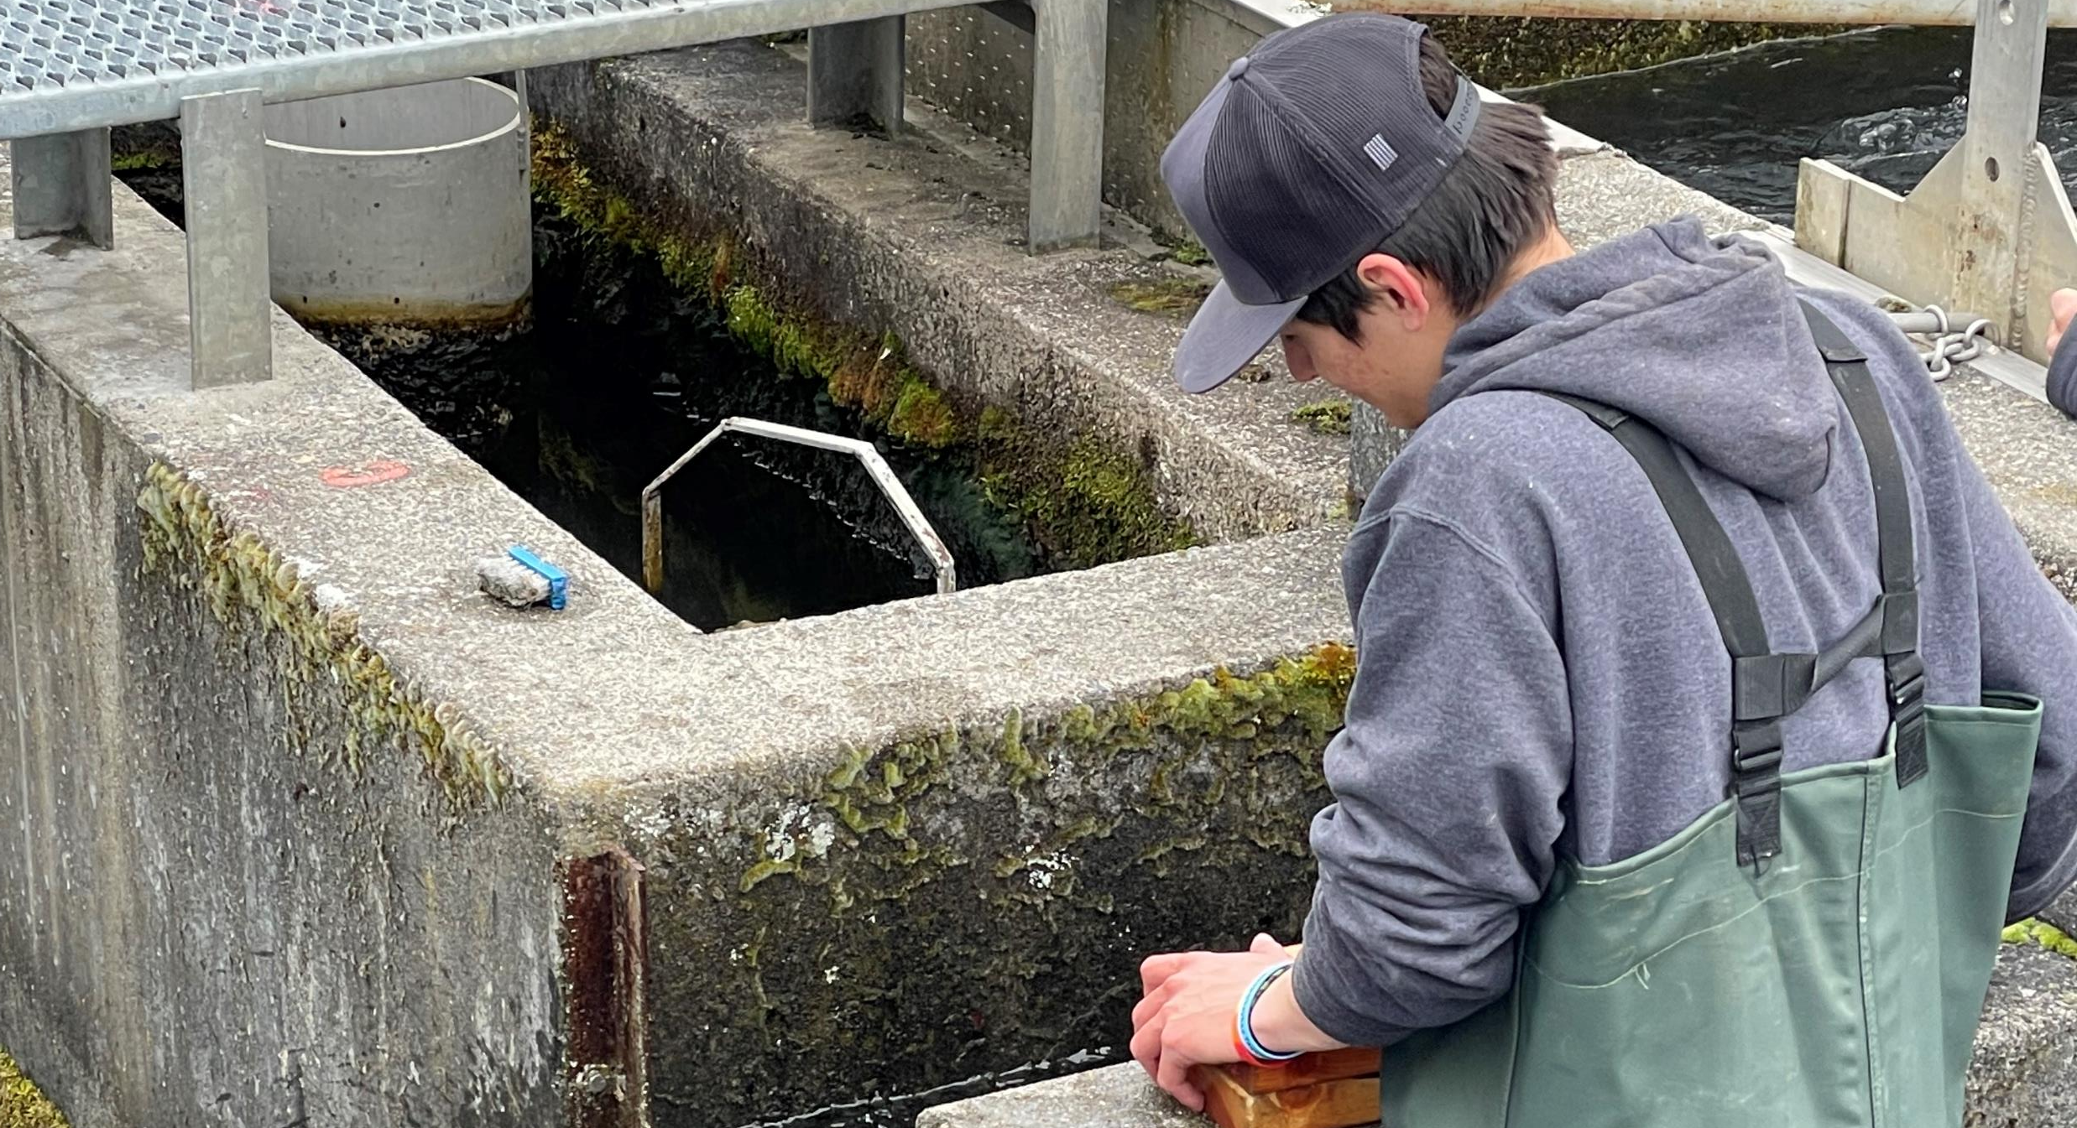
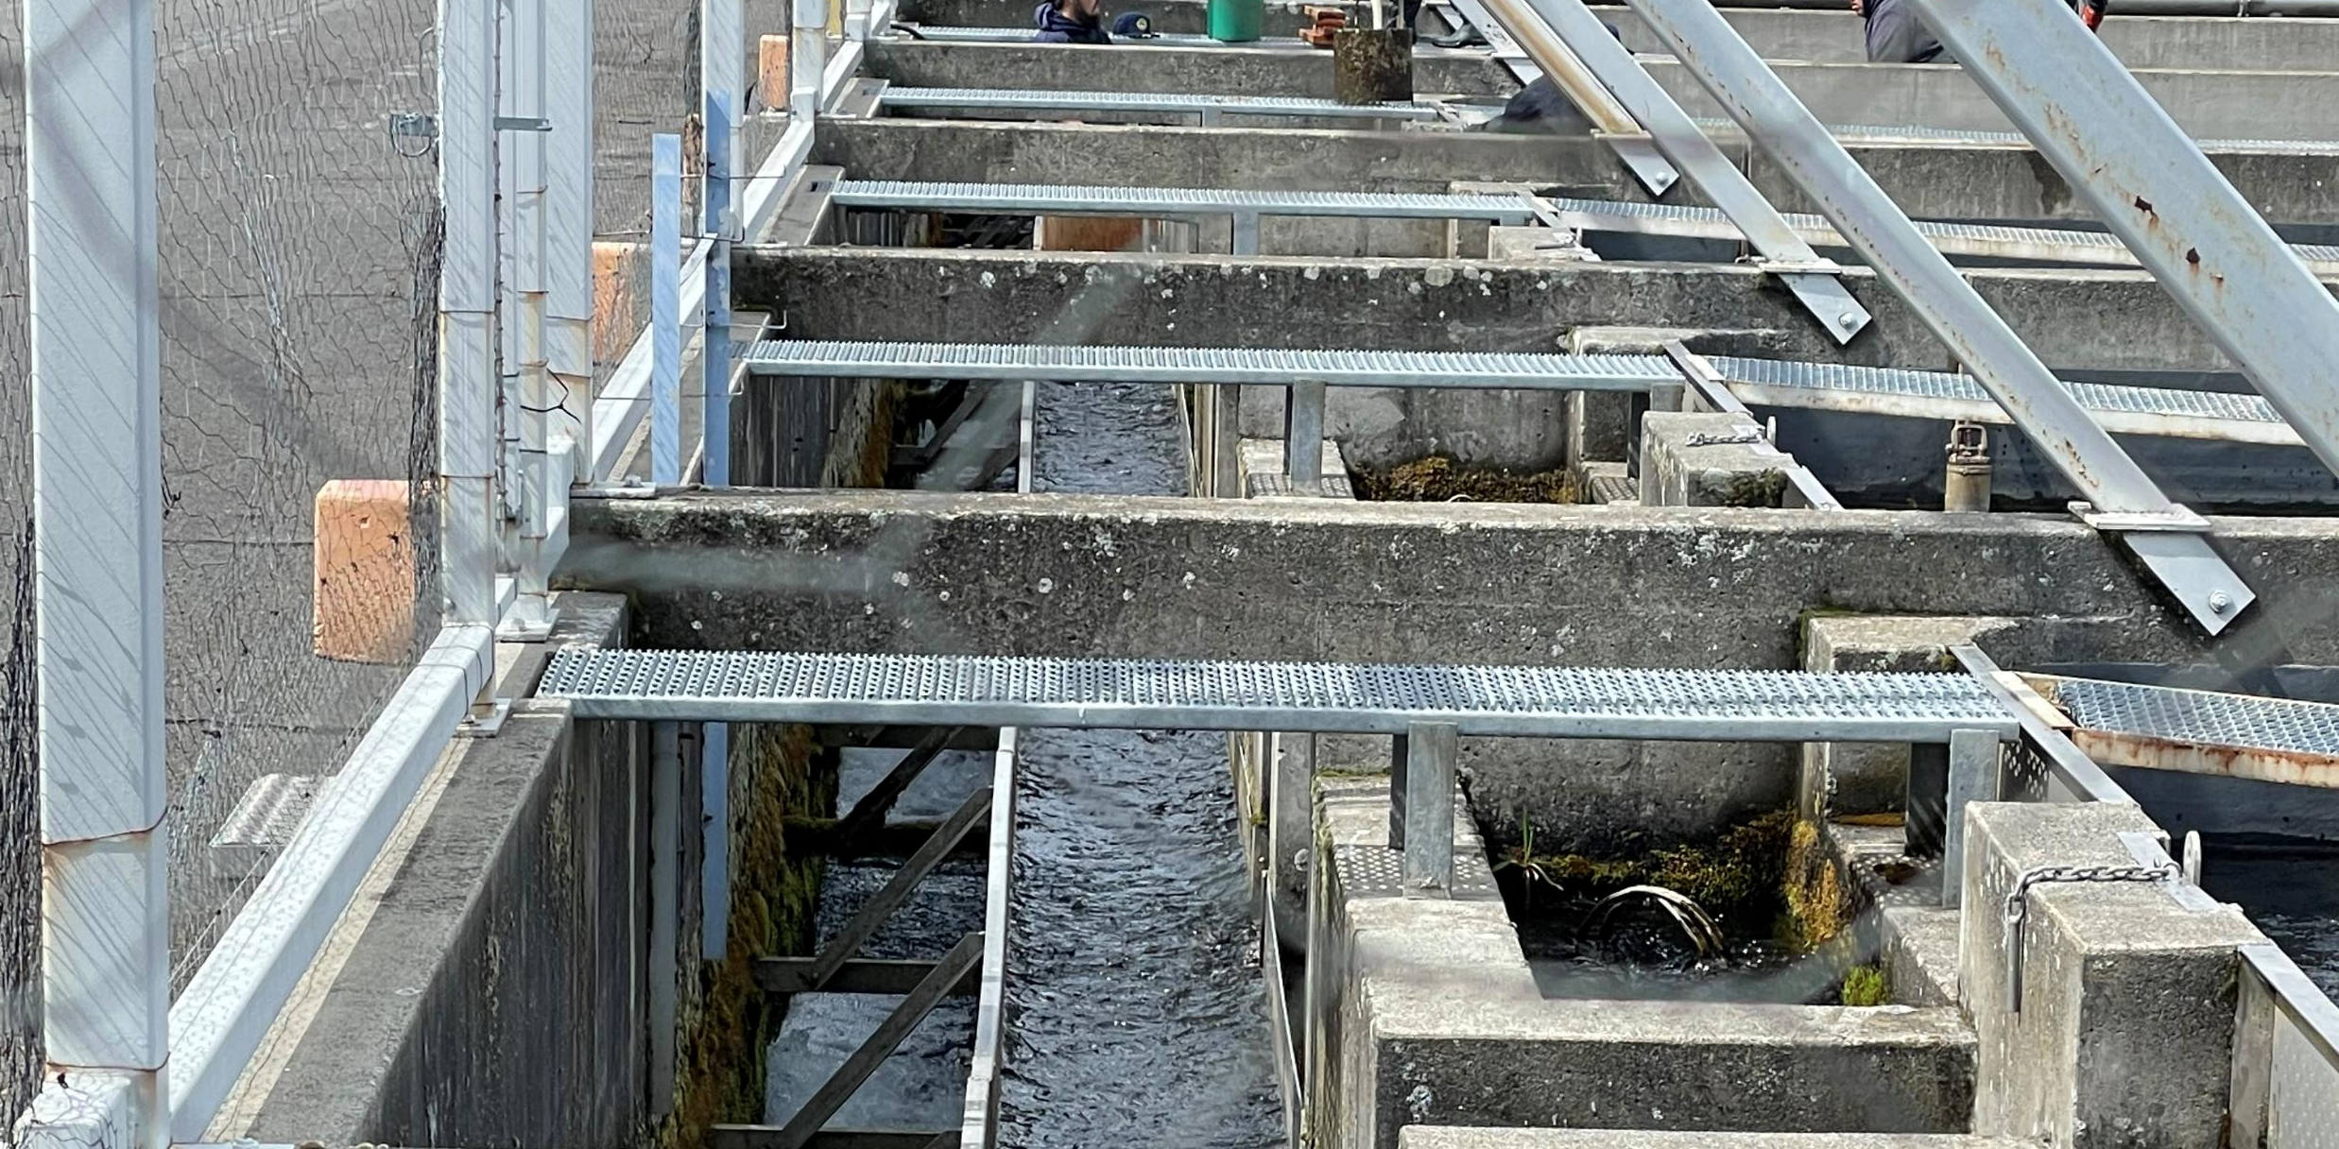
Release
Truck releases range from 45 min to 1.5 hr hauls.
There are an average of 28 truck loads released at 3 locations over 6 days.
Direct releases occur mid April when fish reach 5.6 fpp
Direct releases are usually accomplished with 3 release teams and take 1 day.

Slide 20
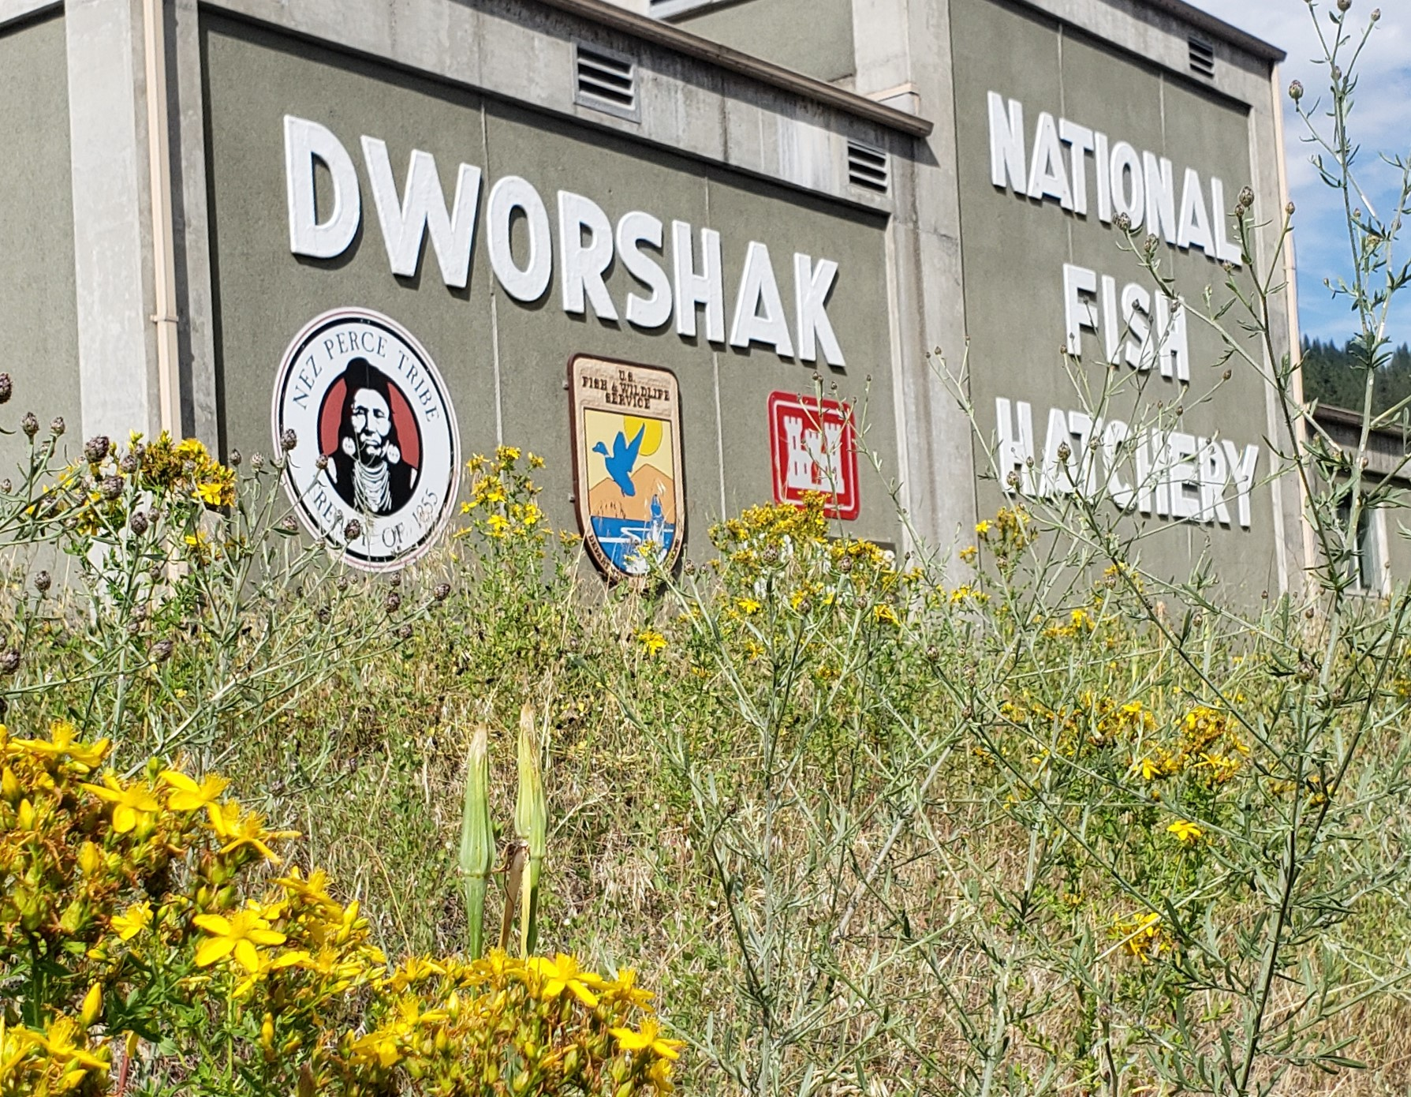
Potential Operational changes
Changes to release goal sizes
Increased reservoir water could minimize boiler use and disease exposure
Increased river pump capacity could allow for program goal increases
Roof or shade structure
Electrical Upgrades
Increased adult holding capacity
Gravity Flow through cleaning instead of pumped

Slide 21
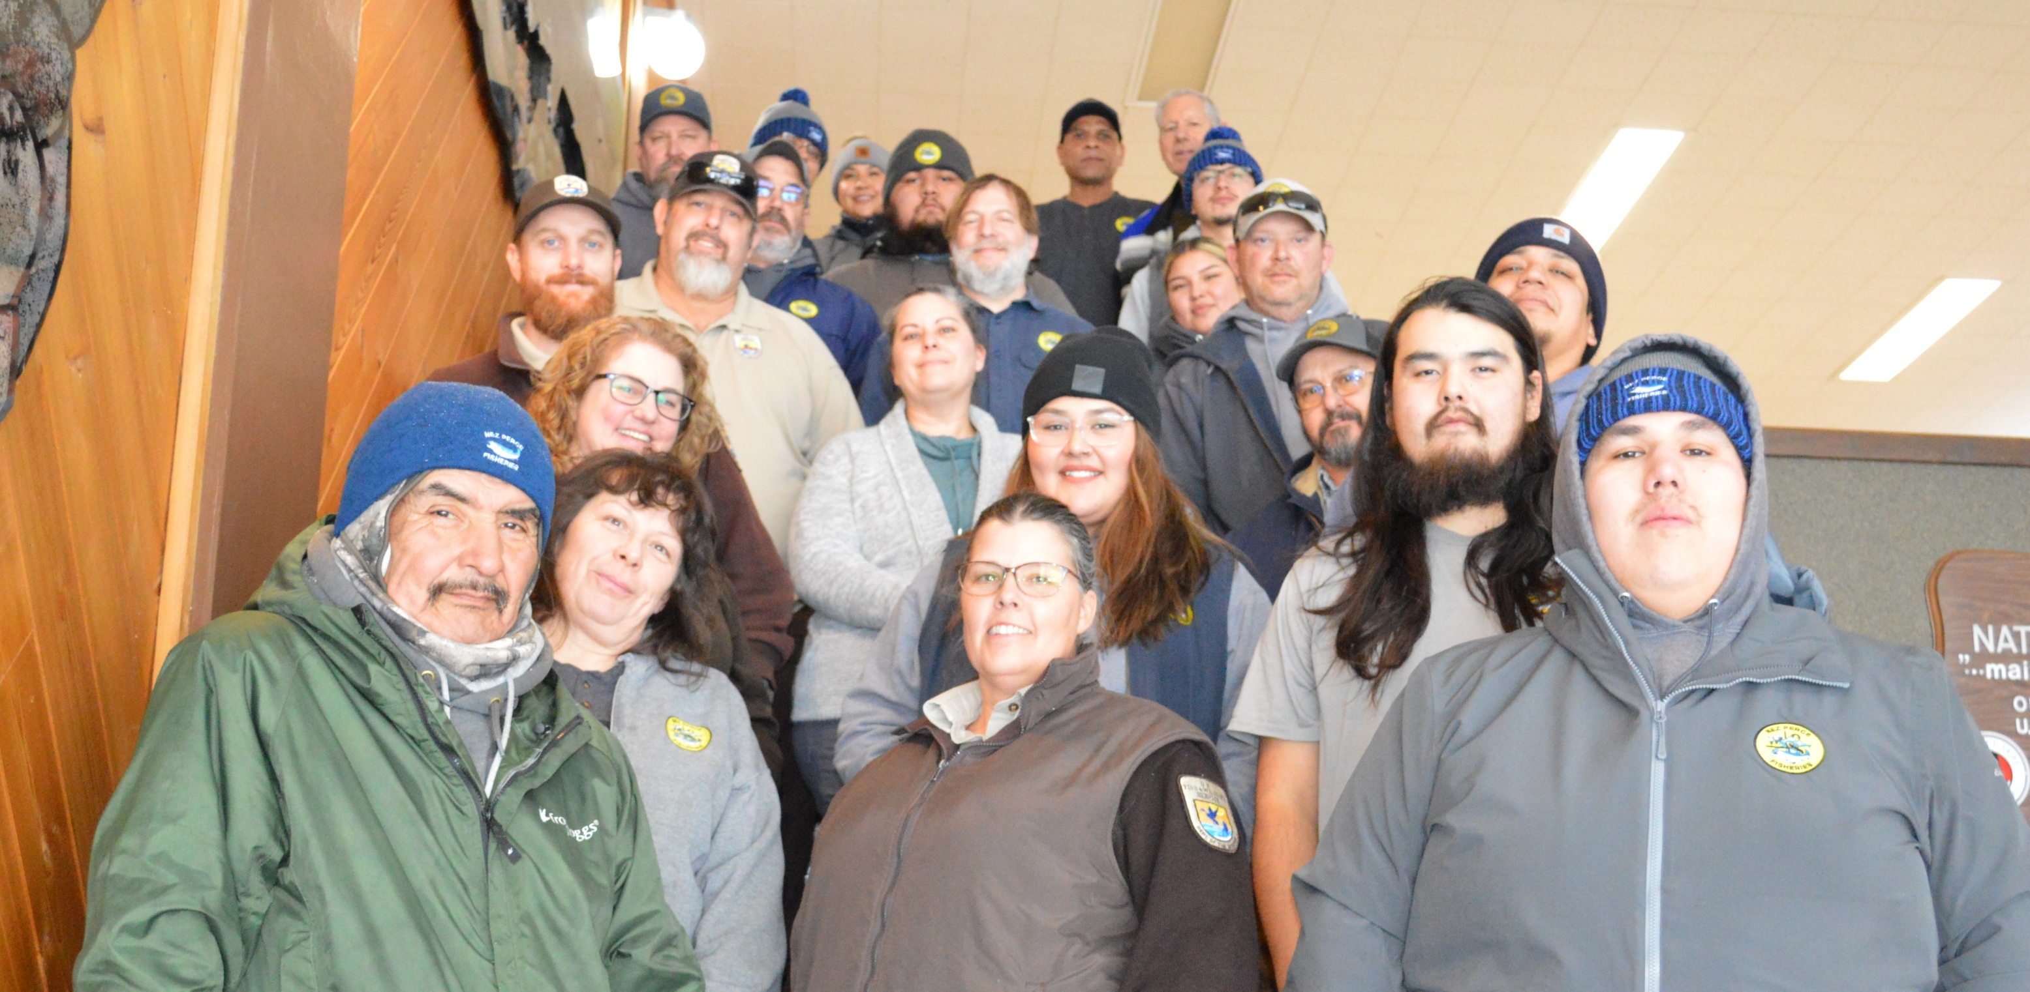
Another great year – Thanks to these guys!!
OK to APPLAUD now

