Slide 1
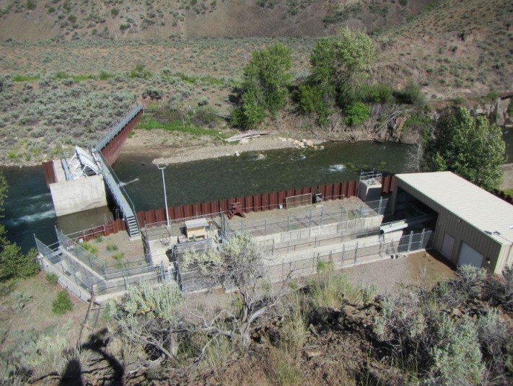


Infrastructure and Operations Audit of
The Upper Salmon Basin 2022
Lytle Denny, Anadromous Fish Program Manager
Shoshone-Bannock Tribes
2023 LSRCP Annual Meeting
April 25, 2023

Slide 2
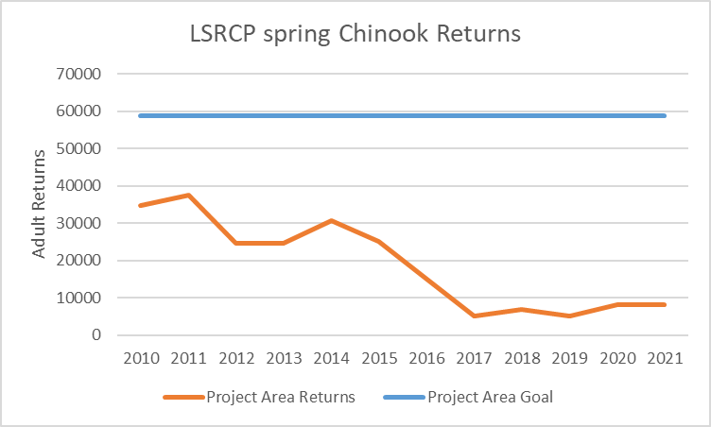
Background
So why an audit?
We have a deficit to fill

Slide 3
LSRCP Adult Deficit
All Basins

Slide 4
Why it is important to address the fish deficit?

Slide 5
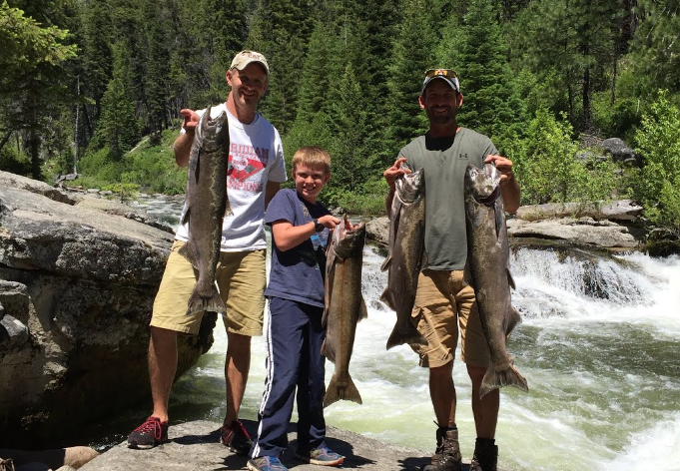
Why it is important to address the fish deficit?

Slide 6
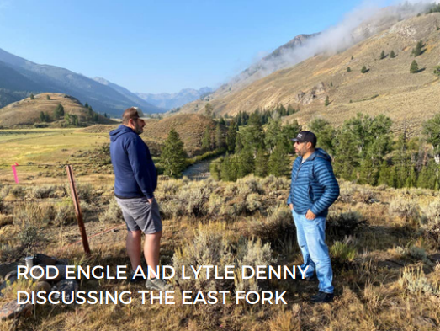
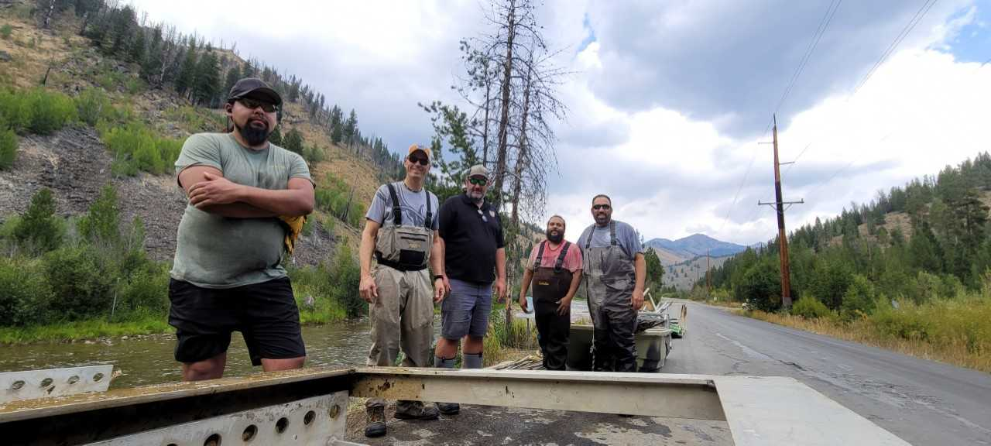
Audit
Scope
Goal
Develop a 10-year strategic plan that will enable the LSRCP to meet adult return goals
Objective
Identify short-term options that will enable the LSRCP to immediately begin working on addressing the fish deficit
Identify long-term options that will enable the LSRCP to consistently meet the adult return goals
Target Watersheds
Upper Salmon
East Fork Salmon River
Yankee Fork Salmon River
Panther Creek
Valley Creek

Slide 7
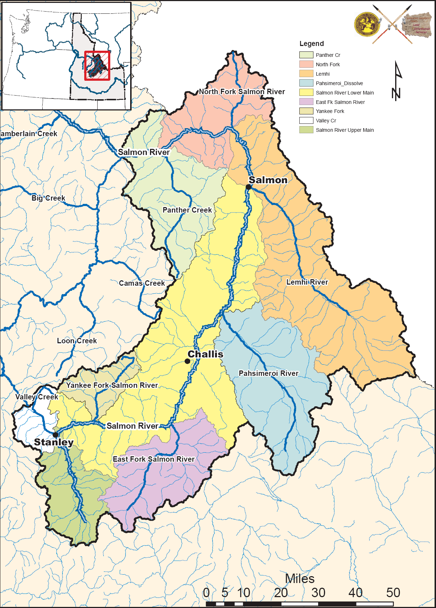
Background
Base Plans for Upper Salmon
Location | Smolts | Adults
Sawtooth | 1,300,000 | 11,310
East Fork | 700,000 | 6,090
Valley Creek | 300,000 | 2,045
Total | 2,300,000 | 19,445
Sawtooth was constructed in 1985 to be the central rearing facility for the Upper Salmon
Three release locations were identified
Adult goal was set at 19,445
Target release of 2.3 million smolt
Assumed SAR of 0.87%

Slide 8
Sawtooth
Infrastructure & Audit Findings
A smolt program has been in operation since 1985
Current production is short by 300,000
On-station release is larger than originally planned
Current production does not include Valley Creek or East Fork Salmon River
Yankee Fork was initiated in 2008
Location | Smolts
Sawtooth | 1,700,000
Yankee Fork | 300,000
Total | 2,000,000

Slide 9
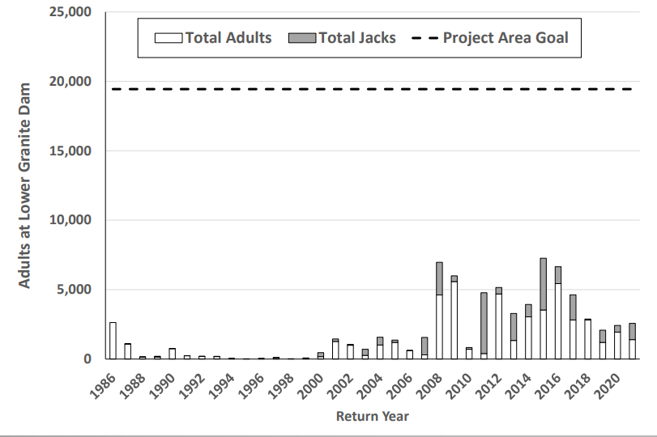
Sawtooth
Infrastructure & Audit Findings

Slide 10
Sawtooth
Infrastructure & Audit Findings
Average adult returns are far short of the adult goal (-13,445 deficit)
SARs average 0.33% compared to assumed 0.87%

Slide 11
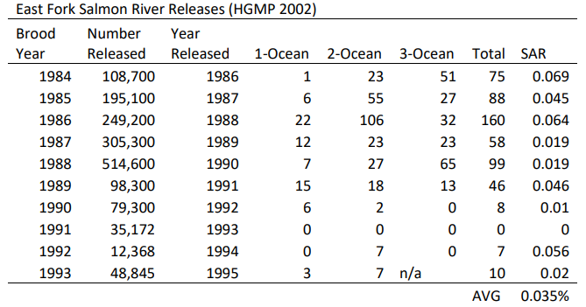
East Fork Salmon River
Infrastructure & Audit Findings
A smolt program was operated from 1984-1998
Smolt release numbers were below target
Target – 700,000
Low - 12,368 High – 514,600
Adult returns were below target
Target 6,090
Low – 0 High – 160
SARs were below target
Target – 0.87%
Low – 0 High – 0.06%

Slide 12
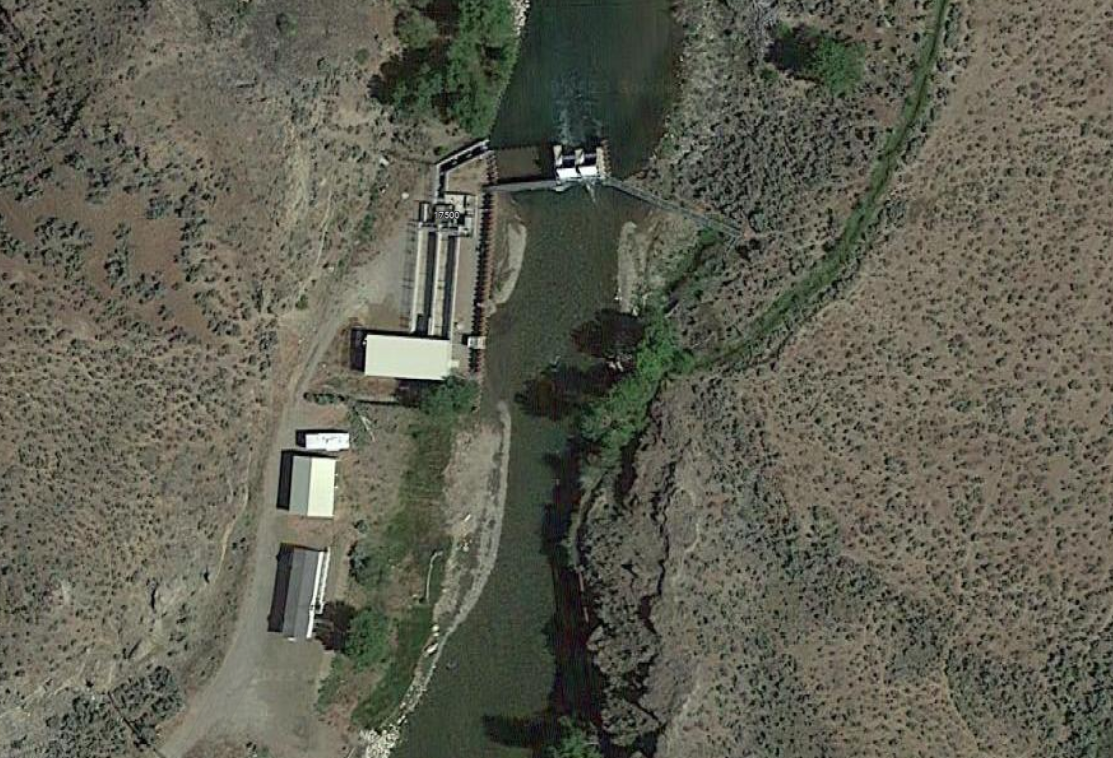
East Fork Salmon River
Infrastructure & Audit Findings
A satellite facility was constructed in 1984

Slide 13
East Fork Salmon River
Infrastructure & Audit Findings
A satellite facility was constructed in 1984
Fish Ladder
Radial Gates
Holding Ponds
Barrier
Spawn Shed
Office & Patio
Intake
Bunkhouse

Slide 14
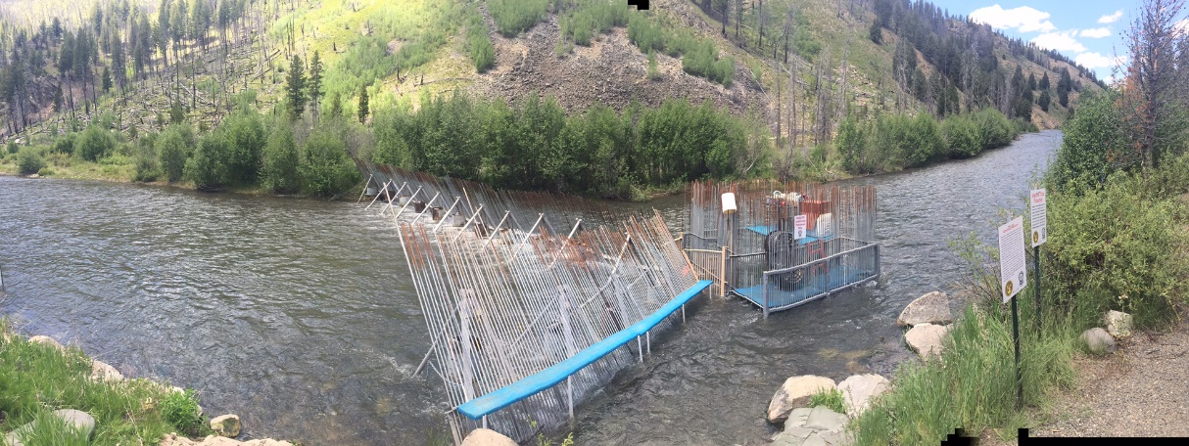
Yankee Fork Salmon River
Infrastructure & Audit Findings
A smolt program has been in operation since BY 2008
Smolt release target is 300,000, can be increased to 600,000 under existing Bi-Op
Acclimation facility is needed
A picket weir and trap has been in operation since 2008

Slide 15
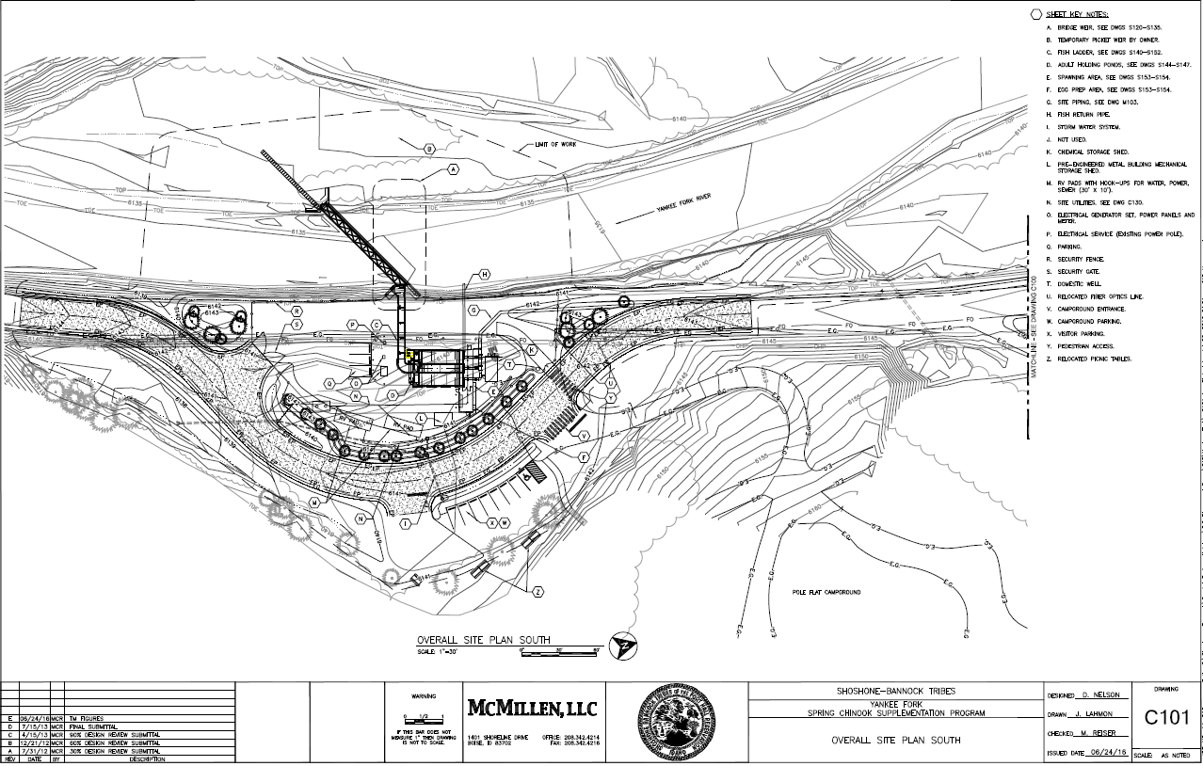
Yankee Fork Salmon River
Infrastructure & Audit Findings
Significant planning has been completed by the Tribes

Slide 16
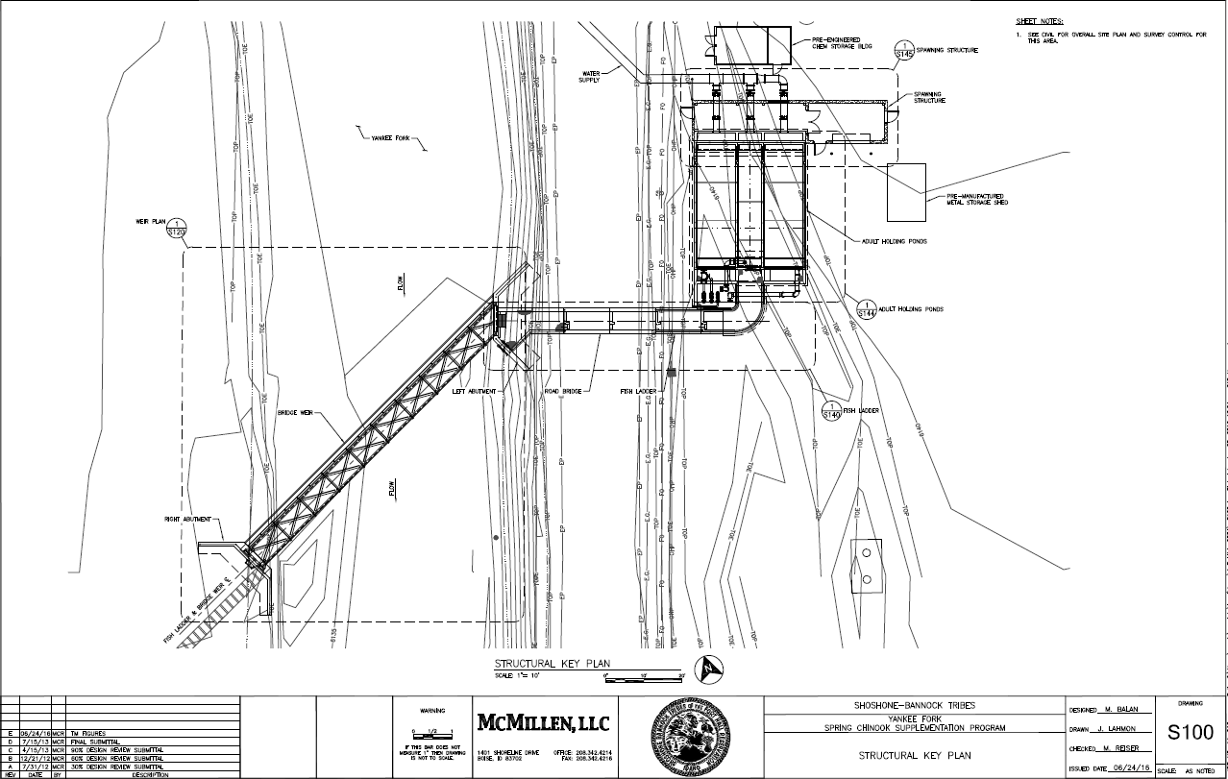
Yankee Fork Salmon River
Infrastructure & Audit Findings

Slide 17
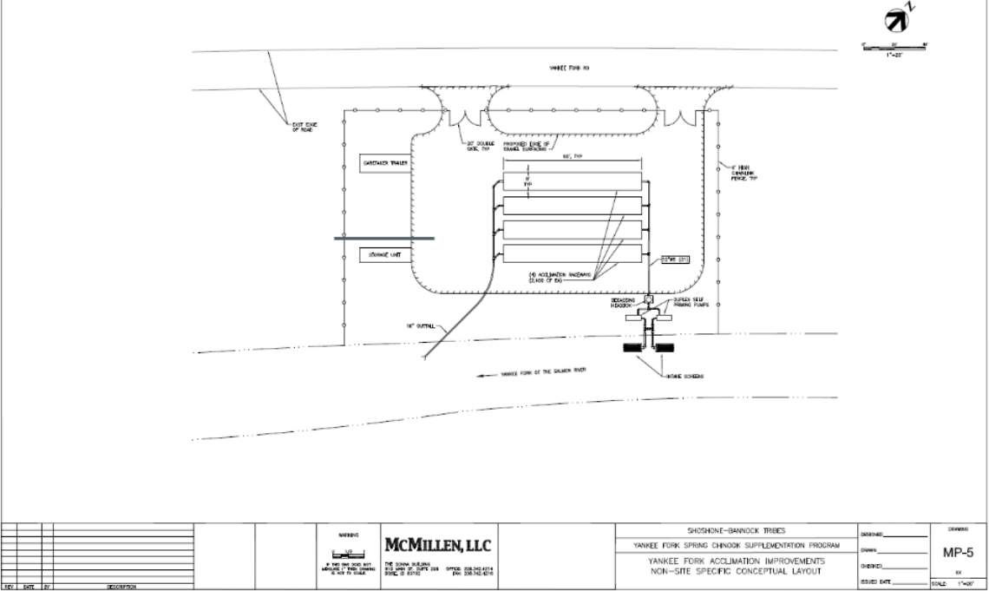
Yankee Fork Salmon River
Infrastructure & Audit Findings

Slide 18
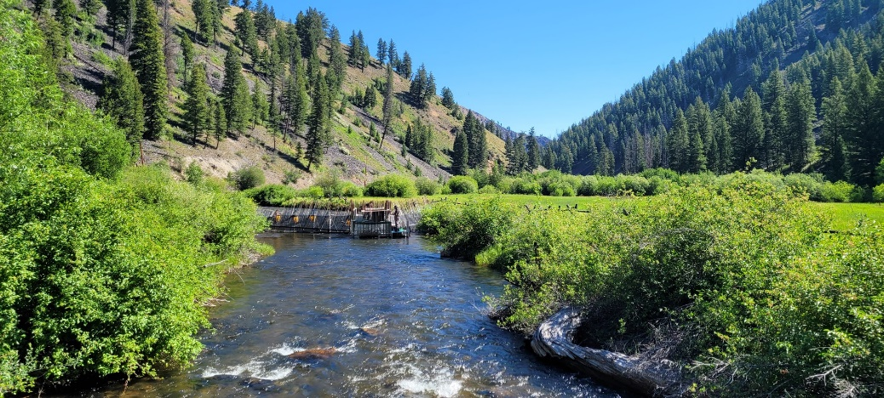
Panther Creek
Infrastructure & Audit Findings
An eggbox program has been in operation since 2014
Currently permitted for 400,000 smolts
A picket weir and trap has been in operation since 2018

Slide 19
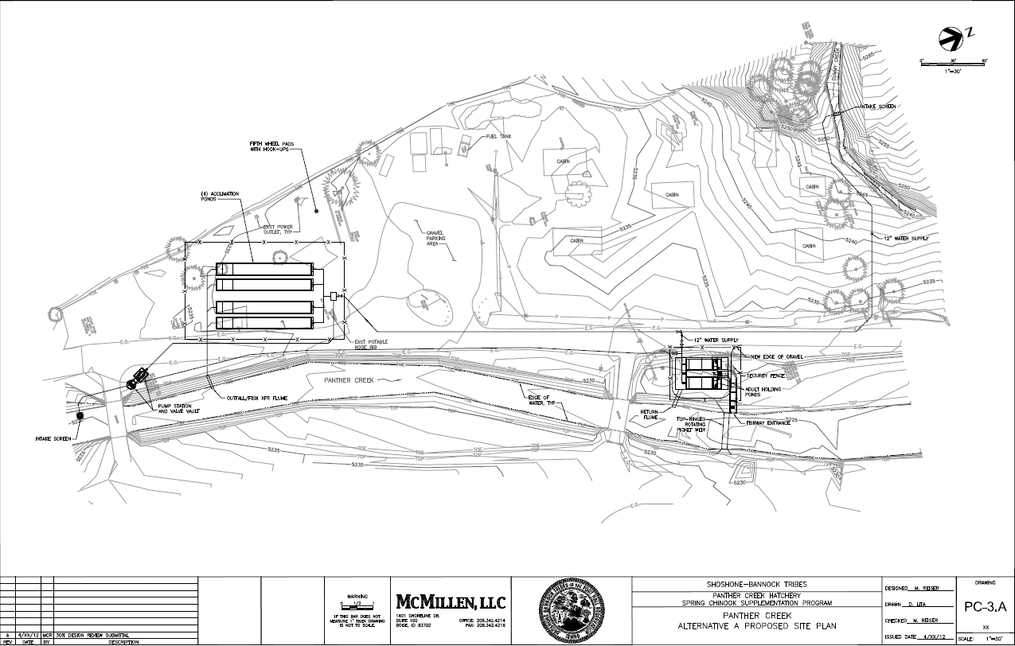
Panther Creek
Infrastructure & Audit Findings
Significant planning has been completed by the Tribes

Slide 20
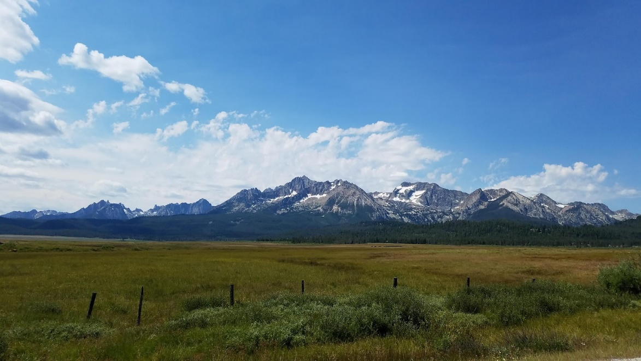
Valley Creek
Infrastructure & Audit Findings
Included as part of the LSRCP mitigation
Release target was set at 300,000 smolts
Adult goal was set at 2,045
No program has been implemented
No current infrastructure in place

Slide 21
Short-Term Summary
Infrastructure & Audit Findings
Upper Salmon
Increase Rearing Density
Decrease Size-At-Release
East Fork Salmon River
Develop options paper
Start w/ 180,000 smolt program using East Fork stock
Adapt holding ponds to be conducive for acclimation

Slide 22
Short-Term Summary
Infrastructure & Audit Findings
Yankee Fork Salmon River
Increase program from 300k to 360k
Develop acclimation facility
Develop resistance board weir/trap
Collect broodstock
Valley Creek
Develop options paper
Panther Creek
Develop 360K smolt program
Work w/ Trustees Council to use funds to develop satellite facility and production at Sawtooth

Slide 23
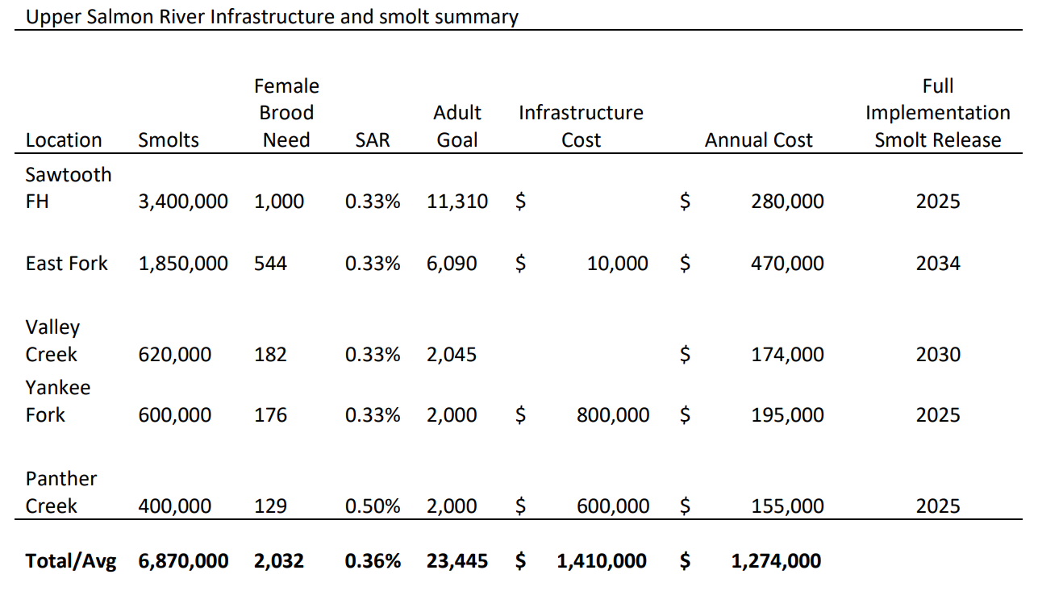
Long-Term Summary
Infrastructure & Audit Findings

Slide 24
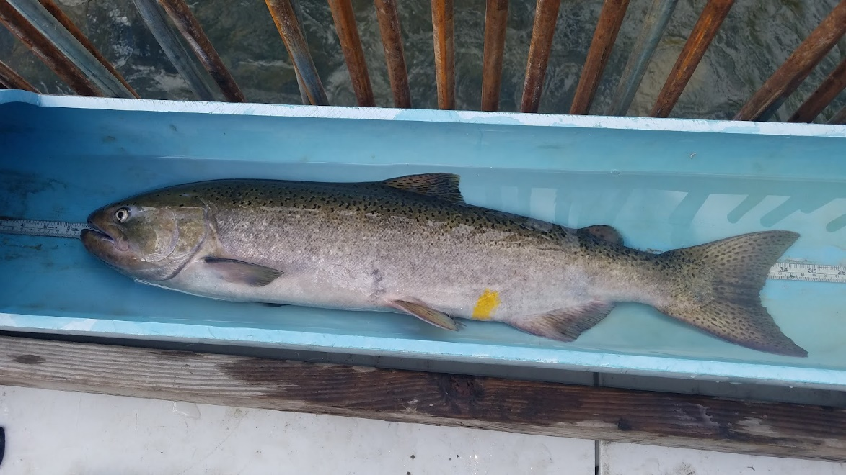



Questions

