Slide 1
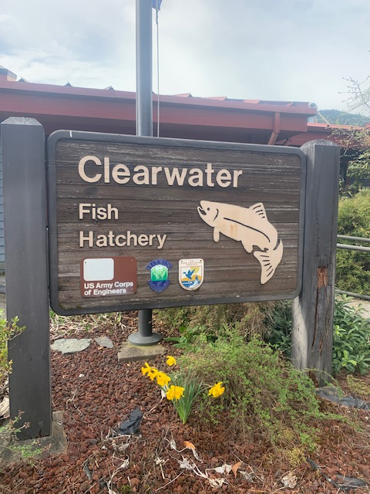


Lower Snake River Compensation Plan Infrastructure Audits

Slide 2
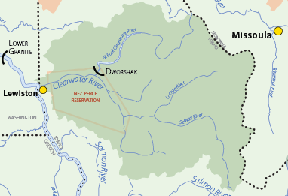
Mitigation Goal
11,900 Chinook adults (Spring and Summer runs)
14,000 Steelhead adults

Slide 3
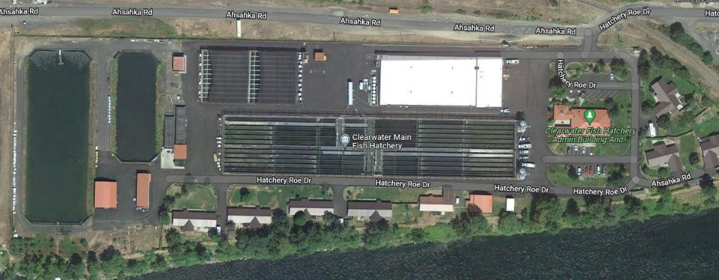
Facility Location
Located on the North Fork of the Clearwater, 1.5 miles below the Dworshak Dam
Incubations
Chinook Bank
Vat Room
Mud Valve Settling Basin
Total Flow Settling Basin
Adult Holding
D-Side
C-Side
Steelhead Bank
Residences

Slide 4
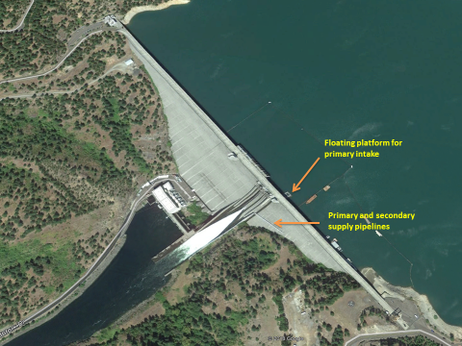
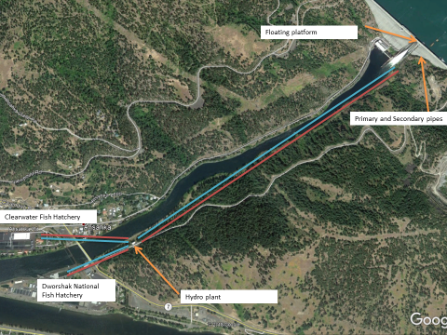
Dworshak Reservoir Pipeline
About 80-89 cfs from a gravity line from Dworshak Reservoir
Primary Intake
Adjustable snorkel to target desired water temperatures
Secondary Intake
Stationary intake 245 feet below the top of Dworshak Dam

Slide 5
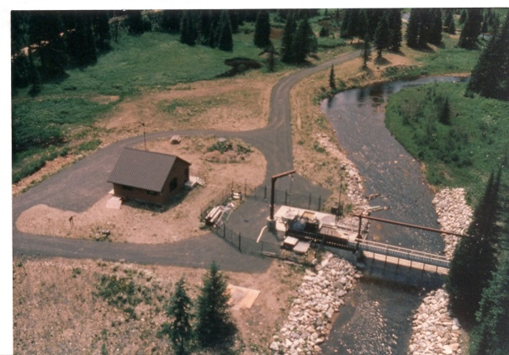
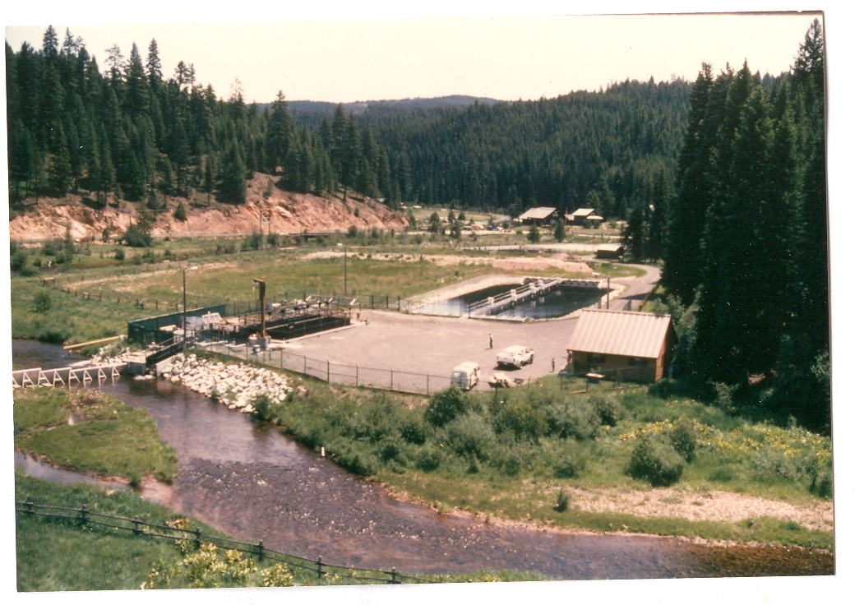
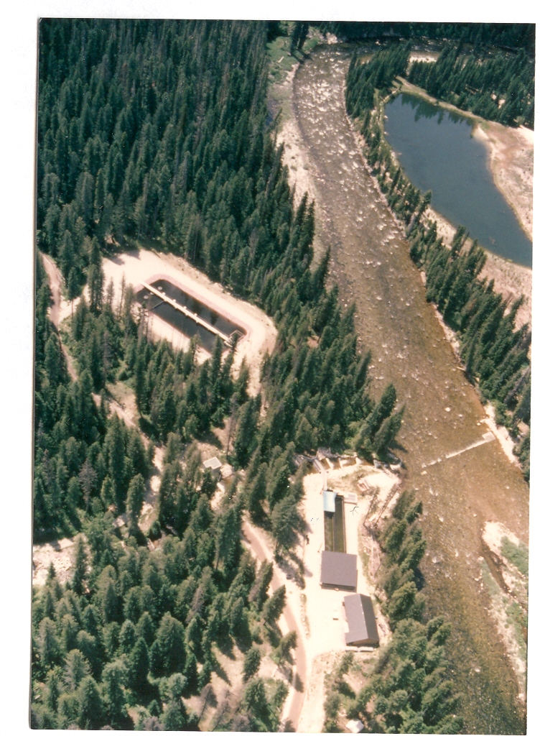
Chinook Broodstock Collection
Red River and Crooked River Satellite Traps (Spring Run)
Powell Satellite Trap (Summer)
Dworshak National, Kooskia National and NPT Cherry Lane

Slide 6
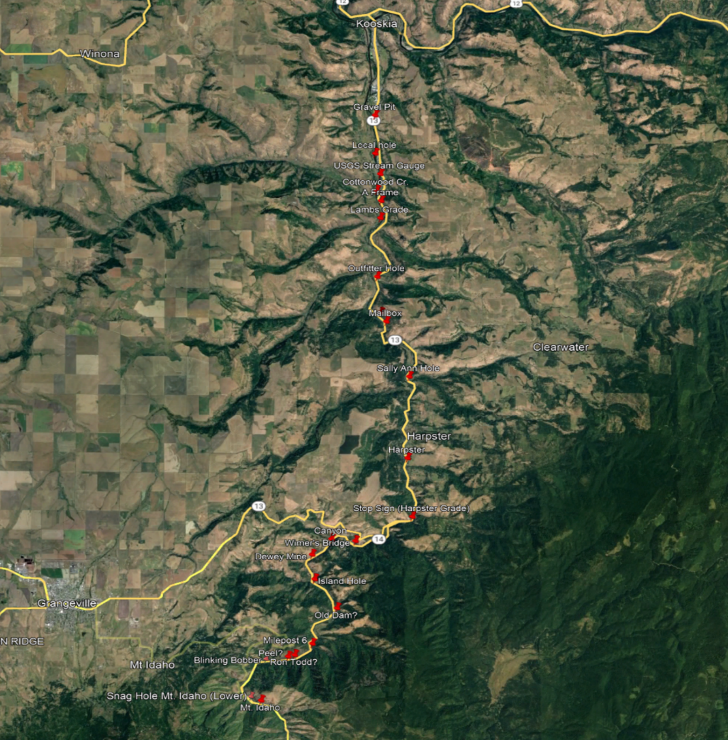
Steelhead Broodstock Collection
Angler-based broodstock collection
Dworshak - North Fork Clearwater trap

Slide 7
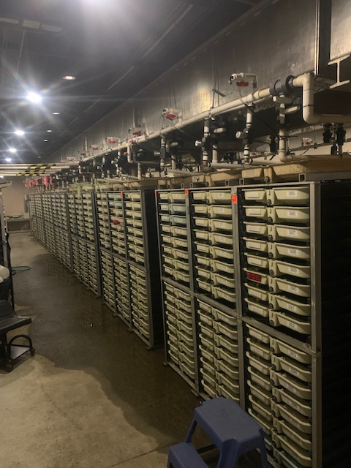
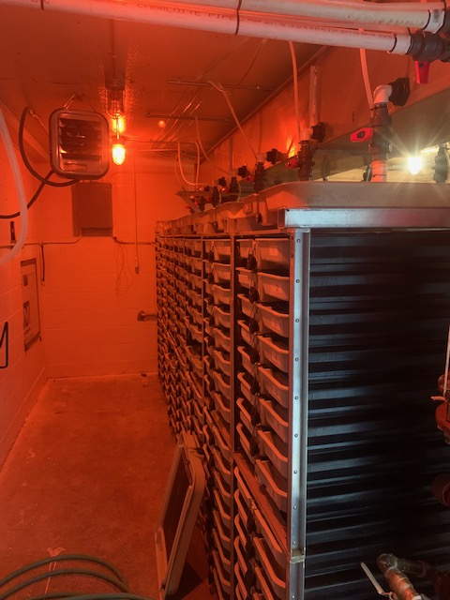
Incubation
Primary Incubation
49 Double-stacked Heath incubators
18 stacks can be heated
Isolation Incubation
15 Double-stacked Heath incubators
No heated stacks

Slide 8
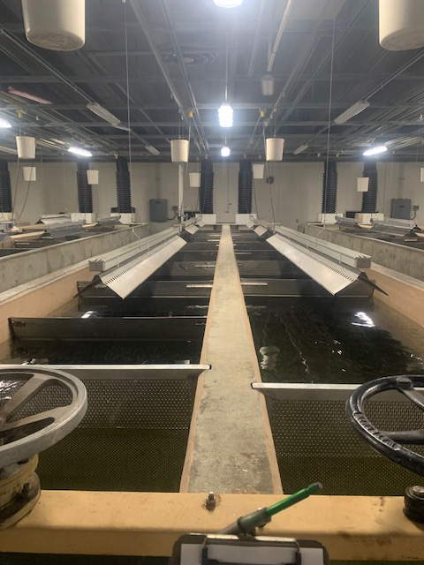
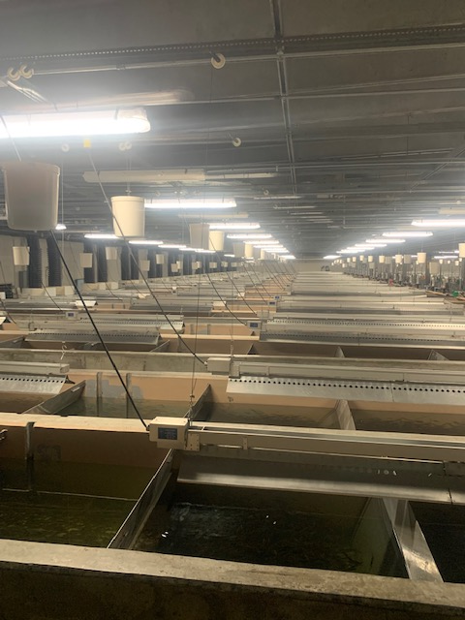
Vat Room
60 Vats (40’x4’x3’)
Max DI < 0.35
Max FI < 1.32 at Marking Event

Slide 9
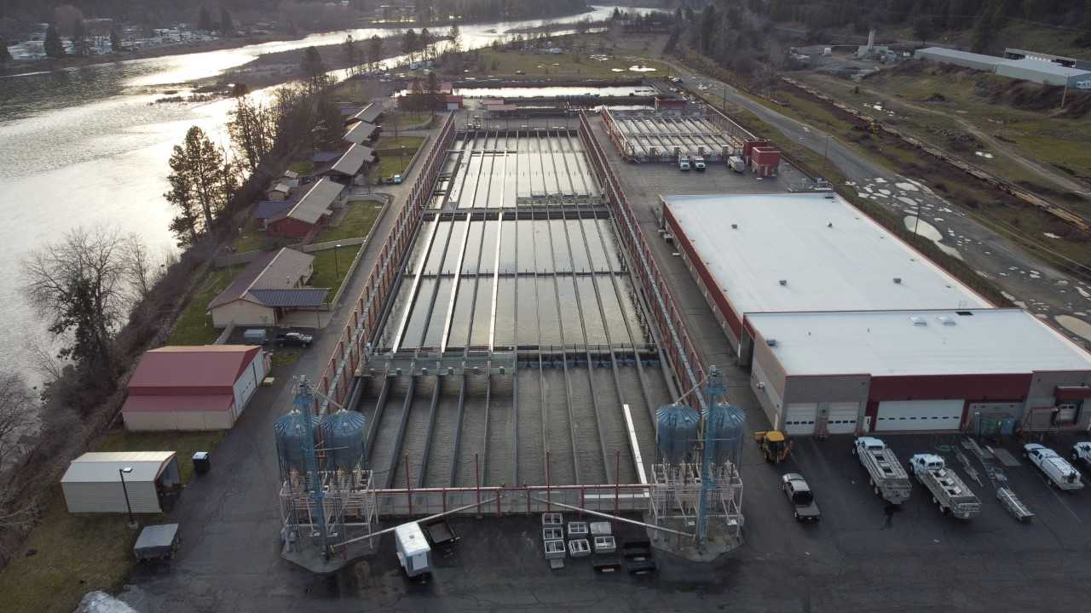
Steelhead Bank
24 300’ raceways
DI < 0.35
FI < 2.5 @ release

Slide 10
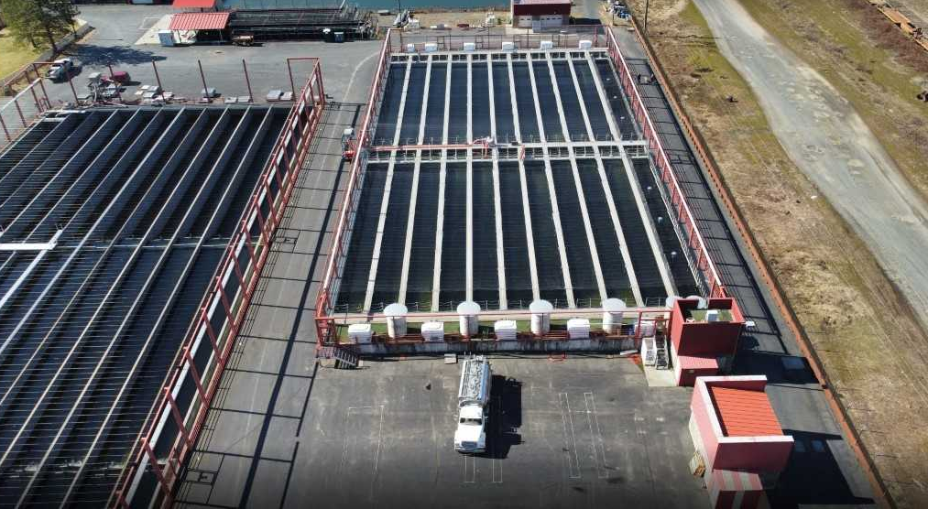
Chinook Bank
21 100’ raceways
DI < 0.32
FI 1.2 < @ release

Slide 11
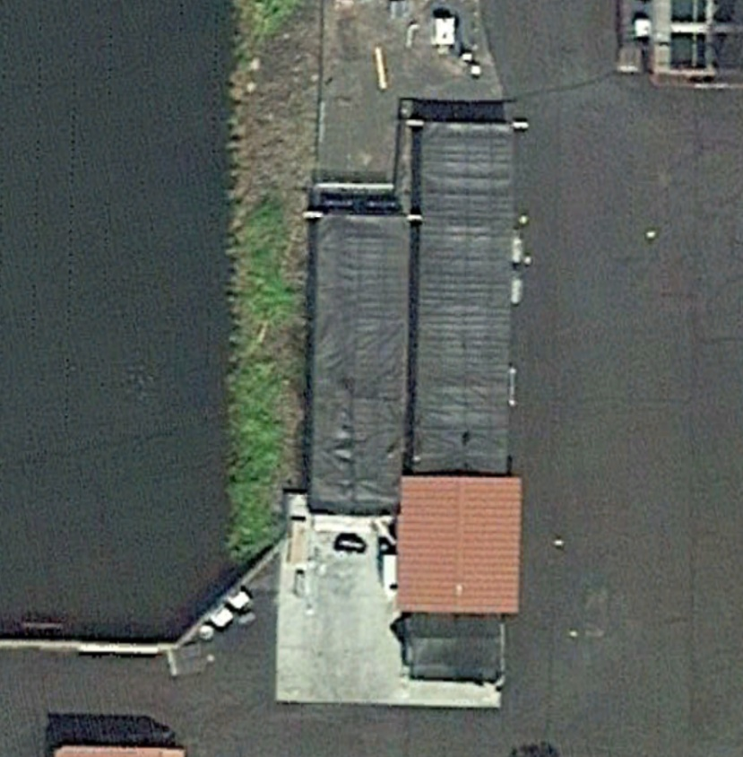
Adult Holding Ponds
2 Large Ponds (7000 ft³)
2 Medium Ponds (6000 ft³)
DI < 0.32
FI < 1.2 @ release

Slide 12
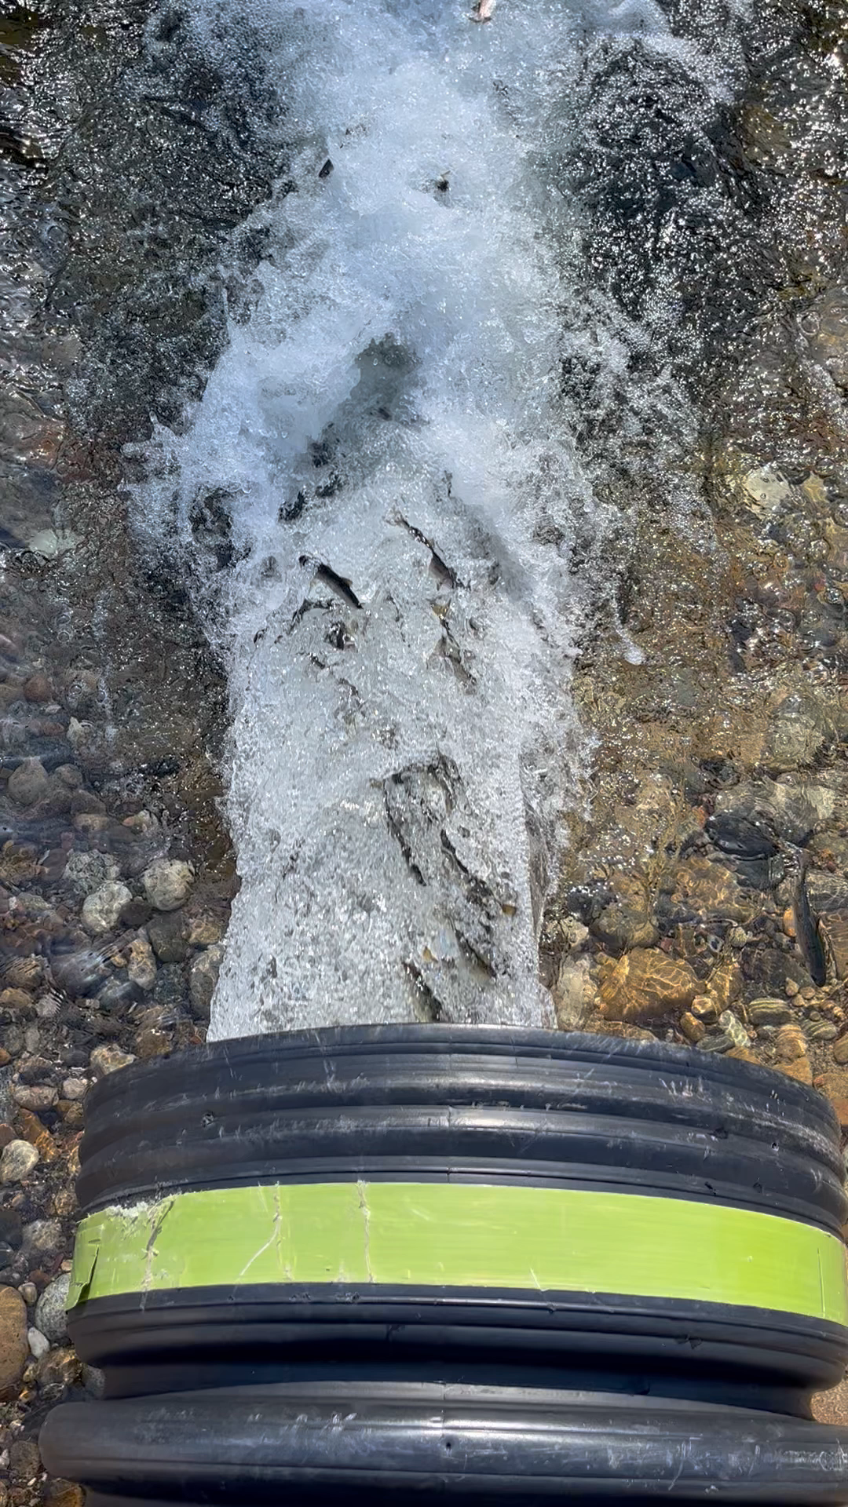
Chinook Release
Spring Chinook
Red River: 1,280,000
Lower Selway: 400,000
Clear Creek: 720,000
North Fork Clearwater: 709,000
Summer Chinook
Powell: 640,000

Slide 13
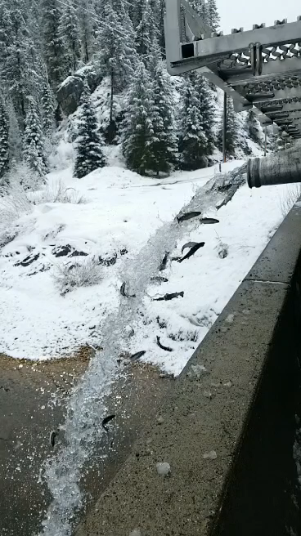
Steelhead Release
Red House: 219,000
Meadow Creek: 501,000
Newsome Creek: 123,000

Slide 14
NPDES
No compliance issues

Slide 15
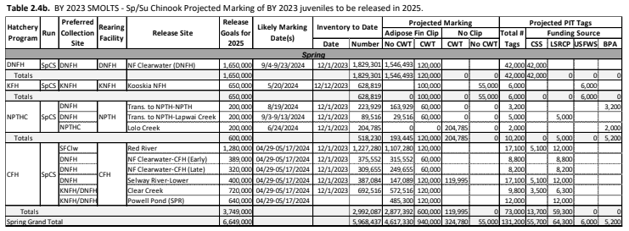
Chinook Marking

Slide 16
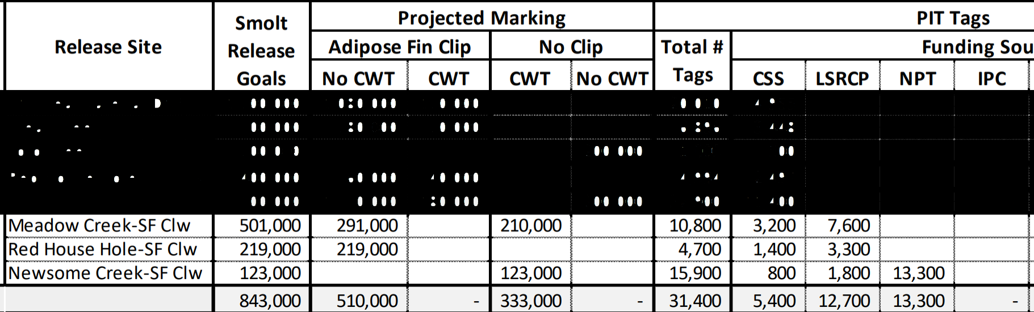
Steelhead Marking

Slide 17
Summary of Operational/Infrastructure Changes for Program Efficiency
Expand Incubation and Early Rearing
Replace the existing Clearwater pipeline
Add boxes under intake in the Vats to reduce water velocity
New piping in the Vat room

