Slide 1

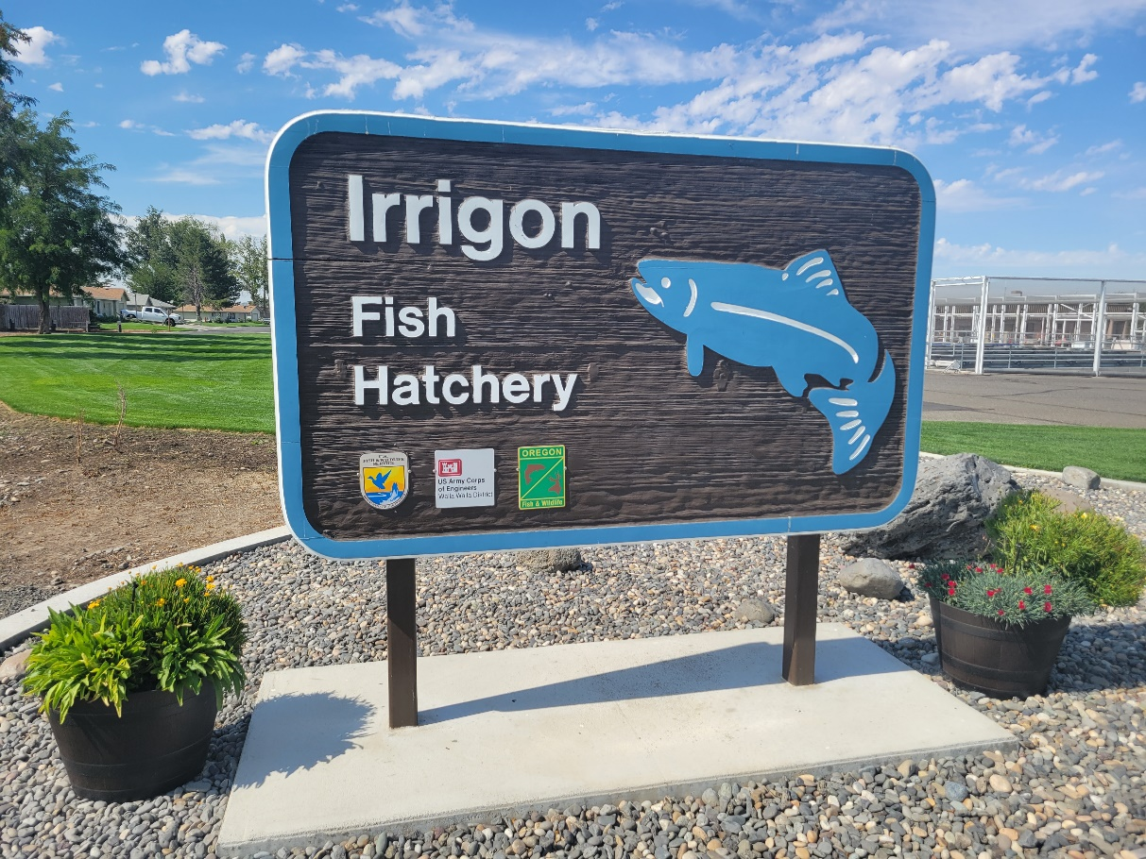
Irrigon Hatchery

Slide 2
Overview
Began Operation in 1984
Wallowa River Steelhead Program - Harvest Mitigation. 9,184 Adults to Ice Harbor Dam
Little Sheep Creek Program - Integrated Harvest/Supplementation. 2,000 adults to Ice Harbor Dam.

Slide 3
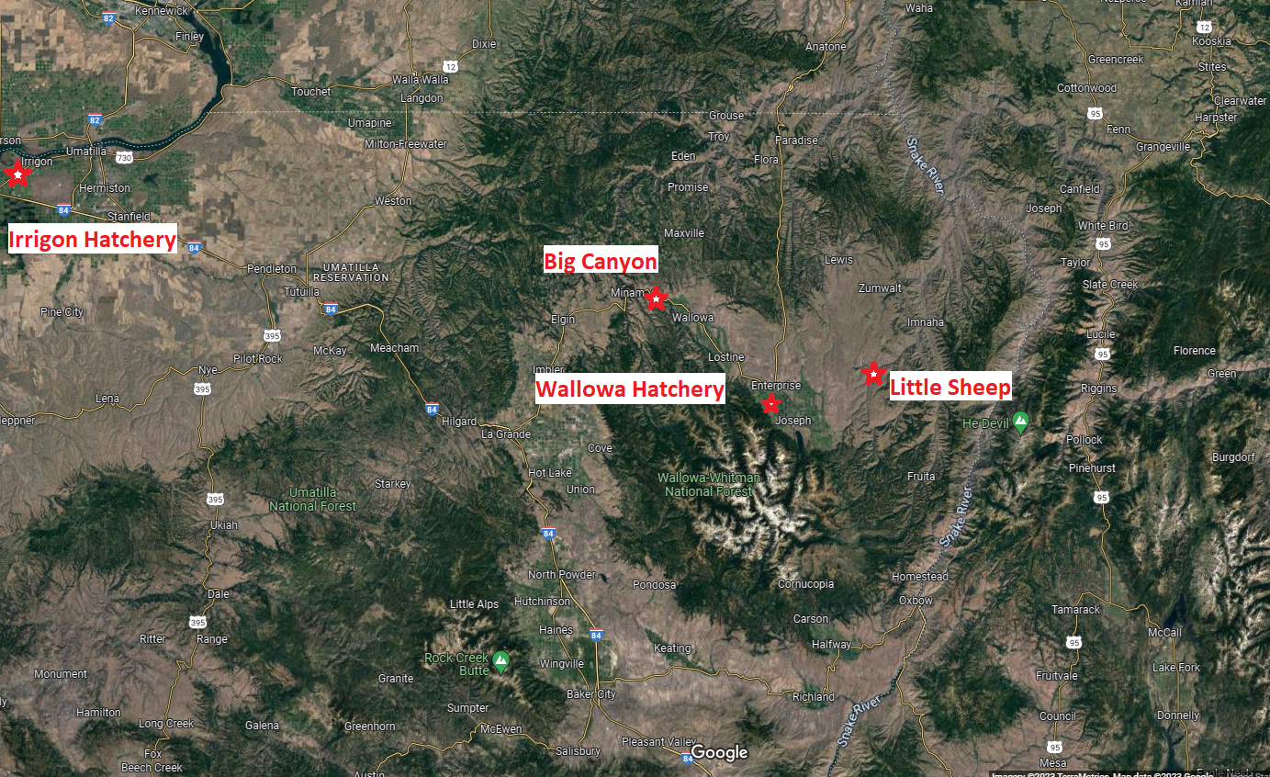
Facility Overview

Slide 4
Summer Steelhead Production
Program | Stock | Release Site | Transfer Date | Production Goal | Target F/lb. | Production Pounds
LSRCP/ ODFW | Wallowa River | Wallowa Acclimation | November | 400,000 | 10.0 | 40,000
LSRCP/ ODFW | Wallowa River | Wallowa Acclimation | April | 160,000 | 5.5 | 29,091
LSRCP/ ODFW | Wallowa River | Big Canyon Acclimation | March | 240,000 | 5.5 | 43,636
LSRCP/ ODFW | Imnaha River | Little Sheep Acclimation | February | 215,000 | 5.0 | 43,000
Grand Total |  |  |  | 1,015,000 |  | 155,727

Slide 5
Fall Chinook Production
Program | Stock | Release Site | Transfer Date | Production Goal | Target F/lb. | Production Pounds
LSRCP/ ODFW | Snake River | Salmon River | May | 1,000,000 | 50.0 | 20,000
LSRCP/ ODFW | Snake River | Grande Ronde River | May | 200,000 | 50.0 | 4,000
Grand Total |  |  |  | 1,200,000 |  | 24,000
LSRCP/ ODFW | Snake River | Grande Ronde River | May | *300,000 | 50.0 | 6,000
LSRCP/ ODFW | Snake River | Snake River Couse Creek | May | *600,000 | 50.0 | 12,000
Grand Total |  |  |  | *900,000 |  | 18,000
*Proposed additional production beginning as early as Brood Year 2024.

Slide 6
ODFW/Other Production
Program | Stock | Release Site | Transfer Date | Production Goal | Target F/lb. | Production Pounds
ODFW | Rainbow Trout | NE Oregon Waters | March- July | 97,280 | 3.0 | 32,427
ODFW | Rainbow Trout | NE Oregon Waters | March- July | 15,900 | 0.66 | 24,091
Grand Total |  |  |  | 113,180 |  | 56,518
ODFW/ CTUIR | Umatilla Coho | Umatilla River | December Cascade | 620,000 | Eyed Egg | -

Slide 7
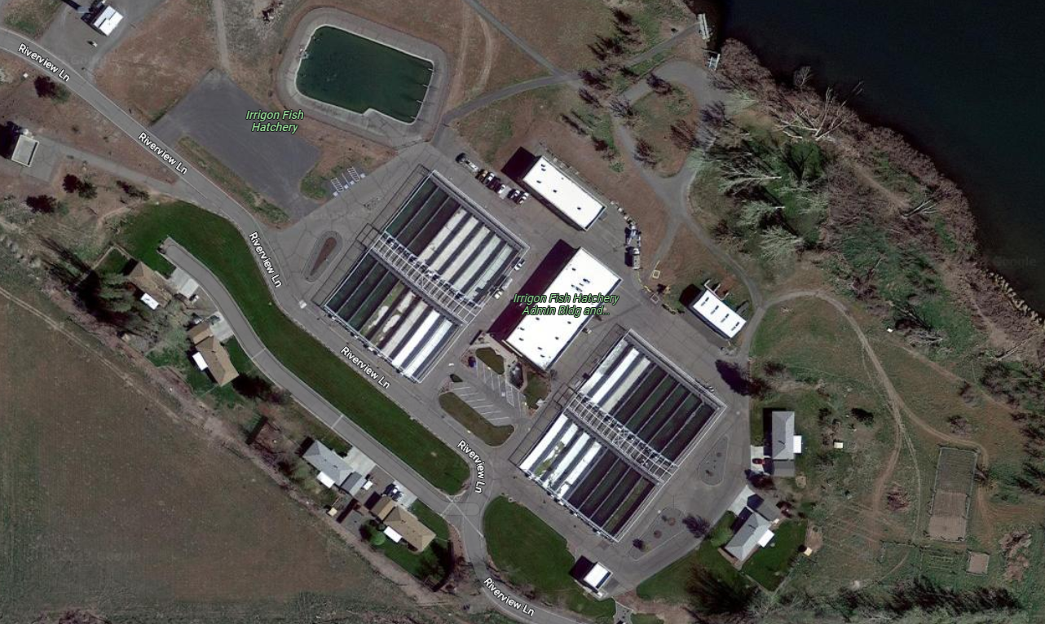
Facility Layout

Slide 8
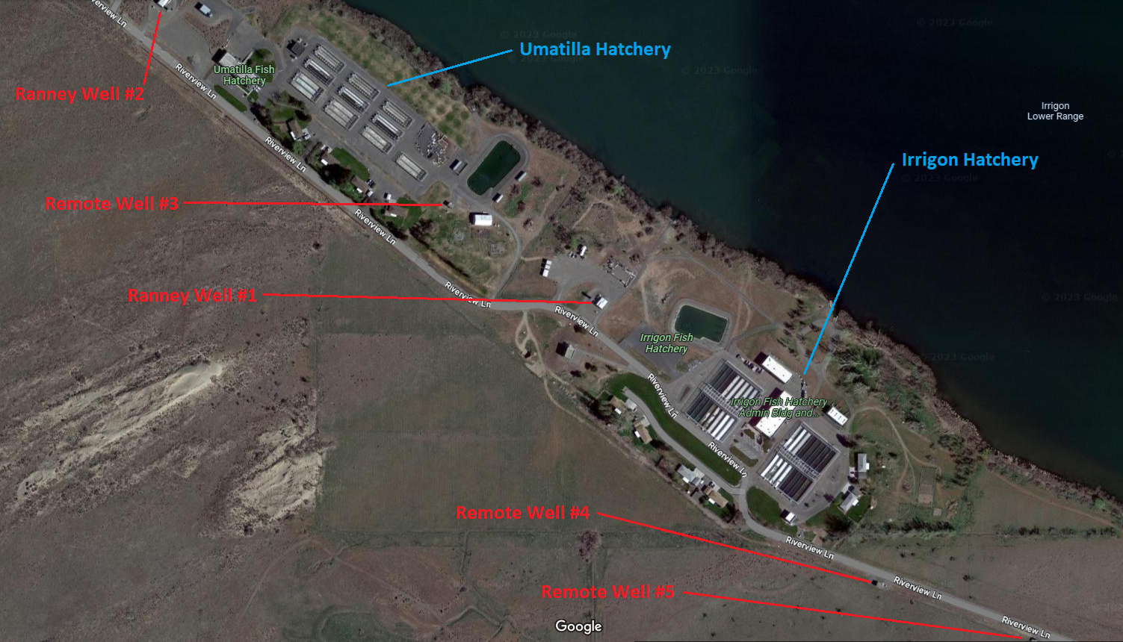
Water Supply

Slide 9
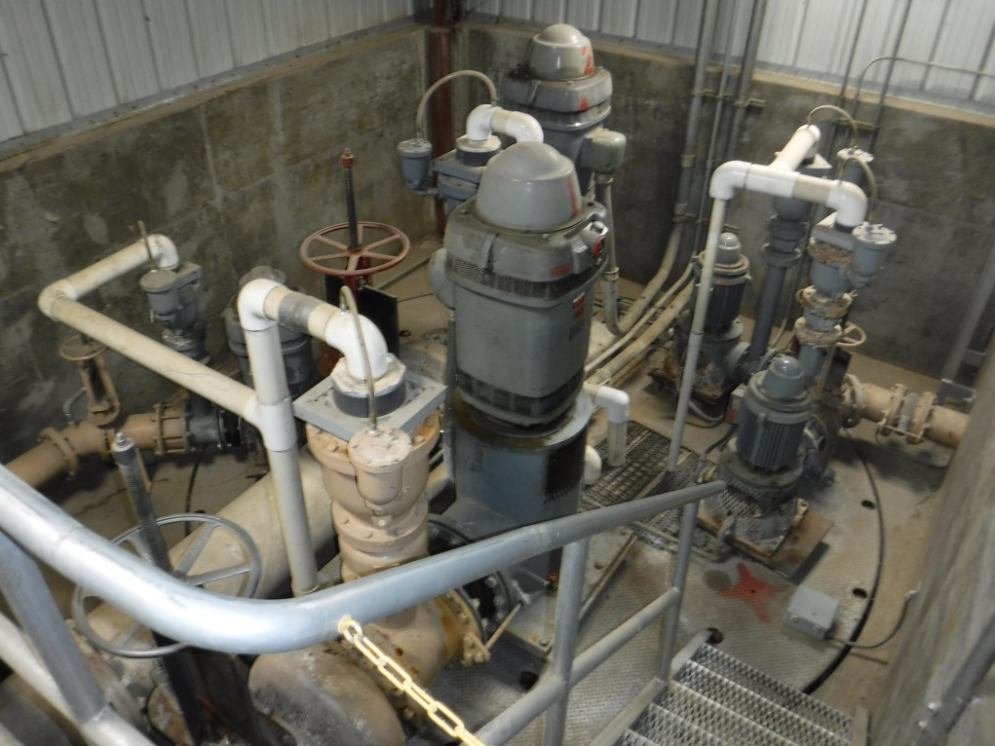
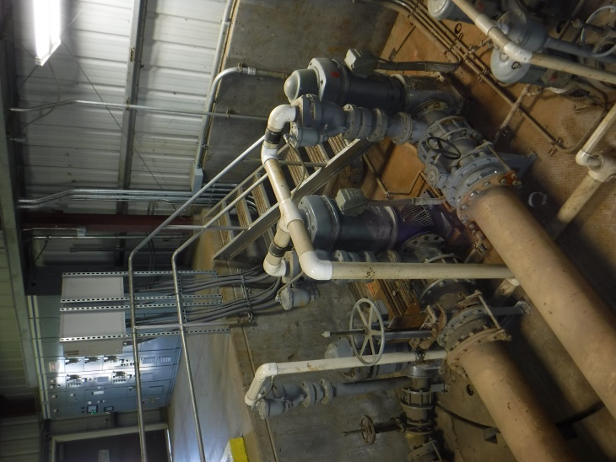
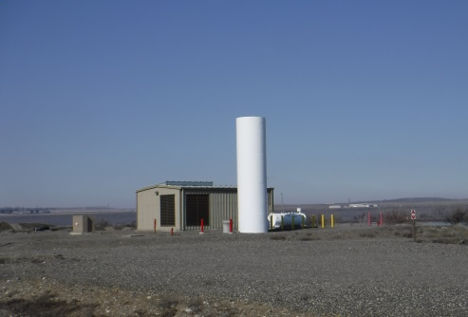
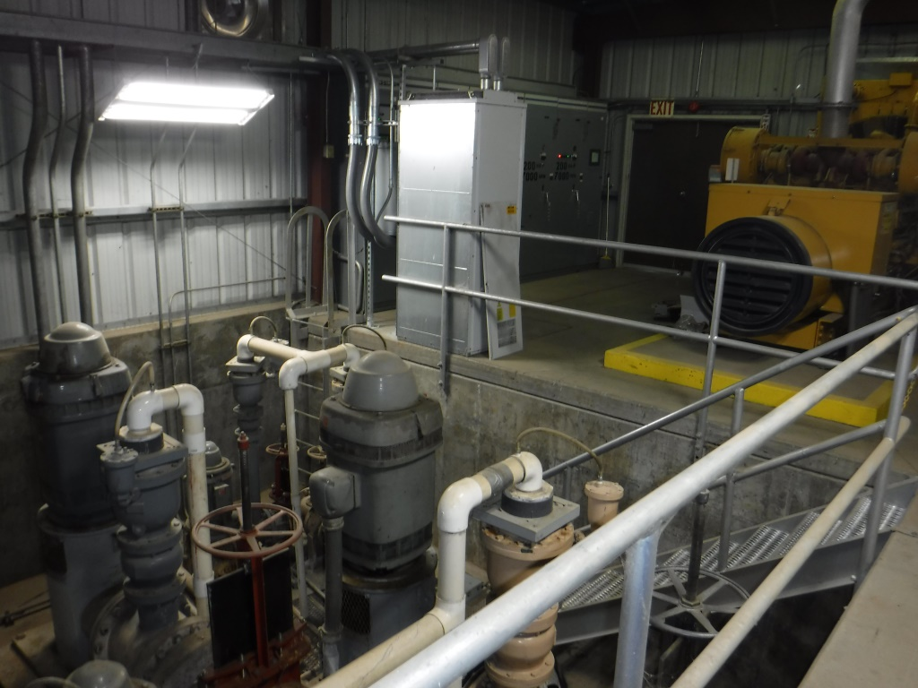
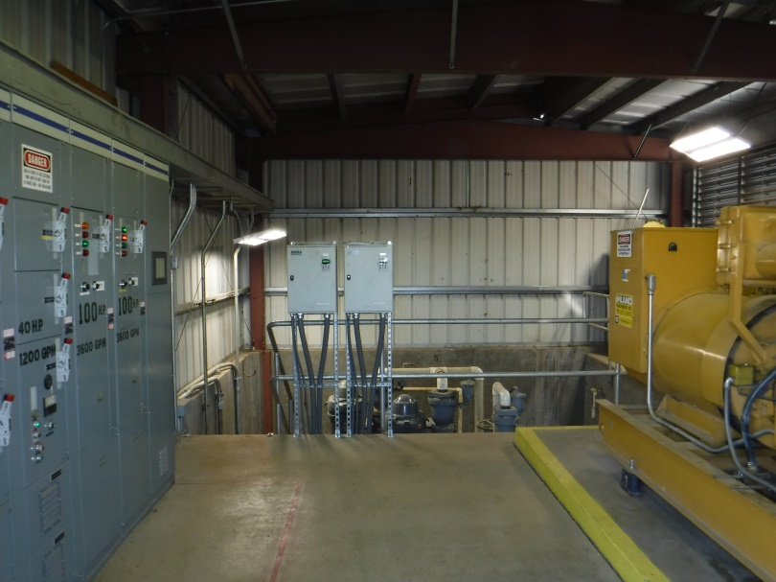
Ranney Well

Slide 10
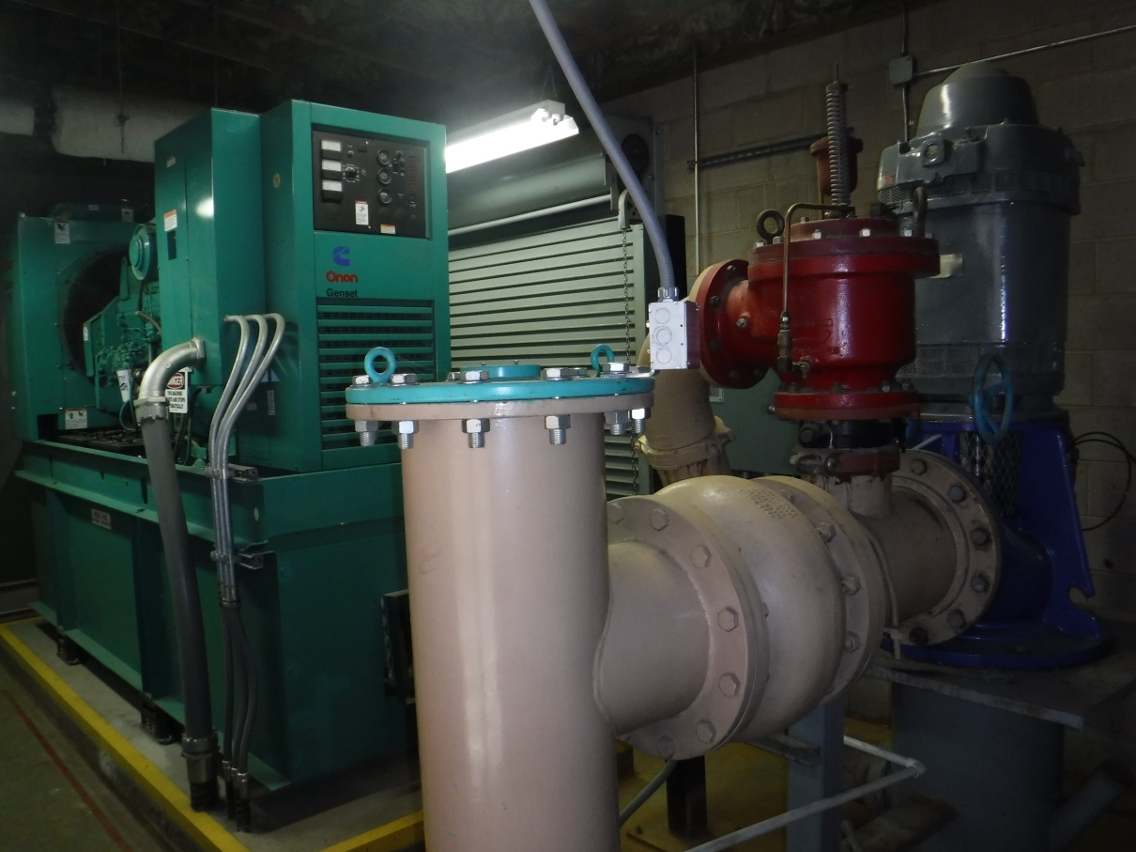
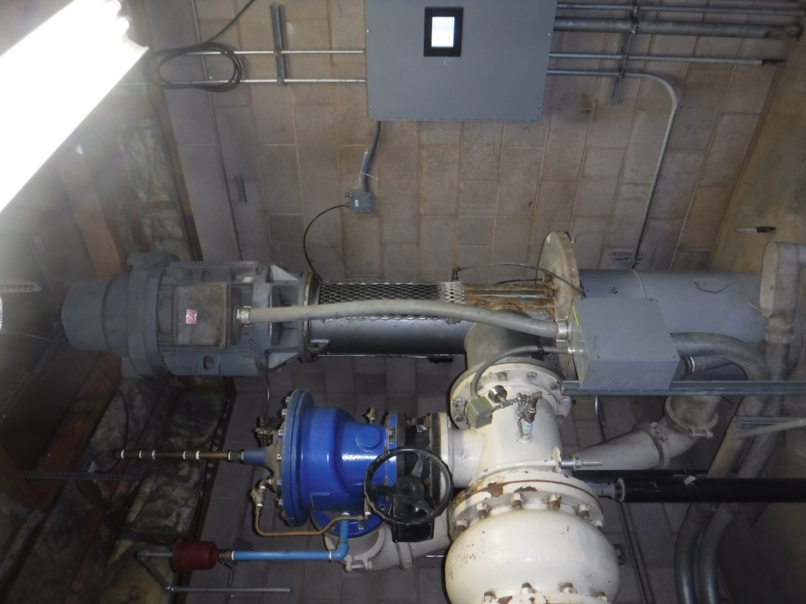
Remote Well

Slide 11
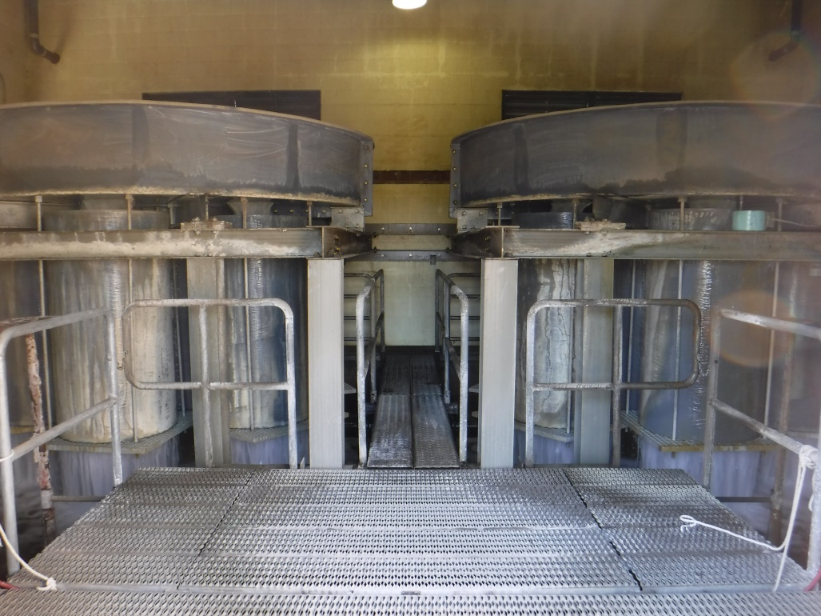
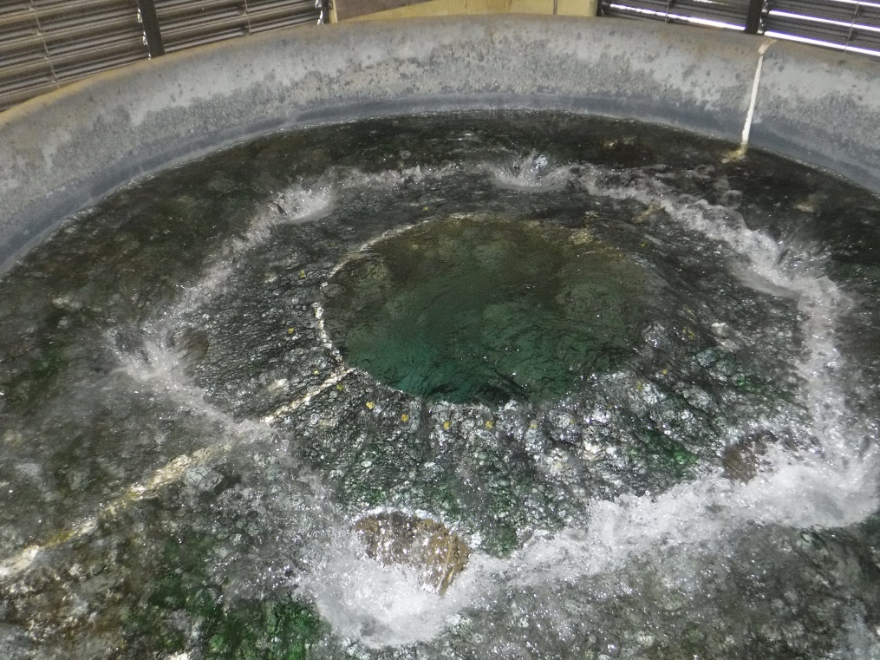
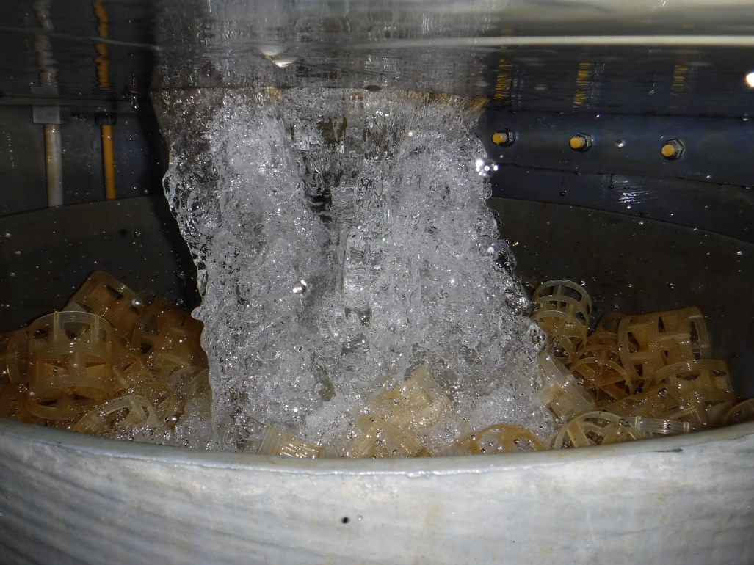
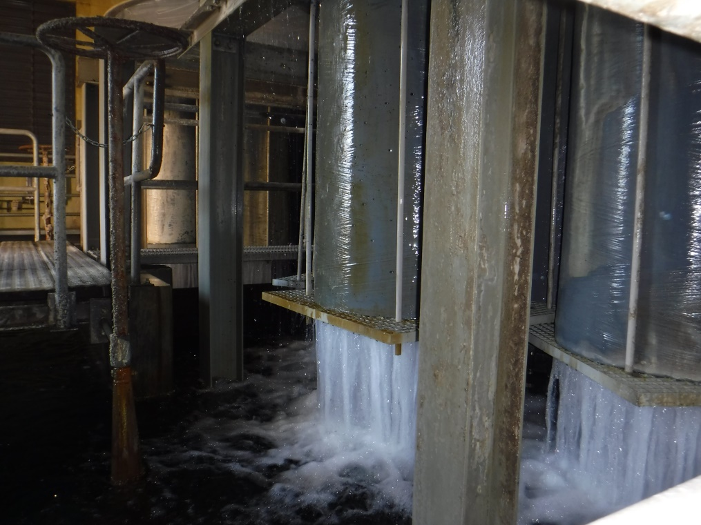
Aeration Tower

Slide 12
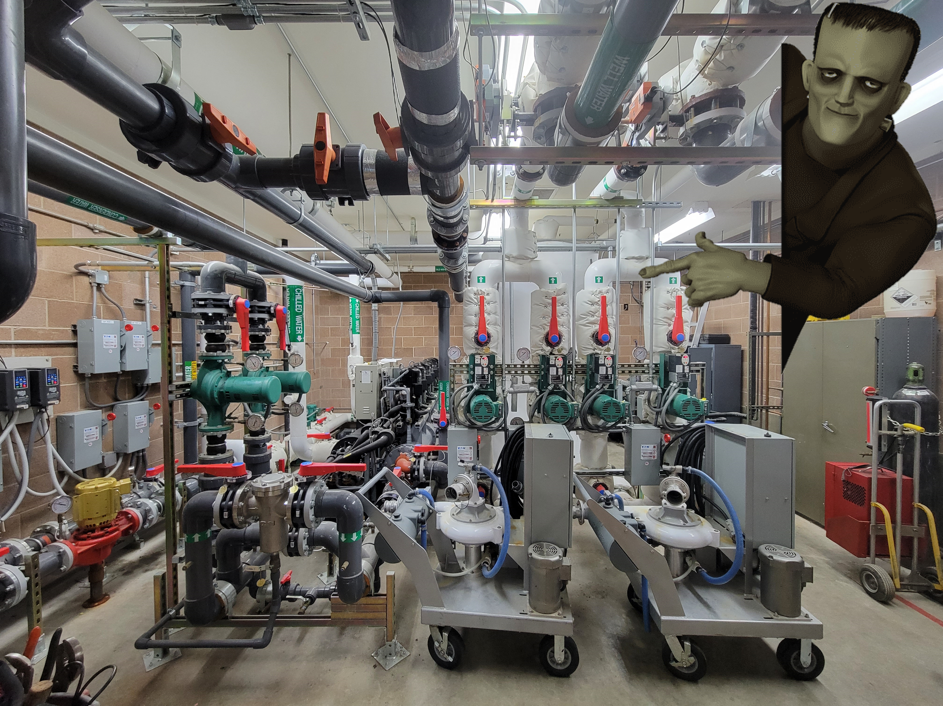
FRANKEN
CHILLER

Slide 13
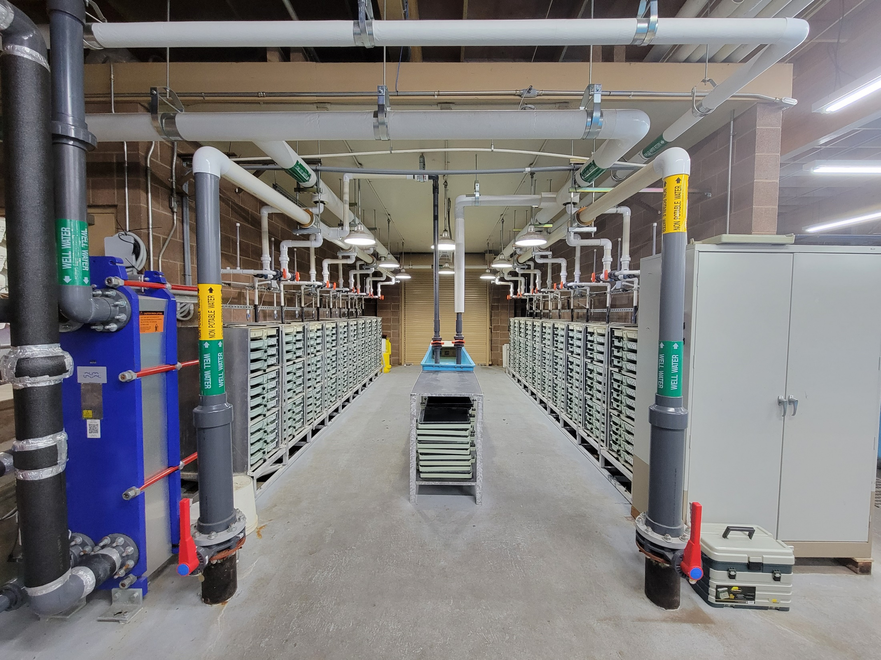
20 Twelve-tray Stacks

Slide 14
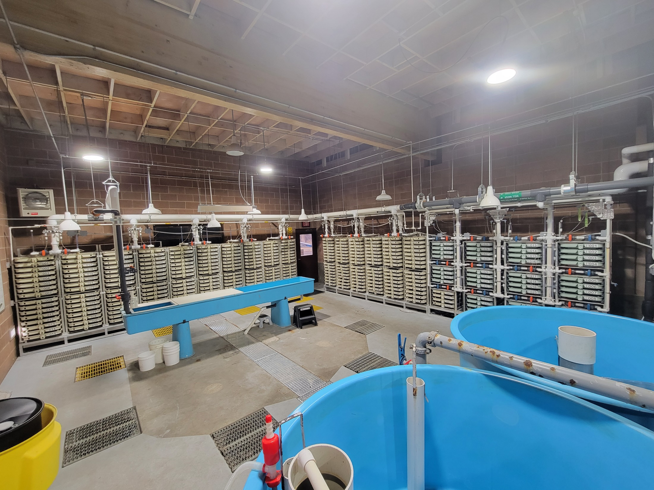
16 Sixteen-tray Stacks
12 Four-tray Stacks

Slide 15
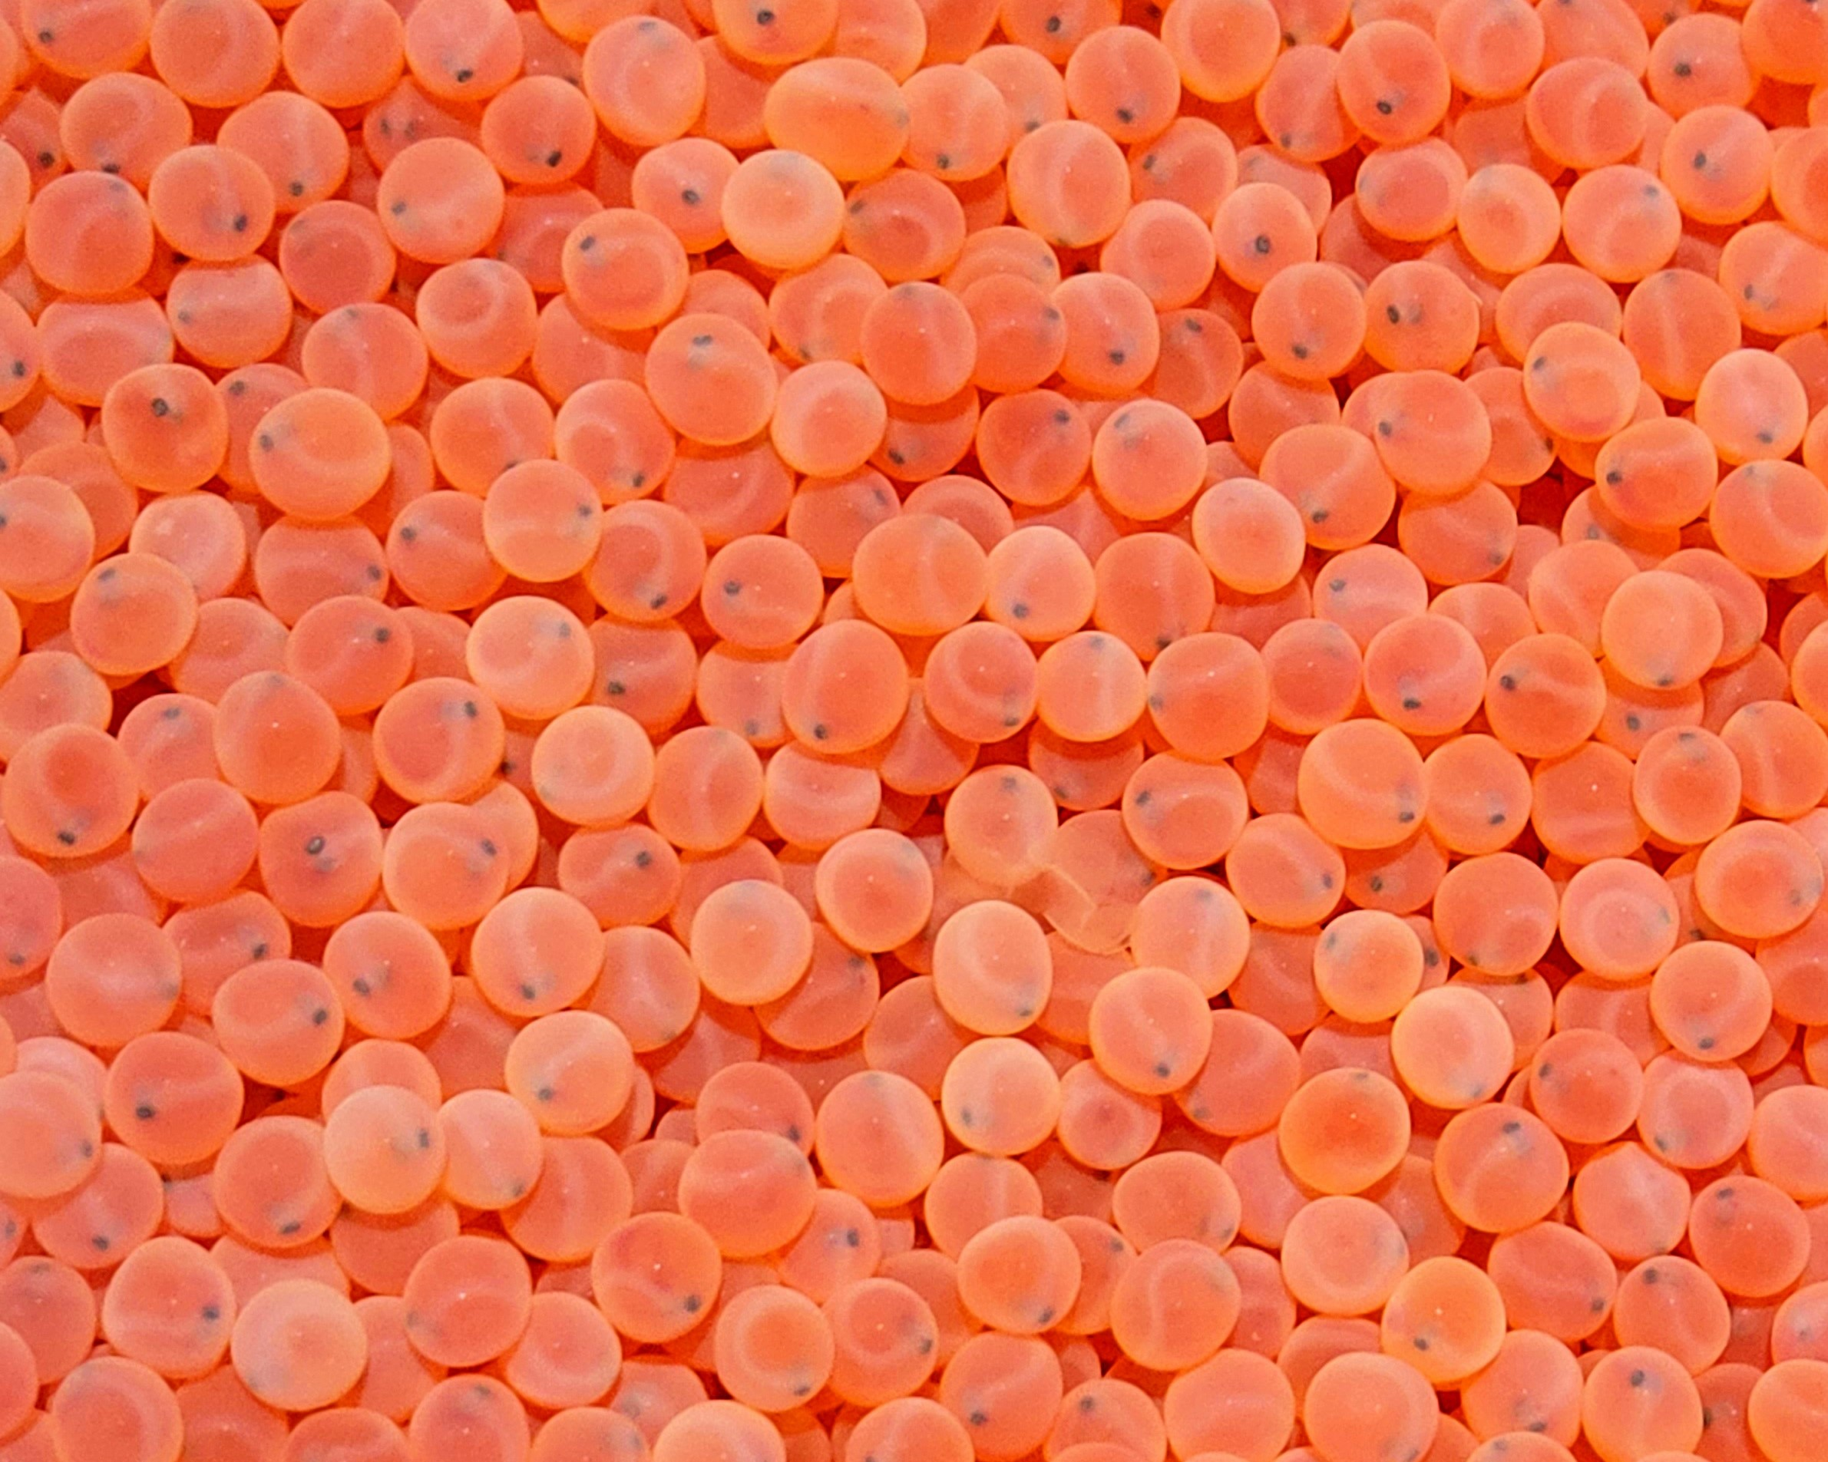
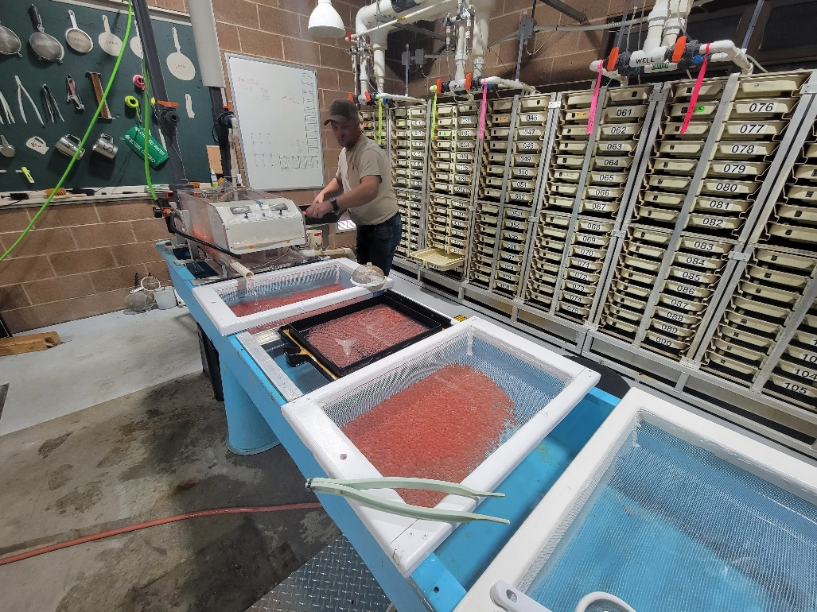
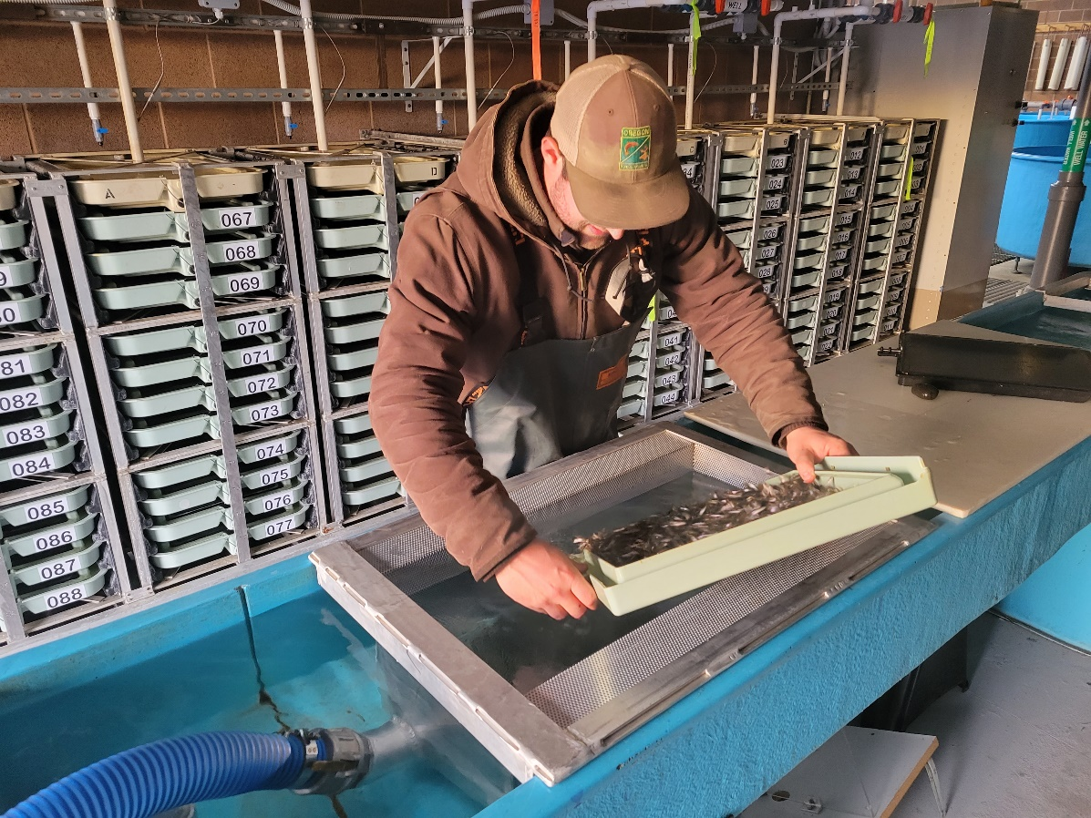
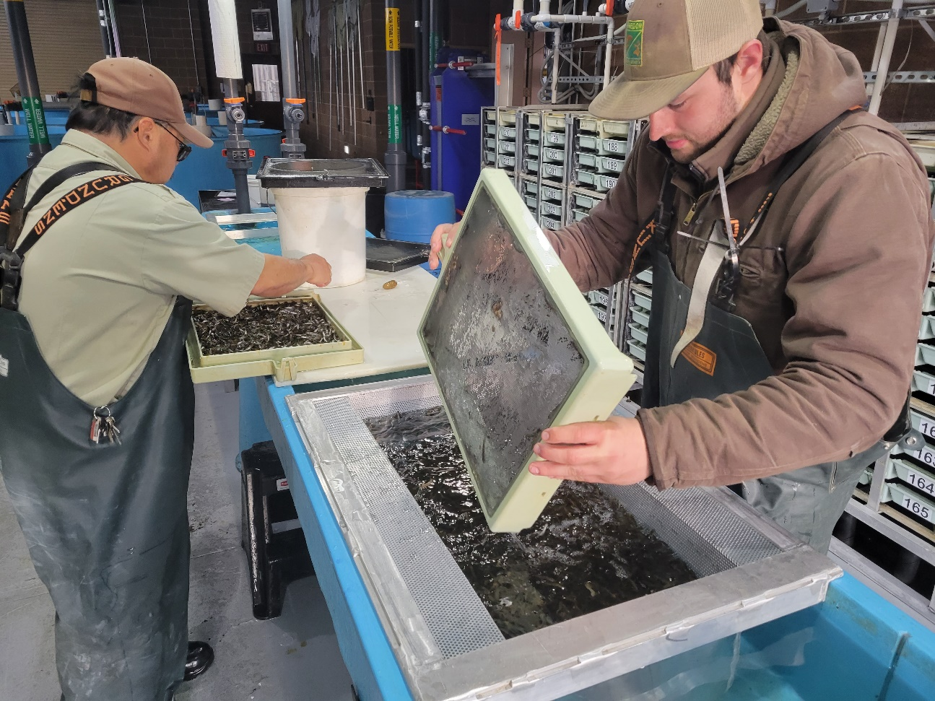

Slide 16
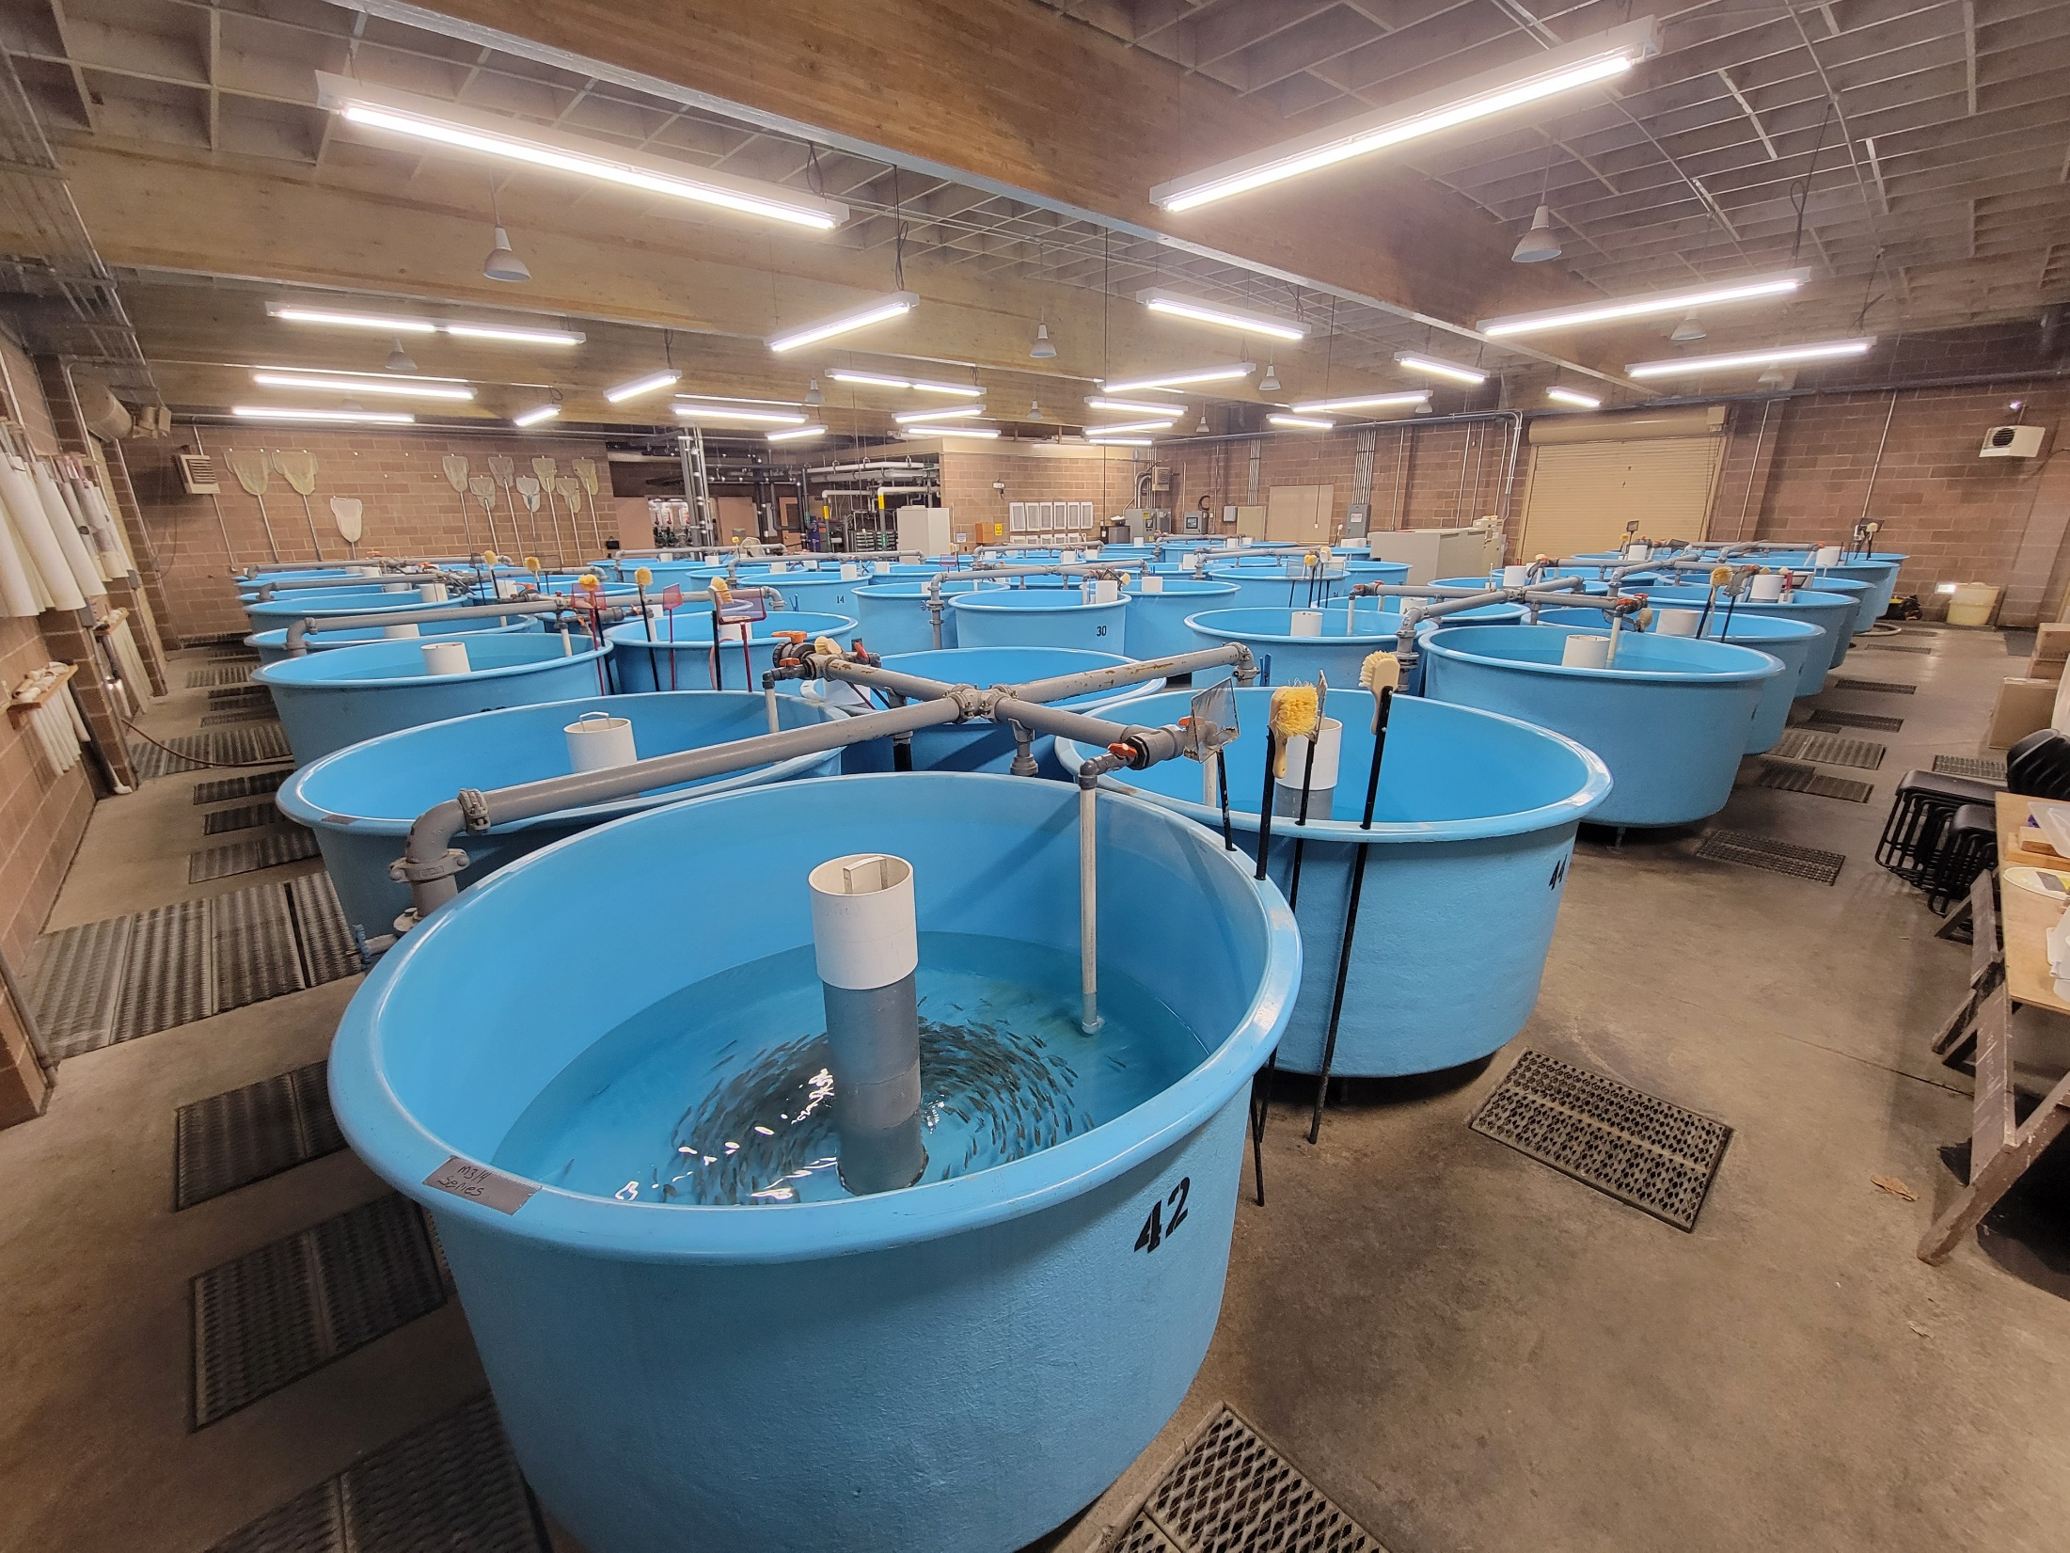
Circular Tanks
64 Tanks 68ft3

Slide 17
Early Rearing Densities
Species | Fish/RW | Size | Lbs. | D.I. | F.I. | Lbs/Ft3
StS Circular | 40,000 | 350 | 114 | 0.79 | 1.54 | 1.68
StS Pre- Mark | 200,000 | 150 | 1,333 | 0.07 | 0.62 | 0.18
ChF Pre- Mark | 500,000 | 150 | 3,333 | 0.16 | 1.32 | 0.44
StS moved from Circulars to Raceways at 350 fish/lb.
StS and ChF marked and tagged at 150 fish/lb.

Slide 18
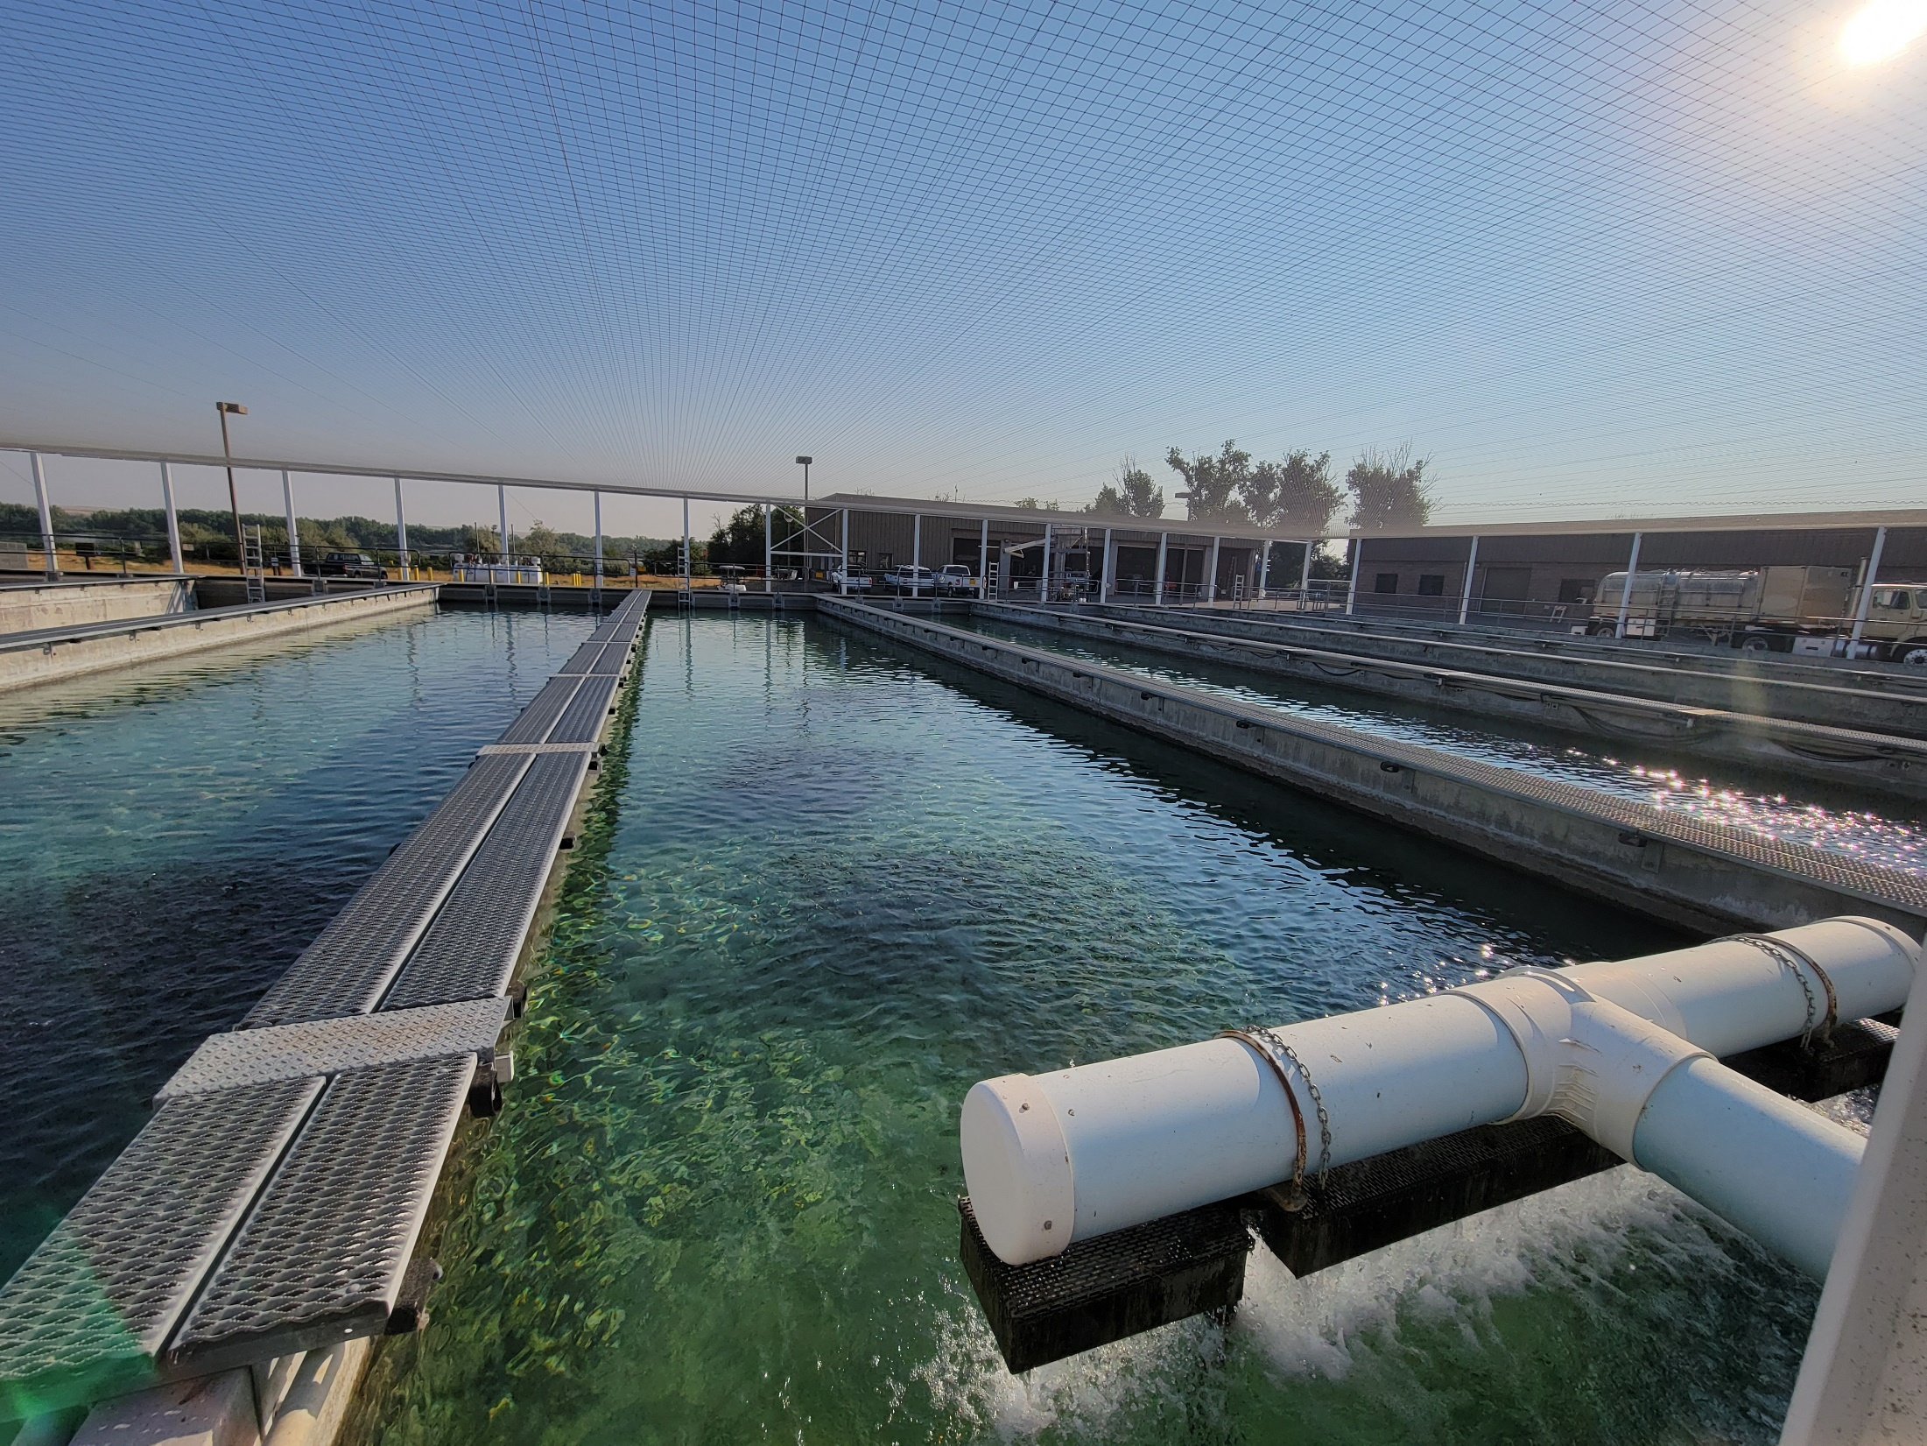
Oregon Raceways
32 Raceways 100 x 20 x 3.75

Slide 19
Final Rearing Densities
Species | Fish/RW | Size | Lbs. | D.I. | F.I. | Lbs/gpm
StS WA | 40,000 | 5.5 | 7,273 | 0.12 | 0.75 | 6.06
StS IM | 35,883 | 5.0 | 7,167 | 0.12 | 0.72 | 5.97
ChF | 200,000 | 50.0 | 4,000 | 0.13 | 0.82 | 3.33
Rb Legal | 24,320 | 2.7 | 9,007 | 0.12 | 0.77 | 7.51
Rb Trophy | 5,300 | 0.66 | 8,030 | 0.08 | 0.48 | 6.69
Final Flows Range 1,000 – 1,300 gpm. Turnover 60 – 40 Min.

Slide 20
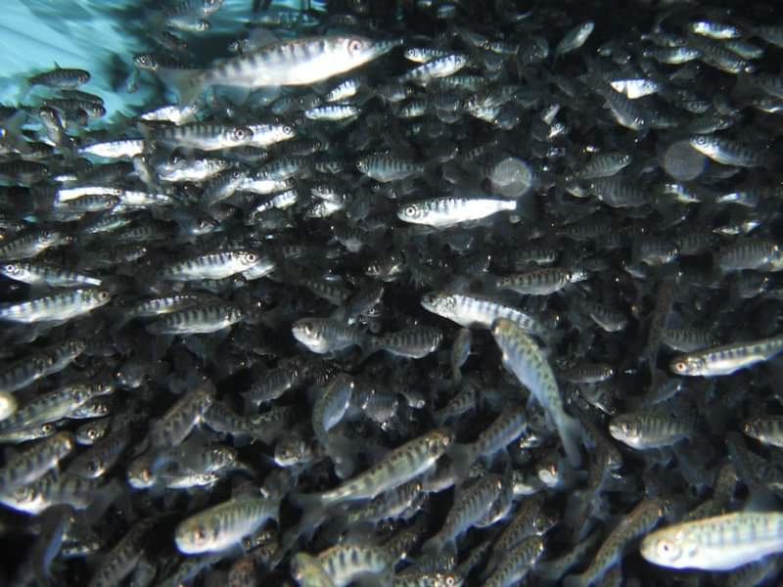
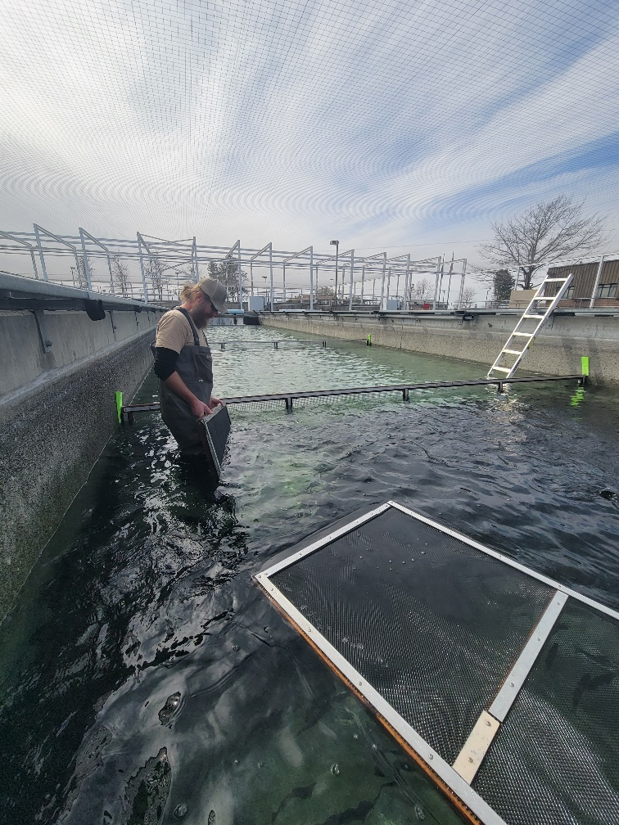
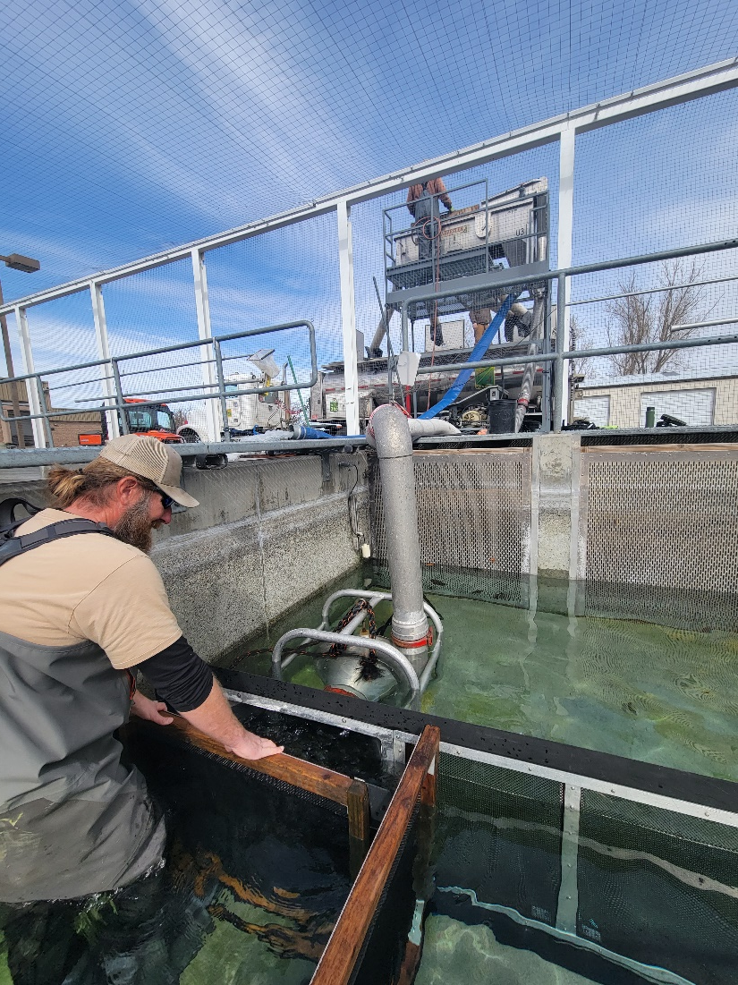
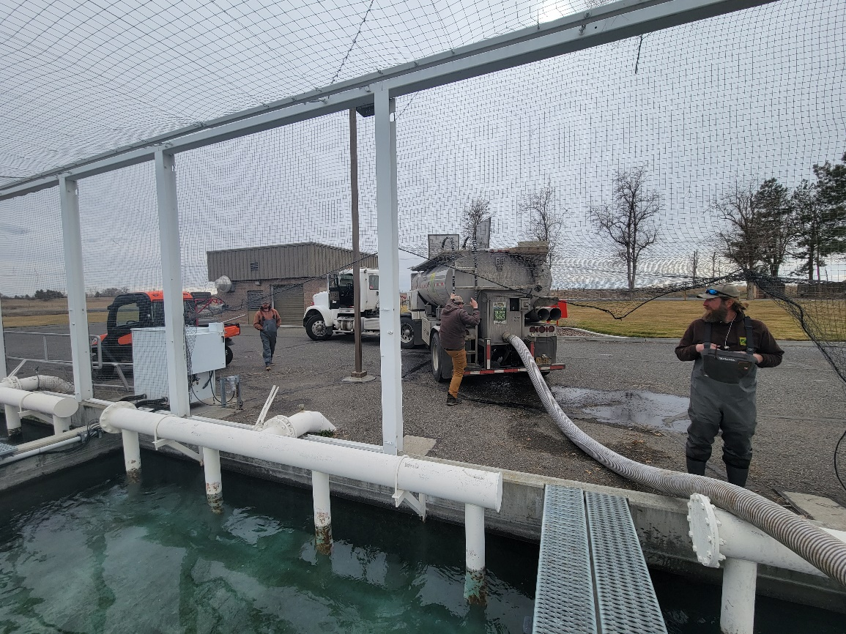

Slide 21
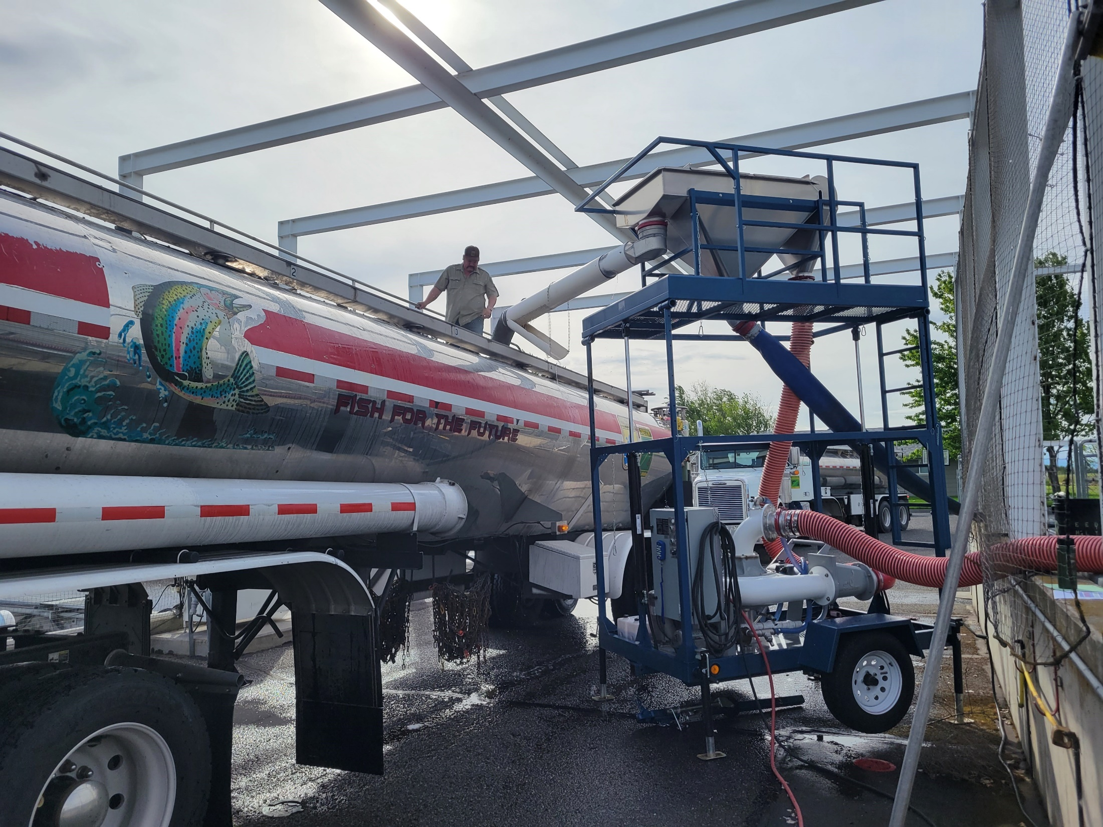

Slide 22
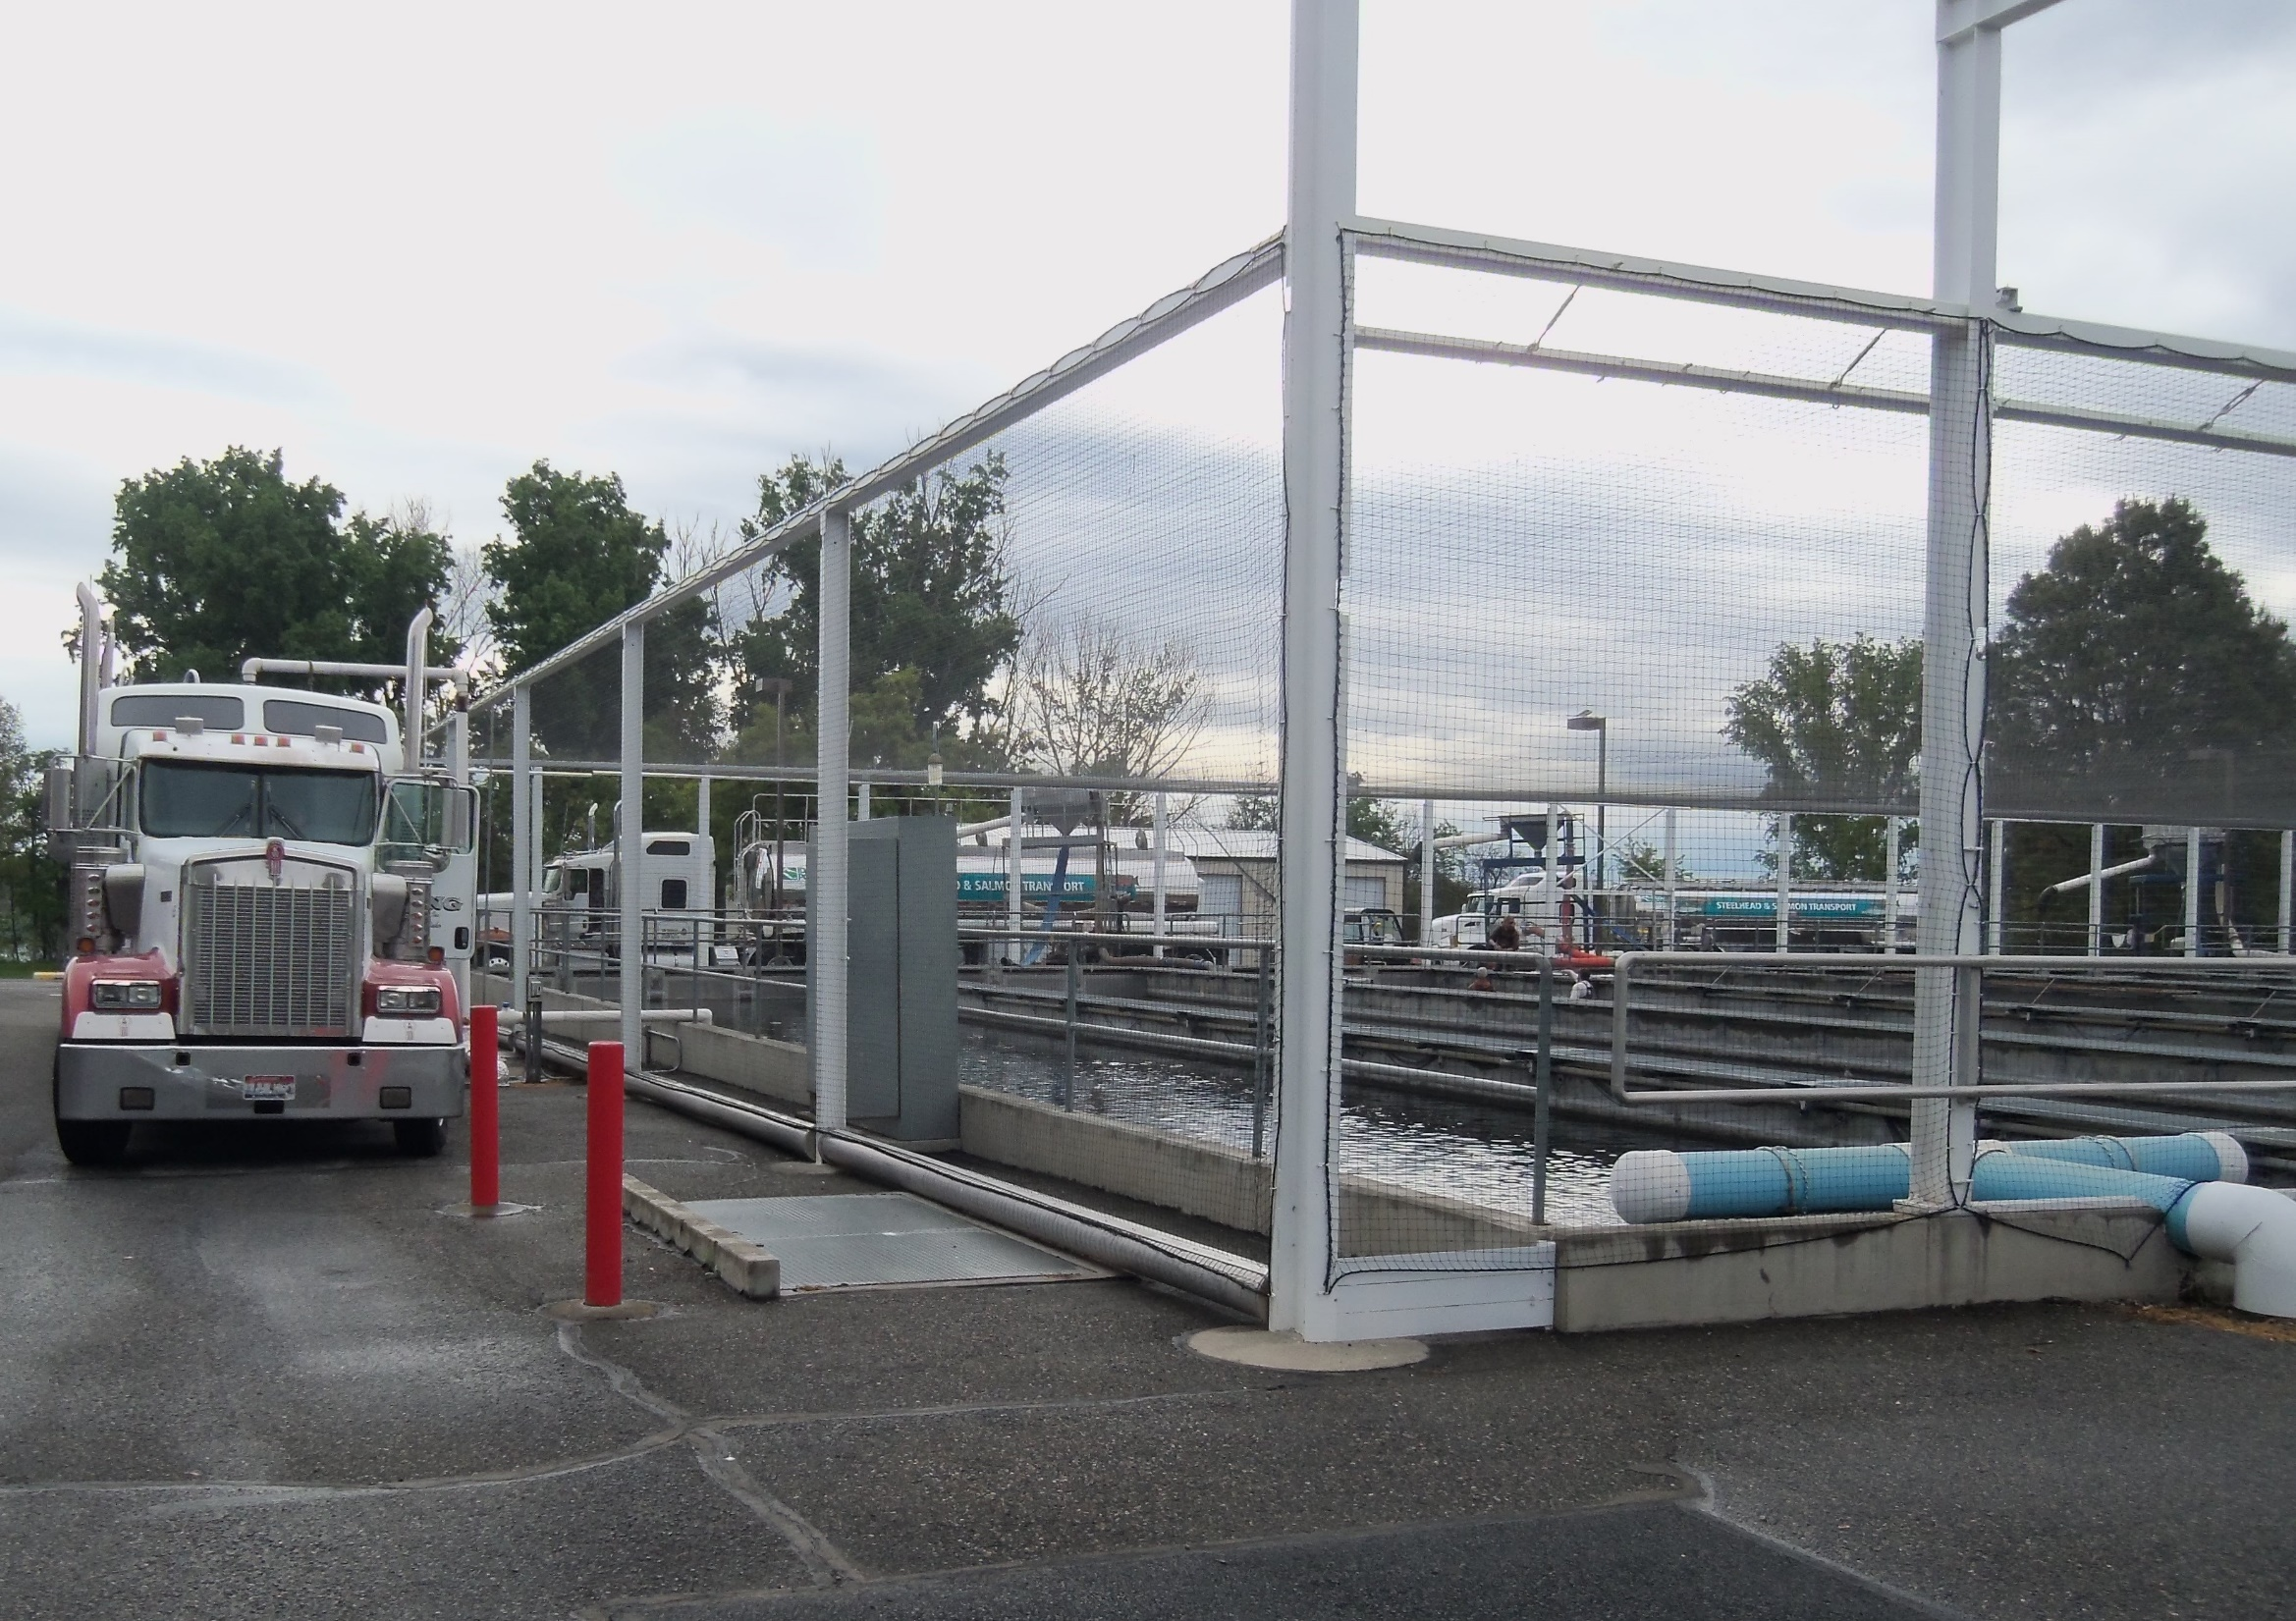

Slide 23
Efficiency
Low Head Oxygen Supplementation (LHOS)
Cost estimate for this project is $10,000 per LHO or $320,000 and, $200,000 for an additional oxygen tank purchase or piping from existing tank, and $50,000 annually.

Slide 24
Efficiency
Partial Reuse
Effluent water from the raceways could be collected by installing a pump in an existing vault prior to being discharged into the Columbia River. The water could be pumped back to the aeration tower where it would mix with the fresh water coming from the wells before being gravity fed to the facility.

Slide 25
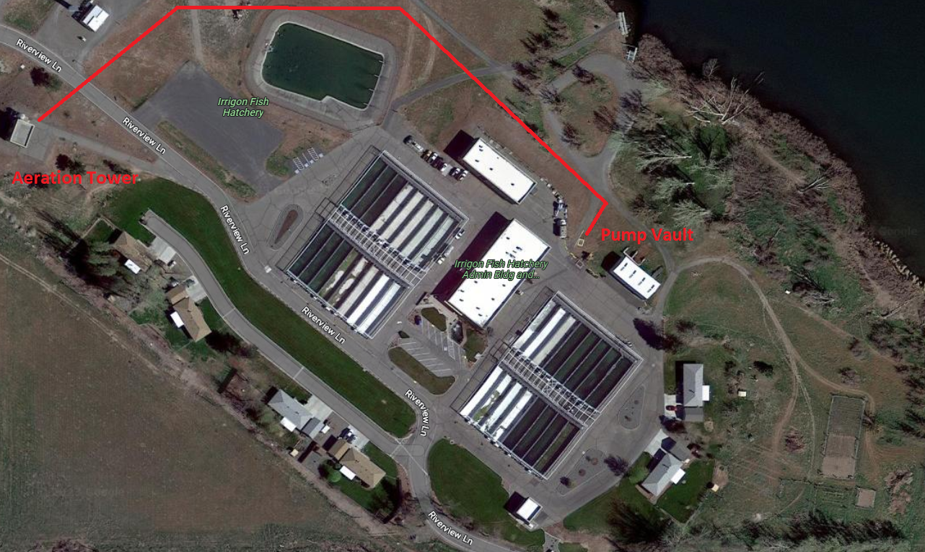
Reuse System

Slide 26
Production Modification
A production change is in negotiation to convert the remaining yearling Fall Chinook at Lyons Ferry Fish Hatchery to sub-yearlings. As part of this conversion, Irrigon would rear an additional 900,000 sub-yearling fall Chinook and has already reduced the rainbow trout program from 121,600 legals (2.7 fpp) and 21,200 trophies (0.66 fpp) to 96,650 legals and 15,810 trophies to make space. This change is proposed for Brood Year 2024.

Slide 27
Chinook Production Gained For Every Rb or StS Pond Removed
Type | # Fish | Size | Lbs. | D.I. | Lbs./ft3
+0 | 200,000 | 50 | 4,000 | 0.13 | 0.53
+1 | 80,000 | 14 | 5,714 | 0.12 | 0.76

Slide 28
Production Modification
Moving 400k StS Gains 10 Raceways
Type | # Fish | Size | Lbs.
+0 | 2,000,000 | 50 | 40,000
+1 | 800,000 | 14 | 57,143
Cost Estimate
Chiller Unit | +0 ($0.10/smolt) | +1 ($0.20/smolt)
$750,000 | $200,000 | $160,000

Slide 29
Production Modification
Moving Rb Program Gains 6 Raceways
Type | # Fish | Size | Lbs.
+0 | 1,200,000 | 50 | 24,000
+1 | 480,000 | 14 | 34,286
Cost Estimate
Chiller Unit | +0 ($0.10/smolt) | +1 ($0.20/smolt)
$750,000 | $120,000 | $96,000

Slide 30
