Slide 1
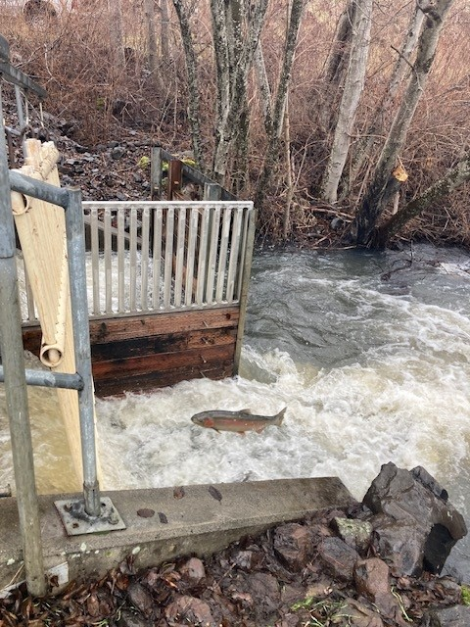
Lyons Ferry Hatchery Steelhead Production Overview
Wallowa, Touchet, and Tucannon Stocks

Slide 2
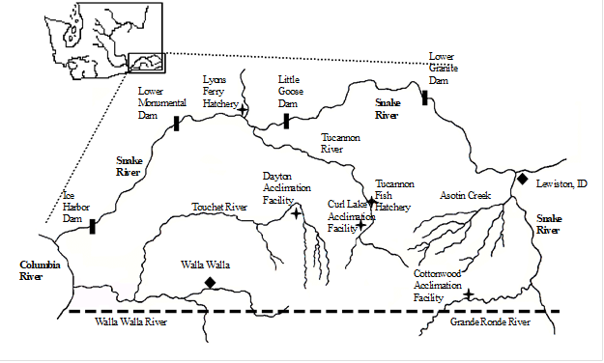
Facility Locations
Lyons Ferry Hatchery is located at RM 59 on the Snake River between Lower Monumental Dam and Little Goose Dam
Tucannon Hatchery is located at RM 36 on the Tucannon River and the Tucannon Adult Trap and Intake is located about 1 mile upstream of the hatchery
The Dayton Acclimation Pond is located in Dayton, WA at RM 53 on the Touchet River. This is the same location as the Snake River Lab and the Dayton Adult Trap
The Cottonwood Acclimation Pond is located at 28.7 on the Grande Ronde River and the adult trap and intake are located just upstream of the mouth to Cottonwood Creek.

Slide 3
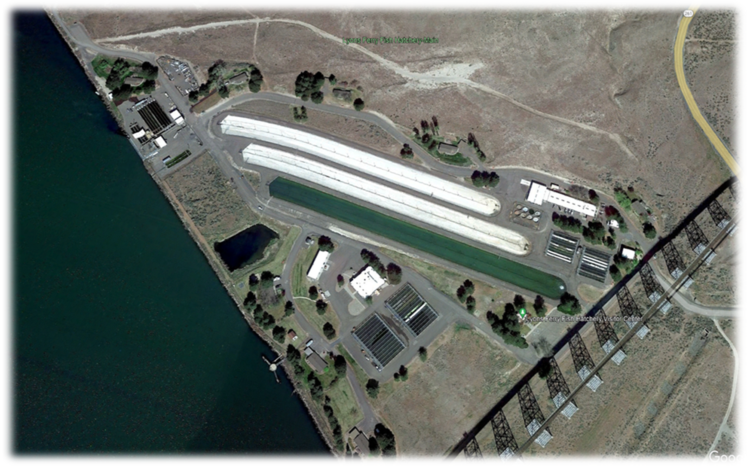
Lyons Ferry Hatchery
Adult Ponds
FCH Spawn Bldg
Rearing Lakes
STLH and
SPCH Spawn
Bldg
Office and Incubation Room
Adult Trap
Head Tank
Release Structure
And Outlet
RBT
Raceways
Steelhead
Raceways
South Side
Incubation Room
FCH and SPCH
Raceways

Slide 4
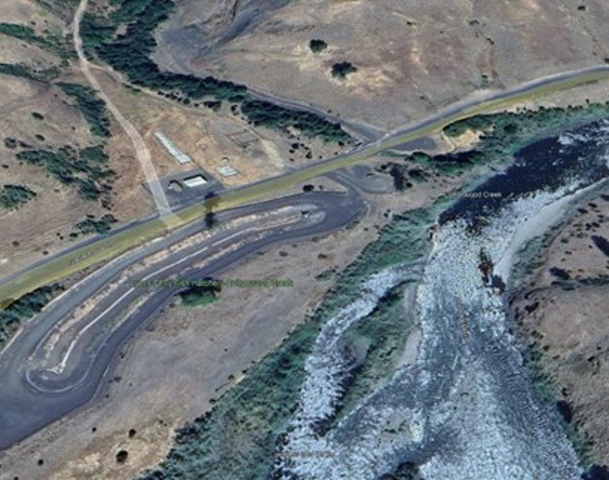
Cottonwood Acclimation Pond
Intake and Trap
Mouth
Bunkhouse and Shop
Pond Outlet
Outlet Structure
Cottonwood Acclimation Pond
~357,000 ft³

Slide 5
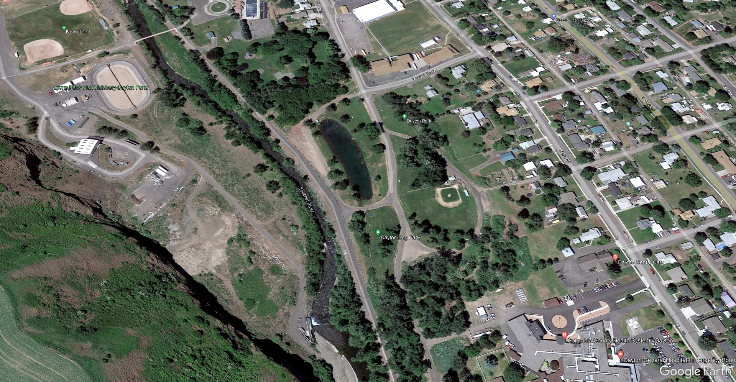
Dayton Acclimation Pond
Pond Outlet
SRL
Intake and Trap
Mouth
Bunkhouse and Shop
Dayton Acclimation
Pond ~200,000 ft³
Bunkhouse
And Shop
Pond Outlet
Outlet Structure
Cottonwood Acclimation Pond
Intake
And Trap

Slide 6
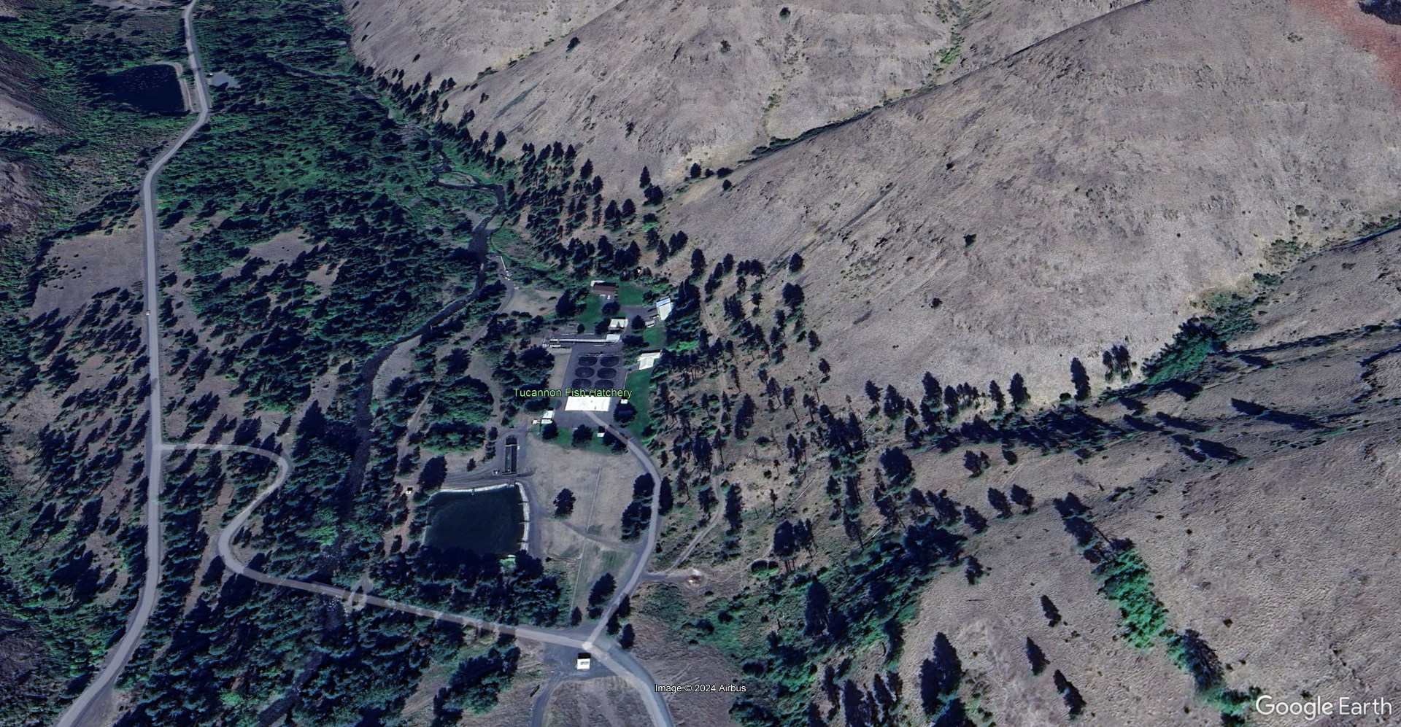
Tucannon Fish Hatchery
Pond Outlet
SRL
Intake and Trap
Mouth
Bunkhouse and Shop
Dayton Acclimation
Pond
A-Pond
Tucannon R.
Bunkhouse
And Shop
Round Ponds
East and West
Raceways
Office and Incubation
Pond Outlet
Rearing Pond
Outlet Structure
Spring Collection
Cottonwood Acclimation Pond
Intake
And Trap

Slide 7
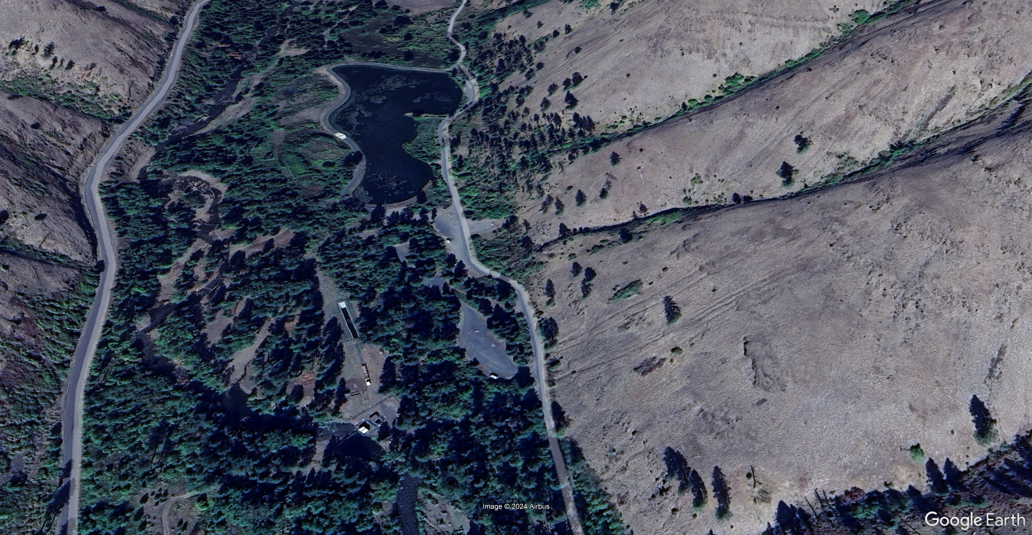
Tucannon Fish Hatchery
Pond Outlet
SRL
Intake and Trap
Rainbow
Lake Intake
Mouth
Bunkhouse and Shop
Dayton Acclimation
Pond
Rainbow
Lake
Bunkhouse
And Shop
Pond Outlet
Settling Pond
Outlet Structure
Hatchery
Intake
Cottonwood Acclimation Pond
Adult Trap
Intake
And Trap
Barrier Dam

Slide 8
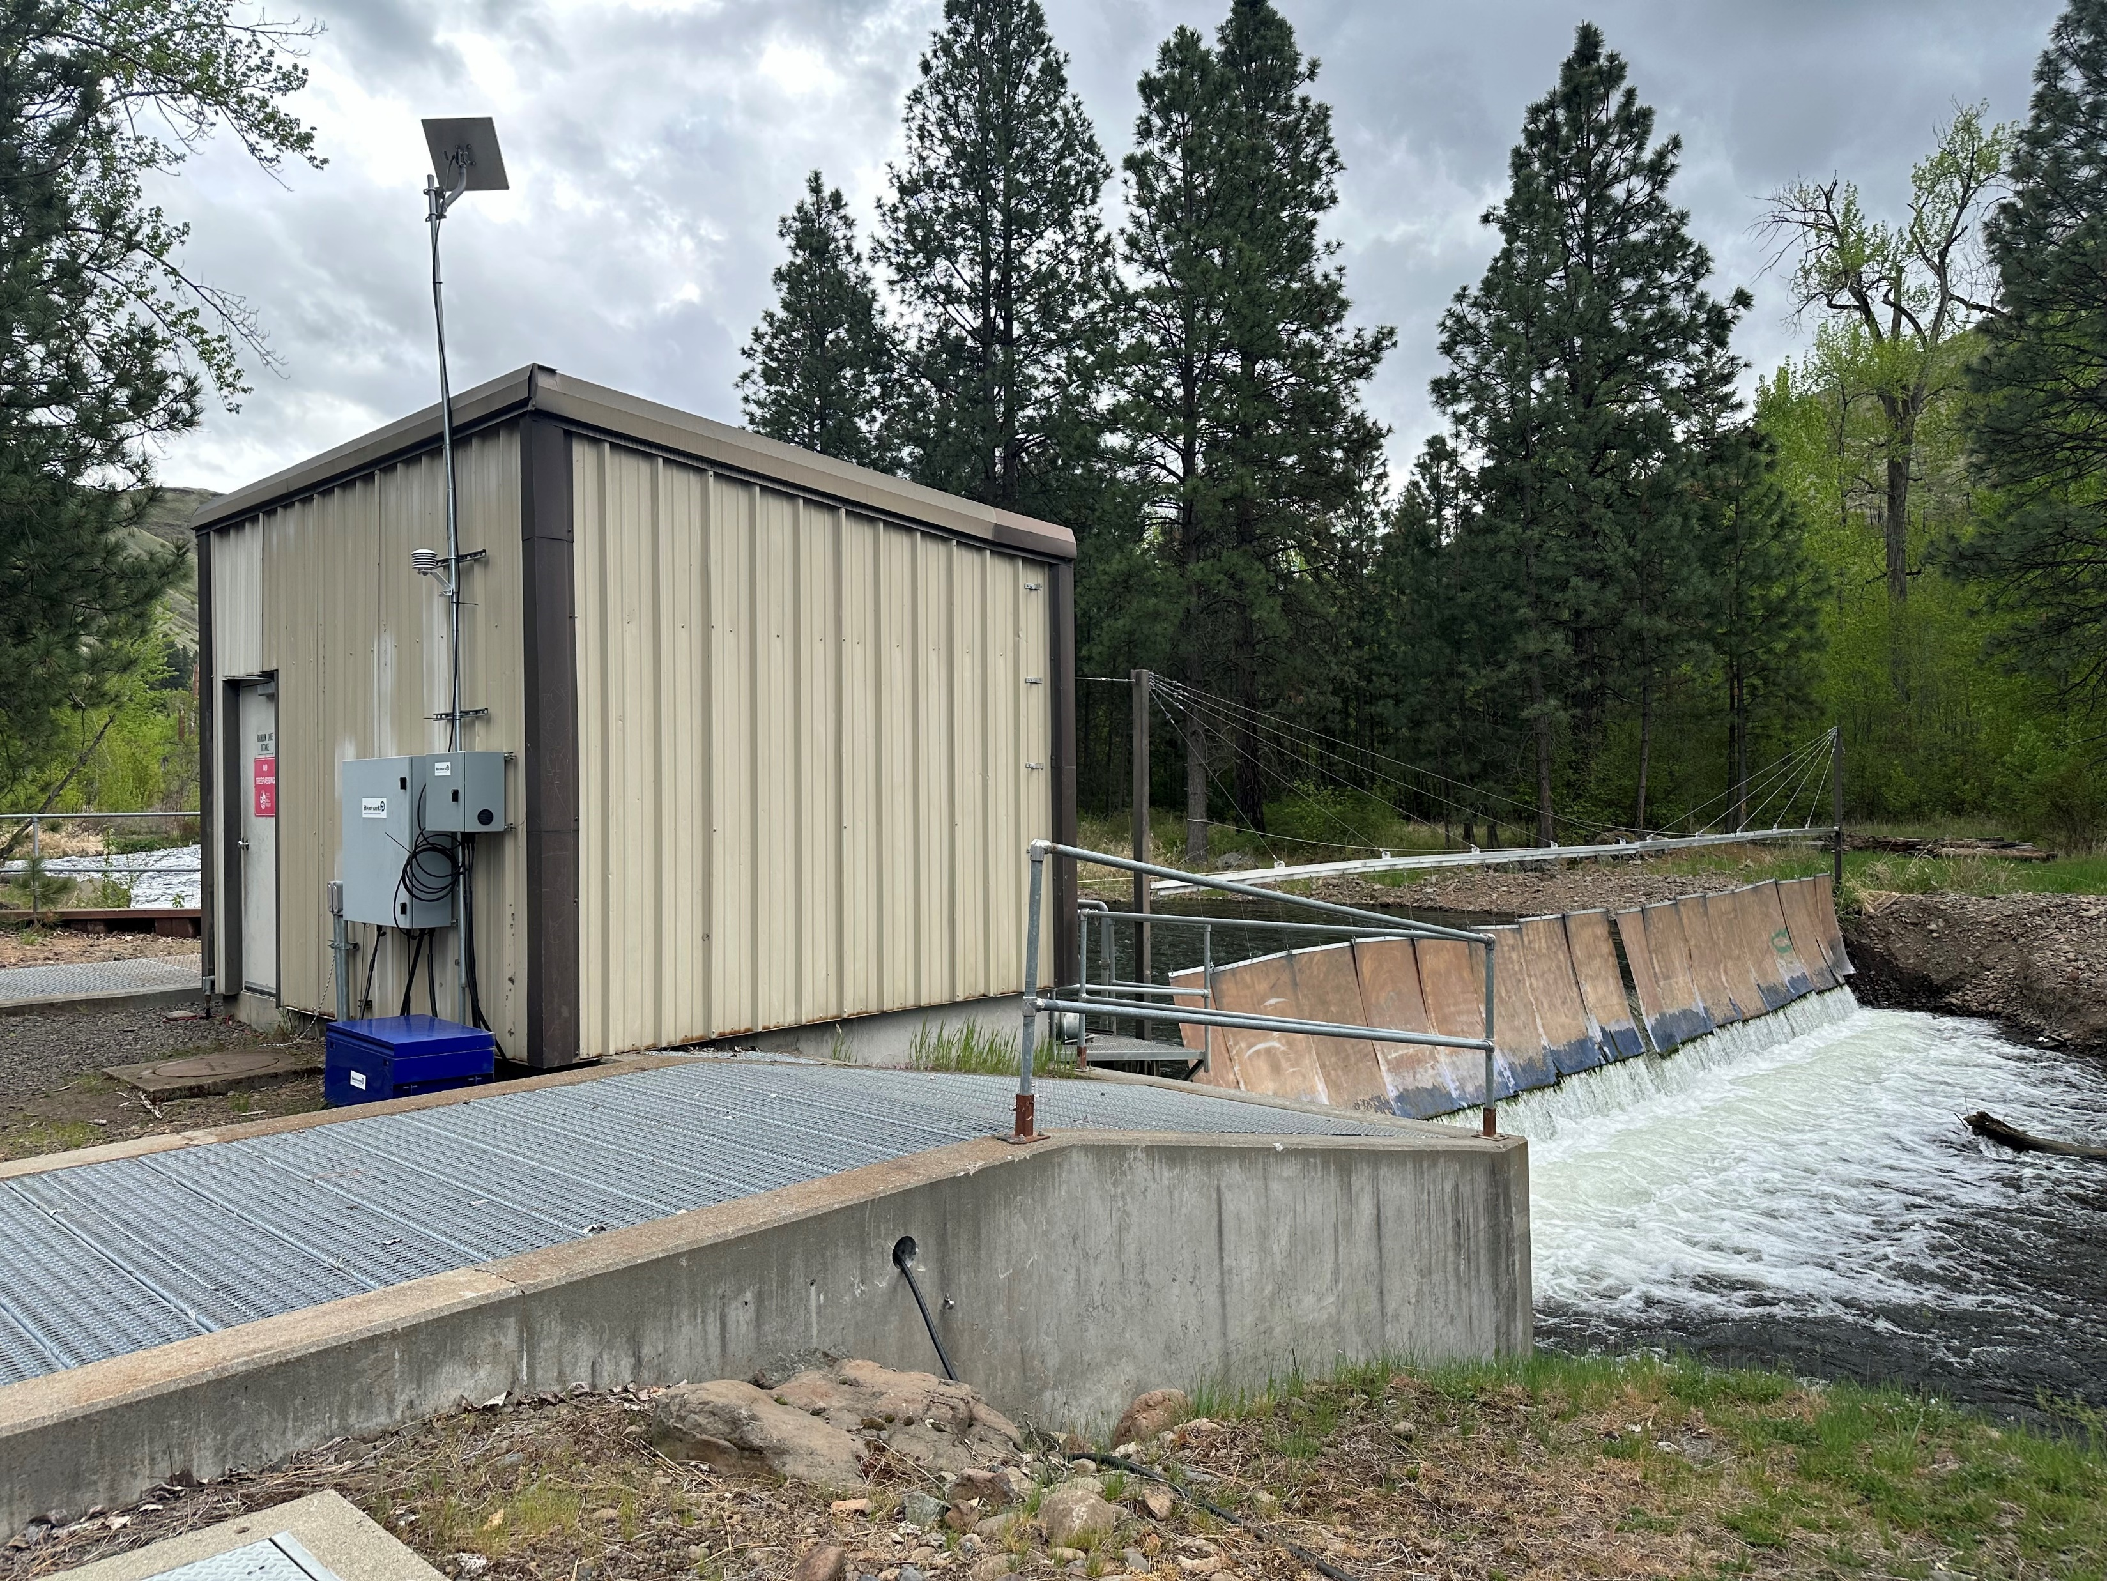
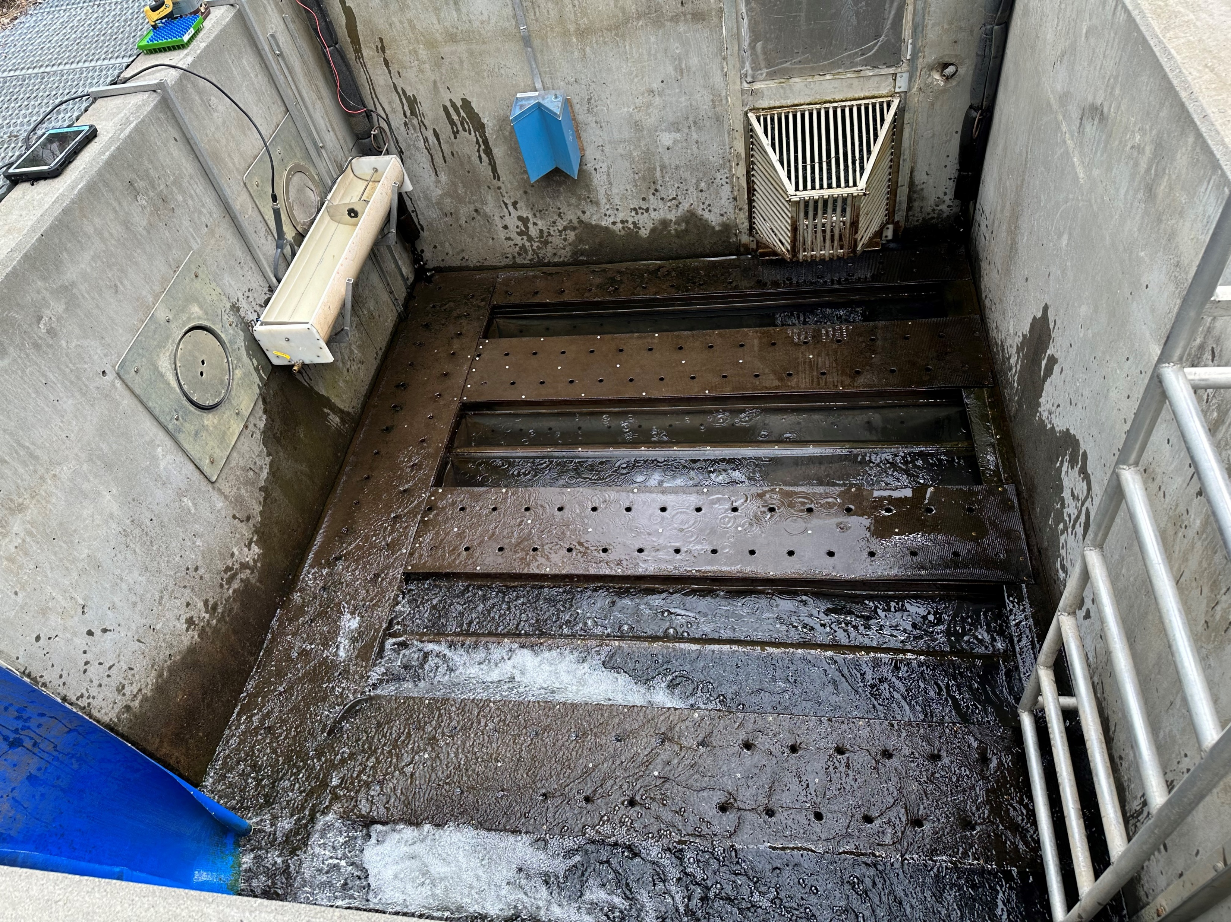
Tucannon Fish Hatchery
Pond Outlet
SRL
Intake and Trap
Mouth
Bunkhouse and Shop
Dayton Acclimation
Pond
Bunkhouse
And Shop
Pond Outlet
Outlet Structure
Cottonwood Acclimation Pond
Intake
And Trap
Barrier Dam

Slide 9
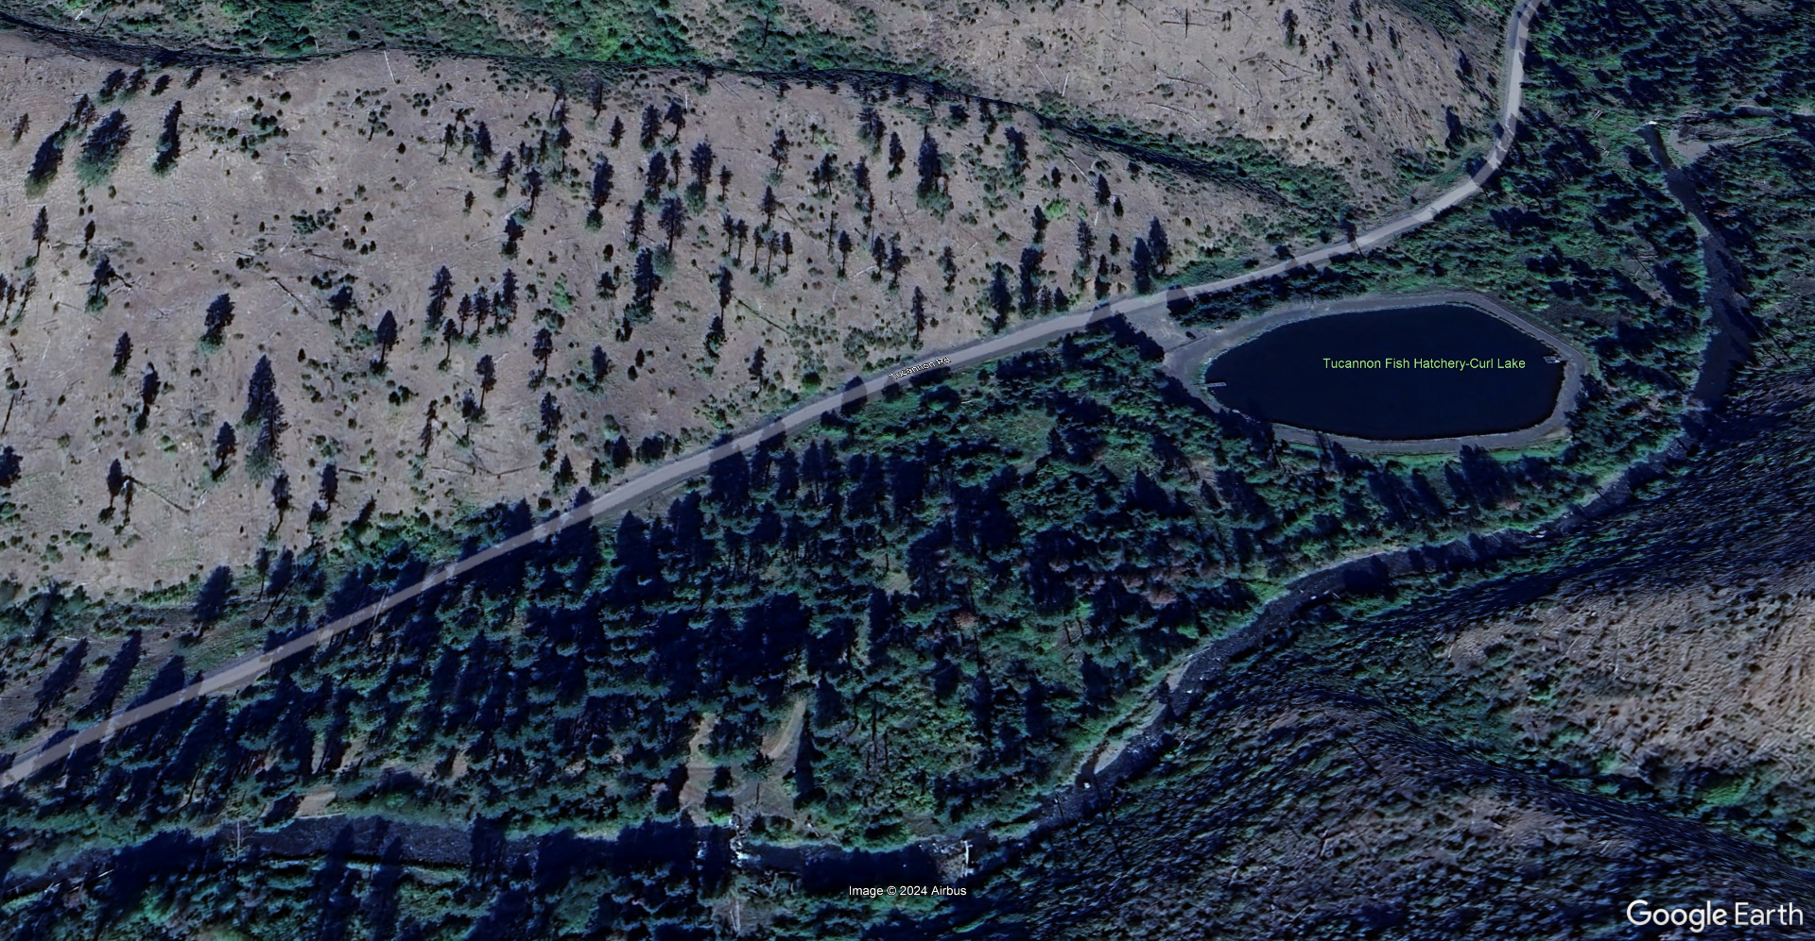
Curl Lake Acclimation Pond
Pond Outlet
SRL
Curl Lake
Acclimation
Pond,
~784,000 ft³
Intake and Trap
Mouth
Bunkhouse and Shop
Dayton Acclimation
Pond
Bunkhouse
And Shop
Pond Outlet
Outlet Structure
Curl Lake
Intake
Cottonwood Acclimation Pond
Intake
And Trap
Barrier Dam

Slide 10
Facility Water Supply
Lyons Ferry Hatchery – 119 cfs, 100% well water, 52.5°F (high iron and manganese)
Tucannon Hatchery – 16 cfs river water, 2 cfs well water (well #2 54 – 57°F, well #3 61°F), 5.3 cfs spring water (51 – 52°F)
Cottonwood Acclimation Pond – 6 cfs from Cottonwood Ck.
Dayton Acclimation Pond – 6 cfs from Touchet River
Curl Lake Acclimation Pond – 6 cfs from the Tucannon River

Slide 11
Rearing Parameters
Other than early rearing in the troughs, we do not exceed 0.25 DI on all steelhead and rainbow trout.
Raceway FI ranges from 0.15 – 0.7, 0.625 – 1.25 turnovers/hr
Lake FI will exceed 1.6
Troughs and tanks are cleaned daily
Early rearing in raceways: broomed 3 days/wk tapering to once/week near the end of the rearing cycle
Lakes are not cleaned due to size and depth

Slide 12
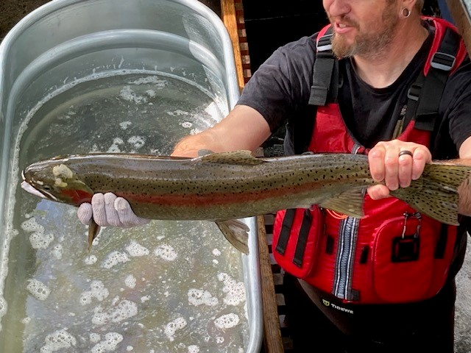
Lyons Ferry Hatchery Steelhead Programs
The Wallowa Program is a mitigation program with a total release goal of 385K: 225K release in the Grande Ronde R., 100K release on the Touchet R., and 60K release at Lyons Ferry into the Snake R.
The Tucannon Program consists of both mitigation and conservation: 50K conservation and 100K mitigation
The Touchet Program is a 100% conservation program of 50K

Slide 13
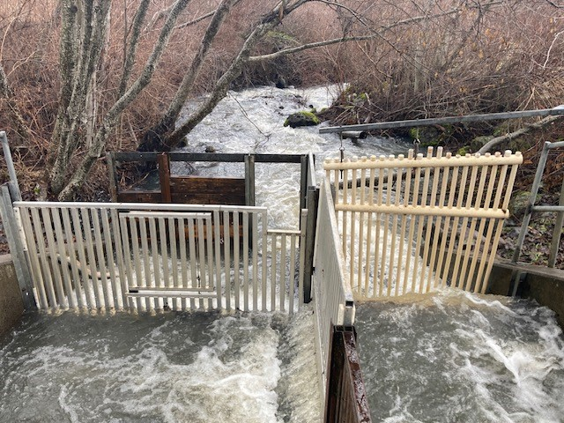
Wallowa Program
All brood stock collected at Cottonwood Ck. trap
90 – 100 females and males needed for egg take goal of ~450K, depending on egg loss and fecundity
Eggs and milt are transported back to Lyons Ferry for 1:1 fertilization
Eggs are then water hardened for 1 hour in vertical heath stacks
Eggs are treated with formalin daily until 1 week prior to hatching
After 14 days eggs are shocked, picked, and enumerated
Eggs are combined at 10K per tray

Slide 14
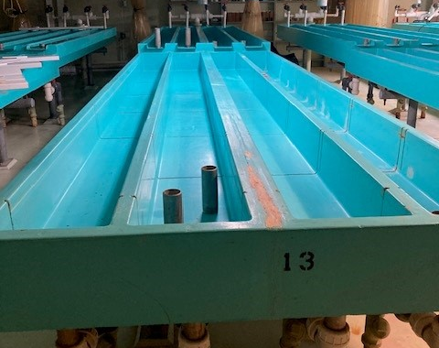
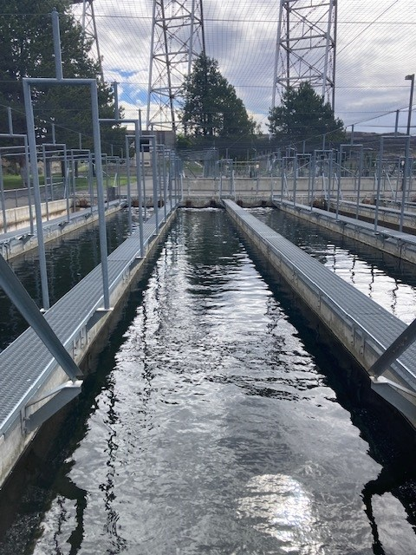
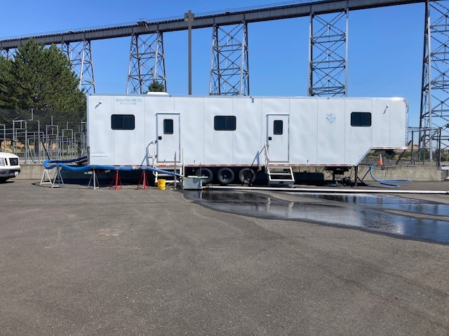
Wallowa Program
Once buttoned up the fish are moved to 1’x 15’ x 0.5’ troughs on the north side of the hatchery at 10K per trough to start on feed
Fry will remain in troughs until ~600-700 fpp and then moved outside into 10’ x 88.5’ x 3.5’ raceways, ~90K per raceway
In early to mid August the fish are marked and tagged, 40K AD+CWT and 365K AD only (405K total) into Lake #3 for a 385K release

Slide 15
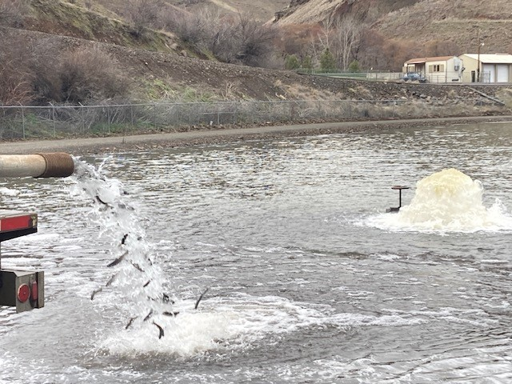
Wallowa Program
Intake and Trap
Bunkhouse and Shop
Mouth
At the end of January Lake #3 is drawn down and 225K smolts are transferred to Cottonwood AP at 6.5 – 7.0 fpp
The last week of March the lake is drawn down again to transfer 100K to the Dayton AP at 4.5 fpp
The remaining 60K smolts are a direct stream release from Lyon Ferry Hatchery at 4.5 fpp
Pond Outlet
Cottonwood Acclimation Pond

Slide 16
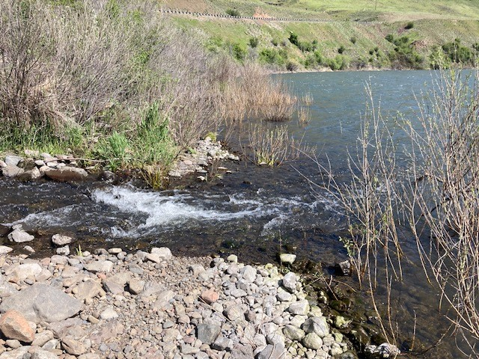
Wallowa Program
The smolts at Cottonwood are acclimated for 3 months and released at 4.5 fpp
The smolts at Dayton Acclimation Pond are acclimated for 2 weeks and the released
The 60K on-station release happens 2-3 days after PIT tagging and the transfer Dayton Acclimation group

Slide 17
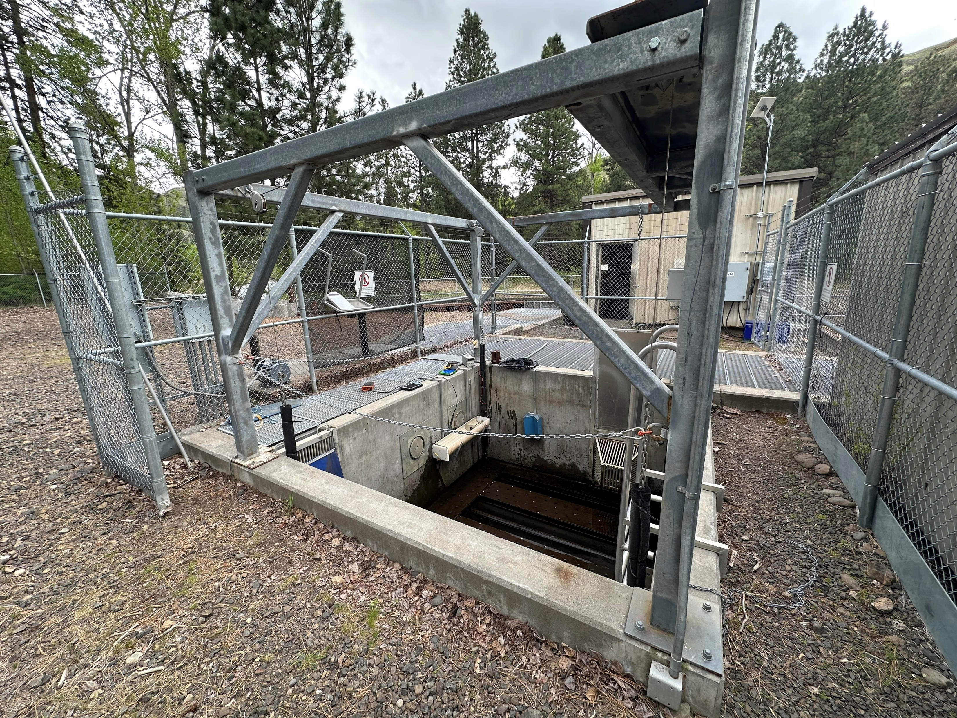
Tucannon Program
All broodstock is collected at the the Tucannon Adult Trap
25 pairs needed for the Mitigation Program
13-15 pairs needed for Conservation Program
All broodstock is PIT tagged at collection then transported to Lyons Ferry Hatchery

Slide 18
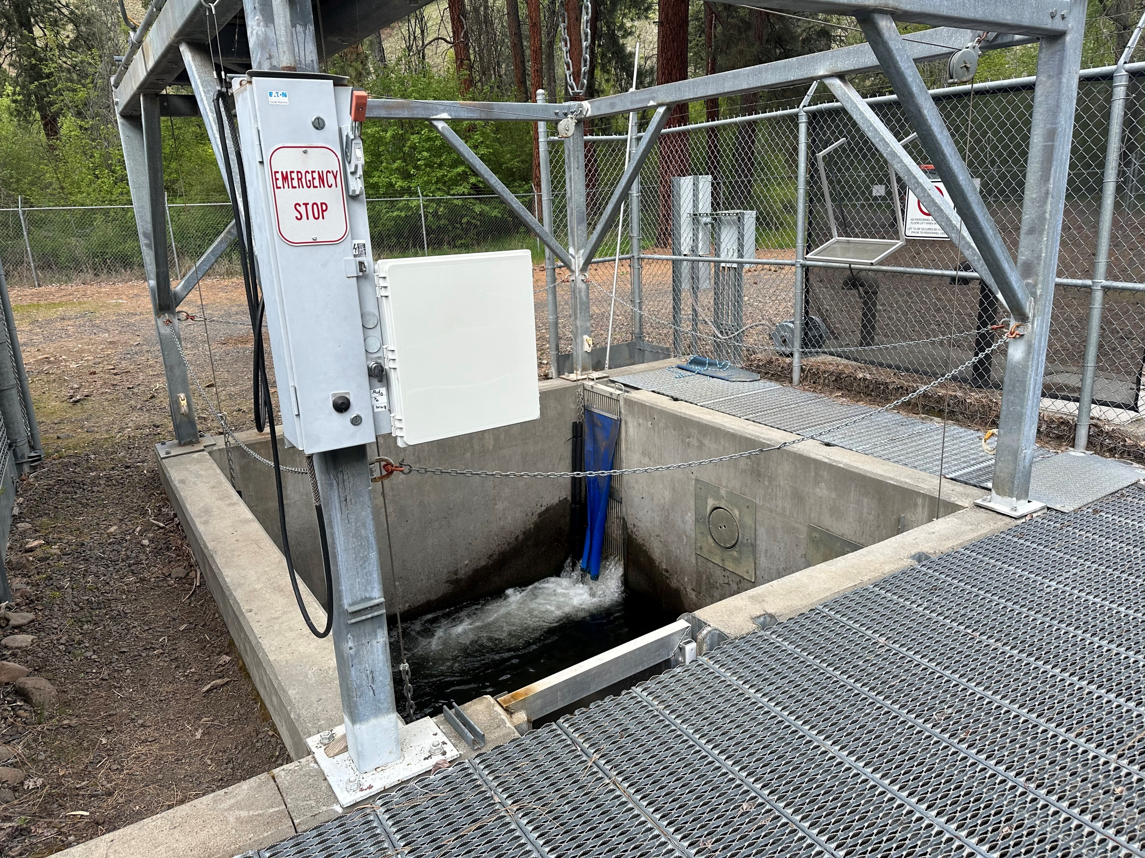
Tucannon Program
Spawning generally occurs the 2nd week of March – mid to late April
Conservation Program – males and females used are WxW and/or WxE
Mitigation Program – HxH and/or HxE
Fertilization – 2x2 spawning matrix used
Eggs are rinsed and water hardened in vertical heath stacks for one hour, 1 female/tray
Eggs are treated with formalin daily until 1 week prior to hatching
After 14 days eggs are shocked, picked, enumerated, and returned to the heath stack until buttoned up
Once buttoned up and ready for feed, fry are transferred to the north side incubation room, placed in troughs and begin feeding, 8K - 12K/trough

Slide 19
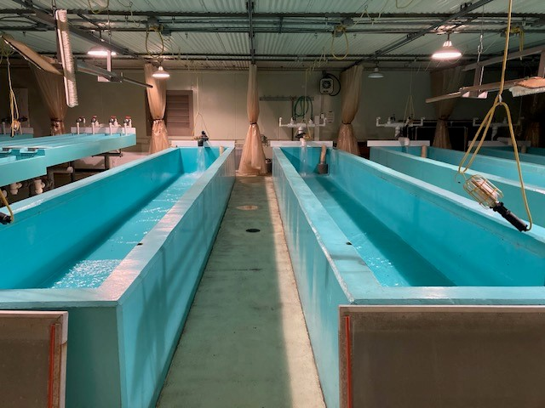
Tucannon Program
Once fry are 600-700 fpp they are transferred to 3.75’ x 27.5’ x 2’ intermediate tanks
They are then transferred to raceways outside when they reach 0.15 – 0.20 DI
Marking and tagging generally occurs the first week of September
Conservation Program – 100% (50K) CWT Only
Mitigation Program – 75K Ad Clipped + 25K AD+CWT

Slide 20
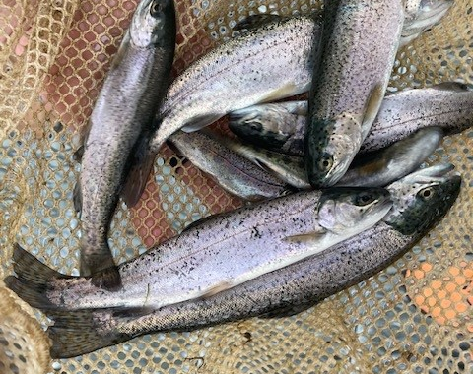
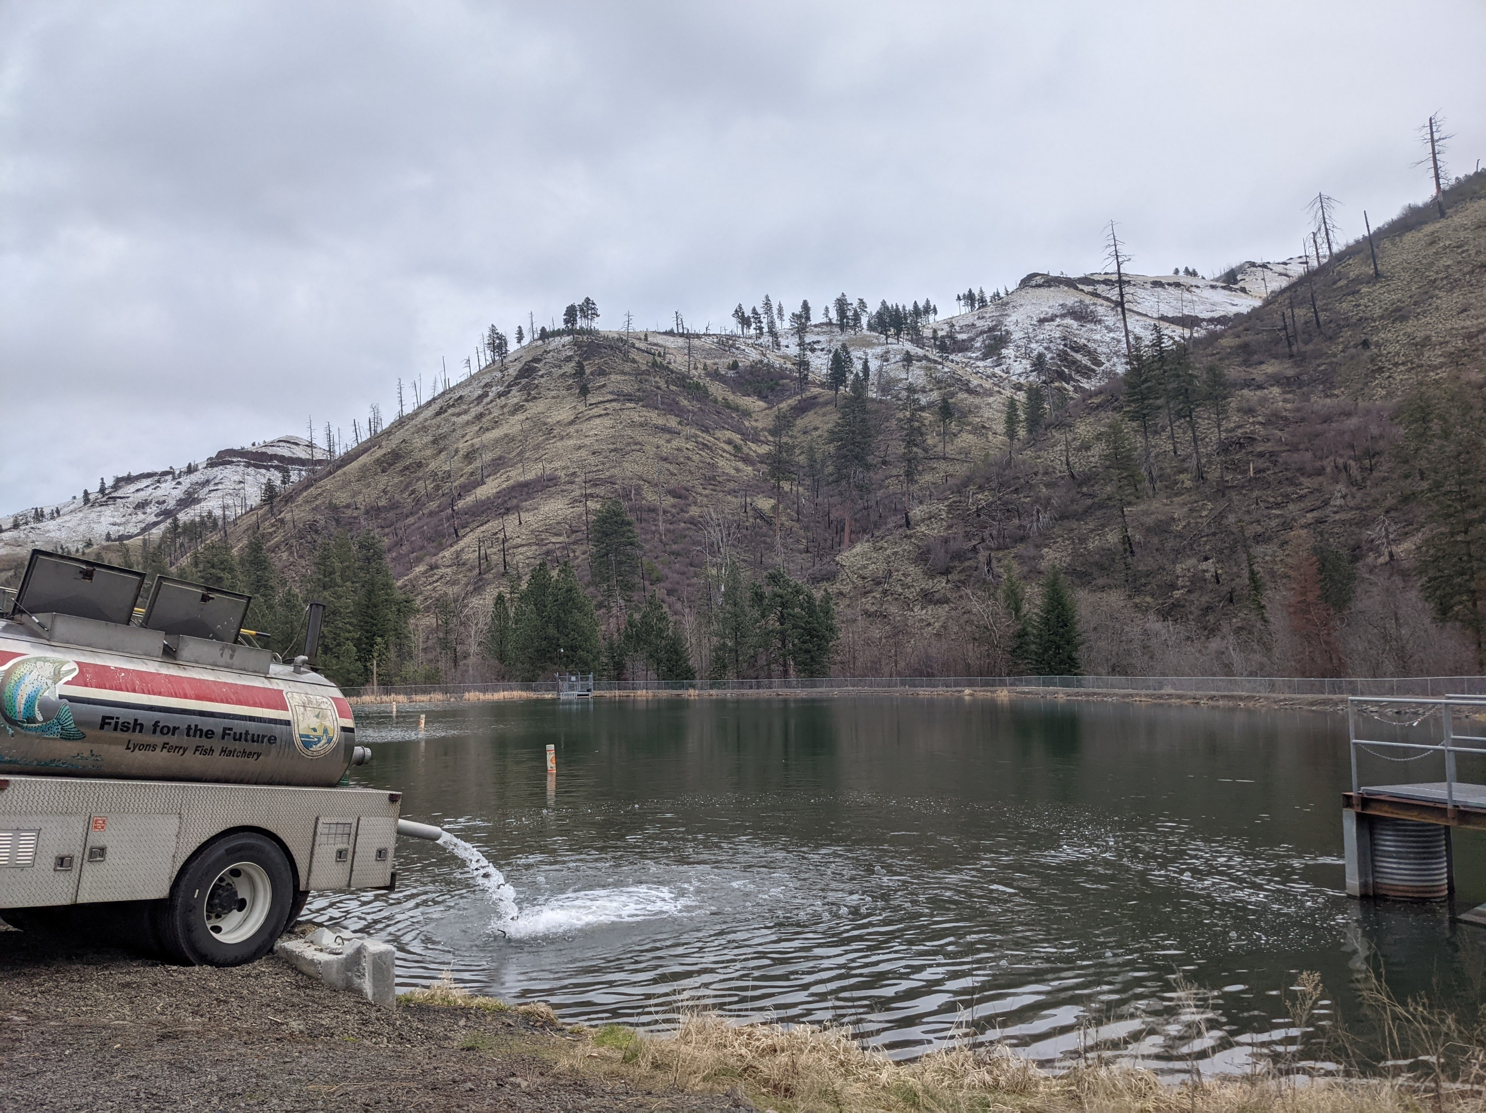
Tucannon Program
The first week of April the conservation group is transferred to Curl Lake
The week of April 15th the mitigation group is transferred and released directly in the river at the Tucannon Hatchery
Target release size 4.5 – 6.0 fpp

Slide 21
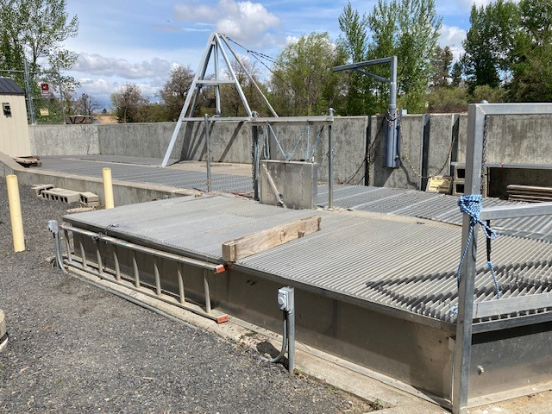
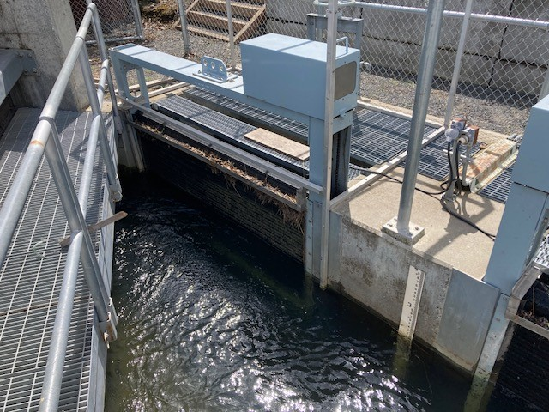
Touchet Program
All brood stock is collected at the Dayton Adult Trap and transferred to Lyons Ferry Hatchery
100% Wild
13-15 pairs needed for program for a 50K release goal
All brood stock is PIT tagged at collection

Slide 22
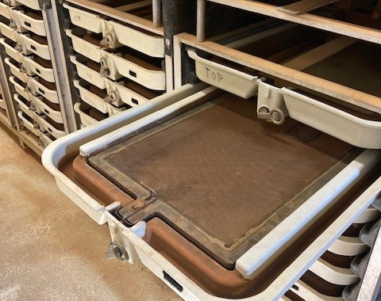
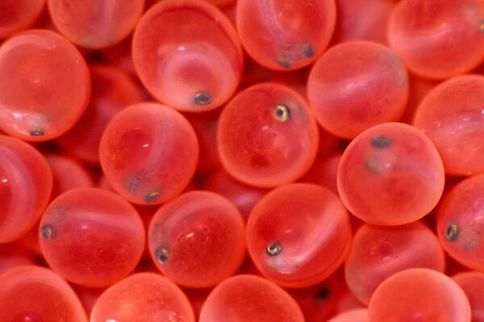
Touchet Program
Spawning generally occurs the 2nd week of March – mid to late April
Fertilization – 2x2 spawning matrix used
Eggs are rinsed and water hardened in vertical heath stacks for one hour, 1 female/tray
Eggs are treated with formalin daily until 1 week prior to hatching
After 14 days eggs are shocked, picked, enumerated, and returned to the heath stack until buttoned up
Once buttoned up and ready for feed, fry are transferred to the north side incubation room, placed in troughs and begin feeding, 8K – 12K/trough

Slide 23
Touchet Program
Once fry are 600-700 fpp they are transferred to 3.75’ x 27.5’ x 2’ intermediate tanks
They are then transferred to 10’ x 88.5’ x 3.5’ raceways outside when the DI reaches 0.15 – 0.20
Marking and tagging generally occurs the first week of September
Conservation Program – 100% (50K) CWT Only

Slide 24
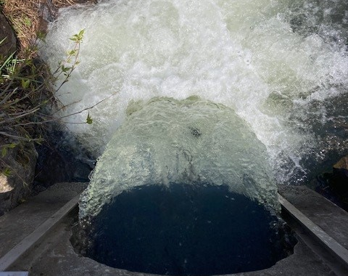
Touchet Program
The last week of March smolts are transferred to the Dayton Acclimation Pond
Acclimate for 2 weeks
Release mid April at 4.5 – 6.0 fpp

Slide 25
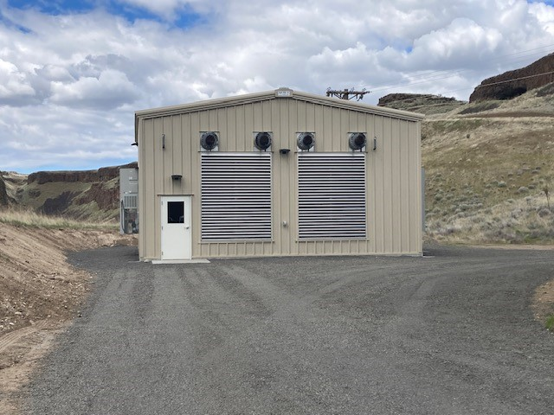
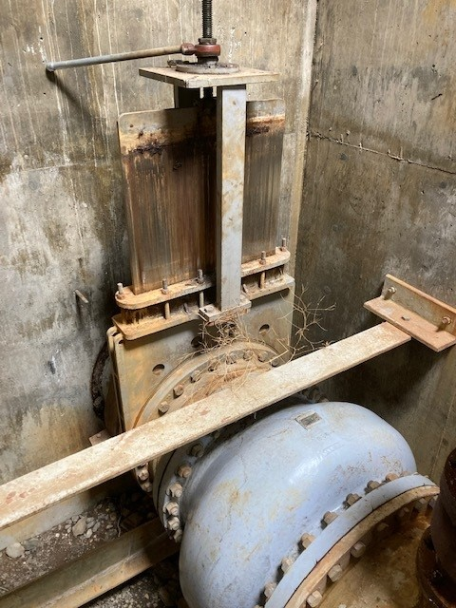
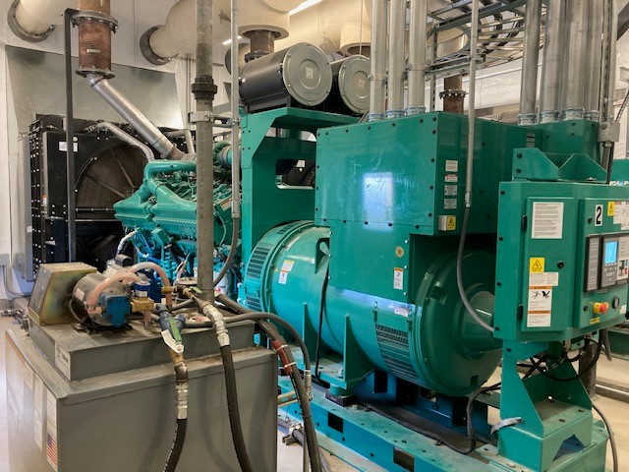
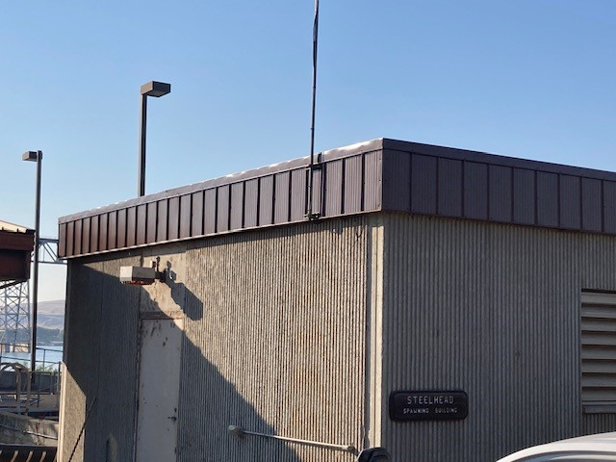
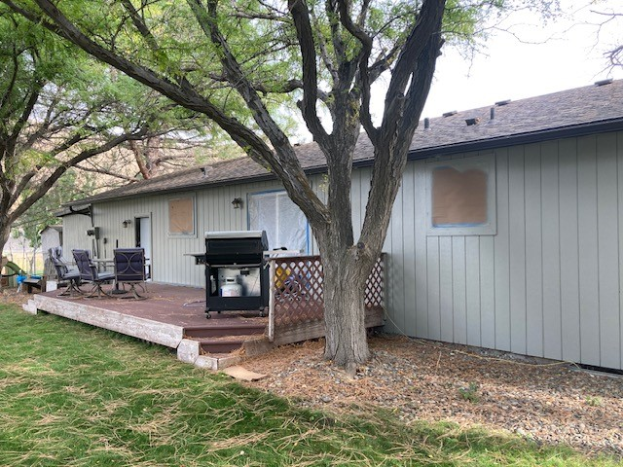
Projects Completed, In the Works, and Some Potentials
New Generator Bldg, completed spring of 2023
New well vault ventilation and gas monitoring system, completed summer of 2023
Dayton Dam fixed and Obermeyer Weir installed, completed summer of 2023
New skirting along steelhead spawn bldg., completed spring of 2023 (in-house)
New valves at Marmes Well Site, starting summer of 2024
New formalin system in the south side incubation room, summer of 2024 (in-house)
New roof on FHS-3’s office, summer of 2024 (in-house)
Paint all residences, started summer of 2023 and will be complete summer of 2024 (in-house)

Slide 26
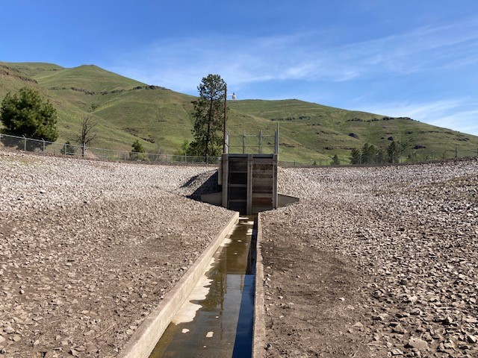
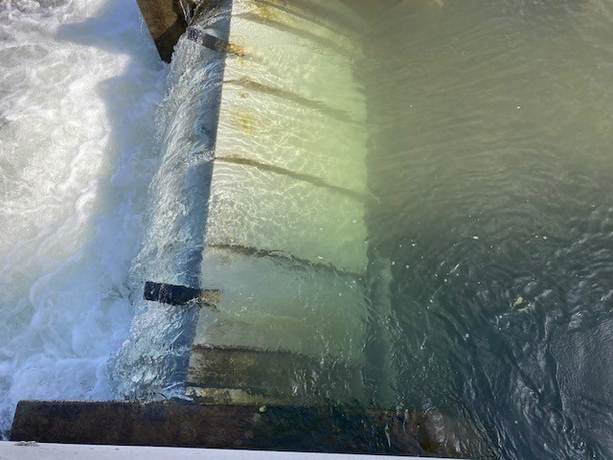
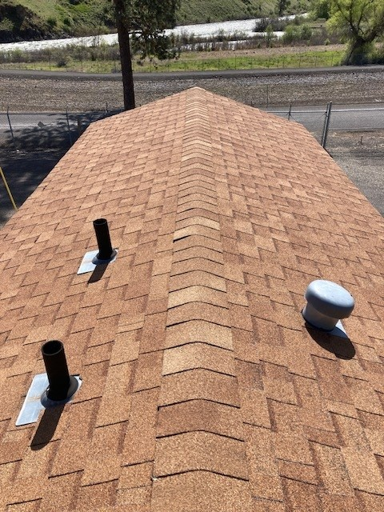
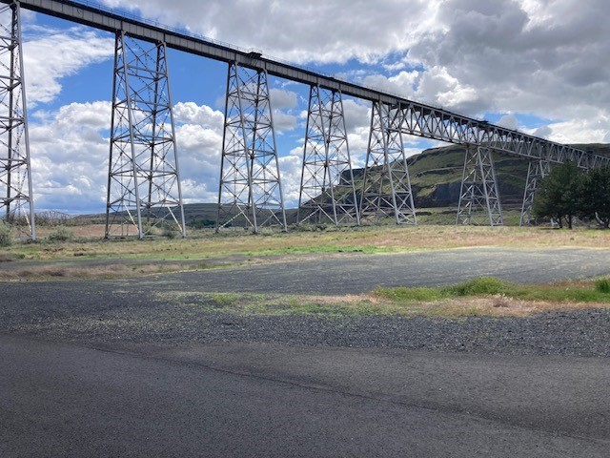
Projects Completed, In the Works, and Some Potentials
3 new small rearing lakes, 100% design completed
Shade structures over north and south side raceways and potentially over lakes, talked about
New roof for Cottonwood bunk house, in the works
Wing walls added to lower end of Cottonwood Acclimation Pond to help with fish release and dead spots in the pond, in the works
Otter fence around rearing lakes, talked about

Slide 27
