Slide 1
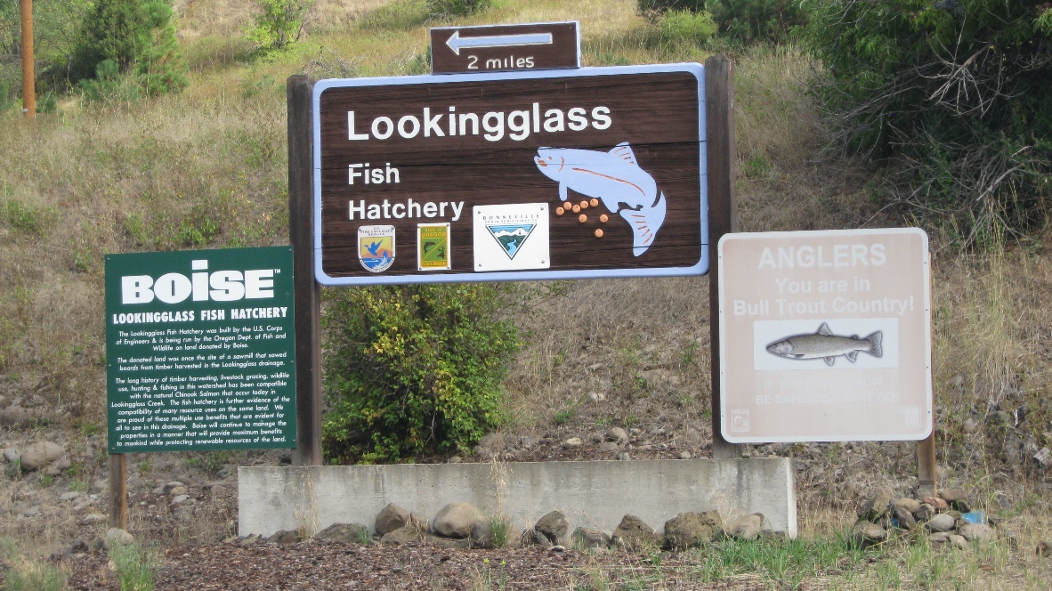
Lower Snake River Compensation Plan Infrastructure Audits
Lookingglass Hatchery

Slide 2
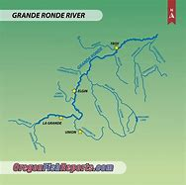
Current Mitigation Goal
5,820 summer Chinook adults – Grande Ronde River Basin
Upper Grande
Ronde River
Catherine Creek
Lookingglass Creek

Slide 3
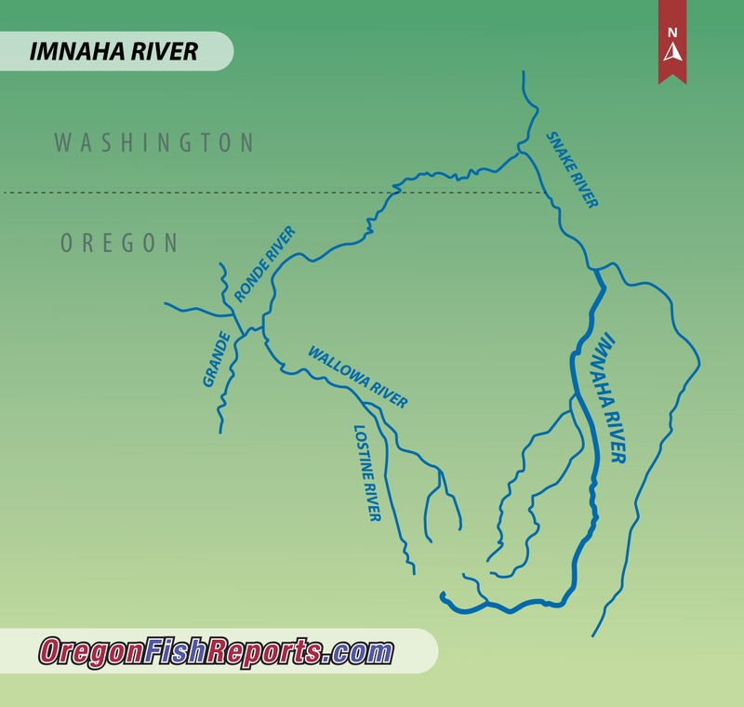
Current Mitigation Goal
Imnaha River and Lostine River

Slide 4
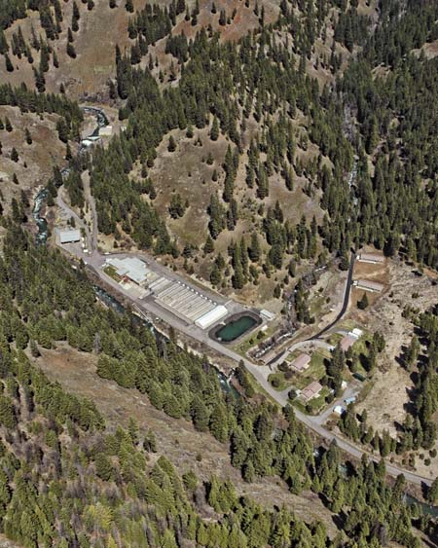
Facility Location
Located 2.2 miles from the Grande Ronde River up the Lookingglass Creek Basin
Intake Building , Traveling water Screens, TW-2 well & aeration tower
Equipment Bldg.
Main Hatchery Building, shops, Incubation and early rearing
Residences and Domestic Well
Endemic Bldg. with six circular tanks
Lookingglass Creek
18 Raceways and four Adult Holding Ponds
Settling Basin
Main Hatchery Road

Slide 5
Water Supply
42 CFS at the main intake which provides water for Fish Ladder, Trap and facility. Water flows through a 42” gravity line from Lookingglass Creek throughout the facility.
Tempering Well #2 at 4 CFS for tempering main intake water and early rearing.
Domestic Well # 1 & 3, 2.39 CFS total
Water temp from 32 to 70 F
Elevation of 2,550 feet

Slide 6
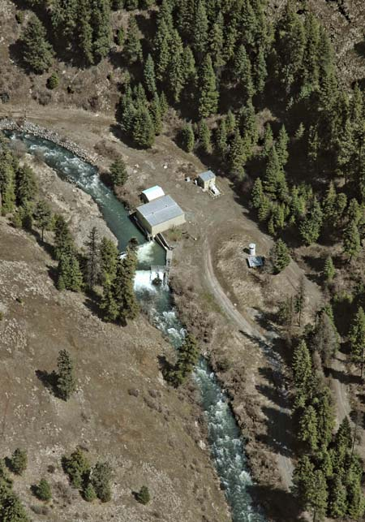
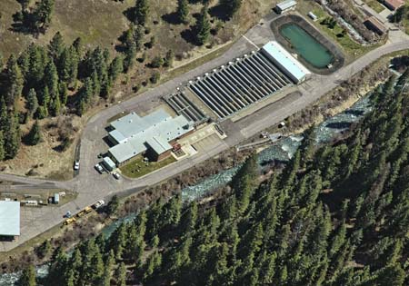
Broodstock Collection
915 Broodstock are collected annually from five stocks (Imnaha River, Lostine River, Upper Grande Ronde River, Catherine Creek and Lookingglass Creek), of Snake River Spring Chinook Salmon to meet production goals.
Upper fish ladder and trap
Endemic Bldg.
Adult Holding Ponds
Lower Fish Ladder and trap

Slide 7
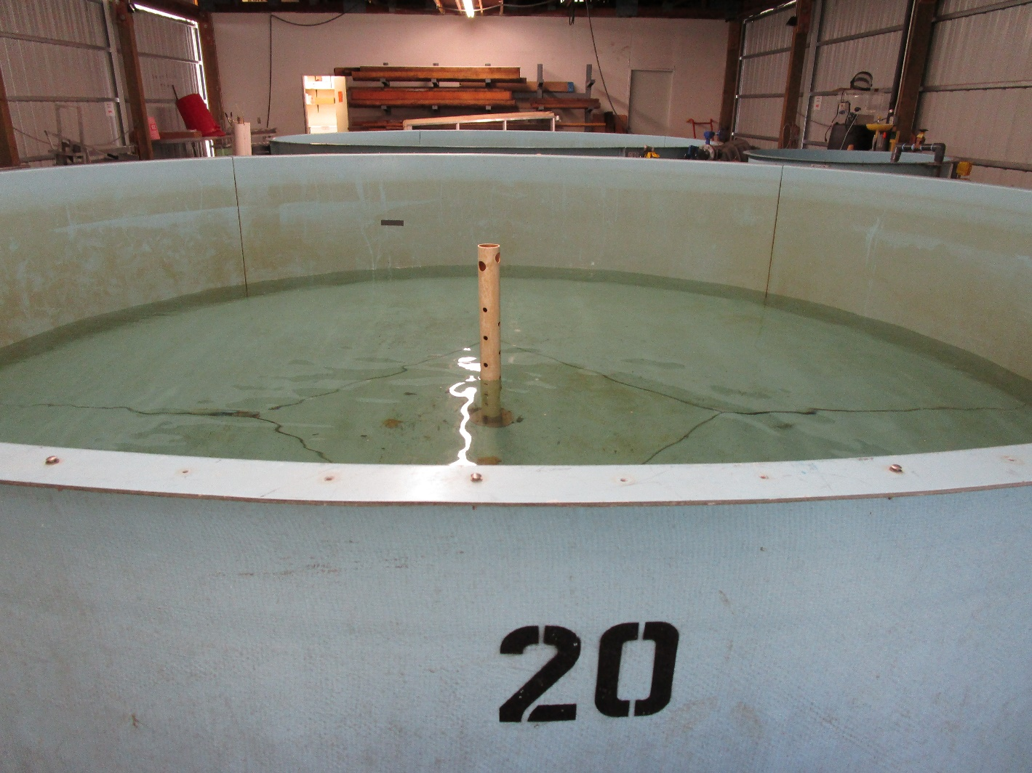
Endemic Bldg. with Circular Tanks

Slide 8
Incubation
One female’s eggs per tray until eye-up due to Elisa BKD testing (low: 0.1 - 0.199 OD units, Medium: 0.2 – 0.499 OD units, High: 0.5 and above OD units)for culling of med/high positive females.
Average fecundity is 3,775 per female (2018-2022 five-year average).
After picking, enumerating, and culling med/high females, eggs are combined to 5,000 eggs per tray, max.
63 – eight tray stacks plus 16 - eight tray stacks are put in eight double deep Canadian troughs until eye up and eggs are combined.

Slide 9
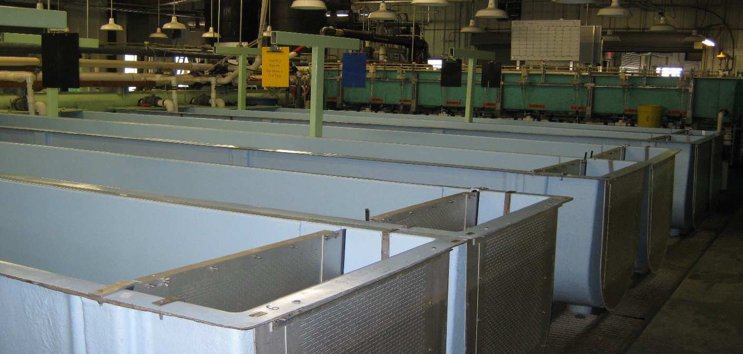
Nursery Rearing
Max DI < 0.20
Max FI < 1.5 at 50 gpm
30 Double Deep Canadian Troughs (21’ L x 2.5’ W x 3’ D)

Slide 10
Outdoor Rearing
18 Raceways (100’L x 10’W x 3.5’D)
4 Adult holding ponds (76’L x 10’W x 3’D)
3 Adult holding circulars (25’W x 4.5’D)
3 Adult holding circulars ( 6’W x 3.0’D)
DI < 0.15
FI < 1.50
Endemic Bldg.

Slide 11
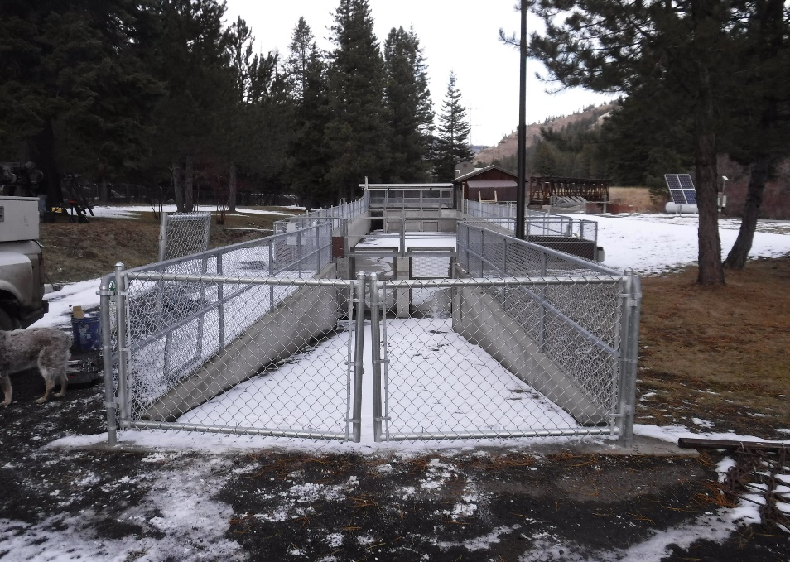
Release
Longest Haul - Smolts are transported to the acclimation site on the Imnaha River. There are two acclimations one week apart.
4-hour hauling – IM
2-hour hauling – other
stocks
0.5 lb. fish/gal
22 fish per pound

Slide 12
Haul/Release
Smolts are transported to acclimation sites on the Lostine River, Catherine Creek, and Upper Grande Ronde River. Lookingglass Creek Smolts are held at LGH and volitionally released.
2-3 Hour hauling time
0.5 lb fish/gal
22 fish per pound
Lookingglass Creek
Upper Grande Ronde River
Catherine Creek

Slide 13
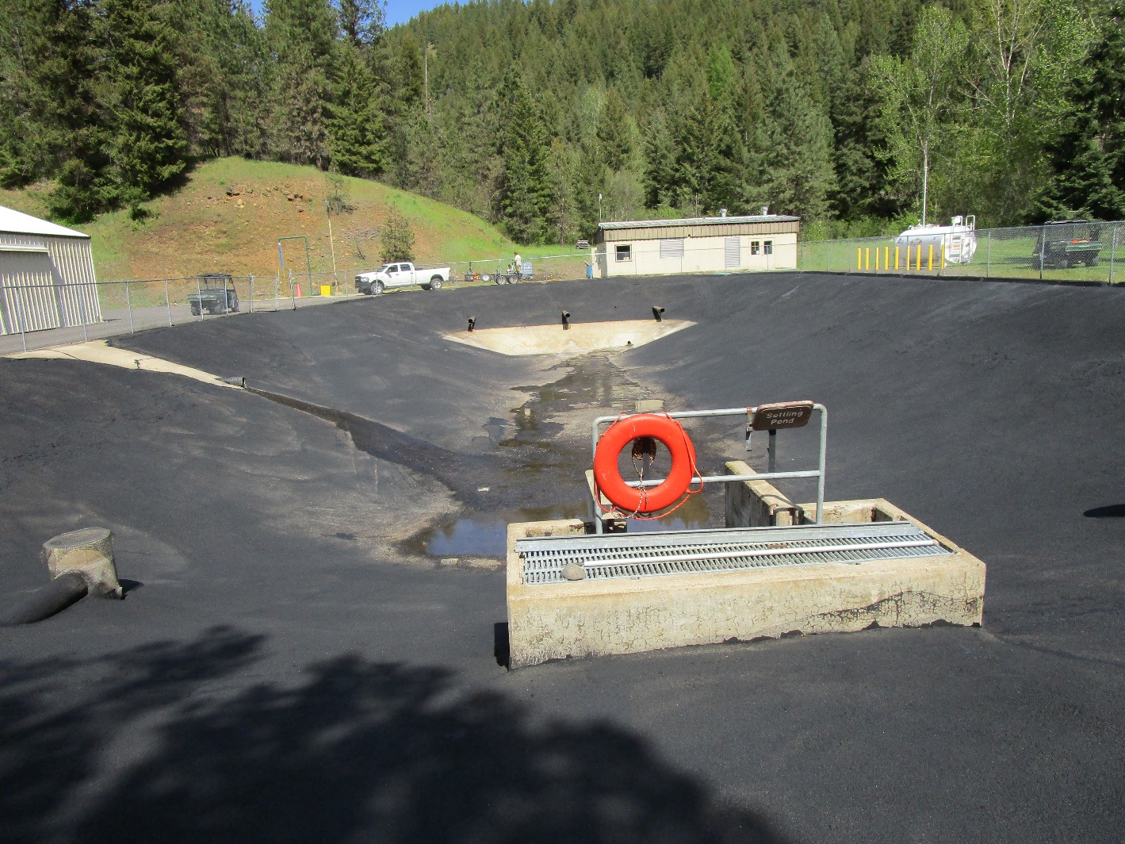
Settling Pond

Slide 14
NPDES
Facility does quarterly DEQ TSS water samples which includes total suspended solids, settleable solids, pH, total phosphorus and Ammonia-N sampling during the months of highest production: February, June, September, December.
The hatchery completes yearly domestic water drinking samples plus Nitrite/Nitrate domestic water samples in January of each year.

Slide 15
Marking
Marking occurs in August for CWT and October for PIT tagging
80 fpp target size for CWT
35 fpp target size for PIT tagging
CWT based on % decided for each stock from 45% to 100% CWT
33,000 PIT tags

Slide 16
Operational Changes
New Traveling Water Screens and Fish Ladder at Intake to facilitate fish passage
Construction starts in 2024 between May through Sept.
Researching where LGH juveniles can be reared off-station during construction
Cost = $7.5 mil

Slide 17
Current Operational Changes
New Chiller Units
New Chillers with higher capacity to produce chilled water (currently 160 GPM to 250 GPM+)
Cost = $600 k
Plans are in place to move forward with chiller replacement. 2022 one chiller control panel broke down. There were no new parts but a used one was found, and the chiller repaired. But for how long???

Slide 18
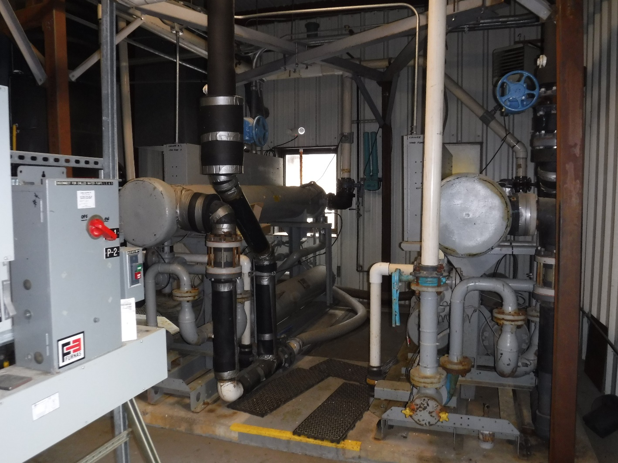
New Chiller Units

Slide 19
Future Operational Changes
Proposed incubation building adjacent to the existing incubation and early rearing building. Lack of incubation space limits increased rearing at LGH
Proposed additional well for incubation and early rearing water supply
More rearing space would increase production and additional adult returns
Cost = $Unknown at this time.

Slide 20
Operational Changes
Optimize Collection
Increase Imnaha River production from 490,000 smolts at release to 510,000 smolts at release.
Increase total smolt rearing in raceways from 65K to 75K throughout all 18 raceways or as each stock program allows.
Remove the Endemic Building and add 3 raceways.
Maintain final rearing at DI=0.15 max

Slide 21
Maximize production capacity of Lookingglass Fish Hatchery
Program | Current Smolts | Proposed Smolts
Optimize Rearing Containers | 1,390,000 | 1,490,000 (DI = 0.15)
Rear at 0.2 DI | 1,390,000 | 2,200,000
New raceways | 0 | 300,000
Expand Existing Raceways | 0 | 510,000
Total New Smolts | 1,390,000 | 2,200,000
Program | Current Smolts | Proposed Smolts
Optimize Rearing Containers | 1,390,000 | 1,490,000 (DI = 0.15)
Rear at 0.2 DI | 1,390,000 | 2,200,000
New raceways | 0 | 300,000
Expand Existing Raceways | 0 | 510,000
Total New Smolts | 1,390,000 | 2,200,000

Slide 22
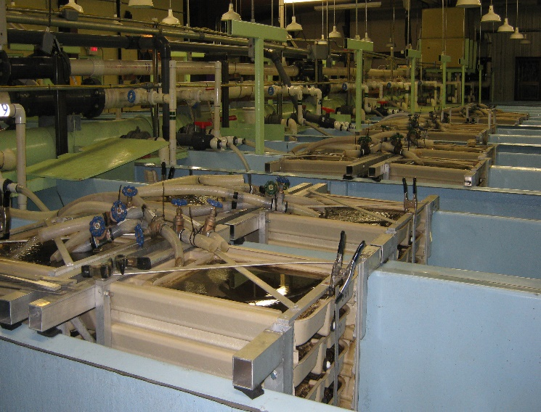

Expand Incubation Space Adding on an incubation bldg. Or? What is currently used:

Slide 23
Summary of Operational Changes
Program | Current Smolts | Proposed Smolts
New Chiller Units | 1,390,000 | Will provide chilled water for expanded program
New Traveling Water screens and Upper fish ladder for fish passage | 0 | 0
Proposed Incubation Bldg. addition | 1,390,000 | 810,000?
Total | 1,390,000 | 2,200,00

Slide 24

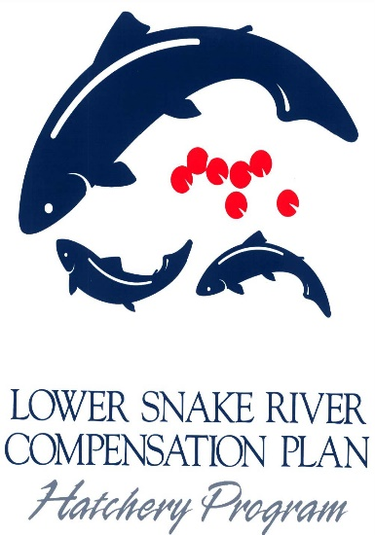


Questions
Thank You, Lower Snake River Compensation Plan
Lookingglass Hatchery’s Co-managers:
Nez Perce Tribal Fisheries
Confederated Tribes of Umatilla Indian Reservation

