Slide 1
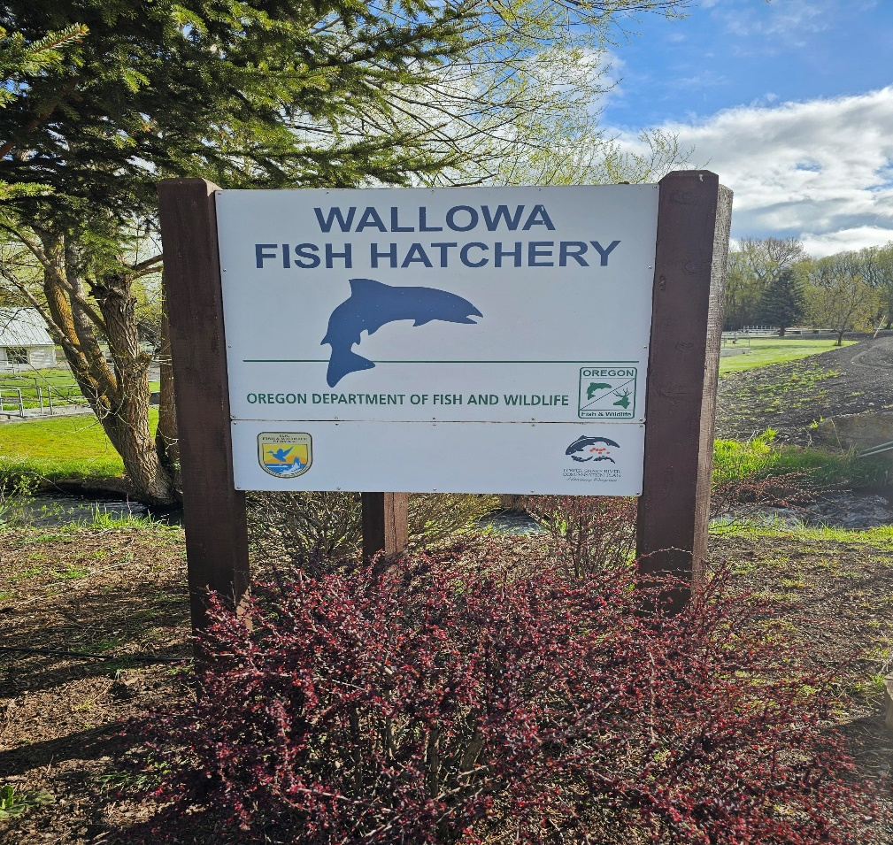
Lower Snake River Compensation Plan Infrastructure Audits
Wallowa Hatchery

Slide 2
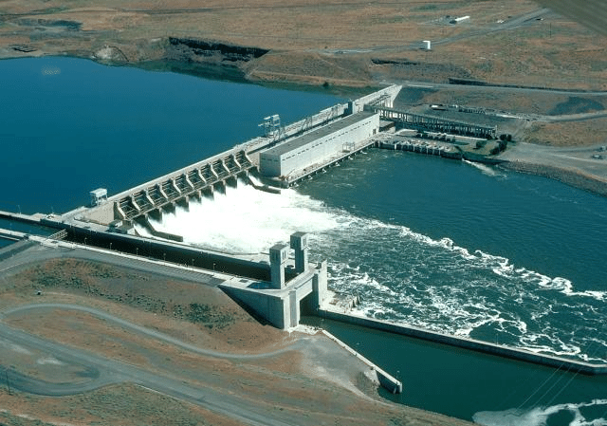
Mitigation Goal
Wallowa River (56H) Stock: The LSRCP adult return goal is 9,200 adults for harvest and escapement to the area above Ice Harbor Dam. This includes adults to Big Canyon facility.
Imnaha River (29H) Stock: The program goal is to return 2,000 hatchery adults to the area above Ice Harbor Dam.

Slide 3
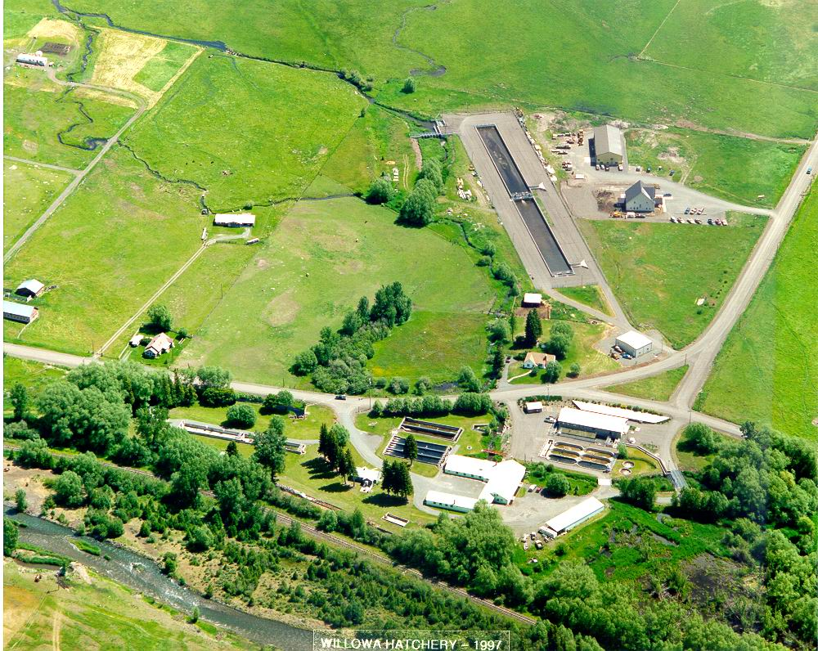
Facility Location
Wallowa Hatchery is located along Spring Creek, a tributary of the Wallowa River (Grande Ronde River Subbasin), 1 mile west of Enterprise, Oregon.
Acclimation Ponds
Spring Creek Acc. Intake
Wallowa River Intake. 1 mile.
House 1
Office/Incubation/Spawn Room
House 2
Spring Cr. Weir & Ladder

Slide 4
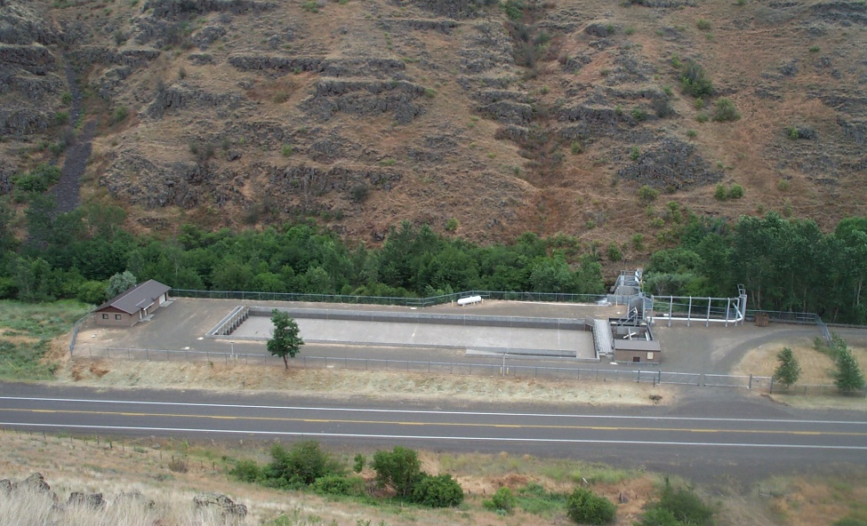
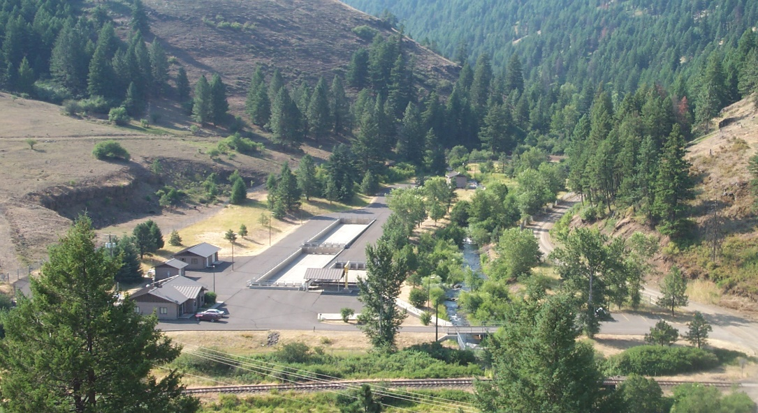
Satellite Facility Locations
Little Sheep Creek acclimation facility is located along Little Sheep Creek, a tributary of the Imnaha River. Approximately 9 miles Southwest of the town of Imnaha, Oregon.
The Big Canyon acclimation facility is located at the junction of Deer Creek and the Wallowa River, just east of the town of Minam, Oregon.

Slide 5
Water Supply
Water rights for the entire hatchery total 23,813 gpm from several sources. (Spring Creek, Wallowa River, Lower & Upper Spring, and two wells.)
Spring run off and fluctuation from Wallowa Lake can cause rise and drop in flows.
Wallowa River water temps can range from low 30’s to upper 60’s. Spring Creek water ranges from mid 30’s to Upper 60’s.
Wallowa Hatchery sits at 3700 feet above sea level. Time of year plays a huge role in temperatures of different water sources.

Slide 6
Broodstock Collection
Approximately 410 adults are required to produce the base program needs for the Wallowa stock (56H.)
Angler-caught fish are being integrated into the Wallowa stock. These fish are caught on the Grande Ronde in October and held until spawning in early March. 30% of the Wallowa stock may be spawned from angler-caught broodstock.
Approximately 126-137 adults are required to produce the base program needs for the Imnaha stock (29H.)

Slide 7
Incubation
Wallowa eggs are loaded at two females per tray (10,000 average at 4 gpm)
Little Sheep eggs are loaded at 3 females per tray. (15,000 average at 4 gpm)
Wallowa stock green egg take goal of 965,000 eggs.
Little Sheep green egg take goal of 275,000 eggs.
Wallowa incubation has 19, 12 tray stacks.
Little Sheep incubation has 5, 12 tray stacks.
Both rooms can supply spring(44-48F) and well(54-56F) water to the eggs.

Slide 8
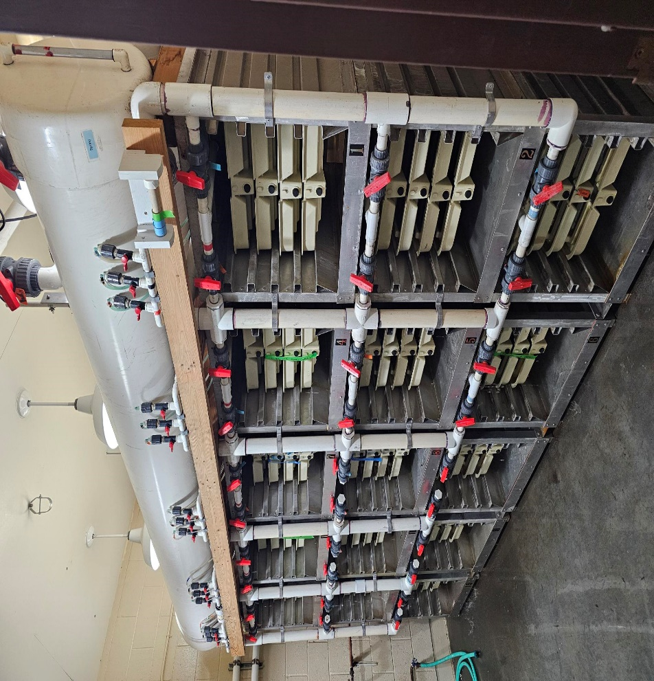
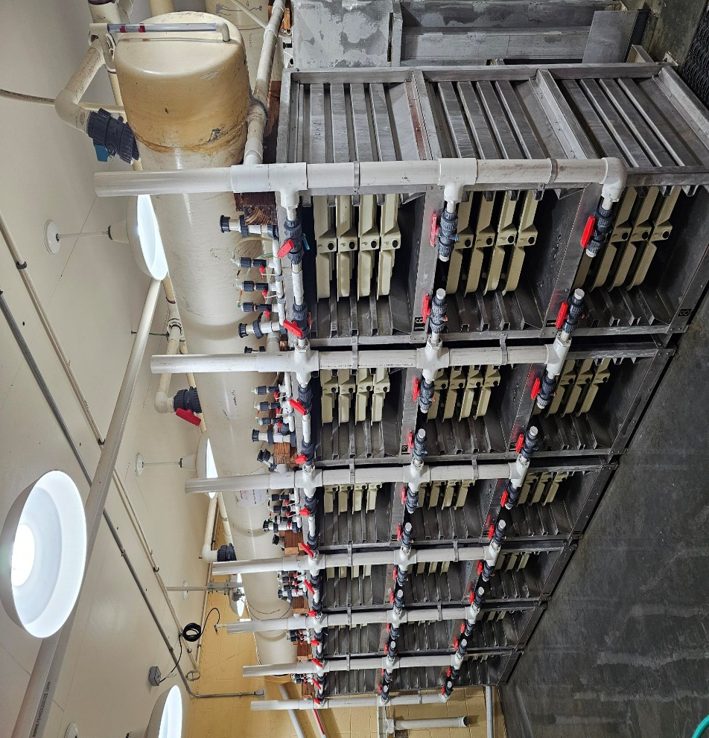
Incubation Set up
Little Sheep Room
Wallowa Room
Notes:
Talk about upgrades that we want to accomplish. New head tanks, 16 instead of 12 tray stacks, new plumbing, and formalin system upgrade.

Slide 9
Acclimation Ponds
Wallowa Acc. 2 ponds (300’x 42’x3.5’)
Little Sheep Acc. (195’x50’x3.5’)
Big Canyon Acc. 2 ponds (150’x30’x3.5’) 1 pond (70’x30’x3.5’)
DI ~ .11 to .16
FI ~ .9 to 1.2

Slide 10
Release
Wallowa 1st release smolts are transported from Irrigon hatchery in November @ 10 f/lb and the 2nd release smolts in April @ 5.5 f/lb. Both release groups are forced out in April. Release target goals of 5 f/lb.
Little Sheep smolts are transported from Irrigon in February @ 5 f/lb and released in April with a target goal of 4.5 f/lb.
Big Canyon smolts are transported from Irrigon in March @ 5.5 f/lb and released at a target goal of 5 f/lb.

Slide 11
NPDES
Total Suspended Solids (TSS) – Composite samples are collected once per week during normal operations and each time a cleaning event occurs during the month of highest production for each calendar quarter. Samples are also taken during severe disturbance of stream due to storms, run-off, etc.
Settleable Solids (SS) – Grab samples are collected once per week during normal operations and each time a cleaning event occurs during the month of highest production for each calendar quarter.
pH – measured once during normal operations for the month of highest production for each calendar quarter.
Dissolved Oxygen (DO) – measured only when conditions warrant (e.g., periods of low flows and high temperatures).
Flow Logs – Measurements are taken once per week during normal operations and during each cleaning event for the month of highest production for each calendar quarter. Flows are also recorded when using a chemical which discharges into the effluent, in order to follow prescribed dilution rates.
Wallowa Hatchery has had no noncompliance issues.

Slide 12
Wallowa November Transfer
Wallowa smolts transferred from Irrigon in November instead of February.
Transferring approximately 400,000 smolts frees up space and much needed water for Irrigon hatchery.
Smolts are transferred at 8-10 f/lb and are held at a DI of 0.08
At release they are 6-6.5 f/lb with a DI of 0.12
The trouble we run into is weather and water temperatures to be able to get them to their target goal of 5 f/lb.
So far, we are seeing our 2nd transfer group from Wallowa and our Big Canyon group return to the rack better. Both groups are larger at release and are held for a short acclimation roughly 3-4 weeks.
Mike G. will go into the nitty-gritty!

Slide 13
Operational Changes
Possibly acclimating Fall Chinook at Big Canyon after consultation is approved.
500K @ 50 f/lb
Acclimation would run from mid to end of April through mid May, possibly longer depending on water availability.
Deer Creek supplies Big Canyon Hatchery. Dependent on snowpack for good flows.

Slide 14
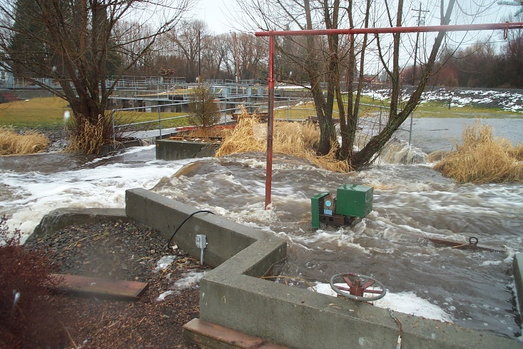
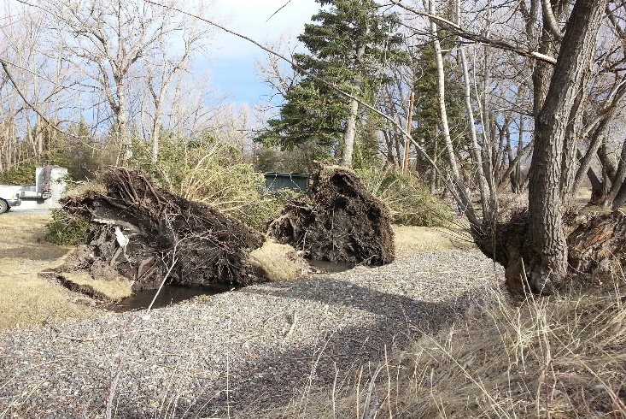
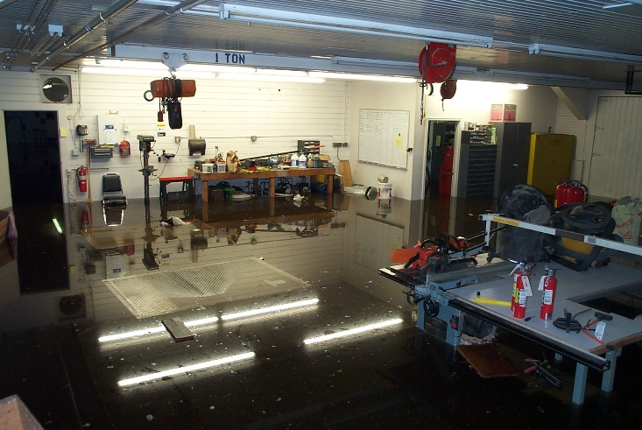
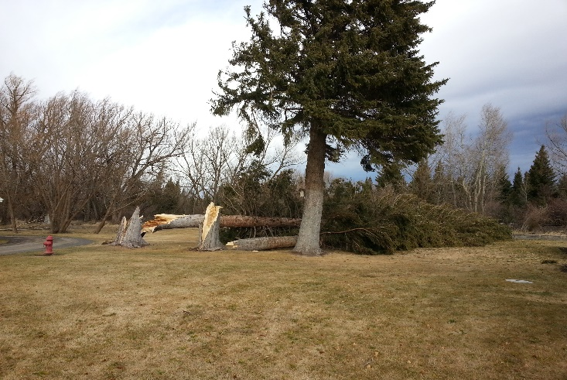
Facility Challenges
Wallowa Hatchery flooding. Wallowa Hatchery 90 mph wind.
Notes:
Hatchery flood. Breached containment walls and flooded entire old hatchery building and shop. February wind storm that caused major damage to the facility. Loss of 10+ spruce trees and various other trees. Power outages and clogged intakes. NO FISH LOSS!

Slide 15
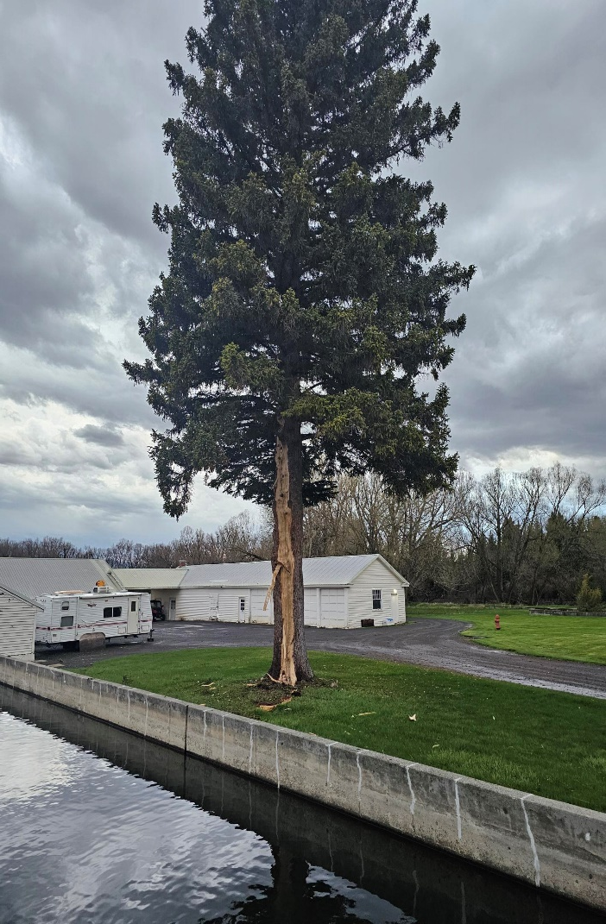
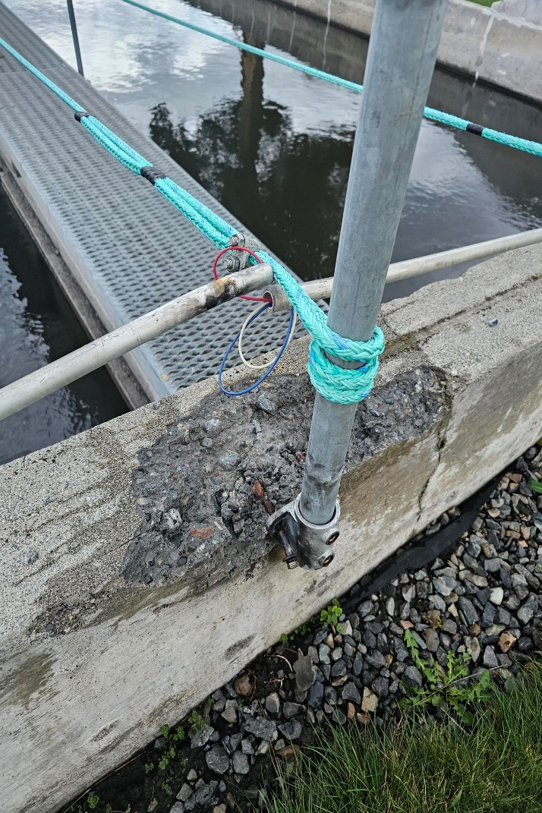
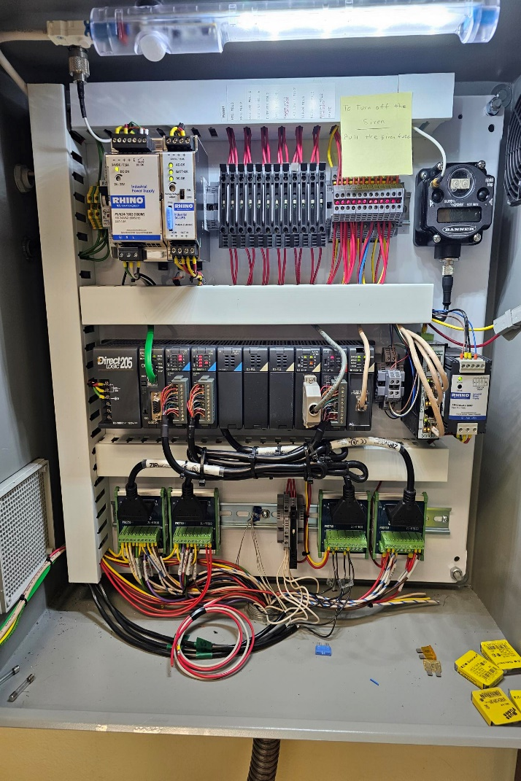
Facility Challenges
Wallowa Hatchery lightning strike.
Notes:
Lightning Strike on April 14th, 2024. Struck the last spruce tree on the hatchery. Caused a major alarm issue. Fried all 5 pond alarms and back fed power to the hatchery alarm panel. Completely shut down all alarms. Blew two railing brackets apart and welded one to the grip strut. Caused cement damage on raceways 1-3.

Slide 16
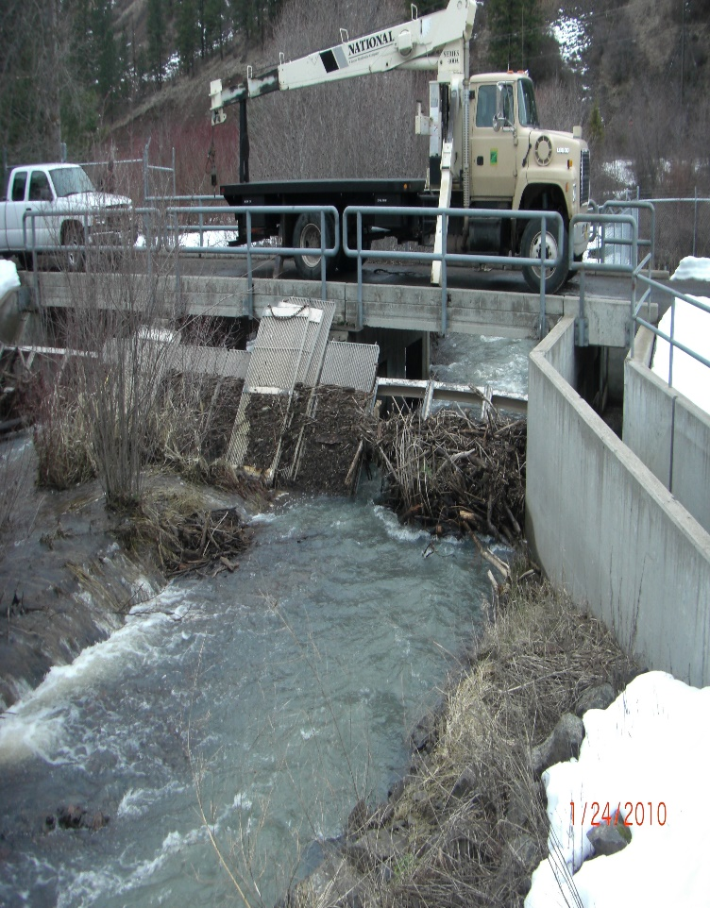
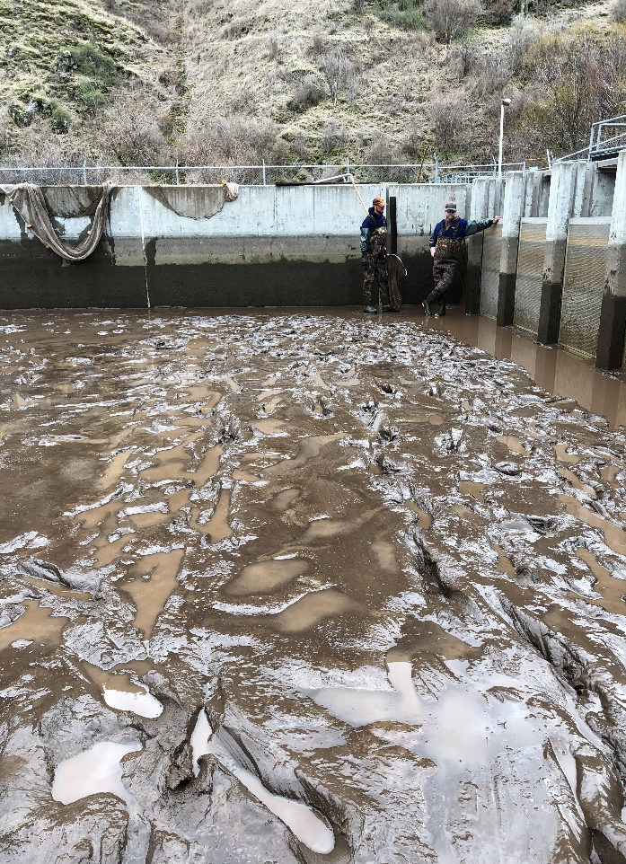
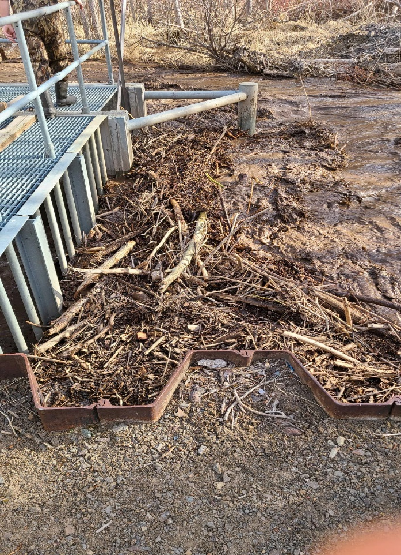
Satellite Facility Challenges
Little Sheep & Big Canyon high water events.
LI Acc. pond 2019
LI intake2023
BI Blow out 2010
Notes:
Devils gulch blow out in 2019, emergency force out. Devils gulch blow out 2023, emergency force out. BI blowout, panels removed to let water a debris through. Flowing over the bridge.

