Slide 1
Lyons Ferry and Tucannon Hatcheries Production Overview

Slide 2
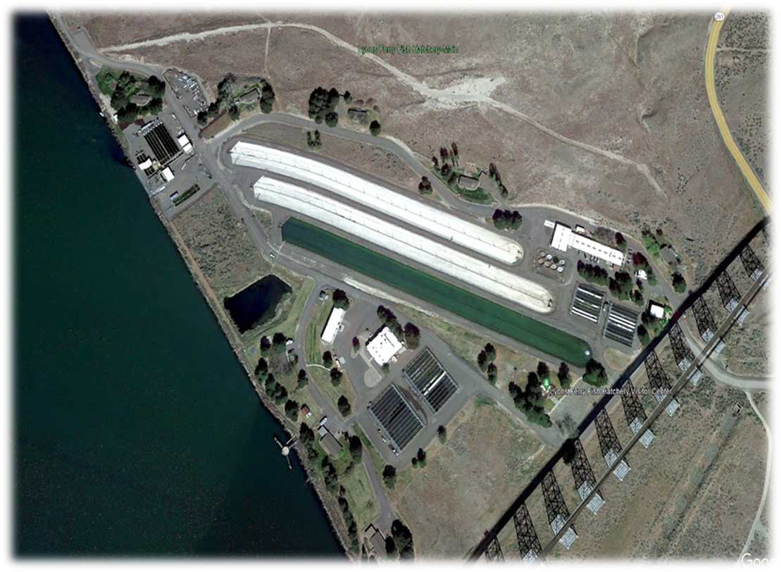
Lyons Ferry Hatchery

Slide 3
Current Production
Snake River fall Chinook
Two stocks of spring Chinook: Tucannon and Touchet/Carson
Three stocks of summer steelhead: Wallowa, Tucannon and Touchet
  Wallowa’s = mitigation
  Tucannon’s = mitigation and conservation
  Touchet’s = conservation
Rainbow trout

Slide 4
Fall Chinook
  Adults trapped at Lower Granite Dam and transported for LFH for holding and spawning, ~1,200 females needed.
  Green eggtake of ~4.6 million
  Ship ~1.32 million eyed eggs to Irrigon for ICP and WDFW programs
  Ship 1.9 million yearlings to FCAP, NPT
  Release 700k sub-yearlings and 450k yearlings on-site
  All release groups have 200k that are Ad/CWT’d, the remainder are unmarked/untagged
  Proposal to switch the 450k yearling release to sub-yearlings.
    Would require ~312 more females and 167 more males
    Eyed egg transfers to Irrigon would go from ~1.35 million to ~2.3 million
    Would make on station release of sub-yearlings 1.2 million
    FCAP site Big Canyon would increase from 200k on the second release group to 400k
    ODFW site Big Canyon would release 500k (new addition)
    Direct release of 600k at Couse Crk on the Snake River (new addition)

Slide 5
Spring Chinook
  Tucannon
    Adults trapped at Tucannon Hatchery and transported to LFH for holding and spawning
    Green eggtake of ~250k
    Release goal of 225k
    Juveniles currently transported to TFH in October for overwintering/acclimation at ~25fpp
    Three release strategies.
      Direct release at the hatchery
      20k direct released ~0.25 miles upstream of the mouth of the Tucannon River
      20k put on a barge at LFH and then release just below Bonneville Dam
    Have started new growth regime to try and produce a longer leaner smolt at release. Will transport fish to TFH at closer to 15fpp instead of 25fpp.
  Touchet
    Adults are trapped at the Dayton AF adult trap. 2022 was the first year of adult returns and we trapped ~24
    Most adults scaled the dam in 2022 due to abnormal high flows in May and June
    Program was started with eyed eggs from either USFWS Little White Salmon or Carson Hatcheries.
    WDFW will receive eyed eggs until we capture enough adults for broodstock. This option does have a sunset.
    Release goal of 250k.
    Juveniles transported to the Dayton AF in February, released in March into the Touchet river.

Slide 6
Summer steelhead
  Wallowa stock
    Adults collected and spawned at the Cottonwood Acclimation Facility trap
    Gametes are transported back to LFH, spawned, fertilized and disinfected/water hardened
    Green eggtake of ~450k
    225k at the Cottonwood Acclimation Facility
    100k at the Dayton Acclimation Facility
    60k on-station at LFH
  Tucannon stock
    Adults collected at TFH, transported and spawned at LFH
    Green eggtake of ~200k. Have not met broodstock needs for the last 5 years
    50k (conservation program) are acclimated at Curl Lake and released there
    100k (mitigation program) are released at Marengo and TFH
  Touchet stock
    Adults collected at Dayton Acclimation Facility, transported and spawned at LFH
    Green egg take of ~60k
    50k (conservation) acclimated and released from Dayton Acclimation Facility

Slide 7
Rainbow Trout
  Spokane stock
    Receive eyed eggs from WDFW Spokane Hatchery in December or January
    16,000 transferred to IDFG each October
    1,650 transferred to NPT each spring
    32,500 are planted as fall catchables at 3.0fpp
    74,000 are planted as spring catchables at 2.5fpp
    1,000 spring jumbo’s at 0.67fpp into lowland lakes

Slide 8
REARING
Fall Chinook
  Moved from vertical incubators to raceways or adult ponds
  Sub-yearlings are marked back into raceways, yearlings are marked into Lake #1
  Sub-yearlings are moved to Lake #1 after they have been on 1.2mm feed for a week or two.
  FCAP subs are transferred out from the raceways and adult ponds
Spring Chinook
  Moved from vertical incubators to raceways. Small lots of eggs will go to shallow troughs for better feed start and to match them up in size to larger lots.
  Fry will go from shallow troughs to raceways between 800 and 400fpp
  Marking occurs in early March.
  Touchet’s are moved to Lake #2 in April/May. Tucannon’s stay in raceways until they are shipped to TFH
Steelhead
  Hatched out in vertical incubators and moved to shallow troughs at swim up.
  Wallowa stock go directly from shallow troughs to outside raceways between 1,000 and 800fpp
  Tucannon and Touchet stocks go from shallow troughs to intermediate tanks. Then from tanks to outside raceways between 500 and 150fpp.
  Wallowa’s are marked from raceways to Lake #3
  Tucannon’s and Touchet’s are marked and split out back into raceways.

Slide 9
Rainbow
  Hatched and feed started in shallow troughs
  Moved to intermediate tanks within a month of feed start
  Moved from intermediate tanks to outside raceways in April, ~500 to 250fpp.
Fall Chinook – 0.09 DI until marking, 0.16 DI until splitting or at release
Spring Chinook – 0.09 DI until marking, 0.16 DI until splitting or at release
Summer Steelhead – 0.09 DI until marking, 0.25 DI until splitting or at release
Rainbow – 0.09 DI until ~100fpp, 0.25 DI until splitting or release

Slide 10
WATER
Water and space are our limiting factors from the last half of January through May
Yearling steelhead are shipped to Cottonwood AF at the first of February so the water demand for the lake can be reduced. (6,000gpm down to ~3,000gpm)
Touchet spring Chinook are shipped to Dayton AF at the first of February so the water can be shut off to the lake. (~4,500gpm)
This provides ~7,500gpm of water for the fall Chinook raceways.

Slide 11
Options to increase spring Chinook production
Construction of three new rearing lakes would improve rearing conditions for several current production group and provide rearing potential for an additional 500,000 spring Chinook smolt program. Total cost is estimated at $11M
Replacing the dilapidated captive brood tanks would cost about $1.2 M and could provide rearing opportunities for 500,000 spring Chinook smolts at an annual operation cost of approximately $75,000.
Experimental Age-0 spring Chinook production to 30-50 fpp releases in late May to early June would be possible with Lyons Ferry rearing temperatures (52 F). This differs from traditional parr programs (September releases at 60-100 fpp) in size and timing. Potential across LSRCP programs is large (10-22M Age-0 smolts) if capacity at multiple facilities is considered. Experimental groups would displace current sub-yearling fall-Chinook at 100,000 per raceway.
Converting Lyons Ferry rearing lakes to all steelhead (400,000 each or 1.2 M total) by moving production withing LSRCP facilities. That movement potentially frees space for up to an additional 2.75 – 3.5M spring Chinook at other LSRCP facilities. This idea is based on the reciprocal study that was implemented because the mean SAR from LFH rearing lake steelhead averaged 2.9% compared to 1.1% at Irrigon raceway-reared steelhead from BY97-2008. During the same timeframe, the remaining LSRCP steelhead facilities also averaged in the 1% to 1.5% range. Total costs are $600,000 in infrastructure/equipment and $948,000 annually.

Slide 12
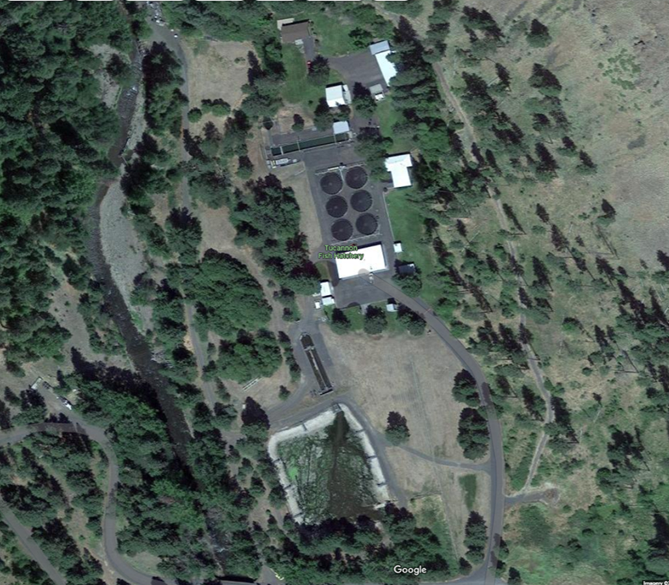
Tucannon Fish Hatchery

Slide 13
CURRENT PRODUCTION
Rainbow trout
  Eyed eggs are received from the WDFW Spokane hatchery in Dec/Jan
  Eggs are hatched in shallow troughs. Fry are moved outside to round ponds May/June
  Juveniles are split to the A-Pond and empty round ponds in July/Aug
  When river water temperatures drop to 50º, in October, the fish are moved to the earthen rearing pond.
  In April, lowland lake planting begins and usually finishes up by the first part of June
  Release goal is 94,000 fish at 2.5fpp each spring
Tucannon spring Chinook
  Juveniles are received from LFH in October. The go into the A-Pond and round ponds
  At transfer, the barge group and lower river release groups are separated.
  PIT tagging occurs in February/March for the three different release groups.
  Fish are direct release at the hatchery, trucked to the lower river and put on a barge in April.
  Release goal is 225,000 smolts annually.

Slide 14
ADULT TRAPPING
Spring Chinook
  Adults are trapped and hauled to LFH. Majority of the trapping occurs in May through early July. A few more adults show up in mid-August just prior to spawning.
Steelhead
  Adults can be trapped in February through April. In the past few years, we are seeing adults returning later and some adult collection is occurring in May to try and meet broodstock needs.

Slide 15
FACILITY OPTIONS
Move the reduced jumbo trout program from TFH to LFH. The program was 4,000 fish at .67fpp and is now 2,500 fish at .67fpp. They were moved to the same raceway at LFH as the jumbo trout program there. This opened up four round ponds for the acclimation/over winter at TFH of the Tucannon spring Chinook. This is a zero-cost move.
Move the catchable rainbow trout program off-site and rear Tucannon spring Chinook in the earthen pond. There are a few issues with this idea. A new production well would be needed at TFH to provide water to the earthen pond during the summer. Raceways needed for the rainbow at LFH are potentially slated to be filled with spring Chinook. Estimated cost for a new production well is $100,000 and rearing the rainbow at a private facility is estimated to cost $200,000.

Slide 16
Any questions or comments?

