Slide 1

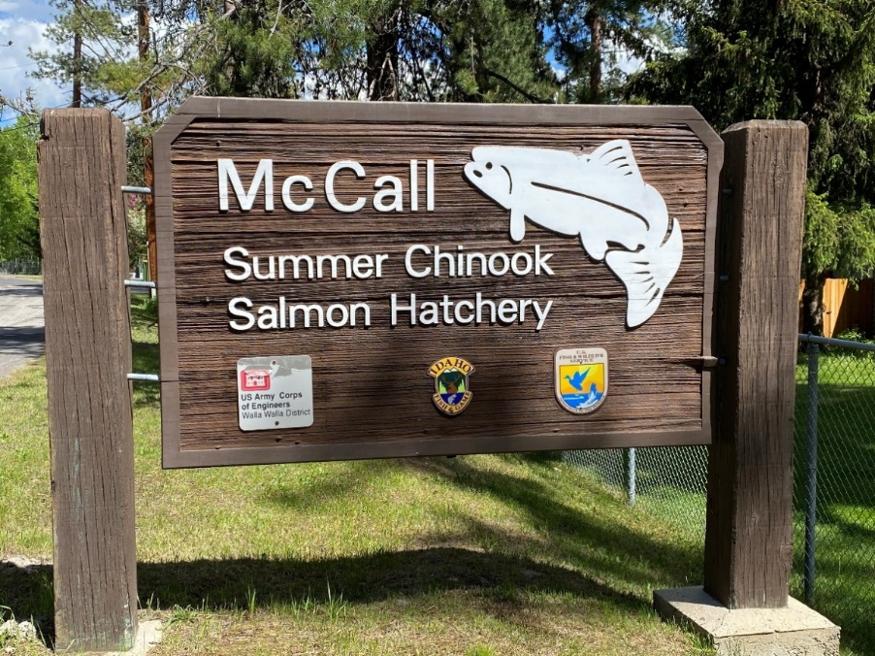


McCall Fish Hatchery Infrastructure Audit
McCall Fish Hatchery
Jamie Mitchell
IDFG – Fish Hatchery Manager
2023 LSRCP Annual Meeting

Slide 2
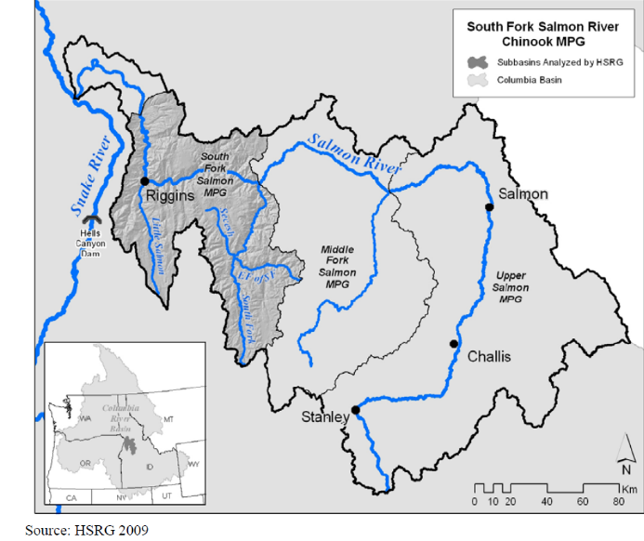
Mitigation Goal
8,000
Adults

Slide 3
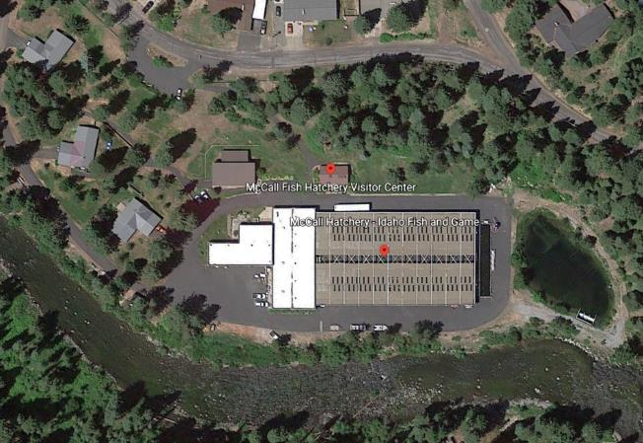
Facility Location
Located on the North Fork Payette River downstream of Payette Lake
Dormitory and Office
Housing
Settling Pond
NEW PONDS
NF Payette R
Collection Basin
Indoor Inc & Early Rearing
Outdoor Rearing Ponds

Slide 4
Water Supply
Deep and Surface intakes (2)
20 cfs from a 1/4 mile 36” gravity line from Lardo Dam on Payette Lake
Low lake levels from November to April result in only 13.5 cfs during winter months
Water temp 37 to 56 F
Elevation of 5,000 feet

Slide 5
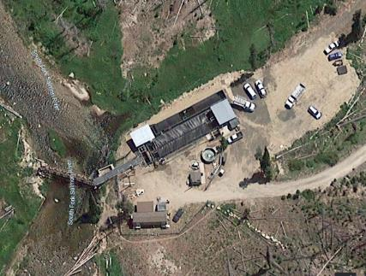
SFSR- Broodstock Collection
Satellite Facility
Upper end of South Fork Salmon River Watershed
~1,400 Broodstock are collected annually to meet production needs
New brood holding ponds are being constructed onsite at McCall

Slide 6
Incubation
Up to 40 – eight tray stacks
Segregated eggs loaded at two females per tray (~8600 eggs/tray average at 5 gpm)
Integrated and Johnson Ck eggs loaded at 1-female per tray (4,000 eggs/tray)
IHOT max is 8,000 eggs per tray

Slide 7
Nursery Rearing
14 indoor vats (4’x 40’x2’)
Max DI < 0.8
Max FI < 1.5 at 80 gpm

Slide 8
Marking
Marking occurs in June and July @ Move out
<200 fpp target size for AD Only
<150 fpp for CWT
SEGS - 730K AD Only, 120K AD and 26K PIT
INTS – 150K CWT ONLY and 26K PIT

Slide 9
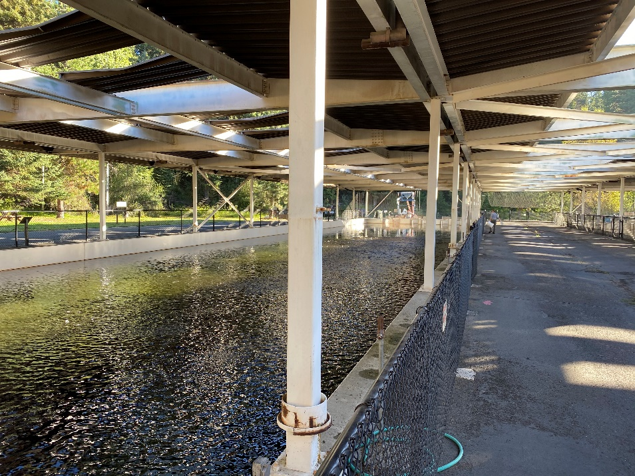
Outdoor Rearing
Two ponds (40’x196’x4.5’)
Collection Basin (15’x101’x4’) for Johnson Creek (BPA program)
DI < 0.25
FI < 2.00

Slide 10
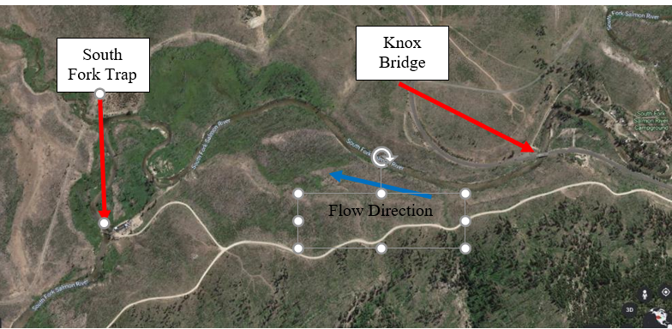
Release
Smolts are transported to the Knox Bridge on the South Fork Salmon
5 trucks, 2 trips/day for 3.5 days
2 hour hauling trip
0.5 lb fish/gal
<20 fish per pound

Slide 11
IPDES
Flow, TSS, low level TPO4
Facility exceeded phosphorus discharge limits in 2021 and 2022
Hatchery will dredge settling pond in FY23 to address problem
Low Phos feed component evaluation
Increased monitoring frequency

Slide 12
Operational Changes (operation “more smolts please”)
Current infrastructure
New Adult Holding Ponds
Rearing space for additional 360,000 smolts at 20 fpp at DI < 0.3
Water diverted from pipeline that feeds rearing ponds
Available due to low flows being highest in summer
Smolt flow requirement is lowest
$1.8M infrastructure cost

Slide 13
Operational Changes
Optimize Rearing Ponds
Increase total smolt rearing in large rearing ponds from 500K to 600K each
Maintain final rearing at DI=0.24?
Dependent on re-use from hatchery building (1000-2000 gpm) if smolt rearing occurs in adult holding ponds

Slide 14
Operational Changes
Optimize Collection Basin
Current Johnson Creek program is 150,000, but collection basin can rear ~200,000 smolts
MOVE JC to adult holding
MOVE INT to adult holding

Slide 15
Summary of Operational Changes
Program | Current Smolts | Proposed Smolts
New Adult Holding Ponds | 0 | 300K INT and JCAPE Production
Collection Rearing Basin | 150,000 JCAPE | 200,000 SEG
Rearing Ponds | 850,000 SEG 150,000 INT | 1,000,000 SEG
Total | 1,150,000 | 1,500,000

Slide 16
Operational Changes Feasible?
Strong Maybe
Indoor rearing densities – pre-mark move out in May
INTS stay indoor until Mid Sept
Highly Relevant Resident trout program???
TPO4 issues
Cost to the fisheries???

