Slide 1
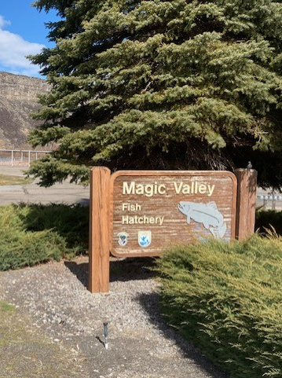
2024 LSRCP Annual Meeting

Slide 2
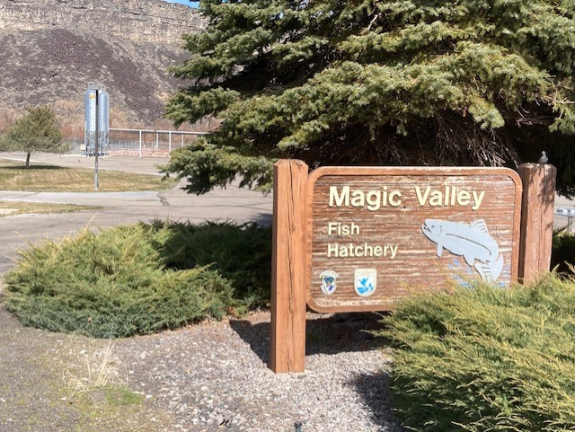
Current Staff
Hatchery Manager – John Rankin
Hatchery Assistant Manager – Steve Kammeyer
Fish Culturist – Wade Symons
Notes:
92 years experience

Slide 3
Presentation Summary
Current Production Goals
Current issues/bottlenecks
Recent Projects

Slide 4
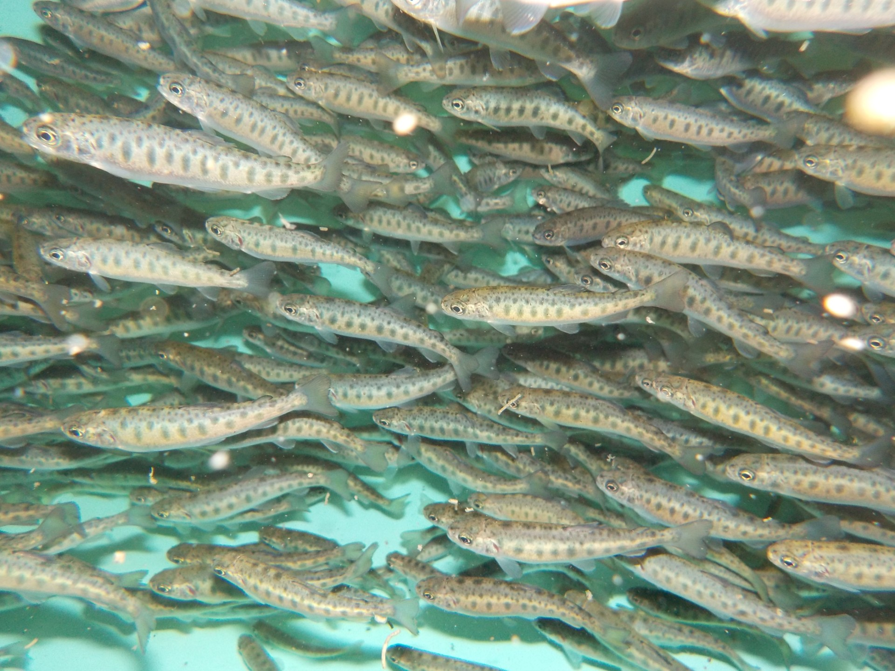
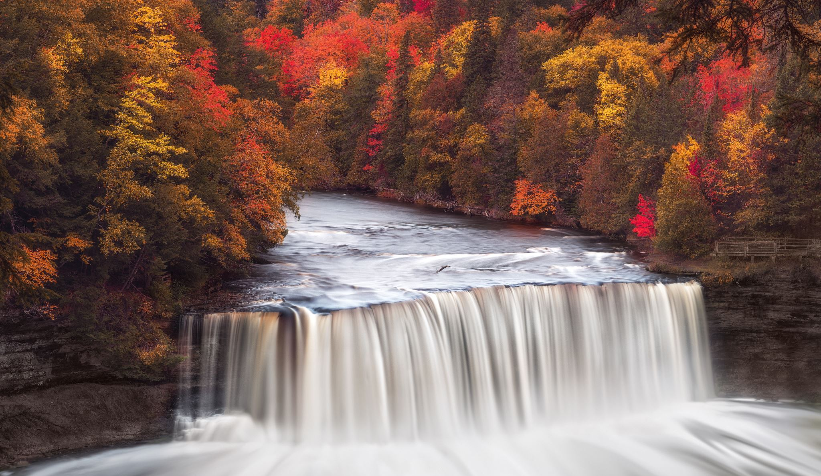
Hatchery Capacities and Production Goals
32 – 200ft concrete raceways. Currently only using 25.
Flow – 74cfs. Water right is for 120cfs.
Current production goal is 1.55 million - 8.5” smolts. Originally hatchery was able to raise 2 million smolts.
  868,000 USRB’s – Pahsimeroi Hatchery and Yankee Fork.
  682,000 SAW A’s – Little Salmon River and Sawtooth Hatchery.
62,000 fish/raceway (D.I. = .33, F.I. = 1.2).
Adult return goal of 11,660 fish above Lower Granite Dam.

Slide 5
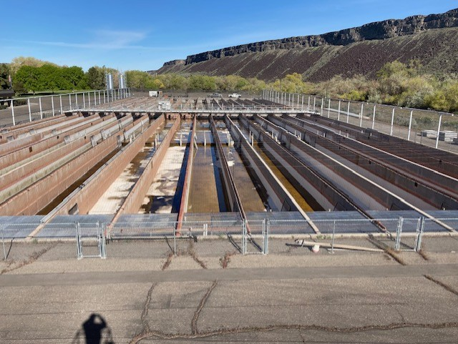
Hatchery Challenges
Water - Currently have 74cfs which is a 39% reduction from the original 120cfs. Also, meeting upcoming changes to the waste load allocations.
Disease – IHN and Cold Water.
Structural – Hatchery built in 1985 and concrete raceways are deteriorating fast. Need replaced. Vat room drainage issues.

Slide 6
Recent Completed Projects

Slide 7
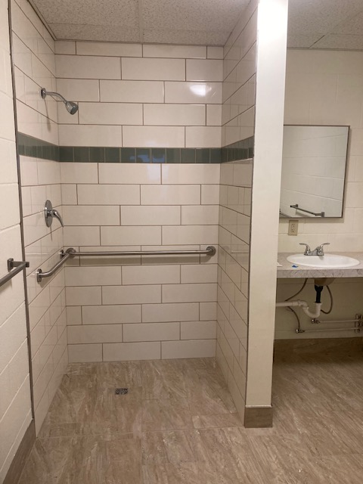
ADA Bathroom

Slide 8
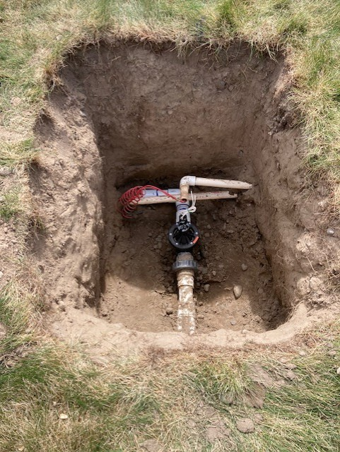
Sprinkler System Repair

Slide 9
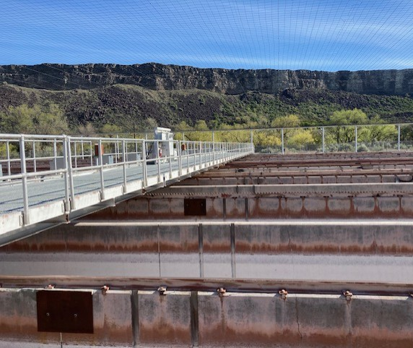
Replace the Motor and Drive on Traveling Bridge

Slide 10
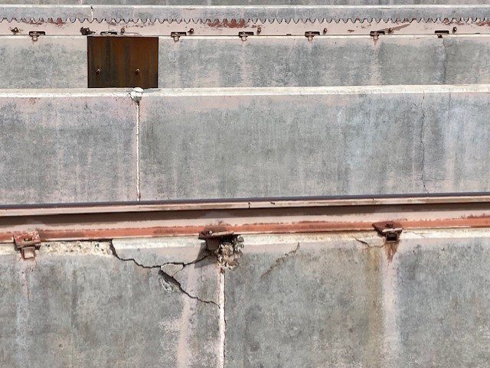
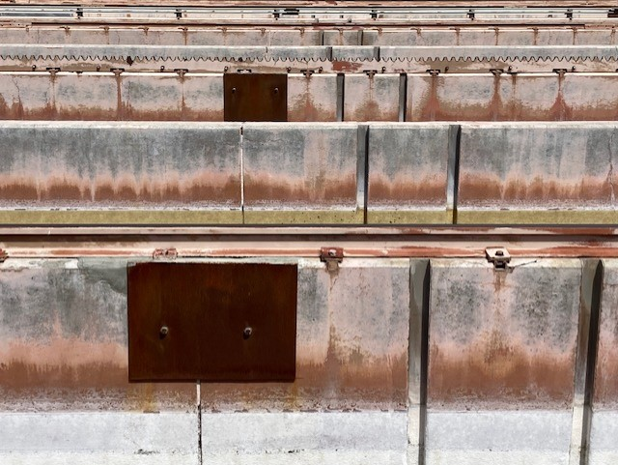
Repair Spalling Concrete on Raceways

Slide 11
Upcoming Large Projects

Slide 12
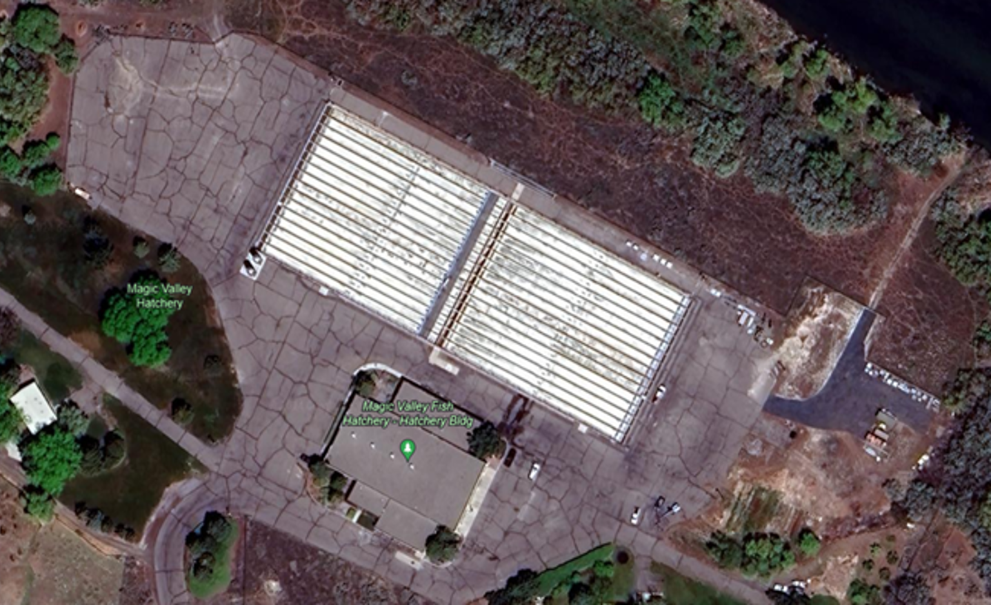
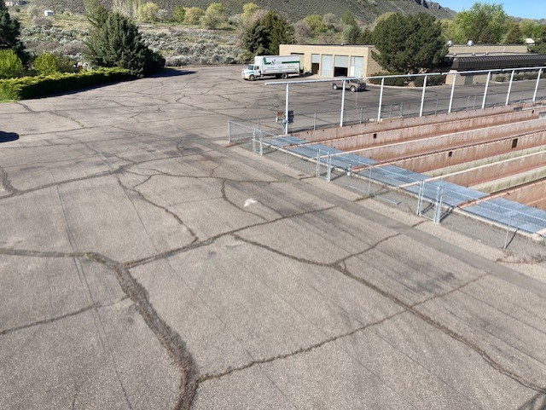
New Asphalt

Slide 13
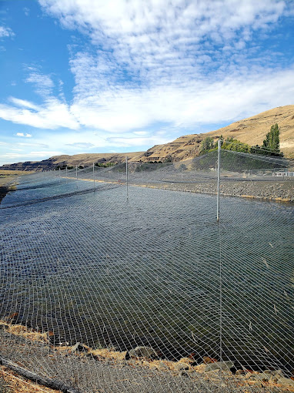
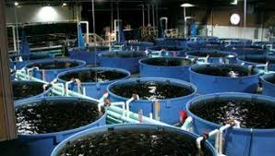
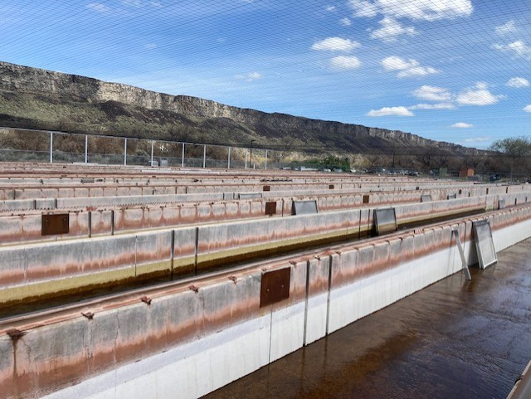
Raceway Rebuild 2028??

