Slide 1
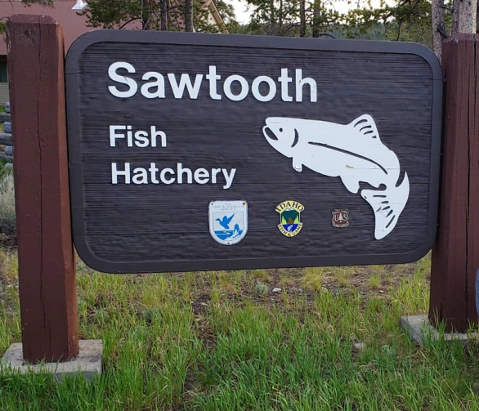
Lower Snake River Compensation Plan Infrastructure Audits
Sawtooth Fish Hatchery

Slide 2
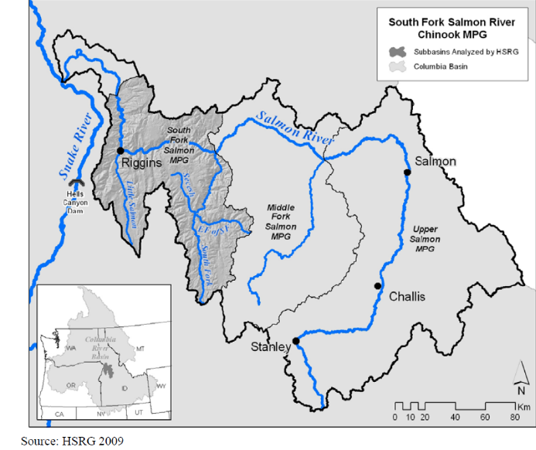
Mitigation Goal
19,445 spring Chinook adults
Upper Salmon

Slide 3
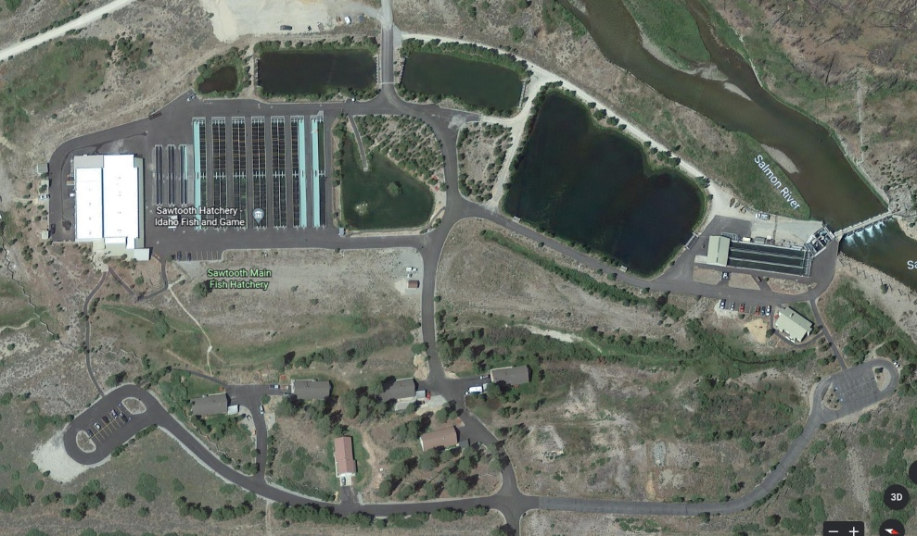
Facility Location
Located on the Salmon river 5 miles south of Stanley
Small Raceways
Off-Line Settling Basin
Trout Pond
14 Raceways
Full-Flow Settling Basin
Nursery/Admin/ Shop
Adult Holding/Trapping
Residences

Slide 4
Water Supply
35 cfs total from a 54” gravity line from Salmon River
River freezes resulting in low/no water during winter months
Water temp from 32 to 70 F
5 production wells, 1 well for de icing
Well water temp 41 to 56 F

Slide 5
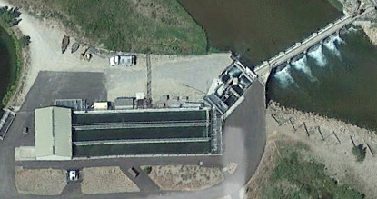
Current BY22 Broodstock Collection
1150 Chinook Broodstock are collected annually to meet current production needs
427 A run steelhead
Brood holding ponds on station

Slide 6
Incubation
A run steelhead eggs loaded two females per tray
Segregated/Integrated Chinook eggs loaded one female per tray
80 – eight tray stacks (includes 20 – eight tray stacks that can be heated)

Slide 7
Nursery Rearing
14 Vats (4’x42’x2.5’)
1 Display vat (3.8’x17’x2.6’)
6 Small raceways (6’x104x2.25’)
Max DI < 0.55
Max FI < 2.0 at 41 F

Slide 8
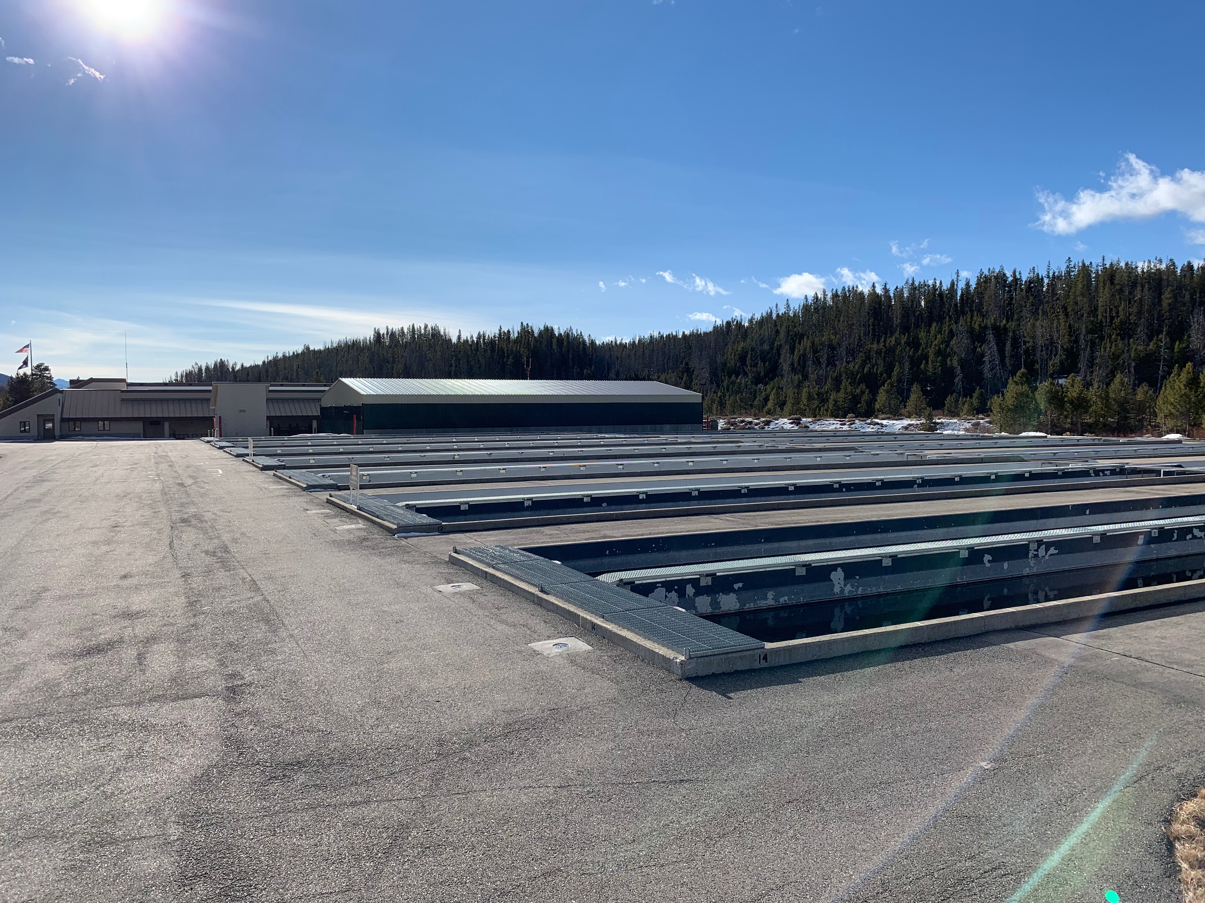
Outdoor Rearing
14 Large raceways
DI < 0.30
FI < 1.80 @ release

Slide 9
Release
INT Chinook smolts are transported to the County line Bridge 10mi south of the Hatchery
YF Chinook smolts are transported to YF for direct release or Pond Series 1 for acclimation
SEG Chinook smolts released at dusk on station

Slide 10
NPDES
No compliance issues
Hatchery will dredge one of the two settling ponds in FY23

Slide 11
Marking
Marking occurs in late May early June
120 fp target size
18,900 Segregated PIT tags
8,500 Segregated YF PIT tags
1,000 Integrated PIT tags

Slide 12
Operational Changes
Two new vats
Early rearing space for 150,00 fry to reduce overall ponding numbers per container
Vats are not needed to expand production to 2.4m smolts, would just help reduce fish numbers between vats
Plumbing is already in place
$200k infrastructure cost

Slide 13
Operational Changes
Optimize Final Rearing
Right size release groups to match rearing container maximums
Spawning more A run steelhead

Slide 14
Summary of Operational Changes
Program | Current | Proposed
New Vats |  | 150,000 fry
Addition of Chinook brood needed for 2.4m | 1150 | 1380
Increase Chinook Production | 2,000,000 @ 18 fpp | 2,400,000 @ 18 fpp
Addition USRA spawning | 427 Females | 648 females
Total | 2,000,000 | 2,400,000

