Slide 1
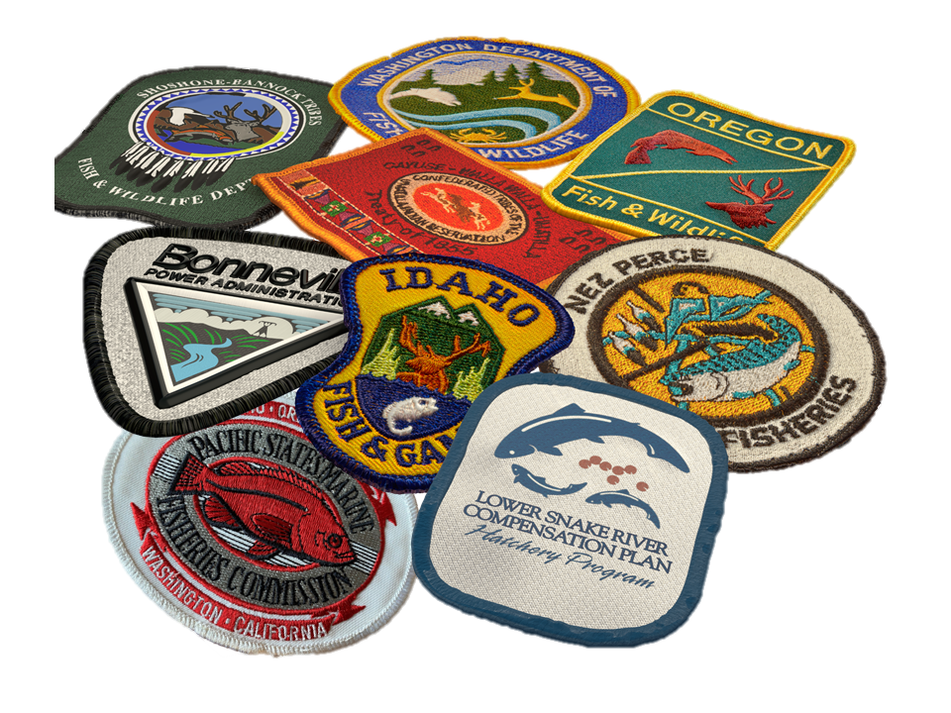
LSRCP 2024
The Next Decade

Slide 2
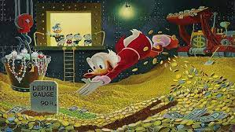
Columbia Basin Restoration Initiative
“$200M over 10 years in additional capital funding will be made available by Bonneville to the U.S. Fish and Wildlife Service (FWS) for Lower Snake River Compensation Plan (LSRCP) hatchery modernization, upgrades, and maintenance, as guided by the priorities of other fishery managers including the Six Sovereigns.”

Slide 3
RDC Update
$25M over five years (2023-2028)
$8.7M obligated ($3.6M expended) in FY23
$16.3M planned for obligation in FY24/FY25
$1M In-house hatchery projects (ODFW, IDFG, WDFW) in FY23-24

Slide 4
LSRCP FY23 RDC Obligations - $8.7M
Facility | Purchase Order Description | Obligation Amount
Clearwater | Clearwater Pipeline leak Assessment | $ 176,426
Clearwater | Clearwater Roof Project | $ 613,796
Dworshak | Dworshak Flow Meter, Forklift, Chiller | $ 133,500
IDFG | IDFG In-house Maintenance Projects | $ 490,000
Irrigon | Irrigon Raceway Valves | $ 275,174
Lookingglass | Lookingglass Intake Design | $ 257,703
Lookingglass | Lookingglass Quarters roofing | $ 501,167
Lookingglass | Lookingglass New Chiller | $ 931,100
LSRCP | LSRCP/Fisheries Program Support | $ 96,780
Lyons Ferry | Dayton Dam Repair | $ 1,264,251
Lyons Ferry | Lyons Ferry Marmes Check Valves | $ 1,185,085
McCall | McCall Adult Holding Shade Structure | $ 552,802
McCall | MCCALL FISH HATCHERY SETTLING POND DREDG | $ 170,000
ODFW | ODFW In-house Maintenance Projects | $ 359,780
Sawtooth | Sawtooth Well Rehab | $ 373,903
Sawtooth | Sawtooth Back-up Generator | $ 170,905
Sawtooth | Sawtooth Early Rearing Vats | $ 178,342
Tucannon | Tucannon Siding Replacement | $ 325,000
Wallowa | Wallowa Bridges | $ 397,060
WDFW | WDFW In-house Maintenance Projects | $ 153,217
Yankee Fork | Yankee Fork Resistance Board Weir | $ 100,000

Slide 5
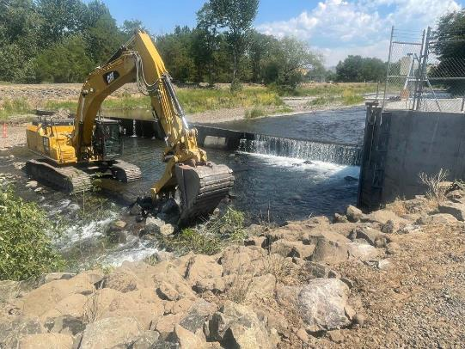
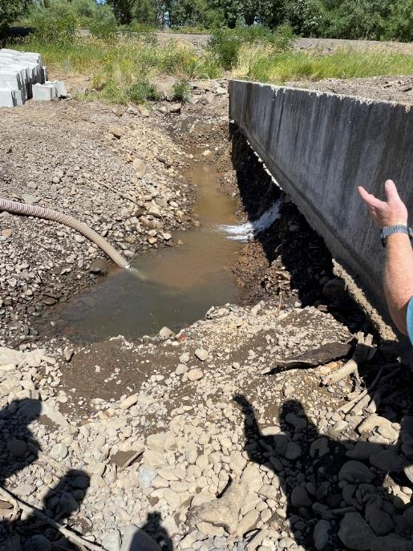
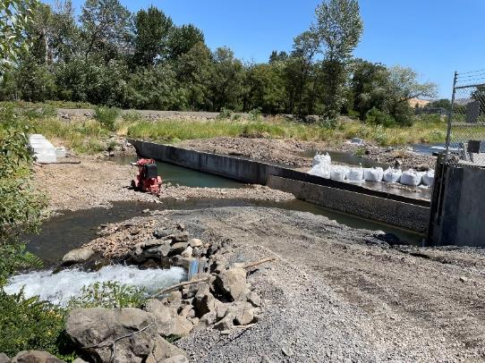
Dayton Dam

Slide 6
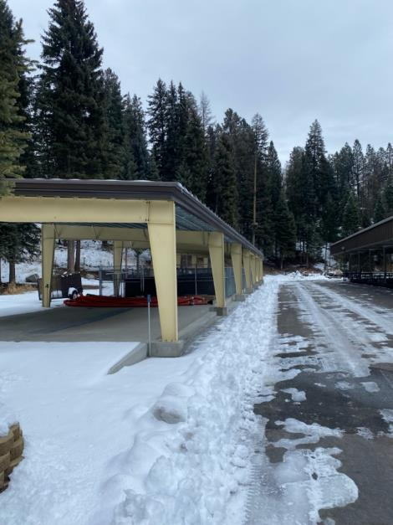
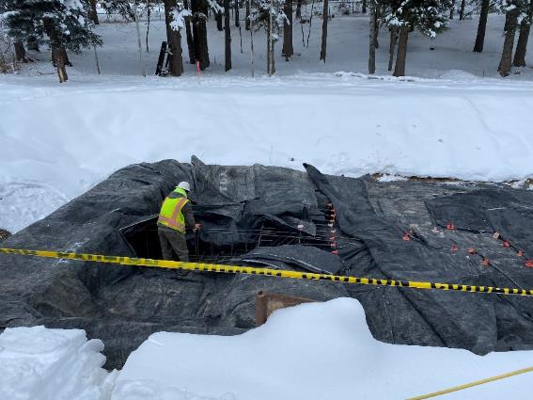
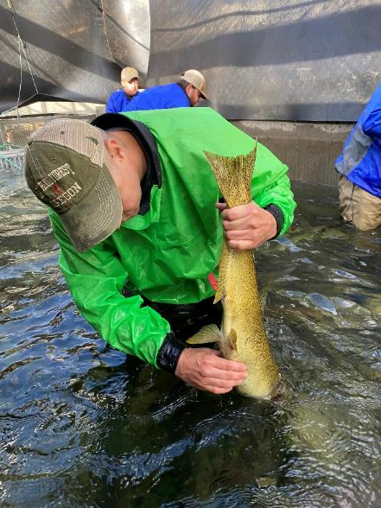
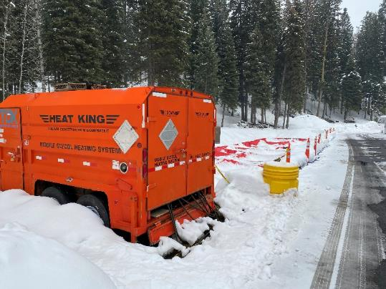
McCall

Slide 7
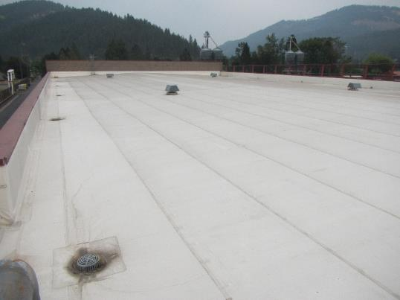
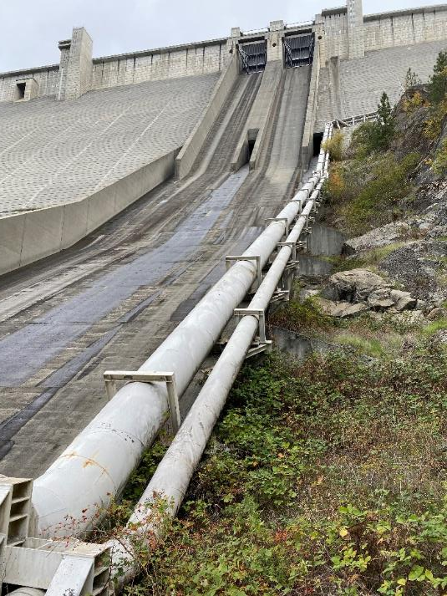
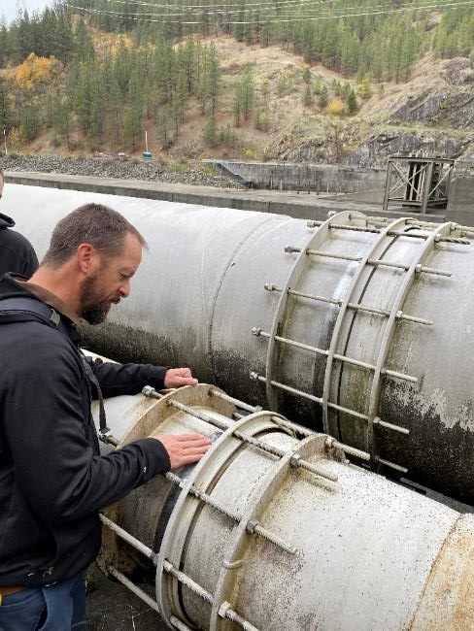
Clearwater

Slide 8
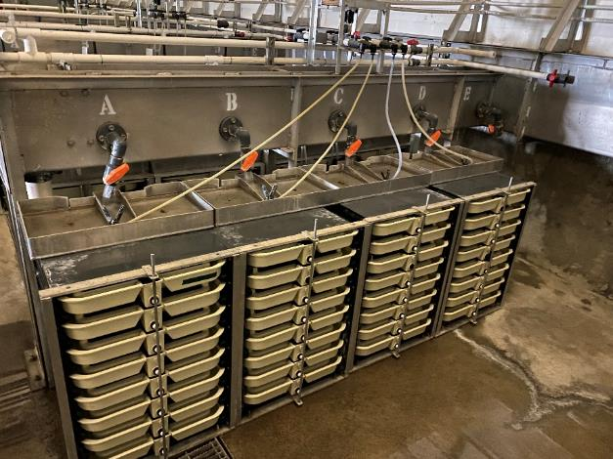
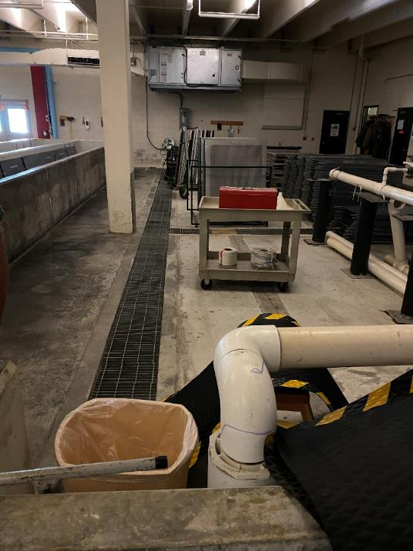
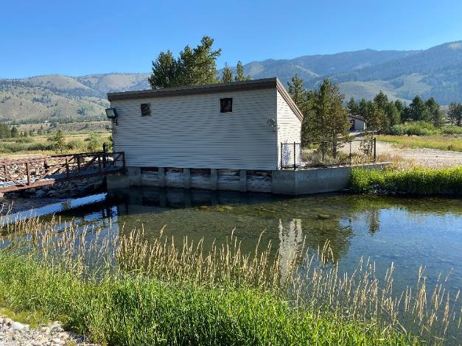
Sawtooth

Slide 9
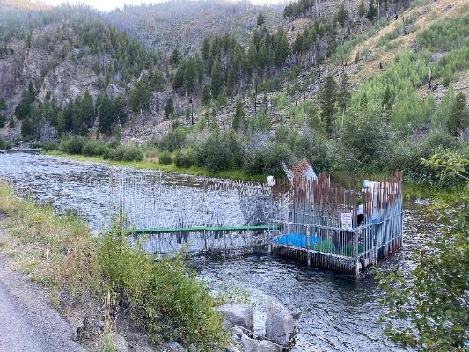
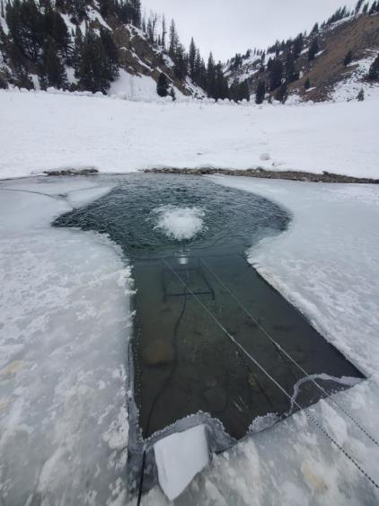
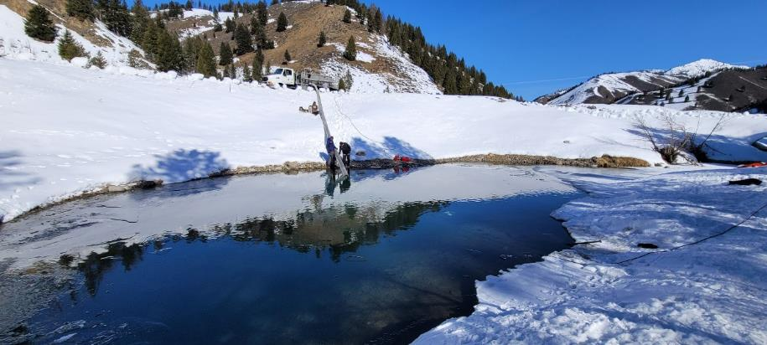
Yankee Fork

Slide 10
LSRCP FY24 RDC Engineering - $17.2M
Facility | Purchase Order Description | Obligation Amount
Hagerman | Hagerman Repaving | $ 3,171,897
Irrigon | Irrigon Raceway Valves | $ 855,271
Lookingglass | Lookingglass Incubation Rehab | $ 650,000
Lookingglass | Lookingglass TW2 Well Back-up | $ 400,000
Lookingglass | Lookingglass Raceway Expansion Design | $ 150,000
Lookingglass | Lookingglass Intake NOAA Compliance | $ 7,700,000
Magic Valley | Magic Valley Rehab Raceways Study | $ 200,000
Magic Valley | Magic Valley Paving | $ 1,584,391
McCall | McCall Hatchery Visitor Center Rehab | $ 200,000
McCall | McCall Epoxy Raceway bottoms | $ 450,000
McCall | McCall Rehab Fish Waste Treatment | $ 80,000
Sawtooth | Sawtooth Quarters Re-roof | $ 400,000
Wallowa | Wallowa Fish Ladder Rehab | $ 1,300,000

Slide 11

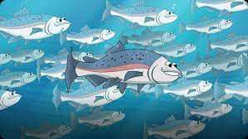
LSRCP DM List
Annual budget of $3M of maintenance and a need of $227M
  A lot of dreams and a few priorities
  Now we have a lot of prioritizing and refining to do
to

Slide 12
LSRCP Deferred Maintenance List - $227M
Category | Cost Estimate
COMPLIANCE | $ 24,455,000
FISH & FISH HEALTH | $ 16,520,000
HUMAN SAFETY | $ 1,625,000
IMPROVEMENT | $ 29,300,000
INFRASTRUCTURE | $ 15,679,500
PIPELINE | $ 105,400,000
SOLAR/SHADE | $ 33,600,000
Grand Total | $ 226,579,500

Slide 13
LSRCP Deferred Maintenance List - $227M
Category | Cost Estimate
COMPLIANCE | $ 24,455,000
FISH & FISH HEALTH | $ 16,520,000
HUMAN SAFETY | $ 1,625,000
IMPROVEMENT | $ 29,300,000
INFRASTRUCTURE | $ 15,679,500
PIPELINE | $ 105,400,000
SOLAR/SHADE | $ 33,600,000
Grand Total | $ 226,579,500

Slide 14
LSRCP Immediate Needs - $34M
Category | Cost Estimate | Number
FISH & FISH HEALTH | $ 16,520,000 | 36
HUMAN SAFETY | $ 1,625,000 | 5
INFRASTRUCTURE | $ 15,679,500 | 61
Grand Total | $ 33,824,500 | 102

Slide 15
LSRCP Immediate Needs - $34M
Fish and Fish Health
  Repair and epoxy raceways, valves, chillers, settling pond dredging, equipment
Human Safety
  Quarters sprinklers, dormers, basement egress
Infrastructure
  Windows, siding, quarters, asphalt, signage, equipment, roofs

Slide 16
LSRCP Pipelines - $106M
FACILITY | PROJECT | COST ESTIMATE
LYONS FERRY | Main pipeline replacement - all design work, permitting, etc | $ 1,200,000
LYONS FERRY | Main pipeline replacement - all construction activities | $ 40,000,000
CLEARWATER | Pipeline scoping, include replacement | $ 1,200,000
CLEARWATER | Main pipeline replacement - all design work, permitting, etc | $ 3,000,000
CLEARWATER | Main pipeline replacement - all construction activities | $ 60,000,000
 | Total | $ 105,400,000

Slide 17
LSRCP Pipelines - $106M
New Clearwater Pipeline
  1.6M spring Chinook at Clearwater
  1.8M spring Chinook at Dworshak
Lyons Ferry Pipeline
  Replace main pipeline that was repaired in 2017(?)

Slide 18
LSRCP Compliance - $25M
FACILITY | PROJECT | COST ESTIMATE
CURL LAKE | Intake | $ 550,000
TUCANNON | Improve intake, fish ladder, fish passage | $ 6,750,000
IMNAHA | Intake | $ 650,000
SAWTOOTH | Weir, intake, fish ladder | $ 7,550,000
RED RIVER | Intake, Exclusion Barrier, Fish Ladder, Trap | $ 2,300,000
SOUTH FORK | Intake | $ 500,000
COTTONWOOD | Intake and Adulit Holding | $ 80,000
BIG CANYON - OR | Bridges | $ 400,000
EAST FORK | Intake | $ 5,000,000
LITTLE SHEEP | Intake and Fish Ladder | $ 75,000
POWELL | Intake | $ 50,000
SOUTH FORK | Intake | $ 550,000
 | Total | $ 24,455,000

Slide 19
LSRCP Compliance - $25M
Excludes Lookingglass - $7.7M slated for 2025 construction
Excludes Wallowa – on FY24 list but still has real estate issue
Sawtooth Weir ($7.5M) is high priority for Sockeye program and Chinook trapping

Slide 20
LSRCP Improvements - $55M
FACILITY | PROJECT | COST ESTIMATE
HAGERMAN | Additional employee dorm space | $ 300,000
YANKEE FORK | Improve release structures, resistance weirs, etc | $ 250,000
HAGERMAN | Raceway waterflow improvements - CONSTRUCT | $ 2,750,000
LYONS FERRY | New Rearing Lakes | $ 10,000,000
MAGIC VALLEY | Raceway Replacement - Final design and any permitting | $ 16,000,000
 | Total | $ 54,430,000

Slide 21
LSRCP Improvements - $55M
Lyons Ferry project is scoped, Magic Valley scoping begins in FY24, Hagerman isn’t started
New facility in Upper Salmon?
  Walla Walla Hatchery (1M smolts) = $30M
  Jack Hernandez (6M smolts) = $135M
    3,000 gpm on full RAS
    300,000 pounds production
    Location for Sockeye rearing and captive brood refugia needs?

Slide 22
LSRCP Solar/Shade - $55M
FACILITY | PROJECT | COST ESTIMATE
CLEARWATER | Raceway shade stucture (design & construct) | $ 5,900,000
SAWTOOTH | Raceway shade stucture (design & construct) | $ 5,900,000
LYONS FERRY | Raceway shade stucture (design & construct) | $ 5,900,000
LOOKINGGLASS | Raceway shade stucture (design & construct) | $ 5,900,000
IRRIGON | Raceway shade stucture (design & construct) | $ 5,900,000
DWORSHAK | Raceway shade stucture (design & construct) | $ 4,100,000
 | Total | $ 33,600,000

Slide 23
LSRCP Solar/Shade - $33M
Dworshak Design complete
Difficult engineering by landing on raceway walls on thirty 8’x80’ raceways
  $4.1M McMillen Estimate
  $2.5M estimate by independent contractor
  Ready for bid
Other facilities were put “on the list”, but haven’t gone to design yet

Slide 24
What’s Next?
Solicit additional projects and prioritize all projects
Review 5-year condition assessments in 2024 – Chris Starr, Mark Olson, Stan Zazado
Solicit comments from Asset Recommendation Team
Develop 9-year plan (FY25-33)
Develop action plan and staff needs for engineering, contracting, execution
Submit project list over $2.5M to BPA by August 2024

Slide 25
LSRCP Asset Management Recommendation Team
Lead – Chris Starr LSRCP
NPT – Becky Johnson (alt Jeremy Sommer)
USFWS – Chris Foster (Dworshak NFH)
ODFW – Andrew Gibbs
IDFG – Cassie Sundquist
WDFW – Ace Trump
CTUIR – Jen Krajcik
SBT – Lytle Denny

Slide 26
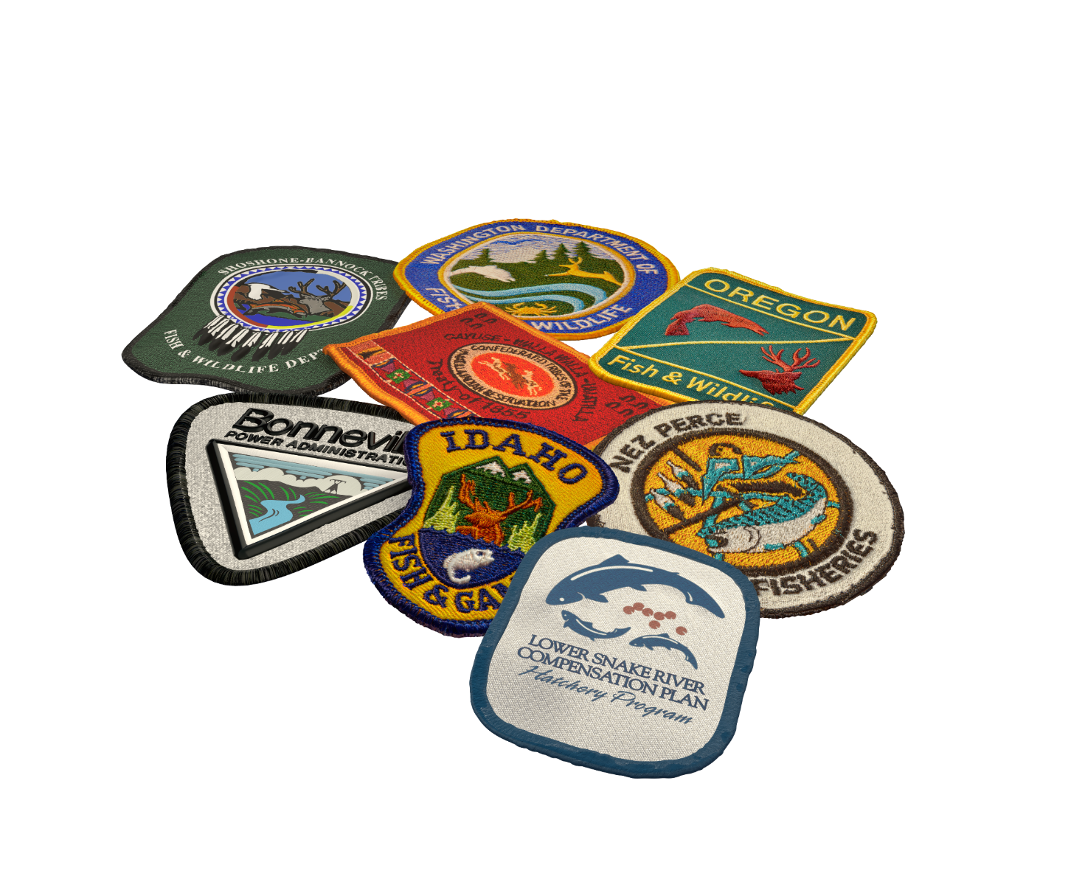
Fish for the Future

