Slide 1
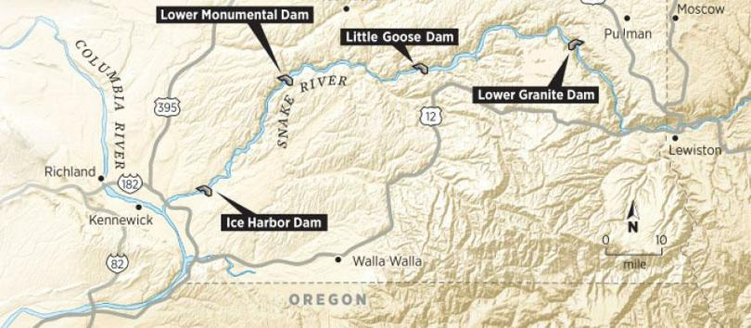
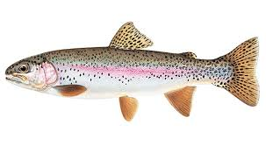

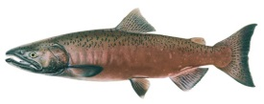
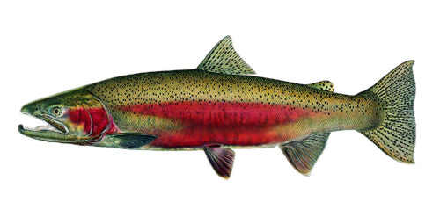
Lower Snake River Compensation Plan – ISRP Review(s) and Program Performance
Rod Engle USFWS-LSRCP, 5/8/2024

Slide 2
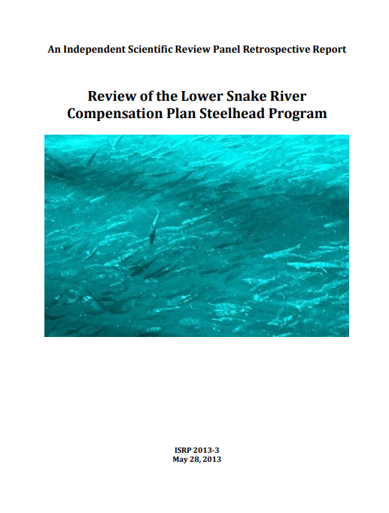
ISRP – Program Reviews
Chinook program review completed last year (Spring ‘23 report).
Steelhead Jan. 21-24, 2025
Tuesday – Friday after MLK Day
Boise, ID at Federal Building (LSRCP)
Block of rooms at Oxford Suites, call to reserve
Last Steelhead review 11 years ago
Initiated discussions on narratives, presentations, agenda….. More work to come.
Products
Report card associated with steelhead program performance
Presentations/narratives/reports/studies
Overall report (similar to spring/summer Chinook) in May 2025

Slide 3
LSRCP ”In Place, In-Kind”
Species | Project Area Goals | Coastwide Harvest Objectives | Total Adults (Goals + Objectives)
Fall Chinook | 18,300 | 73,200 | 91,500
Spring/Summer Chinook | 58,700 | 234,800 | 293,500
Steelhead | 55,100 | 110,200 | 165,300
Rainbow Trout | 86,000 pounds stocked
Goals developed from pre-dam escapement estimates (1955-67)
Addressed 48% loss due to construction and operation of the dams in lower Snake River.
52% natural spawning escapement assumption into the future.
Project Area goals are primary focus due to ESA-listings, decline of natural production and effects on downstream harvest structure over time.
U.S. Fish and Wildlife Service (USFWS). 2020. Lower Snake River Compensation Plan: Fiscal Year 2018 Report. U.S. Fish and Wildlife Service, Lower Snake River Compensation Plan Office. Available: https://www.fws.gov/sites/default/files/documents/2018%20LSRCP%20Annual%20Report.pdf
Notes:
These are the goals for the three species (plus Rainbow trout). Other species were obviously impacted but through negotiations between COE and States, these species were the only ones identified for compensation in the documents.
Rainbow trout were predominantly a Washington request for loss of angler days due to the dams. Concern was expressed over loss of the river fishing environment in the areas of the dams (140 miles impacted) and that lake/reservoir fishing wouldn’t be as beneficial.
Total Production goals reflect harvest at time of goal development.
Providing harvest downstream of the project area (predominantly through sport and commercial fisheries) was identified as an objective in the historical documentation of the program (NMFS and USFWS 1973) although exact estimates of the Snake Basin production in those fisheries was not possible at the time.

Slide 4
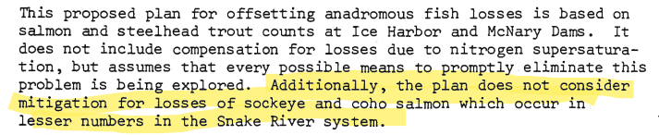
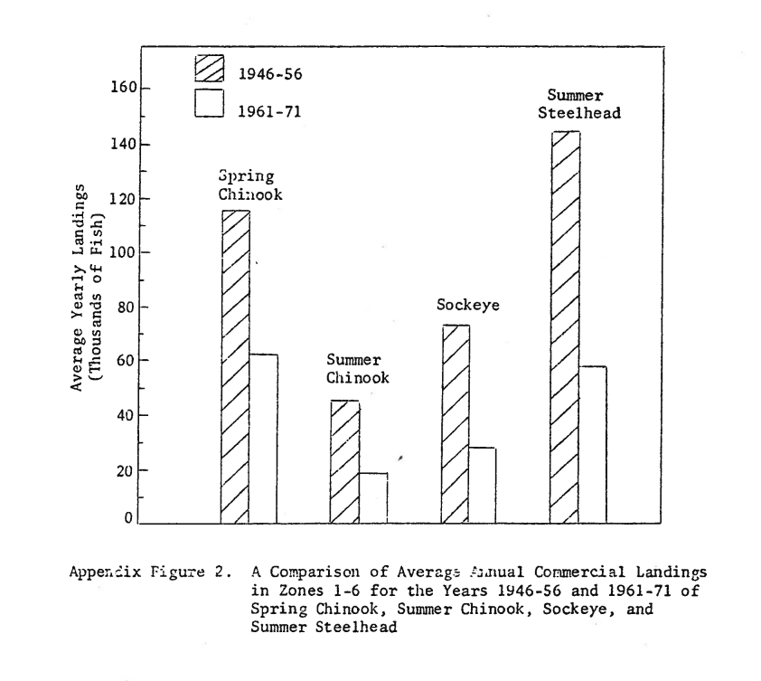
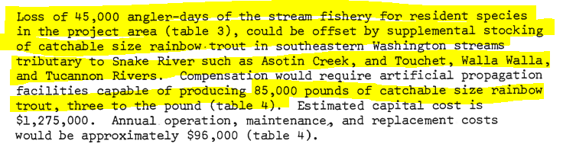
1975 COE Report to Congress – Appendix A, B
A- 1972 Report by NOAA-Fisheries and USFWS
Discusses multiple facets of mitigation (wildlife, fisheries, lands).
Concept of trout mitigation for lost angler days due to reservoir inundation… WA.
WDFW Response to the report identified what would (mostly) become LSRCP mitigation.

Slide 5
Other specific losses related to inundation were identified, including spawning habitat for 5,000 fall Chinook salmon adults through inundation, as well as significant loss of angler days for the steelhead trout fisheries in the free-flowing 140 miles of rivers and streams, and resident species angling opportunities. This latter impact was planned to be addressed by acquiring and providing permanent public fishing areas (see Wildlife Mitigation section) and stocking 93,000 pounds of catchable trout (233,000 fish at 2.5 per pound) in the State of Washington where most inundation impacts occurred. Through discussions between the USACE and Washington, this goal was later reduced to 86,000 pounds after instream habitat improvements in the form of structures were placed in southeast Washington tributaries - (Herrig 1990).
U.S. Fish and Wildlife Service (USFWS). 2020. Lower Snake River Compensation Plan: Fiscal Year 2018 Report. U.S. Fish and Wildlife Service, Lower Snake River Compensation Plan Office. Available: https://www.fws.gov/sites/default/files/documents/2018%20LSRCP%20Annual%20Report.pdf

Slide 6
The LSRCP project area is defined as the area upstream of Ice Harbor Dam extending to Lower Granite Dam and is inclusive of the Walla Walla Basin, a Columbia River Basin tributary in SE Washington adjacent to the Snake River basin. Early in the LSRCP implementation process, Washington selected the Walla Walla basin for portions of its summer steelhead mitigation program due to the paucity of suitable anadromous fish streams in SE Washington (Herrig 1990). Trout mitigation occurs predominantly within the State of Washington waters except for 6,200 pounds raised for Idaho waters.
U.S. Fish and Wildlife Service (USFWS). 2020. Lower Snake River Compensation Plan: Fiscal Year 2018 Report. U.S. Fish and Wildlife Service, Lower Snake River Compensation Plan Office. Available: https://www.fws.gov/sites/default/files/documents/2018%20LSRCP%20Annual%20Report.pdf

Slide 7
2011 ISRP Review
Let’s talk about steelhead!

Slide 8

LSRCP Steelhead Goals
Steelhead goals estimated same as other LSRCP goals for spring/summer and fall Chinook.
Trout mitigation also to be addressed during ISRP review (86,000 lbs)

Slide 9
Allocation of compensation (adults) by State as suggested by Columbia Basin Fisheries Technical Committee (reproduced from WDFW 1974). This allocation was not to be used as a specific indicator of release sites.
 | Washington |  |  | Oregon |  | Idaho
Area or Basin | Spring Chinook salmon | Fall Chinook salmon | Steelhead | Spring Chinook salmon | Steelhead | Spring-Summer Chinook | Steelhead
Snake River
Below Lewiston |  | 5,000
Lewiston – Hells Canyon |  | 9,728 | 2,208
Hells Canyon Dam |  | 3,648 |  |  | 1,368 | 1,200 | 1,368
Tucannon River | 1,152 |  | 1,632
Clearwater River |  | 68 |  |  |  | 288 | 20,736
Asotin Creek |  |  | 816
Grande Ronde River |  |  |  | 5,856 | 7,632
Salmon River |  |  |  |  |  | 46,656 | 16,896
Imnaha River |  | 68 |  | 3,216 | 1,920
Small Tributaries |  |  |  |  | 264 | 288 | 264
Totals | 1,152 | 18,512 | 4,656 | 9,072 | 11,184 | 48,432 | 39,264
Notes:
All numbered tables and figures are from the Draft LSRCP 2018 Biennial Report (Version February 2020).
The Clearwater and Salmon River breakdown of spring/summer Chinook and steelhead reflected where the committee thought salmon/steelhead production was coming from. As the table caption states, the committee was specific to say that these areas should not be used as specific indicator of release sites (ie. There’s flexibility).
The Hells Canyon

Slide 10
Steelhead project area goal distributed by basin or area for the Lower Snake River Compensation Plan Program. Associated targets for smolt-to-adult recovery (SAR), coastwide harvest, total adults produced (includes jacks) and smolt-to-adult survival (SAS) are also provided. Distribution of the adult goal for B-Steelhead in the Salmon Basin will be determined in 2020. The historical SAR of 0.50% used to size the LSRCP program to achieve 55,100 steelhead (WDFW 1974) has changed over time. The Clearwater Basin SAR reflects a higher rate of survival due to limited rearing space for LSRCP steelhead (Warren 2018).
Basin/Area | Steelhead Type | Distribution of the Project Area Goal | SAR (%) | Coastwide Harvest Objectives (2:1) | Total Adults Produced | SAS (%)
Clearwater (Idaho) | B-Steelhead | 14,000 | 1.66 | 28,000 | 42,000 | 4.98
Salmon (Idaho, Hagerman NFH Production) | A-Steelhead | 13,600 | 0.94 | 27,200 | 40,800 | 2.82
Salmon (Idaho, Magic Valley Production) | A-Steelhead | 11,660 | 0.73 | 23,320 | 34,980 | 2.19
 | B-Steelhead | TBD
Grande Ronde (Oregon) | A-Steelhead | 9,184 | 0.68 | 18,368 | 27,552 | 2.04
Imnaha (Oregon) | A-Steelhead | 2,000 | 0.61 | 4,000 | 6,000 | 1.83
SE Washington | A-Steelhead | 4,656 | 0.79 | 9,312 | 13,968 | 2.37
Totals |  | 55,100 |  | 110,200 | 165,300

Slide 11
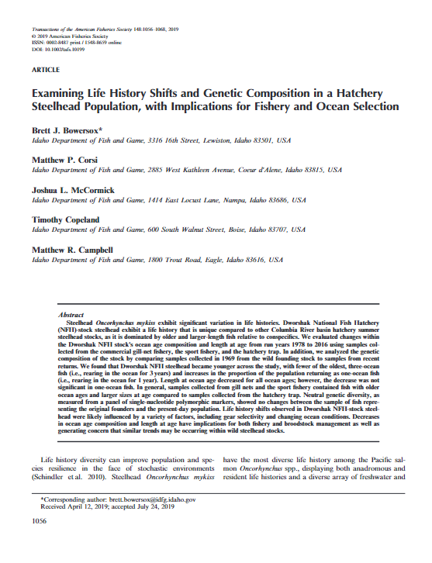
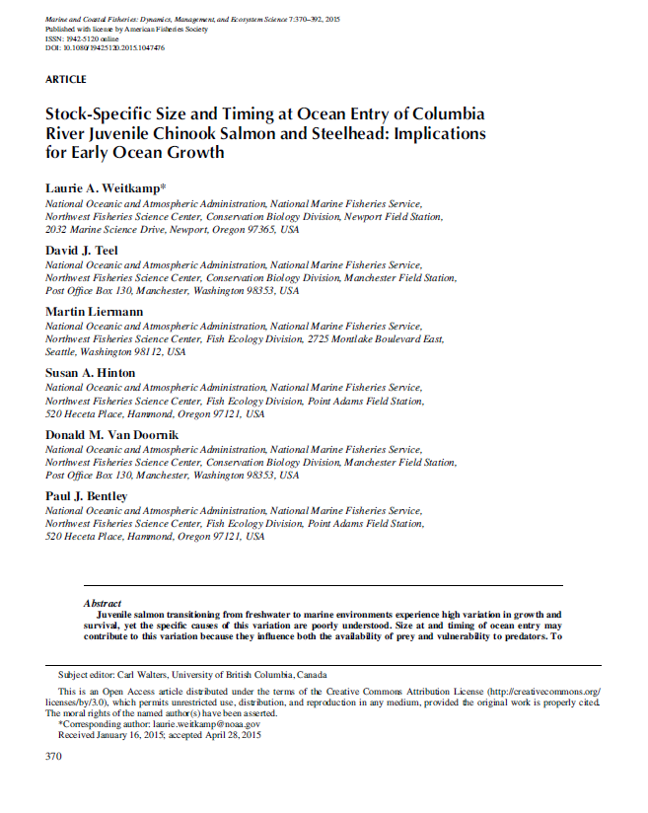
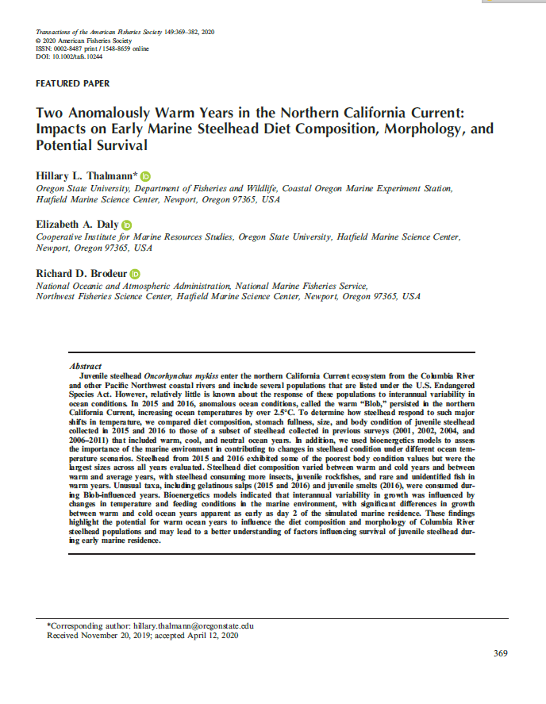
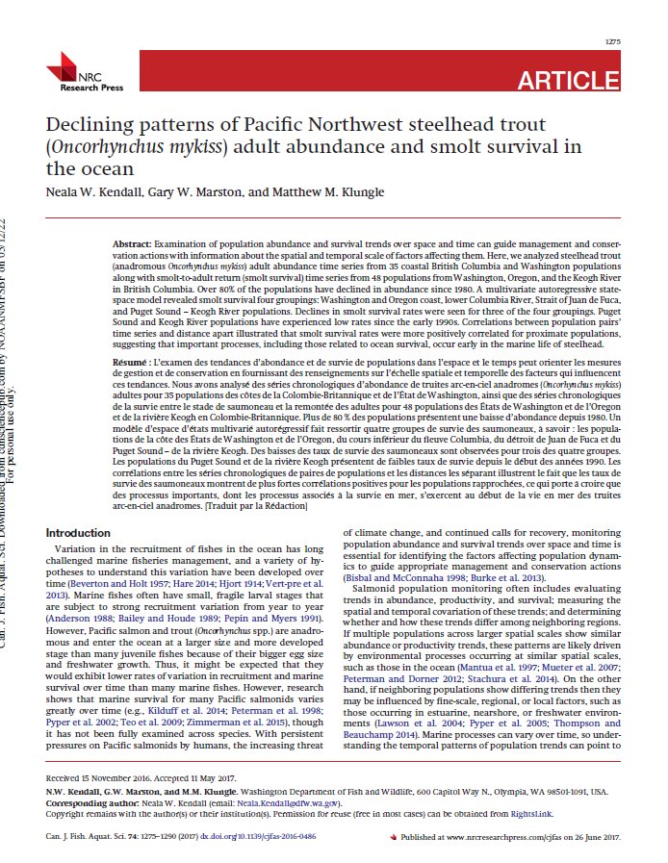
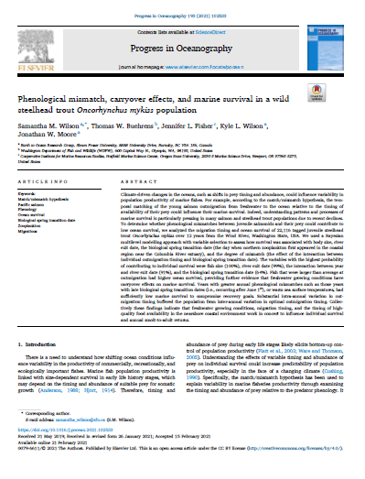
What is happening with steelhead?
Ocean prey and surface temperature changes, ocean warming, blob.
Population declines coastwide and in-basin.
Declines in adult size/age (environment, fisheries)
Rapidly decreasing abundance and fisheries (2015)
Notes:
Wilson et al. Phenological mismatch, carryover effects, and marine survival in a wild steelhead trout Oncorhynchus mykiss population – ocean prey and surface temperature
Yesterday – L. Weitkamp, blob prey availability, sea surface temps.
Kendall et al. 2017 - Declining patterns of Pacific Northwest steelhead trout (Oncorhynchus mykiss) adult abundance and smolt survival in the ocean
Thalmann et al. 2020 - Two Anomalously Warm Years in the Northern California Current: Impacts on Early Marine Steelhead Diet Composition, Morphology, and Potential Survival
Van Doornik et al. 2019 - Insights, from genetic analyses, into stock-specific distribution of juvenile steelhead (Oncorhynchus mykiss) from the Columbia River during early marine migration
Bowersox et al. – Examining life history shifts and genetic composition in a hatchery steelhead population, with implication for fishery and ocean selection.

Slide 14
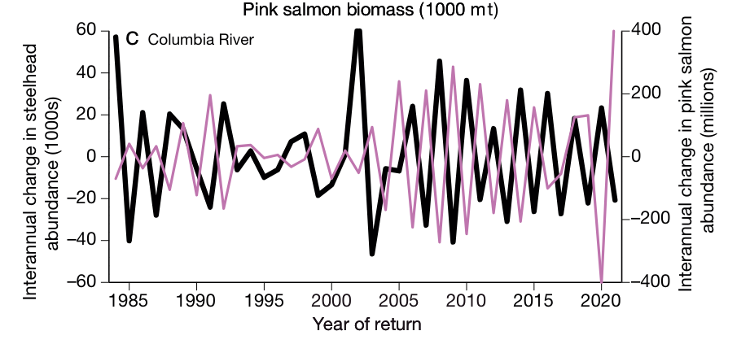
Interaction with Pink Salmon
Ruggerone et al. 2023, interaction with B-steelhead and odd-year pink abundance over 38 years.
Less interaction with A-run (1 year in ocean).
Notes:
Interannual change in abundances of Columbia River B-run summer steelhead (black line) and North Pacific pink salmon (pink line) during 1984−2021

Slide 15
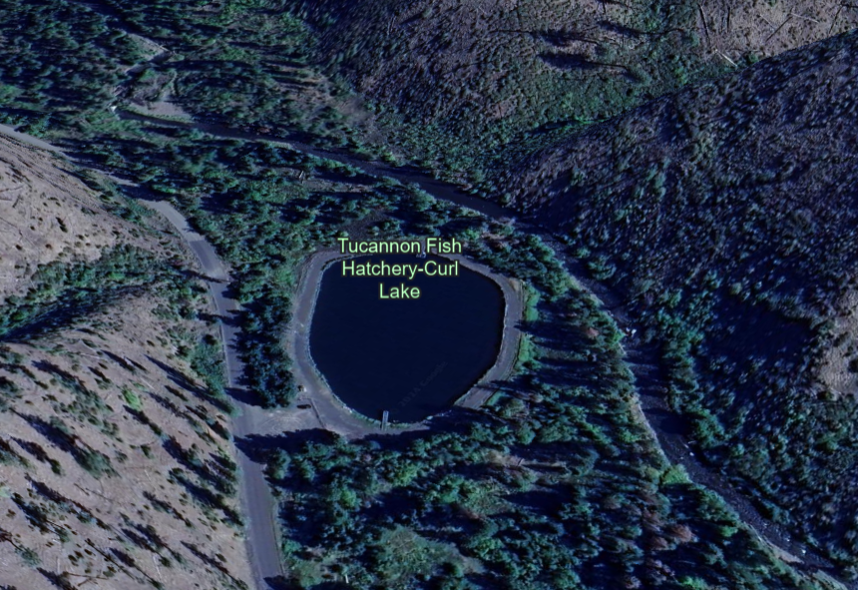
LSRCP Trout Program
Wooten Hills Project Kickoff
Restoration efforts supported by WDFW, NPT, CTUIR others to look at more channel meandering in Tucannon.
Discussing impact to lakes in Tucannon and potential changes to LSRCP trout mitigation efforts

Slide 16
Upcoming ISRP Review
LSRCP performance since 2011
Discussion and presentation of several items and steelhead programs expected
Reciprocal study results (Wallowa Stock steelhead)
Early vs. Late brood (Wallowa stock)
A/B changes in upper Salmon River
Changes in size of steelhead performance over time
PRAS evaluation
So many more….!
January 21-24, 2025 – Oxford Suites hotel block,

Slide 17
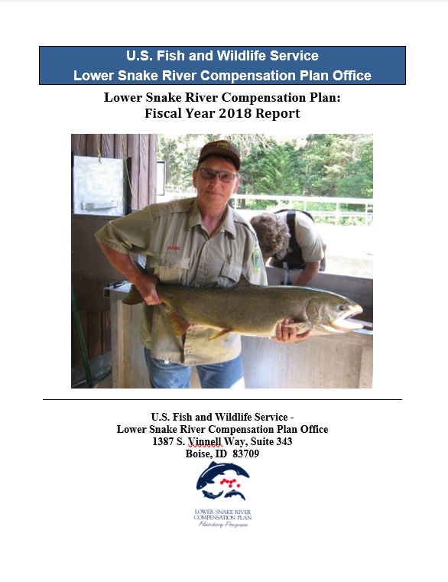
Miscellaneous - LSRCP Report!
FY2018 was when last report was completed (2020).
LSRCP has started a report that will cover FY19-23
Will have updated performance information for all three programs
Programmatic changes and background on administration of the program.
Targeting October for DRAFT for review.
Question yesterday regarding how programs compare to one another….

Slide 19
Questions?

Slide 20
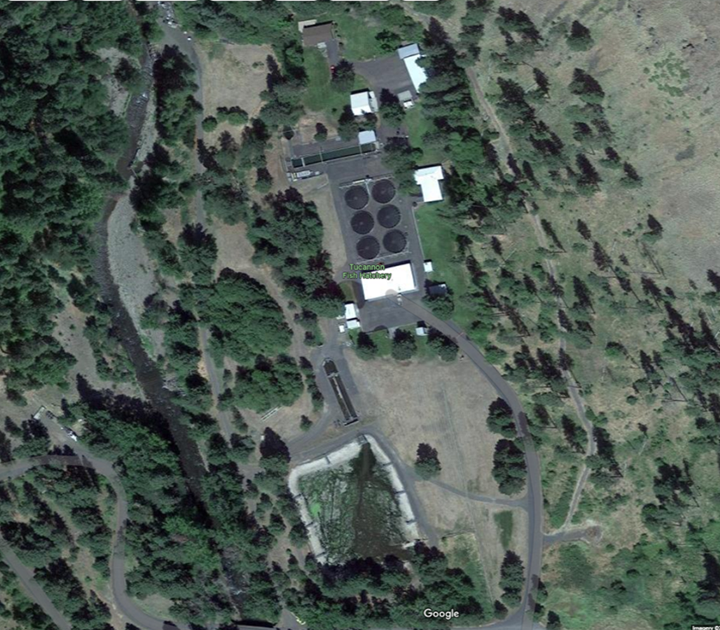
Summary
Change happens and is happening…, flexibility and communication is paramount to LSRCP involvement and partnerships we maintain.
Adult-based compensation for anadromous salmon/steelhead species ensures adaptive management framework and requires adequate monitoring/infrastructure.

