Slide 1
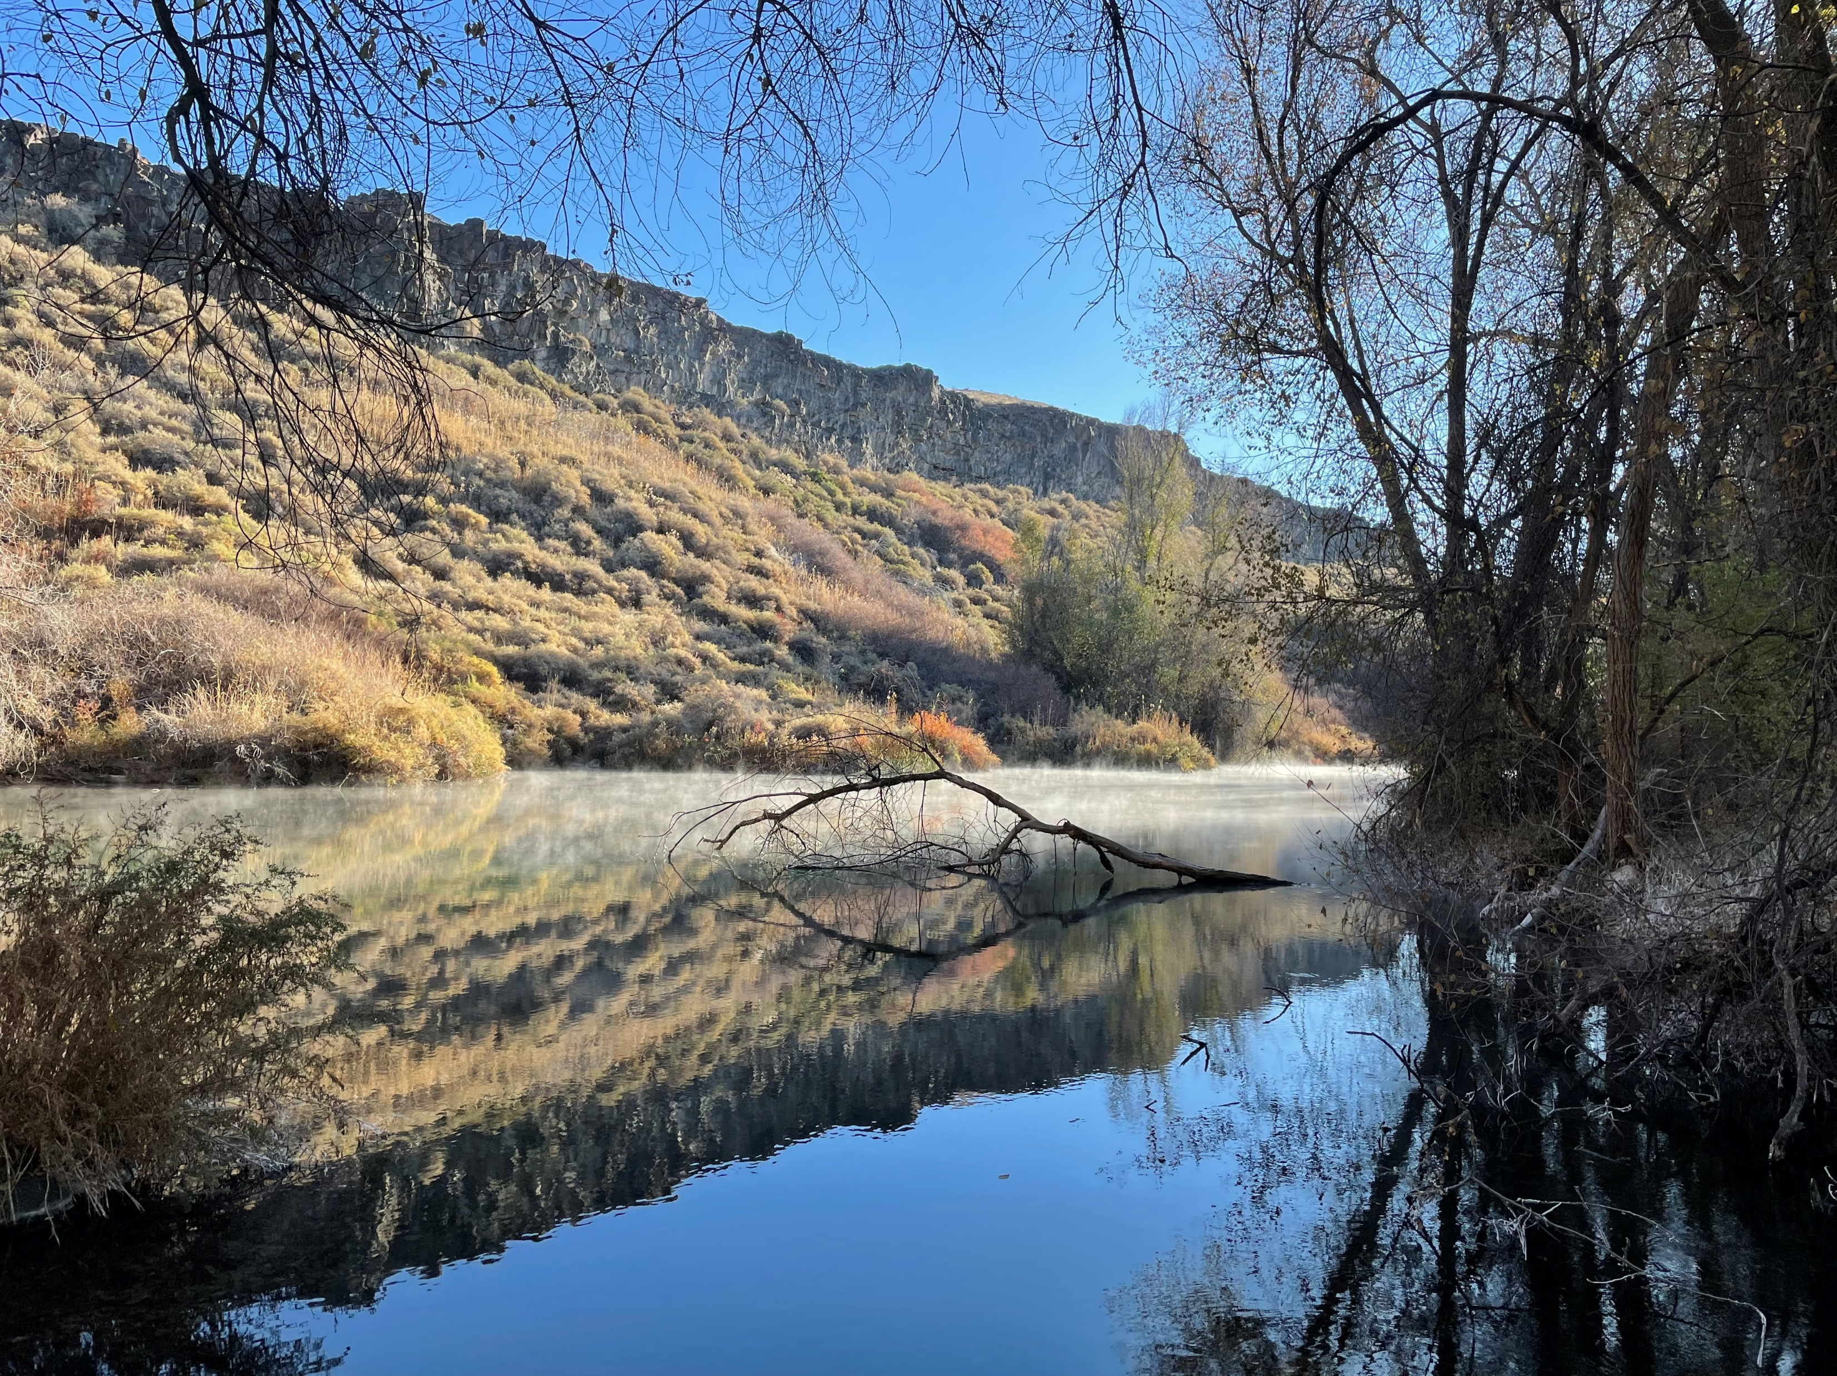
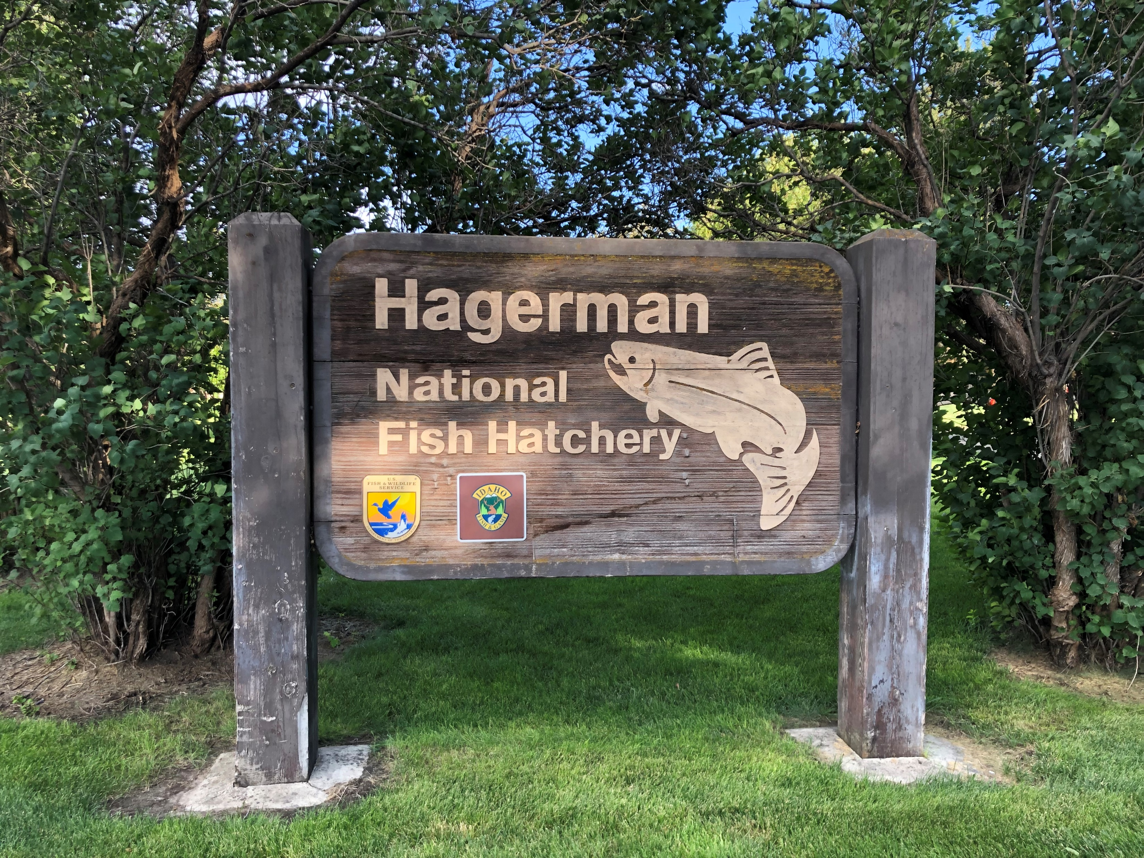
Hagerman National Fish Hatchery Overview
2024 LSRCP meeting

Slide 2
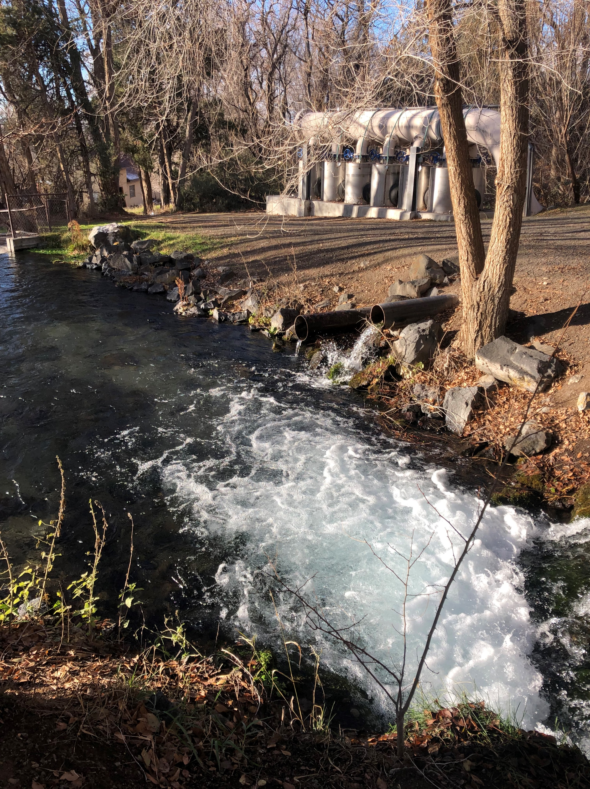
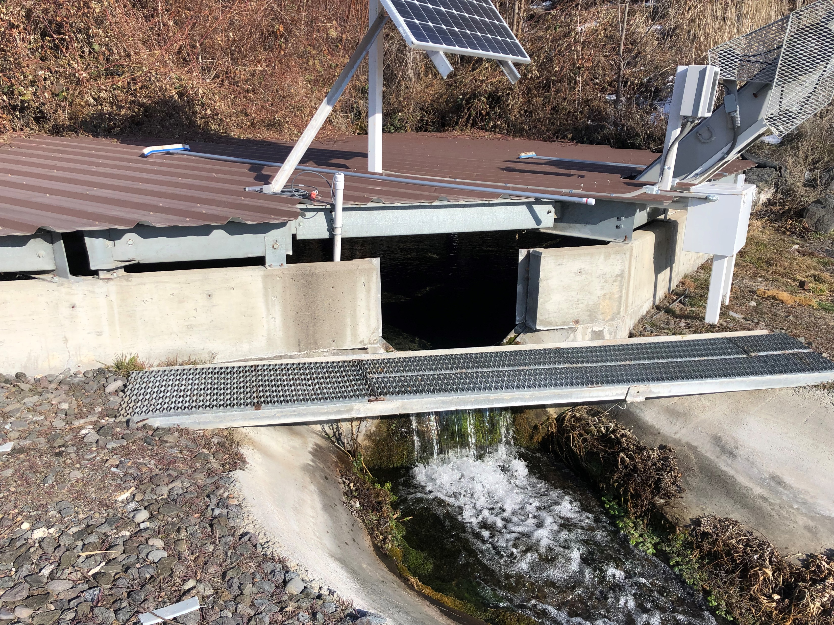
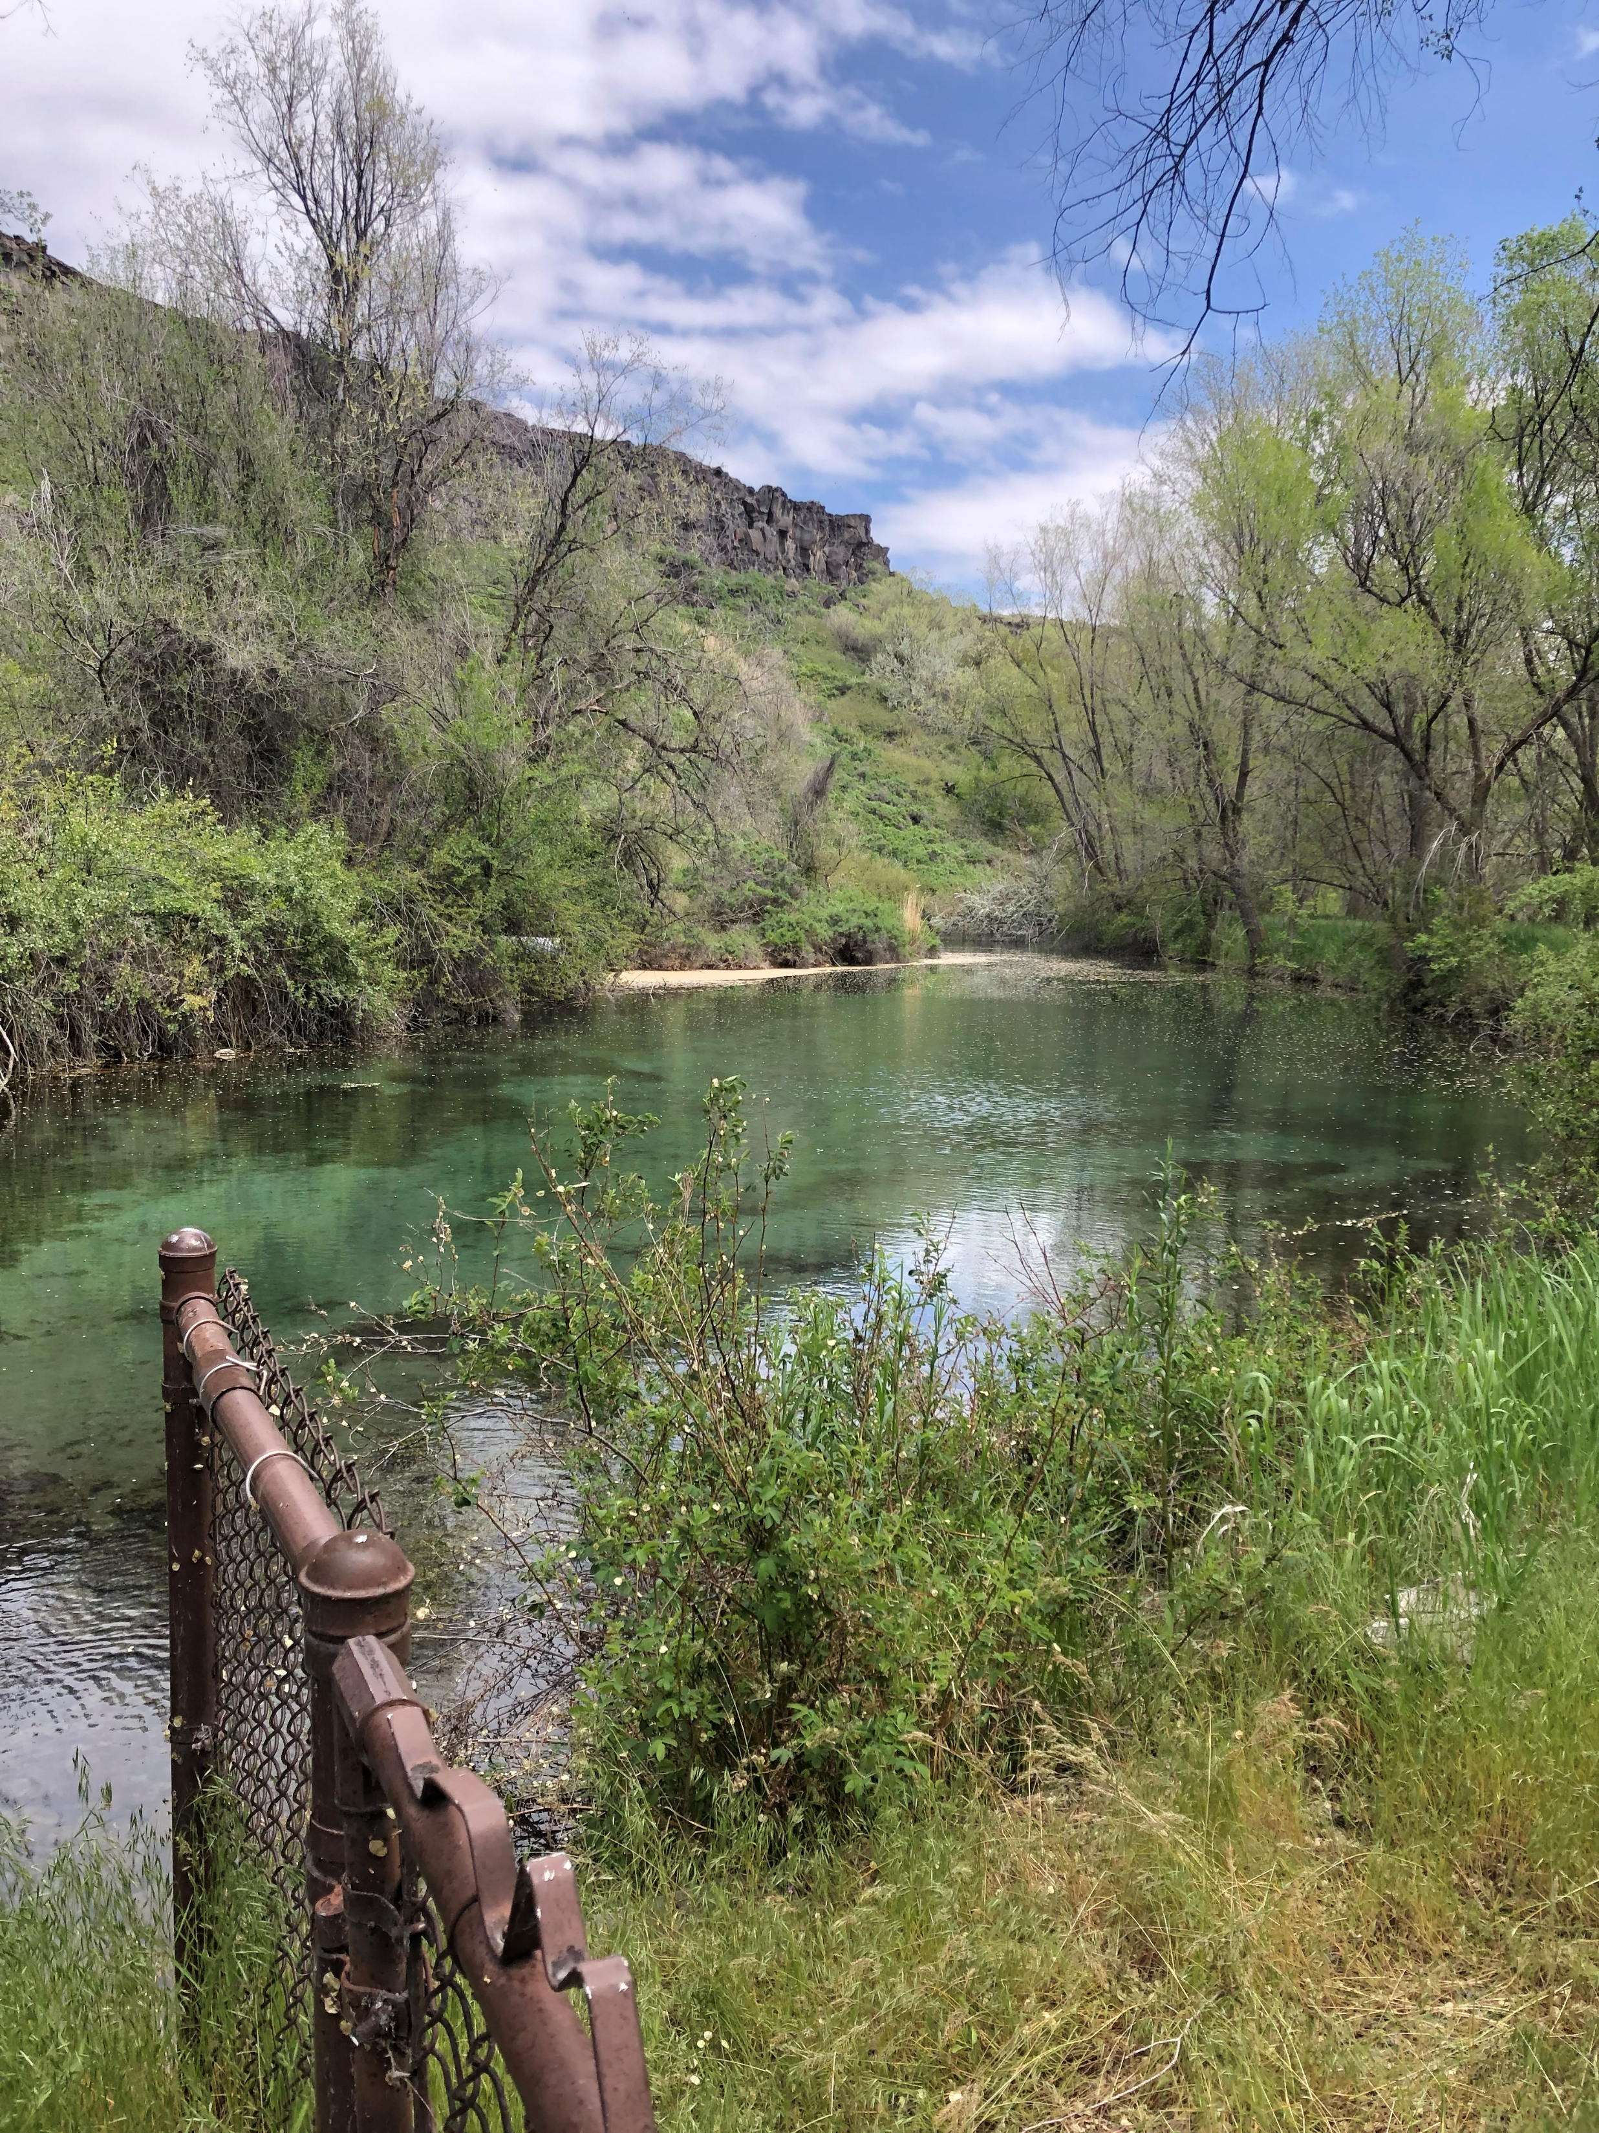
WATER SUPPLY
Multiple open spring sources at 59˚F feed the early rearing buildings and outdoor raceways
~60 CFS of water available for fish production depending on time of year
Notes:
HNFH has multiple open spring sources that supplies the hatchery with water. Some of these are hillside seeps that are captured via pipeline and then combine into a flume or weir , and we have 2 manmade lakes that also supply water to the hatchery. The water is a constant 59 degrees farenheight.

Slide 3
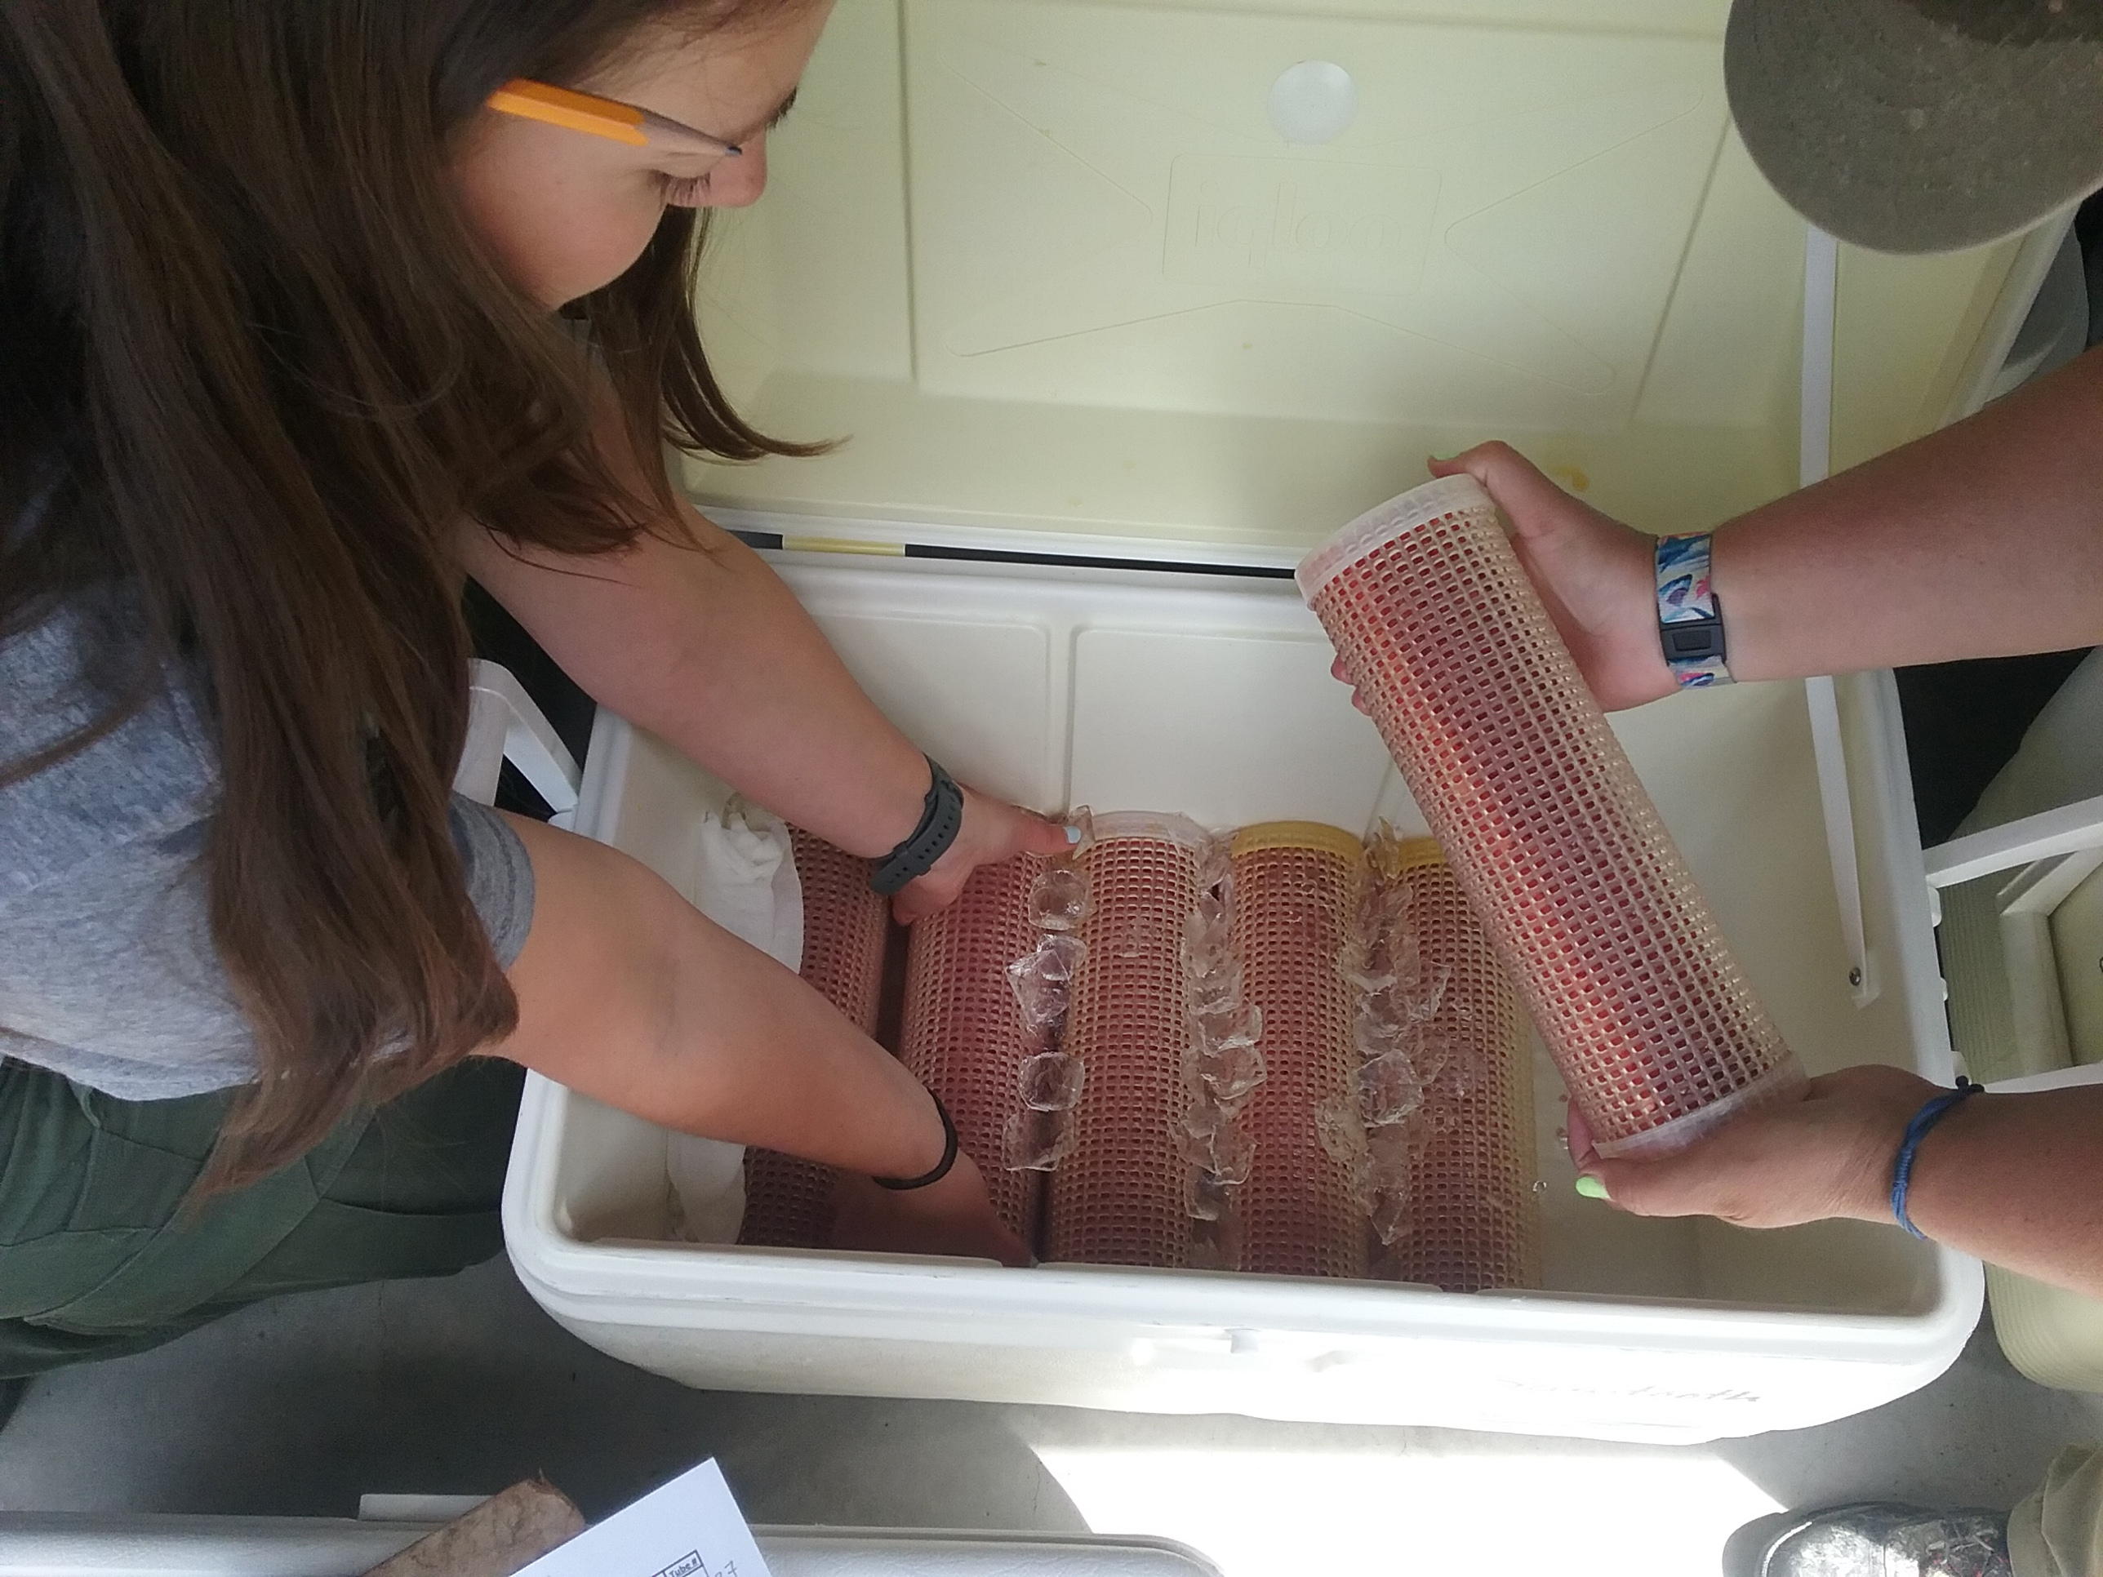
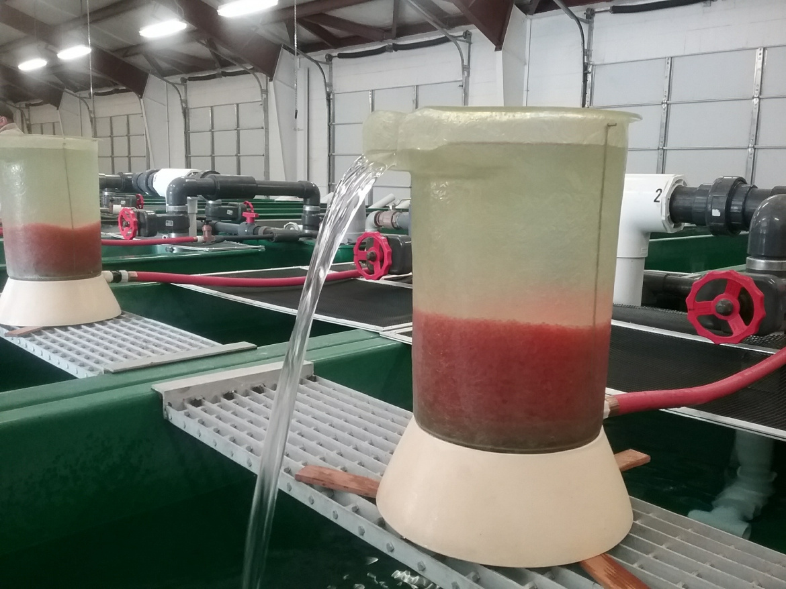
MITIGATION GOALS
Receive eggs from Sawtooth Fish Hatchery (IDFG) late May – early June
Overall release goal 1,560,000 steelhead smolts at 4.5 FPP
  Sawtooth weir – 1,410,000
  PRAS evaluation – 90,000
  E. Fork Salmon River – 60,000
Notes:
Receive eyed eggs from Sawtooth fish hatchery from late may to early June . HNFH’s overall release goal is 1.56 million steelhead smolts that are released at 4.5 FPP.

Slide 4
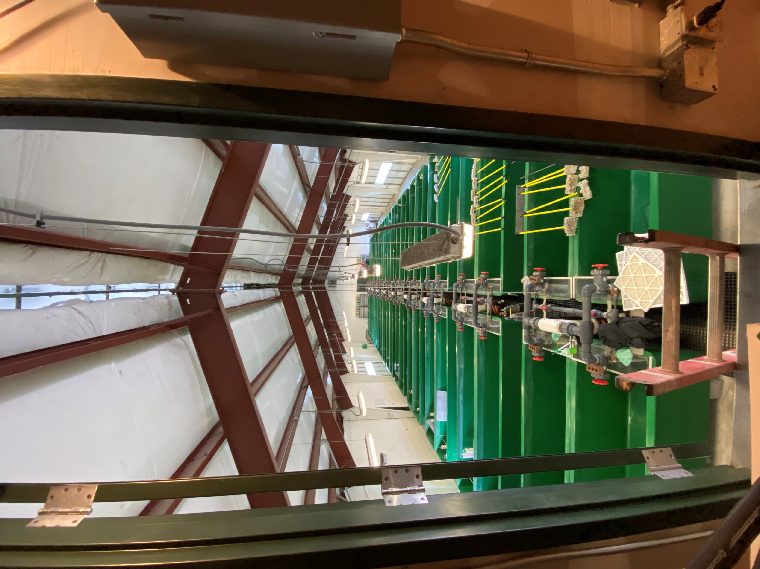
EARLY REARING
40 vats Hatch 1 (14.25 x 3.3 x 2 ft)
20 vats Hatch 2 (14 x 3 x 2 ft)
3 vats PRAS (18.5 x 3 x 2 ft)
Max DI < 0.70
Max FI < 0.76
Rear to ~120 FPP
Notes:
We can put ~30,000 fish to 120 fpp in H1, ~22,00 in H2, and ~35,000 in PRAS vats to get our maximum densities. We rear these to around 120 fpp for them to then go through the marking trailers.

Slide 5
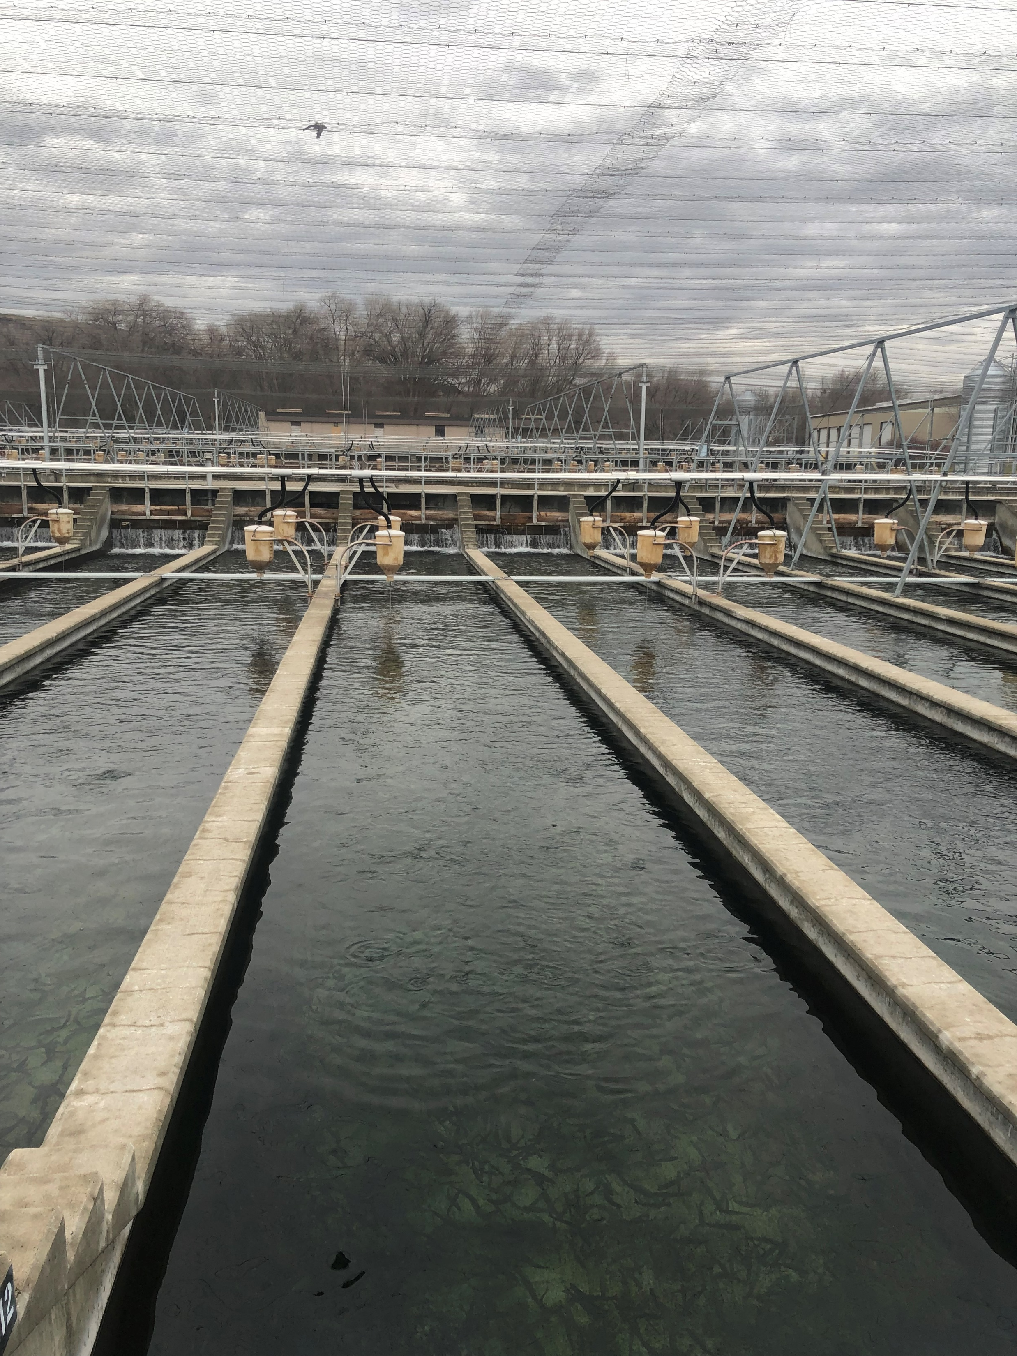
OUTDOOR REARING
66 steelhead raceways, use ~54 of them
  Serial Reuse
  DI < 0.30
  FI <1.60
12 “trout raceways”
3 PRAS tanks
  DI < 0.30
  FI < 1.20
Notes:
Steelhead raceways 100x10x3.08
Trout raceways 66x8x2.25
PRAS 30x6 feet deep

Slide 6
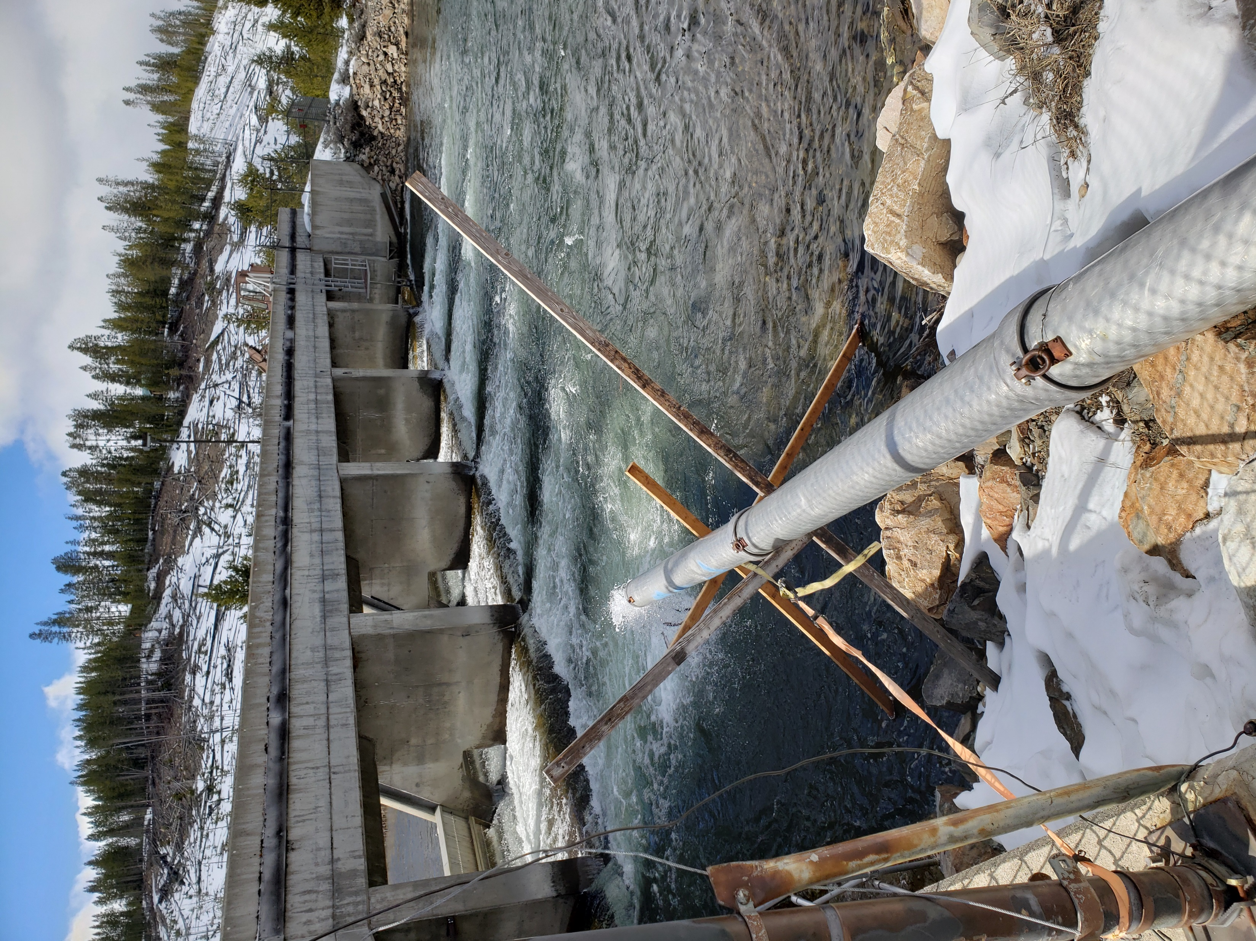
RELEASE
Start shipping fish to Sawtooth the first week of April and end the last week of April
Usually start with PRAS fish, then SAW A, then East Fork fish due to weather and road conditions
Use Rich Thompson Trucking out of Jerome, Idaho.
  4 LSRCP trucks with 5 tanks
  1,000 lb capacity/tank

Slide 7
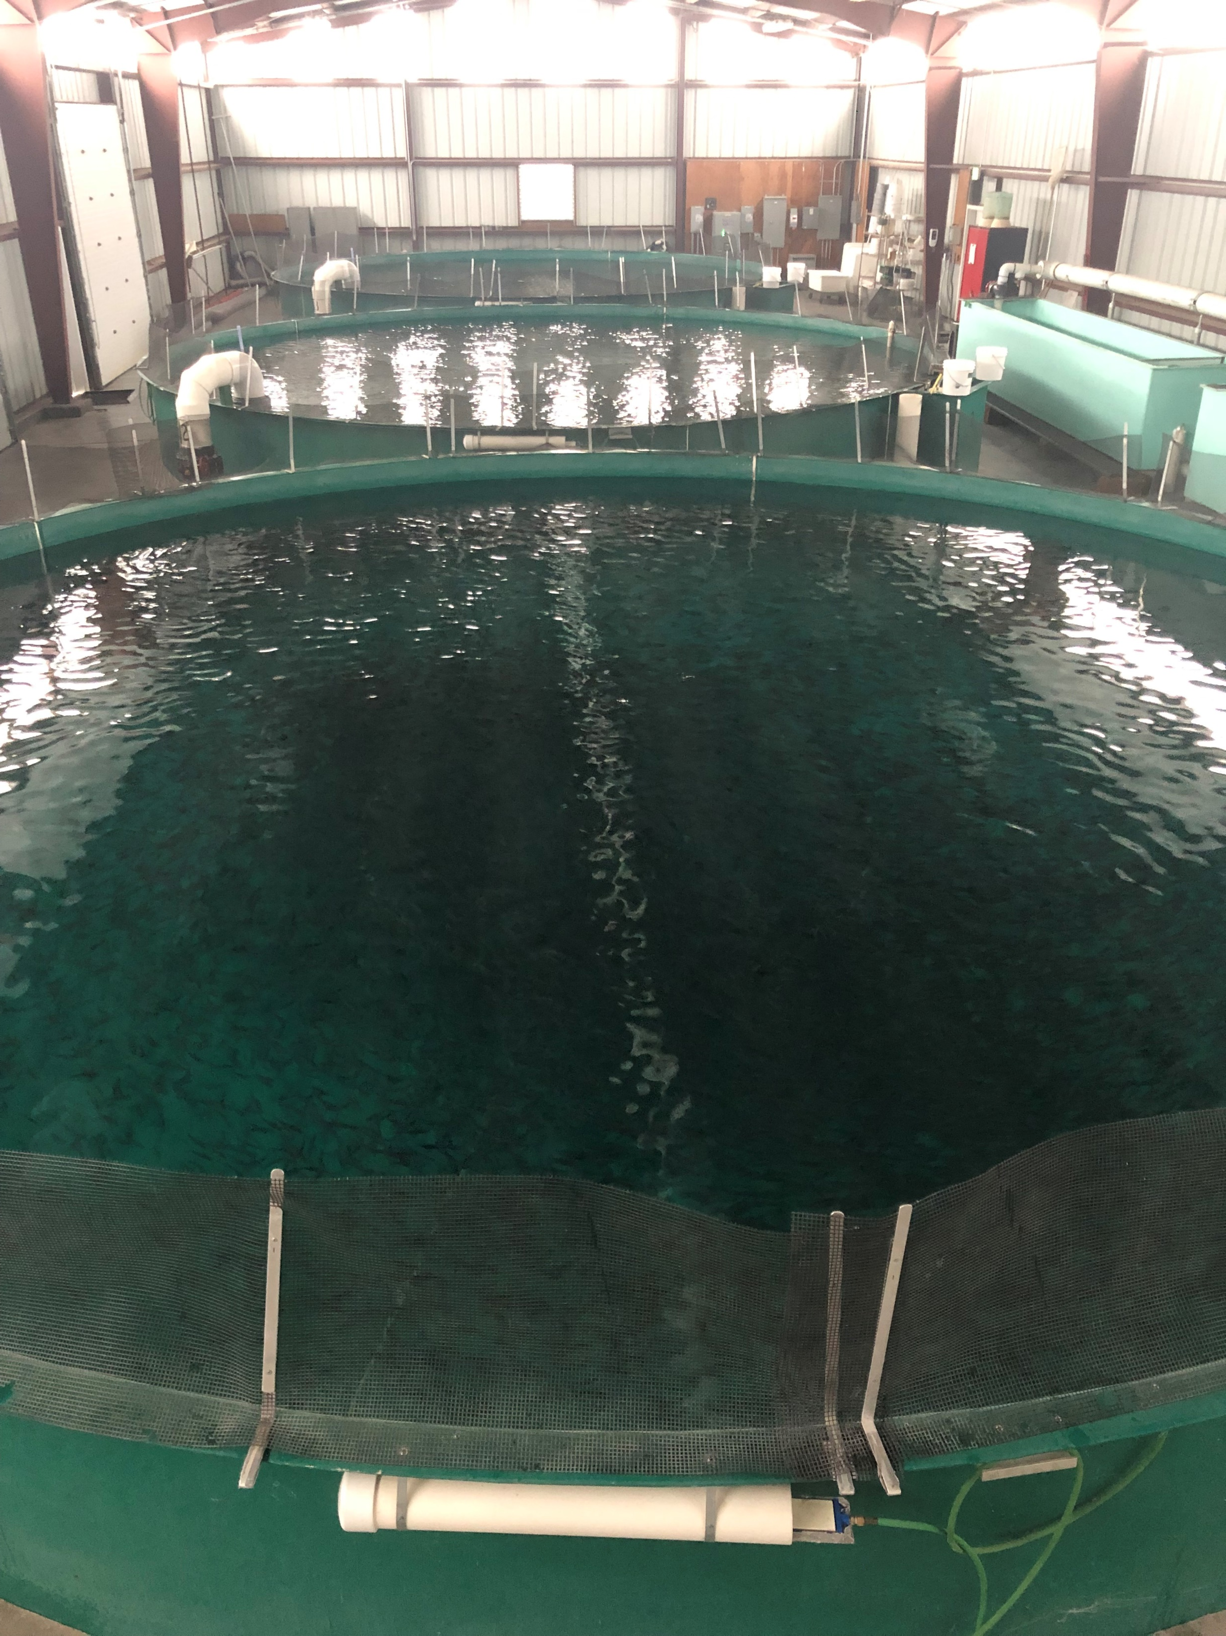
BOTTLENECKS AND LIMITATIONS
MARKING
  We are rushed to get our fish to 120 FPP for marking
  Our last fish on station historically don’t go on feed until early July
INITIAL OUTDOOR REARING
  Our fish get moved into 100 ft raceways at 120 FPP – we have a hard time feeing in large raceways
PRAS OUTMIGRATION
  PRAS has not been out-migrating as successfully as raceway fish

Slide 8
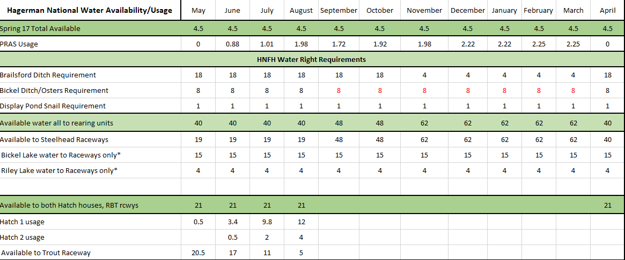
BOTTLENECKS AND LIMITATIONS
WATER
We have ~60 CFS available to the raceways but it fluctuates and has been declining.
Bound by senior water rights

Slide 9
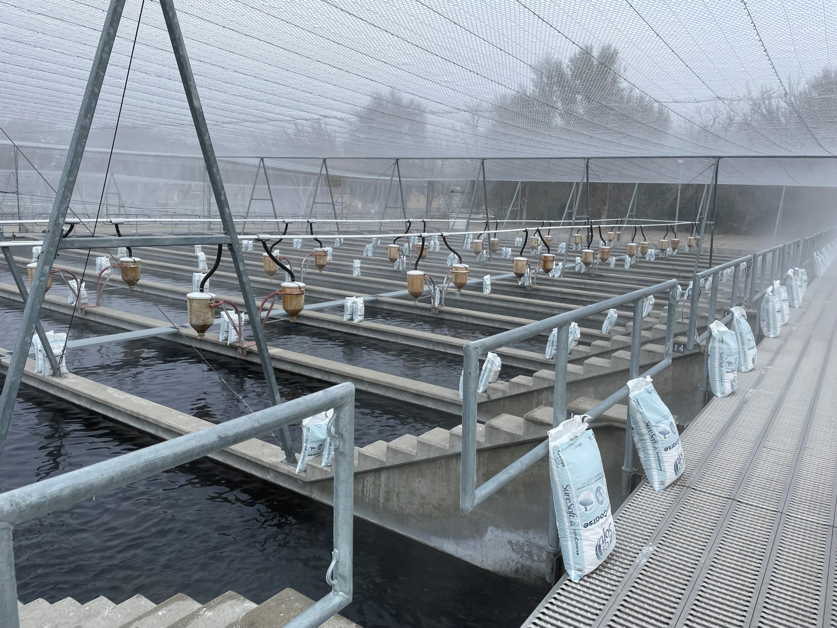
OPPORTUNITIES FOR IMPROVEMENT
KEYWAYS AT 50’
  This would help HNFH staff to start hand feeding small fish instead of chasing around the large raceway
SHADE COVER
  Keep algae down, less salting the raceways to keep clean
ACCLIMATION
  Keep steelhead smolts at Sawtooth prior to release or rear PRAS fish in linear raceways

Slide 10
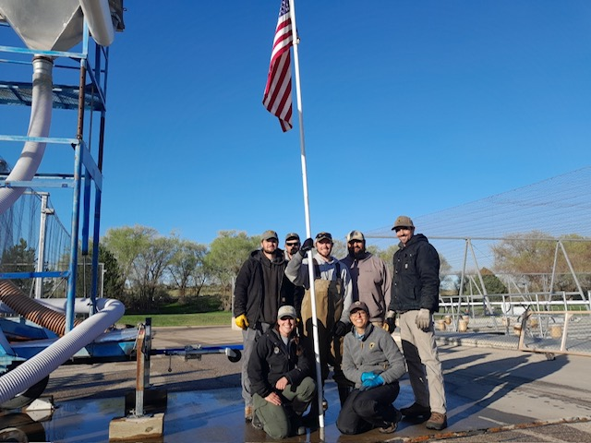
QUESTIONS?

