Slide 1
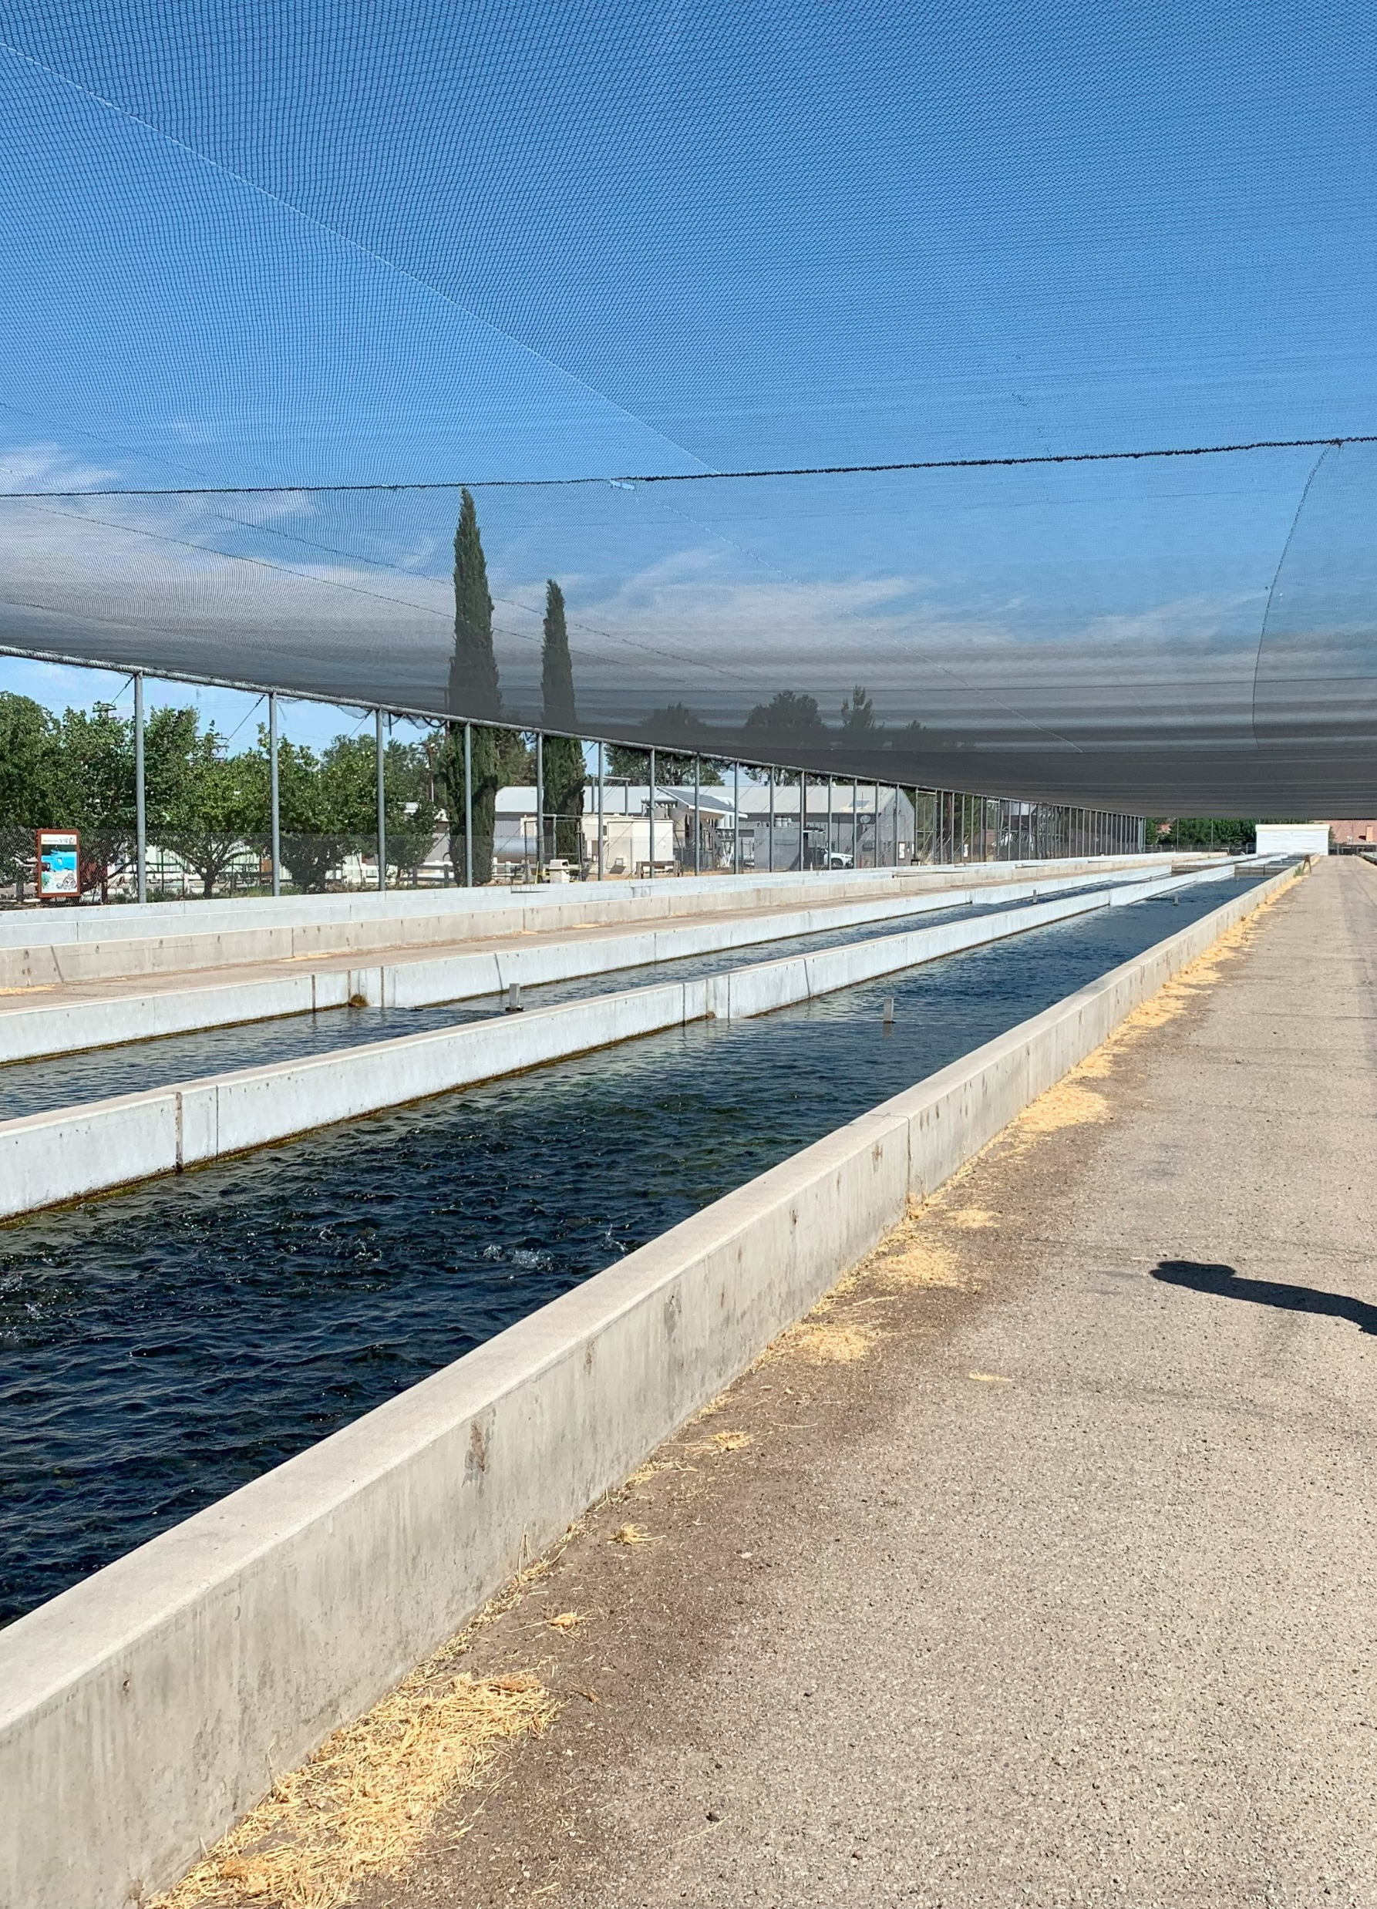
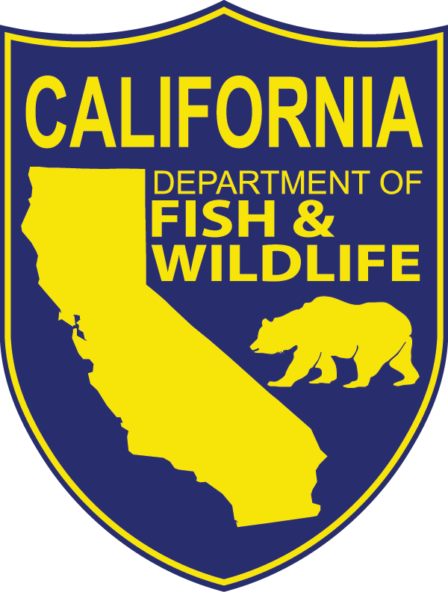
Climate change and California’s hatcheries
2024 Lower Snake River Compensation Program Meeting
Idaho Fish and Game HQ – Boise, ID
May 8, 2024
What we have seen and what we are planning to do
Derek Nelson, PE
Vice President – McMillen Inc
Ken Kundargi
Environmental Program Manager, Fisheries Branch – California Department of Fish and Wildlife

Slide 2

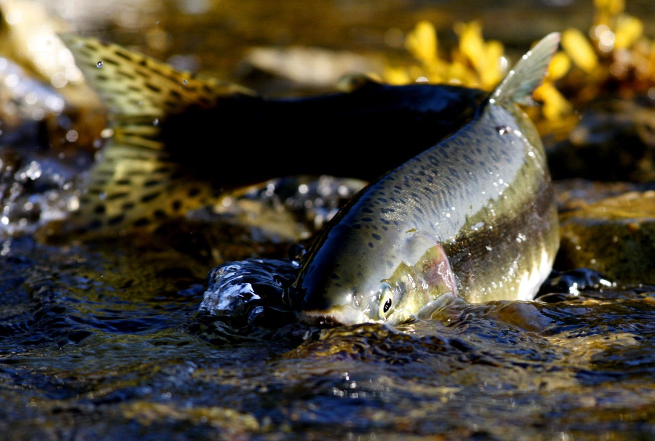
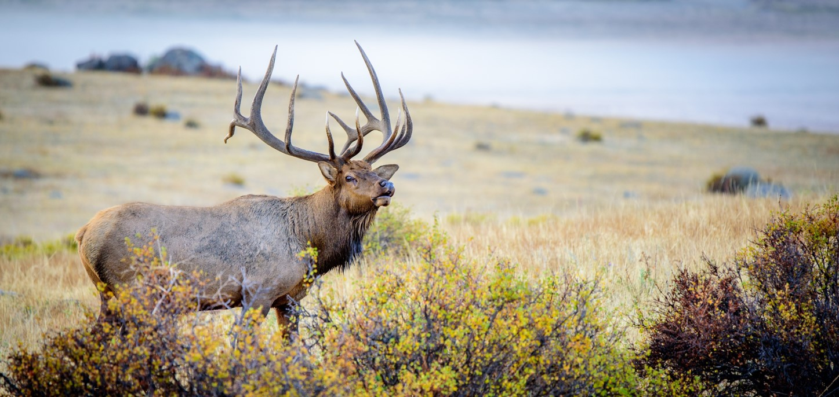
CDFW’s Mission
To manage California’s diverse fish, wildlife, and plant resources, and the habitats upon which they depend, for their ecological values and their use and enjoyment by the public.
Notes:
Hatchery program is a tool to meet this mission

Slide 3
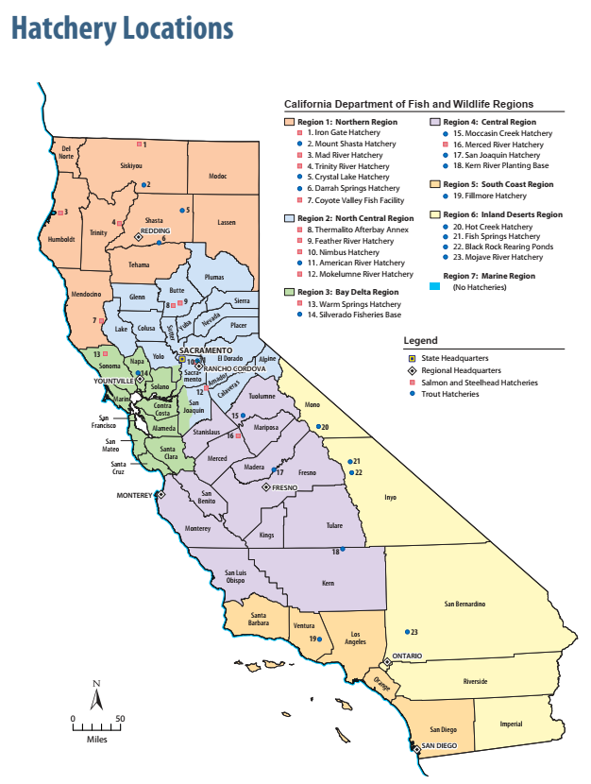
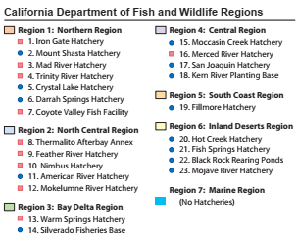
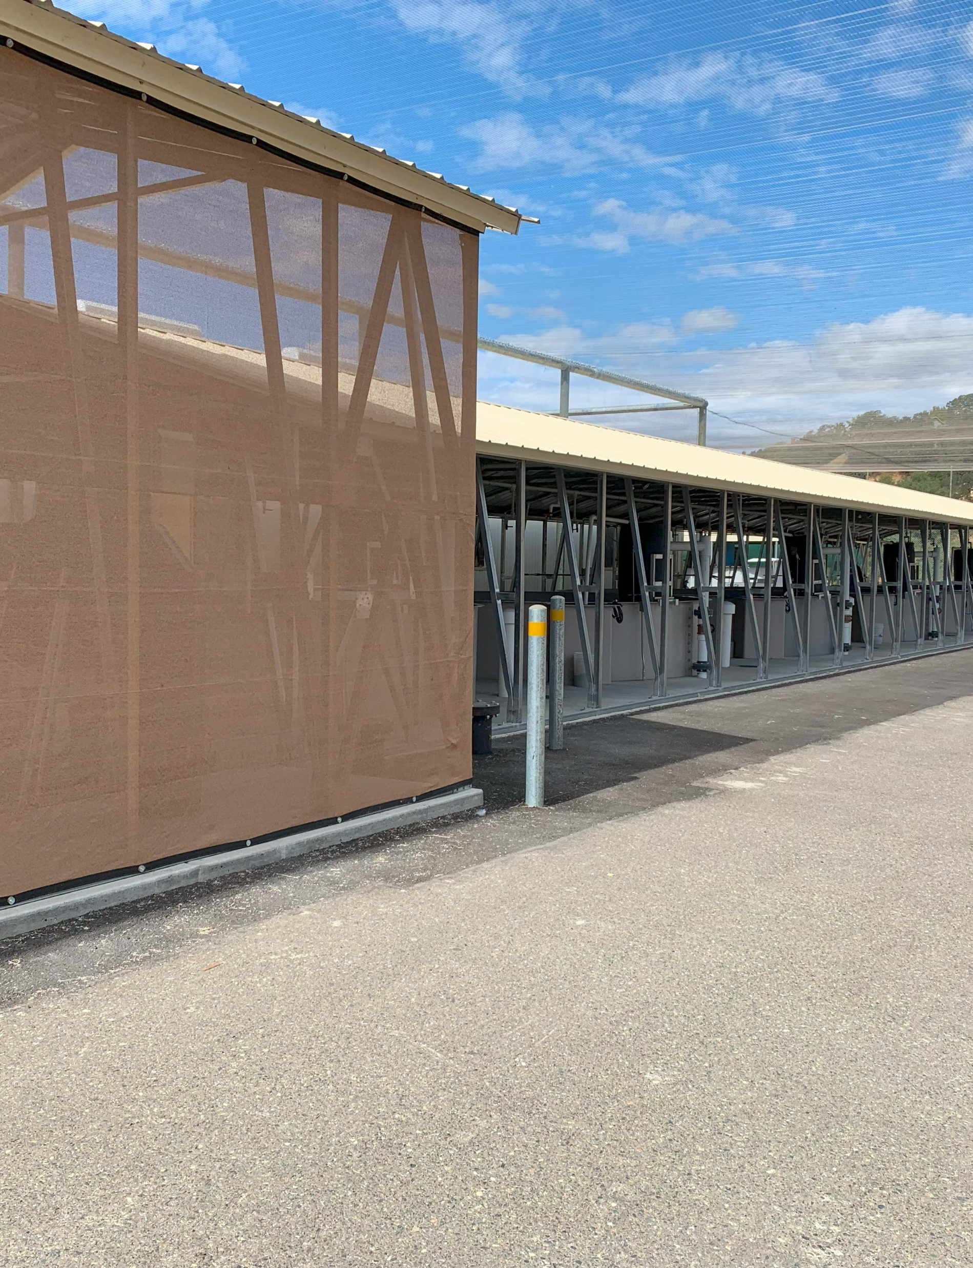


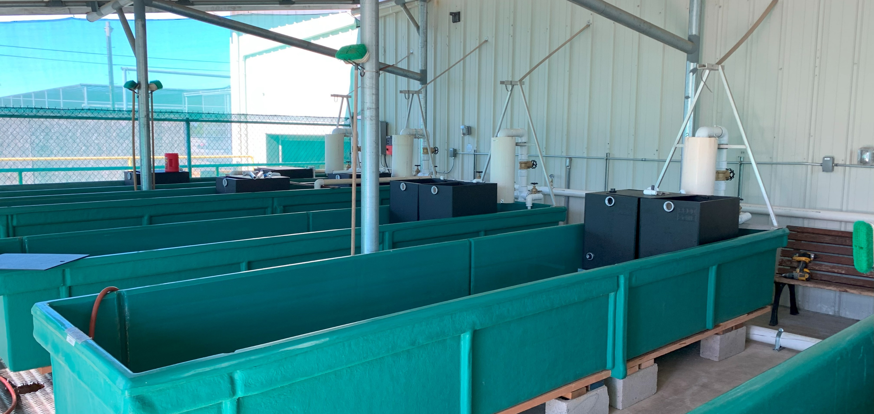
California’s Fish Hatcheries
10 Salmon and Steelhead Hatcheries
13 Trout Hatcheries
Notes:
Trinity already evaluated. Iron Gate abandoned as dam is removed.

Slide 4
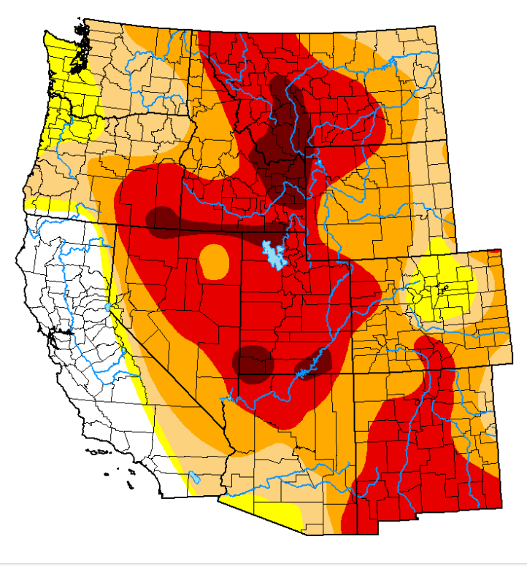
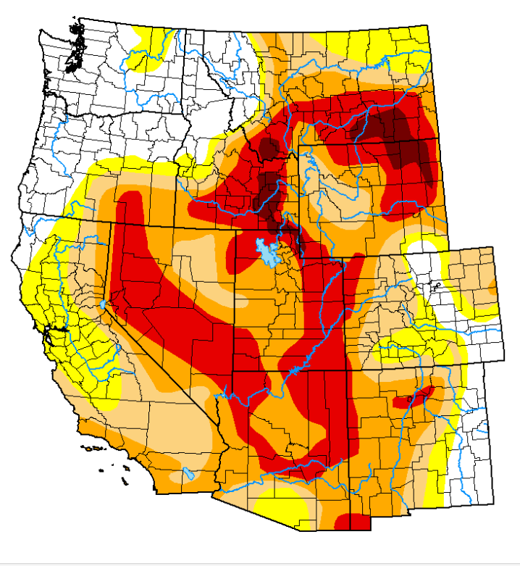
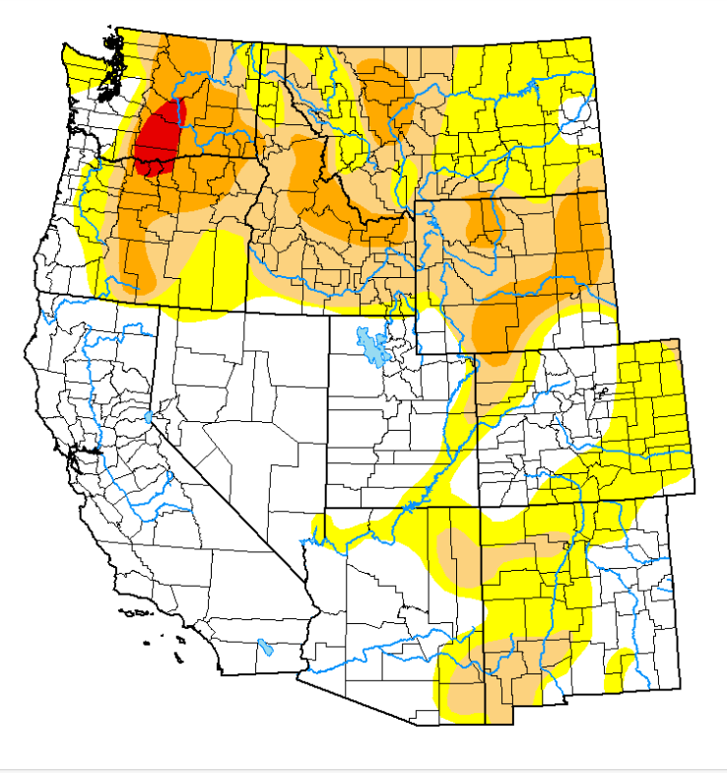
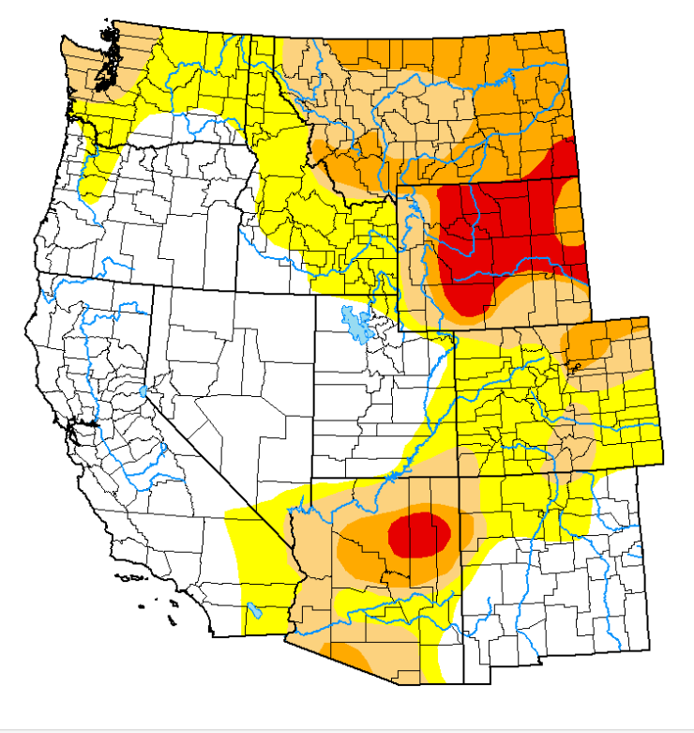
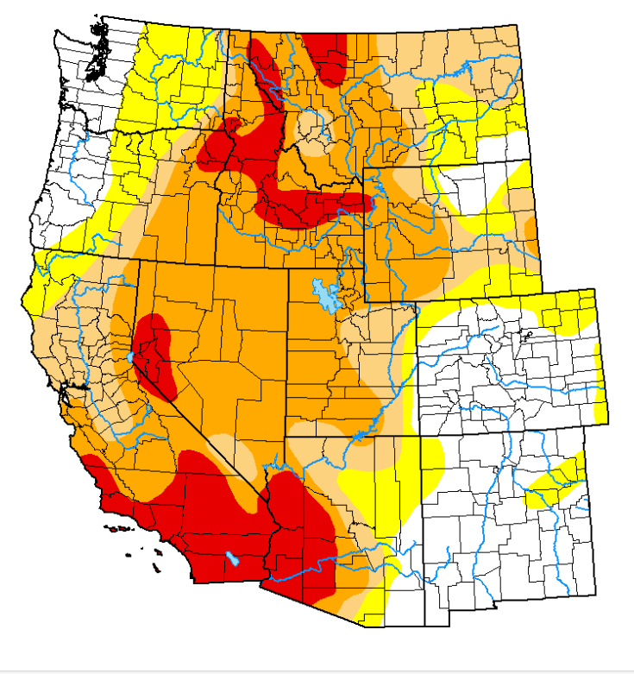
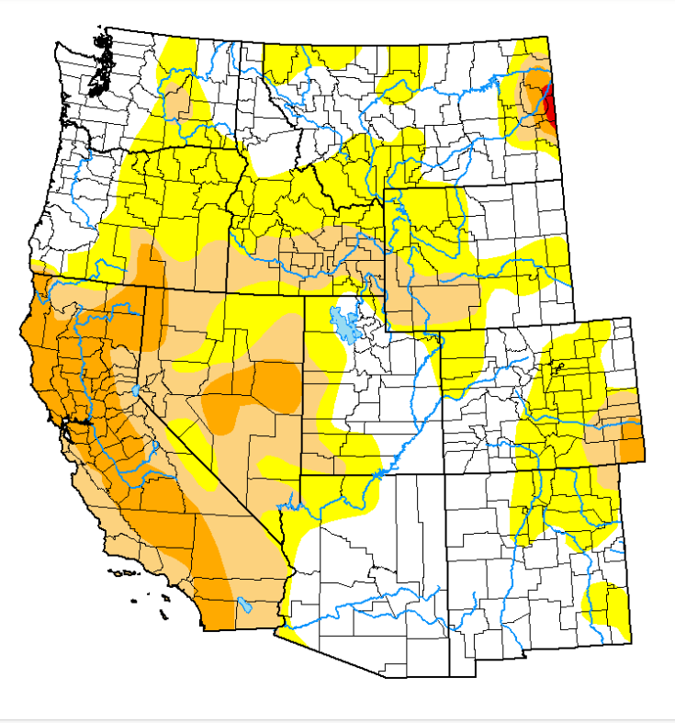
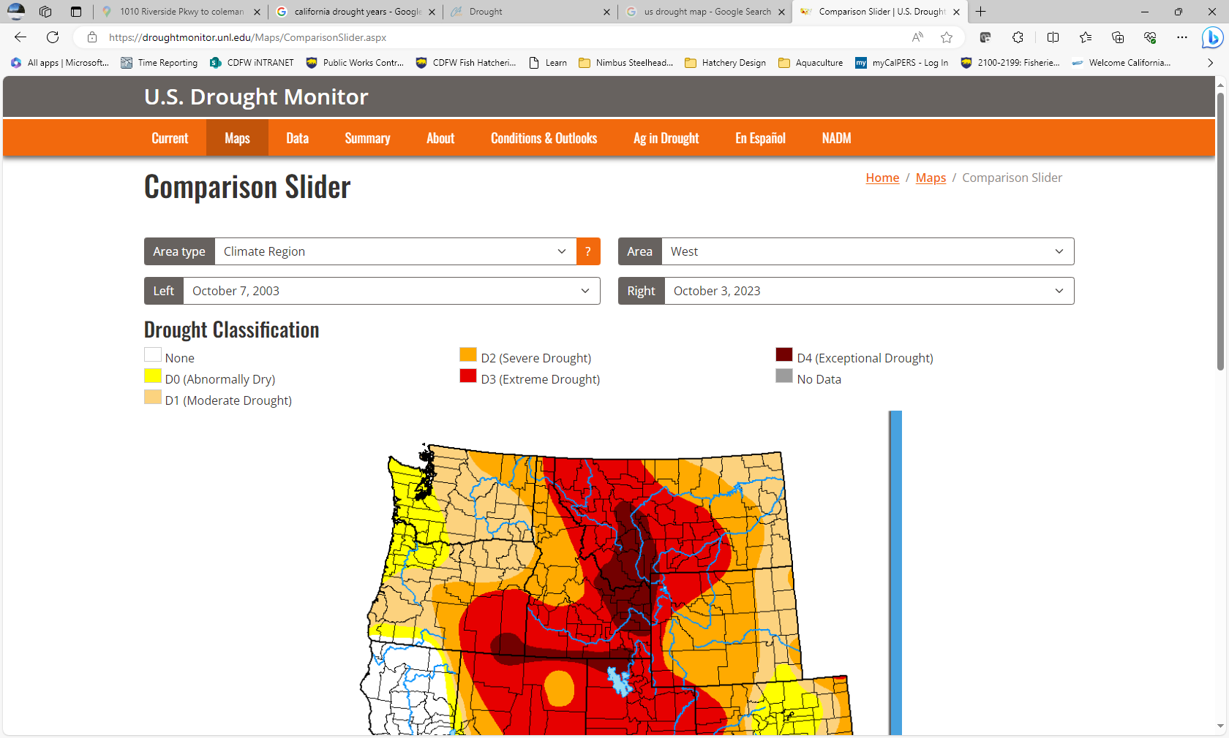
20 Years of Drought in the West: 2003 – 2008
U.S. Drought Monitor
  The U.S. Drought Monitor is produced through a partnership between the National Drought Mitigation Center at the University of Nebraska-Lincoln, the United States Department of Agriculture and the National Oceanic and Atmospheric Administration.
October 7, 2003
October 5, 2004
October 4, 2005
October 3, 2006
October 9, 2007
October 7, 2008

Slide 5
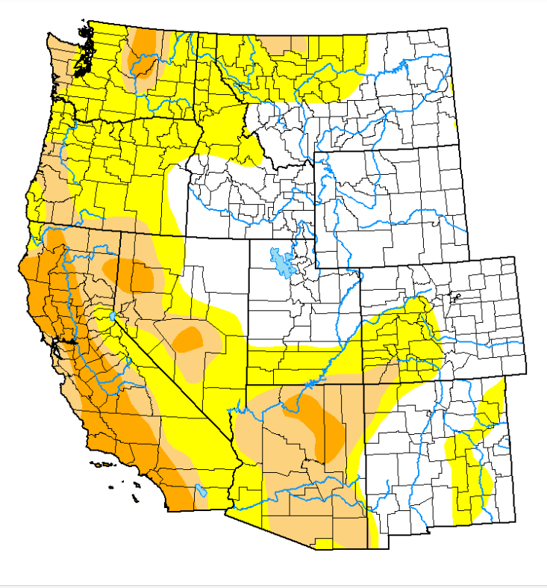
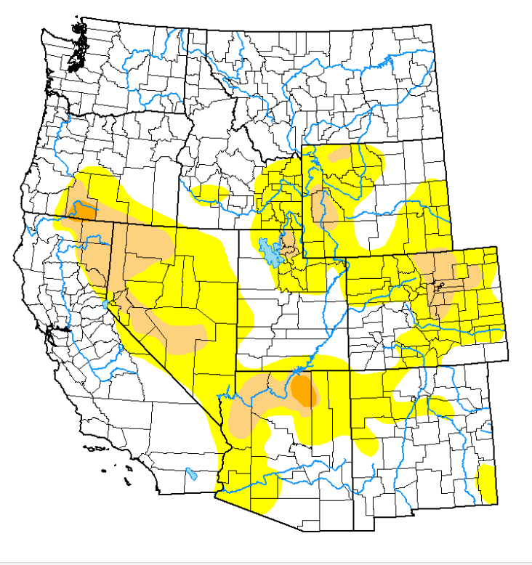
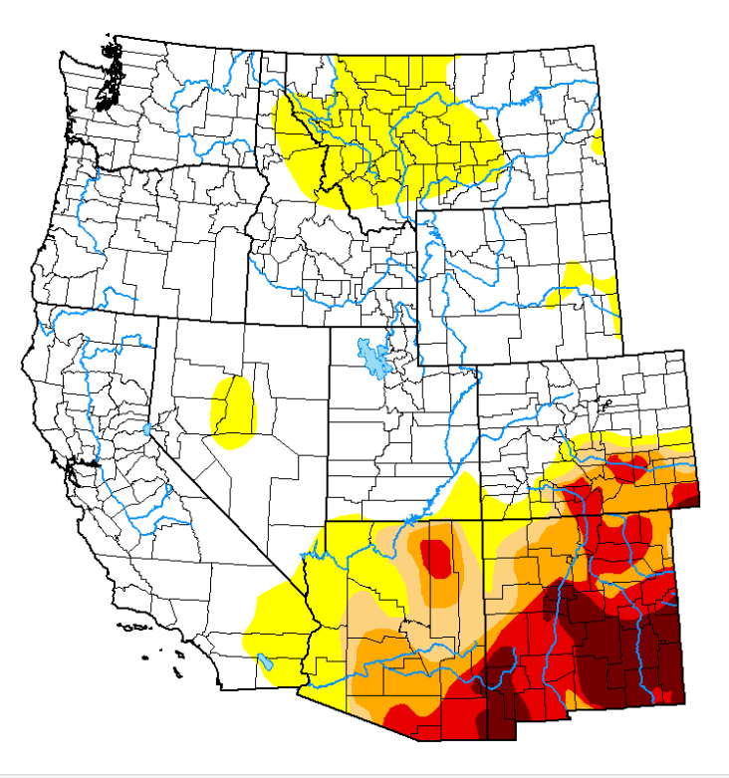
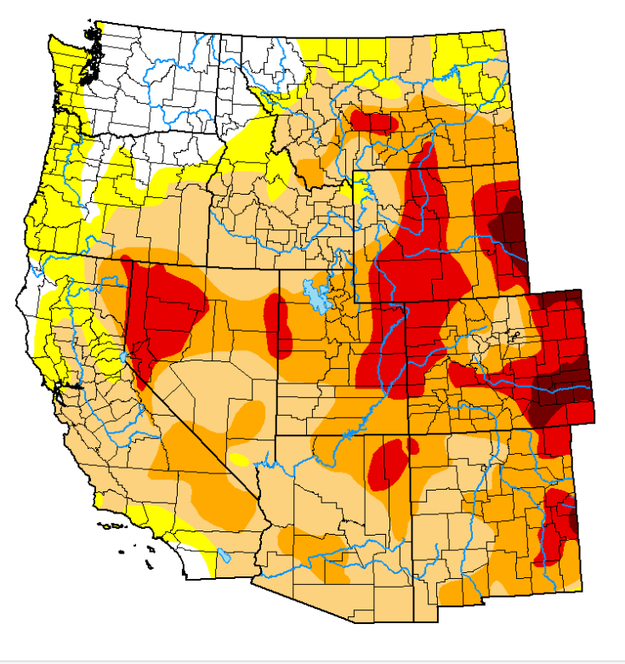
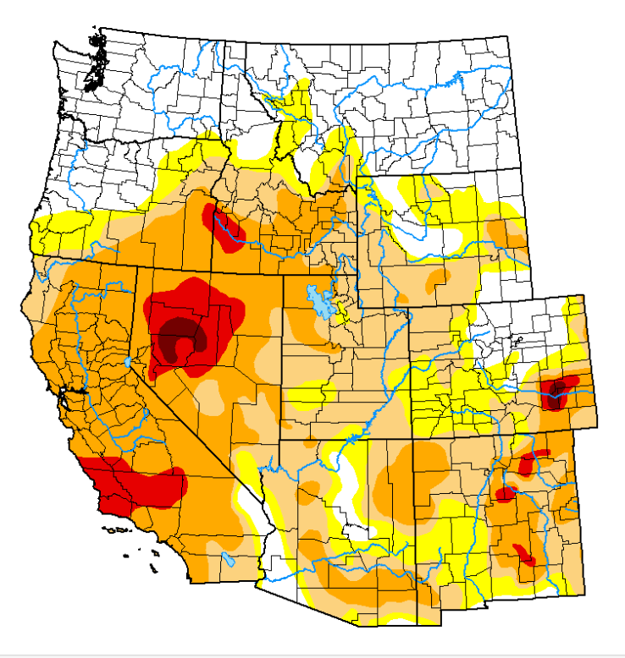
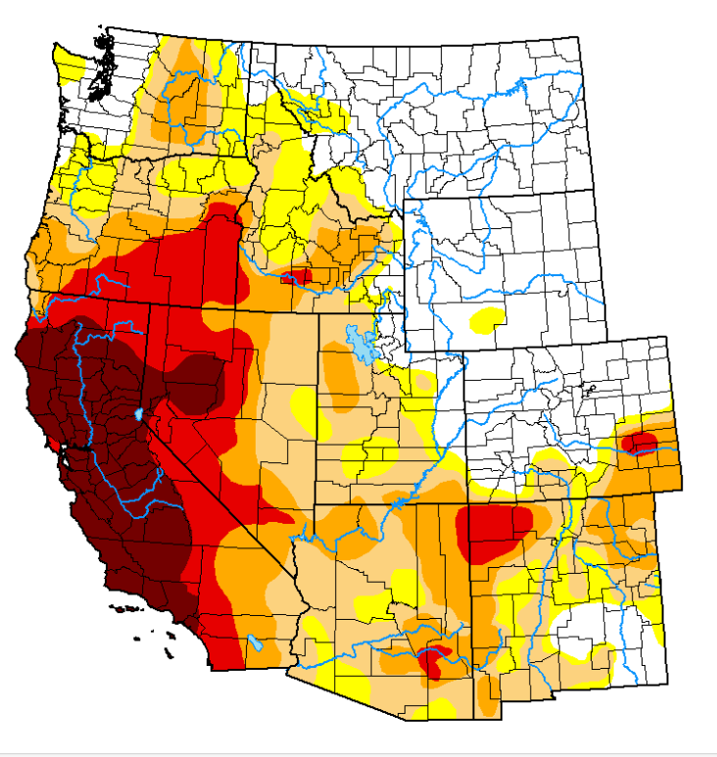
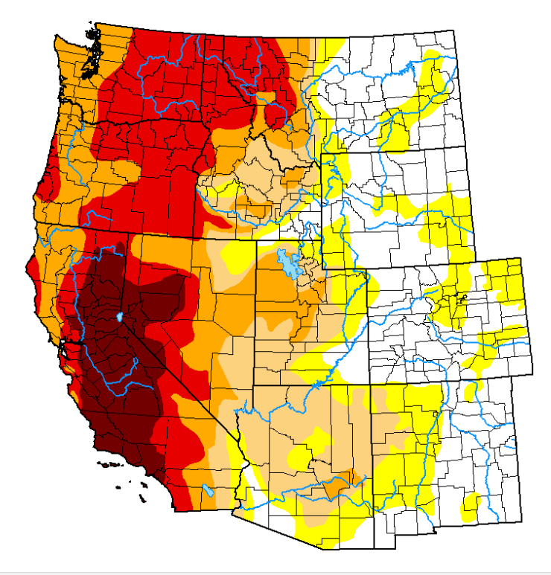
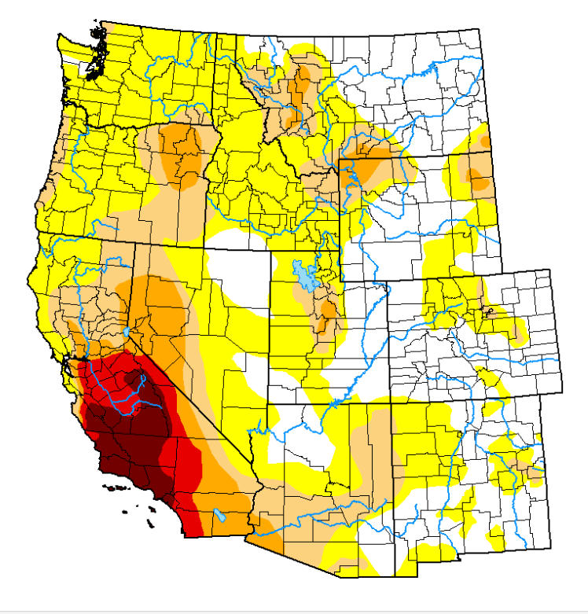
20 Years of Drought in the West: 2009 – 2016
October 6, 2009
October 5, 2010
October 4, 2011
October 9, 2012
October 8, 2013
October 7, 2014
October 6, 2015
October 4, 2016

Slide 6
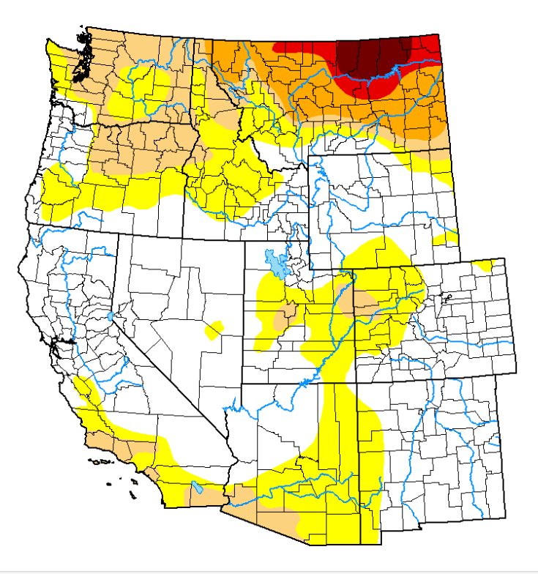
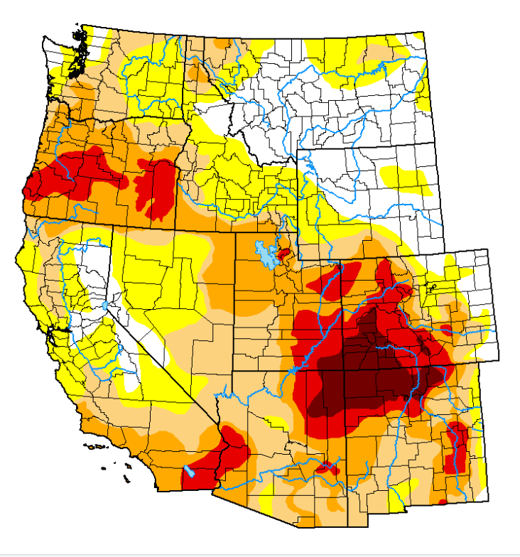
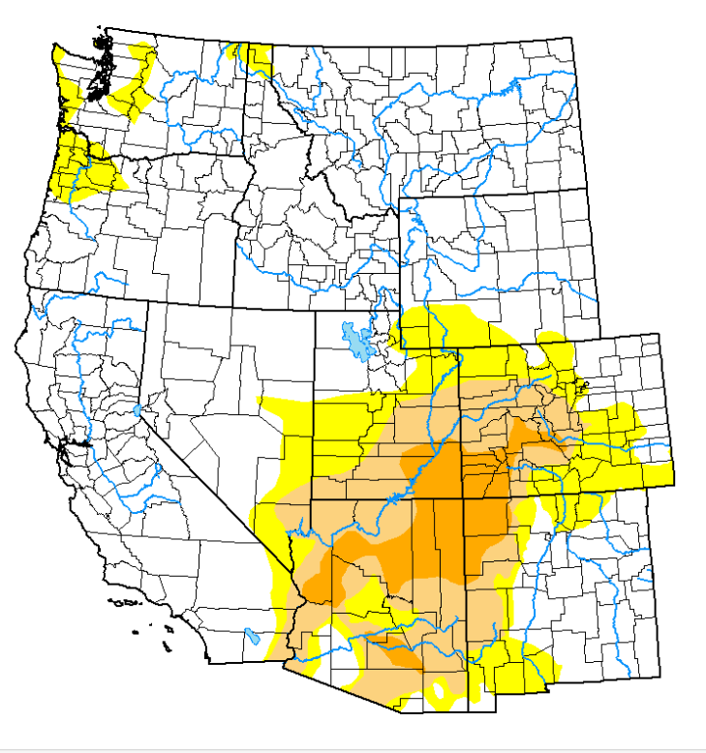
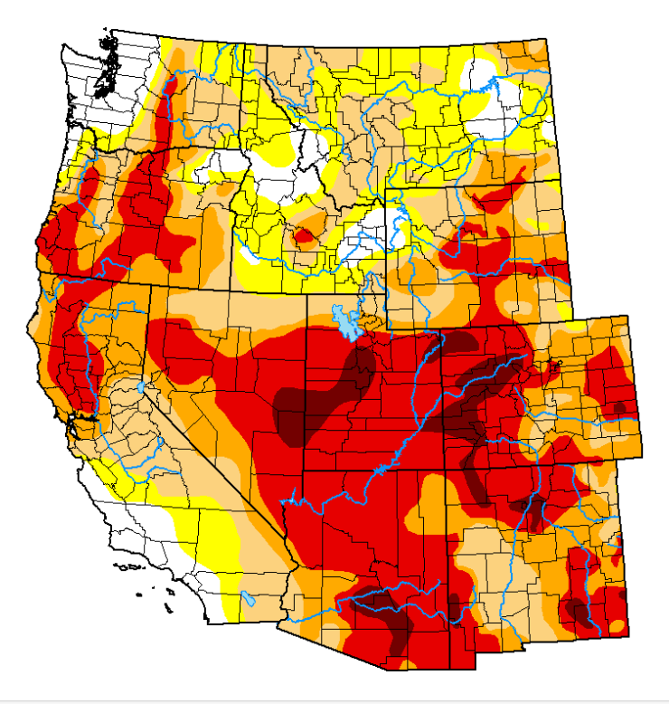
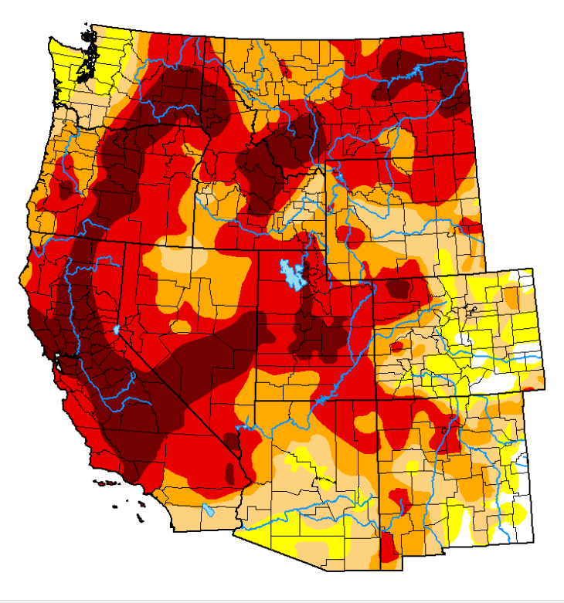
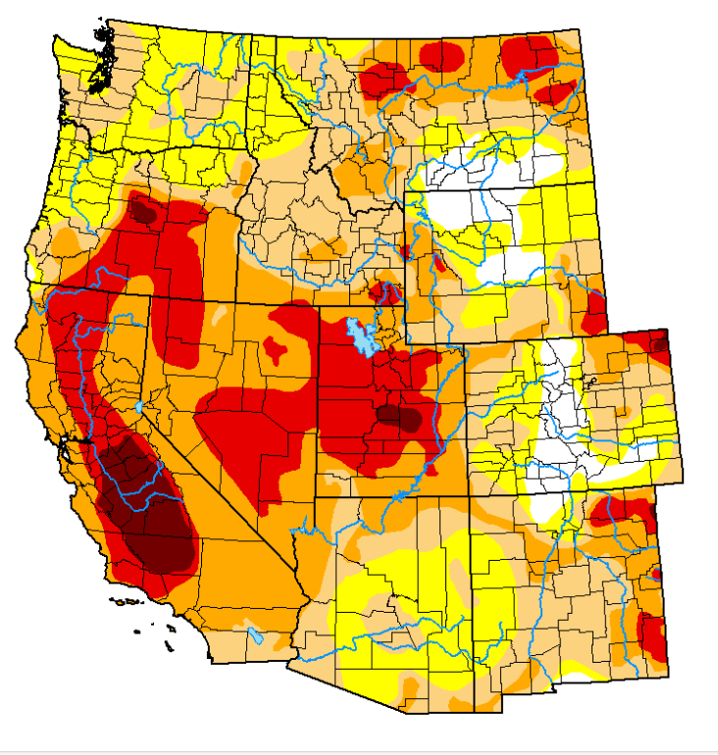
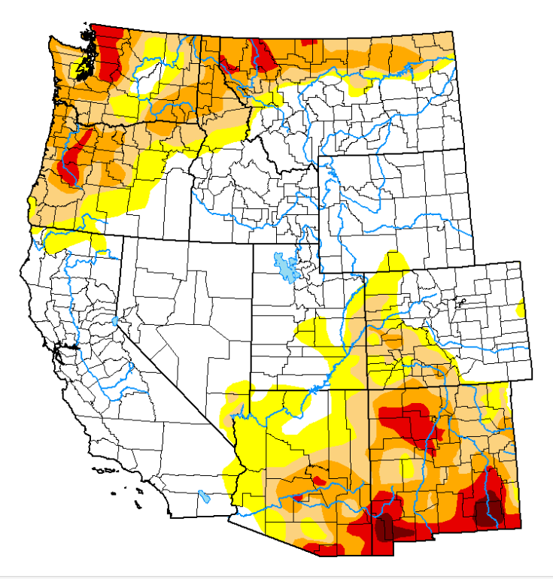
20 Years of Drought in the West: 2017 – 2023
October 3, 2017
October 9, 2018
October 8, 2019
October 6, 2020
Not free from Severe Drought Stage.
No Drought to Extreme Drought possible over a 1-year timeframe
Only 1 year (2019) since 2011 when Exceptional Drought not present in the parts of the Region
October 5, 2021
October 4, 2022
October 3, 2023
Notes:
Never fully goes away. Fluctuates Highly. Regional variability. Western States issues. October beginning of water year for Cal

Slide 7
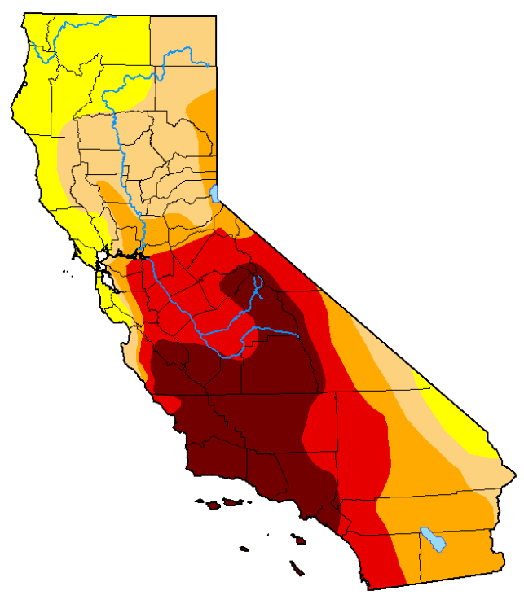
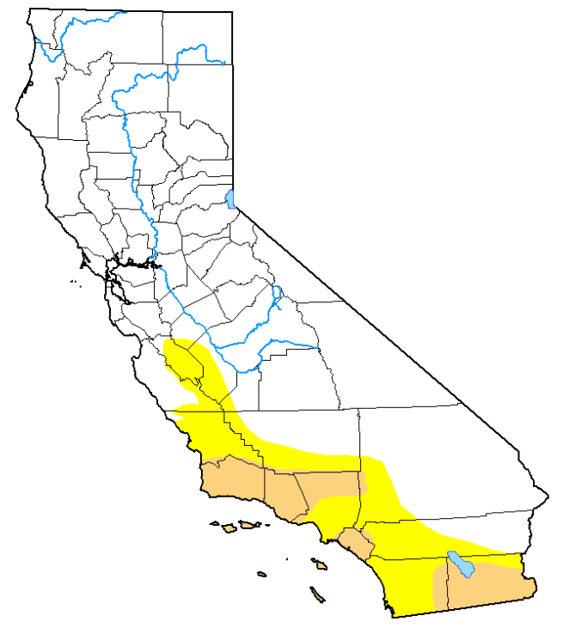
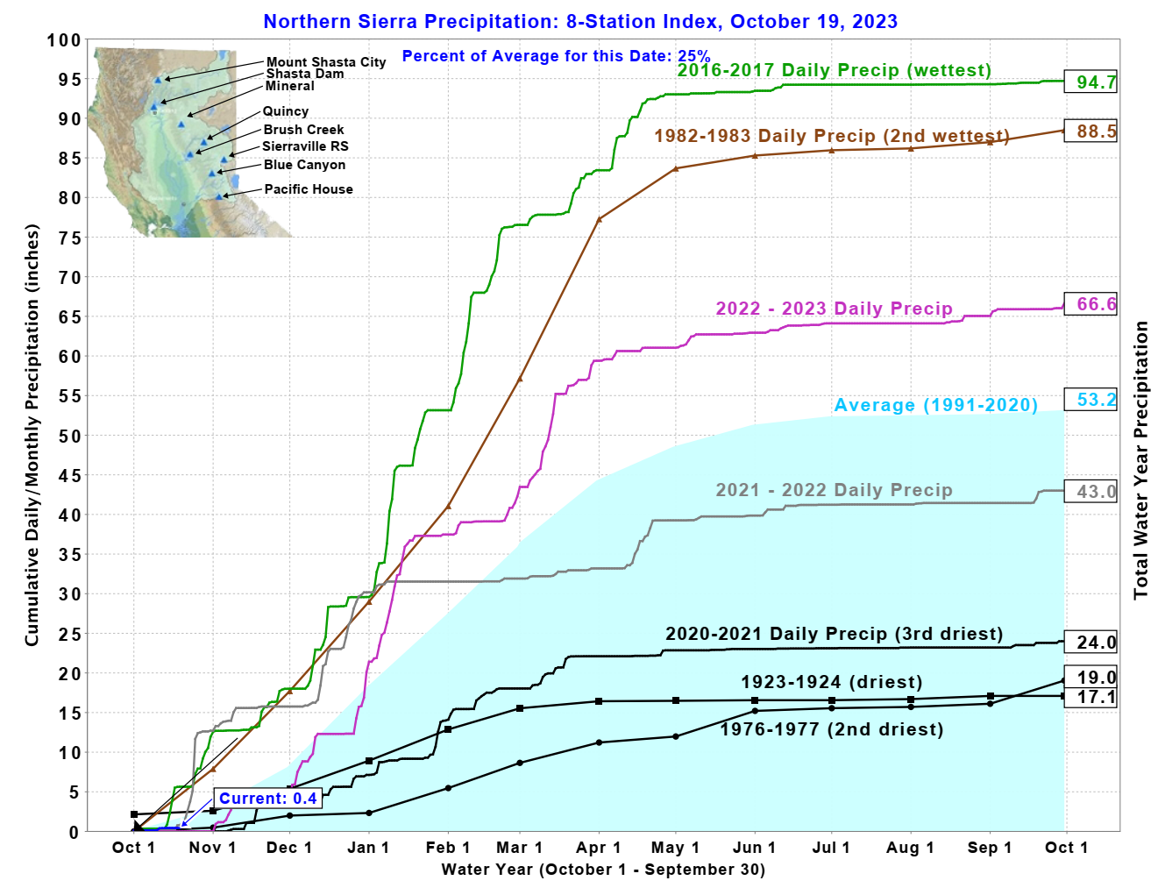
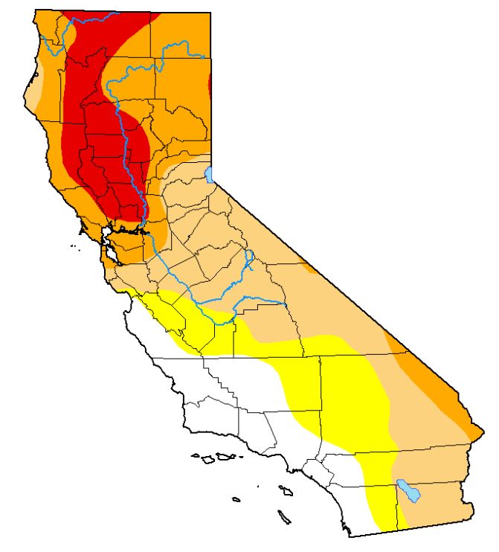
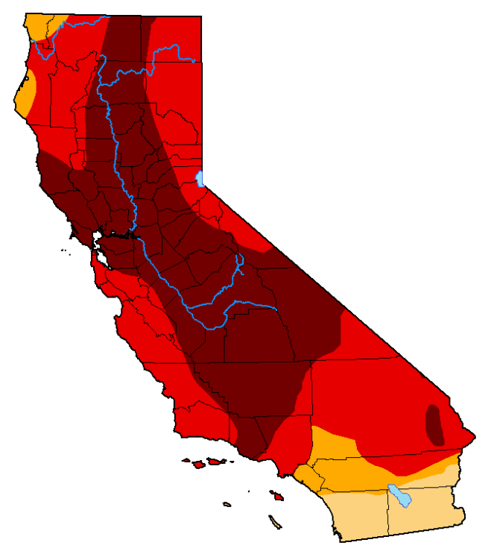
Northern Sierras - Wettest Year: 2016-2017 vs 3rd Driest Year: 2020-2021
October 4, 2016
October 3, 2017
October 6, 2020
October 5, 2021
Notes:
100 Years of data. Driest and wettest. Wettest and third driest in the last 5 years. Illustrates extremes

Slide 8
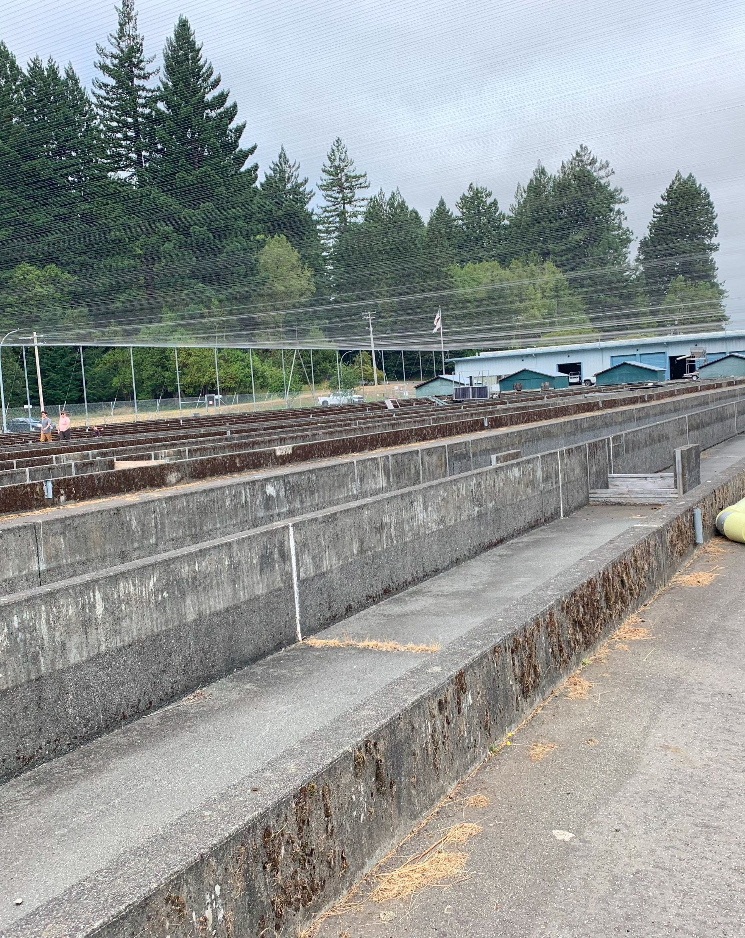
How Climate Change has Affected California’s Hatcheries
Region 1 – Northern Region
Crystal Lake Hatchery (Cassel, CA)
  Reduction of water availability from intake surface water.
  Increased predation (Bears, Otters, Predatory Birds).
  Increase of stocking in out of Region waters due to a reduction of available stocking waters (low/warm water).
Iron Gate Hatchery (Hornbrook, CA)
  Early fall run smolt releases (April rather than May – Mid June) due to low/warm water in the Klamath.
  Moved 1 Million Fall Run to Trinity River Hatchery due to C. Shasta spore counts and warm water in the Klamath to allow for additional growth.
Mount Shasta Hatchery (Mount Shasta, CA)
  McCloud River Redband Rainbow Trout rescued in 2021, released in 2023.
  Loaned (4) 6’ round tanks to Livingston Stone National Fish Hatchery due drought impacts at their water source.
Darrah Springs Hatchery (Paynes Creek, CA)
  Increase of stocking in out of Region waters due to a reduction of available stocking waters (low/warm water).
  Air blower system installed to assist with pathogen treatments.
Mad River Hatchery (Arcata, CA)
  Increased predation (Otters, Predatory Birds).
Trinity River Hatchery (Lewiston, CA)
  Increase in soft shell and other disease related issues in eggs and fish (Saw increase in incubation and fish mortalities).
  Early release strategies required to release when river temperatures were adequate.
  Purchased portable, chilled UV treated egg incubation units.
Notes:
Cold Water Availability
Increased Pathogen Detection
Increased Predation
Alternative Trout Stocking Strategies

Slide 9
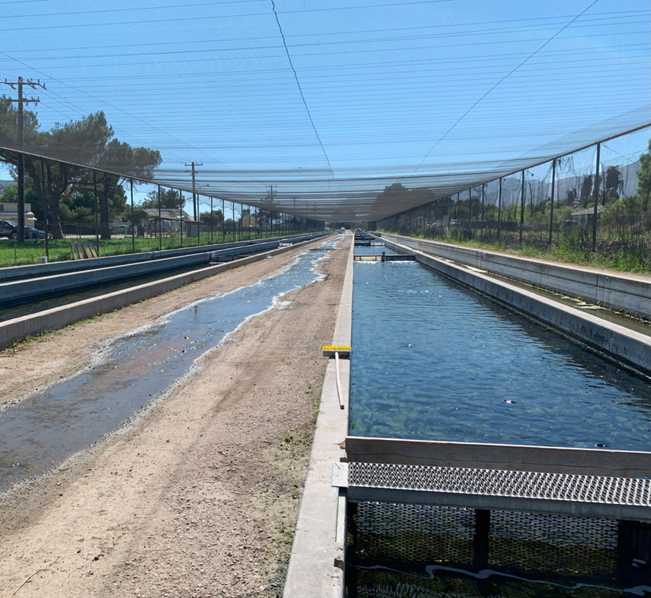
How Climate Change has Affected California’s Hatcheries
Region 2 – North Central Region
American River Trout Hatchery (Rancho Cordova, CA)
  Facility evacuated and fish released early due to waters exceeding 70 deg F.
  Increase in Annual Operating Costs due to extended use of onsite chillers.
  Increase in pathogen prevalence and persistence due to warm water temperatures.
Nimbus Fish Hatchery (Rancho Cordova, CA)
  Facility evacuation. Moved fish to Mokelumne River Hatchery until water temperatures fell to safe levels.
  Increased concern with straying American River Steelhead into the Mokelumne River and potential for hybridization. Increased operation costs to incorporate genetic monitoring.
  Modified in-river release schedules due to high temperatures and low flows.
  Increased fall-run Chinook production to mitigate for decreases in natural spawning area and impact of Thiamine Deficiency Complex.
  Incubated eggs using portable chiller units due to high water temperatures.
Mokelumne River Hatchery (Clements, CA)
  Modified release schedule and location due to high water temperatures at planned release sites.
Feather River Hatchery (Oroville, CA)
  Modified in-river release plan for spring-run Chinook smolts to release in the bay using net pen acclimation due to poor in-river conditions.
  Cancelled in-river releases of fall-run Chinook due to high temperatures and low flows.
  Increased fall-run Chinook production to mitigate for decreases in natural spawning area and impact of Thiamine Deficiency Complex.
Notes:
Poor Salmon/Steelhead Returns
Increased Production
Alternative Salmon/Steelhead Release Strategies
Changes to Facility Operation Season

Slide 10
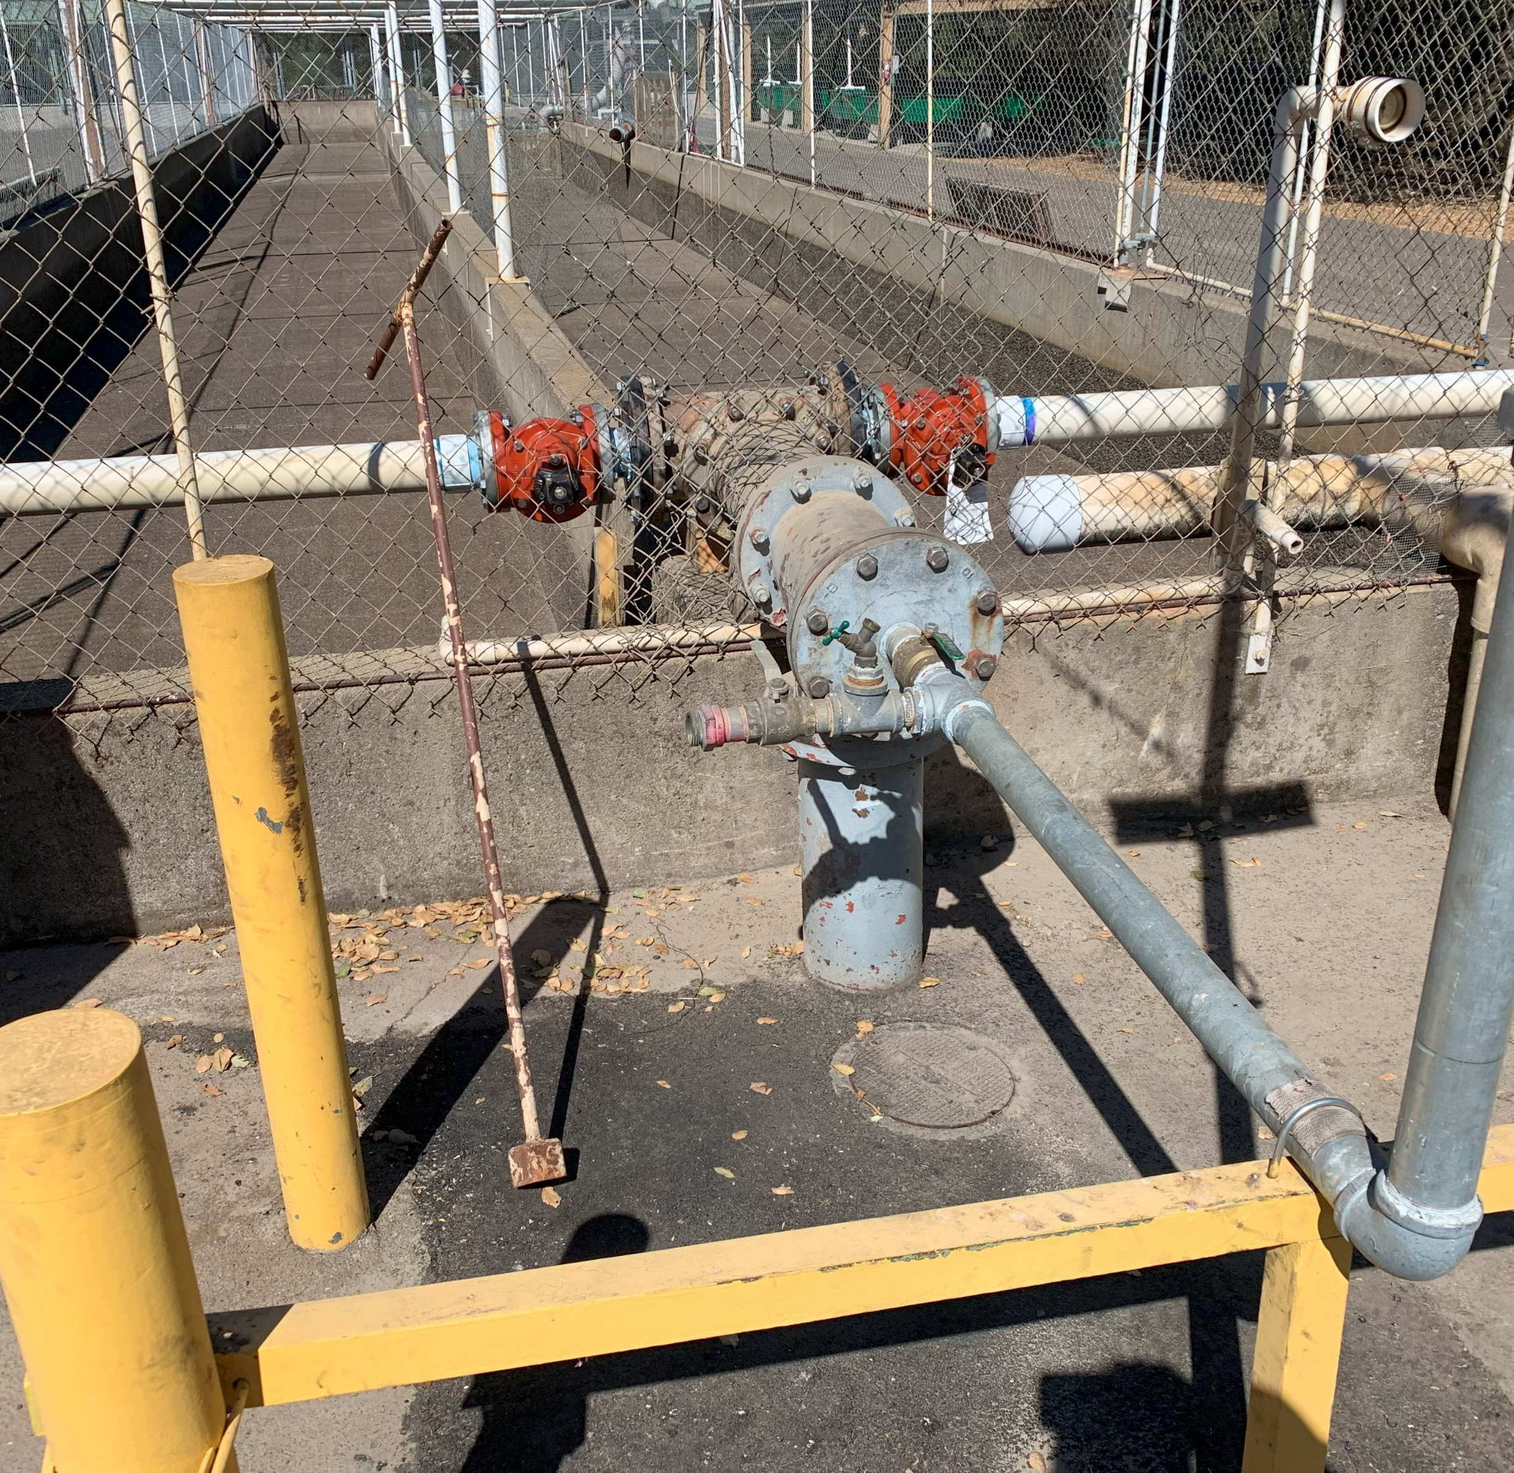
How Climate Change has Affected California’s Hatcheries
Region 3 – Bay Delta Region
Warm Springs Fish Hatchery (Geyersville, CA)/Coyote Valley Fish Facility (Ukiah, CA)
  Fish were transferred from WSH to CVFF for imprinting. Due to low flows in the mainstream Russian River, Russian River smolts were transferred back to Dry Creek below WSH.
  Inland Steelhead were planted early to a cold-water fishery to create room and available water for an enhanced mitigated steelhead program.
  Half of the Coho Broodstock were transferred to Casa Grande High School Hatchery to decrease tank densities.
  Increased pathogens detected throughout facility.
  USACE altered dam water release protocols to draw from available cold-water pool.
Silverado Fisheries Base (Napa, CA)
  Fire evacuations resulting in the loss of all inland salmon on site.
  Longer period of seasonal water warming. Reducing onsite available fish culture season by two months. Facility currently not in operation July-September.
Notes:
Fish Rescues
Fish Transfers
Facility Evacuations
Increased Incubation/Fish Mortalities

Slide 11
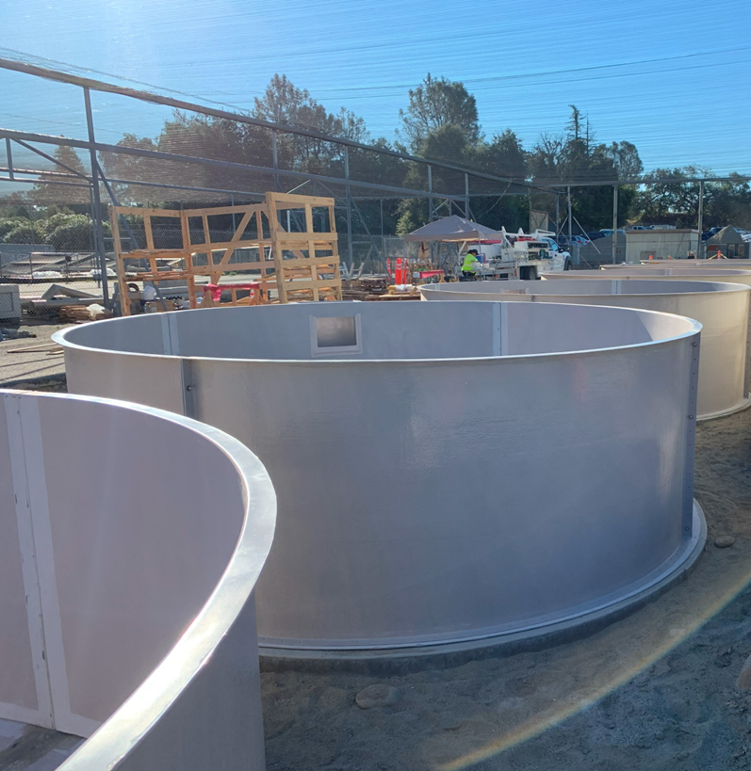
How Climate Change has Affected California’s Hatcheries
Region 4 – Central Region
Moccasin Creek Hatchery (Moccasin, CA)
  Hatchery flooded due to 1000-year event. Approx. 6” of rain in a few hours. Lost over a million fish.
  Trout planting plan is routinely changed due to poor water quality at typical planting sites.
Kern River Planting Base (Kernville, CA)
  Hatchery flooded, damaging siphon water intake pipe, lifting round tanks off foundation.
  Elevated water temperatures in Kern River prevent holding fish at facility during summer months.
  Access to several planting locations damaged during fire event.
  Facility currently shutdown and closed to the public.
San Joaquin River Hatchery (Friant, CA)
  Drawdown at Lake Millerton in anticipation of snow runoff depleted cold water pool, resulting in a sudden 8 deg F increase. Approx. 50k fish loss.
  Low DO from incoming water.
Merced River Hatchery (Snelling, CA)
  Numbers of returning Chinook have steadily decreased in recent years. Current production is approx. 1/3rd of production goals.
  Portions of the Merced River have been drying up with increased frequency and duration.
Notes:
New Equipment Purchases
Equipment Transfers
Increased Operational Costs

Slide 12
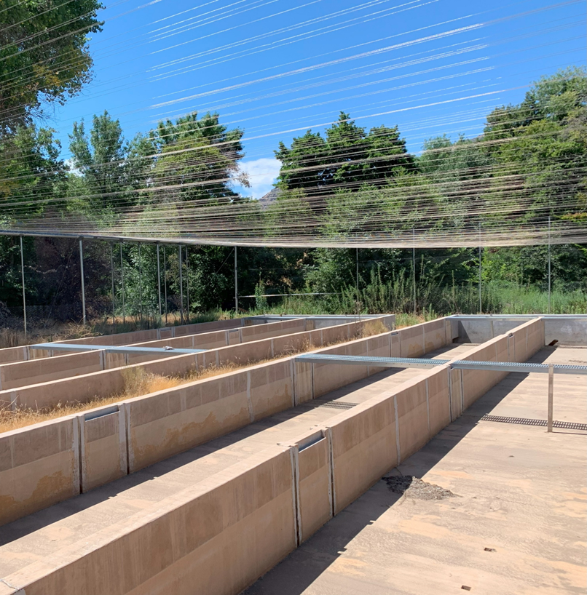
How Climate Change has Affected California’s Hatcheries
Regions 5/6 – South Coast/Inland Desert Regions
Fillmore Trout Hatchery (Fillmore, CA)
  Extreme rain events has elevated the water table. Groundwater is seeping through the existing asphalt causing sink holes and flooding of local creeks.
Hot Creek Hatchery (Mammoth Lakes, CA)
  Historical reduction of available surface water flows. 2022-2023 Snowpack caused above average runoffs and water infiltration into ground surface resulting in significant damage to onsite asphalt and sink holes present throughout facility.
  Facility currently closed to the public.
Fish Springs Hatchery (Big Pine, CA)
  Extreme rain events has elevated the water table. Groundwater is seeping through the existing asphalt causing sink holes and flooding of local creeks.
Black Rock Rearing Ponds (Independence, CA)
  Extreme rain events has elevated the water table. Groundwater is seeping through the existing asphalt causing sink holes and flooding of local creeks.
Mojave River Hatchery (Victorville, CA)
  Limited operations over the past 10 years due to PKD and Lactococcus outbreaks. Drought and climate change related?
Notes:
Extreme Weather Events
Facility Closures due to Natural Disasters

Slide 13
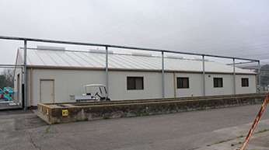
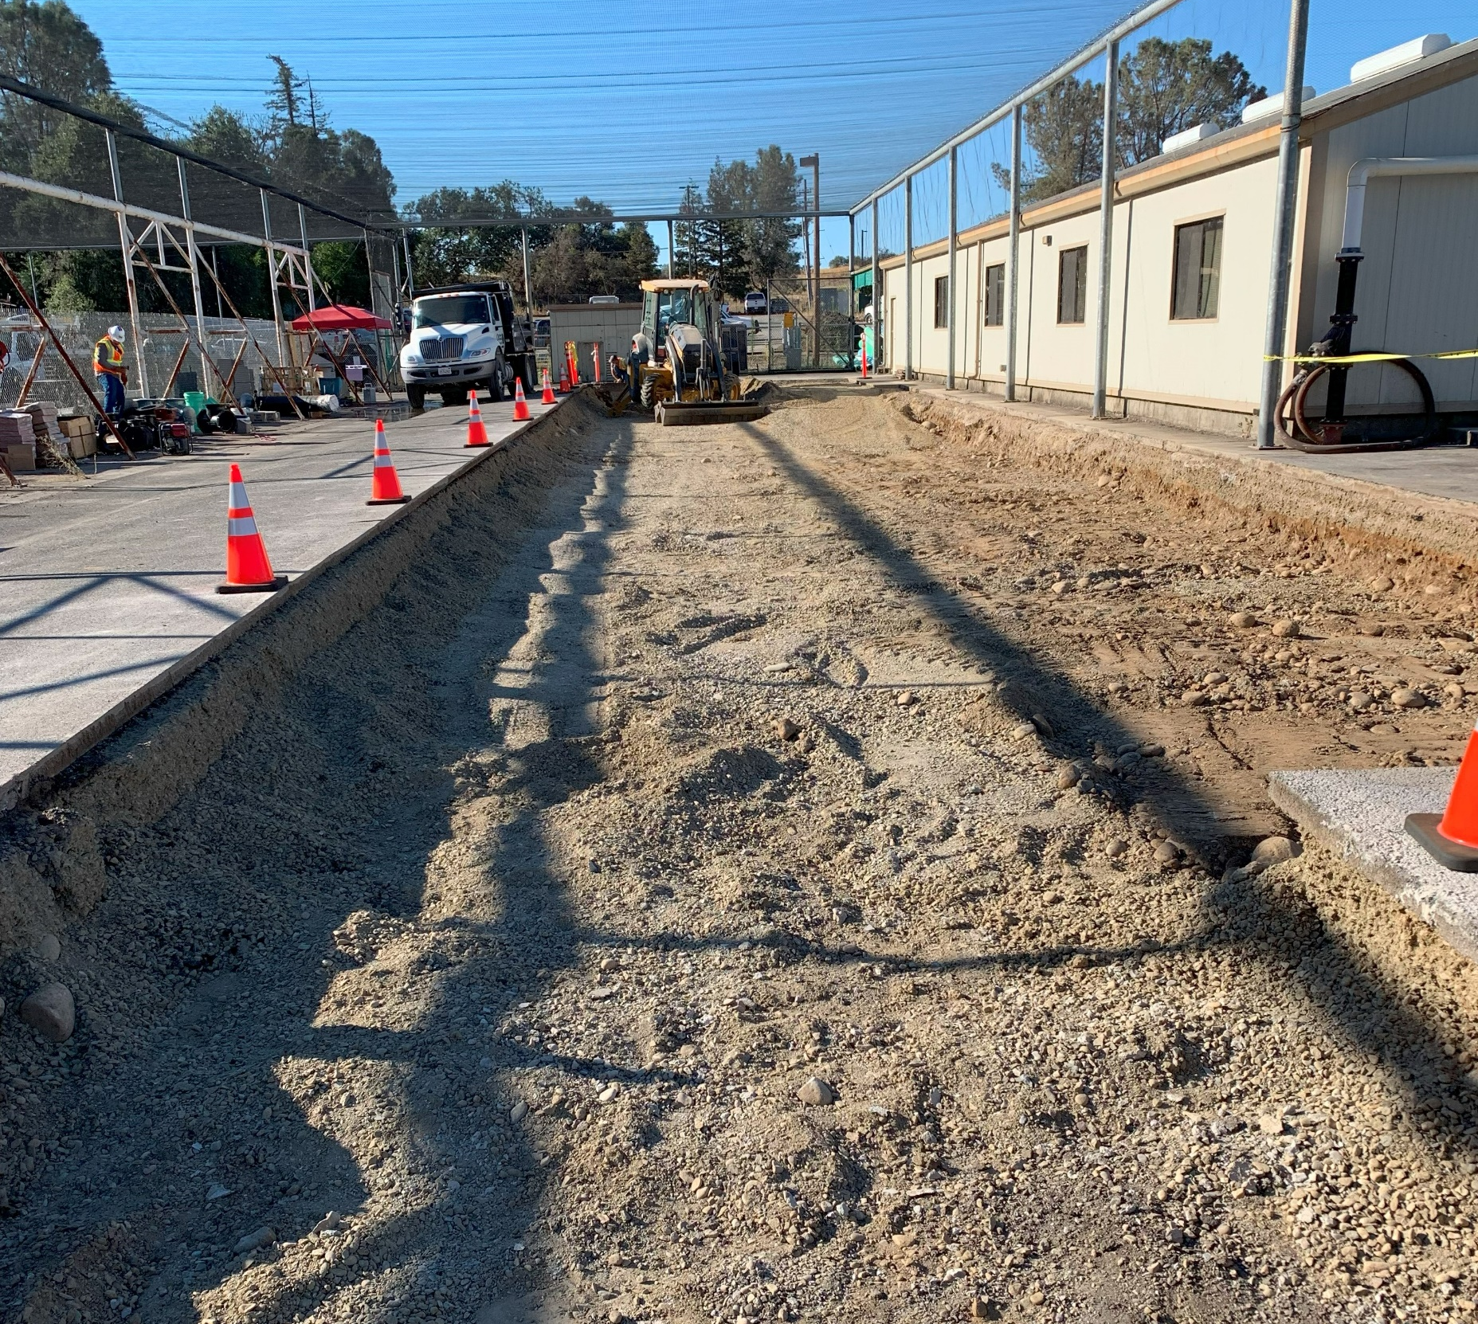
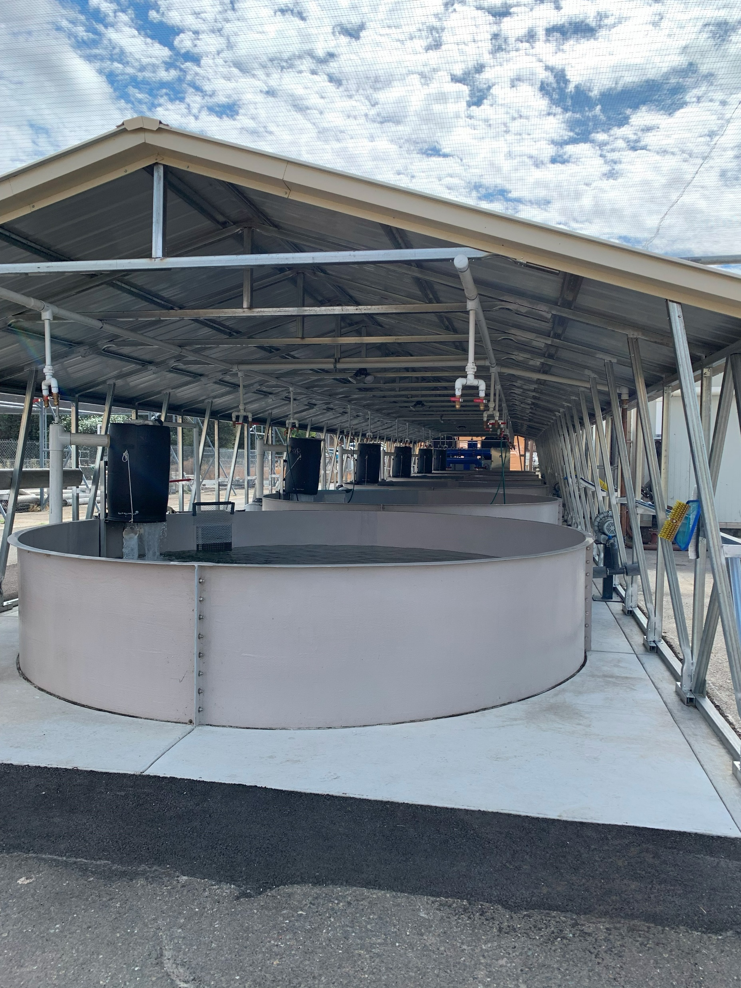

What’s Next for California Hatcheries?
Its time to modernize to be more resilient to climate change.
What needs to be done?
How best to do it?

Slide 14
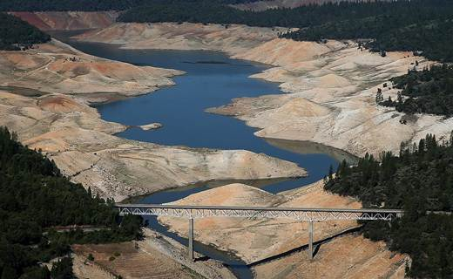
Climate Induced Hatchery Upgrades Evaluation
In 2022 CDFW obtained funding from the California Legislature to complete an evaluation of CDFW operated hatcheries for Climate Resiliency.
Goal of Evaluation is to determine which hatcheries are most susceptible to Climate Change.
Develop plans and specifications for projects at most susceptible hatcheries.

Slide 15
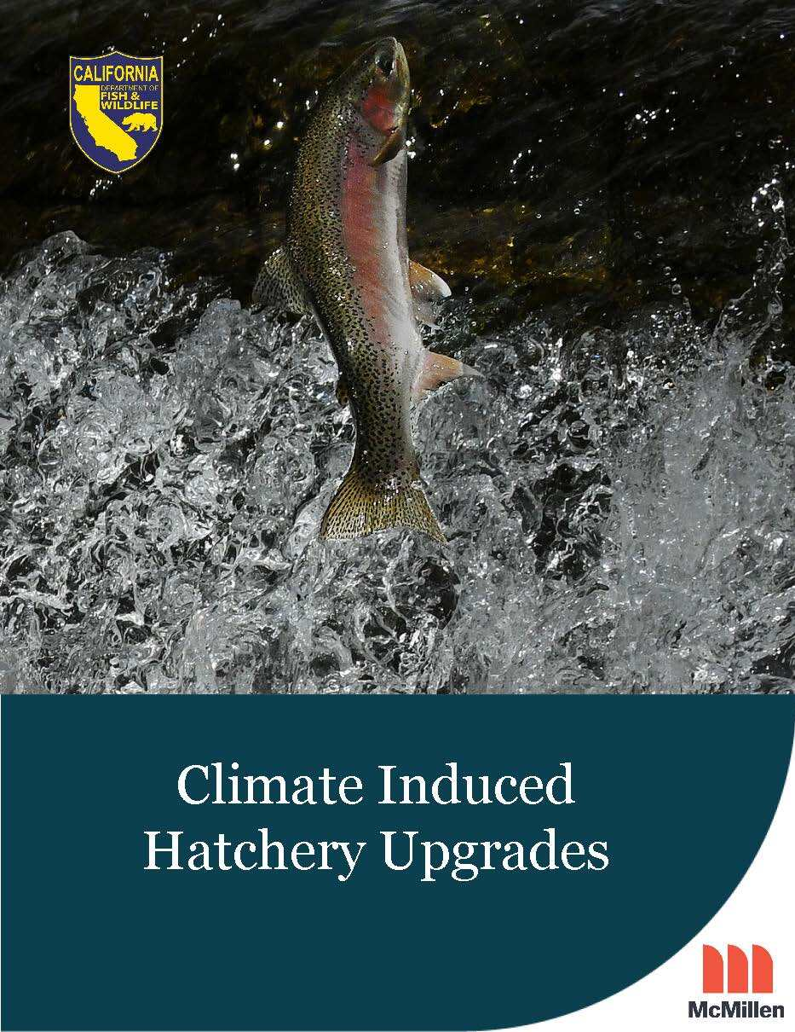
Climate Induced Hatchery Upgrades Evaluation
Evaluation Consists of:
  Site Visits to 21 Hatcheries (Iron Gate Hatchery and Trinity River Hatchery were omitted)
  Individual Reports consisting of an overview of the current infrastructure and equipment, susceptibility to the affects of climate change, and recommendation for facility improvements to accommodate climate change.
  Upon completion of individual hatchery reports McMillen will prepare plans and specifications to make improvements at hatcheries deemed most susceptible to climate change.
  Individual Hatchery Reports Est. Completion Date: October 2024
  Design Work Est. Completion Date: March 2026
CDFW selected McMillen Inc (formerly McMillen Jacobs Associates) to conduct the evaluation.

Slide 16
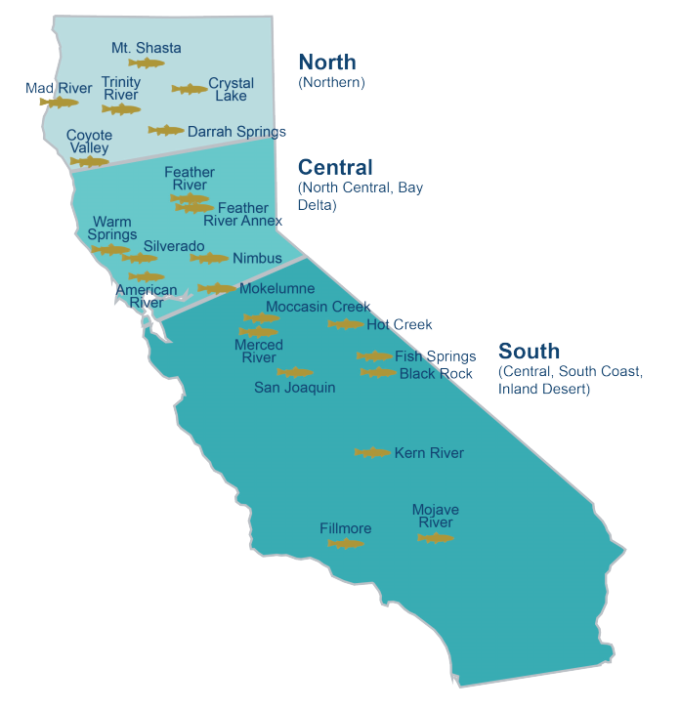
Climate Induced Hatchery Upgrades Status
Site Visits – Complete
  Bioprogram
Climate Evaluation at each site
  10 Global Models
Climate General Impacts (Averages)
  Air Temp - >3 °F (107.6)
  Surface Water Temp - >3-5 °F (70+)
    Regulated/Unregulated
  Ground/Spring Water - >2-3 °F
  Flow Impacts – Higher Winter, Lower Summer
  Fire Impacts – 17%
Notes:
Reference years. 1983-2003 2024-2043, 2044-2063

Slide 17
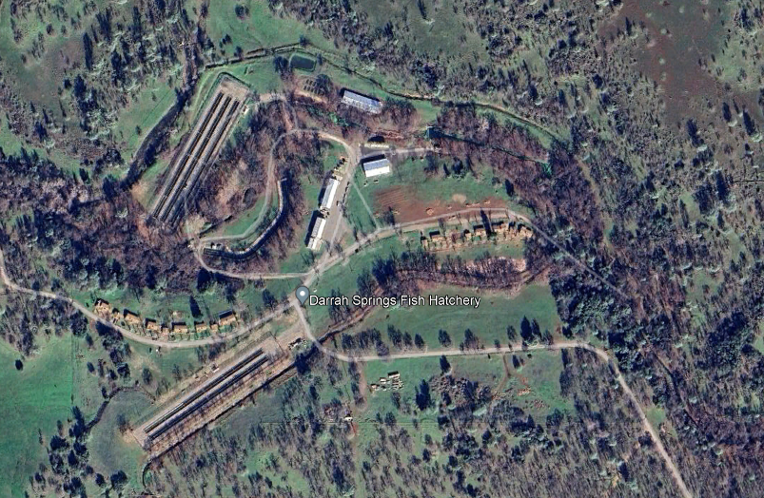
Climate Induced Hatchery Upgrades Status
Draft Alternatives Analysis Reports
  Introduction
  Bioprogram
  Climate Evaluation
  Existing Infrastructure Deficiencies
  Alternative Selected
  Alternative Cost Evaluation
  Environmental Permitting
  Conclusions and Recommendations
  References

Slide 18
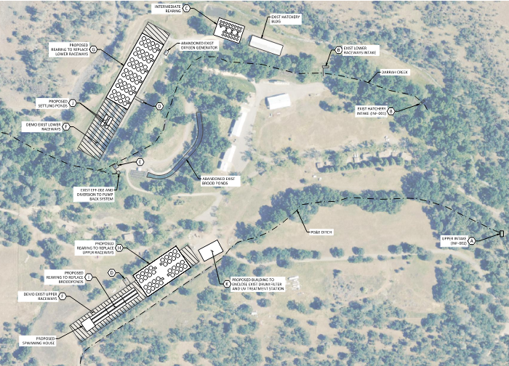
Climate Induced Hatchery Upgrades Status
Alternatives
  RAS/PRAS
  Chilling w/Energy Recovery
  Rearing Covers
  Oxygenation
  Operational Changes
  Water Treatment
  Biosecurity
Additional Challenges
  State LEED Requirements
  Net Zero

Slide 19
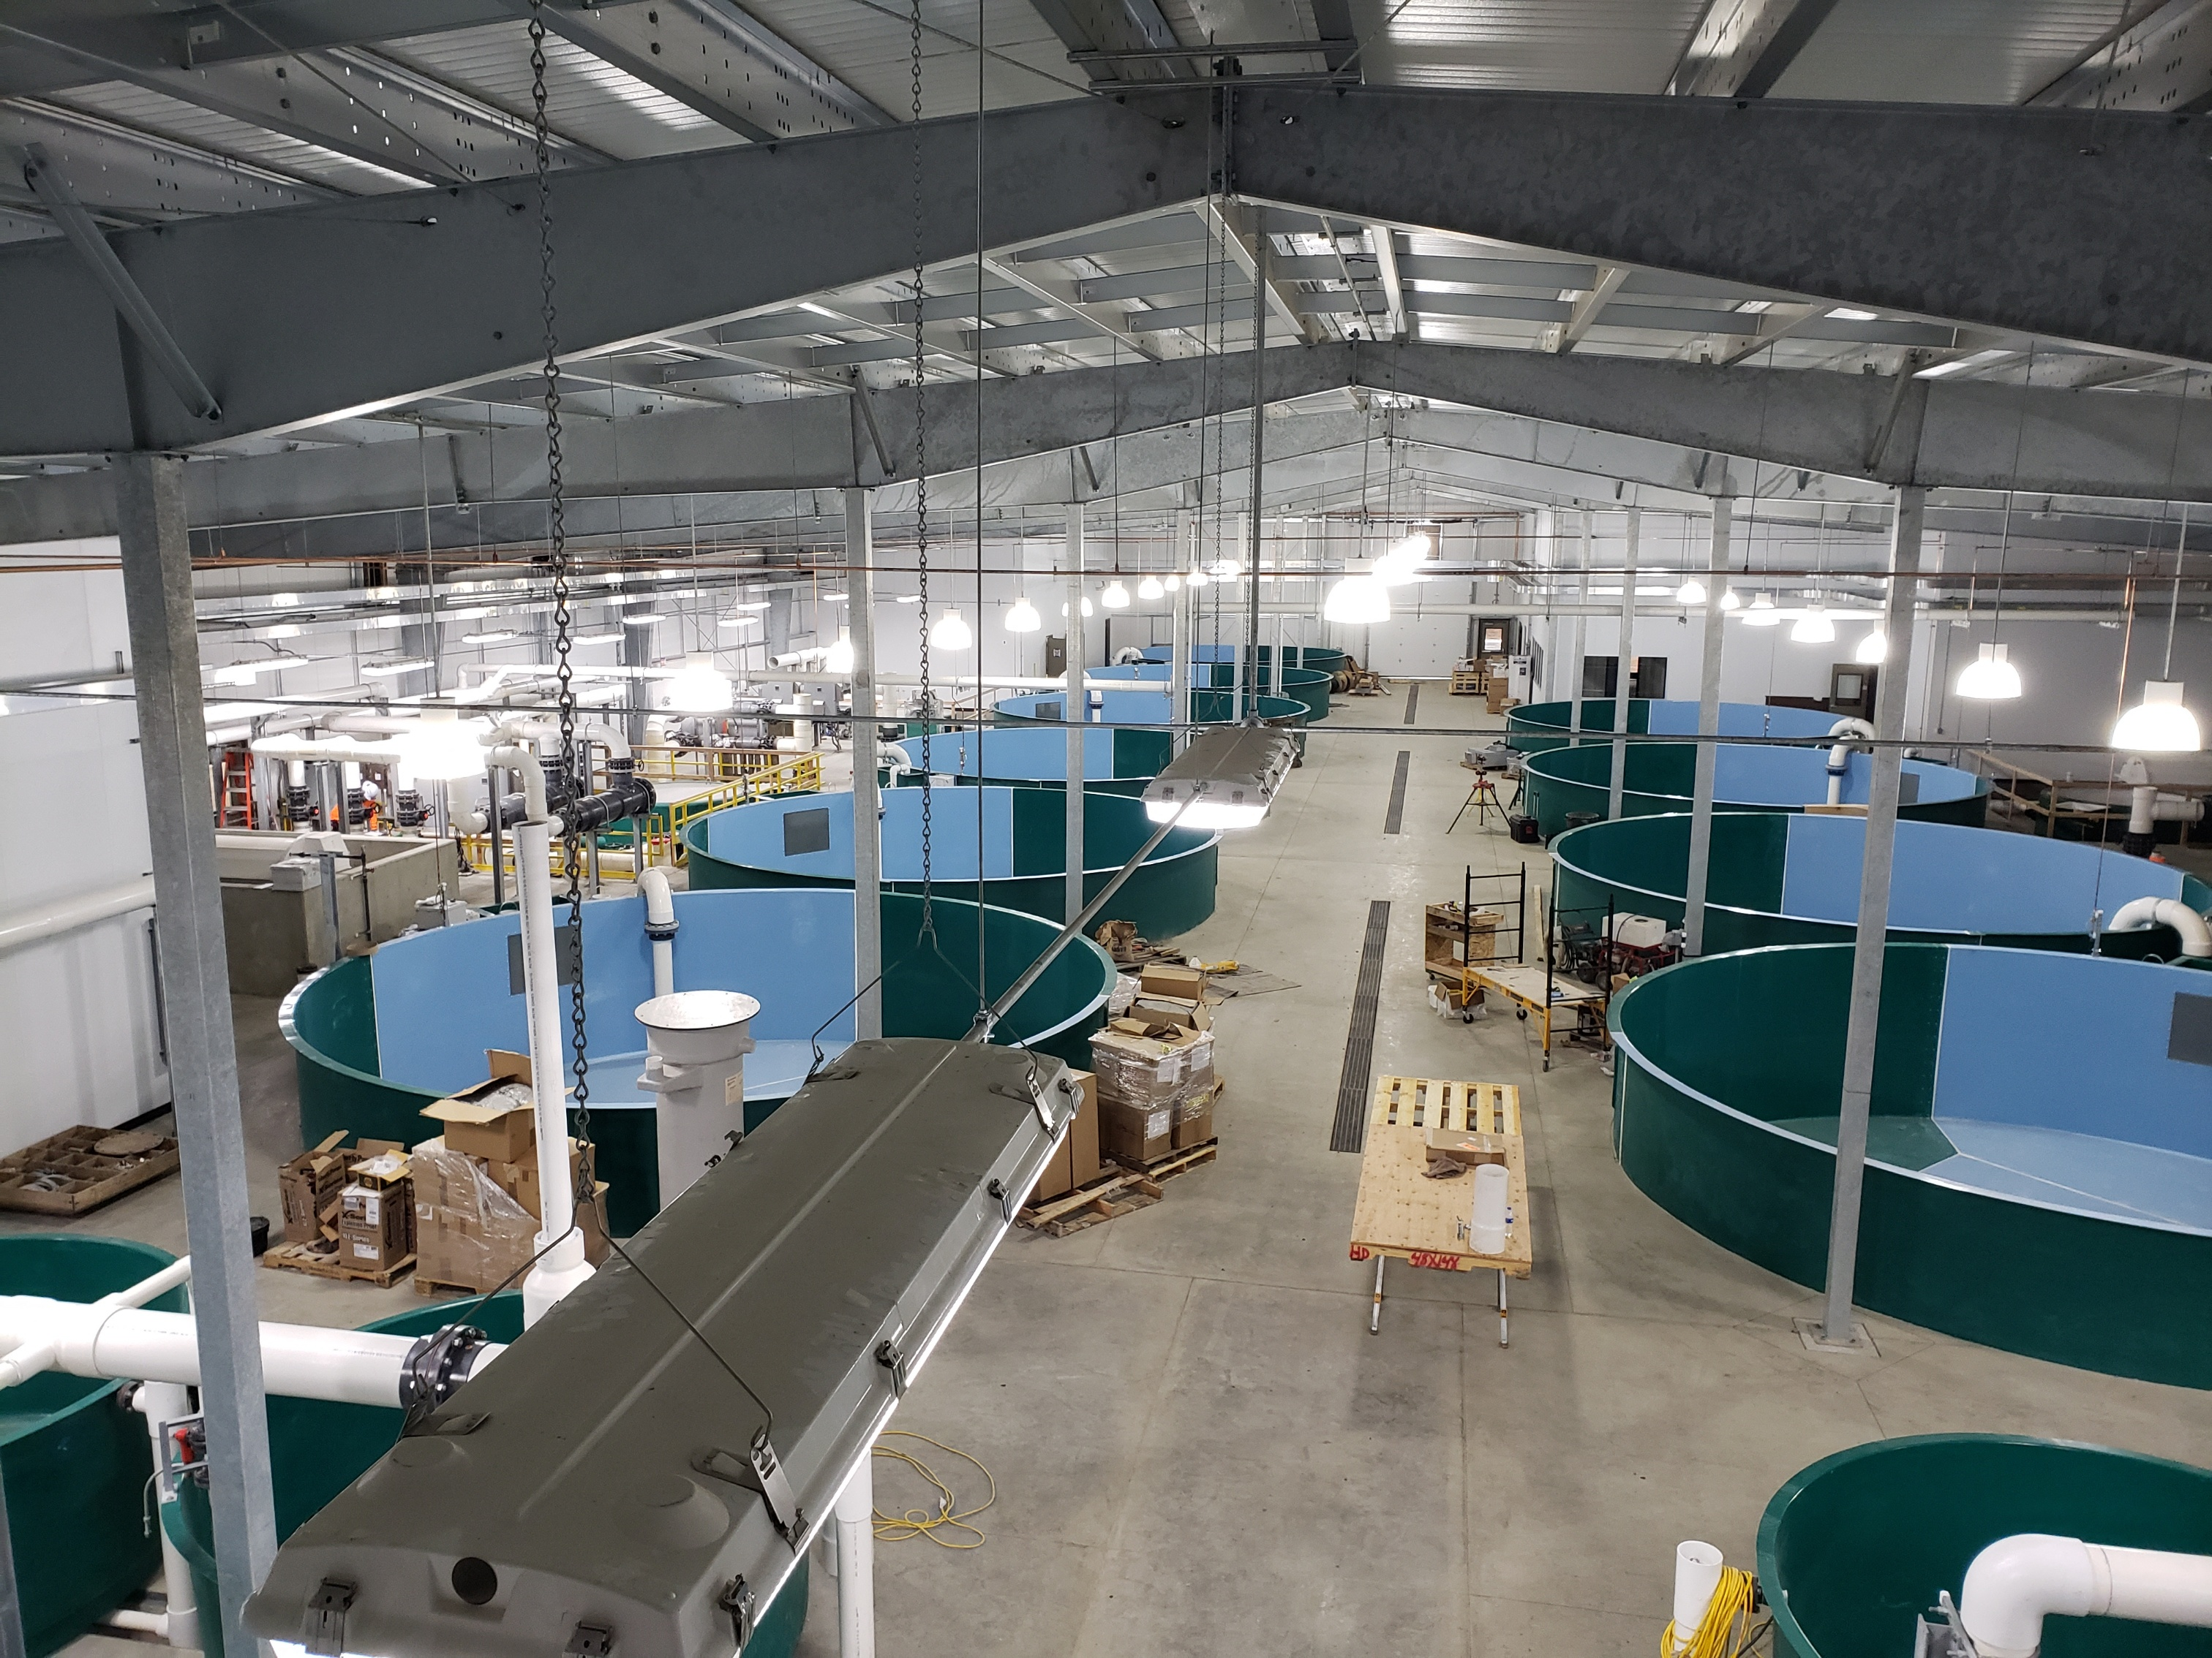
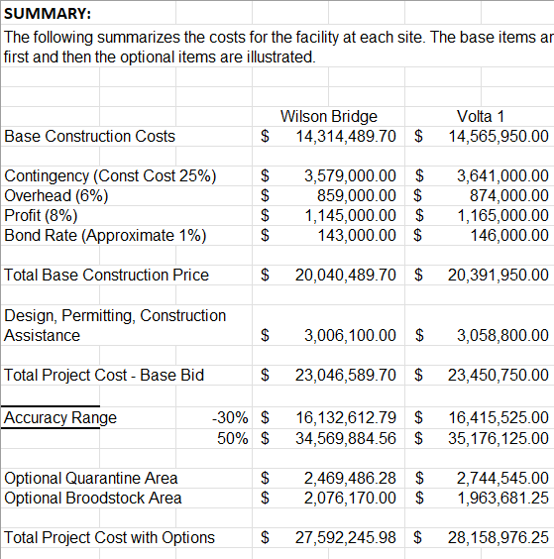

Climate Induced Hatchery Upgrades Status
Future Tasks:
  Alternatives Cost Estimates
  Complete Hatchery Reports
  Preparation of Plans and Specifications

Slide 20

What CDFW Hopes to Achieve
Move away from a traditional outdoor, flow through model using concrete raceways for fish rearing.
Implement a model of indoor, recirculating aquaculture where the fish rearing climate can be fully controlled.
A hatchery system that is more resilient to the effects of climate change.
Evaluate new species to be grown or evaluate moving production to a location more suitable.
Notes:
Sacramento Perch

Slide 21

Climate Change and California’s Hatcheries
QUESTIONS?

