Slide 1

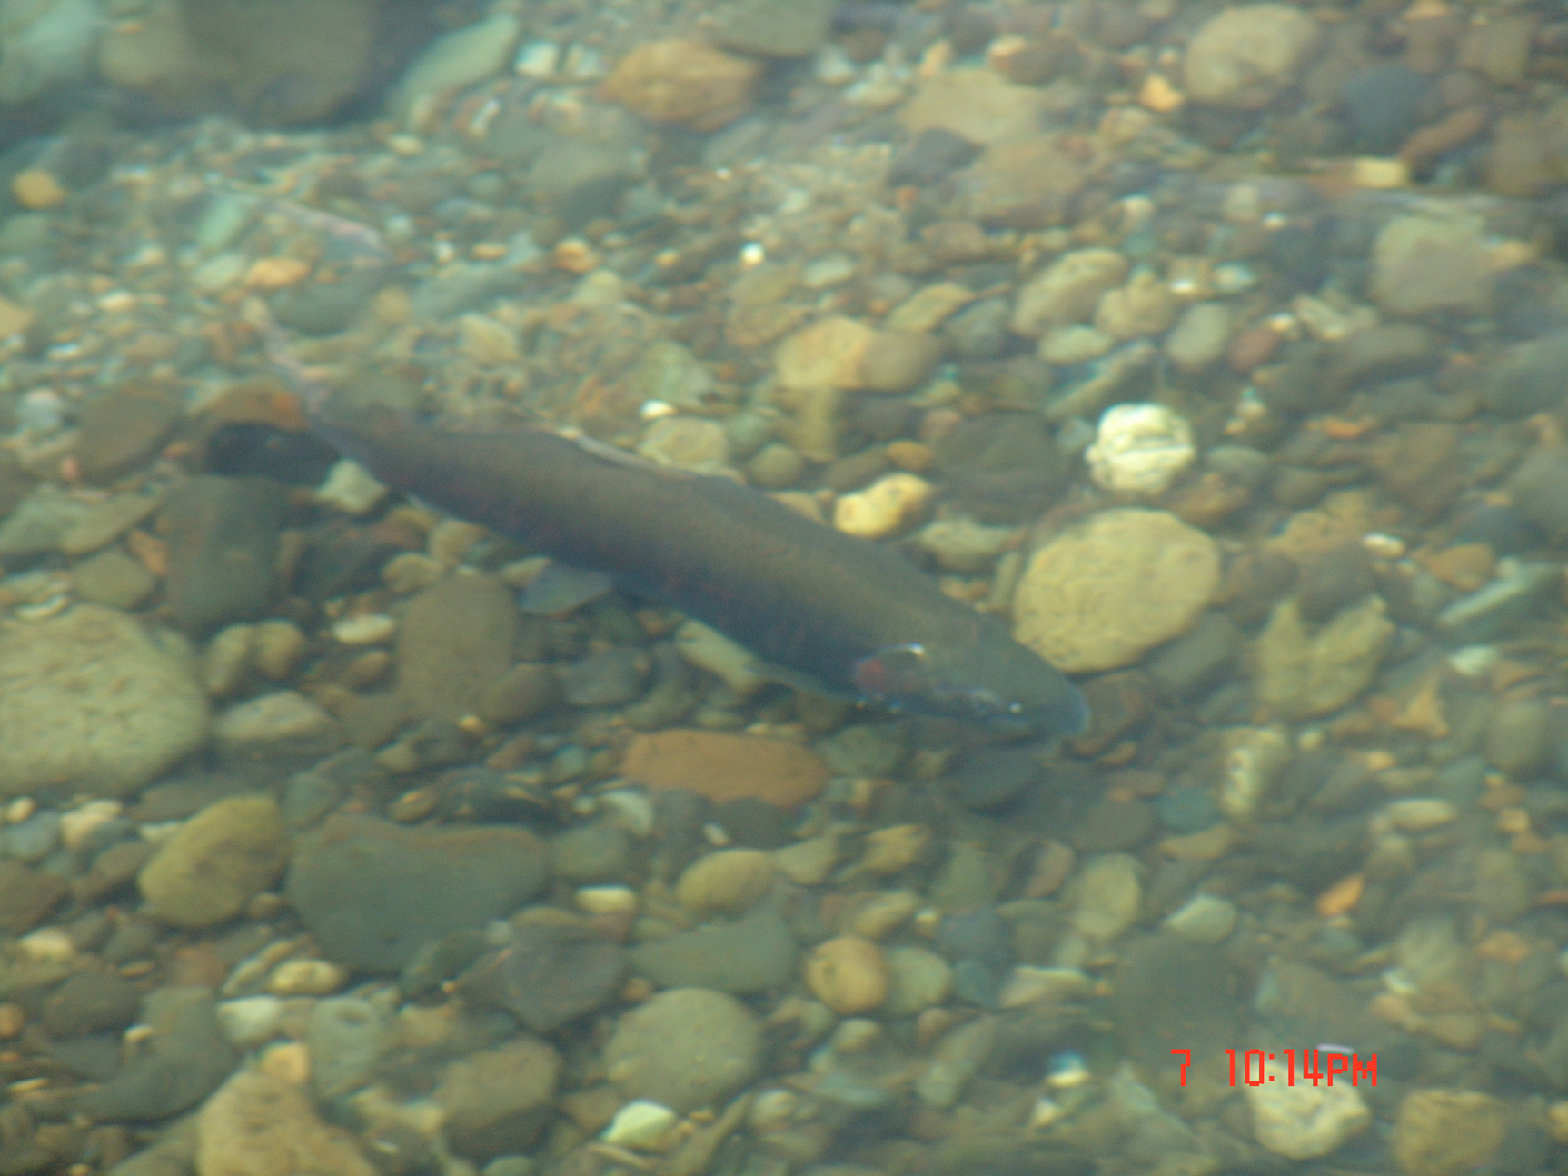
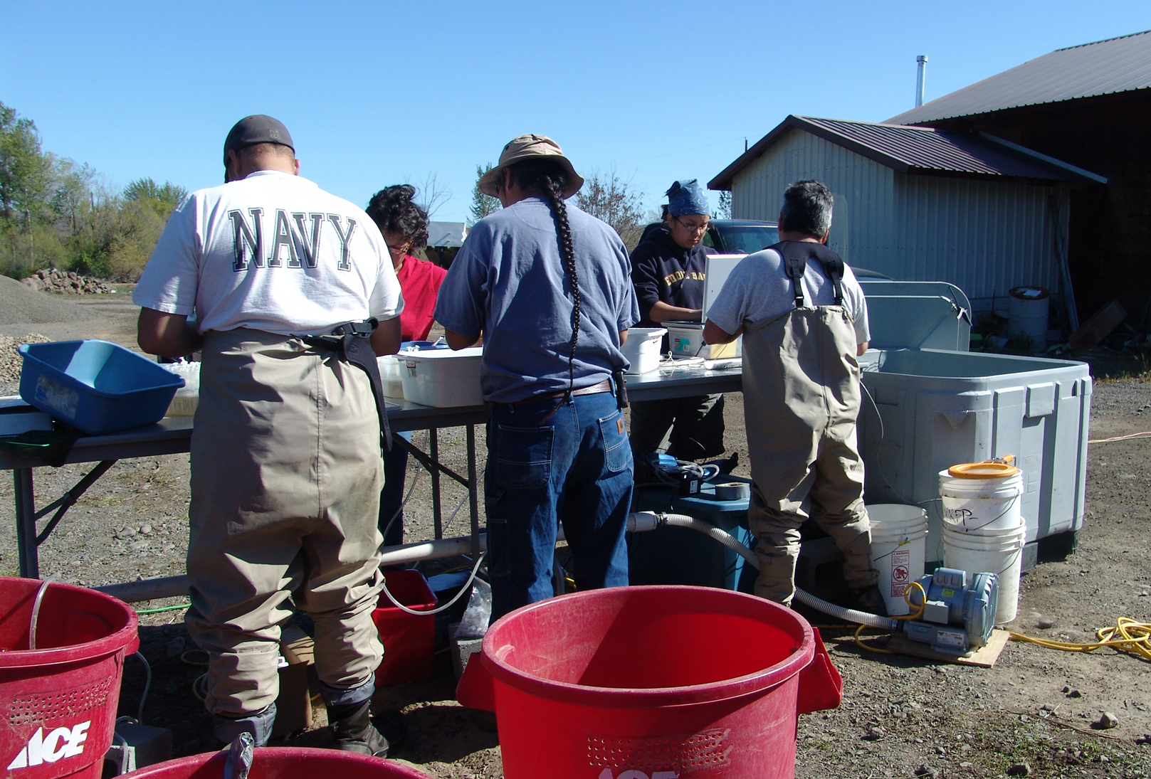
Emigration and survival of hatchery-reared Spring Chinook and Coho Salmon in the Yakima River Basin – LSRCP May 2024
William J. Bosch, Shubha N. Pandit, Todd Newsome, Andrew P. Matala, Chris Frederiksen, Zack Mays, David Lind, Mark V. Johnston, Gabriel Temple, Donald Larsen, and others
Acknowledgements: átwai Melvin Sampson, Yakama Nation, Levi George, MRS and Prosser staff, techs, Charlie Strom, Daniel Brownlee, Michael Fiander, Daylen Isaac, Anneliese Myers, WDFW, NOAA, USFWS, BOR, CRITFC, PSMFC, and BPA
Notes:
Preliminary results, consistent with revision submitted for publication in NAJFM, January, 2024.

Slide 2
“We have been too content with turning out a nice looking report of the number of fish hatched, reared, and presumably planted; and not sufficiently concerned with what actually happened to the fish afterward” – WM Keil 1935.

Slide 3
Can reducing the homogenization that hatchery-reared fish experience under present practices provide benefits?
Notes:
Can and should we be doing more? Some recent literature and talks on the subject of whether and how current hatchery practices can be modified to perhaps achieve better results (adult returns), summarized in the question at the bottom which is the focus of this opportunistic investigation.

Slide 4
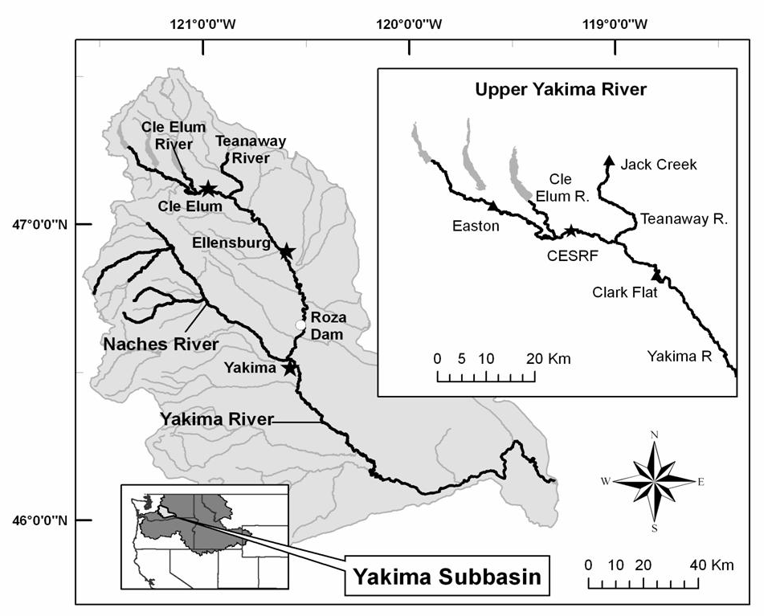
Spring Chinook Supplementation – Volitional Smolt Releases
Notes:
This is another study using the Cle Elum Spring Chinook supplementation fish and infrastructure. Fish are marked (large subset with PIT tags) in Oct/Nov then moved to accl. sites in Jan/Feb.

Slide 5
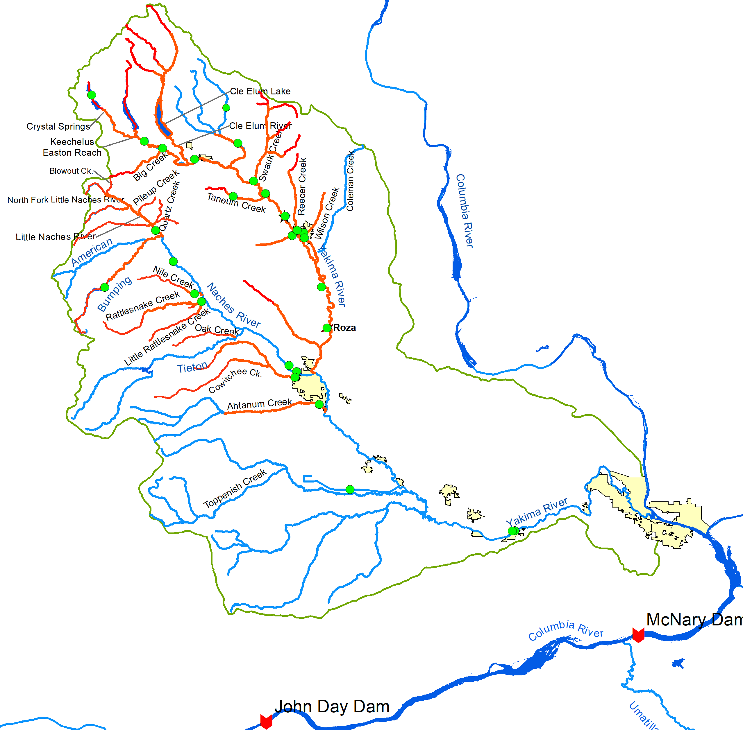
Coho Reintroduction
Parr
90mm FL
Jun-Aug release
Smolts
113mm FL
Mar/Apr release
Migrate to sea in same year
Brood Years 2006- 2017
Roza
Wapato Diversion Dam
Sunnyside Diversion Dam
Chandler Smolt Trap
Prosser Hatchery
Prosser Diversion
Notes:
Green dots indicate locations of parr and smolt releases included in this evaluation. Parr released in late June to early August, smolts in late-March to mid-April; both groups migrate to sea in same year as smolts.

Slide 6
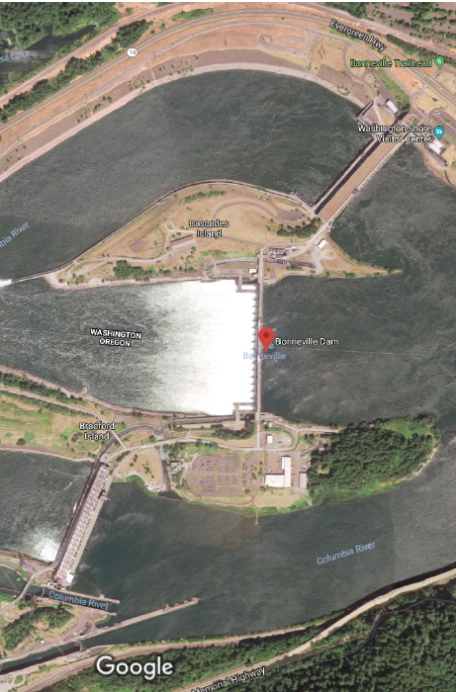
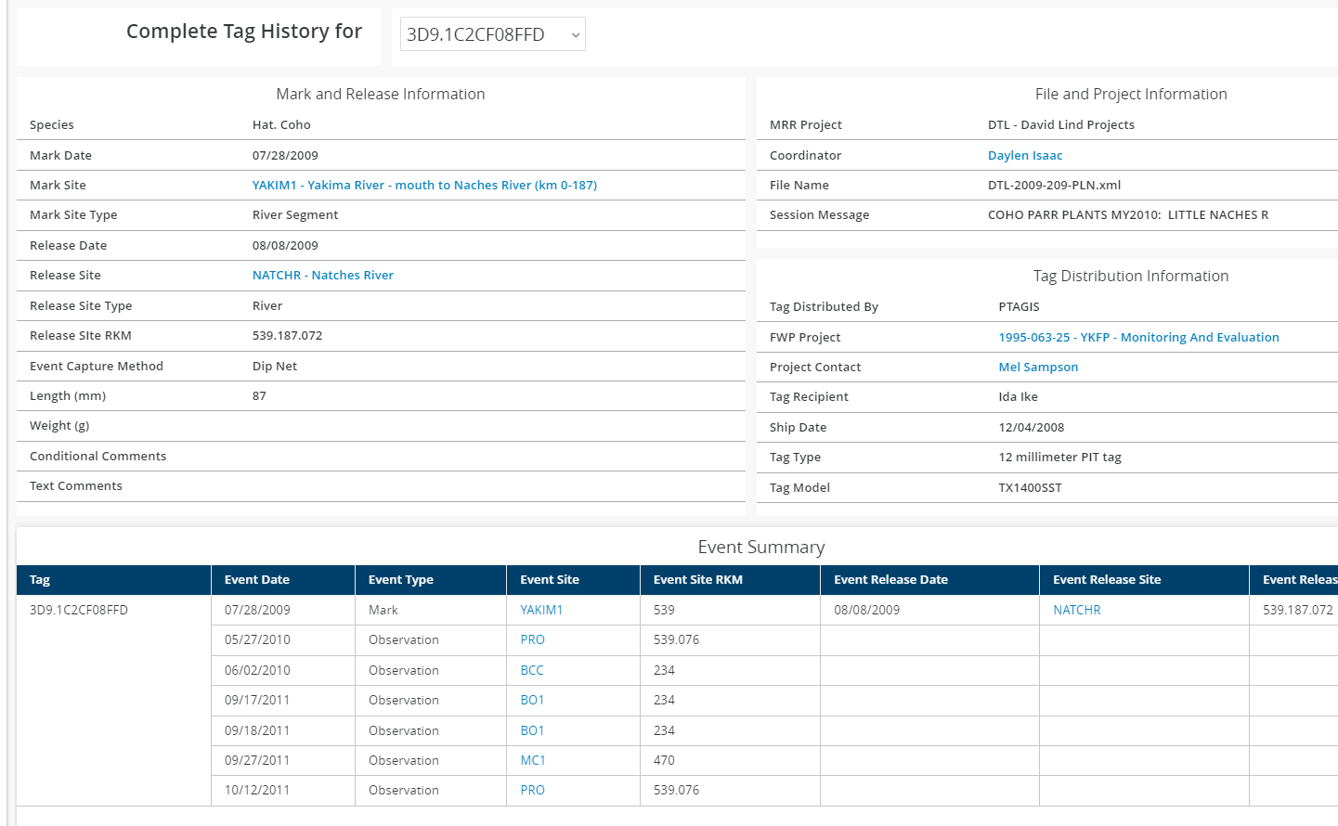
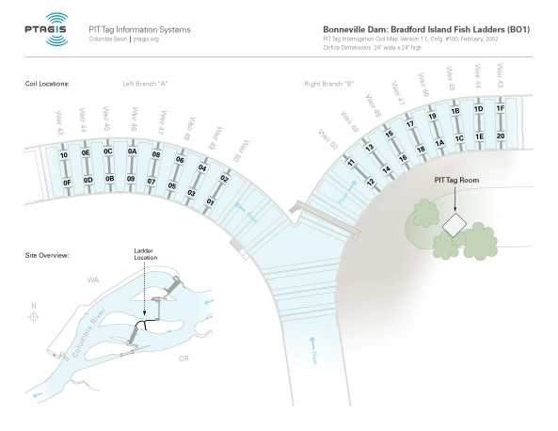
Methods – Downstream PIT Detects
03
Emigration Timing – McNary and Bonn.
Emigration Survival – McNary
Release to Bonn. adult survival
Bonn. juv. to Bonn. adult survival
Age-at-return
Notes:
We evaluated juvenile detections at McNary and Bonneville Dams to compare differences in arrival timing, and adult detections at Bonneville Dam to compare Bonn-Bonn smolt-to-adult return rates (SARs) and age-at-return for the coho released as parr relative to those released as smolts.

Slide 7
Sp Ch Juv Passage at Bonneville Dam
Notes:
When a fish left the acclimation sites was a much more important determinant of travel days to Bonn. Dam than was fish size at emigration.

Slide 8
Juvenile Emigration Timing - Coho
 | Parr | Smolt
McN | 30-May | 16-May
Bonn | 1-June | 21-May
Notes:
Smolt emigration timing was significantly later for coho released as parr at both McNary (15 days) and Bonneville (11 days); p-value close to zero for both normalized data sets.

Slide 9
Juvenile Emigration Timing - Coho
Notes:
Smolt emigration timing was significantly later for coho released as parr, e.g., May 31 v May 21 at Bonn. p<0.01 for 11 brood years.

Slide 10
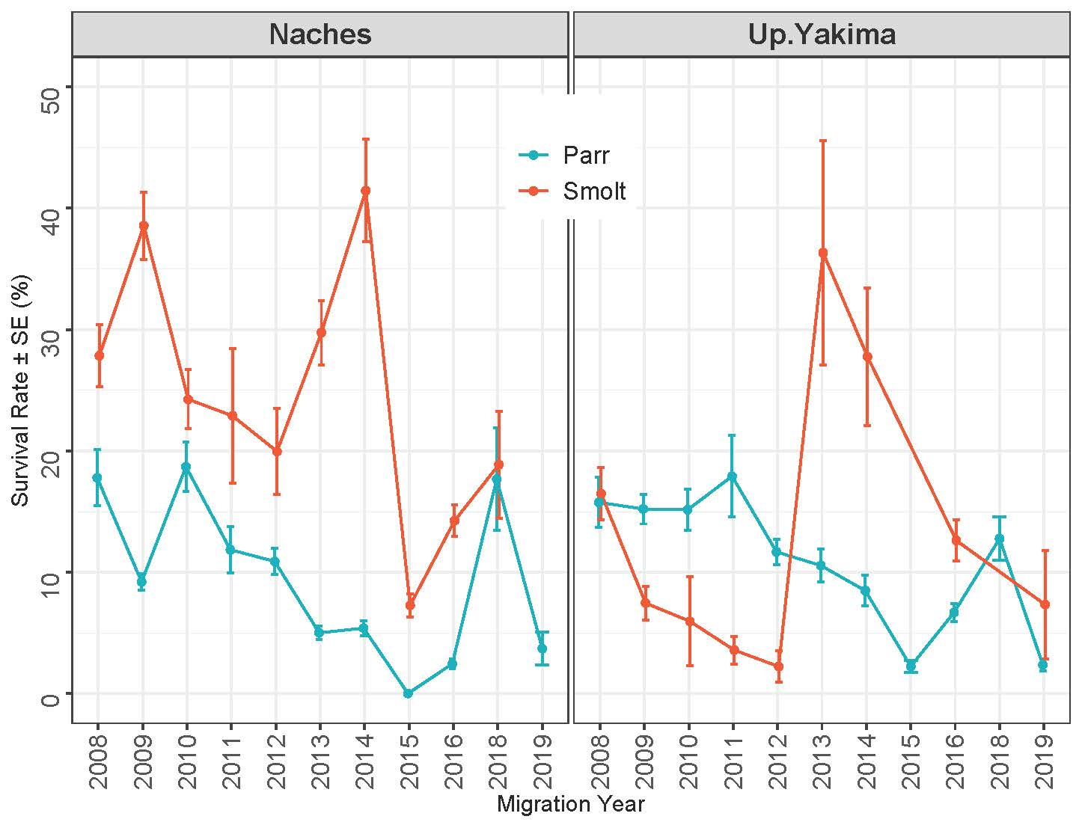
Juv. Survival to McNary Dam - Coho
Notes:
In general, smolts fared better as juveniles to McNary than did parr which might be expected, as parr releases had losses from overwinter mortality prior to smolt emigration.

Slide 11
Bonn. smolt to Bonn. adult returns - Coho
P = 0.03* | Parr | Smolt
Mean | 5.15% | 2.31%
± SE | 0.97% | 0.75%
Notes:
Parr releases achieved statistically better Bonn-Bonn SARs than did smolt releases for brood years 2007-2017 (5.15% vs 2.31%; p=0.032; 5.6% to 3.1%, p=0.087 for 2006-2017) and at all release locations (not statistically evaluated). Note only 30, 51, and 19 Bonn juv detects in 2009, 2010, and 2017 respectively with no adult return detections for those fish. Only 52 cumulative juv. Bonn detects from Ahtanum releases.

Slide 12
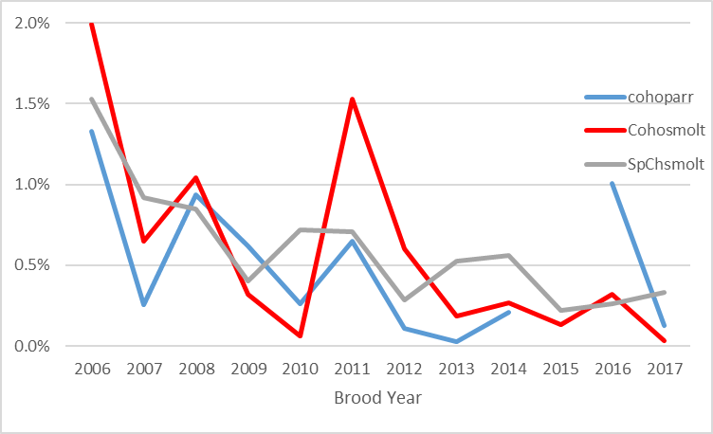
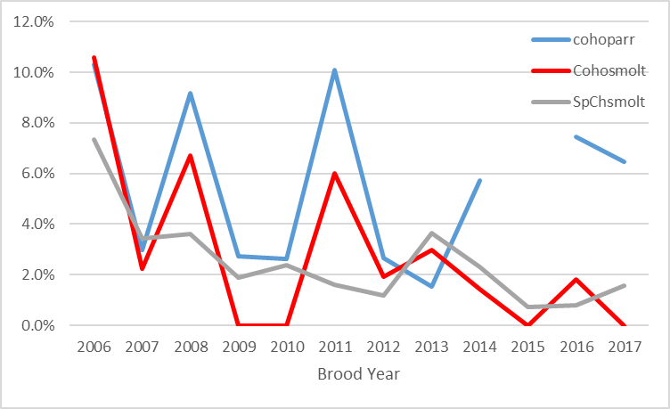
SARs with Spring Chinook
Release to Bonn. Adult
Bonn. Juv. Bonn. Adult (marine index)
Notes:
We have release to Bonn. SAR data for PIT-tagged spring Chinook from the accl. site exits, so I plotted those data with our coho results. The figures are not exactly “apples to apples” as coho data are for Naches/Upper Yakima combined (if separated the N values might get pretty low in some cases by brood year), while sp ch is only for upper Yakima. But it is interesting to see the consistency between the two data sets knowing that the spring Chinook is a robust data set given how many fish are PIT tagged annually.

Slide 13
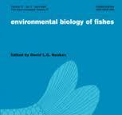

SpCh Returns to Bonneville Dam by Age, Bosch et al. 2023
Mean Date of Acclimation Exit
N
37
950
1890
40
Mean fork length at time of PIT-tagging
Notes:
Earlier migrating fish tended to be larger and return at younger ages. Later migrating fish tended to be smaller at release and return at older ages.

Slide 14
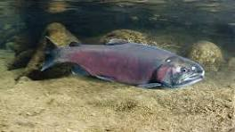
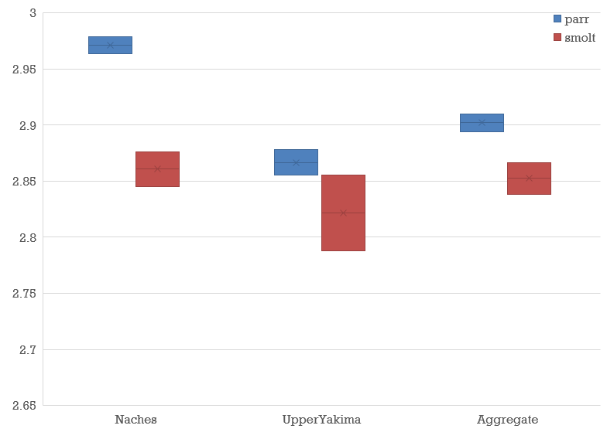
Coho Returns to Bonneville Dam by Age
Bosch et al. 2024
Notes:
Overall, parr releases returned at a slightly older age distribution (more age-3 returns) than did smolt releases, but there was considerable variability across brood years and release locations. Still, pooled stats over all years showed a significantly older age-at-return for parr releases in the Naches system and combined over all brood years and release locations (NaParr, n=451; UY parr, n=885; NaSmolt, n=495; UYSmolt, n=129). Interestingly, while parr releases did not fare as well in the Naches system, they had a pooled age-3 return rate >97%. Note results very similar to similar spring Chinook study in Upper Yakima.

Slide 16
Summary & Take-Homes
Diversity in 3 metrics: emigration timing, marine survival, and age-at-return
Differences by watershed
Explore different release strategies consistent with watershed goals and conditions
Your comments & questions
More info:
Shubha_Pandit@yakama.com
Todd_Newsome@yakama.com

Slide 17
References
Bosch, W. J., S. N. Pandit, B. P. Sandford, G. M. Temple, M. V. Johnston, and D. A. Larsen. 2023. Effects of volitional emigration timing and smolt size on survival and age-at-return in a Pacific Salmon hatchery population. Environmental Biology of Fishes 106:1037-1059. https://doi.org/10.1007/s10641-023-01395-0.
Bosch, W. J., S. N. Pandit, T. Newsome, A. P. Matala, C. Frederiksen, Z. Mays, D. Lind, and M. V. Johnston. 2024. Emigration and survival of hatchery-reared Coho Salmon released as parr and smolts in a reintroduction program. (in review).

