Slide 1
Fall Chinook conversion of yearlings to subyearlings for lfh production
Jenna Fortier
WDFW Snake River Lab
Notes:
Hey everyone, my name is Jenna Fortier. I work at the Snake River Lab in Dayton, Washington. Today I will be giving a talk on the fall Chinook conversion of yearlings to subyearlings for LFH production

Slide 2






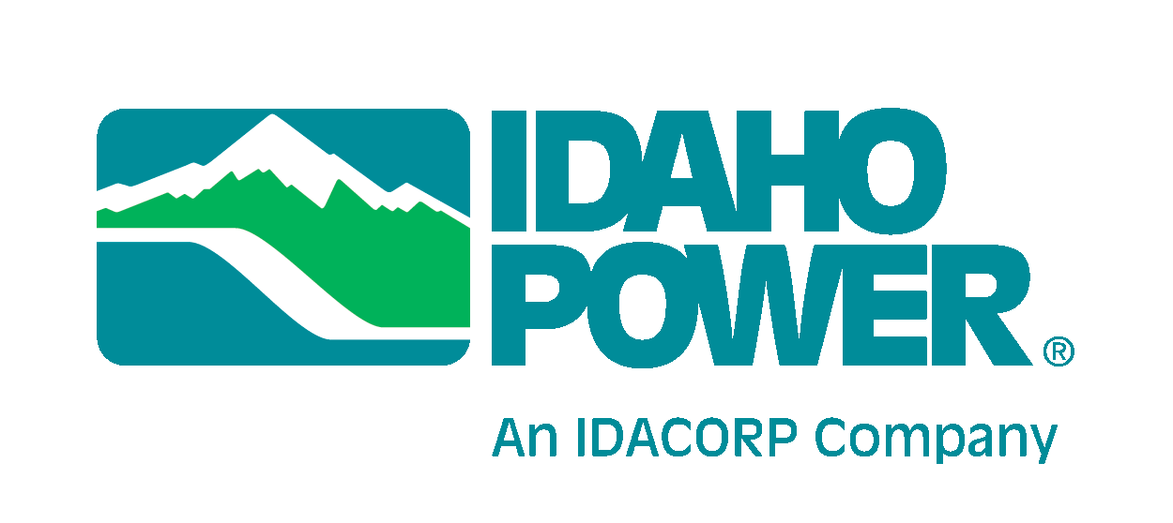


Acknowledgements
A special thanks to:
Michael Herr, WDFW
Joe Bumgarner, Retired WDFW
Rod Engle, LSRCP
Notes:
A special thanks to Michael Herr, Joe Bumgarner and Rod Engle for their guidance.

Slide 3
Historical Timeline
1992
Structural improvements to Juvenile Facilities at SR dams 2018-2020
Structural improvements to Juvenile Facilities at SR dams
1968
US vs Oregon Agreement
<1,000 SRFCH returned
Spill Changes Occur
Emergency Egg Bank Program
Additional Hatchery Production: FCAP, NPTH, IPC
SRFCH returned at over 75,000
Flex Spill at Dams
1970s
1980s
1990s-2000s
2006
2013
2018-Current
Steady decline of the fall Chinook population
Steady increase of the fall Chinook population
Notes:
So just a quick overview of the history of the program and the hydrosystem.
In response to a dramatic drop in the population from overfishing and habitat loss since the 30s, an emergency egg bank program was initiated by WDFW in the 70s (click). This program helped preserve the FCH population while Lyons Ferry was being built. (Click)
(Click) In the mid 80s there were thought to be less than 1000 fall Chinook returning annually.
Lyons Ferry Complex was finished in 1988(Click)
(Click)While steps were being taken to mitigate the loss of the run, the fall Chinook population was steadily declining and were officially listed as threatened in 1992(Click)
(Click)Between the 1990s and 2000s, additional hatchery production programs were created like FCAP, and IPC also started taking part in mitigation efforts. (Click)
(Click)Agencies collaborated with evaluations, run reconstructions, and hatchery implementations to help bring the run back to life with 75000 returning in 2013 and the run has steadily increased.
Throughout this timeline various structural improvements at juvenile facilities, and spill changes have occurred to benefit migration.

Slide 4
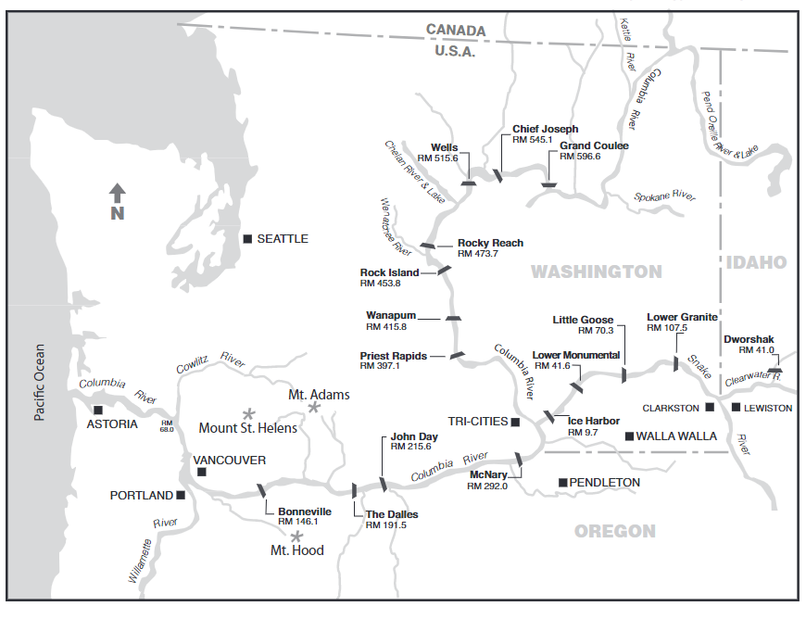
ICH
Lyons Ferry Hatchery
Notes:
Here is Lyons Ferry- where we raise and PIT tag our yearling and subyearlings fall chinook. And just a quick reference, here is Bonneville Dam (Click) which we used for our returns to the river and Ice Harbor (click) which would be for returns to the LSRCP area. and here is Lower Granite which is our end boundary area.

Slide 5
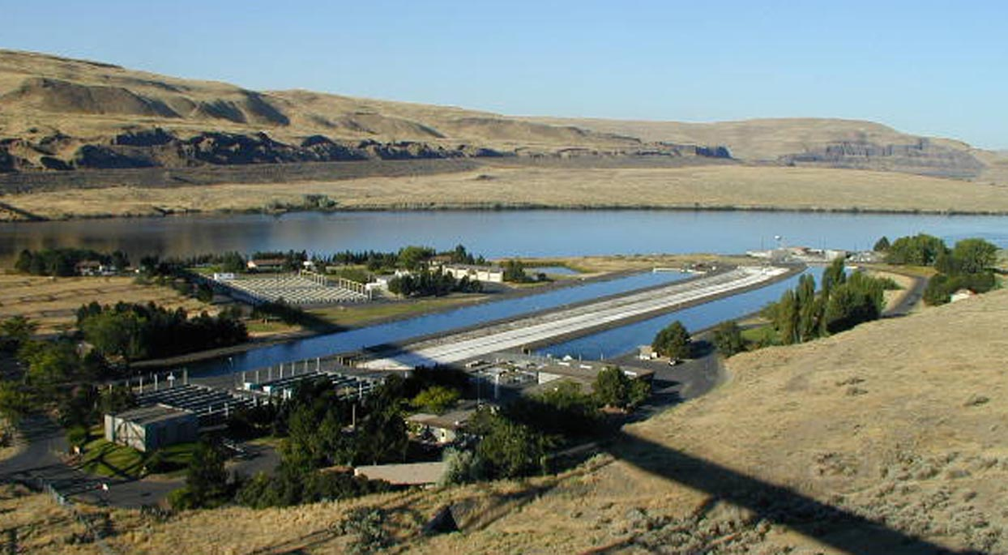
Notes:
Here is a picture of Lyons Ferry hatchery where our fish are reared.

Slide 6
Historical Returns to LGr
Notes:
Here is a visual of our Snake River Fall Chinook returning to Lower Granite Dam. In dark blue are our natural returns, light blue are our hatchery returns. The solid black line is where the delisting criteria is for our natural origins (3000). The small dotted line is our short term restoration goal (7500), and the longer dotted line is our long term restoration goal (a little over 14,000) for our natural origin fish.

Slide 7
Yearlings vs subyearlings
Yearling
Subyearling
Skewed Age Structure
Mini-Jacks
Returns are older and resemble Natural Origin Life History
No mini-jacks
Notes:
When this program got started, the yearling life history was the best strategy to produce a successful fish.
Over the years, we have gained knowledge to show that a subyearling life history is a better strategy for a successful return.
Yearlings return in higher numbers but have a skewed age structure and mini jacks return
Subyearlings returns are older and resemble a NOR life history and there are no mini jacks.
Subyearlings would be a higher quality return for fishermen and broodstock collection.

Slide 8
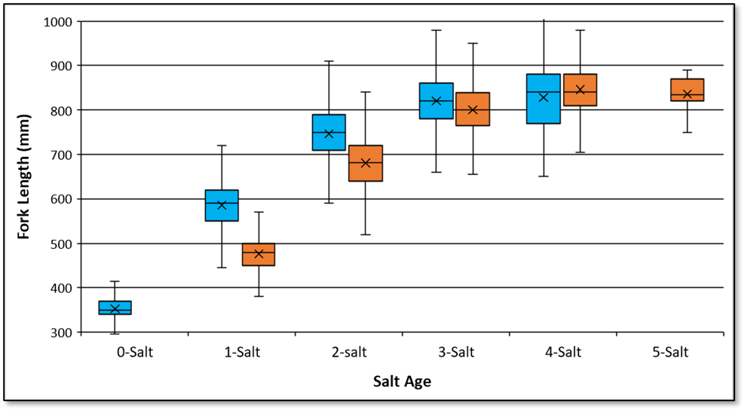

Notes:
In 2022, a white paper was written by Joe Bumgarner, Bill Young and Stuart Rosenberger analyzing the differences between subyearlings and yearlings. With the goal of providing data to replace the yearling program with an increased subyearling release at Lyons Ferry Hatchery.
They found that while subyearlings and yearlings aren’t statistically different, the median and mean sizes of subyearlings at the 1-2 salt ages are smaller than those released as yearlings. However, there is not a size difference between 3-4 salt age fish.
This is new and was not the case prior to 2010.

Slide 9
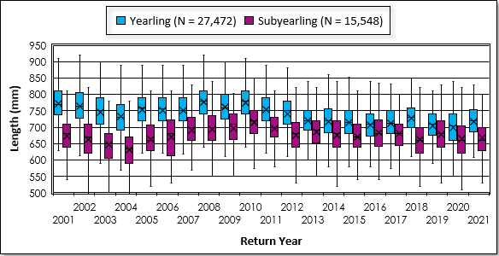
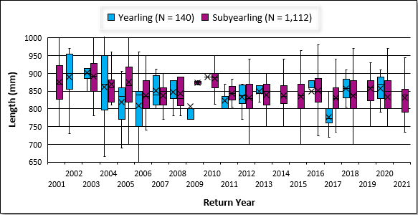
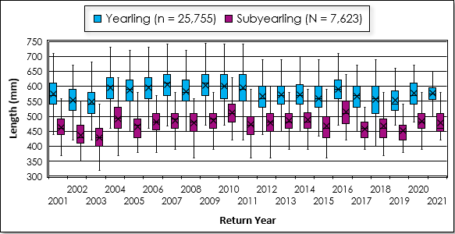
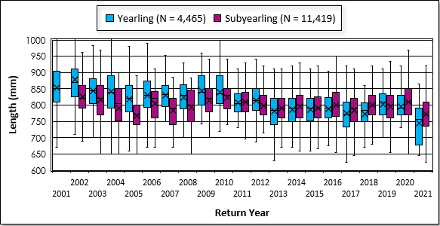
Size at Returns
1 Salt jacks
2 Salt adults
3 Salt adults
4-5 Salt adults
Notes:
Here are our size of returns again, you can see the 1 and 2 salts remain fairly consistent, and then when you get to the 3, 4, and 5 salt ages and their sizes start to shift. 2013 is when they noticed 3 salt subyearlings returning slightly bigger than yearlings
And our 4 and 5 salt ages, as you can see there is a noticeable difference, and a lot less yearling returns.

Slide 10
Current vs proposed changes
Notes:
Here is our current yearling program vs proposed subyearling changes. By replacing the yearlings with subyearlings, you can see that we would get more subyearlings, proportionally, than those of the current yearling program, especially in the 3-4 salt ages. Again, they aren’t necessarily bigger though, there would just more of them. This also would allow our releases to follow a more closely aligned life history to those of the natural population.

Slide 11
A mini project on mini-jacks
Up until this there was no real analysis on mini-jacks
They exist but SAR/SAS don’t account for mini-jacks
We don’t know much about them
What is it costing the program
What is it costing fishermen
How this all can be applied to a change in our program
Notes:
We did a MINI project on the MINI jacks… to see how they were contributing to the overall returns.
When looking at all the data the returns gave us, this piece of the data was missing.
It had been documented that managers knew mini-jacks were there, but because they are not of a targeted harvestable size, they don’t count for our mitigation goals, or our return and survival estimates.
The basic data we do know is: they are reared as a yearling and return within the same year of release, and they are sizes between 25-55 cm. Literature also states mini-jacks have a higher than normal gonadosomatic index. However, we did not look at this aspect. But literature suggested it’s similar to smaller jacks, where they utilize the sneaker male mating strategy.
We also wanted to know what it was costing the program and the fishermen.
And how this can help provide more information for the yearling to subyearling conversion

Slide 12
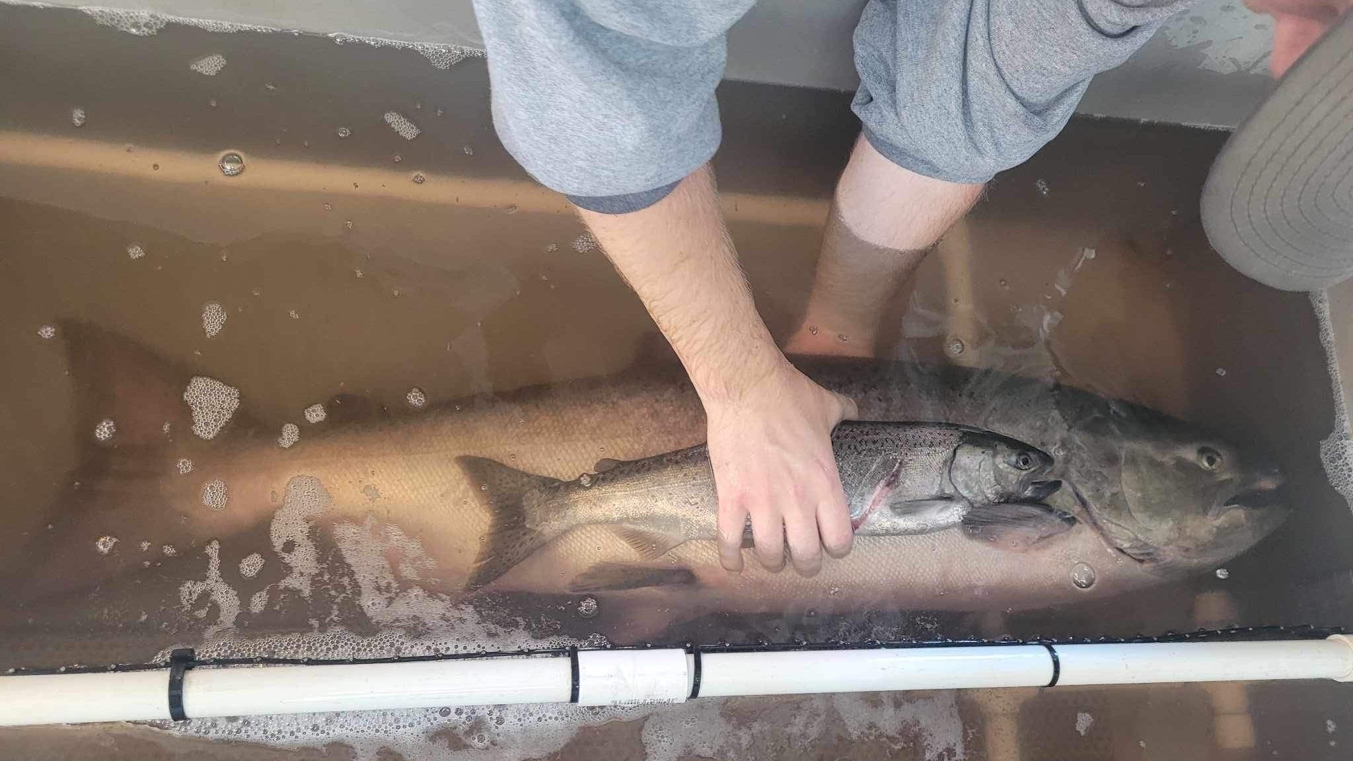
Notes:
Here’s a great comparison of a mini-jack versus an adult. Even without the data, you can tell we wouldn’t want the smaller fish for harvest or broodstock.

Slide 13
Methods
PIT tagged Fish were queried through PTAGIS
Yearlings: 30K annually Subyearlings 20K annually
2008-2018 for Yearlings and 2012-2018 for Subyearlings
Fish Assignments were based on travel days from release
Juveniles were removed-only had downstream detections
Mini-Jacks returned <1 year from release
Jacks returned 1-1.5 years from release
Adults returned > 2 years from release
Notes:
So for the analysis click PIT tagged fish were queried. Annually staff woud tag 30K Y and 20K SY. But this wasn’t consistent. So analyzed 2008-2018 for Y and 2012-2018 for SY.
Click Fish assignments were based on travel days from release
Juveniles were removed
MJ returned <1 year from release
J returned 1-1.5 yrs from release
A returned >2 yrs from release

Slide 14
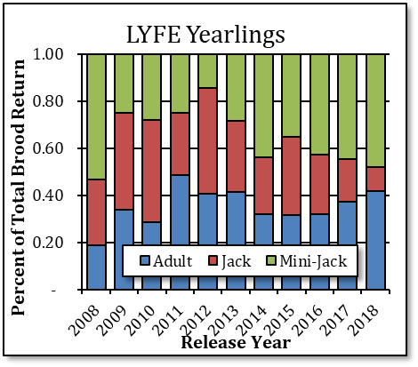
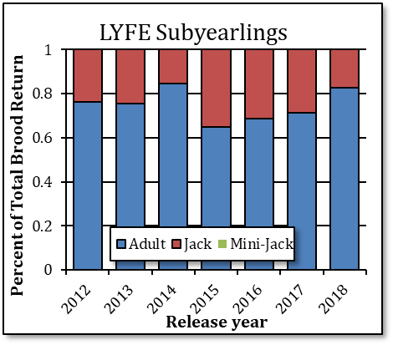
Results: Age composition to Bonneville
Notes:
These are the results for the age composition of onstation subyearling and yearling release groups to Bonneville Dam.
As you can see here, we look at the release years and the percent of total brood returning to Bonneville Dam.
Data indicates for yearling releases, mini-jacks were produced, whereas the subyearling releases, they were not. This was the same when we looked at fish returning to the LSRCP area.
For the Subyearling releases, those fish returning to Bonneville averaged 77% were adults, 23% were jacks and no mini-jacks. For the Yearling releases, fish returning to Bonneville averaged 36% were adults, 28% were jacks, and 36% were mini-jacks.

Slide 15
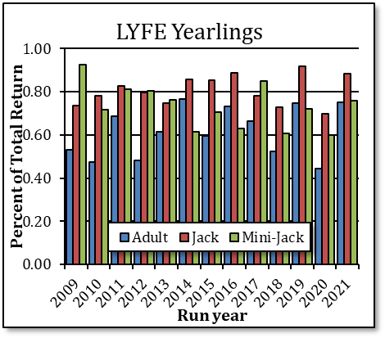
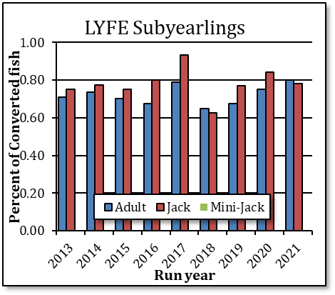
Results: Conversion rates
Notes:
Conversion rates were analyzed for yearling and subyearling groups as well.
These fish were detected at Bonneville Dam and Ice Harbor Dam. Meaning they were not harvested in the Zone 6 fishery.
And as you can see, the zone 6 fishery doesn’t pull out mini-jacks.
On average for the yearling group, 62% of adults converted to Ice Harbor, 81% of the jacks and 73% of the mini-jacks. On average for the subyearling group conversion rates averaged 73% of adults and 78% of jacks, and no mini-jacks were detected.

Slide 16
Conversion Cost
Rearing space
Money utilized benefits to rear subyearlings
Increased Production
=
Cost Neutral
Produce a closely aligned life history of the natural rearing of SRFCH
Notes:
Our goal is to have a higher quality fishery and more productive broodstock collection.
When weighing the cost of this conversion it ultimately becomes cost neutral.
Here’s how:
Yearlings utilize 14 months of raceway rearing space whereas subyearlings only utilize space for half of that time.
2. The money utilized from feed, water usage, staff time is less
3. if we add in additional subyearling production to offset the yearling removal, we have greater amounts of production costs. However, it is for a shorter amount of time. Ultimately it becomes cost neutral.
3. But, it allows for a production route that closely aligns with the life history of a naturally reared Snake River fall Chinook. And also allows for other species to be reared.
So while monetarily it may be cost neutral, the benefit to the overall production and program is positive.

Slide 17



Increasing Production: Same fish, more poundage!
Yearling and Subyearling = Identical Run Timing
X
Mini-Jacks
Yearlings
Subyearlings
Replace 450,000 yearlings
With 1.6 million subyearlings
Production
=
Notes:
The White paper gave justification to pursue this change in our program
They found:
1. The Avg Run Timing of Adult SRFCH at Bonneville Dam from both release groups are identical
and The Avg Run Timing overlaps with the fall Chinook fisheries above and below Bonneville Dam
2. Future Yearling production at LFH would removed and replaced by increased subyearling returns
3. While LFH Yearlings out-perform LFH subyearlings
Yearlings produce mini-jacks, so these would be removed from the population
4. To keep contributions the same, we would replace 450,000 yearlings with a total 1.6 million subyearlings (this is an additional 1.15 million to our already 450,000 in current production).
5. Projections looked at the additional subyearling production and it either equaled or increased the overall harvest (in poundage) in the Columbia River. Again, not necessarily bigger, but older returns and more of them.

Slide 18
Next Steps…
Increase brood collection for BY2024
Release a total of 1.6 million subs at LFH in 2025
BY23 would be the last yearling release in 2025.
Notes:
If this passes PAC we would increase our brood collection this fall
Which then we would release 1.6 million subs in 2025
And last, BY23 would be our last yearling release 2025

Slide 19
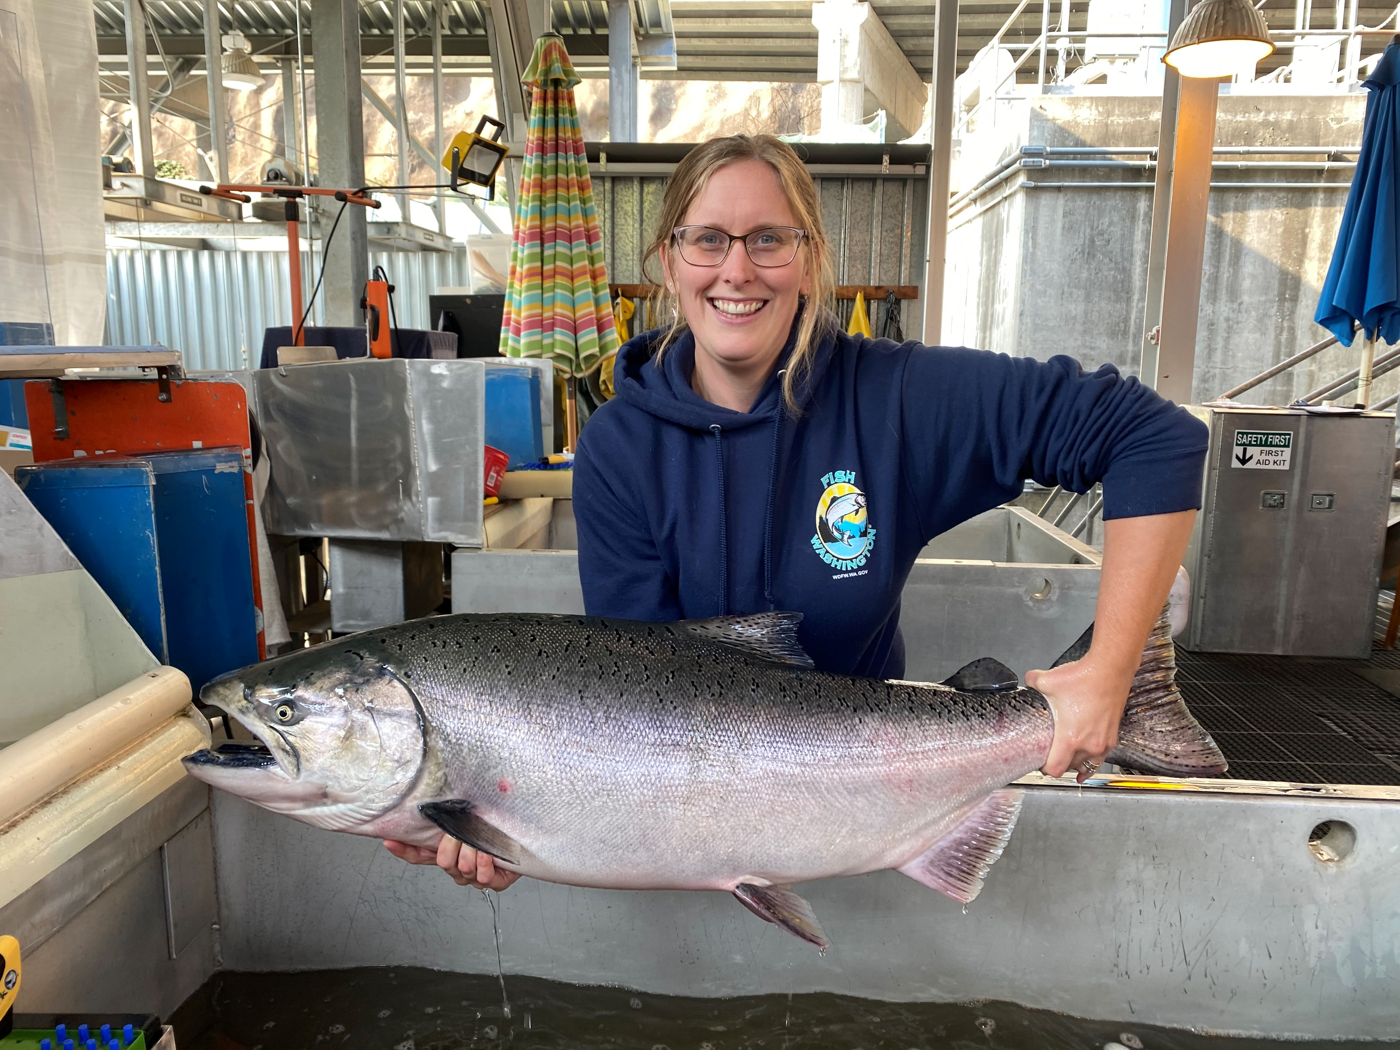
Thank you!
Notes:
I appreciate your time and the opportunity to present this information to you.
I know that was a lot of information in a very short time frame. But if you have any questions, please ask, if I can’t answer them right away, I can make sure to get back to you after today.

