Slide 1
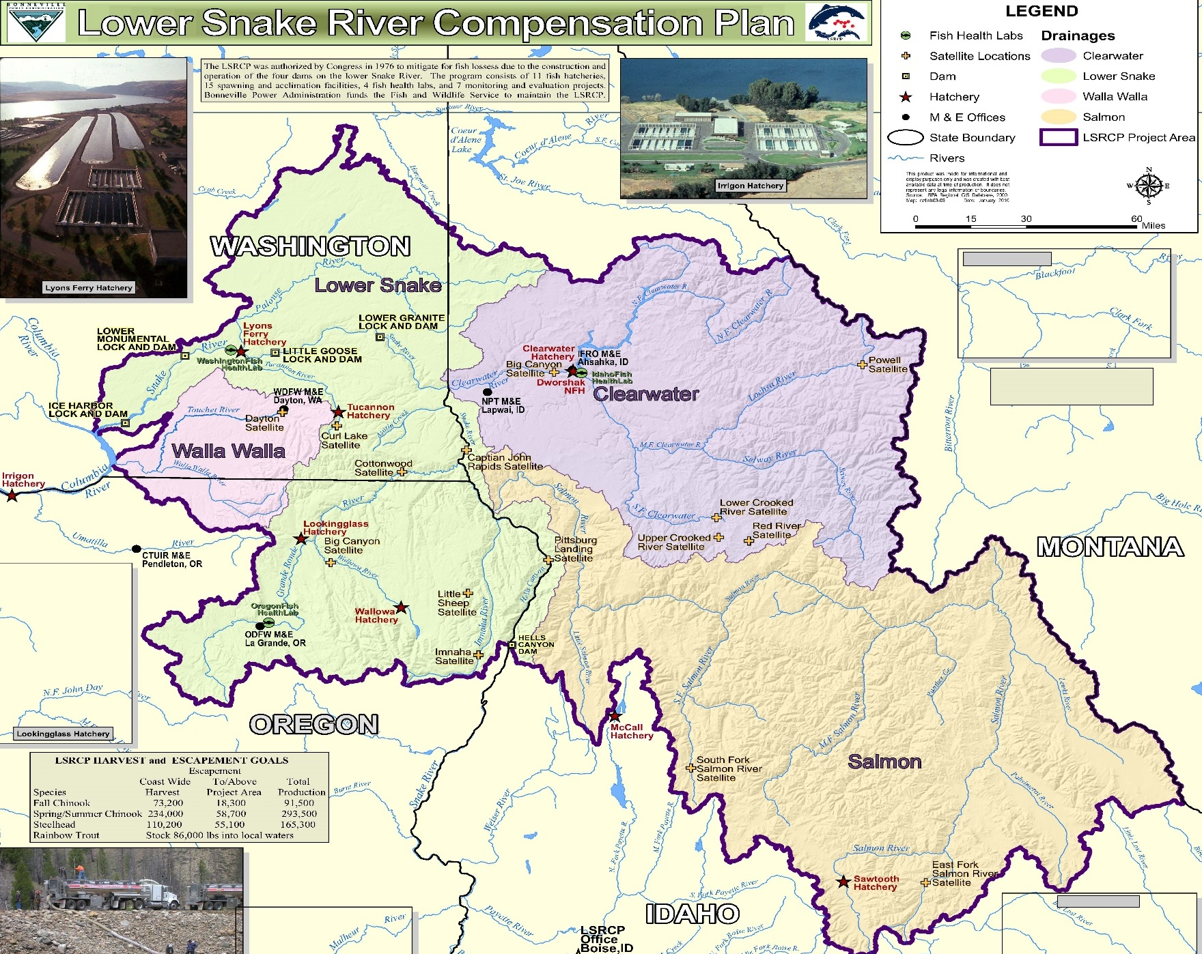
Notes:
Introduction – I’m in a 4-month detail position for Mark Robertson, who retired at the end of 2022. My detail goes through mid June.
I have been in the Idaho ES office for the last 13.5 years working primarily in our classification and recovery branch.
During my detail, one of my primary tasks is to help develop an “options” paper that Nate referenced earlier in the meeting.

Slide 2
Notes:
The options paper approach will focus on upper Salmon River spring summer chinook for the Lower Snake River Comp program.

Slide 3
Table 1. Computation of Lower Snake River Compensation Measures from COE (1975) and modified from Herrig (1990) to include trout. Year, or years, of maximum counts at McNary Dam between 1954-67 are provided in parentheses. Trout mitigation was specific to the State of Washington for lost fishing opportunity due to inundation from the projects. A higher percent passage (68%) for fall Chinook salmon was observed during the passage period but was discounted by the fisheries agencies (Herrig 1990).
 | Fall Chinook Salmon (1958) | Spring-Summer Chinook Salmon (1957) | Steelhead Trout (1962-63) | Trout
McNary Dam Count | 97,500 | 222,100 | 172,600
Ice Harbor Dam Maximum Percent Passage (1962-67) | 33.5% | 55% | 66.5%
Estimated Snake River Pre-Project Run | 32,663 | 122,200 | 114,800
Lower Snake River Compensation Goals | 18,300 | 58,700 | 55,100 | 86,000 pounds into local waters (WA-79,800, ID-6,200).
Notes:
These are the goals for the LSRCP program by species.
My focus is on the portion highlighted in blue, particularly in the upper salmon river area.

Slide 4
Average by Basin
LSRCP Chinook Program Performance, Brood Year 2007 - 2016
Basin | Smolts | Basin Adult Goal | SAR BY07-16 Mean | Adults BY07-16 Mean | Adult Shortfall
Northeast Oregon | 1,390,000 | 9,068 | 0.62% | 8,583 | (485)
Southeast Washington | 475,000 | 1,152 | 0.37%* | 1,780 | 628
Clearwater | 5,599,000 | 21,035 | 0.40%* | 22,534 | 1,499
Salmon | 3,000,000 | 27,445 | 0.37% | 11,000 | (16,445)
Total | 10,494,000 | 58,700 | 0.42% | 44,071
* SARs based on expected or available data, not complete for entirety of BY07-16
Notes:
This is further breakdown of the previous slide with spring summer chinook goals split up by geographic areas. As you see, the basin adult goal adds up to 58,700 – same as in the last slide.
As others have noted over the last several days, target goals are not being met in the upper salmon.
What we are aiming to do is to compile future options, with cooperator input and in consideration of ESA-related sideboards, that may help us start addressing these shortfalls.

Slide 5
Status
Snake River spring/summer-run Chinook listed under the ESA in 1992
Notes:
I wanted to run through the ESA status of the snake river spring summer chinook, touch on the Recovery Plan, and visit the latest 5 year status review findings. A bit of an updated ESA review. I imagine many have you have had input into these various documents or have reviewed them, so I apologize if it’s a bit of a repeat for you.
I’ve also tried to identify certain recovery related thoughts that may connect with the program, particularly for the Upper Salmon area.
As you all likely know, the Snake River spring/summer-run chinook Evolutionary Significant Unit (ESU) were listed as threatened under the Endangered Species Act in 1992.
There is also critical habitat designated for the species – I won’t discuss that aspect of the ESA further in this talk.

Slide 6
Recovery Plan
Snake River spring/summer-run Chinook and Snake River steelhead - 2017
Notes:
The final Recovery Plan for both Snake River spring/summer-run chinook and Snake River basin steelhead was finalized in 2017.

Slide 7
Recovery Plan
Notes:
This map, taken out of the Recovery Plan, shows the Snake River ESU, along with historical habitat and migratory corridors.
Achieving recovery – delisting – of the ESU is the long-term goals of the recovery plan.

Slide 8
Recovery Plan
p. 54
Notes:
This statement out of the Recovery Plan identifies the role of hatcheries in recovery of these fish.
In my mind this sums up how the LSRCP program operates with cooperation of all comanagers.
This also seems to sum up what this annual meeting is trying to accomplish.

Slide 9
Recovery Plan
p. 154
Notes:
This statement out of the recovery plan identifies how NMFS views hatcheries from a threats standpoint.
While it says hatcheries can be a threat, they are also identified as a benefit to recovery – help bridge periods of adverse environmental conditions.
These hatchery programs obviously serve multiple purposes for these fish.

Slide 10
2022 5-Year Status Review
2022 5-Year Review: Snake River Spring/Summer Chinook Salmon
Notes:
Now I wanted to switch gears and go through some of the main findings of the latest 5 years status review for Snake River Spring/Summer Chinook
Came out in 2022 so it’s relatively new.
Introduce what a 5-year status review is and why they are done and what are in them.
Review the listing status of the species every 5 years and provide a recommendation of the status
Also provides an updated review of the threats
Provide future action recommendations that can be carried out over the next 5 years to benefit the species – these actions may be the same or different than in the recovery plan

Slide 11
2022 5-Year Status Review
2022 5-Year Review: Snake River Spring/Summer Chinook Salmon (p. 77)
Notes:
This latest status review recommends to retain the current listing status of threatened.
Though, NMFS does say it has concern about current abundance and productivity trends.
If the recommendation was to uplist to endangered, or delist, a federal rulemaking would be required, take public comment, etc.
Again this is just a status recommendation, but it provides a snapshot of NMFS current thinking on the matter.

Slide 12
2022 5-Year Status Review
2022 5-Year Review: Snake River Spring/Summer Chinook Salmon (pp. 18-20)
Notes:
This table is of the current Upper Salmon River MPG population risk ratings.
All in high.

Slide 13
2017 Recovery Plan Status
Notes:
Looking back to the status in 2017 recovery plan, the status was similar.

Slide 14
2017 Recovery Plan Status
Notes:
Looking back to the status in 2017 recovery plan, the status was similar.

Slide 15
2022 5-Year Status Review
2022 5-Year Review: Snake River Spring/Summer Chinook Salmon (pp. 35-37)
Notes:
Like I mentioned, in addition to the status recommendation, 5 year reviews also provides recommended actions partners can take over the next 5 years.
The bottom box is an example recommendation specific to the Upper Salmon area. Most other recommendations are habitat based.
Is this something worth considering in relation to LSRCP target goals? It is supported by NOAA – which is helpful if it something worth moving forward with.

Slide 16
2022 5-Year Status Review
2022 5-Year Review: Snake River Spring/Summer Chinook Salmon (p. 33)
Notes:
Digging into this action a little further, this expands on the migratory concern identified in the previous slide.
Specifically calls out the Deadwater Reach of the mainstem Salmon River as a potential location of higher than average mortality and slower travel rates.
Not sure how this may help LSRCP target goals, but it may be something to consider in this options paper.
Again, just an example of some information in these 5 year status reviews that may help with developing the options paper.

Slide 17
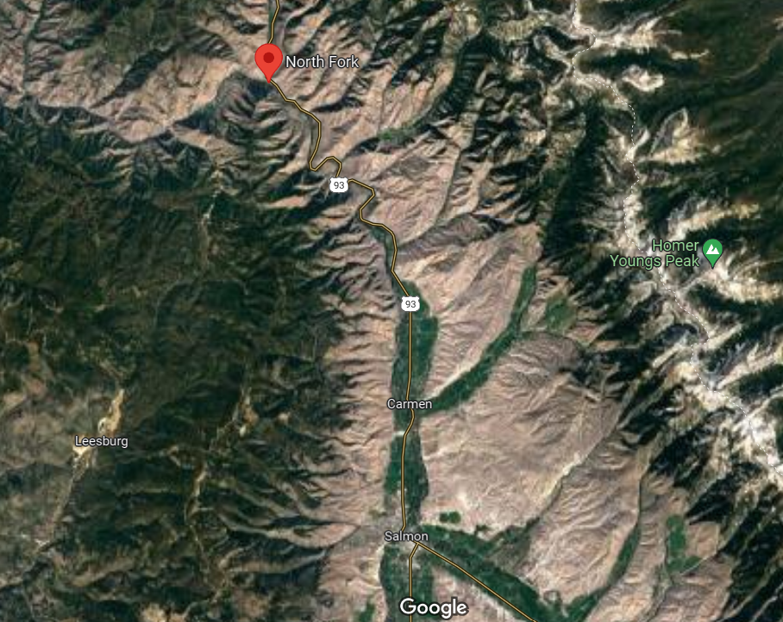
Notes:
The Deadwater Reach appears to be just below the town of North Fork.
The city of Salmon is south towards the bottom of the map.

Slide 18
Section 7(a)1 vs 7(a)2
2017 NMFS BiOp – Four Salmon River Basin Spring/Summer Chinook Salmon Hatchery Programs in the Upper Salmon River Basin
Notes:
Switching gears again – This is a table out of the 2017 NMFS BiOp showing the covered hatchery programs within the upper salmon basin.
Effects of hatcheries were evaluated using the status of the species form the 2015 status review.
A new consultation would need to consider the latest status review -likely 2022 version or possibly later.
Having a different status can possibly change NMFS thinking when it comes to their effects analysis in these consultations.

Slide 19
Section 7(a)1 vs 7(a)2
7(a)1 – Section 7(a)(1) of the Act directs Federal agencies, in consultation with and with the assistance of the Secretary of the Interior or of Commerce, as appropriate, to utilize their authorities to further the purposes of the Act by carrying out conservation programs for listed species. Such affirmative conservation programs must comply with applicable permit requirements (50 CFR parts 17, 220, 222, and 227) for listed species and should be coordinated with the appropriate Secretary.
7(a)2 - Section 7(a)(2) of the Act requires every Federal agency, in consultation with and with the assistance of the Secretary, to insure that any action it authorizes, funds, or carries out, in the United States or upon the high seas, is not likely to jeopardize the continued existence of any listed species or results in the destruction or adverse modification of critical habitat.
Notes:
I am sure Mark has outlined this in the past, but it’s a good reminder that there are 2 Section 7(a)s of the ESA – the first is more proactive and directs federal agencies to carry out conservation actions to benefit listed species – the purpose is to help recover the species when they can.
The second requires federal agencies not jeopardize the continued existence of any listed species.
The second is probably more familiar with everyone (BiOps, concurrence letters), but there is likely a lot of work occurring under the first – such as certain hatchery programs that help recovery chinook salmon.

Slide 20
Section 7(a)1 vs 7(a)2
2017 Recovery Plan (p. 45)
Notes:
The Recovery Plan differentiates between the two Section 7s and encourages federal agencies to utilize section 7(a)1 in addition to adhering to requirements in section 7(a)2.

Slide 21
“Options” Paper
Cooperatively develop a planning document that incorporates “options” to address the existing LSRCP adult return target shortage for upper Salmon spring/summer chinook. These options may (but are not limited to) include:
  Infrastructure capacity
  Production changes
  Juvenile migratory conditions
  Other options yet to be identified
Notes:
Again to sum things up, what I am working on is compiling an Options paper to help us communicate and receive support for actions that may help achieve the existing target shortage for spring/summer chinook in the Upper Salmon.
Some of the ideas initially identified during this meeting and through other avenues are:
Infrastructure audits– where is their capacity and/or areas for expansion/improvement?
Is there room for increasing hatchery production – have those conversations with NMFS and try and get those ESA questions answered
Are their items outside of our wheelhouse that may help – i.e., juvenile migratory conditions (can help hatchery and possibly wild populations)
Other options that have yet to be identified?

Slide 22
“Options” Paper
Coordinate with NMFS during development for future consultation requirements
Identify, early on, what can be left on the table and what should be removed/revised
Notes:
Thinking back and trying to tie it together with the Recovery Plan and Status Review – what are some actions that would both address recovery needs and target goals.
I don’t know if there are any ideas in the RP or 5 year status review that haven’t been implemented, but I think NMFS would be interested in knowing if we have looked or not before we ask for something that may be a more difficult request.
Or, are there other ideas not identified in either the RP or status review that can both help recovery and meet target goals.
In other words, how can we leverage the ESA to help meet these targets – looking at ESA as an opportunity versus an obstacle.
You’ll still have consultation parameters to work within, but hopefully having this options paper and working early with NMFS and our cooperators will make the process easier and may possibly lead to new/revised operations that can help recover these fish while getting closer to target goals for the upper Salmon area.

Slide 23








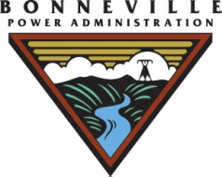



Lower Snake River Compensation Plan Program
Notes:
Questions or thoughts or anything you would like me to clarify – I went through some of that quickly?

Slide 24
2022 5-Year Status Review
2022 5-Year Review: Snake River Spring/Summer Chinook Salmon (pp. 18-20)
Notes:
Next couple of slides are the latest population risk ratings for the Salmon river drainage.
South Fork Salmon River Major Population Group population risk ratings. All in the high category.
These are some of the factors that need to be considered in any changes to hatchery operations.

Slide 25
Recovery Plan
2017 Snake River Spr/Sum Chinook Recovery Plan (p. 53)
Notes:
This Table out of the 2017 Recovery Plan identifies the organizations involved in efforts contributing to recovery of snake river spring/summer chinook salmon.
Along with the USFWS, many of the other organizations in this table are here for this meeting – therefore have a role in trying to recover these fish.
Obviously this is known by all of you, but it’s important to keep in mind when working on ESA related decisions for these fish

Slide 26
Average by Basin
Notes:
This shows the shortfalls by basin in a different format.
What we are aiming to do is to compile future options for consideration, with cooperator input and in consideration of ESA-related sideboards, that may help us start addressing these shortfalls.
One audience of focus is NOAA – A communications tool per se.
Ultimately there may be limited options to present – but if we don’t look, we won’t know and the LSRCP is committed to further investigating to meet our mitigation and partner obligations.

Slide 27
2022 5-Year Status Review
2022 5-Year Review: Snake River Spring/Summer Chinook Salmon (p. 27)

Slide 28
Recovery Plan
p. 155
Notes:
Introduction slide to the 2017 NMFS BiOp for spring/summer chinook salmon.
This is taken out of the 207 Recovery Plan.
Final BiOp conclusion was that these hatchery operations were not likely to jeopardize the species or destroy or adversely modify critical habitat.

