Slide 1
LSRCP Annual Meeting BPA Hatchery Programs and Funding Outlook
Andy Traylor
April 27, 2023

Slide 2
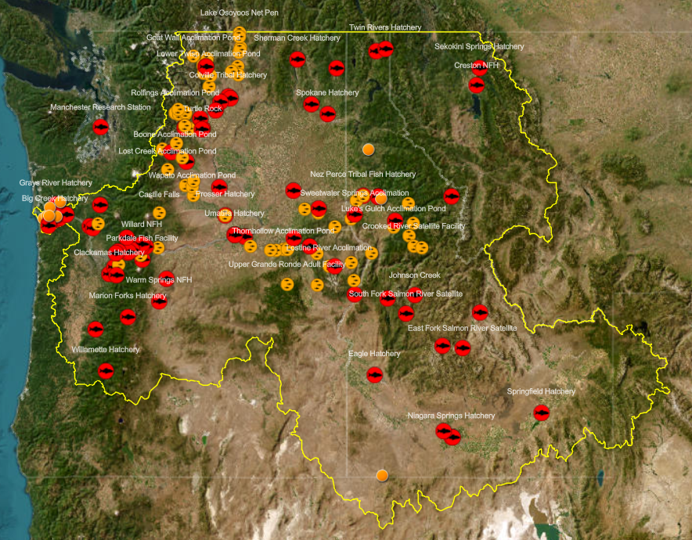
Notes:
BPA funding touches each one of these facilities in some way, some 100% others are cost shared
Willamette – USACE
Estuary – SAFE program and Chum hatcheries
Lower River (Gorge) – Fall Chinook, spring Chinook, coho, steelhead (some Mitchell Act, but lots of USACE funding)
Klickitat, Yakima, Methow, lots of BPA F&W facilities

Slide 3
BPA Environment, Fish & Wildlife
BPA Power Services
F&W Program
Habitat Restoration and Protection (40%)
Research, Monitoring & Evaluation (30%)
Hatchery Production (16%)
Coordination (10%)
Predator Removal (2%)
Data Management (2%)
Direct Funding Agreements
USACE
USBOR
Direct Funding Agreement
USFWS, LSRCP
Notes:
Provide some context to how and where BPA funds different hatchery programs.
Different business lines: EFW – Scott A, SES level, Executive Vice President. PS – Suzanne Cooper also SES, PS is a lot bigger than EFW
$247M in FY23
LSRCP DFA is unique in that it’s specific to hatcheries (with some M&E) and BPA funded 100%
DFA’s for Corps/BOR in PS because there’s a lot more than just fish $
USACE DFA: Covers Chief Joe, Libby, all the mainstem Col and Will dams, all lower snake dams) [Col River basin] labor to operate the dams, M&S, electric reliability compliance, small cap, cultural resources, O&M of hatcheries, fish transport, fish counting.
Other interesting thing about the Corps DFA in contrast to the DFA for LSRCP, is the cost share. Ex. B1 is 50/50 and B2 is 100% BPA funded
BOR – Leavenworth, Entiat, Winthrop NFHs
Overview of how BPA funding trickles down to hatcheries within the region
------------------
The USACE and USBOR expense DFAs were established (1997 and 1996 respectively) for BPA to provide direct funding to pay for the power O&M expense costs which includes Hydropower Specific Costs and the power portion of the Joint Use Costs such as those related to the O&M of FCRPS mitigation hatcheries. Power: Labor, subcontracts, M&S, electric reliability compliance. Joint: Cultural resources, fish O&M (hatcheries, transport, counting)

Slide 4
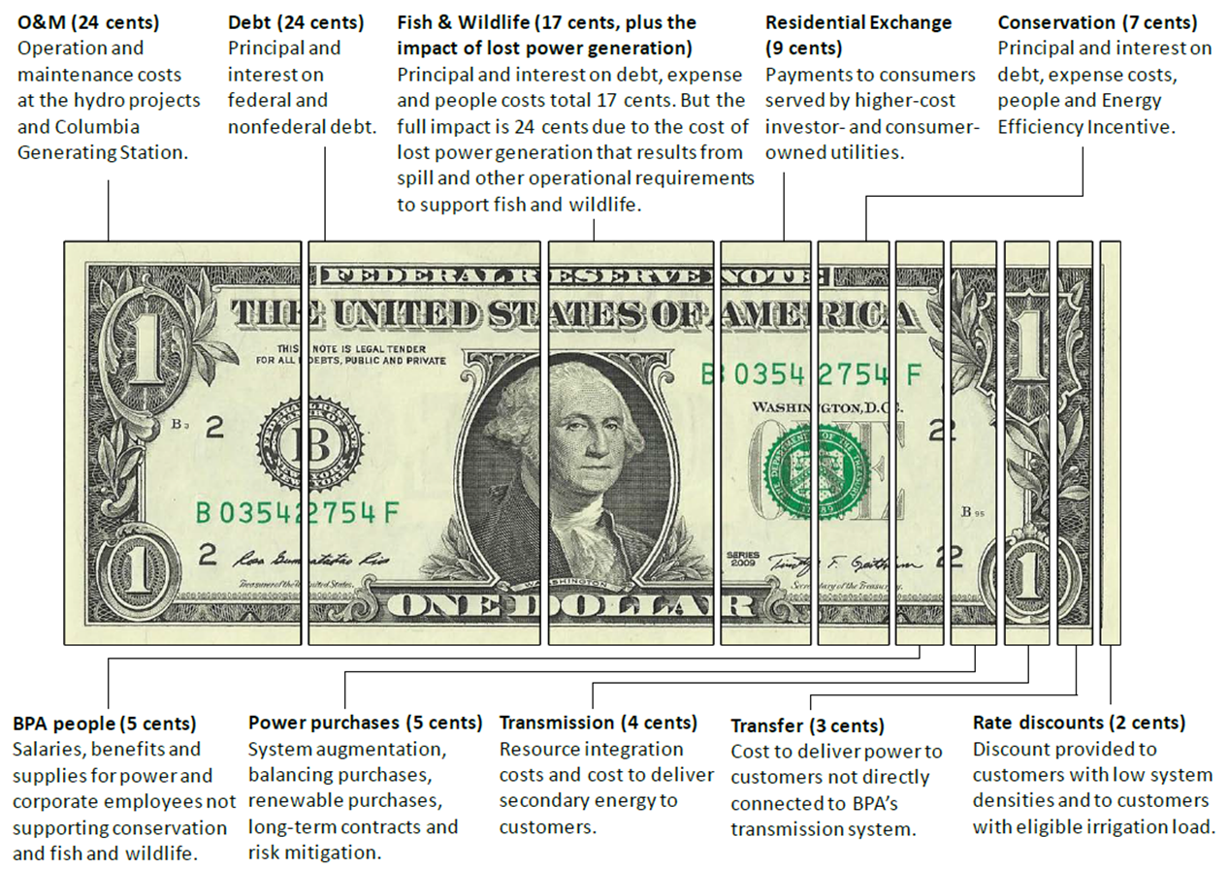
How BPA spends a dollar of its power revenues
Notes:
BPA is unique – self funded.
Columbia Generating Station – 1 nuclear energy plant

Slide 5
F&W Expense Program Projected Cost Trends
+ 8.8%
Notes:
This chart shows the history of the direct program Integrated Program Review (IPR) budget levels during the past 16 years, or 8 rate case periods. The light green bars are the published rate case numbers – rates that we collected during those respective periods. These do not reflect the expenditures. The purple reflects the current BP22-23 rate period we’re in. The dark green reflects projected fish and wildlife expense program projected costs for FY24/25.
Program budgets grew significantly starting in 2008, which coincided with the initiation of the Accords agreements and the 2008 BiOp. As you can see in this graph, the program reached its highest ‘watermark’ in BP-18 with $277M in projected costs. In the BP-20 IPR for FY20 and FY21, the F&W Program budget was reduced by $28M to account for the ongoing increase in spill costs. Consistent with BPA’s Strategic Plan issued in 2018, IPR projected costs for BP22 remained relatively flat with a minor 1% decrease.
BPA is projecting an 8.7% increase in fish and wildlife costs for BP-24. This is the largest percentage increase in projected F&W Program costs since BP-10. The estimated cost increase stems from inflationary pressure on the cost of materials, equipment and staffing across the Fish and Wildlife Program, new fish and wildlife obligations, and necessary investments in existing mitigation assets.

Slide 6
LSRCP Historic Cost Projections
+ 5.7%
Notes:
This chart shows the history of the Lower Snake River Compensation Program Integrated Program Review (IPR) projected costs during the past 16 years, or 8 rate case periods. The light green bars are the published rate case numbers – rates that we collected during those respective periods. These do not reflect the expenditures. The purple reflects the current BP22-23 rate period we’re in. The dark green reflects projected fish and wildlife expense program projected costs for FY24/25.
As you can see in this graph, the program reached its highest ‘watermark’ in BP-18 with $33.5M in projected costs. The current BP22 remained flat in relation to BP-20.
For BP-24, USFWS and BPA determined that a $1.765 million dollar increase
Nate communicates the needs, real advocate for the LSRCP cooperators, COLA, ID min wage, fish food.
Originally developed budget in Feb/Mar for IPR in June. In May, weeks before IPR public meetings, revised budget.

Slide 7
BP-24 IPR (FY24/25)
($ in thousands) | Average BP-22 Rate Case (FY22/23) | Average Final BP-24 IPR (FY24/25) | Percent difference BP-22 vs BP-24
BPA F&W Program | $247,352 | $269,050 | +8.8%
DFA Corps of Engineers | $252,557 | $264,892 | +4.9%
DFA Bureau of Reclamation | $152,616 | $155,791 | +2.1%
DFA USFWS/LSRCP | $31,000 | $32,765 | +5.7%
From IPR BP-24 Final Closeout Report
Upcoming BP-26 (FY26/27/28)
Per MOA: “Develop budget for FY26/27/28 by November 30, 2023”
BP-26 IPR in June 2024
Notes:
Not apples to apples
Ex with Corp cutting trout production in Willamette
“Integrated Program Review”
Real challenge to forecast costs 5 years out.

Slide 8
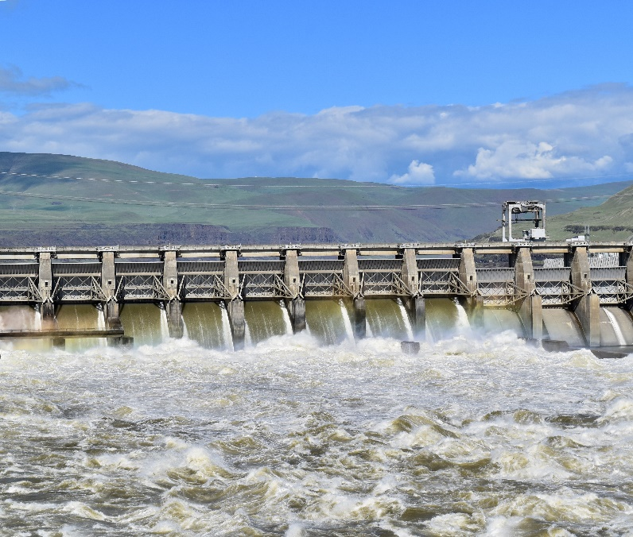
Reserves Distribution Clause
RDC from Power Services financial performance in FY22
Weather variability and favorable water conditions
Trading floor sales driven by higher than expected market prices
$50M towards deferred and non-routine maintenance actions
Accelerated, one-time basis
High priority maintenance of existing assets
$25M to BPA F&W Program, $25 to LSRCP
Will address Mission Critical and Essential assets at F&W Program hatcheries between 0-5 years of expiry
Addresses high and medium priority line items on existing LSRCP 5-year asset management plan
Notes:
The RDC is a component of the Financial Reserves Policy. When reserves decline below certain thresholds, rates increase through the surcharge and other mechanisms.
If business line financial reserves and agency financial reserves are above their respective upper thresholds, the Administrator shall consider the above-threshold financial reserves for investment in other high-value business line-specific purposes including, but not limited to, debt retirement, incremental capital investment, or rate reduction.
RDC is not totally unusual. Transmission also triggered a RDC in FY22, although much smaller ($63.1M) and a separate business line.
Perfect storm: Flows were elevated during much of the year and summer, except April, combined with elevated power prices throughout FY22, the latter of which was largely driven by very high natural gas prices.
Originally the split was $24.7M for BPA F&W, $25.3M for LSRCP
- Note: No RDC funding towards USACE or USBOR hatchery programs

Slide 9
