Slide 1


LSRCP Budgets
This Photo by Unknown Author is licensed under CC BY
Fish for the Future

Slide 2
Notes:
We are woefully behind inflation
M&E and Hatchery budgets are bare minimums
Programs like harvest monitoring distract from LSRCP achieving it’s state mitigation goals

Slide 3
Notes:
Closing a hatchery would save costs
Fish Food doesn’t represent a large budget to recover dollars

Slide 6
Reserve Distribution Clause
Record BPA profits in 2022
Administrator can repurpose financial reserves
$25M to LSRCP and $25M to F&W program to address deferred maintenance needs
Kudos for BPA for recognizing the deferred maintenance as a need and their help (with some prodding) to get $9M (of $25M) for FY23

Slide 7
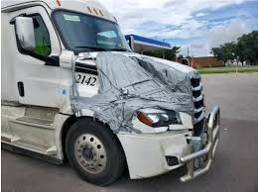
Reserve Distribution Clause
You have $150,000 truck that only meets half your needs and here’s $700 worth of duct tape to fix it

Slide 8
Reserve Distribution Clause
$25M solution to a $220M problem
We’ve been underfunding deferred maintenance for 40 years ($3M or 0.6% of Total Asset Value - $500M)
Not enough infrastructure to meet program mitigation objectives
Bleeding resources trying to achieve goals while infrastructure keeps getting older

Slide 10
AWARD YEAR | FACILITY | PROJECT | COST ESTIMATE
2023 | CLEARWATER | Roof Replacement - Hatchery Building | $ 1,340,000
2023 | SAWTOOTH | Construct comprehensive well plan upgrades (All) | $ 490,000
2023 | LYONS FERRY | Repair / upgrade Dayton Dam, intake upgrades - Construction | $ 1,200,000
2023 | MCCALL | Repair and epoxy coat outdoor rearing ponds | $ 480,000
2023 | TUCANNON | Residences (2) roofing, siding, chimney repair | $ 220,000
2023 | MCCALL | Shade cover over new adult holding ponds - DESIGN / BUILD | $ 750,000
2023 | LSRCP PROGRAM | Replace select egg incubation trays throughout the program - TBD | $ 150,000
2023 | IRRIGON | Replace "River" valve and "Reuse" valve at each raceway | $ 350,000
2023 | CLEARWATER | Replace fence around original adult holding ponds | $ 45,000
2023 | CLEARWATER | Replace hatchery maint water line (service water) | $ 150,000
2023 | MAGIC VALLEY | PRELIM ENG REPORT/ALTERNATIVES - Raceway Replacement | $ 225,000
2023 | LYONS FERRY | Replace / repair adult chute, sorting, controls | $ 450,000
2023 | WALLOWA | Little Sheep COMPLIANCE - intake improvements, intake fish ladder | $ 75,000
2023 | WALLOWA | Repairs Etc - WAL - Weir Bridge & Bridge #2, BC - Entrance Brid | $ 400,000
2023 | LOOKINGGLASS | Dormer for (3) residence back doors | $ 150,000
2023 | SAWTOOTH | Dormer for (6) residence back doors | $ 300,000
2023 | LSRCP PROGRAM | Epoxy paint inside vats - Magic, McCall, Clearwater, Sawtooth, Hag | $ 800,000
2024 | LOOKINGGLASS | Repair and epoxy coat concrete raceways | $ 625,000
2024 | LSRCP PROGRAM | Select facility pipeline inspections - TBD, more info (place holder) | $ 490,000
2024 | LYONS FERRY | Replace check and gate valves at Marmes | $ 950,000
2024 | LOOKINGGLASS | replace intake screens / fish ladder - Compliance | $ 7,500,000
2024 | DWORSHAK | cross connect - DESIGN / BUILD | $ 200,000
2024 | DWORSHAK | upsize production pumps (1) (250 hp) | $ 300,000
2024 | SAWTOOTH | Dredge work above the weir, include permitting | $ 100,000
2024 | SAWTOOTH | Repair/replace fencing around adult ponds, trap, etc | $ 120,000
2024 | WALLOWA | Repair fish ladder and outflow structure | $ 975,000
2024 | SAWTOOTH | Generator replacement | $ 400,000
2024 | LOOKINGGLASS | Repair and epoxy coat concrete raceways | $ 125,000
2024 | LSRCP PROGRAM | Bird Netting - Hagerman, Irrigon, Magic | $ 250,000
2024 | SAWTOOTH | Yankee Fork Acclimation facilities | $ 490,000
2024 | DWORSHAK | Dworshak Shade Structure | $ 3,775,000
2024 | LSRCP PROGRAM | Indirect | $ 1,125,000
 |  | Grand Total Obligations | $ 25,000,000

Slide 11
Expenditures at a Glimpse

Slide 12
Engineering Funded Projects

Slide 13
Budget Template Review
Changes to template
Add 4.5% increase to your budget
Due NLT 2 June, 2023

Slide 14

Budget Template Changes
Changes under the “Travel” tab
*Added Travel Days
*M&IE Rate (Per Diem)
*Hotel Cost Estimate

Slide 15
Budget Template Changes-cont’
Travel Location | Travel Category | Travel Purpose | Priority | Number of Travelers | Travel Length (Days) | M&IE Rate | Hotel Cost Estimate | Travel Cost Estimate | Total | Notes
Boise | Meeting Attendance | LSRCP Meeting | 1 | 1 | 2 | $ - | $ - | $ - | $ -
 |  |  |  |  |  |  |  |  | $ -
 |  |  |  |  |  |  |  |  | $ -
 |  |  |  |  |  |  |  |  | $ -
 |  |  |  |  |  |  |  |  | $ -
 |  |  |  |  |  |  |  |  | $ -
 |  |  |  |  |  |  |  |  | $ -
 |  |  |  |  |  |  |  |  | $ -
 |  |  |  |  |  |  |  |  | $ -
 |  |  |  |  |  |  |  |  | $ -
 |  |  |  |  |  |  |  |  | $ -
 |  |  |  |  |  |  |  |  | $ -
 |  |  |  |  |  |  |  |  | $ -
 |  |  |  |  |  |  |  |  | $ -
 |  |  |  |  |  |  |  |  | $ -
 |  |  |  |  |  |  |  |  | $ -
 |  |  |  |  |  |  |  |  | $ -
 |  |  |  |  |  |  |  |  | $ -
Total Travel Cost |  |  |  |  |  |  |  |  | $ -

Slide 16
Upcoming Budget Deadlines
May 2023 – Mid Year Review’s!
May 12th
Construction $250,000 - $500,000
Goods above $500,000
June 2nd - FY24 Budgets and SOW’s due to the LSRCP office.
June 23rd
Construction $25,000 - $250,000
Goods and/or services $250,000 - $500,000
Vehicles (Auto Choice) Additional Requirements
July 1st
Construction $2,000 - $25,000
Goods and/or services $25,000 - $250,000
Modifications to construction contracts
August 4th
Goods $10,000 - $25,000
Modifications to contracts for goods and/or services
New inter-agency agreements
Services $2,500 - $25,000
Vehicles (Auto Choice) Non-Additional Requirements
August 25th
Modifications to inter-agency agreements
Property requests – transfers, ABZON requests, disposals, etc.
September 16th
FY24 agreement announcements will be posted in Grant Solutions with an October 1st submission deadline.

Slide 17
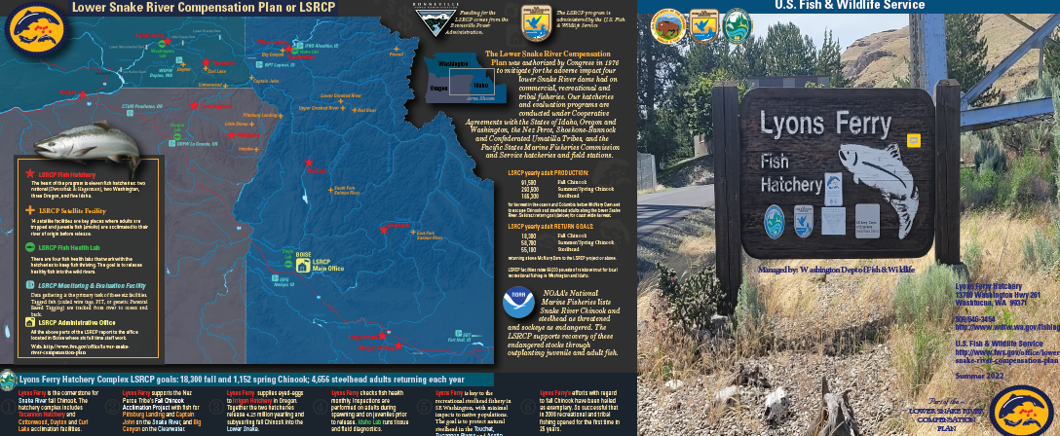
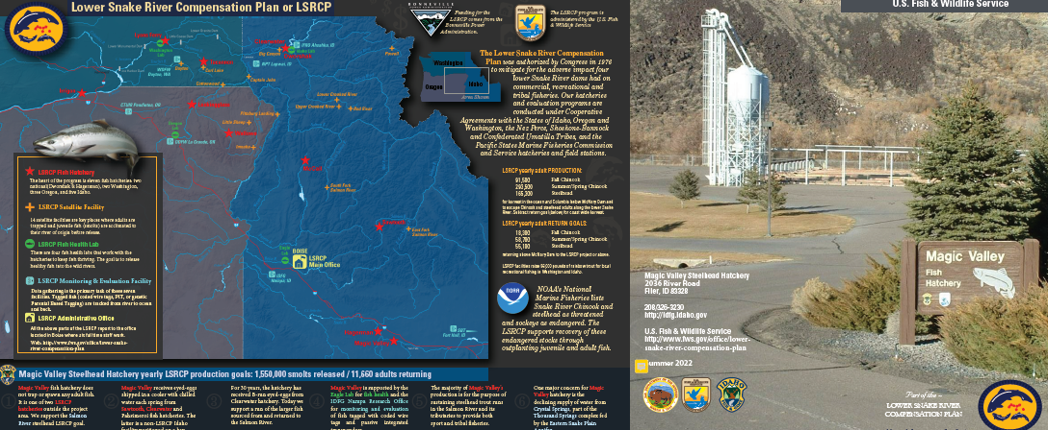
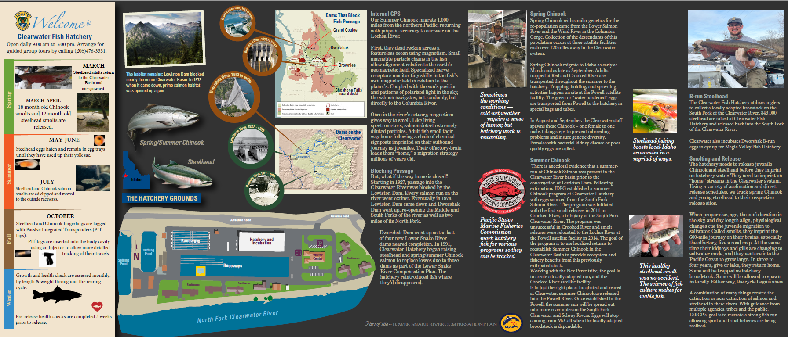
LSRCP Brochures
Jule Keller, WDFW, Lead
Site visits of McCall, Sawtooth, Lookingglass

Slide 18
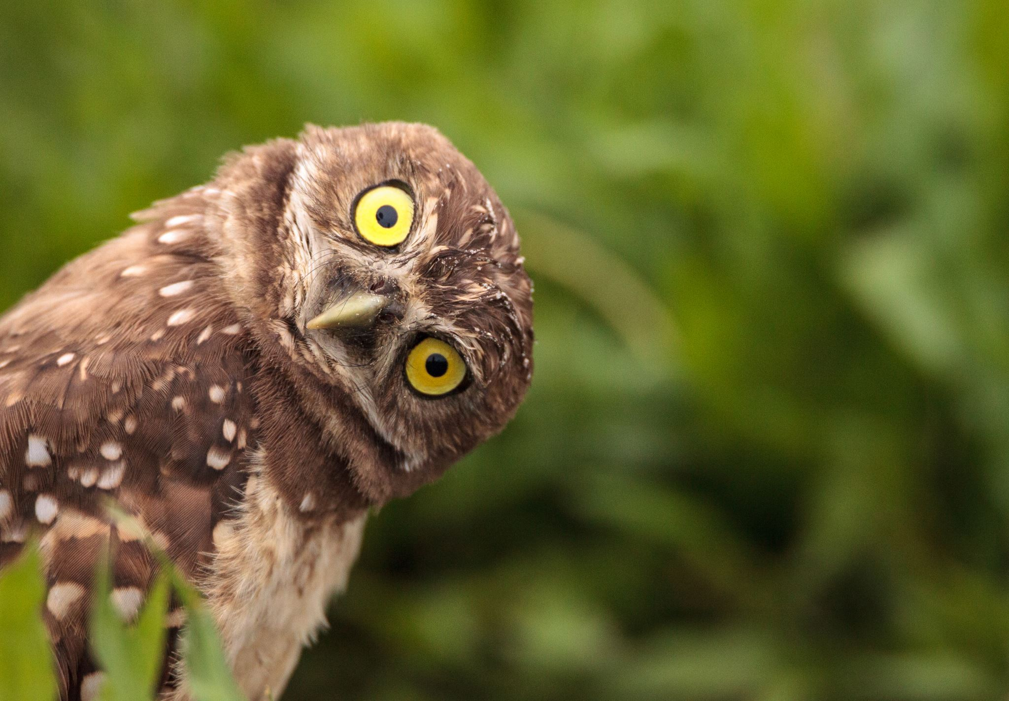
Personal Property, Maintenance, Budget
Questions?

