Slide 1

LSRCP
Fish for the Future!
Nathan Wiese LSRCP

Slide 2
LSRCP 2023
Thanks for everything you are doing!
ISRP Review
Infrastructure audits
Upper Salmon B-Steelhead planning
Yearling to sub-yearling conversion
Panther Creek smolts and eggs
Juggling an incredible transport year
Nice work!

Slide 3
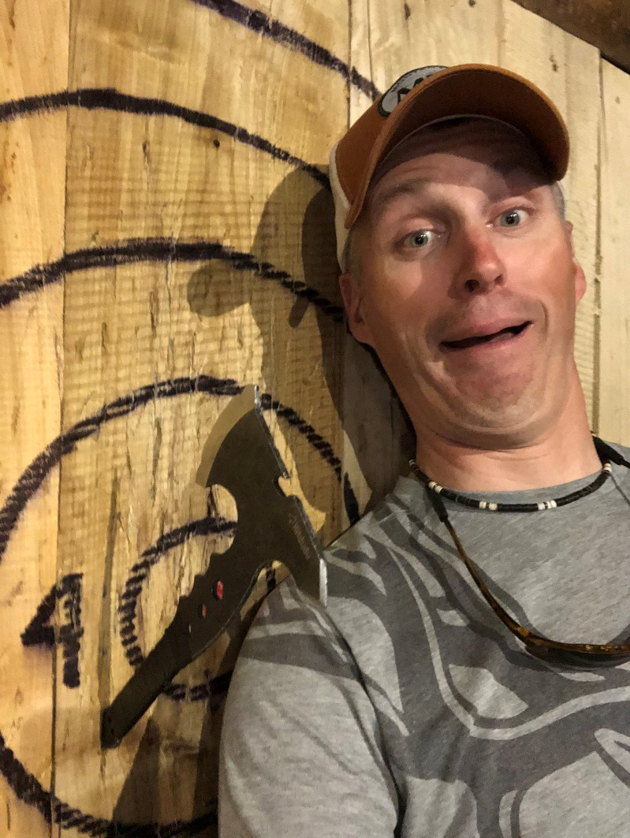
What is the LSRCP Coordinator?

Slide 4
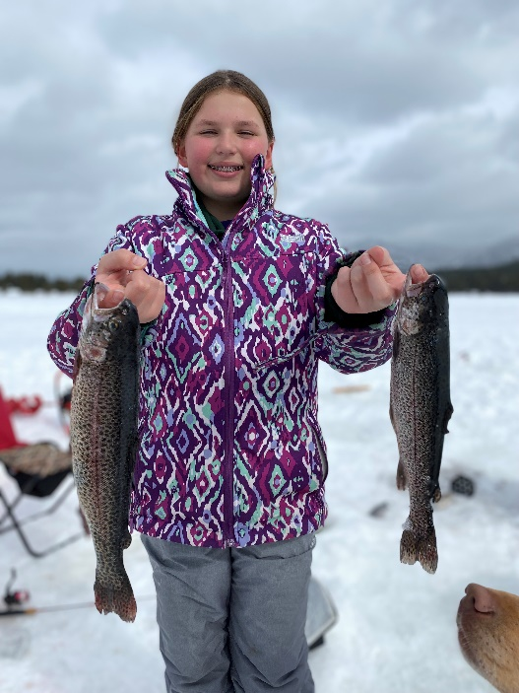
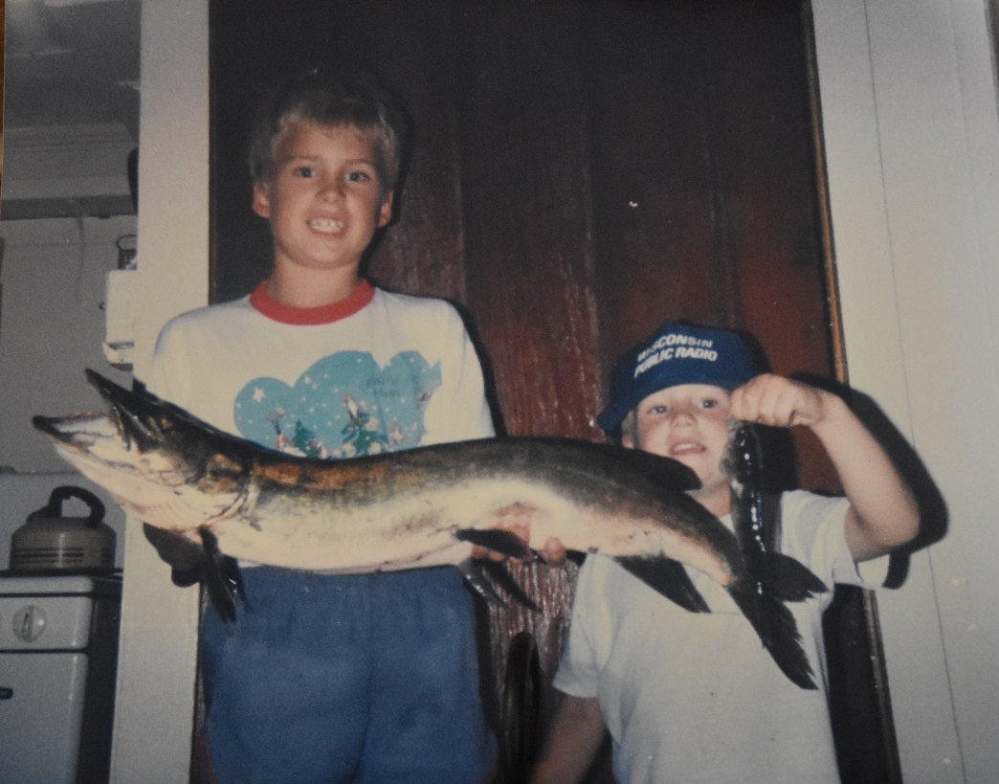
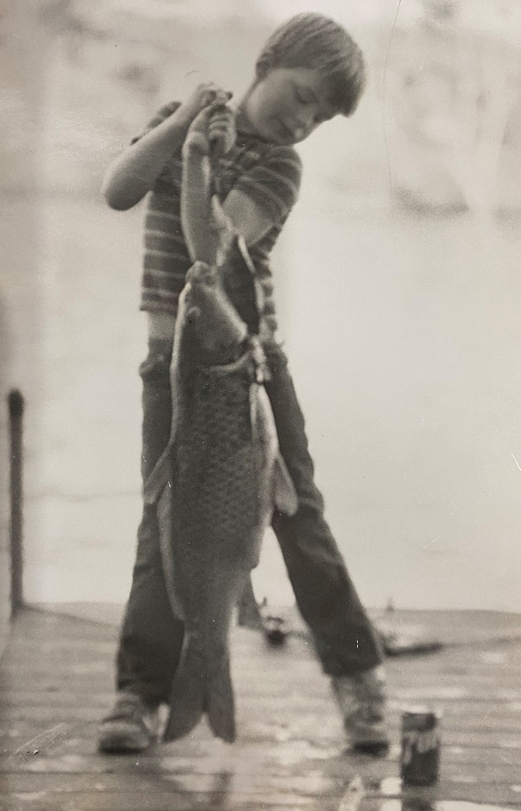
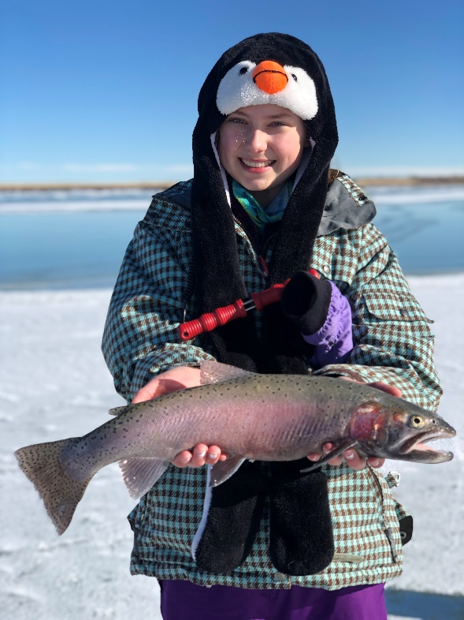

Why am I here?

Slide 5
What are our challenges?
We’re working with a constantly changing environment
Our toolbox and resources are only so deep
There really are social issues that we need to keep addressing
It’s truly a challenge!

Slide 6
Corridor
*Actual fpp rather than targets

Slide 7
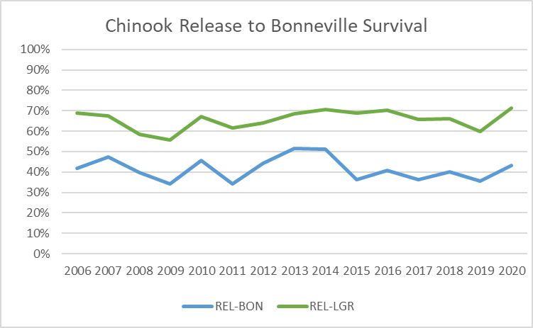

Slide 8
Lower Granite Survival
Release to LGR Survival
Lookingglass | 66%
McCall | 63%
Dworshak | 77%
Clearwater | 66%
Sawtooth | 53%
Average | 65%

Slide 9
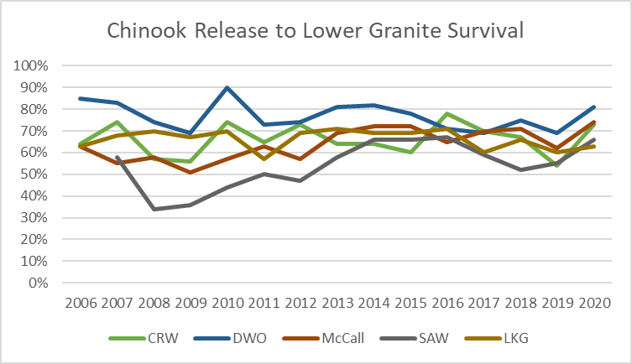

Slide 10
Bonneville Survival
Release to Bonneville Survival
Lookingglass | 42%
McCall | 43%
Dworshak | 47%
Clearwater | 44%
Sawtooth | 31%
Average | 41%

Slide 11
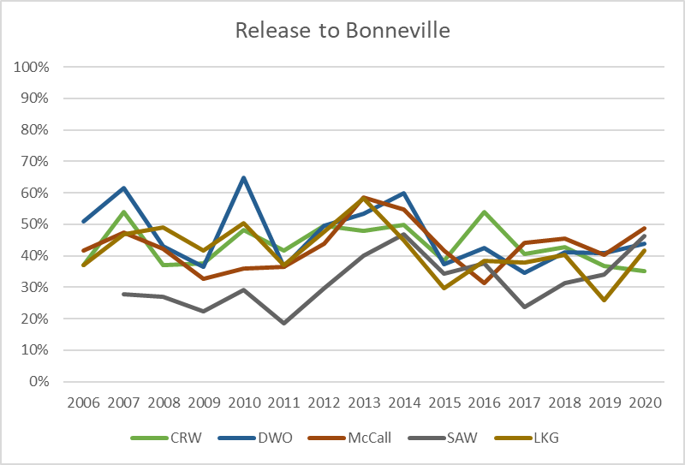

Slide 12
What are our Opportunities?
People care
We have an inspiring mission
We have the best people
We have a diverse set of backgrounds, priorities, and agency missions
We have examples of success

Slide 13
LSRCP 2023
Keep challenging our assumptions
Challenge yourself
Be proud of our accomplishments
Strive for an even better future

Slide 14
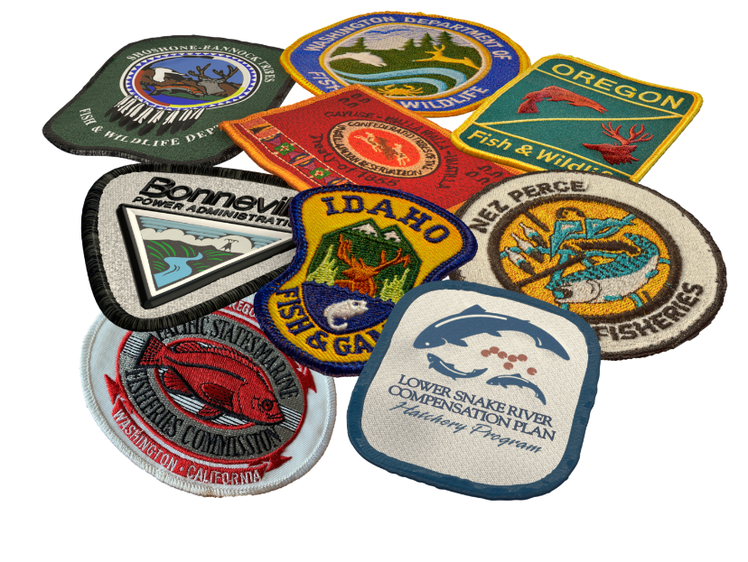
You are
Fish for the Future

