Slide 1
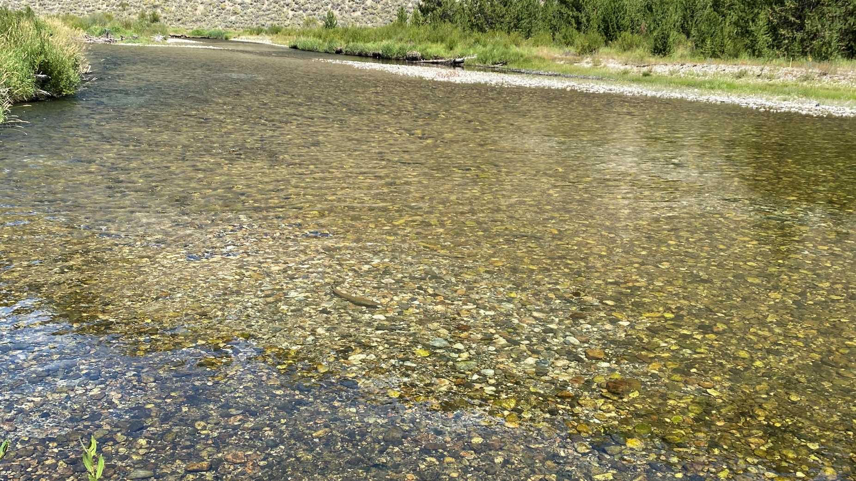
Integrated Chinook Broodstock:
Past Efforts and Future Directions
Darcy McCarrick, David Venditti, Craig Steele, Joshua McCormick
Idaho Department of Fish and Game

Slide 2
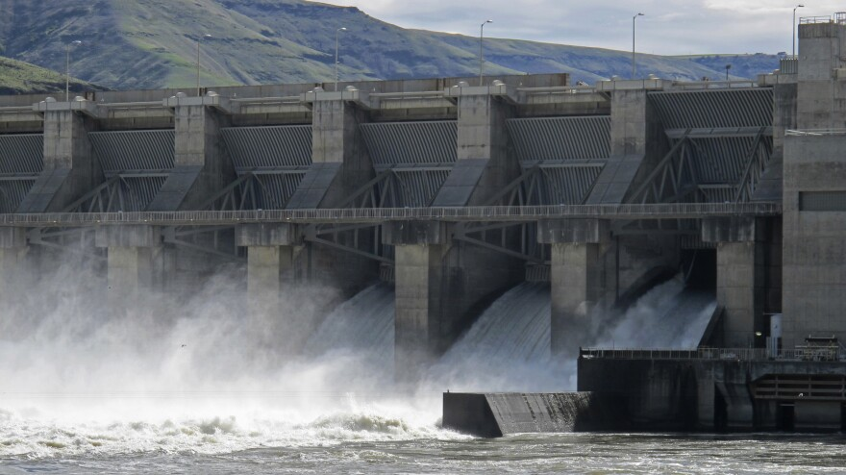
Chinook Salmon
Population declines
  Overexploitation, development, habitat loss
  Dams -> loss of fisheries -> mitigation hatcheries

Slide 3
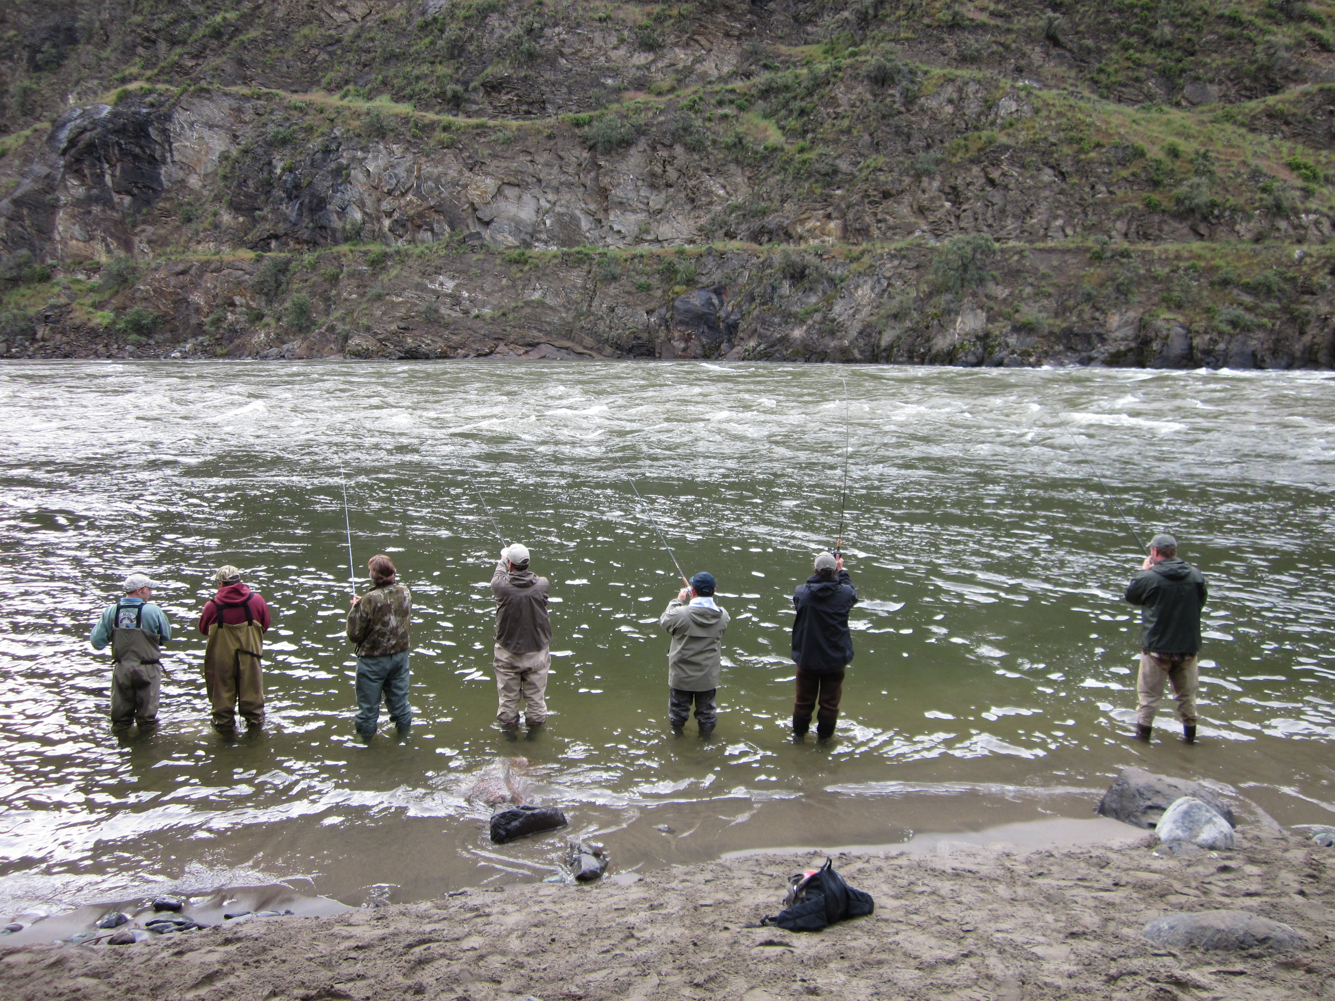
Mitigation Hatcheries
Hatchery production to provide fishing opportunities

Slide 4
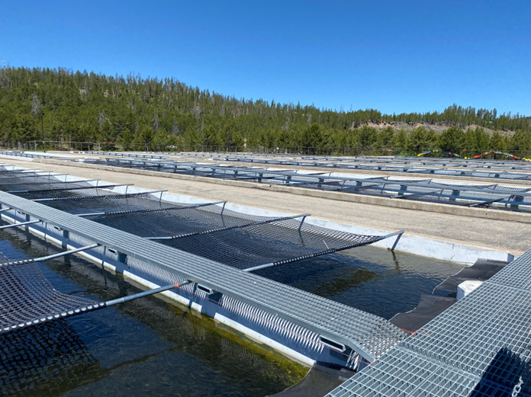
Chinook Salmon
Hatchery/natural concerns
  Domestication
  Gene flow
  Reduced fitness
Supplementation
  Abundance boost

Slide 5
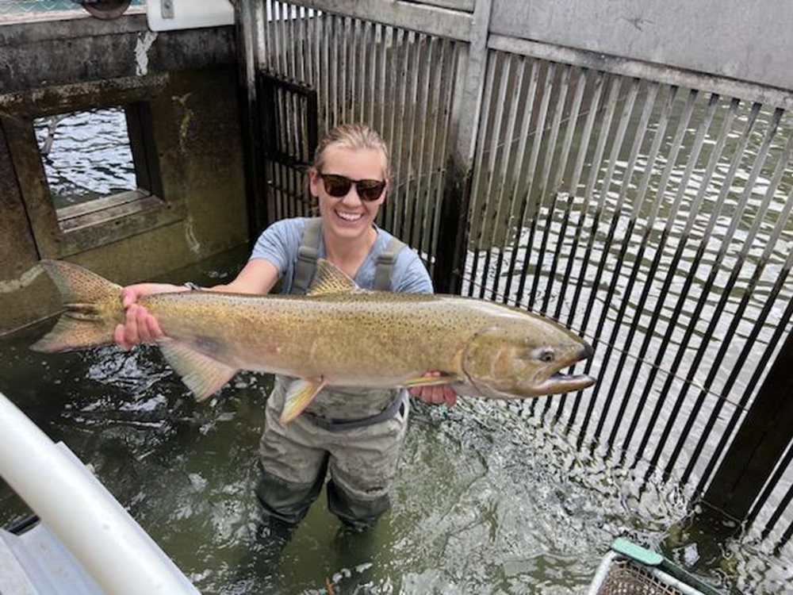
Integrated Hatchery Programs
Bring natural fish into the hatchery
  Increase genetic similarities
  Potentially increase survival in wild
Supplementation

Slide 6
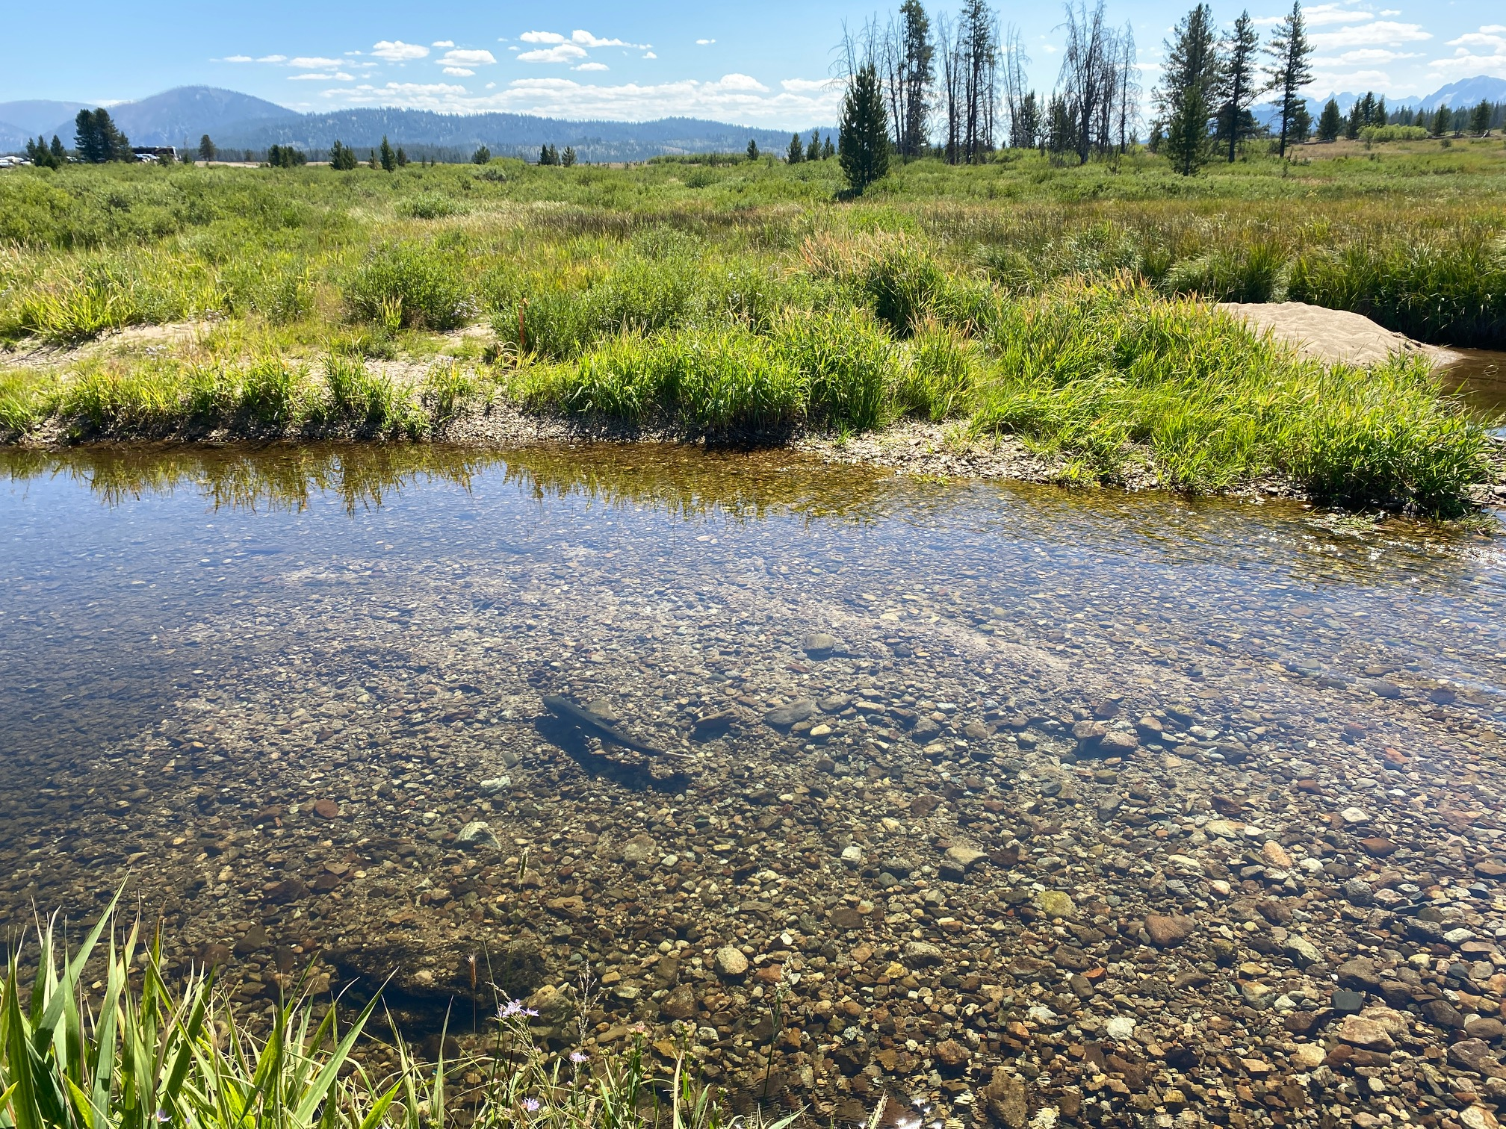
Integrated Hatchery Programs
Concerns with bringing natural origin fish into the hatchery
  Reduced productivity of natural population

Slide 7
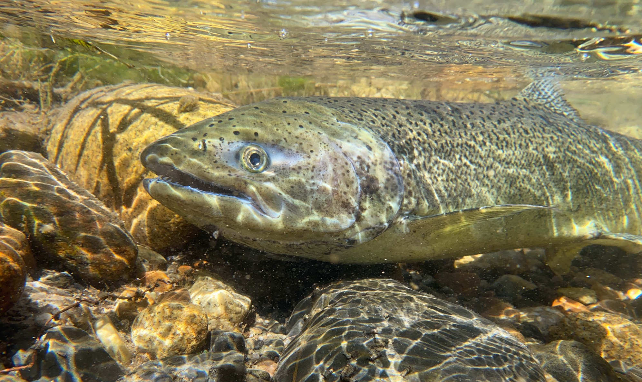
Integrated Broodstock
Reduce risk to the wild population
Supplementation

Slide 8
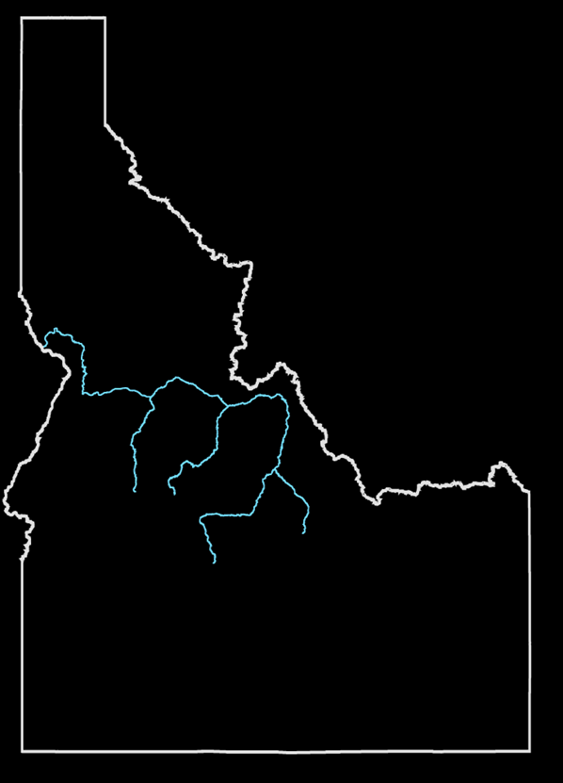
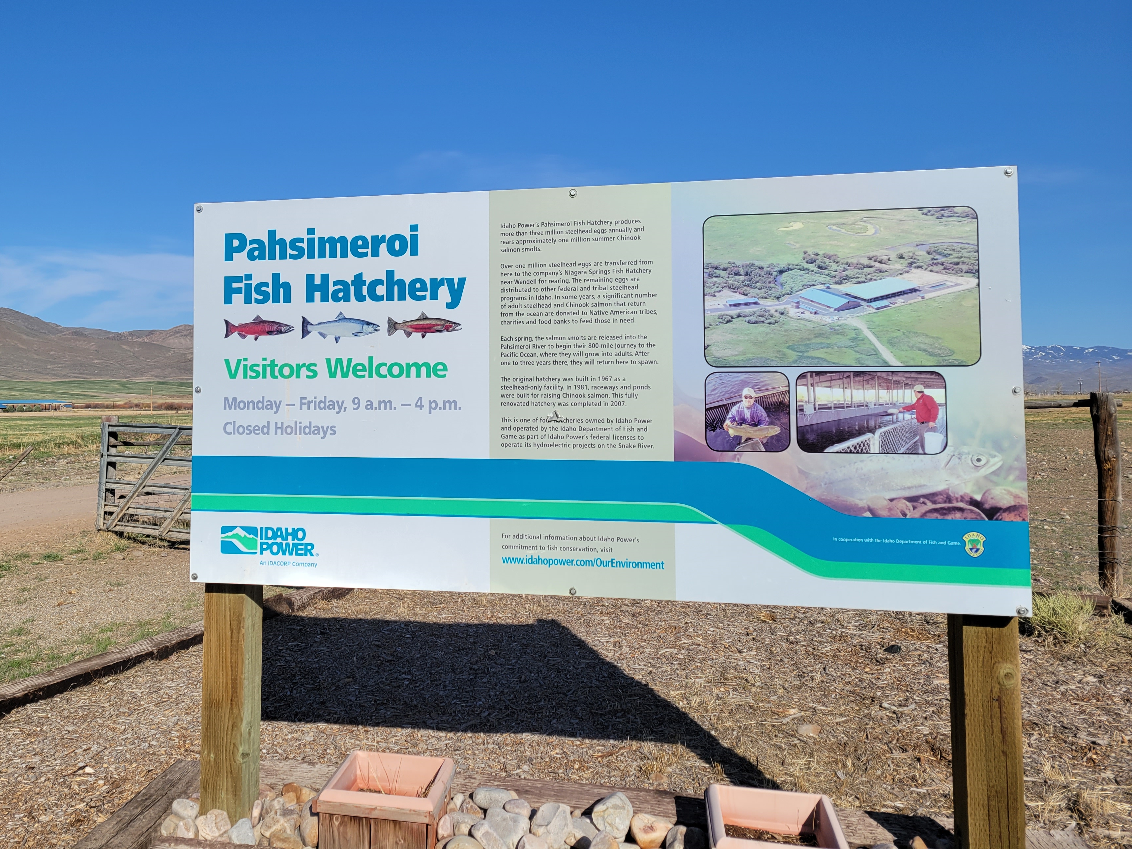
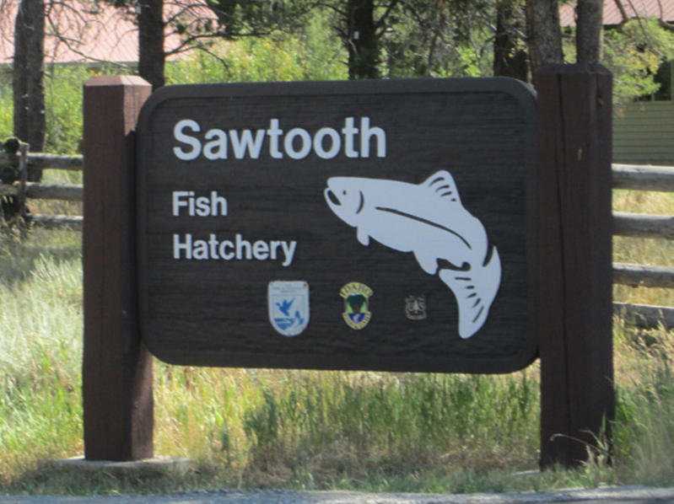
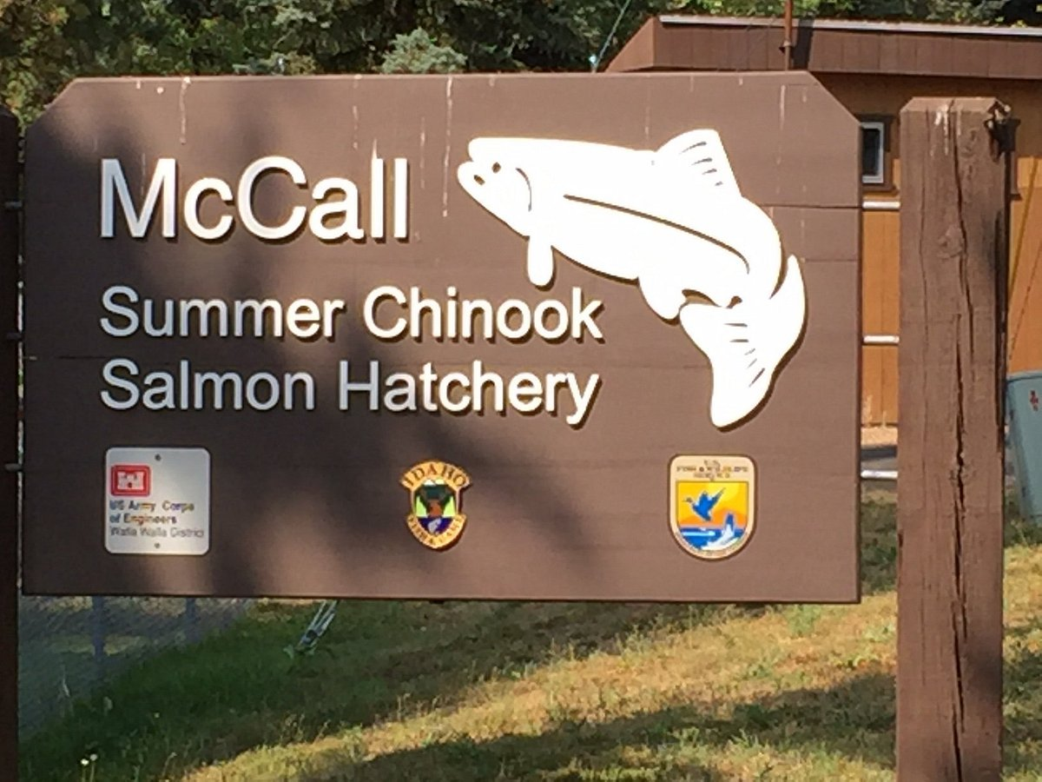
Salmon Basin

Slide 9
Focus on Supplementation

Slide 10
Effect on Abundance

Slide 11
Effect on Abundance

Slide 12
Effect on Abundance

Slide 13
Effect on Abundance

Slide 14
Natural Abundance

Slide 15
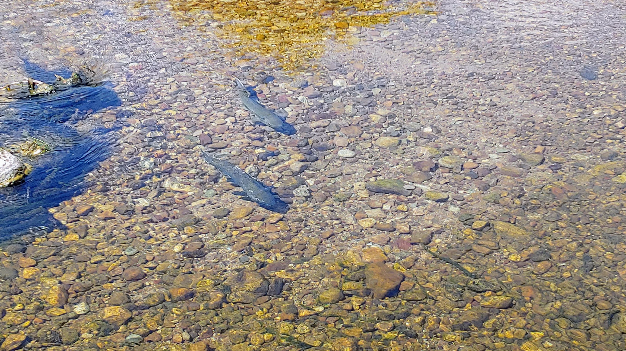
A Shift in Focus
Difficulty meeting current PNI goals
History of supplementation
Knowledge gaps

Slide 16
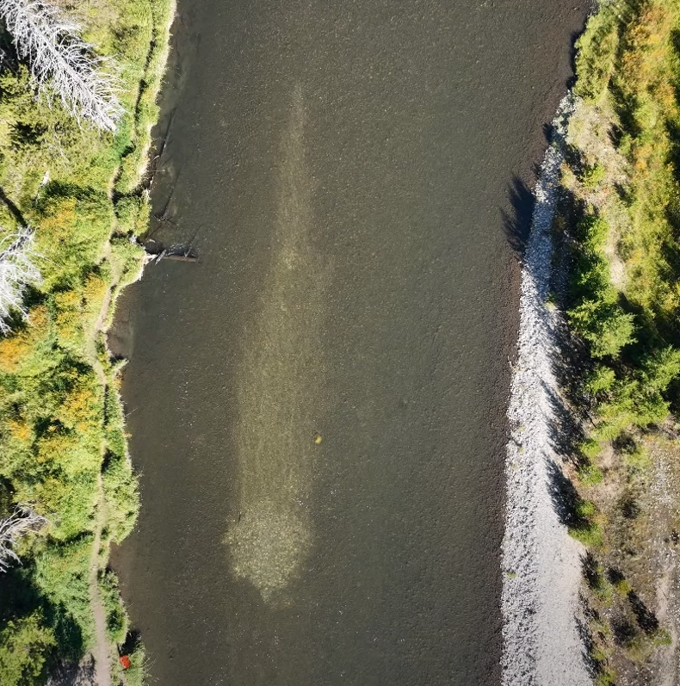
Risk Reduction
Natural environment be driver of fitness
Increase natural origin fish in hatchery
Decrease hatchery origin fish spawning naturally

Slide 17
Population Model
Evaluate management actions in unified framework
  What management actions will optimize the fish that return?
  Proportionate Natural Influence

Slide 18
Population Model
Effects of densities of natural and hatchery spawners
Optimum management strategies based on densities
Life-stage-specific survival
Demographic effects
Fishery

Slide 19
Fishery Evaluation

Slide 20
Fishery Evaluation

Slide 21
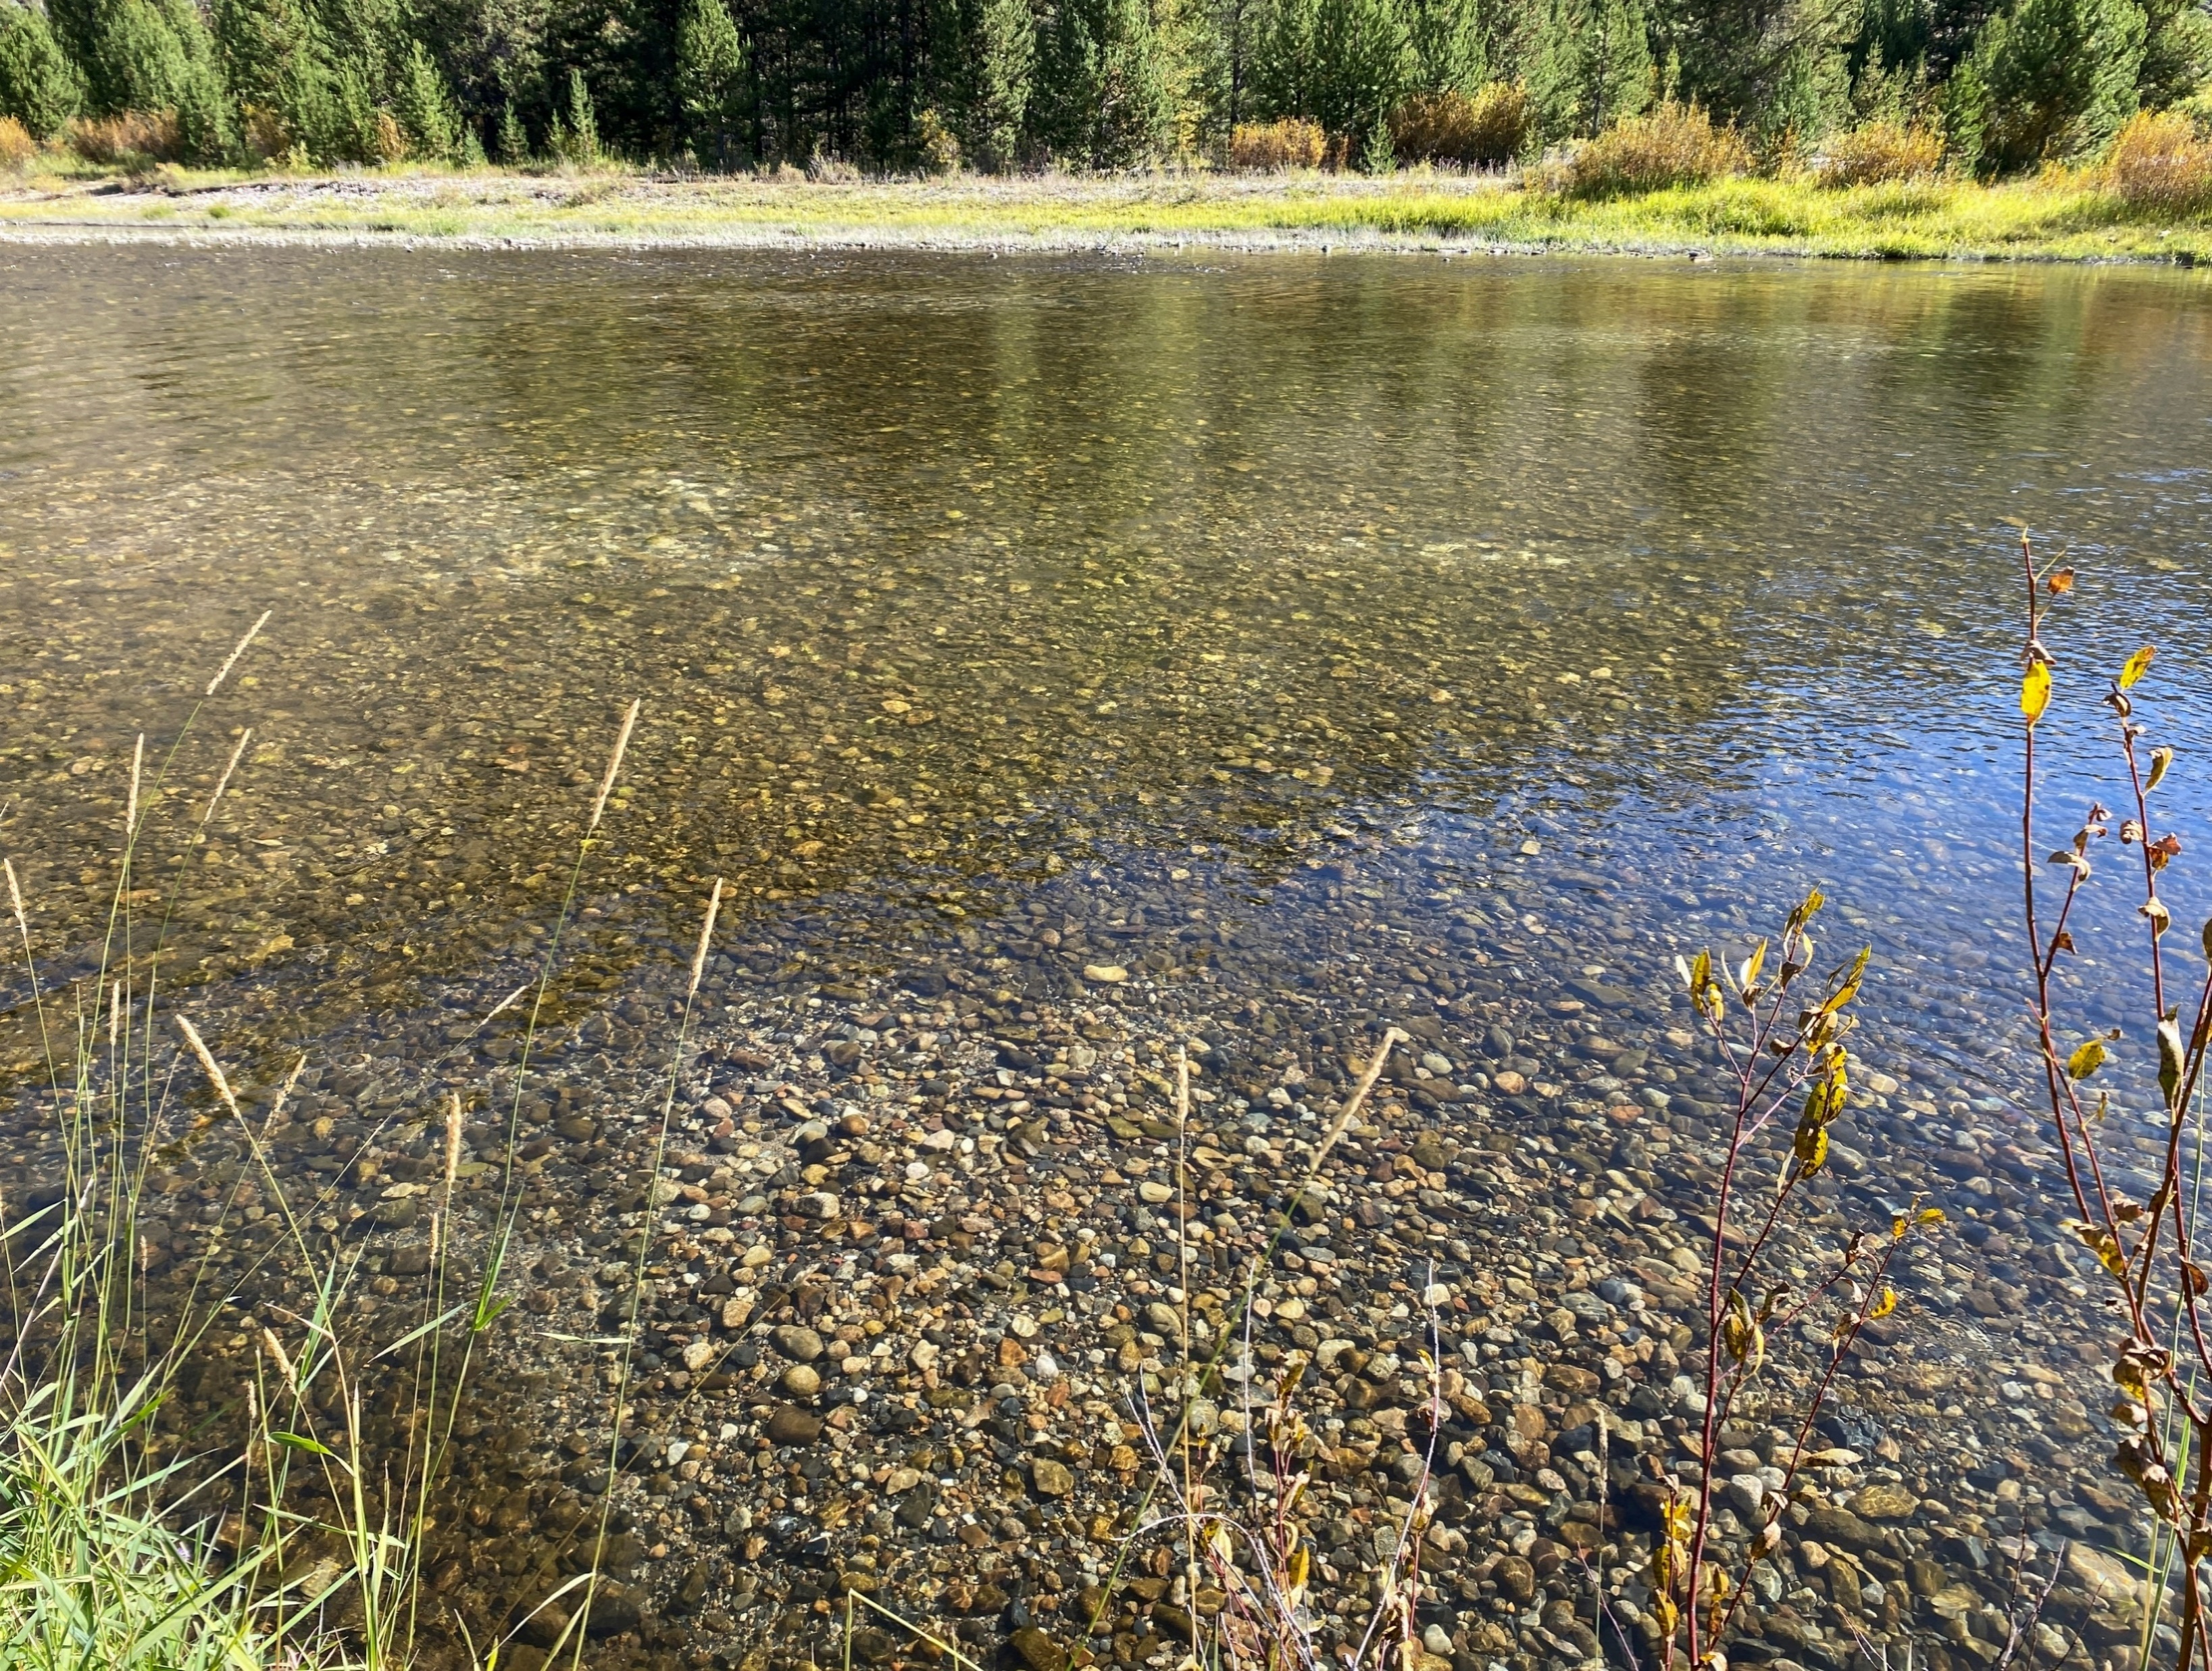
Next Steps
Increase genetic sampling
  Screw traps, hatcheries, fishery
Juvenile sampling
Long-term data compilation
Reference streams

Slide 22
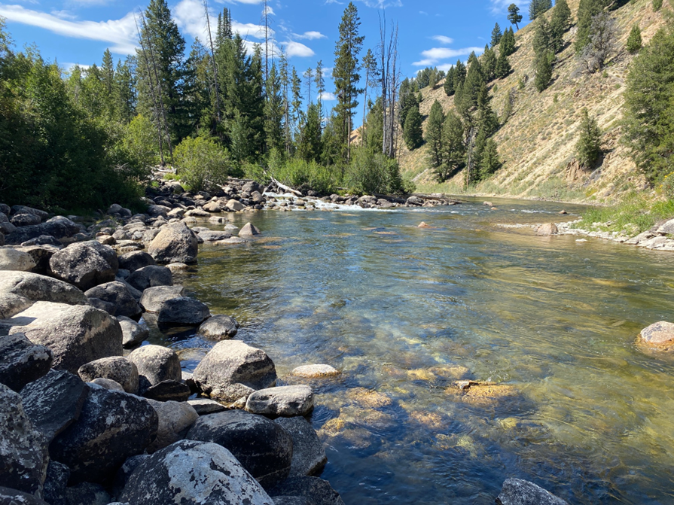
Acknowledgements
IDFG Hatchery and Field Staff
Eagle Fish Genetics Lab
Nez Perce Tribe
Shoshone Bannock Tribe
LSRCP
Idaho Power
BPA

Slide 23
