Slide 1

Wasteload Allocations
NPDES/IPDES Compliance
Cassie Sundquist
Fish Production Program Coordinator
Idaho Department of Fish and Game
2023 LSRCP Annual Meeting

Slide 2
Outline
IDFG hatchery discharge permits
NPDES/IPDES permit development timeline
Total Phosphorus issues at McCall
Wasteload Allocation Process for the Upper Snake Rock TMDL

Slide 3
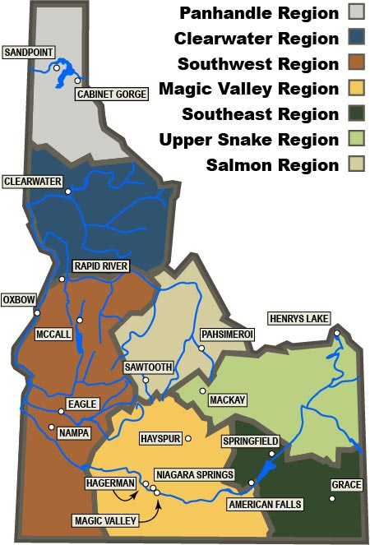
General Permits for Aquaculture Facilities
  IDG131000- 2019 Aquaculture Permit
    Discharge to state waters.
    Jurisdiction transferred to IDEQ in 2020
    Expires in November 2024
    McCall and Sawtooth Fish Hatcheries
  IDG133000- 2019 Aquaculture Permit
    Discharge into tribal waters.
    Remained under EPA jurisdiction
    Expires in November 2024
    Clearwater Fish Hatchery
  IDG130000-2007 Aquaculture Permit
    Discharge to the Upper Snake-Rock Subbasin
    Transferred to IDEQ in 2020
    Administratively extended until the TMDL revision is complete
    Magic Valley and Hagerman National Fish Hatcheries

Slide 4
Overview of the NPDES/IPDES Permit Timeline
2007
NPDES permit was issued to all IDFG hatcheries by EPA for a period of 5 years
2012
The 2007 permit was administratively extended
2017
DEQ reopened the Upper Snake Rock TMDL
2019
EPA issued new permits to everyone except those discharging into the Mid Snake
2020
DEQ took primacy over all permits except for facilities that discharge into tribal waters.
2023
DEQ is in the process of reallocating Wasteloads for Mid Snake hatcheries
2024
DEQ will issue new permits for those under the 2019 permits

Slide 5
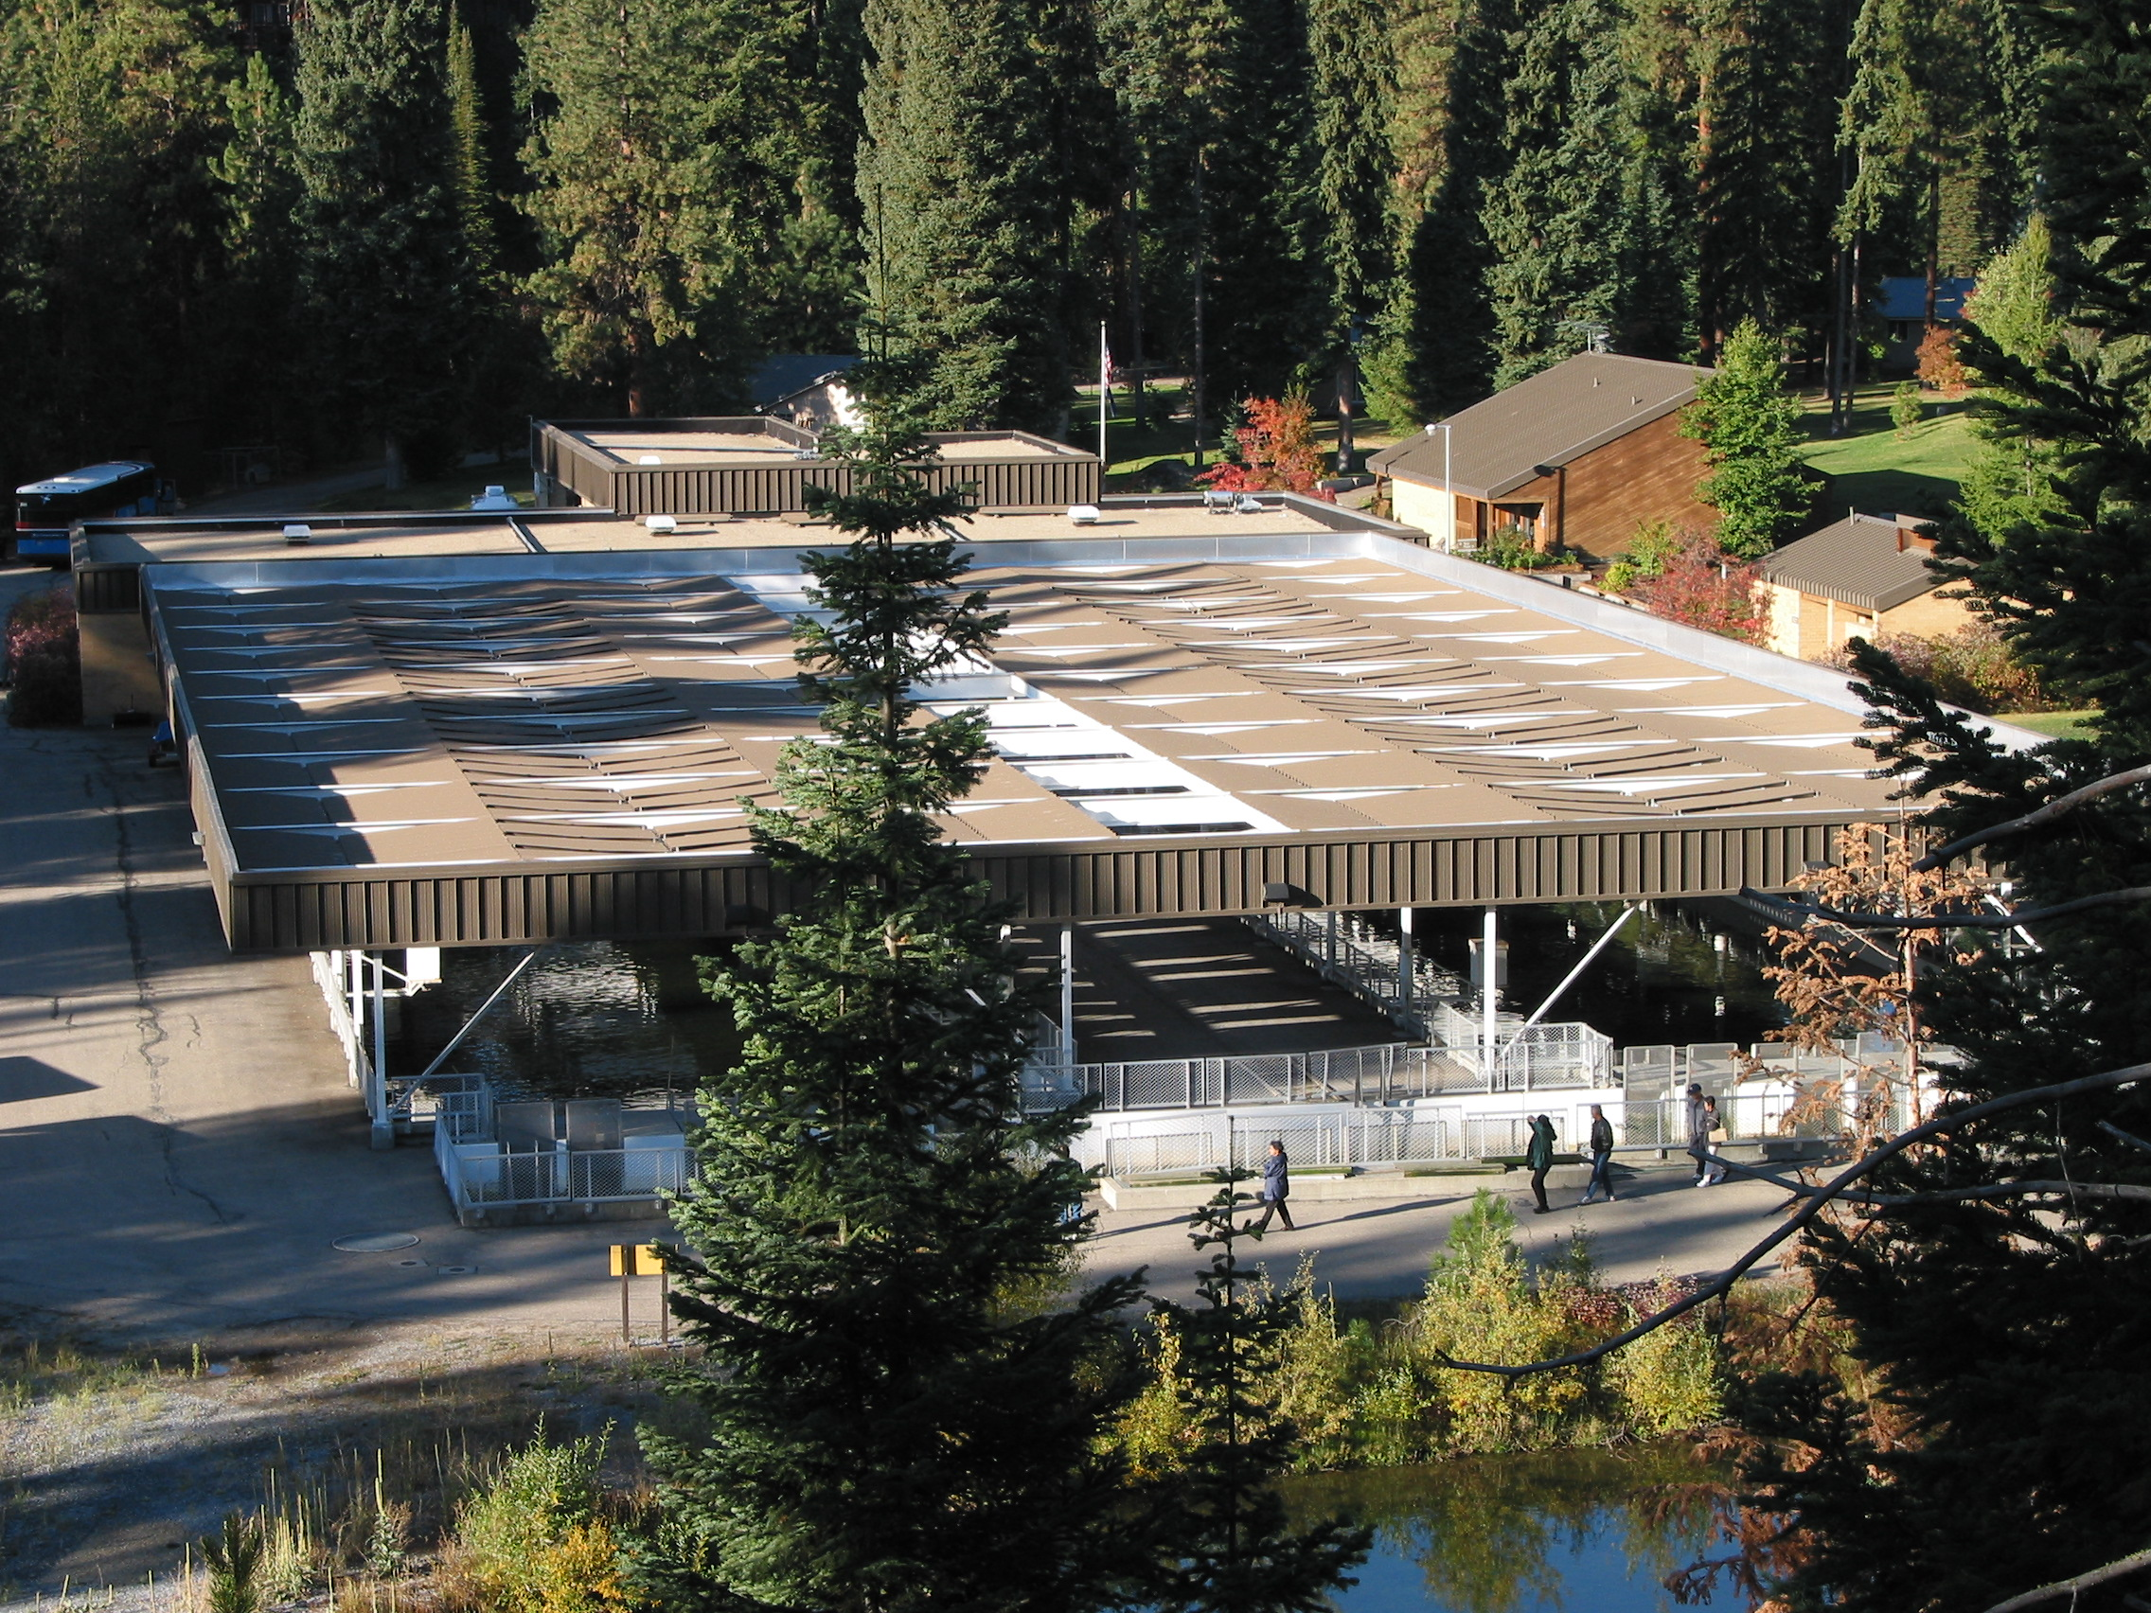
McCall Fish Hatchery Total Phosphorus Violations

Slide 6
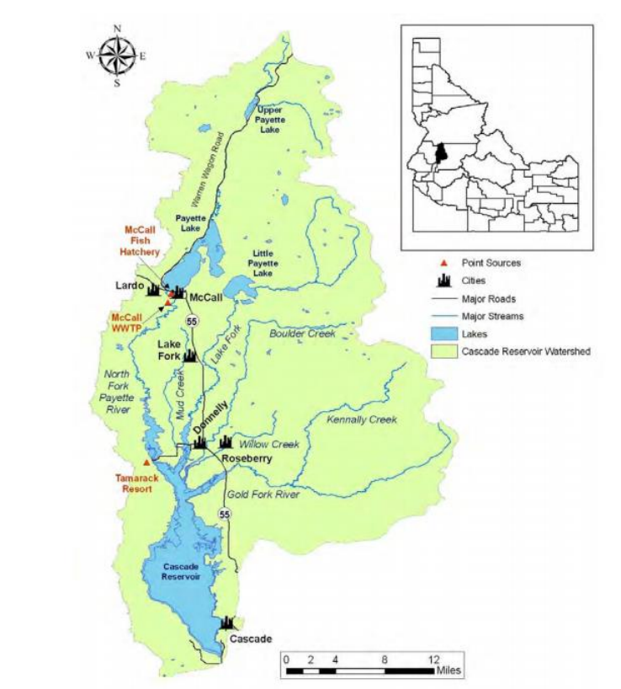
McCall Fish Hatchery
Located within the Cascade Reservoir TMDL
  TMDL was most recently reviewed in 2009
  Assigned a new Total Phosphorus Wasteload Allocation of 480.6 lbs/year
McCall received their new permit in 2019
  EPA incorporated the Wasteload Allocation directly into the permit as a Permit Limit.
  Also assigned an Average Monthly Limit of 0.025 mg/L

Slide 7
McCall Fish Hatchery Total Phosphorus Violations
Average Monthly Limit = 0.025 mg/L
Mg/L

Slide 8
McCall Fish Hatchery Total Phosphorus Violations
Lbs Total Phosphorus
Annual Limit =480.6 lbs/year

Slide 9
Four major changes leading to an increase in Total P violations
1) In 2009 DEQ revised the Cascade Reservoir TMDL
2) In 2019 EPA issued McCall a new NPDES permit
3) Settling pond has not been dredged
4) Low Phosphorus feed is no longer used

Slide 10
#1
2009 Cascade Reservoir TMDL Wasteload Allocation
The 2009 TMDL review concluded point source dischargers needed a reduction in Total P.
  70% reduction for McCall
To calculate this reduction, EPA used past DMR data to assign the new Wasteload Allocation.
  Used bi-annual samples to calculate annual load
  Data showed the hatchery was meeting this new WLA.
  Inaccurate method!
This is the same Performance Based approach DEQ is currently using to develop new Wasteload Allocations for the Mid Snake hatcheries.

Slide 11
#2
2019 EPA issued a new NPDES Permit
Three major modifications with the new permit
1) New annual Wasteload allocation 480.6 lbs/year Total P
2) New Average Monthly Limit 0.025 mg/L Total P
3) Increased frequency of sampling from bi-annual to quarterly

Slide 12
Sample and Reporting Frequency
2007 Permit
  Required bi-annual sampling
  Sample each June and December and apply that to each 6-month period for the annual load
2019 Permit
  Required quarterly sampling in March, June, September and December
  Those samples were applied to each month within the quarter
2022
  Chose to begin monthly sampling to get a more representative depiction of annual load
  DMR’s are only available quarterly so monthly samples must be averaged over the quarter
2023
  After reviewing the data we were able to show that sampling monthly and reporting monthly showed a more accurate representation of the annual load.
  Received approval from DEQ to report monthly sum at the end of the year

Slide 13
Sample and Reporting Frequency
Lbs Total P

Slide 14
Sampling Frequency Bias at Hatcheries with Seasonal Loads
mg/L

Slide 15
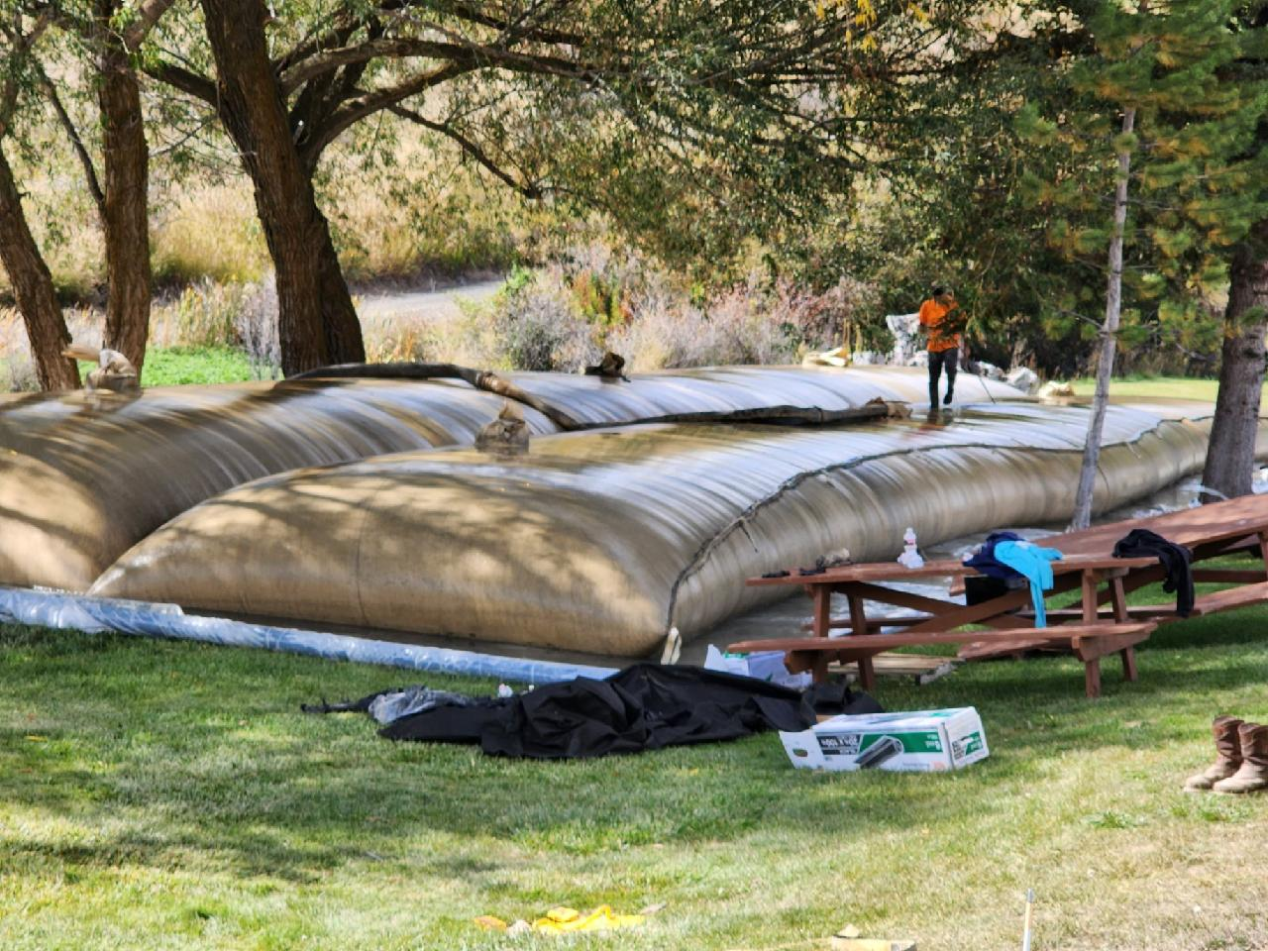
#3 Dredging the Settling Pond
Settling pond was modified in 1999 and hasn’t been dredged since
Showing increased macrophyte growth
Plans to dredge the pond this summer

Slide 16
#4
Low Phosphorus Feed
Past Brood Year Reports as well as the Cascade Reservoir TMDL records indicate a low phosphorus feed was used with success from the mid 90’s to the mid 2000’s.
That food is no longer in production.
Ann will cover more on low phosphorus feeds

Slide 17
Plans moving forward
DEQ cannot increase the Permit limit because doing so would not be consistent with the TMDL.
  This will have impacts on any proposed increased production at McCall.
Ask DEQ to remove the Average Monthly Limit with 2024 permit.
Dredge the settling pond
Evaluate low Phosphorus feeds
If needed, research additional measures to more efficiently remove Total P from the waste stream

Slide 18
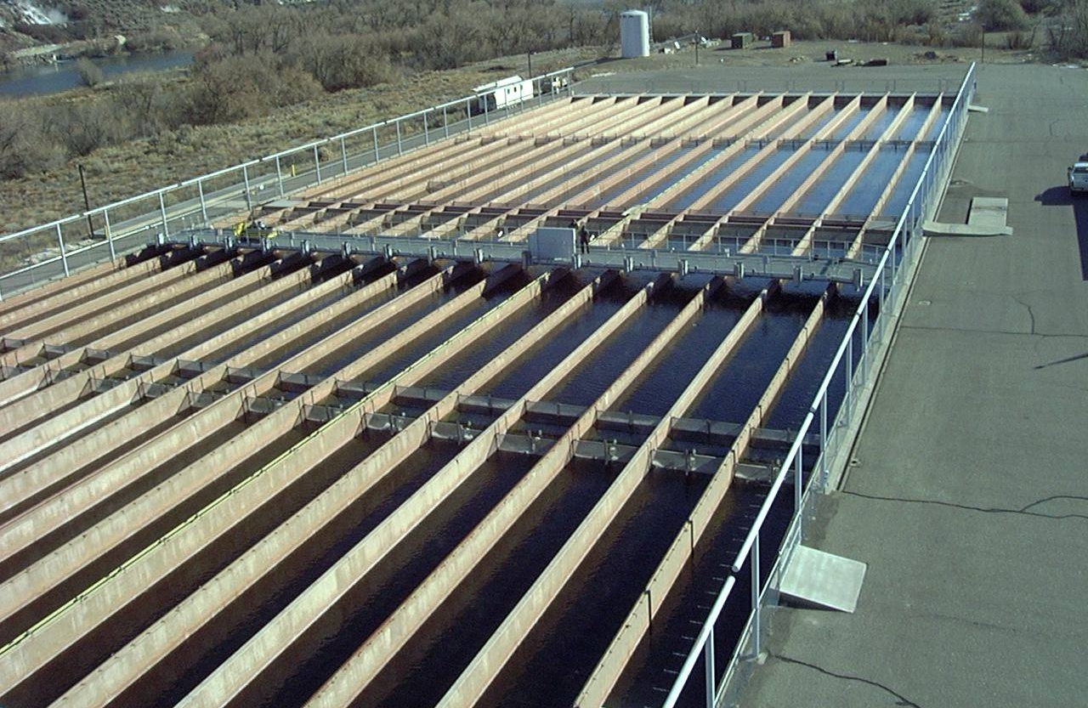
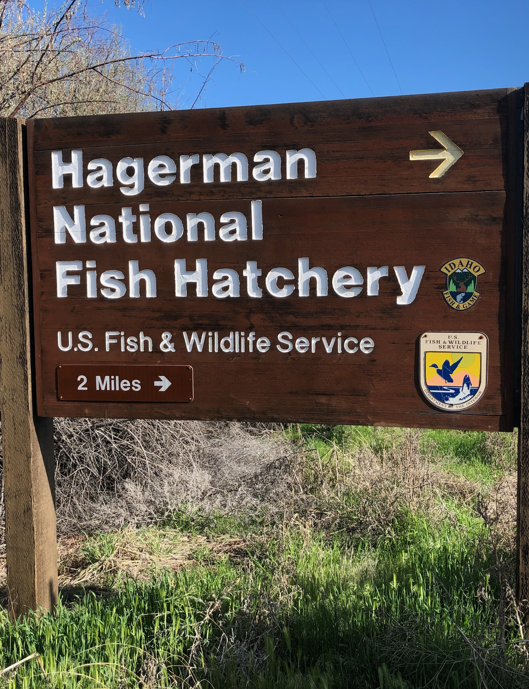
Upper Snake Rock TMDL Revision

Slide 19
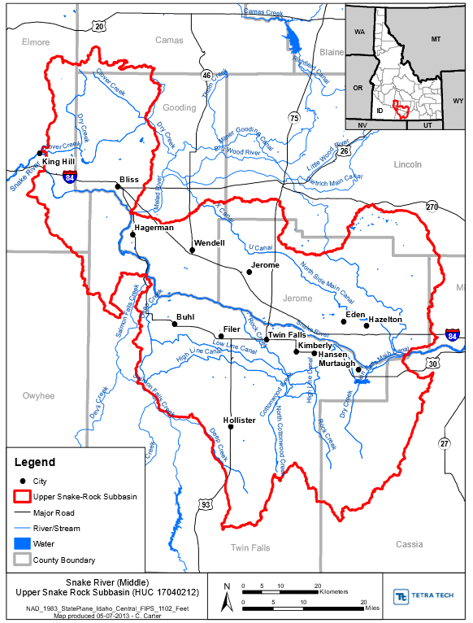
Reopening the Upper Snake Rock TMDL
April 2017- EPA attended a Mid Snake Watershed Advisory Group Meeting and gave an ultimatum.
  DEQ must reopen the Upper Snake Rock TMDL
  OR
  All point-source dischargers in the watershed would be limited to a gross, end of pipe discharge limit of 0.075 mg/L Total Phosphorus
Notes:
The gross end of pipe limit would have put most everyone out of business as the spring water is already above 0.075 mg/L

Slide 20
Influent Total Phosphorus
Mg/L

Slide 21
New Wasteload Allocations
DEQ is currently developing new Wasteload Allocations for all point source dischargers
DEQ sent out the first draft of the proposed allocations in January 2023
  Found some major errors in the data I will share on the next few slides.
  Numerous meetings to get to where we are now
The Mid Snake WAG will vote on the allocations May 17th
Wasteload Allocation will be incorporated in the TMDL
When the TMDL is complete the DEQ Permitting Team will begin assigning new Permit Limits

Slide 22
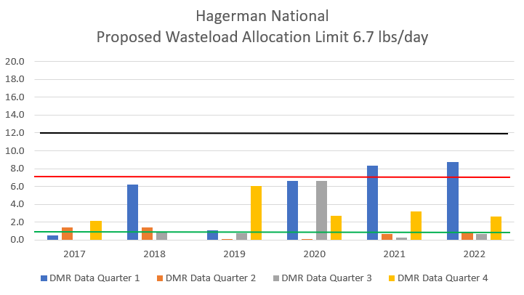
Current WLA = 12.2 lbs/day
45% Reduction
Proposed WLA = 6.7 lbs/day
90% Reduction
First Proposed WLA = 1.23 lbs/day

Slide 23
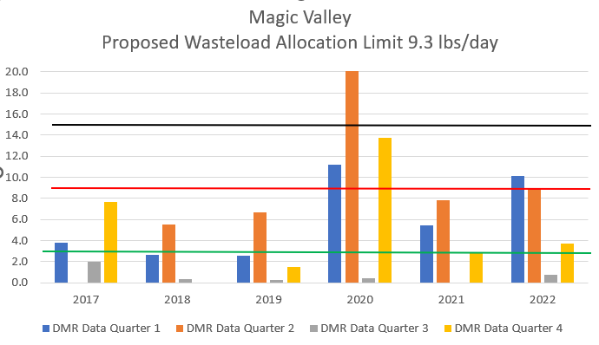
Current WLA = 15.2 lbs/day
39% Reduction
Proposed WLA = 9.3 lbs/day
78% Reduction
First Proposed WLA = 3.35 lbs/day

Slide 24
Plans moving forward
Stay very engaged in the process
  Continue one on one meetings with DEQ as needed
    LSRCP, IPC, IDFG Attorney General & Technical Assistance Bureau, hatchery staff
  Continue attending WAG meetings
  Continue discussions with Idaho Aquaculture Association
Continue collecting monthly samples to provide a more representative picture of the Wasteload at each hatchery
  Prevent some of the issues we are experiencing with McCall
  DEQ Permit writers will use this data when assigning new Permit Limits.

Slide 25
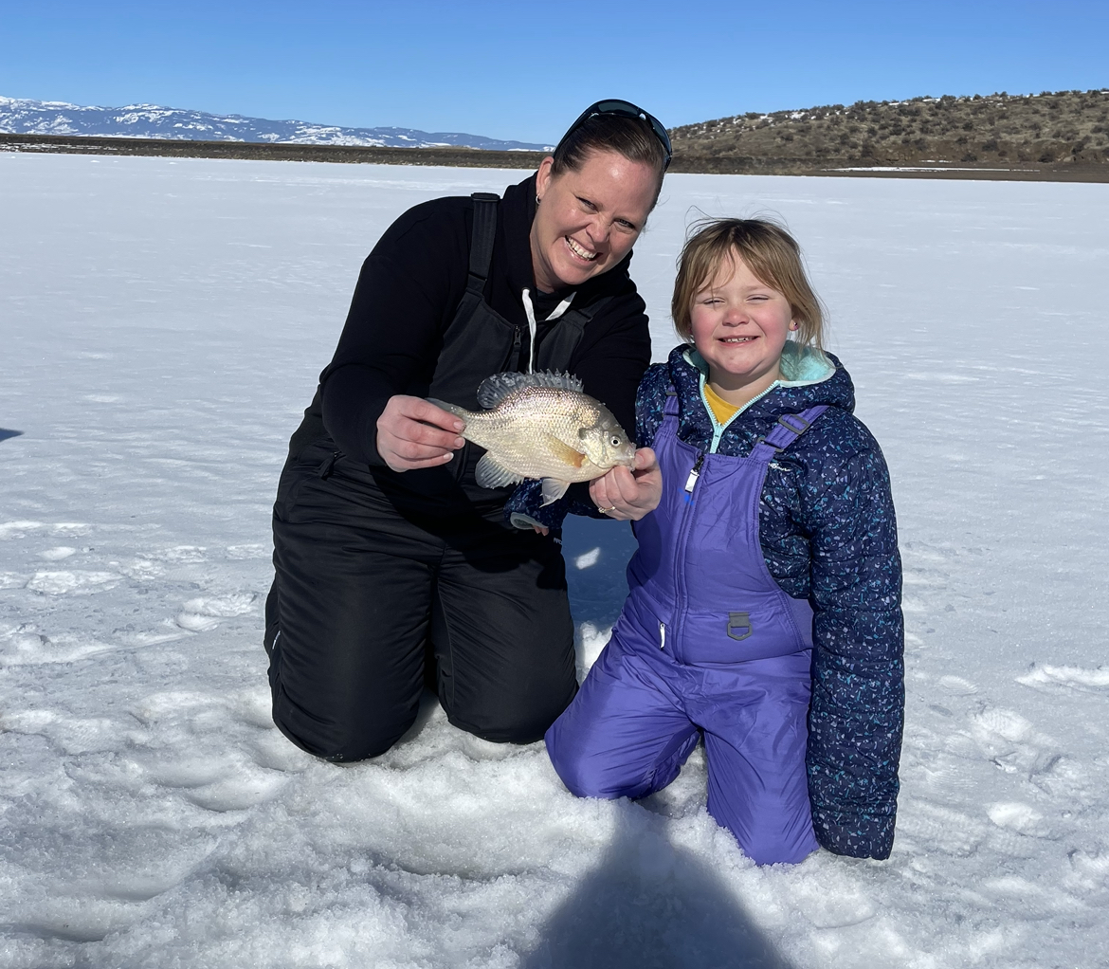
Hold questions until after
Ann’s presentation

