Slide 1
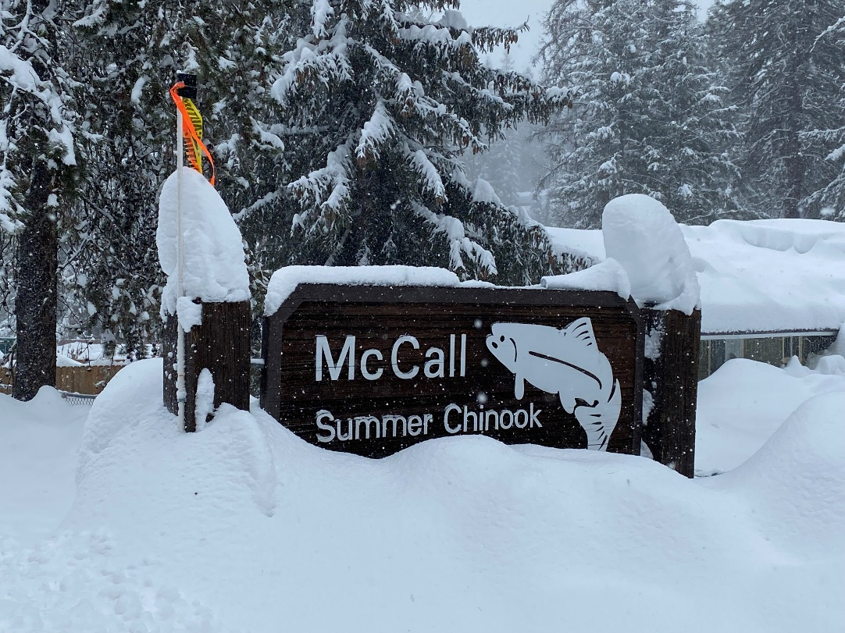
LSRCP Infrastructure
Our Next Year
Nathan Wiese LSRCP

Slide 2
LSRCP Mission
Mitigate for construction and operation of the 4 Lower Snake River Dams
Project Area Targets
  18,300 Fall Chinook
  55,100 Steelhead
  58,700 spring/summer Chinook
✓
✓

Slide 3
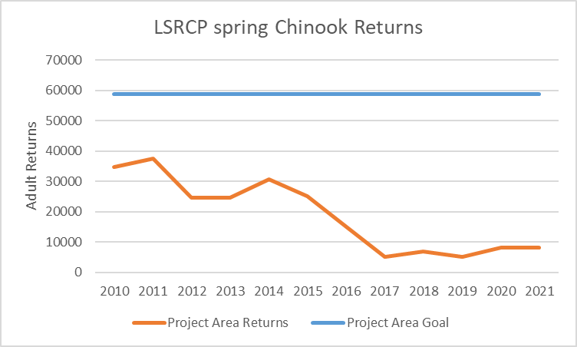
Why Audits??

Slide 4
Audit Goal
Provide conceptual-level information of current infrastructure to LSRCP stakeholders
Increase opportunities to meet LSRCP mitigation targets

Slide 5
Chinook Project Area Goal
= 58,700 Adults
BY2007 - 2016
Current
Annually
  8.4 Million Smolts
  26,100 Adults
Annually
  10.5 Million Smolts
  43,897 Adults

Slide 6
Average by Basin
LSRCP Chinook Program Performance, Brood Year 2007 - 2016
Basin | Smolts | Basin Adult Goal | SAR BY07-16 Mean | Adults BY07-16 Mean | Adult Shortfall
Northeast Oregon | 1,390,000 | 9,068 | 0.62% | 8,583 | (485)
Southeast Washington | 475,000 | 1,152 | 0.37%* | 1,780 | 628
Clearwater | 5,599,000 | 21,035 | 0.40%* | 22,534 | 1,499
Salmon | 3,000,000 | 27,445 | 0.37% | 11,000 | (16,445)
Total | 10,494,000 | 58,700 | 0.42% | 44,071 | (14,629)
* SARs based on expected or available data, not complete for entirety of BY07-16

Slide 7
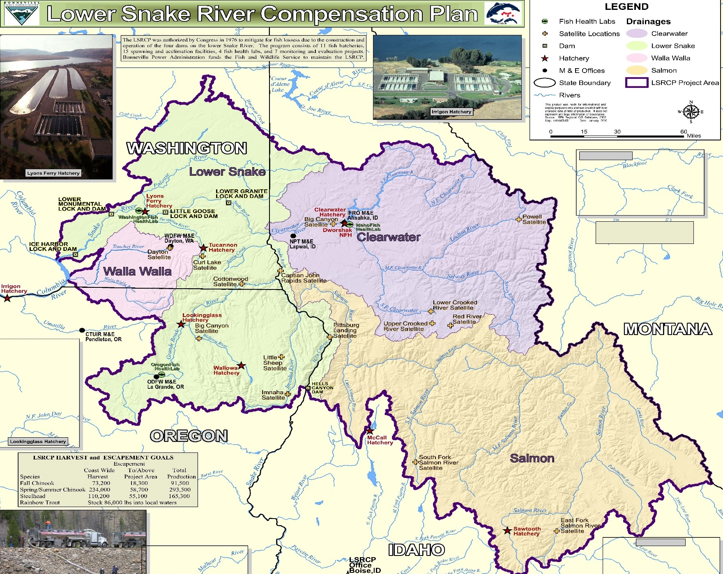
✓
✓
(485)
(16,445)
Notes:
Four Basins

Slide 8
Chinook Project Area Goal
Goal = 58,700 Adults
Current
Future???
Annually
  10.5 Million Smolts
  43,897 Adults
Annually
  13.5 Million Smolts
  58,700 Adults

Slide 9
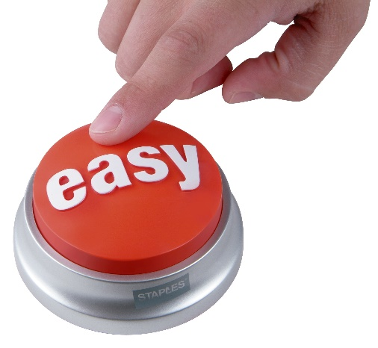
Options
Notes:
Needs to be revised to reflect current performance -

Slide 10

Options
Challenges and considerations with changing the programs.
  LSRCP in-place, in-kind goals
  Performance (potential or actual)
  Type of program
  Space/Infrastructure/Logistics
  Funding
  Policy considerations, U.S. v. Oregon (consensus)
  ESA
  Scientific Recommendations
  Shifting baselines (Climate, Ocean, etc.)

Slide 11
Why Infrastructure Audits?
May be the “easiest” solution
More Chinook smolts = More Adult Chinook
What else?
  M&E priorities – where can we improve performance?
  Management considerations – where/when/how?
  ESA – where can smolts be added?

Slide 12
Governor’s Salmon Workgroup
Enhance and Expand Production
Optimize Hatchery Production
Meet Mitigation Obligations
Maintain Existing Infrastructure
Notes:
We didn’t put enough infrastructure in originally

Slide 13
How were Infrastructure Audits conducted?
Review existing concrete – what could it do?
Identify “bottlenecks” to achieving adult returns
Identify additional investment opportunities
Dream a little….
Identify infrastructure shortfalls
  Should we be building a new hatchery??

Slide 14
What was the Audit?
Review each facility through monthly metrics:
Smolts
Fpp
DI
FI
Flow
Ft3
Temp
Notes:
We didn’t put enough infrastructure in originally

Slide 15
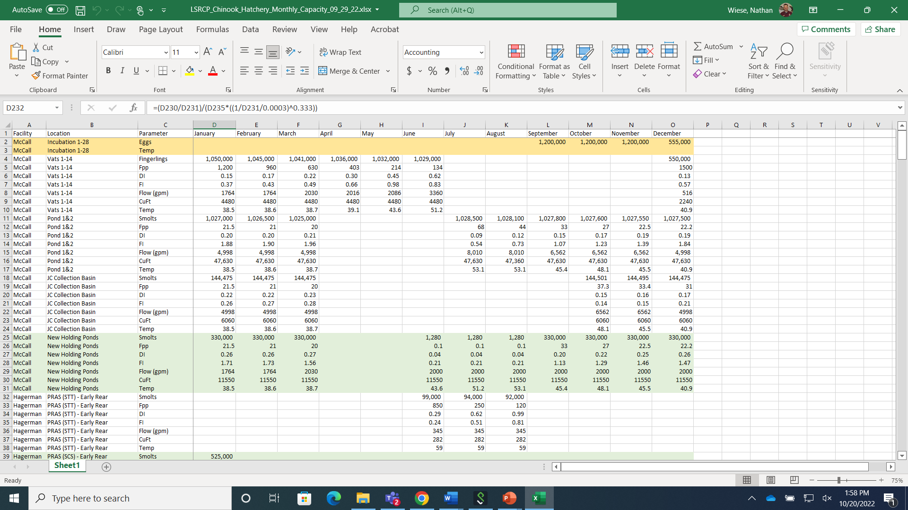

Slide 16
What did we Learn about Infrastructure?
There’s a lot of ways to raise spring Chinook
Sizes from 12-24 fpp
Temp Ranges 37-61 F
DI = 0.14 to 0.35
FI = 1.0 to 2.2 (40% to 89% of Piper)
Water Chemistry ( 7 to 110 ppm CaCO3)

Slide 27
What Else?
Acclimation vs no-acclimation
  Space saving for some facilities
Temp profiles
When to move for marking and how many moves
To chill or not to chill?

Slide 28
Chilled??
Basin | Feeding | Early Temps
Lookingglass | January | 42-44 F Well Water (37-38 F River)
Dworshak | April | 36-38 F Chilled Dworshak Reservoir
McCall | January/February | 38-41 F Payette Lake
Clearwater | December | 42-45 F Dworshak Reservoir
Sawtooth | December | 42-46F Wells (37-41 F River)
Lyons Ferry | December | 52 F - Wells

Slide 29
When to Mark and How Many Moves?
Basin | Marking | Ponding Size | Max DI | Max FI | Moves
Lookingglass | Aug 1 | 175 | 0.2 | 1.5 | Move to Raceways
Dworshak | Sep 1 | 1200 | 0.2 | 0.5 | Start in Raceways and River Water
McCall | July 12 | 100 | 0.6 | 1.5 | Keep in Nursery
Clearwater | April 25 | 100 | 0.8 | 1.3 | Nursery
Sawtooth | May 30 | 130 | 0.5 | 1.8 | Nursery & Raceways
Lyons Ferry | Mar 1 | 400 | 0.09 | 1.6 | Move to Raceways

Slide 32
What Else?
Ways to improve downstream survival?
What about Age 0+?

Slide 33
Release Timing
Facility | Start Release | End Release
Lookingglass | 15-Apr | 17-Apr
McCall | 2-Apr | 12-Apr
Dworshak | 25-Mar | 14-Apr
Clearwater | 14-Mar | 14-Apr
Sawtooth | 8-Apr | 15-Apr

Slide 38
Conclusion
Lots of Chinook rearing strategies
Densities, flows used and size at release, and SAR’s vary widely
Opportunities exist across the program

Slide 39

LSRCP is
Fish for the Future

