Slide 1
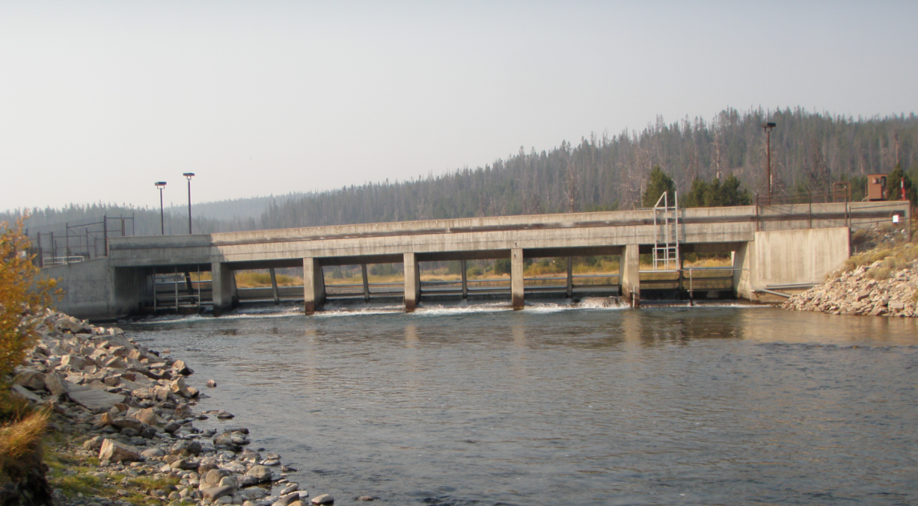

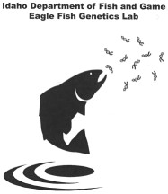
Sawtooth Weir Fish Passage
David Venditti
Sylvia Hamilton
Kurt Tardy
May 8, 2024

Slide 2
Trap Status
Compliance Issues
Chinook
Works well early and in higher water years
Efficiency drops in July / August
Sockeye
Return while efficiency low for Chinook
Does collect some sockeye
Only one (1) natural fish entered in 2023

Slide 3
Chinook Effects
Trap Operation
Low flow passage issues
Circular ladder design
May limit broodstock collection
Dropout below weir
Integrated evaluation
PNI effects

Slide 4
Sockeye Effects
Trap Operation
Same as Chinook
Reduces time in natal lakes
Effects?
May spawn in the Salmon River
Particularly for Pettit adults
May drop back to Redfish Lake
Need to truck
Not a permanent solution
Eliminates volitional return to Pettit Lake

Slide 5
Causes?
Water level and flow effects*
Temperature effect
Trap entrance
Apron • THE HOLE
Eddy below
Turn pools in ladder
Velocity in Ladder
Removed PIT arrays
In and out behavior

Slide 6
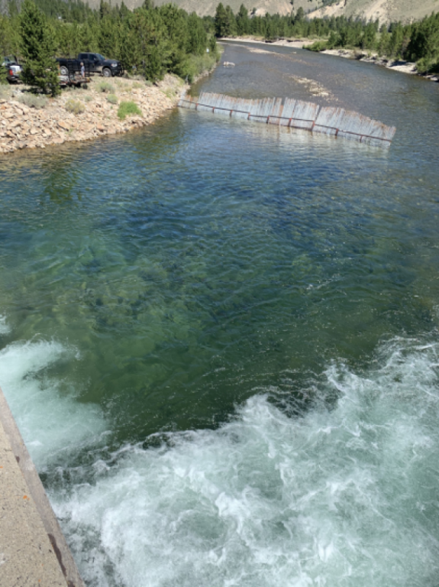
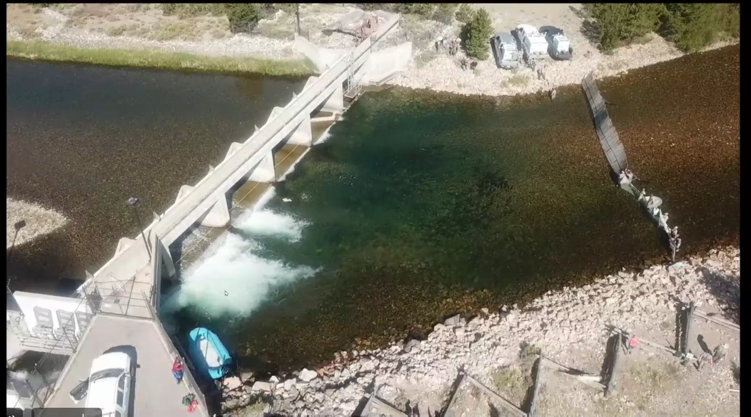
Fish in the Hole
Regardless of the cause
This is what happens

Slide 7
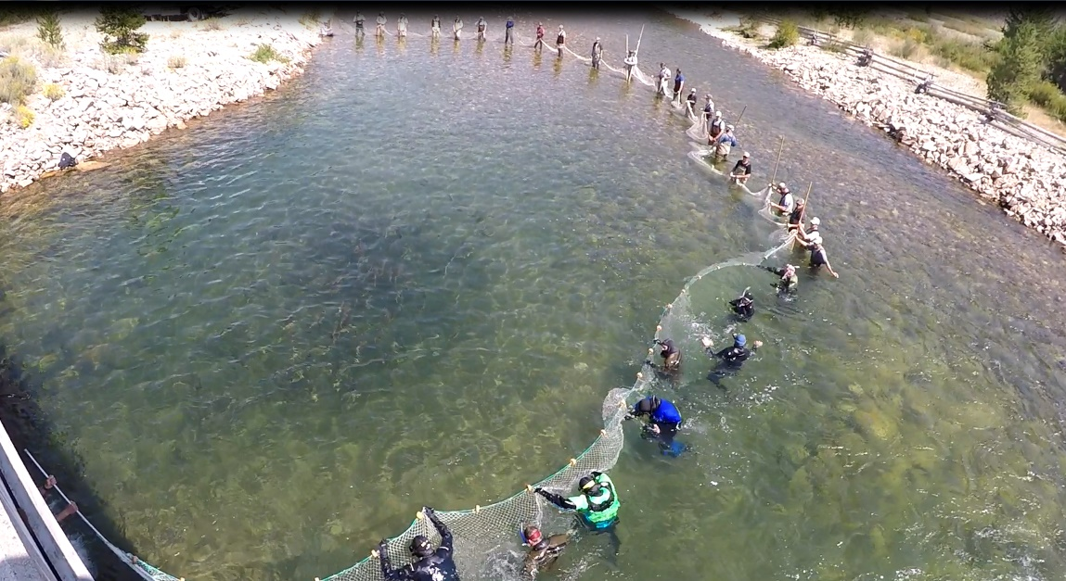
Improvise and Overcome
Round-ups
Chinook
Sockeye
Band-aide
≈ 40 people
≈ $10 K
Not a permanent fix
Safety

Slide 8
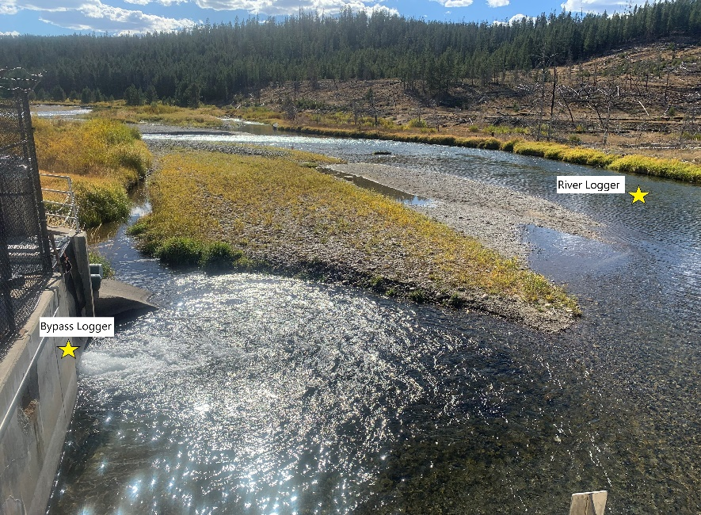
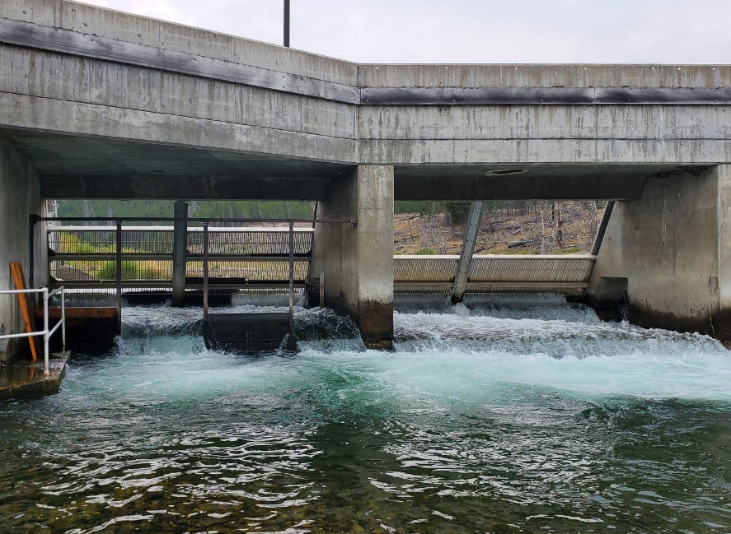
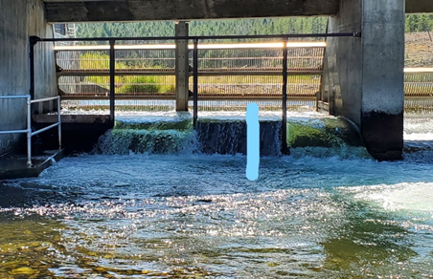
Ladder Entry Adjustments
Observed temperature differential
Ideal velocity and direction
Alterations achieved through use of dam boards and plastic tarps
= Temperature differential

Slide 9
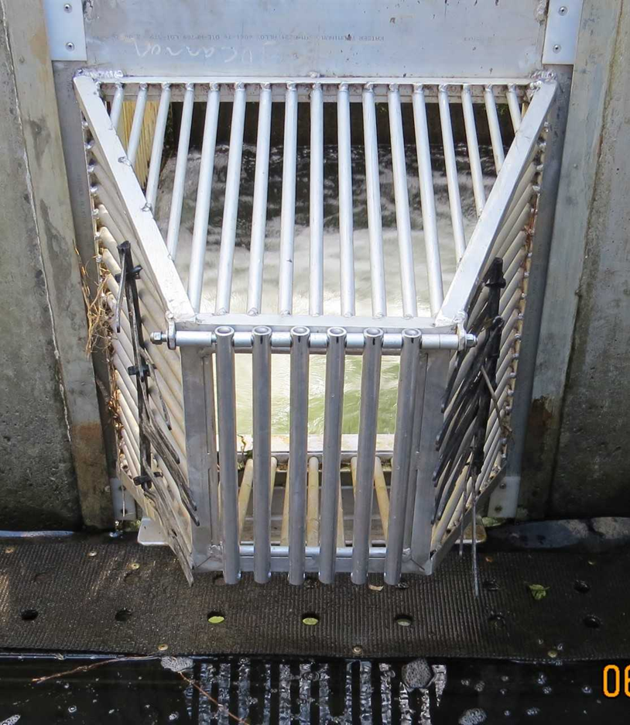
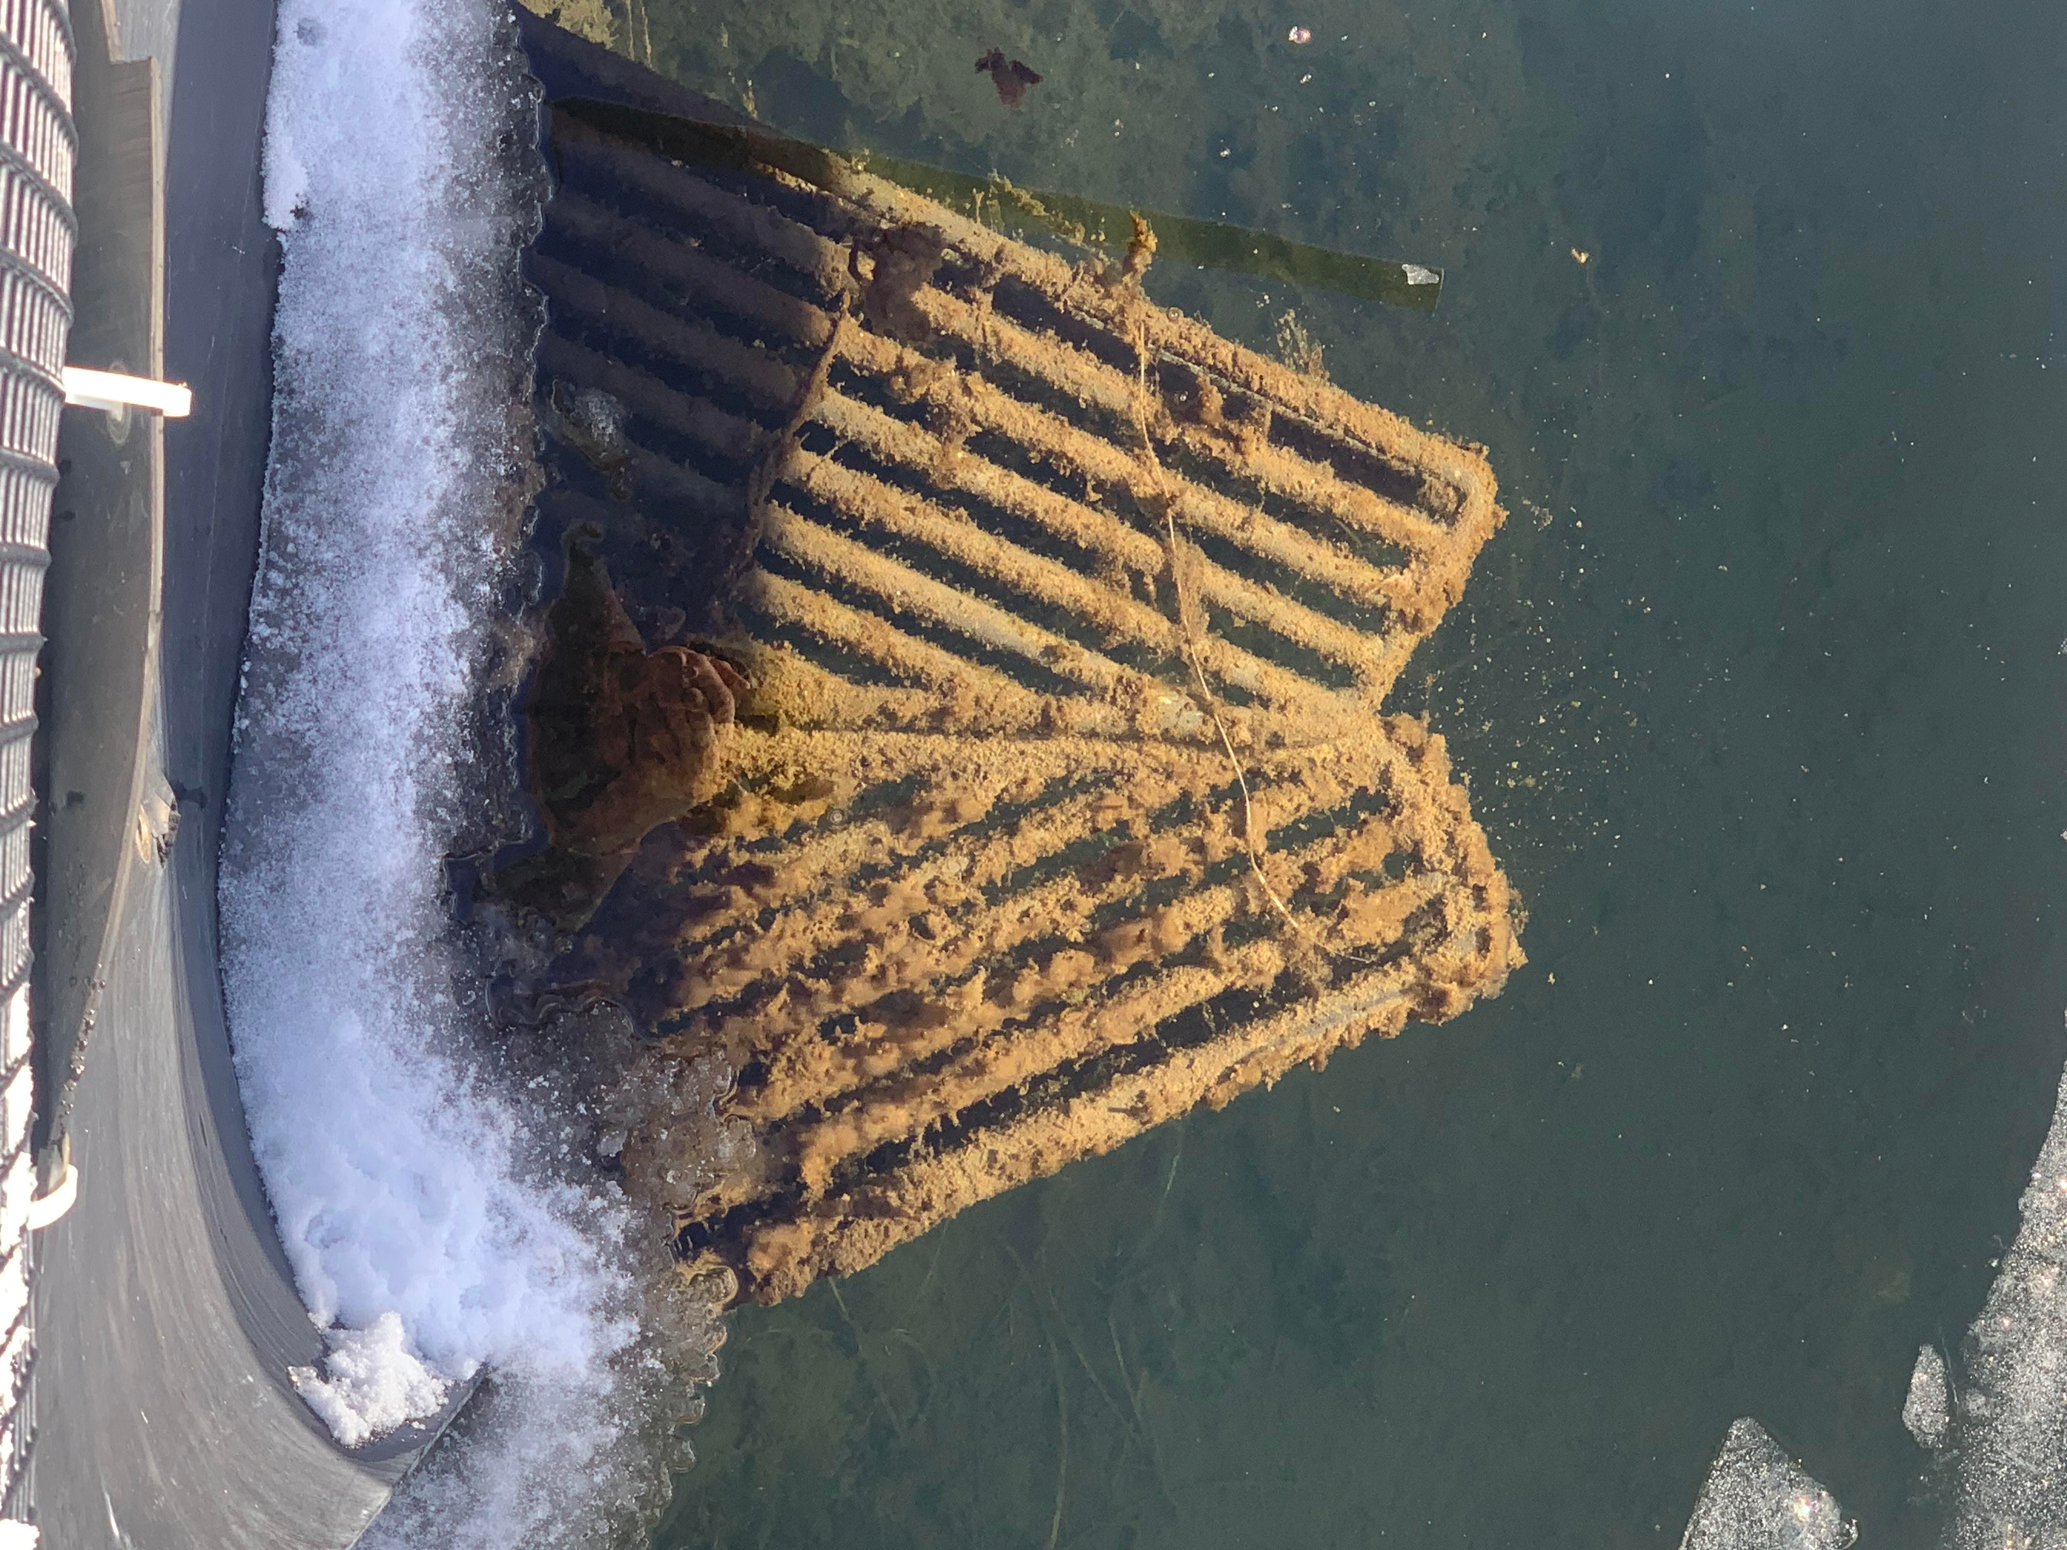
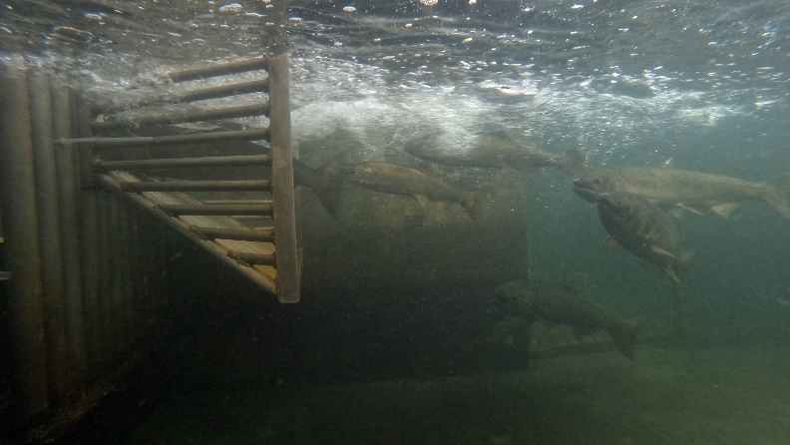
2022-Improve Trap Entry
Fish seen leaving trap from “V” entry
Pivoting bars allow entry but no exit
Used for BY22 Chinook
Didn’t work great for other species
Previous “V” entry
New pivot bar entry

Slide 10
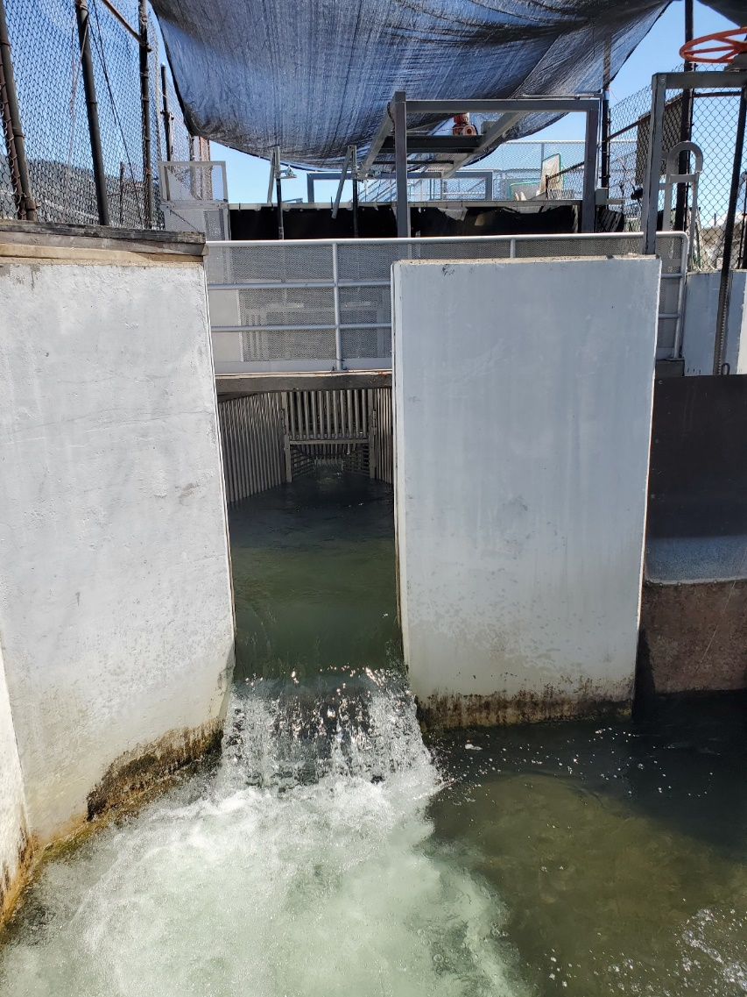
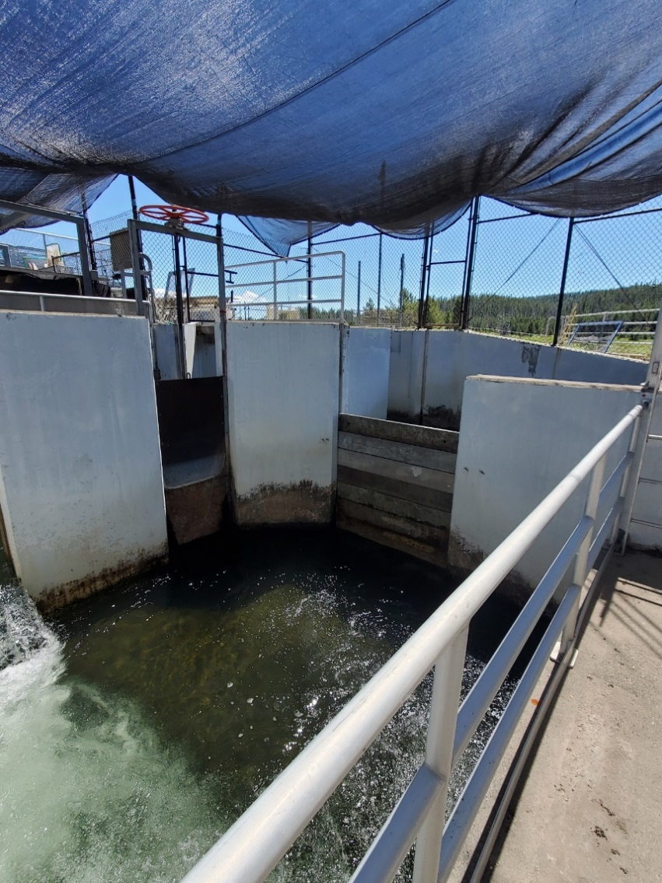
2022-New Ladder Configuration
First step of the First Dam boards blocking the rest of the ladder
der showing how ladder is blocked off
First step of the ladder straight into last step of ladder, then trap entrance
of the ladder straight into last step of ladder, then trap entrance

Slide 11
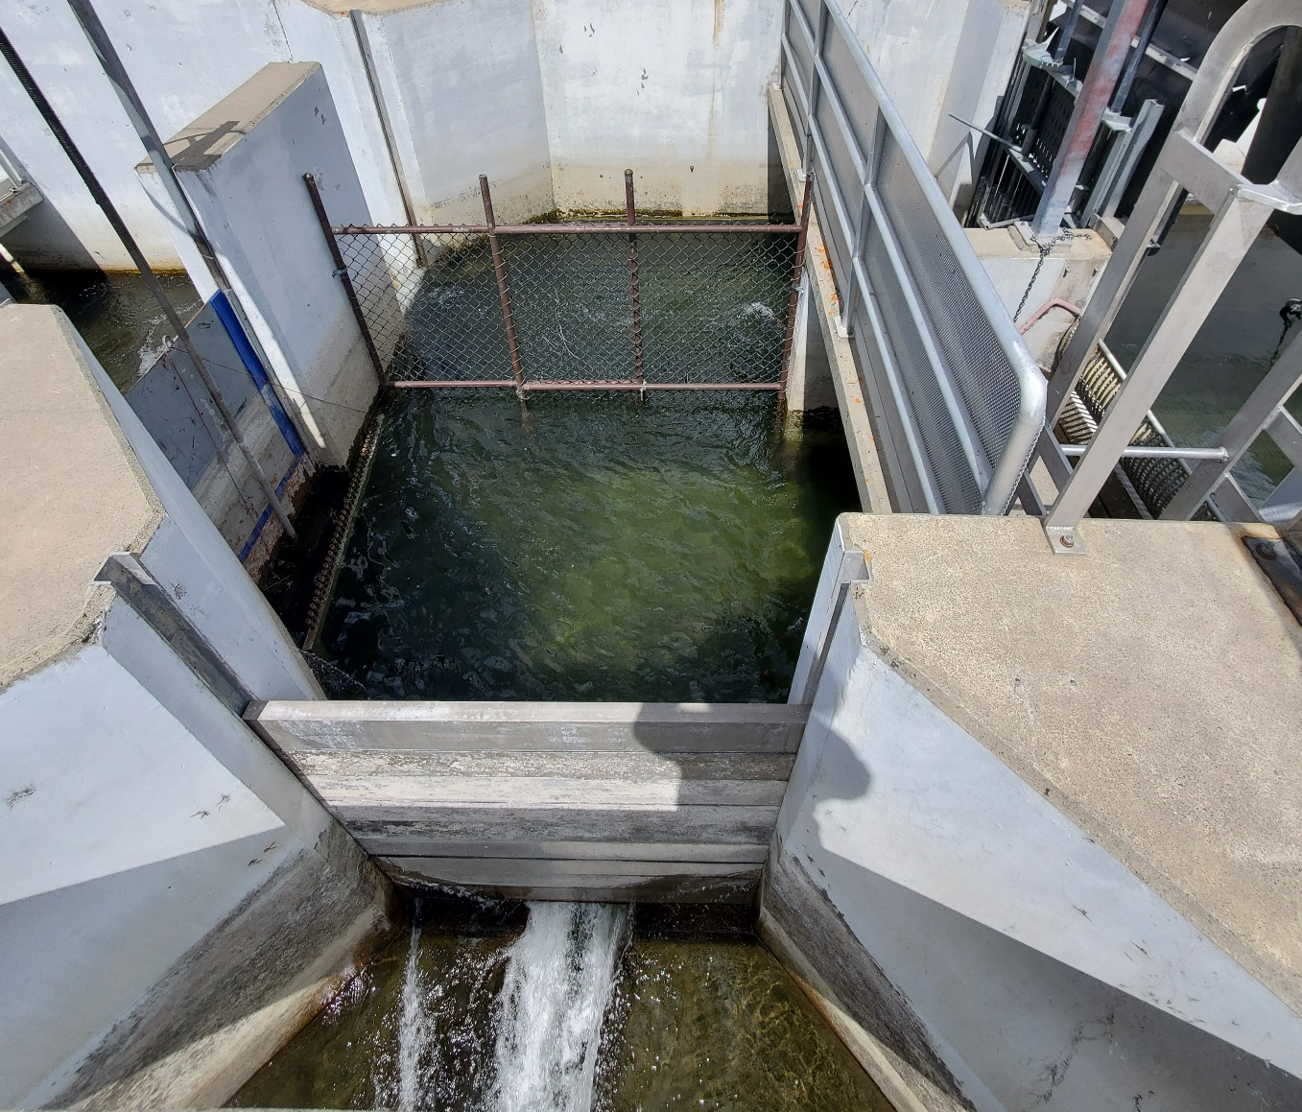
2023-Ladder Improvement
Added fencing to narrow the final step of the ladder so fish have a more direct path into the trap entrance
Added an opening to lower the velocity of the waterfall to lower the jump height

Slide 12
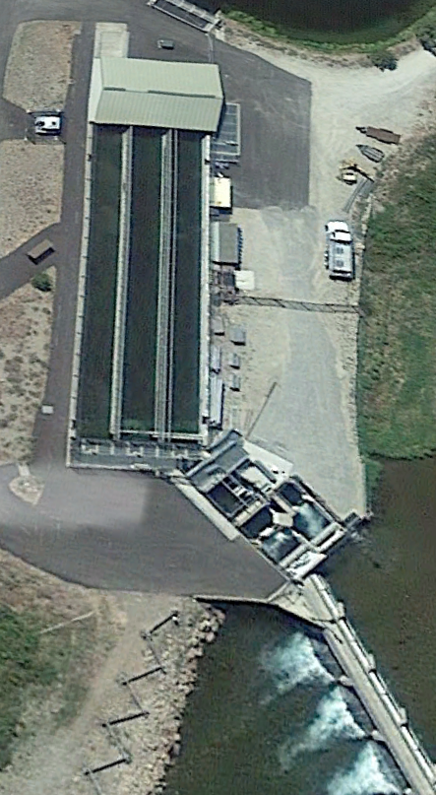
2023-Trap Improvement
Fish swim through the old trap entrance directly into the holding pond (yellow arrows)
Initially operated until first sort in mid August, then returned to using old trap
2023 converted West pond to the trap after the first sort (red arrow)
Use the crowder to separate freshly trapped fish from surplus fish
Surplus fish are operculum punched and placed behind the crowder
Designing a crowd rack to fit in the new trap space

Slide 13
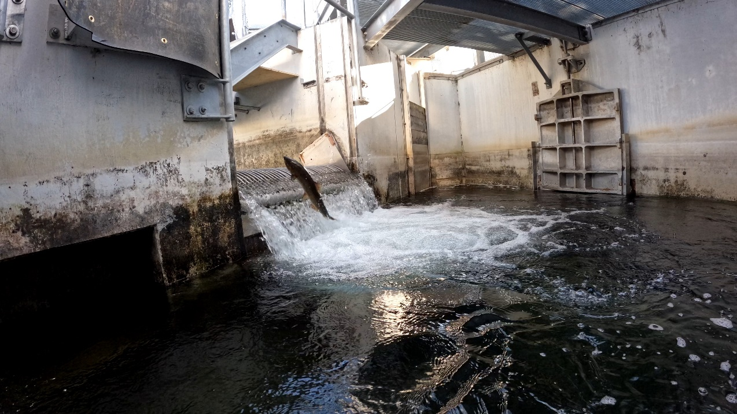
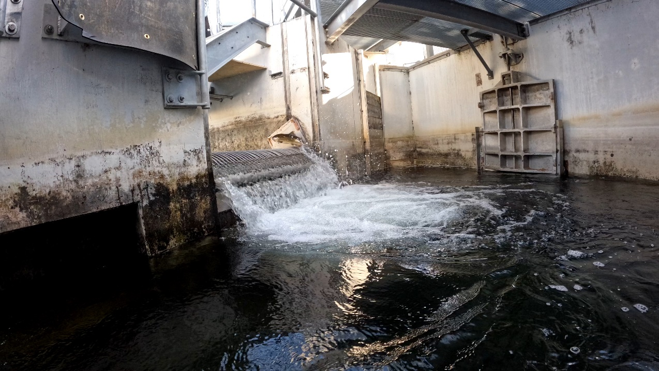
2023-Trap Improvement
A finger weir was installed at the end of the holding pond to help retain fish
Fish no longer observed lingering in ladder
Successful trapping of multiple species, including Rainbow, Cutthroat, and Bull Trout, as well as Sockeye

Slide 14
Hyper-Infuser
Tested in 2022
Too late for Chinook
Strips N₂ from water
Replaces with O₂
Run through ladder
Creates attraction
Not for sockeye

Slide 15
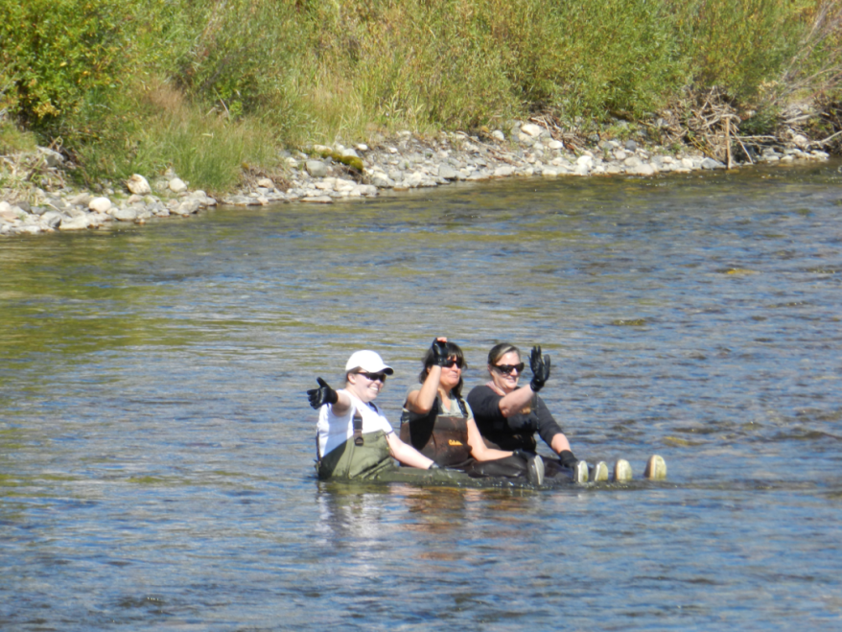
Future Fixes

Slide 16
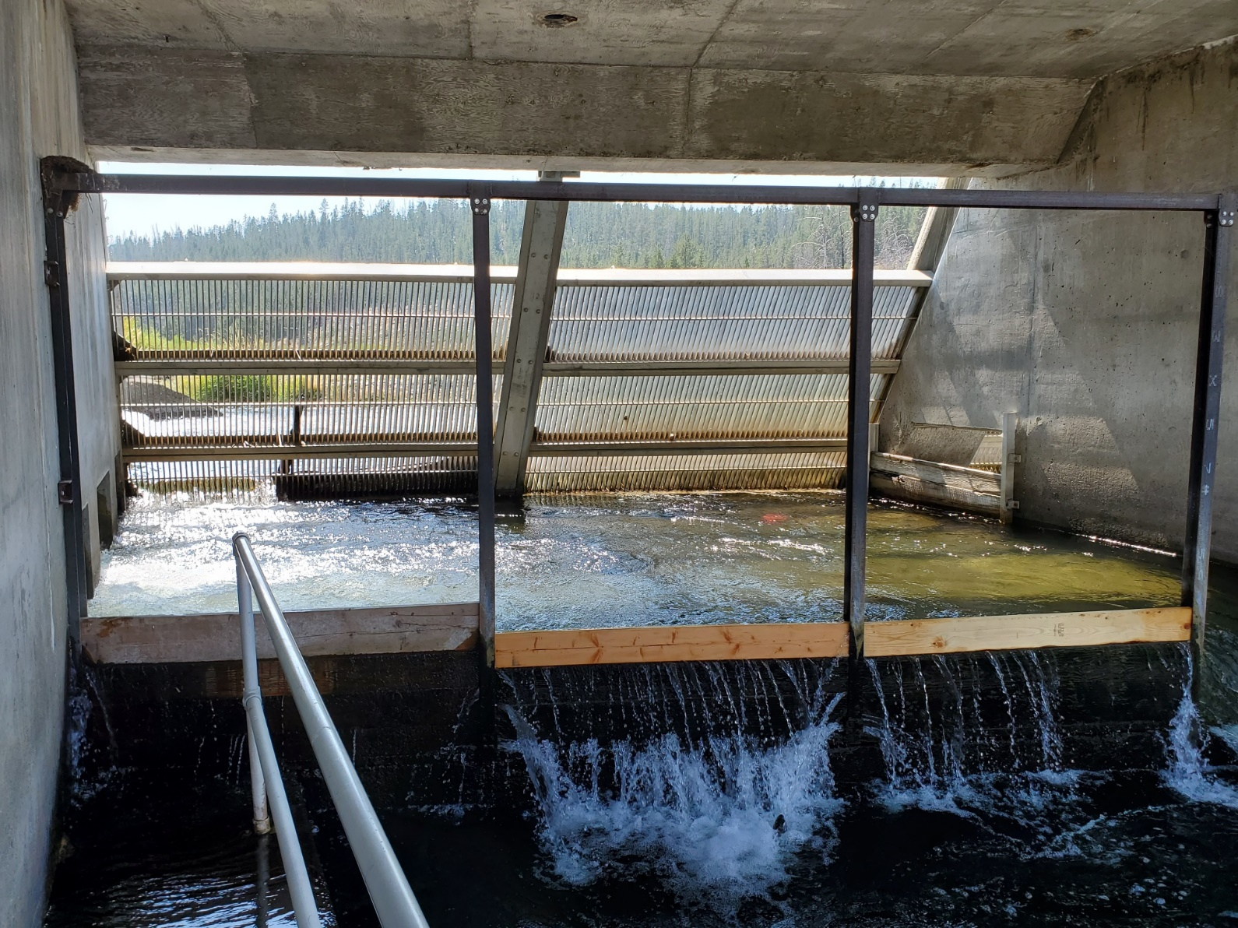
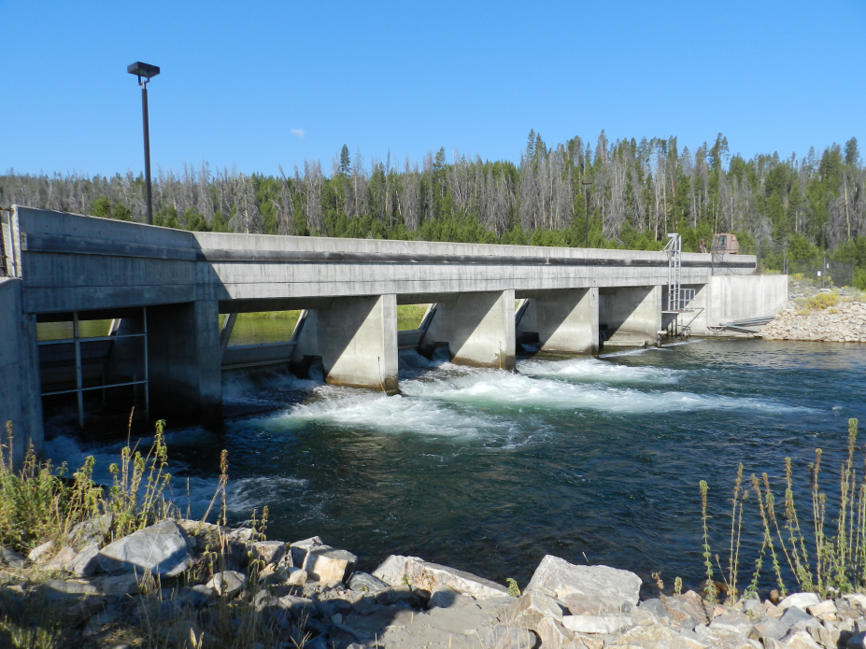
Open Another Path

Slide 17
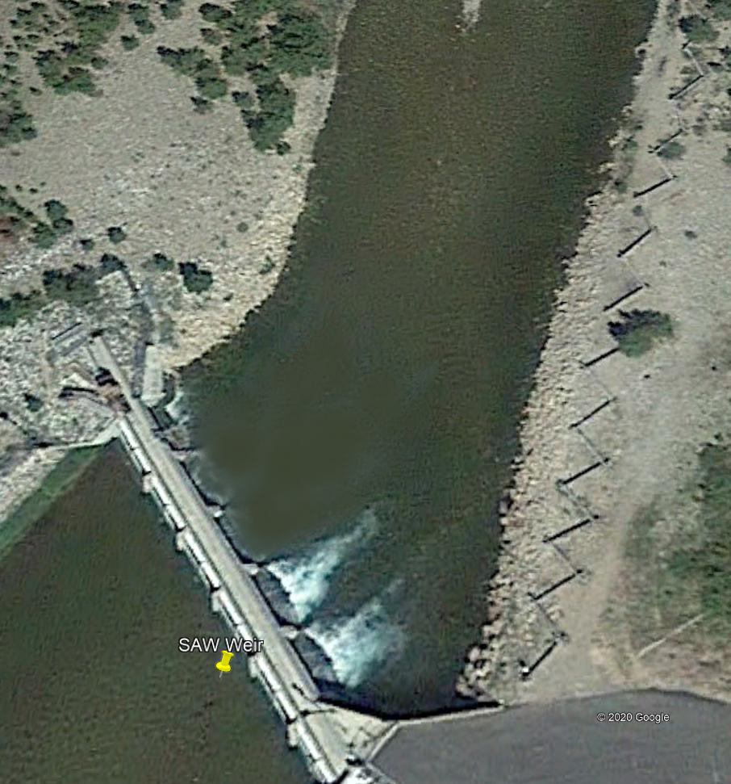
Fish Corral
Pull panel on a bay
Picket in a trap box
Damaged panel in 2022
Sockeye passed
Proof of concept
Pull panels earlier
Fish Zone

Slide 18
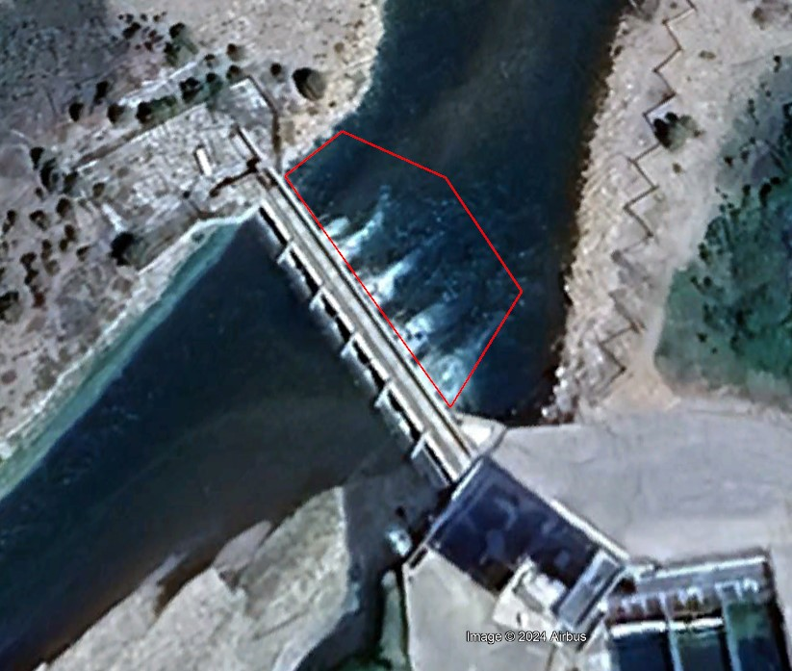
Fill the Hole
Create a riffle
Eliminate holding area
Force fish to ladder
Designs drawn
Work window
Jul. 15 – Aug. 15
3 wk / ≤ 7 d in-water
Trap closure

Slide 19
Rebuild Weir & Ladder
LSRCP $200M Capital Maintenance
SAW weir top of list
2026’ish
Creative Funding
Begin design work sooner?

Slide 20
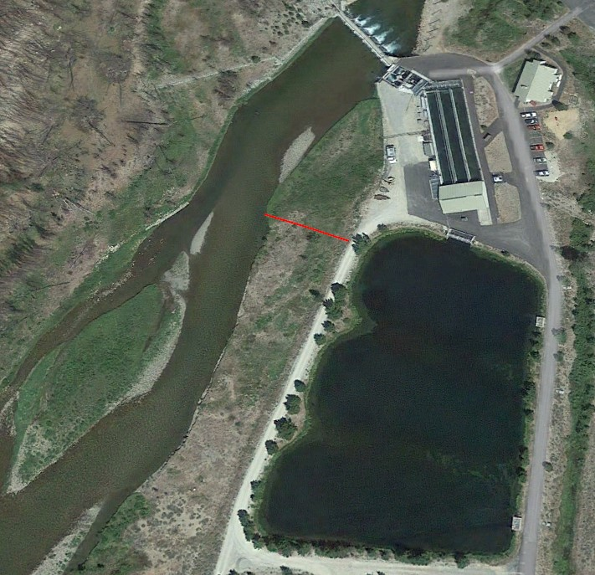
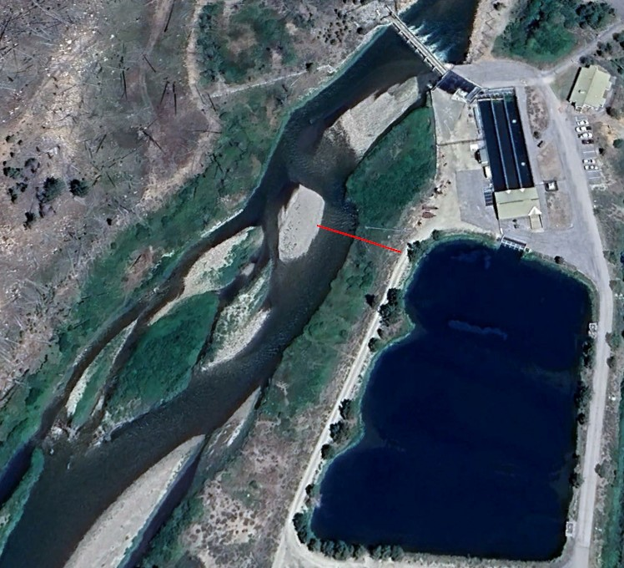
River Processes
34 m
34 m
19.5 m
2016
2023

