Slide 1

Fish for the Future
Station of the Year

Slide 2
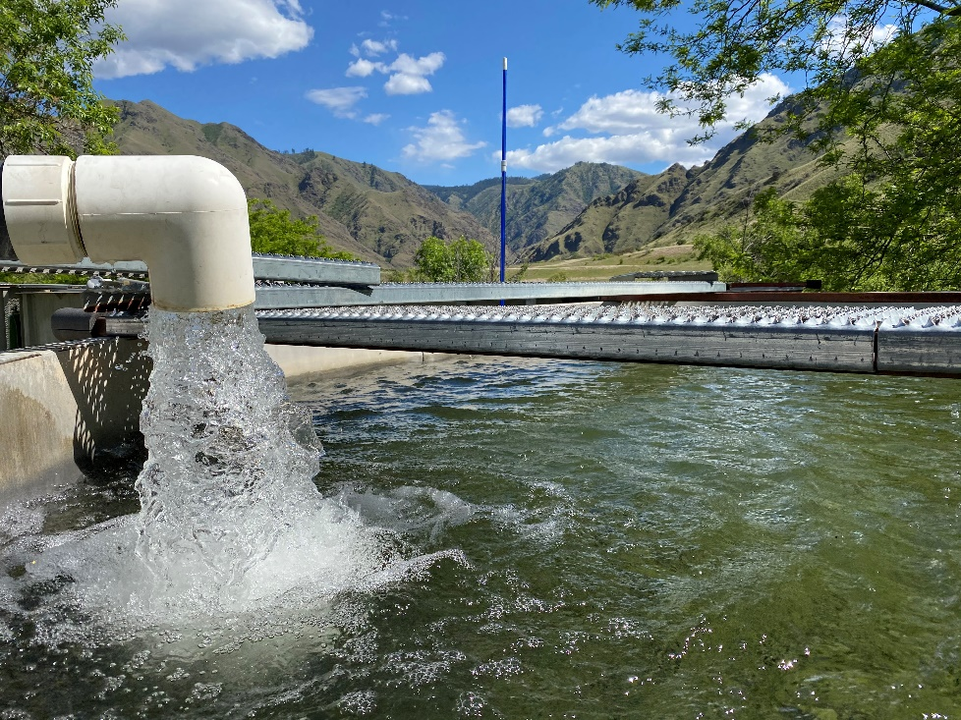
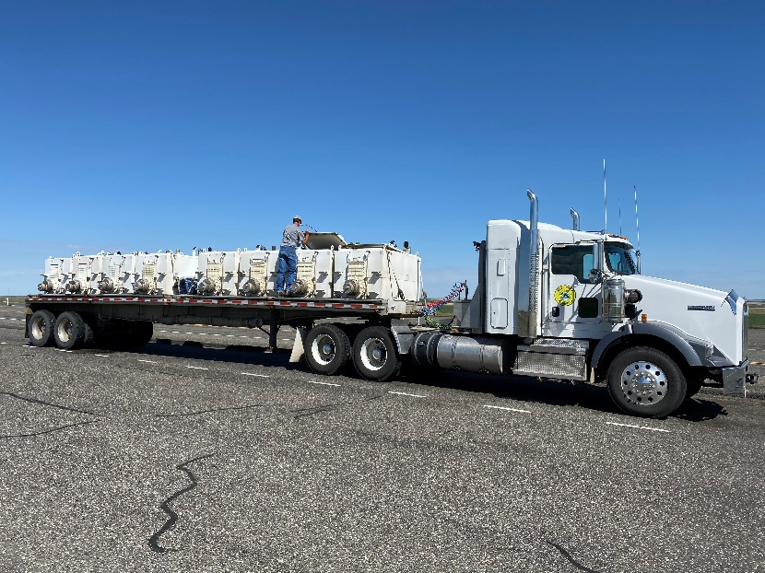
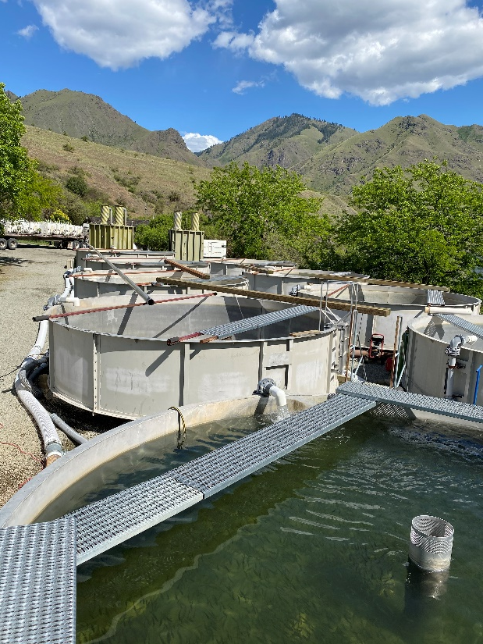
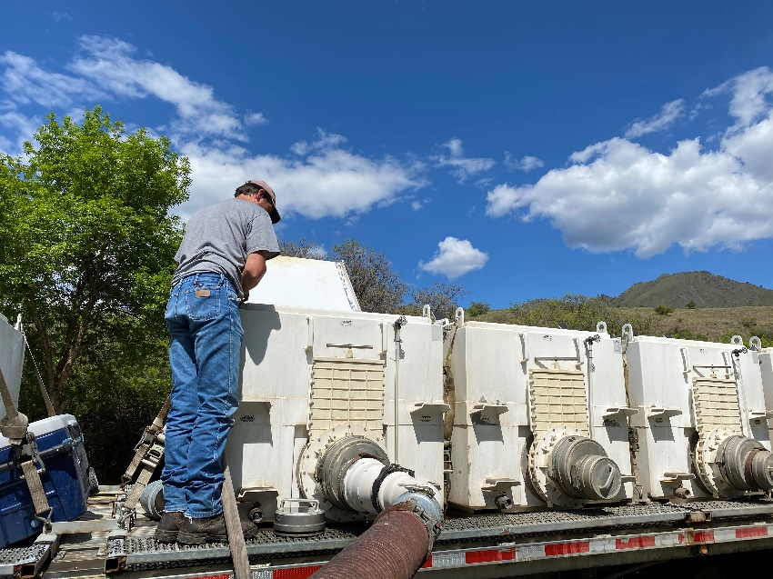
Fall Chinook Acclimation Project

Slide 3
Fall Chinook Acclimation Project
An integral part of LSRCP fall Chinook success
Constantly trouble-shooting and ensuring success of the acclimation project
Have persevered through the thick and thin of fall Chinook
Always ready and willing to help out other projects in need with staff, equipment, trucks, etc., etc., etc.

Slide 4
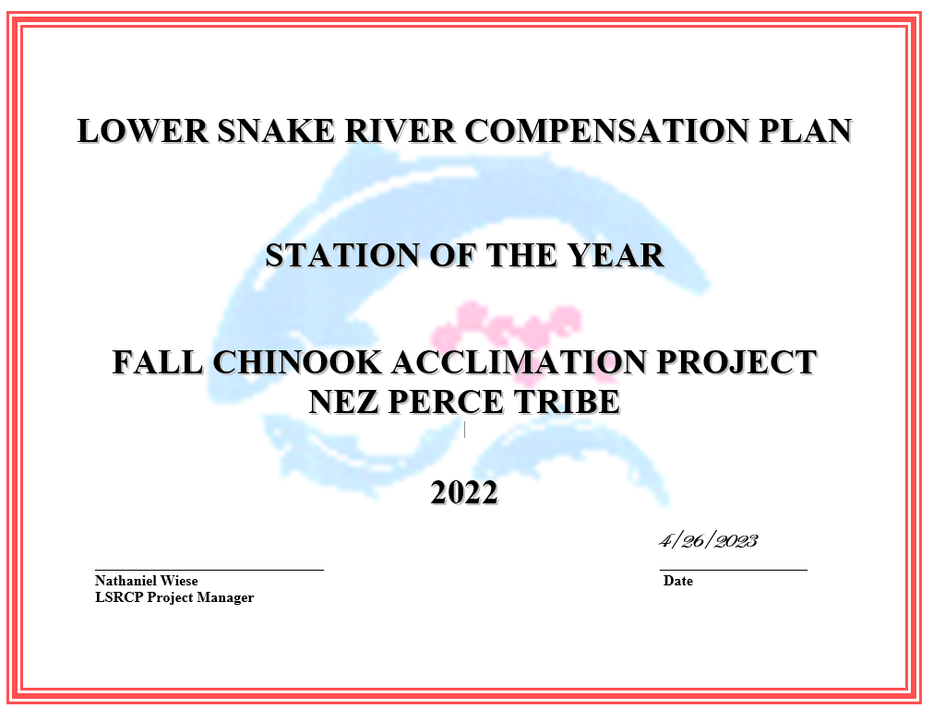

Slide 5
GREAT JOB!

