Slide 1
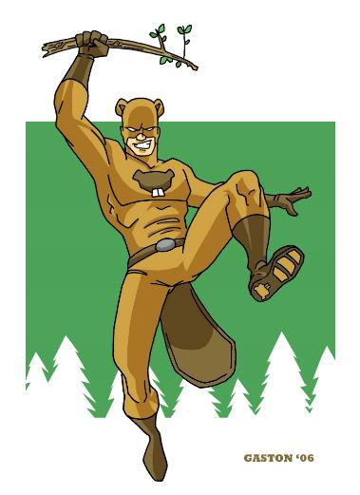
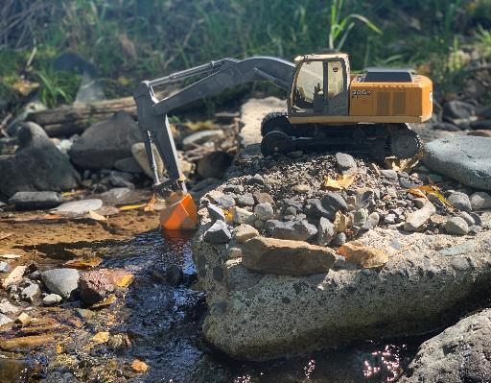
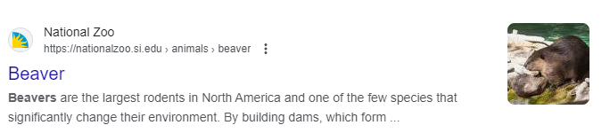
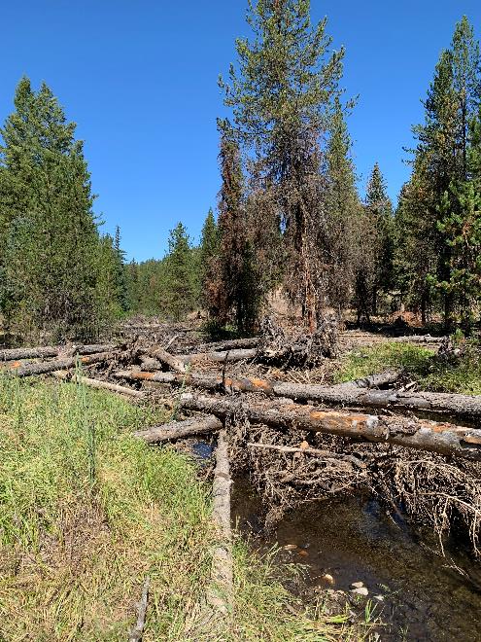
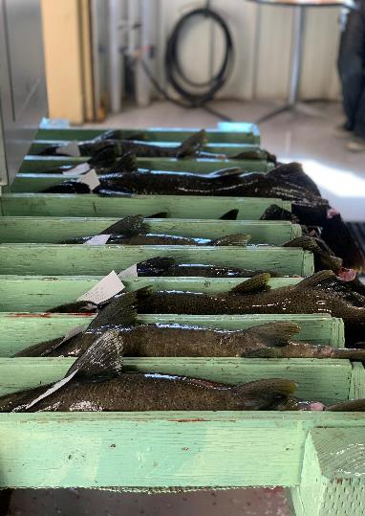
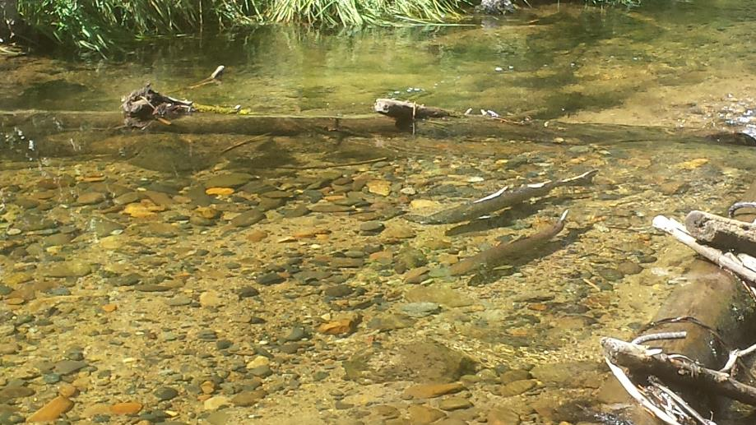
The Upper Grande Ronde River:
A population on the edge
Hungry
Hatcheries Habitat Harvest Hydropower

Slide 2
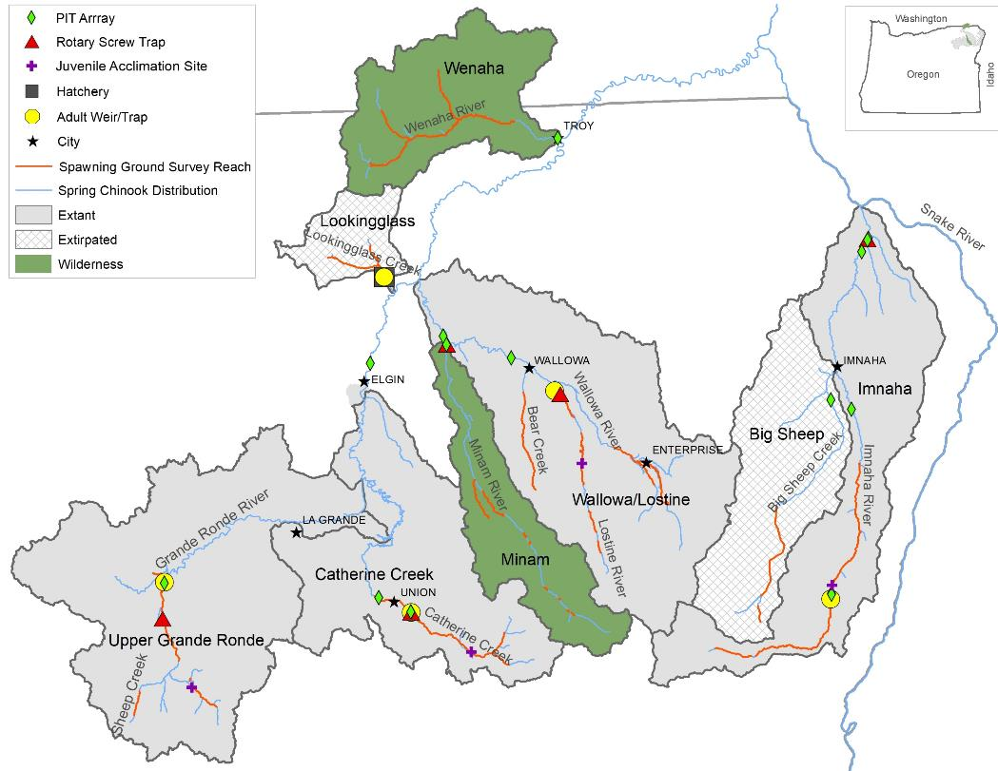
Background
Upper Grande Ronde River
Snake River Spring Chinook Listing
  1992 Spring/Summer Chinook listing as threatened under ESA
Supplementation
  Conventional hatchery program started in 1997
  250,000 smolts a year
  Captive broodstock BYs 1998 ─ 2005, 2007 ─ 2009, 2011
  Goal of 1,617 adults above Lower Granite
    Only have met this twice (last time was 2015)
  2011–2023
    73% pHOS (percent of hatchery origin spawners)
    <0.5% PNI (proportion of natural influence)
Broad Scale Process-Based Restoration Efforts
  Lots of large wood placements
Notes:
There is no goal for pHOS or PNI

Slide 3
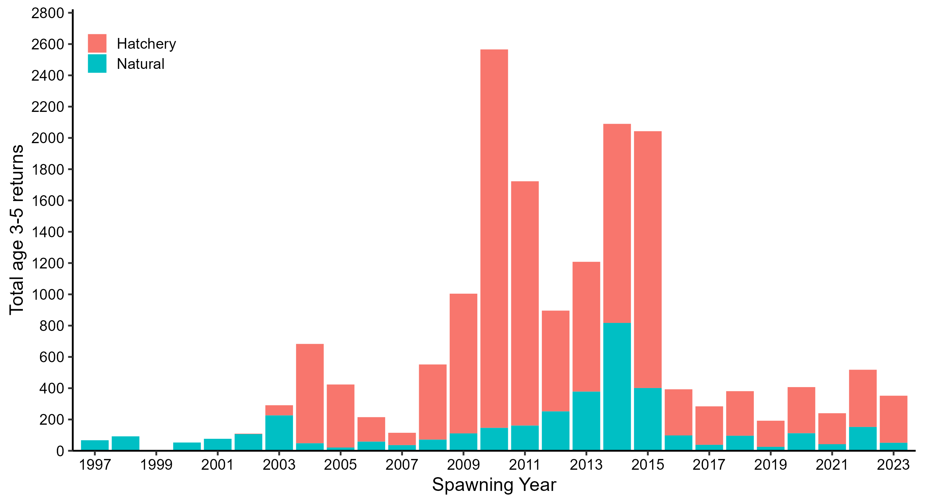
Total Spring Chinook returns to the Upper Grande Ronde
AOP female collection goals to produce 250,000 smolts
2020 = 86
2021 = 89
2022 = 89
2023 = 96
2024 =102
2016-2023
Average: 345
Natural range = 25-152
Hatchery range = 167-366

Slide 4
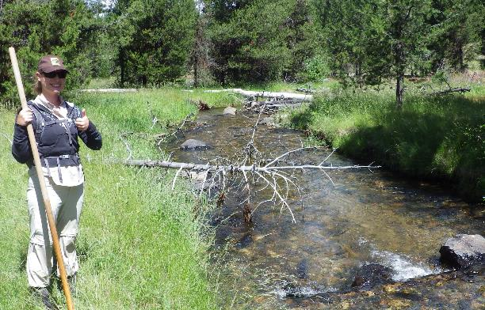
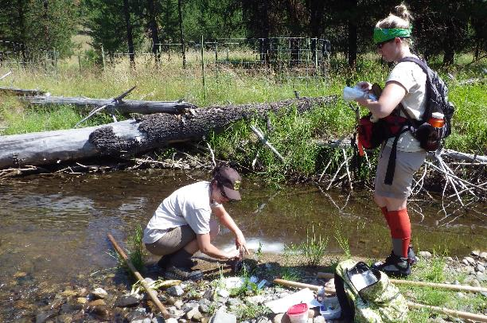
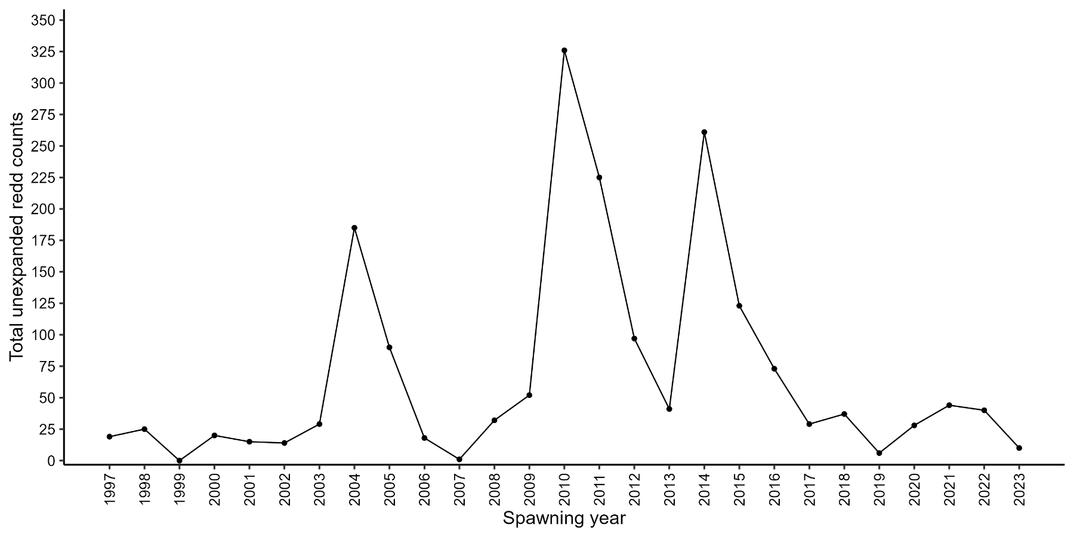
Total Unexpanded Redd Counts

Slide 5
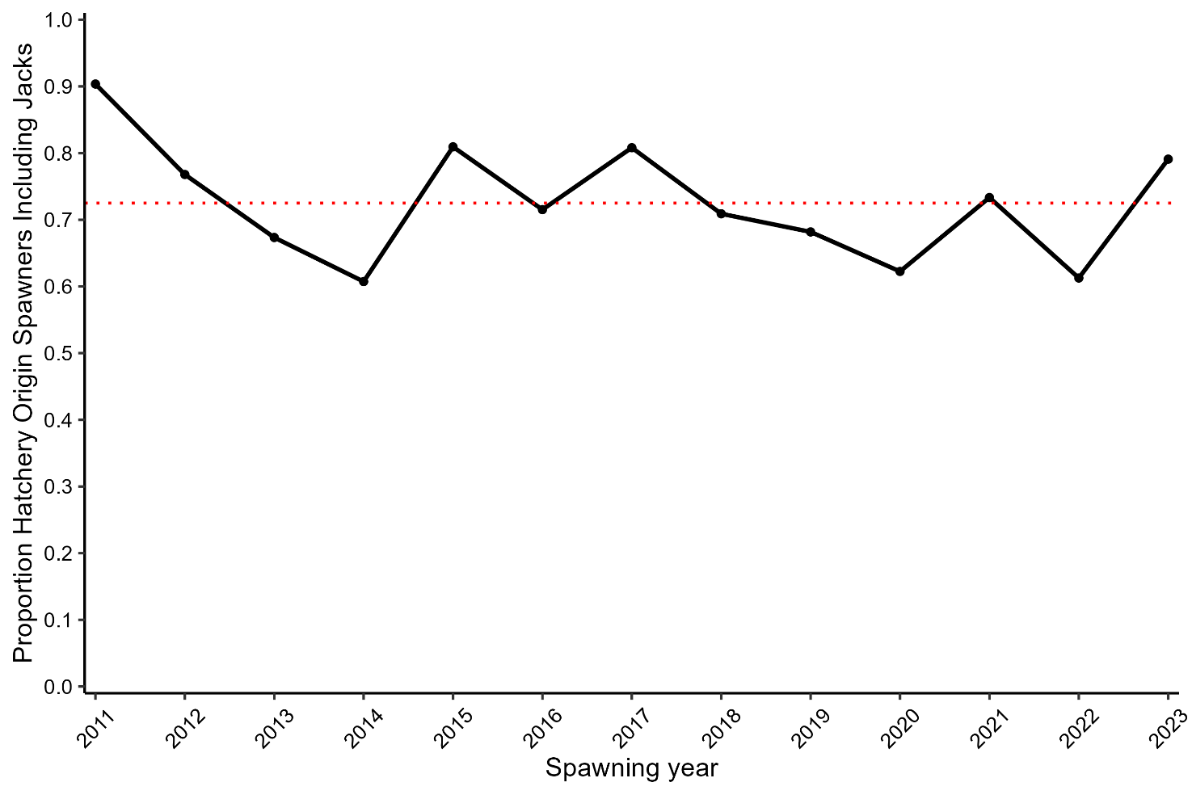
Proportion Hatchery Origin Spawners
Mean = 73%

Slide 6
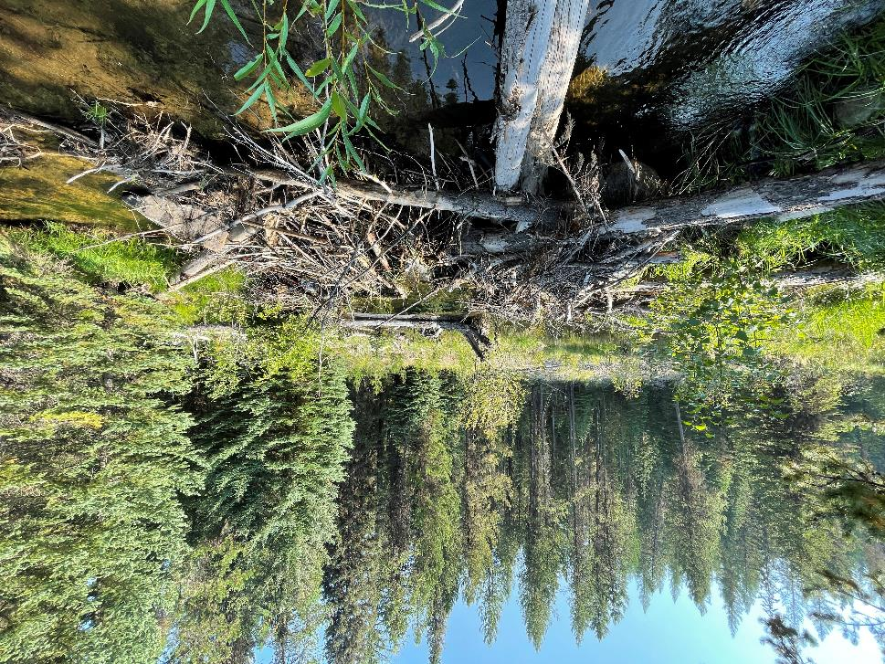
The challenge….
Man-made structures were initiated in 2019 and ‘finalized’ in 2021
2023: At least 7 structures preventing adult ChS passage
Potential for juvenile passage challenges
Some dams are 100% beaver made
Others are built on top of man-made wood structures***

Slide 7
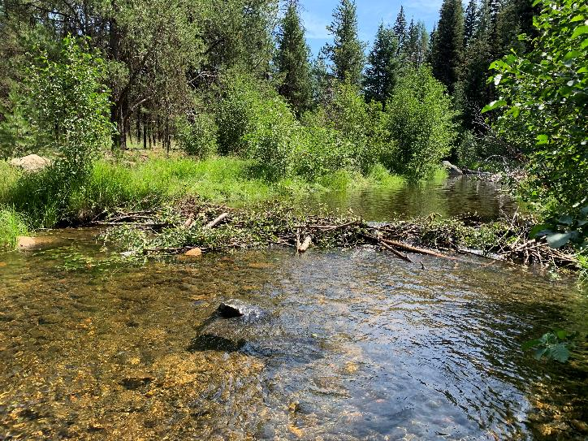
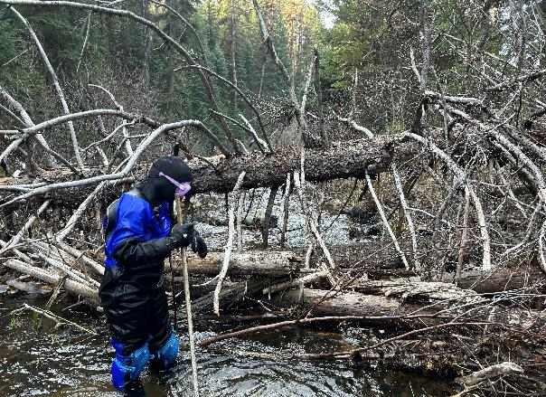
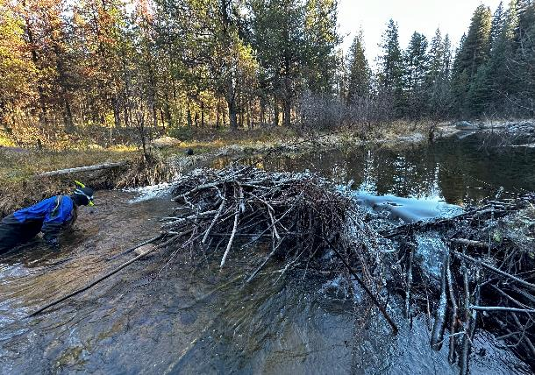
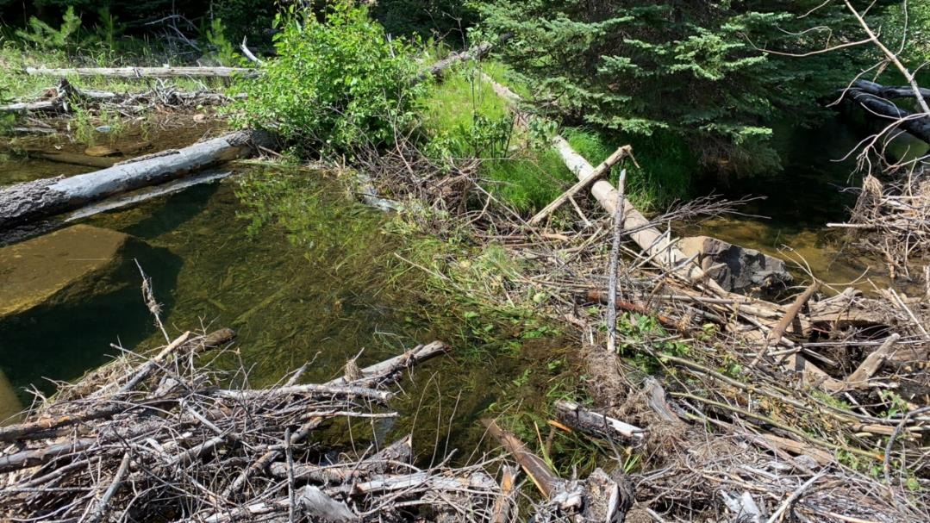
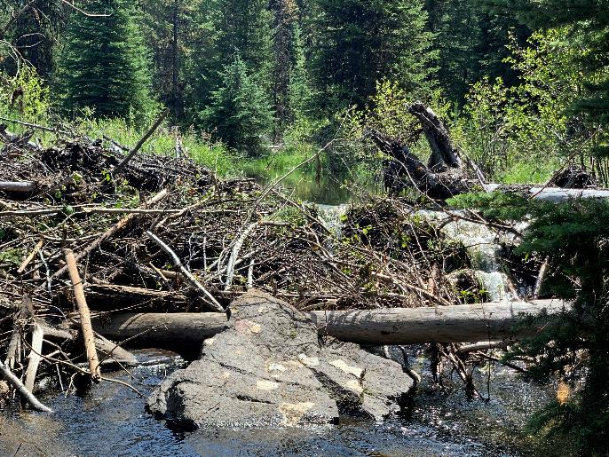

Slide 8
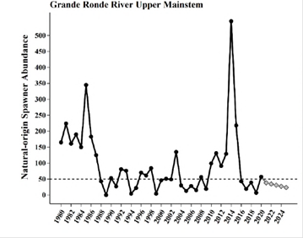
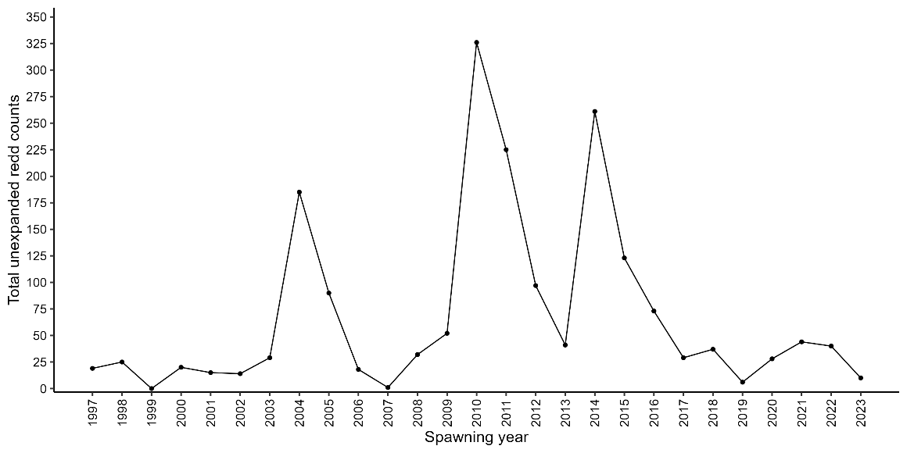
Spawning Distribution Facts
2011–2023
  Waypoints on redds started in 2011
  Most recent 5-year average is 27 redds
  Quasi-extinction Theshold ≤ 50 spawners in 4 consecutive years
  Pre-spawn mortality estimates have exceeded 50%
Notes:
Upper Grande Ronde spring Chinook are ESA-listed as Threatened (NMFS 1992) and the second most imperiled native fish population in Oregon. Recent population abundance is below quasi-extinction thresholds (QET; at or below 50 spawners in four consecutive years) and is projected to remain below QET through 2025 (Bowles citing Storch 2021).

Slide 9
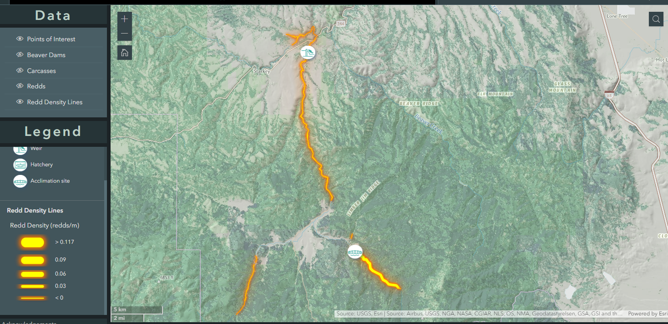
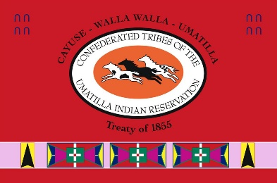
Spawning Distribution Facts
2011–2020 density map of redds (Total surveyed distance = 16 miles)
Most redds are in the upper 4.5 miles of the river
Adult weir
UGR mainstem below vey ~ 11.5 miles
Water flow
Vey Meadows: No access
UGR above acclimation facility ~ 4.5 miles
Sheep Cr ~ 3.3 miles

Slide 10
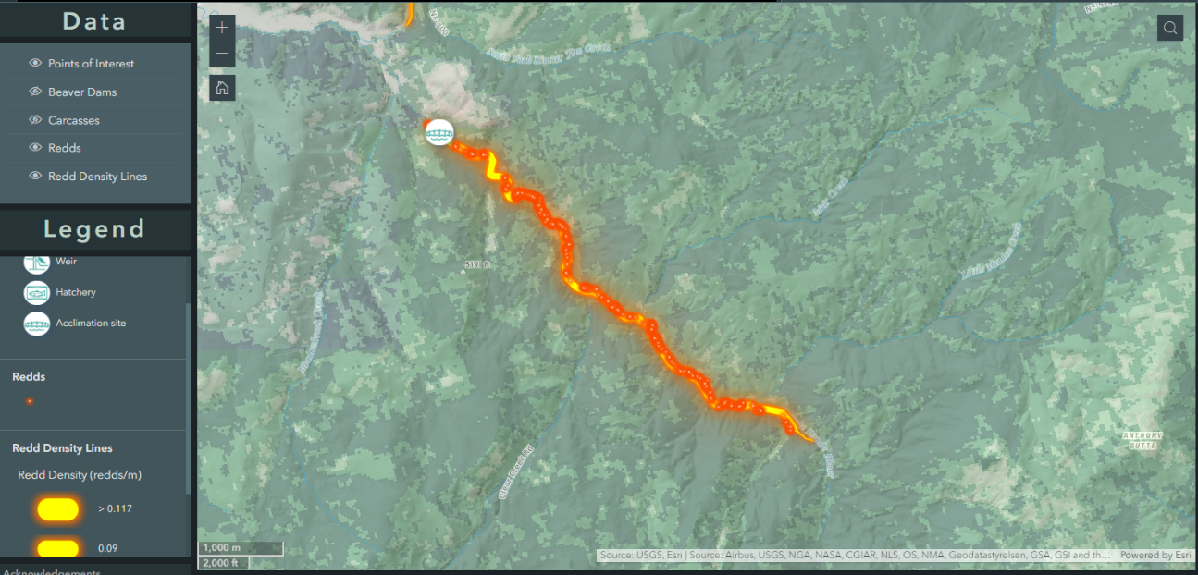
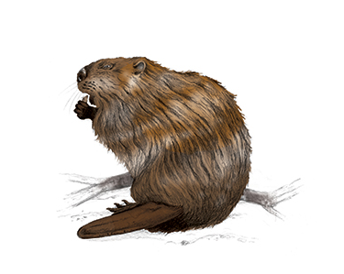
Spawning Distribution Facts
2011–2020
Average of 36% of redds above dam site
Multiple years >50% of redds above dam sites
Vey Meadows: No access
Water flow
~ 4.5 miles of spawning
Notes:
About half of the spawning area

Slide 11
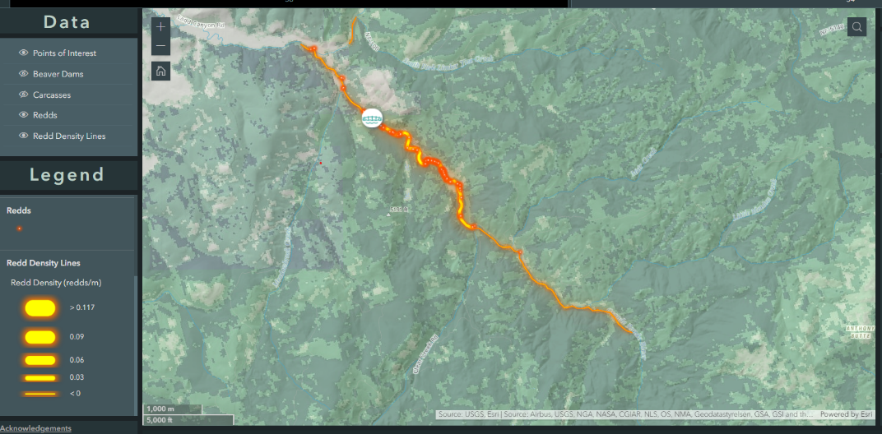
Spawning Distribution Facts
2021–2023
Only 1 redd above the dam site – this was in 2021
2023 (16 total redds & 3 carcasses)- All below “dam site”
Notes:
The structures were being put in during the time the fish were migrate up the river in 2021. A couple of fish may have squeaked through and that is the one redd. It may be worth mentioning how the structures trapped fish in-between them.

Slide 12
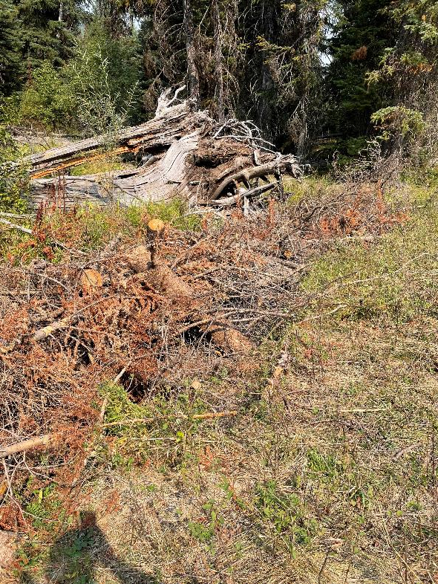
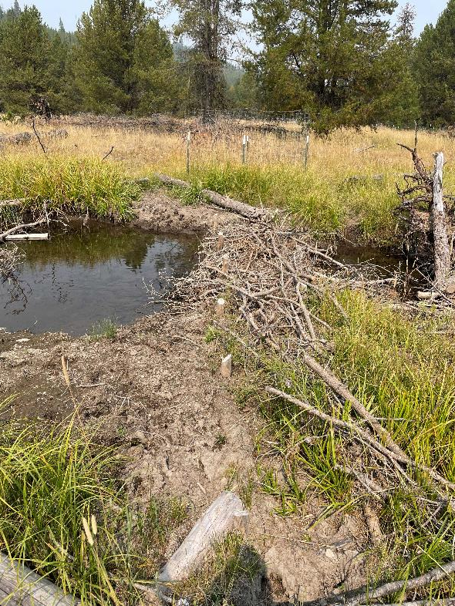
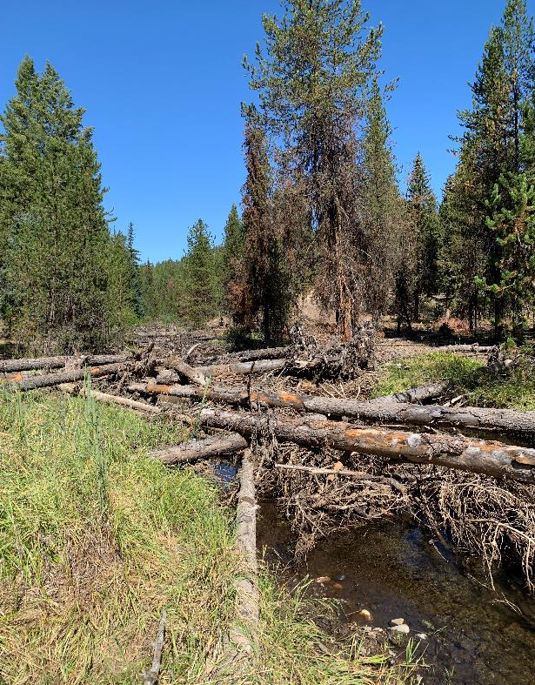
Tributaries
Prescription too much for the stream?
key spawning area

Slide 13
Additional Considerations
Management Recommendations
High pre-spawn mortality
Will structures slow fish passage?
Juvenile Movement
Non-native benefits (e.g., Brook trout)
Functional extirpation rapidly approaching
Further truncating habitat preventing progress towards recovery?
Spawning vs. rearing habitat
Stream flow/power
Temperature
Stage-0 amount of water
Bull trout vs Chinook vs. Steelhead
ODFW fish passage approval
  Early in the process
Monitoring and modifying
  Completing adaptive management cycle
  Fish passage
  Fish distribution
  Monitor at low flows
Larger complex structures – engineered design
Notes:
How far will juveniles move?
Not as much data for bull trout, but same sort of issues.

Slide 14
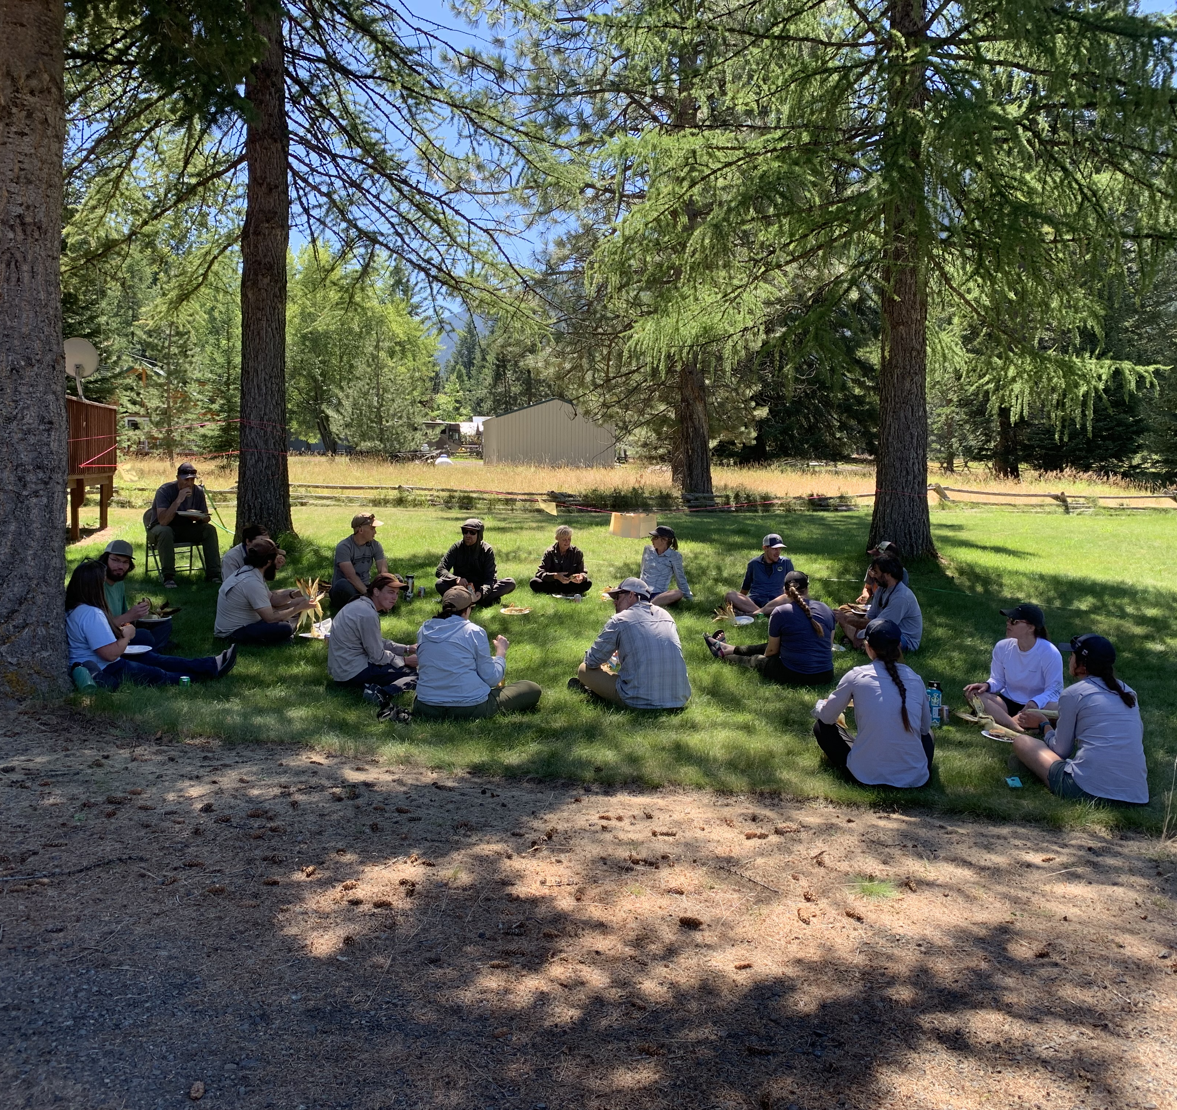
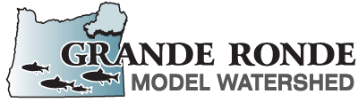
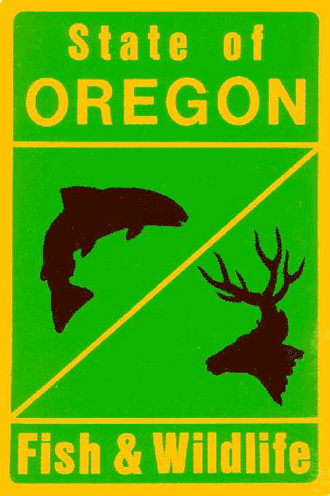

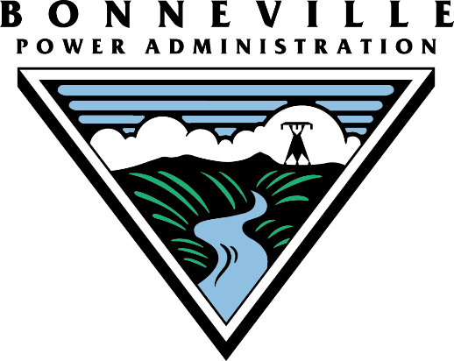
Currently in Development:
Upper Grande Ronde Passage Barrier Adaptive Management Plan
The primary goal of the UGR Passage Barrier Adaptive Management Plan is to provide a pathway for determining the best course of action for mitigating natural and semi-natural barriers to ensure fish passage, while maintaining the positive benefits of structural elements in fluvial systems.

Slide 15
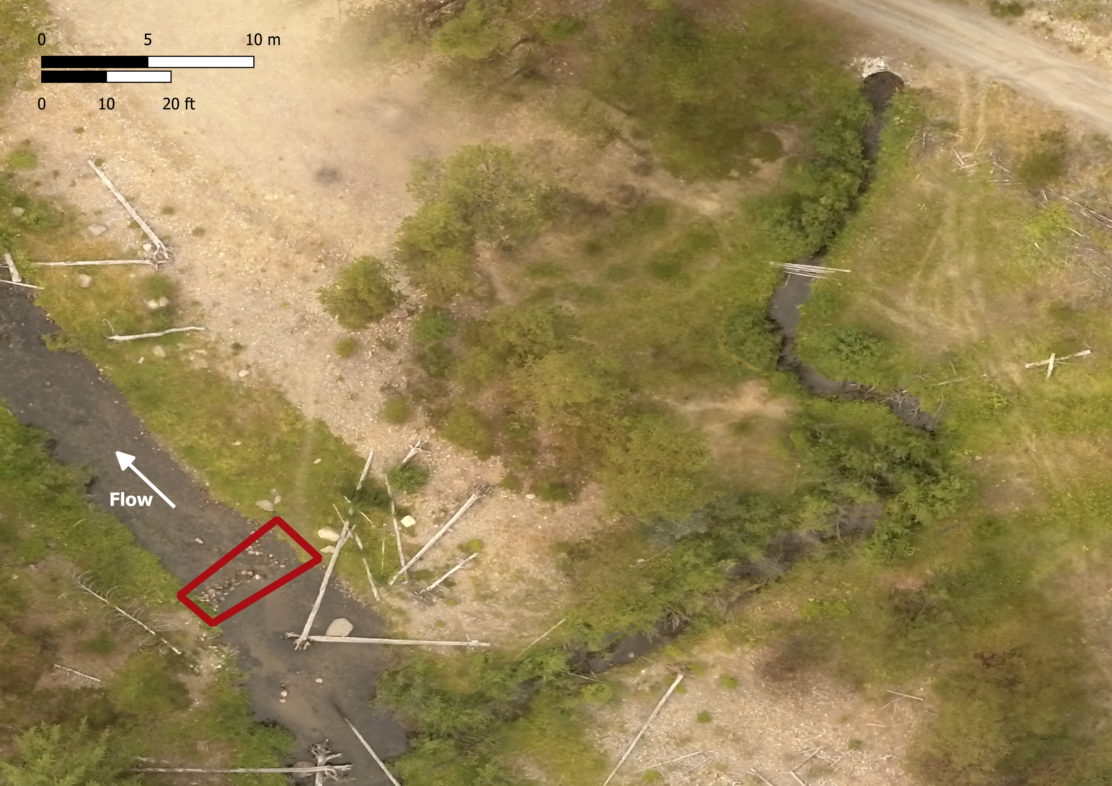
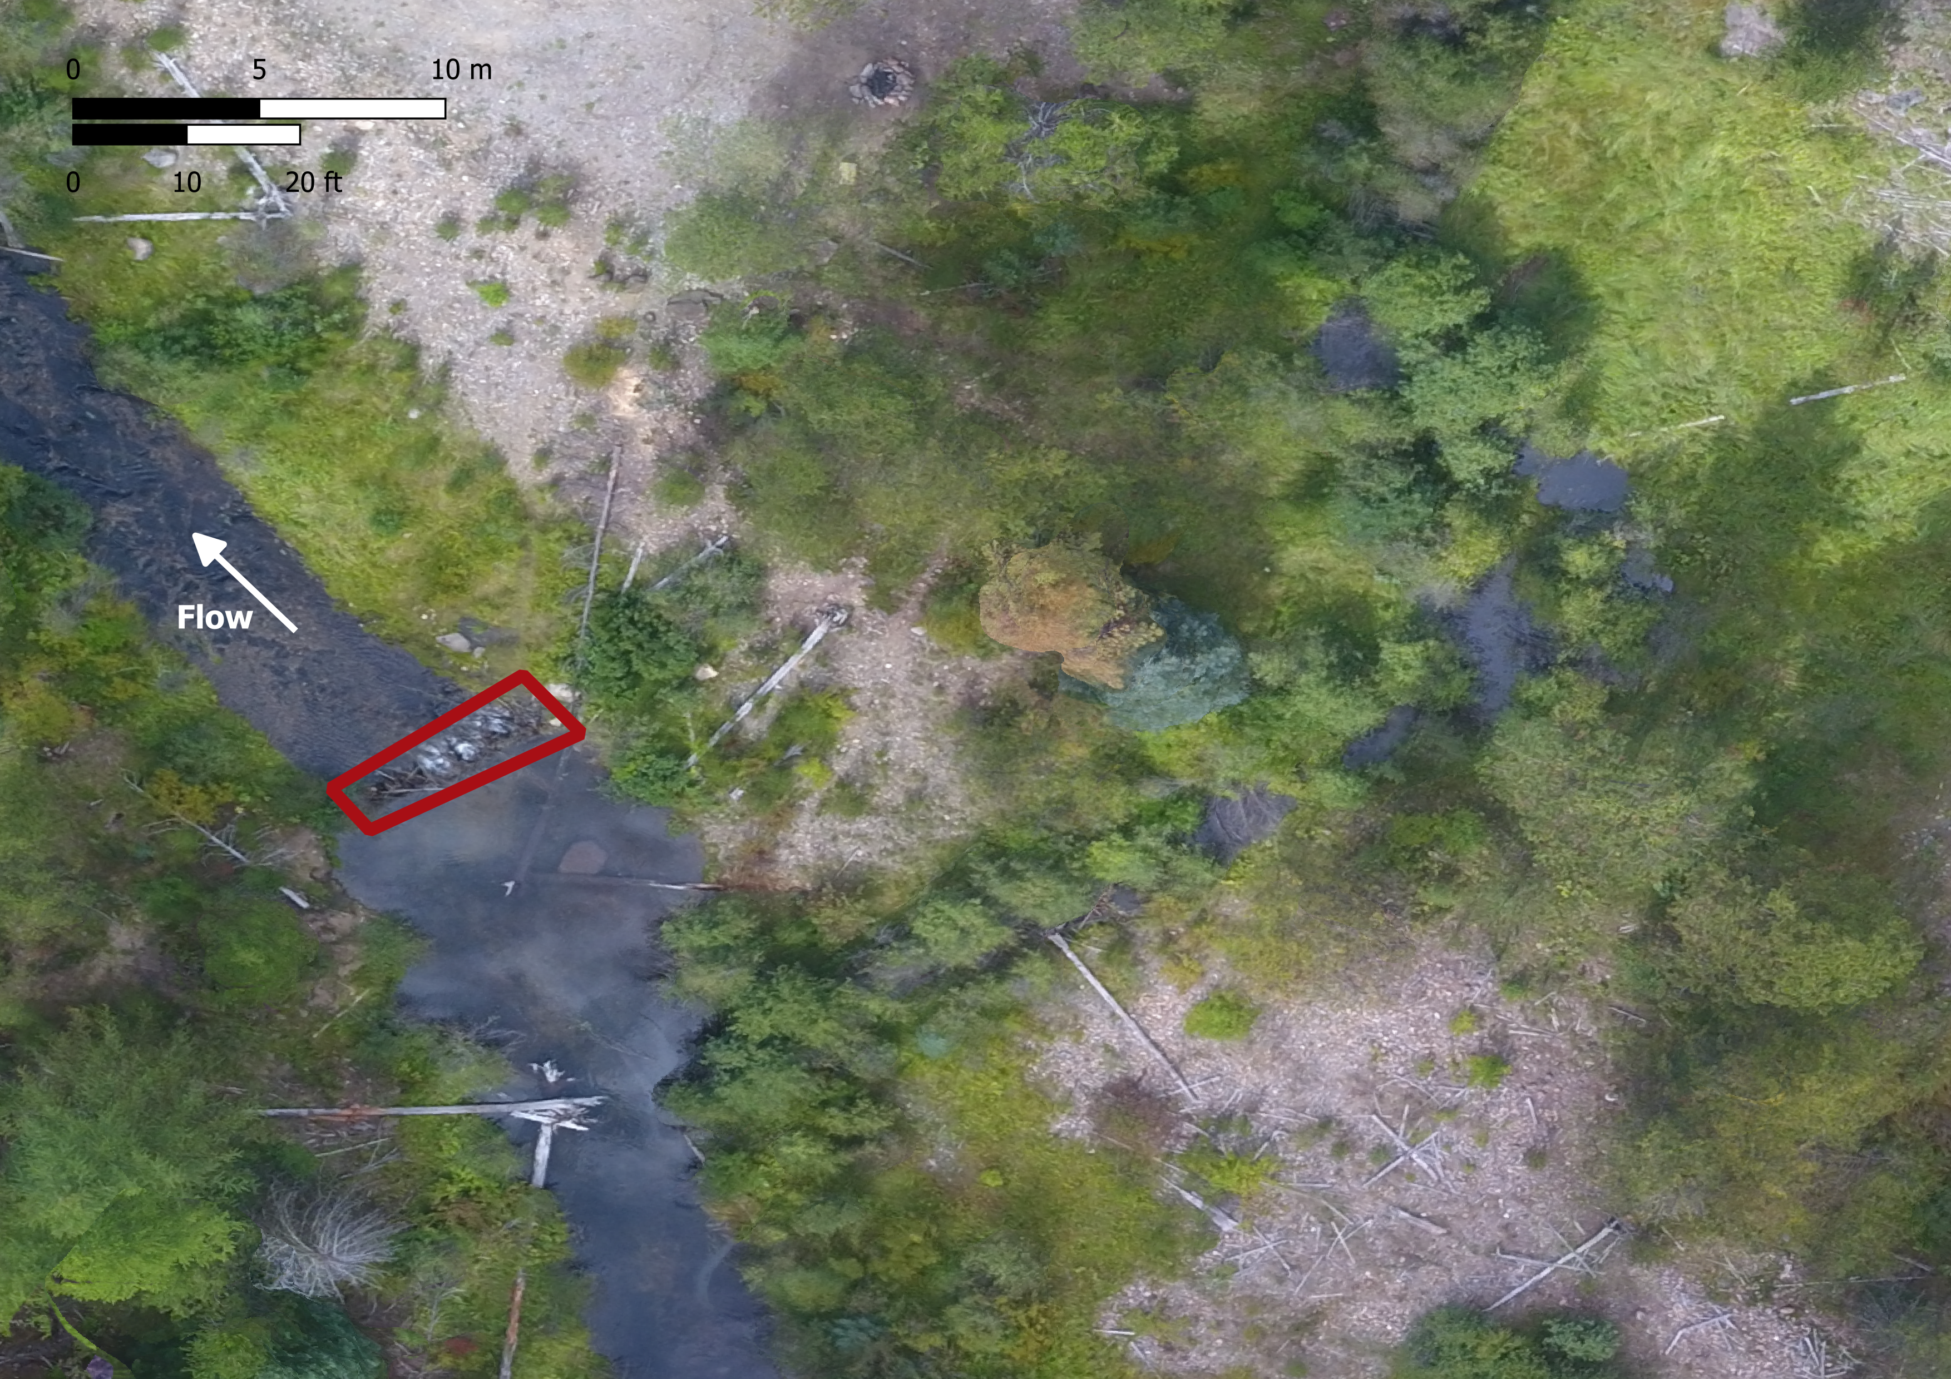
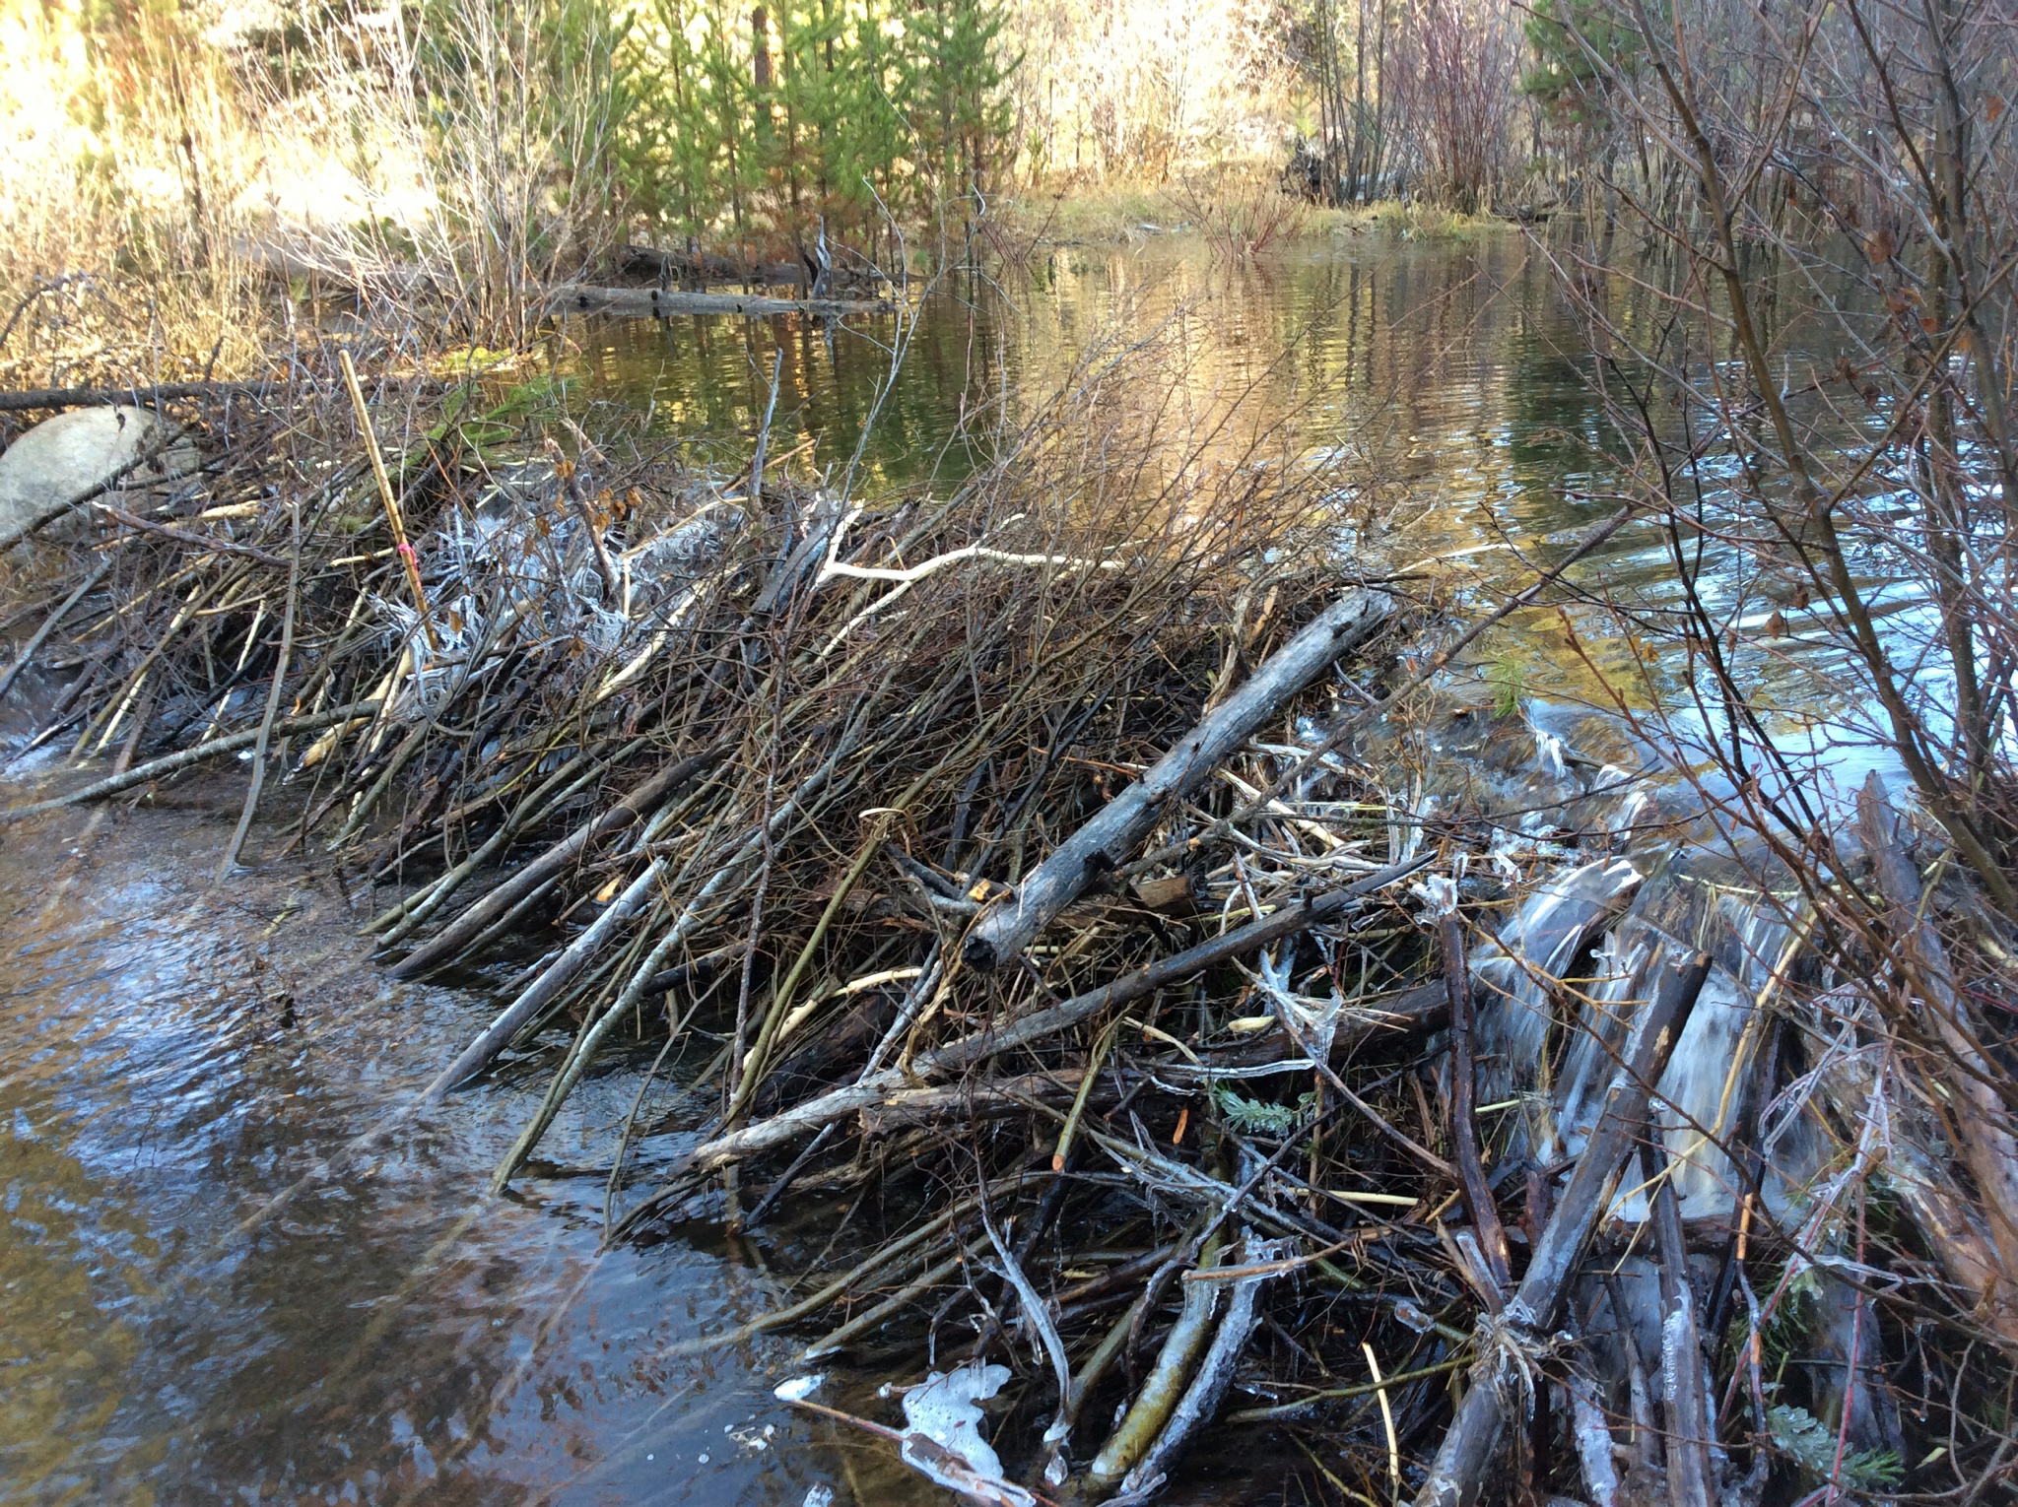
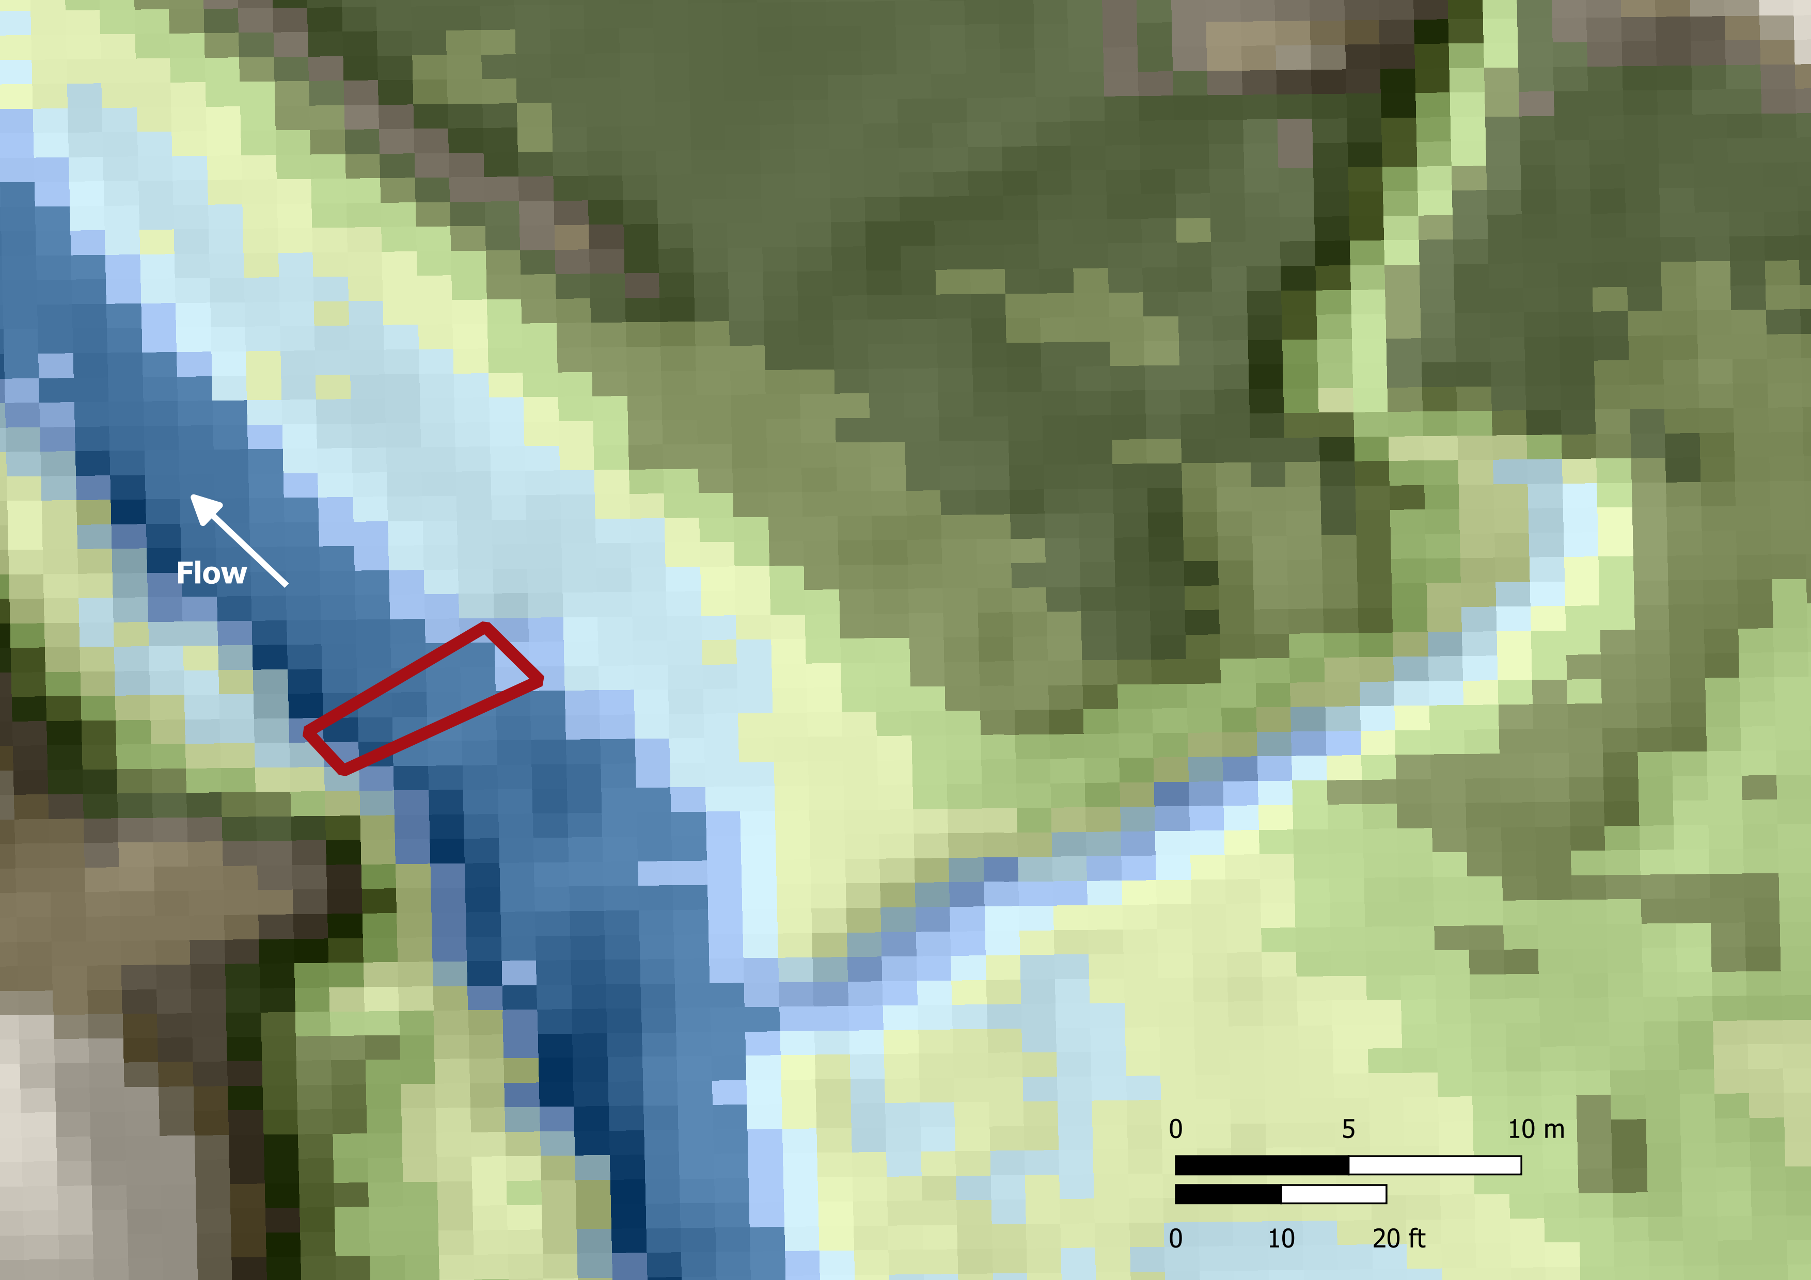
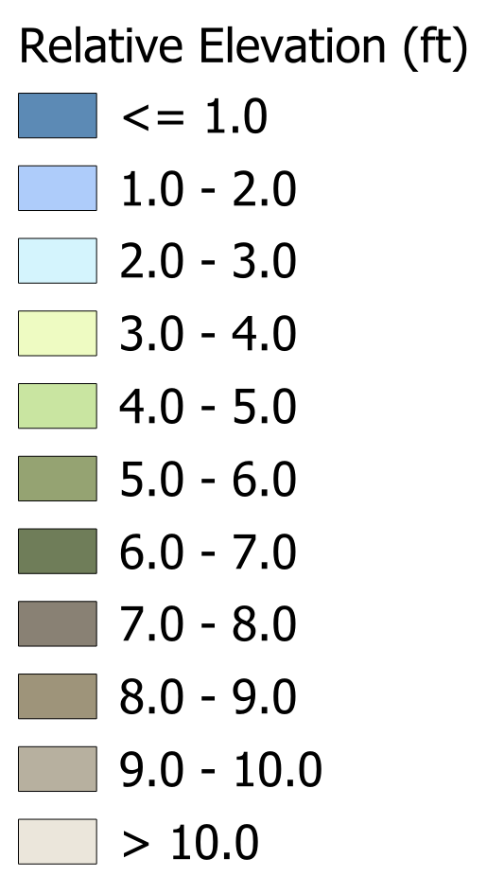
Beaver 8
N
2017 | 2018 | 2019 | 2020 | 2021 | 2022 | 2023
No Barrier |  |  |  |  | Passage Barrier
Latitude, Longitude: 45.05119801, -118.285802
Barrier Description
The structure at Beaver 8 is a natural large beaver dam, approximately 2 m tall and spanning approximately 6 m. It forms an impassable barrier. This is the most upstream dam with drainage from a culvert entering approximately 12 m upstream.
Proposed Mitigation
Beaver 8 may be mitigated by:
Removing boulder weir
Creating floodplain bypass channel
Installing a pond leveler
Reduce dam crest elevation
Notching
2017
2023
2023

Slide 16
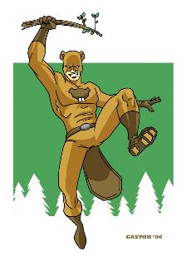

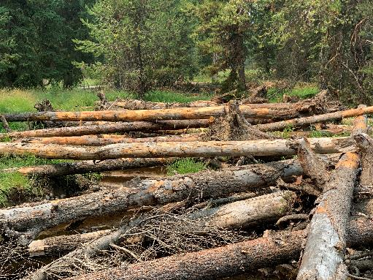
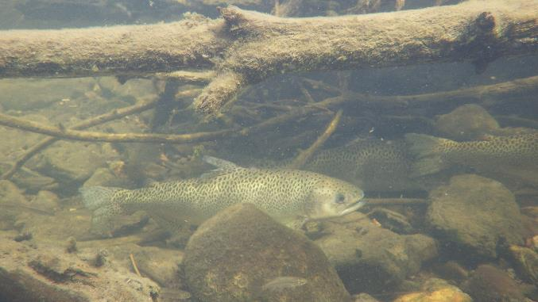
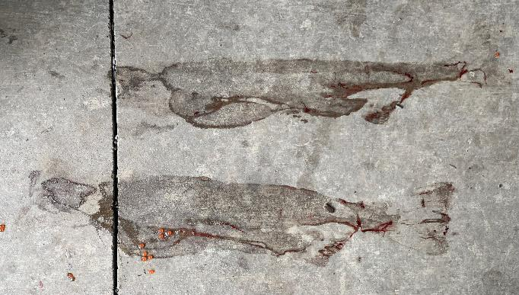
The Question keeping Ethan awake at night…
How should we balance trade offs of promoting beaver-modified habitats in a severely habitat-limited system for ESA-listed salmonids?
UGR log placements
Safety net fish in Sheep Creek; 2013
Fish prints: Lookinglass Fish Hatchery
Notes:
Bull Trout listed as threatened in 1998

